Slide 1
ME205: DESIGN LAB PROJECT
Team I: Belt and Pulley System
Team Members
Ashish Jagarwar
Sourabh Kumar Meena
Arun Kumar
Sangeeta Varma
Hritik Garg

Slide 2
Problem Statement & Software Details
To verify the relationship between ratio of tensions on either side of a belt around a pulley and the lap angle.
To determine the coefficient of friction between belt and pulley
Software used - Solidworks
Contribution
Prototype | Arun Kumar, Sangeeta Varma
Solid Works Model | Hritik Garg
PPT | Ashish Jagarwar, Sourabh Kumar Meena

Slide 3

THEORY
A belt and pulley system is one of the simplest types of pulley system, It contains two pulleys and one belt.
T1 = Tension on `the tight side of belt
μ = Coefficient of friction between belt and pulley
T2 = Tension on the slack side of the belt
θ = Angle of lap in radians
Limiting friction condition:
T1/T2 = $e^{μθ}$

Slide 4
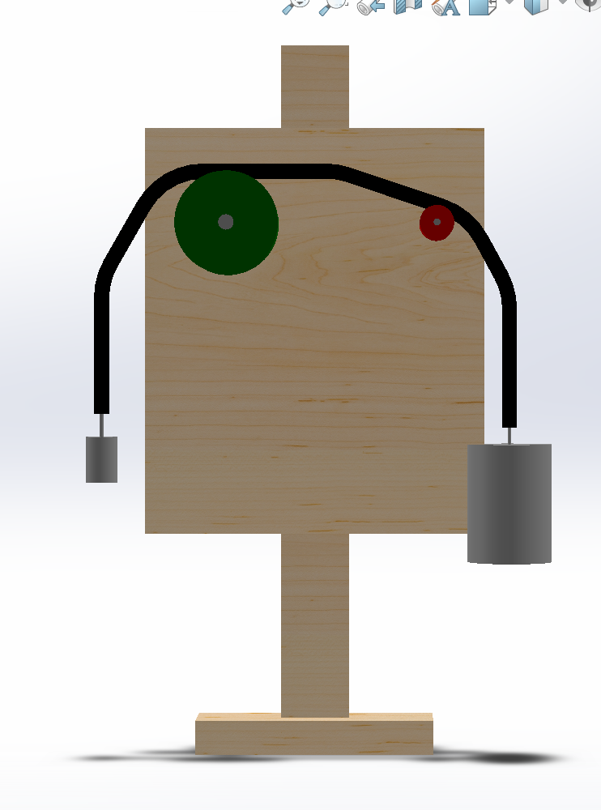
Parameters
Mass – M1 and M2
Tension – T1 and T2
μ = Coefficient of friction
θ = Lap angle
T1 = M1*g
T2 = M2*g

Slide 5
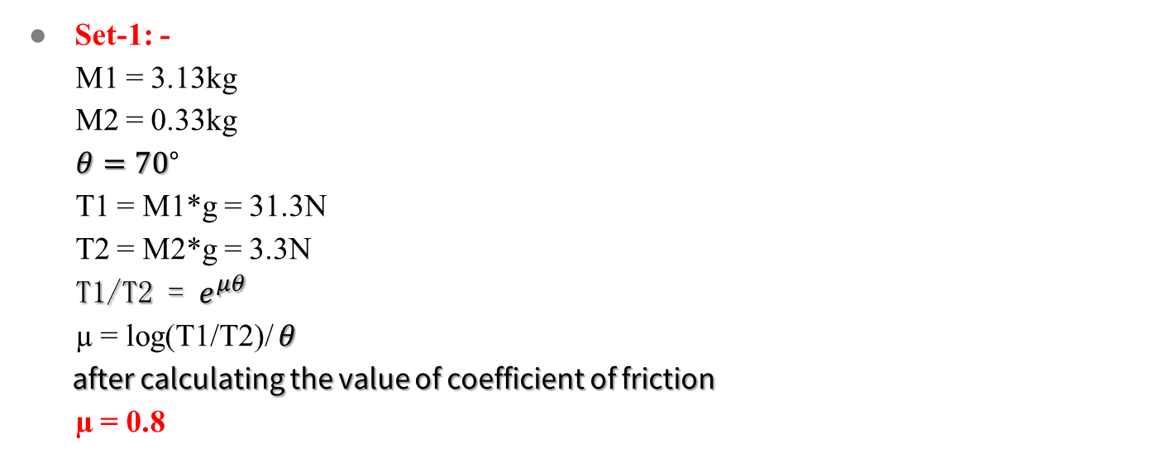
Calculations
Set-1: -
M1 = 3.13kg
M2 = 0.33kg
$θ=70\text{°}$
T1 = M1*g = 31.3N
T2 = M2*g = 3.3N
T1/T2 = $e^{μθ}$
µ = log(T1/T2)/ $θ$
after calculating the value of coefficient of friction
µ = 0.8

Slide 6

Set-2: - M1 = 7.33kg M2 = 0.33kg $θ=\text{90}\text{°}$ T1 = M1*g = 73.3N T2 = M2*g = 3.3N µ = log(T1/T2)/ $θ$ after calculating the value of coefficient of friction µ = 0.85 Error = 5.88%

Slide 7
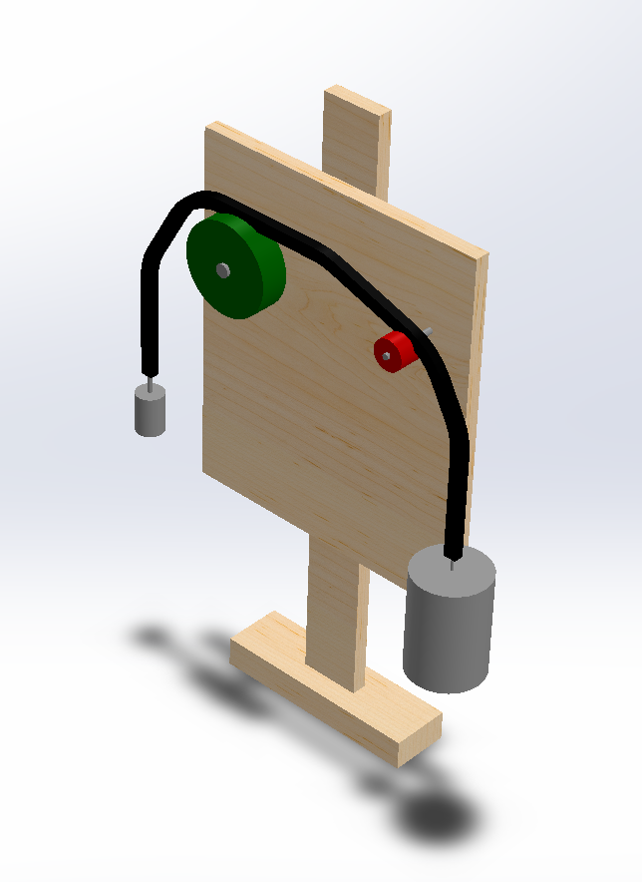
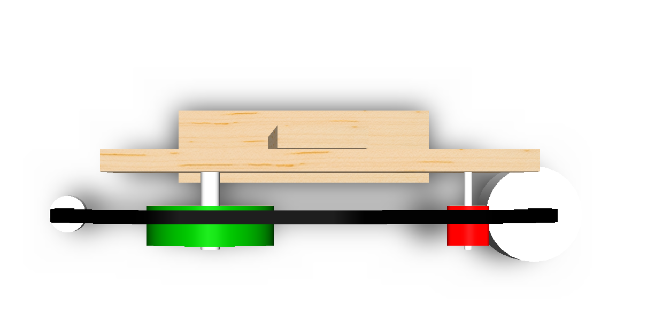
Solid Works Model

Slide 8
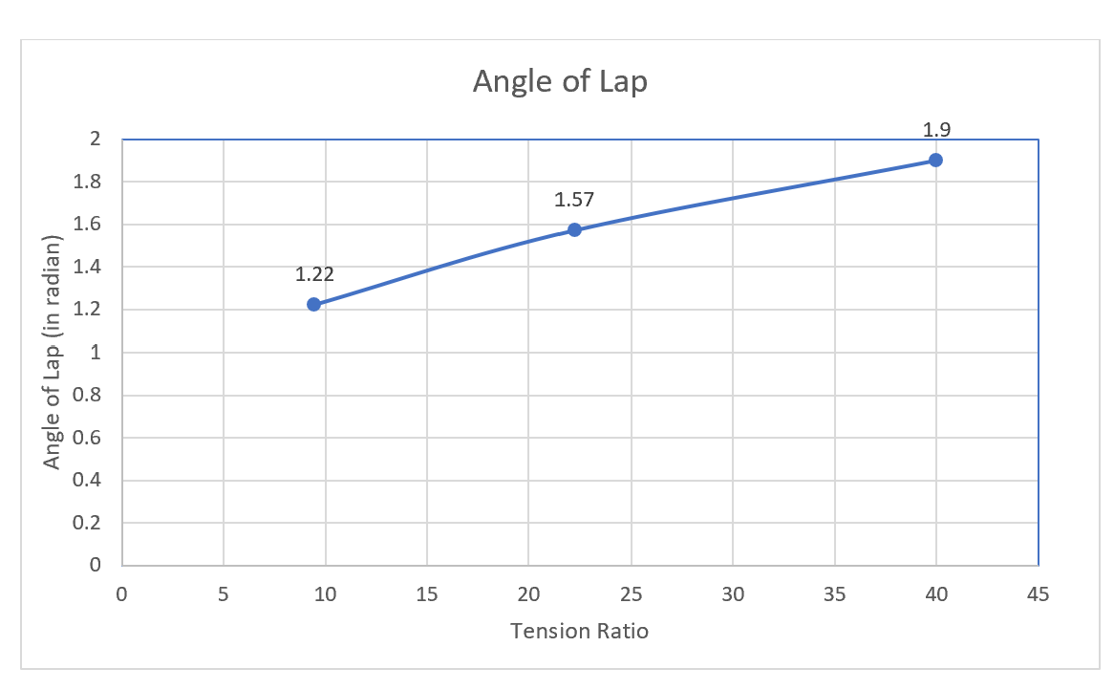


Plots
Angle (In radian) VS T1/T2(tension ratio)

