Slide 1
Analysis of Big Mountain Resort’s Ticket Pricing Strategy in the U.S. Ski Resort Market
Presentation by Sangeeta Jayakar

Slide 2
The Problem at hand:
Big Mountain Resort has found that their operating costs have increased by $1.5M, after the addition of a new chair lift. The goal is to recoup these costs, by determining how ticket prices can be increased, based on the facilities offered by other ski resorts in the market.

Slide 3
This analysis will seek to answer two questions:
First, based on the facilities offered at Big Mountain compared to other resorts in the market, can Big Mountain change their ticket price to reflect their resort offerings and make them appear more appealing?
Second, what facilities can Big Mountain consider investing their resources into in the future?

Slide 4
Key Findings and Recommendations
Big Mountain can raise their prices from $81 to $95.87 based on their current offerings of facilities.
Future investments can be made in extending the vertical drop by adding an additional run point and chair lift, allowing for ticket prices to be raised by $1.99.
Operation costs can be lowered without reducing revenue by closing down the least used run.

Slide 5
Data Collection and Wrangling
Dataset for 330 U.S. ski resorts was made available and merged with dataset depicting population and geographic data for each state
Features of each resort were considered as they related to population density and resort density of their state

Slide 6
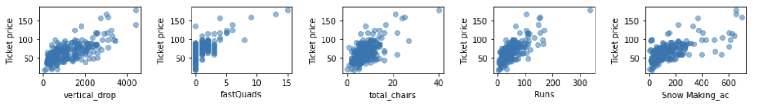
Features Correlated with Ticket Price
With a Random Forest Regression Model, the features that were shown to be most important were:
Vertical drop
fastQuads
Runs
Snow Making area

Slide 7
Modeling Results of Current Pricing
Random Forest Regression Model was used to predict ticket price based on Big Mountain’s current offerings of facilities.
Current ticket price is $81.
Ticket price should be raised to $95.87.

Slide 8
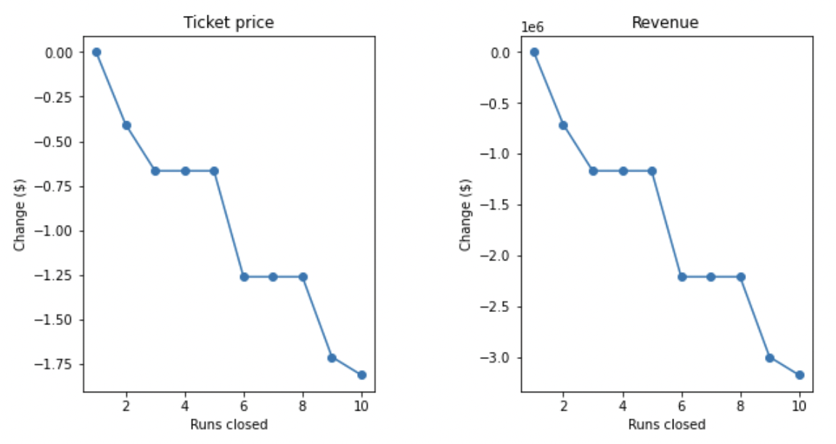
Modeling Results of Future Facilities Investments
Permanently closing down up to 10 of the least used runs:
Closing down 1 run does not affect revenue
Closing down 2 or more runs decreased the revenue

Slide 9
Modeling Results of Future Facilities Investments
Increase the vertical drop by adding a run to a point 150 feet lower down but requiring the installation of an additional chair lift to bring skiers back up, without additional snow making coverage.
Supports a ticket price increase by an additional $1.99
Going from $95.87 to $97.86

Slide 10
Modeling Results of Future Facilities Investments
Increase the vertical drop by adding a run to a point 150 feet lower down but requiring the installation of an additional chair lift to bring skiers back up, and adding an additional 2 acres of snow making coverage.
Same result as previous scenario
Supports a ticket price increase by an additional $1.99
Going from $95.87 to $97.86

Slide 11
Modeling Results of Future Facilities Investments
Increase the longest run by 0.2 mile to boast 3.5 miles length, requiring an additional snow making coverage of 4 acres.
This has no effect on revenue

Slide 12
Summary and Conclusion
This work aimed to answer the question of how Big Mountain can change their ticket price to reflect their facilities offered compared to other ski resorts in the market, as well as what facilities can be invested into for future growth. Big Mountain Resort should change their current ticket price to $95.87, and can further raise prices by an additional $1.99 if they make the recommended changes proposed.

