Slide 1
Roman Spectroscopy data Challenge Introduction Session 2/3
WHY WHO
WHAT

Slide 2
The aim of this data challenge is to
Introduce the Roman spectroscopic elements – the grism and the prism
Gain familiarity with simulated data
Exercise various codes to extract data.
Build community and expertise for spectroscopy with Roman, to use spectroscopy survey data to do a wide range of science.
The data challenge is aimed at beginning user and is meant to be pedagogical.

Slide 3
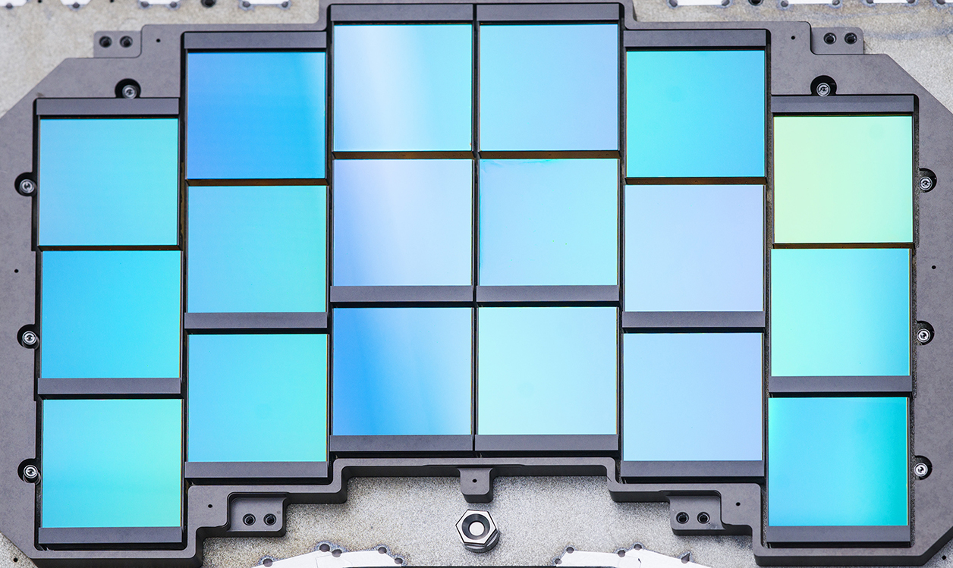
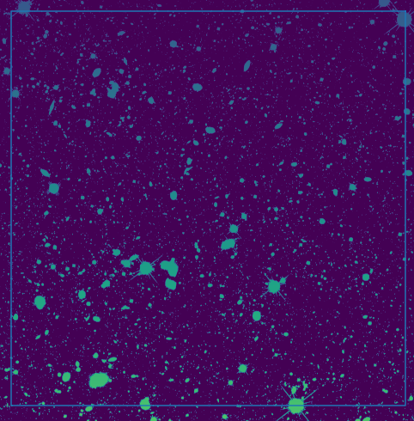
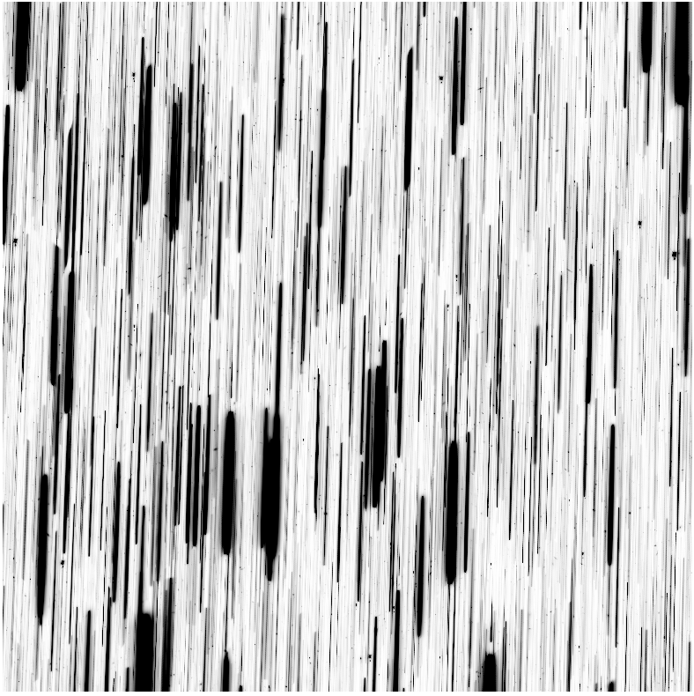
Intro: Slitless Spectroscopic Observations (grism)

Slide 4
Data Flow
A busy astronomical scene
2D spectra of individual objects
1D spectrum of each object
Identification of object and/or get its redshift

Slide 5
Data Challenge Flow
A busy astronomical scene
2D spectra of individual objects
1D spectrum of each object
Identification of object and/or get its redshift

Slide 6
Data Flow
Challenge 3
Challenge 2
Challenge 1
A busy astronomical scene
2D spectra of individual objects
1D spectrum of each object
Identification of object and/or get its redshift

Slide 7
Agenda for today
1. Introduction & Objectives
2. Grism Refresher
3. Understanding the Prism
4. Principles of 2D to 1D Spectral Extraction
5. Introduction to Tools for Spectral Extraction
6. Demonstration: One Object at a Time

Slide 8
After session 3 (~Feb 2026)
we will release a simulated grism (and prism) images
The data challenge will be to identify all line emitters in the images.
Final results will be positions of sources and wavelength and flux of line emission.
Question: calibrated images? Calibration files? Both?
End of challenge period (~June 2026)
Evaluate entries and results
Write a data challenge paper in the next six months with all the entrants as authors.

Slide 9
What this data challenge is and isn’t:
Not a tutorial on simulations.
The code for the simulations will be released after the data challenge is over.
There prob are many data analysis packages, including the official one from SSC(IPAC). The data challenge is agnostic to which code people use.
Code we discuss today are examples meant for tutorials.

Slide 10
What this data challenge is and isn’t:
The SPQR Widefield Preparatory Science team is developing simulated deep slitless spectroscopy "observations” that we will provide so the community can test reduction / extraction software
To support that, we are running a series of 3 tutorial sessions on slitless spectroscopy. (This is #2 of 3.)
This is not a tutorial on simulation software itself, and the code for the simulations will be released after the data challenge is over.
There are many data analysis packages, including the official one from SSC(IPAC). The data challenge is agnostic to which code people use.
Code we discuss today are pedagogical examples meant for tutorials.

Slide 11
How To Access Data Challenge:
Access the GitHub repo RomanSpectraDataChallenge a. Also accessible through url: https://github.com/sangeetak20/RomanSpectraDataChallenge/tree/main/DataChallenge2
In upper right corner: <>Code → HTTPS → copy URL
To clone: go to terminal → git clone https://github.com/sangeetak20/RomanSpectraDataChallenge.git
To access Grism demo notebook (simple summation):
→ RomanSpectraDataChallenge → DataChallenge2 → grism_demo → Grism_extraction_simple_summation.ipynb
To access Grism demo notebook (optimal extraction):
→ RomanSpectraDataChallenge → DataChallenge2 → grism_demo → Grism_optimal_extraction.ipynb
To access Prism demo notebook :
→ RomanSpectraDataChallenge → DataChallenge2 → prism_demo → 1d_spectral_extraction_using_simple_summation_and_optimum_spectral_extraction.ipynb

