Slide 1

Information Security Management System Audit
ISO/IEC 27001:2022 COMPLIANCE
Enterprise Multi-Tenant ISMS Assessment & Risk SaaS Platform
An 8-Phase Enterprise GRC Application Built on Laravel 11, Livewire 3 & Tailwind CSS, Featuring 115 Seeded ISO Controls, 5x5 Risk Heatmap, Auto-SoA Versioning, and 71 Verified Automated Tests.
ISMS Audit Platform Brand Identity
Student Name & Roll No: Kaswan Sangeeta Bhimsingh | Roll Number: 17 | Silver Oak College of Computer Application
Affiliated Institution: Silver Oak College of Computer Application | Gujarat, India
Project Guide & Date: Prof. Harsh Barot | Submission Date: 29-10-2026
Live Production & GitHub: https://ismsaudit.infinityfree.io | https://github.com/sangeetakaswan-dev/isms-tool
Enterprise Tech Stack: Laravel 11.x • PHP 8.2+ • MySQL 8.0 • Livewire 3 • Tailwind CSS • Chart.js 4 • DomPDF & Maatwebsite Excel
ARCHITECTURE: [P1: Multi-Tenancy] • [P2: Assessment Engine] • [P3/P7: 5x5 Risk & Treatments] • [P4: SoA Engine] • [P5: Document DMS] • [P6: Analytics] • [P8: UI & Security]
Student: Kaswan Sangeeta Bhimsingh (Roll No: 17) | Guide: Prof. Harsh Barot | Silver Oak College of Computer Application | Laravel 11 SaaS
Slide 1 / 16
Notes:
Good morning Sir/Ma'am. My name is Kaswan Sangeeta Bhimsingh (Roll No 17). Under the guidance of Prof. Harsh Barot, I am presenting our enterprise ISO/IEC 27001:2022 Compliance Assessment SaaS Platform built using Laravel 11.

Slide 2
PROJECT ROADMAP
8-Phase Agile Engineering & Deliverables Matrix
Structured Multi-Phase Execution from Multi-Tenant Core to Live Production Deployment
Development Phases | Core Engineering Objective | Key Technical Modules Implemented | Verified Deliverables & Tests
PHASE 1 & PHASE 2: Multi-Tenancy Core & Assessment Engine | Establish tenant-isolated architecture, ISO 27001 library, and assessment lifecycle. | • Single-DB multi-tenancy via TenantScope & tenant_user RBAC pivot • Seeded 11 Domains & 115 Controls (Main Clauses 4–10 + 93 Annex A) • Assessment CRUD, team assignment & 0–5 Maturity scoring • Weighted ComplianceCalculator (Partial compliance = 50% weight) | ✔ 37/37 Tests Passing ✔ 115 ISO Controls Seeded ✔ Service-Repo-DTO Layer ✔ Token Invitations
PHASE 3 & PHASE 4: Asset Register, Risk & Statement of Applicability | Quantify asset criticality, evaluate risks, and generate formal ISO 27001 SoA. | • Information Asset Register with Confidentiality, Integrity, Availability (1–5) • Automated StatementOfApplicabilityService mapped from responses • Single & Bulk SoA entry approval workflow with user/timestamp • JSON data_snapshot versioning (soa_versions) & side-by-side comparison | ✔ 54/54 Tests Passing ✔ Auto-SoA Justification ✔ Version Diff Engine ✔ SoA PDF/Excel Exports
PHASE 5 & PHASE 6: Document DMS & Reporting Analytics | Manage versioned compliance policies and executive multi-format reporting. | • Document Management System (DMS) with v1.0 ➔ v1.1 version history • Multi-reviewer approval workflow & document_control_map linking • Strategy Pattern ReportRegistry (6 Report Types) + CSV/PDF/XLSX exports • Daily report_snapshots table for 12-month historical compliance trend | ✔ 63/63 Tests Passing ✔ 6 Strategy Report Classes ✔ 5 Chart.js Visualizations ✔ Export Audit Trail
PHASE 7 & PHASE 8: Risk Register, Jobs, UI Overhaul & Go-Live | Upgrade risk treatment workflows, automate jobs, harden RBAC, and deploy live. | • Dedicated Risk model (1–25 score), 4 Treatment strategies & 5x5 Heatmap • Email + In-App Notifications & 3 Scheduled Jobs (Snapshots, Reminders) • Vanta-style Tailwind UI overhaul, AssetPolicy/RiskPolicy RBAC (403 guard) • Custom error pages (403, 404, 419, 500, 503) & InfinityFree deployment | ✔ 71/71 Tests (169 Asserts) ✔ 25+ Blade Views Polished ✔ 15+ Production Bug Fixes ✔ Live HTTPS Deployment
💡 STRICT ARCHITECTURAL GOVERNANCE ACROSS ALL 8 PHASES: Zero business logic resides in Controllers or Blade views. Every module strictly follows Request Validation ➔ Readonly DTO ➔ Service Class ➔ Repository Interface ➔ Tenant-Scoped Eloquent Model.
Student: Kaswan Sangeeta Bhimsingh (Roll No: 17) | Guide: Prof. Harsh Barot | Silver Oak College of Computer Application | Laravel 11 SaaS
Slide 2 / 16
Notes:
This matrix summarizes our 8-phase engineering journey, progressing from multi-tenant foundations and ISO 27001 assessment workflows to risk management, SoA generation, document control, analytics, and live deployment.

Slide 3
PHASE 1 • FOUNDATION
Phase 1: Multi-Tenancy Core, RBAC & Clean Architecture
Objective: Establish automatic tenant data isolation and enterprise Service-Repository-DTO patterns
🏛️
Service-Repo-DTO Pattern
🏢
Single-DB Multi-Tenancy
🔐
RBAC & Token Invitations
• Thin Controllers: Only validate FormRequests, invoke Services, and return views/JSON.
• Service Layer: All domain rules isolated in app/Services/ (Tenant, Assessment, Risk, SoA).
• Repository Contracts: Interfaces bound in AppServiceProvider for clean testability.
• Readonly DTOs: Type-safe data transfer across layers (TenantData, AssessmentData, RiskData).
• Automatic TenantScope: Global Eloquent scope appends WHERE tenant_id = current_tenant_id.
• Column-Safe Guard: Checks Schema::hasColumn('tenant_id') to protect global ISO catalogs.
• Session Context: EnsureTenantSelected middleware enforces active organization context.
• Zero Data Leakage: Verified via automated cross-tenant isolation feature tests.
• 5 Granular Roles: Owner, Admin, Auditor, Assessor, and Viewer via tenant_user pivot.
• Secure Onboarding: Tokenized email invitations with 7-day expiry and role pre-assignment.
• Policy Enforcement: Role-based checks via roleInCurrentTenant() and Laravel Policies.
• Complete ISO Seeders: 11 Domains + 115 Controls seeded with implementation guidance.
💡 GLOBAL CATALOGUES vs TENANT-SCOPED ENTITIES: ISO 27001 Domains (11) and Controls (115) are stored as global read-only reference tables, while Assessments, Risks, Assets, Documents, and Snapshots are strictly isolated per organization via TenantScope.
Student: Kaswan Sangeeta Bhimsingh (Roll No: 17) | Guide: Prof. Harsh Barot | Silver Oak College of Computer Application | Laravel 11 SaaS
Slide 3 / 16
Notes:
In Phase 1, we established our single-database, shared-schema multi-tenant architecture. Using a Global TenantScope, every query automatically filters by the authenticated user's current_tenant_id.

Slide 4
PHASE 2 • ASSESSMENT ENGINE
Phase 2: ISO/IEC 27001:2022 Library & Assessment Workflow
Objective: Evaluate 115 controls across 11 domains with 0–5 maturity scoring and weighted compliance math
COMPLETE ISO/IEC 27001:2022 CONTROL LIBRARY
MATURITY MODEL (0–5) & COMPLIANCE CALCULATOR
11 Structured Domains: 7 Main Clauses (Clauses 4 to 10 — ISMS Management) + 4 Annex A Themes (A.5 to A.8).
Annex A Theme Breakdown (93 Core + Extended = 115 Total):
• A.5 Organizational Controls: 37 core controls (Policies, Roles, Threat Intel)
• A.6 People Controls: 8 controls (Screening, NDA, Awareness, Remote Work)
• A.7 Physical Controls: 14 controls (Perimeters, Cabling, Clear Desk, Media)
• A.8 Technological Controls: 34 core controls (Crypto, Access, Logging, SDLC)
Assessment Lifecycle: Draft ➔ In Progress ➔ Completed ➔ Archived with team member role assignments (assessment_team table).
Bulk & Granular Evaluation: Single control evaluation or bulk status updates across domains with evidence notes and gap descriptions.
5 Compliance States: ✅ Compliant (100% weight) | ⚠️ Partially Compliant (50% weight) | ❌ Non-Compliant (0%) | ⊘ Not Applicable (Excluded from denominator) | ○ Not Assessed.
CMMI-Aligned Maturity Scale (Levels 0 to 5):
• Level 0: Not Implemented | Level 1: Initial / Ad-hoc
• Level 2: Repeatable | Level 3: Defined & Documented
• Level 4: Managed & Measured| Level 5: Optimized & Continuous
Weighted Compliance Formula (ComplianceCalculator.php):
Score = [(Compliant + 0.5 × Partially_Compliant) / Applicable_Assessed] × 100
Real-Time Domain Analytics: Automatically computes domain-level completion percentages, maturity distribution, and top compliance gaps.
💡 ACCURATE DENOMINATOR HANDLING FOR 'NOT APPLICABLE' CONTROLS: Controls marked 'Not Applicable' require a mandatory justification and are excluded from the compliance score denominator so organizations are not penalized for out-of-scope controls.
Student: Kaswan Sangeeta Bhimsingh (Roll No: 17) | Guide: Prof. Harsh Barot | Silver Oak College of Computer Application | Laravel 11 SaaS
Slide 4 / 16
Notes:
Phase 2 implements the complete assessment lifecycle. Our ComplianceCalculator uses a weighted formula where Compliant equals 1.0, Partially Compliant equals 0.5, and Not Applicable controls are excluded from the denominator.

Slide 5
PHASE 3 & 7 • RISK ENGINE
Phase 3 & 7: Asset CMDB, 5×5 Risk Register & Treatment Plans
Objective: Quantify asset criticality, automate Likelihood × Impact risk scoring, and track mitigations
💻
Information Asset CMDB
🔥
5×5 Quantitative Risk Matrix
🛡️
4-Strategy Treatment Plans
• 6 Asset Categories: Hardware, Software, Data, People, Facility, and Cloud Services.
• CIA Triad Valuation: Confidentiality (1–5), Integrity (1–5), and Availability (1–5) ratings.
• Criticality Detection: Automatically flags critical assets where any CIA dimension >= 4.
• Risk Linkage: Every identified risk links directly to an underlying information asset.
• Automated Risk Score: Likelihood (1–5) × Impact (1–5) = Score (1 to 25).
• 4 Severity Bands: 1–4 Low (Green) | 5–9 Medium (Yellow) | 10–16 High (Orange) | 17–25 Critical (Red).
• 5-Stage Risk Lifecycle: Identified ➔ Assessed ➔ Treated ➔ Monitored ➔ Closed.
• Interactive Heatmap: JSON endpoint (/risks/heatmap/data) powers a clickable 5×5 drill-down grid.
• ISO 27001 Strategies: Mitigate, Accept, Transfer, or Avoid with cost estimates & due dates.
• Automated Transitions: Adding/completing a plan transitions risk from Assessed ➔ Treated ➔ Monitored.
• Proactive Alerts: Dispatches RiskAssignedNotification and daily overdue treatment reminders.
• Route Namespace Fix: Cleanly scoped under risks.treatments.* to eliminate route collisions.
💡 CLOSED-LOOP RISK LIFECYCLE AUTOMATION: Creating a treatment plan automatically advances the parent risk status, notifies the assigned risk owner via database and email channels, and feeds directly into the Phase 6 Executive Risk Register report.
Student: Kaswan Sangeeta Bhimsingh (Roll No: 17) | Guide: Prof. Harsh Barot | Silver Oak College of Computer Application | Laravel 11 SaaS
Slide 5 / 16
Notes:
Across Phases 3 and 7, we built the Asset Register and the quantitative 5x5 Risk Register. Risk scores are automatically computed from Likelihood times Impact, and linked to four ISO treatment strategies: Mitigate, Accept, Transfer, and Avoid.

Slide 6
PHASE 4 & 5 • SoA & DMS
Phase 4 & 5: Statement of Applicability (SoA) & Document DMS
Objective: Automate Clause 6.1.3(d) SoA generation with version snapshots and controlled policy lifecycle
PHASE 4: STATEMENT OF APPLICABILITY (SoA) ENGINE
PHASE 5: DOCUMENT MANAGEMENT SYSTEM (DMS)
One-Click SoA Generation: StatementOfApplicabilityService maps all assessment responses into formal soa_entries.
Applicability & Exclusion Rationale: Auto-generates justification text and captures mandatory exclusion_reason for non-applicable controls.
Single & Bulk Approval Workflow: Authorized leads can approve individual control entries or bulk-approve the entire SoA with audit timestamps.
Immutable Version Snapshots (soa_versions): Stores complete JSON data_snapshot payloads (e.g., v1.0, v2.0) and provides a side-by-side Version Comparison diff view.
Audit-Ready Exports: Generates formatted SoA PDF documents (DomPDF) and multi-sheet Excel workbooks (Maatwebsite).
Centralized ISMS Repository: Manages Policies, Procedures, Records, Templates, and Evidence across tenant-isolated directories.
Semantic Version Control (document_versions): Tracks full file history (v1.0 ➔ v1.1 ➔ v2.0) with change logs and creator attribution.
Peer Review & Approval Workflow: Draft ➔ Under Review ➔ Approved ➔ Archived lifecycle via document_reviews (Approve, Reject, Request Changes).
Control Mapping (document_control_map): Many-to-many pivot linking approved policies directly to ISO 27001 controls as audit evidence.
Pre-Seeded Policy Library: Includes 10 core templates (InfoSec Policy, Access Control, Incident Response, BCP, Backup Policy).
💡 ISO 27001 CLAUSE 6.1.3(d) & CLAUSE 7.5 COMPLIANCE: The SoA module fulfills Clause 6.1.3(d) by documenting control applicability and justifications, while the DMS satisfies Clause 7.5 (Documented Information) through strict version history and approval records.
Student: Kaswan Sangeeta Bhimsingh (Roll No: 17) | Guide: Prof. Harsh Barot | Silver Oak College of Computer Application | Laravel 11 SaaS
Slide 6 / 16
Notes:
Phase 4 and Phase 5 address two mandatory audit artifacts required by external ISO 27001 auditors: the Statement of Applicability with JSON snapshot versioning, and the Document Management System with version control and control mapping.

Slide 7
PHASE 6 & 7 • ANALYTICS
Phase 6 & 7: Executive Analytics, Strategy Pattern Reports & Jobs
Objective: Deliver real-time Chart.js telemetry, extensible multi-format reporting, and automated background jobs
📊
Executive Chart.js Telemetry
📑
Strategy Pattern Reports
⏱️
Scheduled Jobs & Alerts
• 5 Live Chart.js Visuals: Domain Compliance Bar, Maturity Pie, Risk Doughnut, Document Doughnut & 12-Month Trend Line.
• JSON Metrics Endpoint: Asynchronous /dashboard/metrics endpoint powered by DashboardService.
• Daily Compliance Snapshots: report_snapshots table enforces unique(tenant_id, report_type, snapshot_date).
• Defensive Repository: ReportRepository gracefully handles missing optional models without crashing.
• ReportRegistry Engine: Clean Strategy Pattern implementing ReportInterface & AbstractReport.
• 6 Enterprise Report Types: Executive Summary, Gap Analysis, Risk Register, SoA Status, Document Compliance & Asset Inventory.
• 3 Export Formats: Native Streaming CSV, Branded DomPDF, and Maatwebsite XLSX.
• Export Audit Log: Every generated report is recorded in generated_reports with user & timestamp.
• SnapshotComplianceScoreJob: Runs daily at 02:00 to record tenant compliance posture.
• SendTreatmentDueRemindersJob: Runs daily at 08:00 to alert owners of upcoming/overdue risk plans.
• PruneReportSnapshotsJob: Runs weekly on Sundays to enforce a clean 24-month retention window.
• In-App Notification Center: Full /notifications UI with unread counters, mark-read, and mark-all-read.
💡 OPEN-CLOSED PRINCIPLE VIA REPORT REGISTRY (STRATEGY PATTERN): Adding a new compliance report requires zero modifications to ReportController or ExportService—developers simply create a class extending AbstractReport and register its key in ReportRegistry.
Student: Kaswan Sangeeta Bhimsingh (Roll No: 17) | Guide: Prof. Harsh Barot | Silver Oak College of Computer Application | Laravel 11 SaaS
Slide 7 / 16
Notes:
In Phase 6 and 7, we implemented our reporting engine using the Strategy Pattern. Six distinct report classes plug into a central ReportRegistry and export seamlessly to CSV, PDF, and Excel.

Slide 8
PHASE 8 • UI & SECURITY
Phase 8: Enterprise UI/UX Overhaul, Security Hardening & Go-Live
Objective: Transform UI into a Vanta/Drata-grade SaaS, enforce strict Policy RBAC, and deploy to live HTTPS
🎨
Vanta/Drata SaaS UI System
🛡️
RBAC & Security Hardening
🚀
Custom Errors & Live Deploy
• 25+ Views Redesigned: Modern Indigo (#4F46E5) & Slate design system with Inter + JetBrains Mono.
• Split-Screen Auth & Dark Mode: Glassmorphism login/register with twinkling stars and Light/Dark toggle.
• Responsive Navigation: Collapsible desktop sidebar and mobile drawer menu with user topbar.
• Bento Grid & Data Tables: Color-coded status badges, hover actions, and sectioned forms.
• Policy Authorization: AssetPolicy & RiskPolicy block 'viewer' users from mutating data (403 Forbidden).
• Route Guard Audit: Moved /reports and /soa routes inside auth + tenant.selected middleware.
• IDOR Prevention: Cross-tenant direct URL tampering strictly returns 404/403.
• POST Logout & CSRF: Converted GET logout links into @csrf POST forms to prevent CSRF logout traps.
• 5 Branded Error Pages: Custom Tailwind views for 403, 404, 419 (CSRF Expired), 500, and 503.
• Rich Demo Seeders: AssessmentSeeder (115 responses), SoASeeder, DocumentSeeder & NotificationSeeder.
• Production Vite Build: Compiled assets via npm run build and removed public/hot artifact.
• InfinityFree Deployment: Restructured htdocs/ entry point live at ismsaudit.infinityfree.io.
💡 DEFENSE-IN-DEPTH AUTHORIZATION (MIDDLEWARE + POLICIES + TENANT SCOPE): Every request passes through three independent security gates: Route Middleware verifies authentication and tenant context, Policies enforce role permissions (Viewer vs Assessor/Admin), and TenantScope isolates database rows.
Student: Kaswan Sangeeta Bhimsingh (Roll No: 17) | Guide: Prof. Harsh Barot | Silver Oak College of Computer Application | Laravel 11 SaaS
Slide 8 / 16
Notes:
In Phase 8, we overhauled the entire UI to match modern B2B SaaS platforms like Vanta and Drata, enforced strict AssetPolicy and RiskPolicy authorization so Viewers get a 403 on write actions, and deployed live.

Slide 9
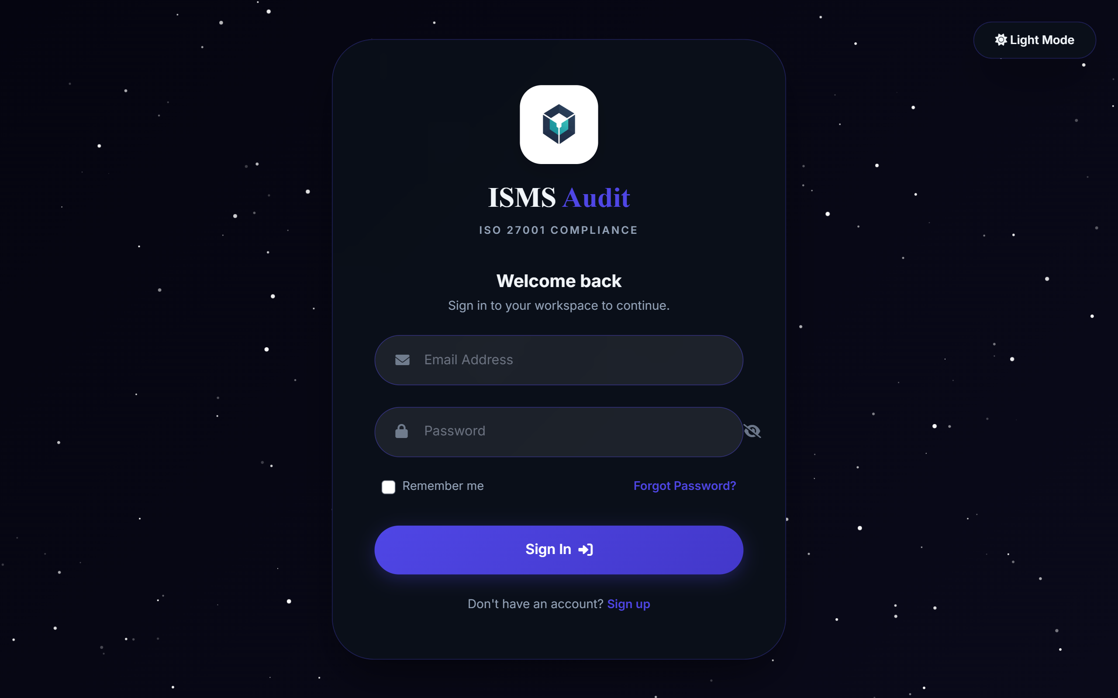
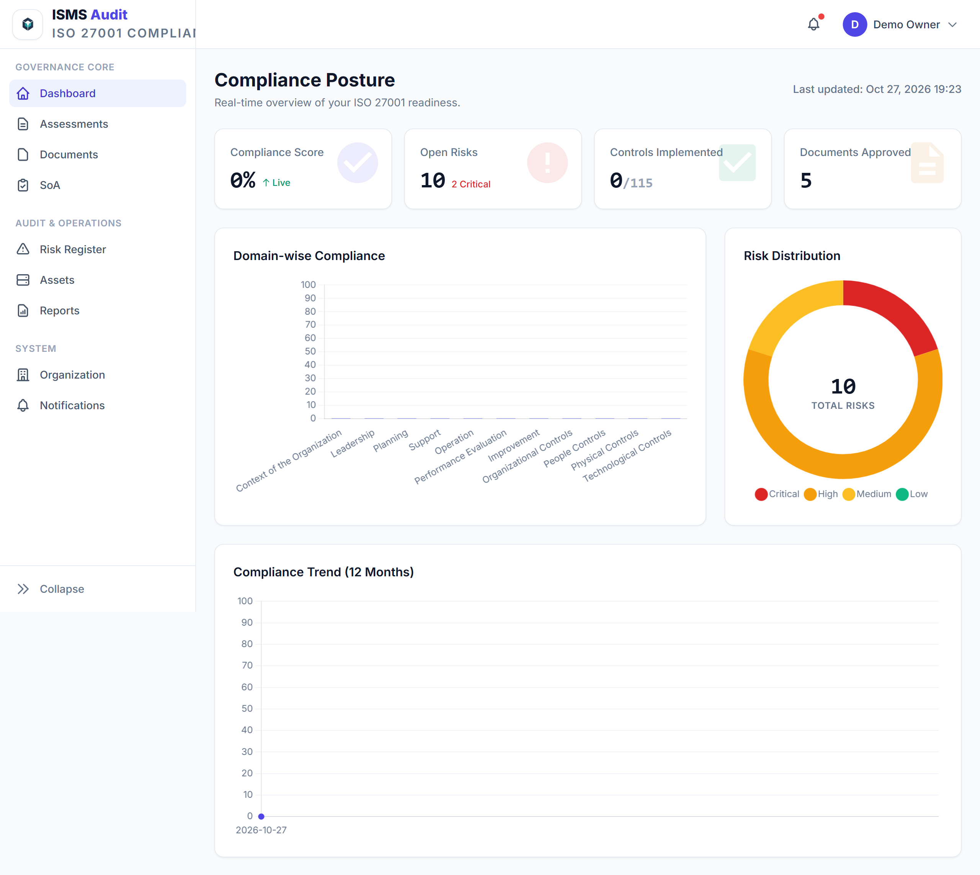
LIVE DEMO • UI & TELEMETRY
Live Prototype: Split-Screen Dark Auth & Executive Dashboard
Visual verification of Phase 8 glassmorphism authentication and Phase 6 Chart.js telemetry
Split-Screen Dark Mode Login with Glassmorphism & Brand Identity
Executive Dashboard: 4 KPI Cards, Domain Bar Chart, Risk & Maturity Breakdown
💡 REAL-TIME COMPLIANCE POSTURE AT A GLANCE: The Executive Dashboard aggregates 115 control responses, active risk severities, and document review states into unified KPI cards and responsive Chart.js canvases.
Student: Kaswan Sangeeta Bhimsingh (Roll No: 17) | Guide: Prof. Harsh Barot | Silver Oak College of Computer Application | Laravel 11 SaaS
Slide 9 / 16
Notes:
Here we see actual screenshots from our live build: the split-screen dark mode login interface on the left, and the Executive Dashboard with real-time Chart.js visualizations on the right.

Slide 10
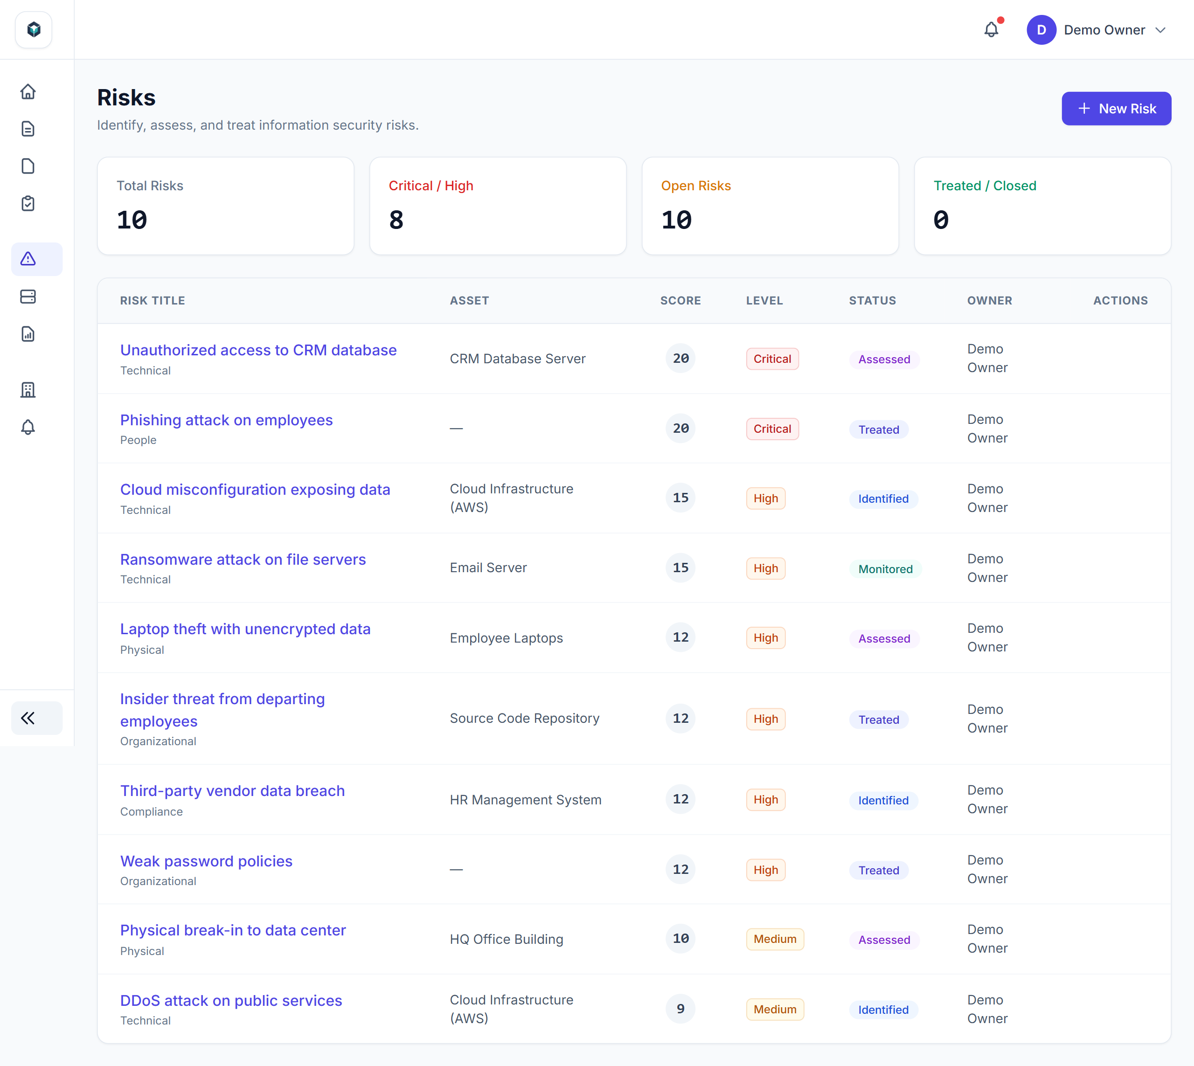
LIVE DEMO • CORE WORKFLOWS
Live Prototype: ISO Control Evaluation & 5×5 Risk Register
Visual verification of domain-by-domain control scoring (Phase 2) and risk treatment tracking (Phase 7)
Control Assessment Interface: Status Badges, 0–5 Maturity & Evidence Notes
Risk Register & 5x5 Heatmap: Likelihood × Impact Scoring & Severity Filtering
💡 SEAMLESS ASSESSOR UX & RISK TRACEABILITY: Assessors evaluate controls domain-by-domain with instant progress bar updates, while risk owners filter high/critical risks directly from the interactive 5×5 severity matrix.
Student: Kaswan Sangeeta Bhimsingh (Roll No: 17) | Guide: Prof. Harsh Barot | Silver Oak College of Computer Application | Laravel 11 SaaS
Slide 10 / 16
Notes:
On the left is the Control Assessment interface where assessors set compliance status and maturity levels across all 115 controls. On the right is the Risk Register featuring automated Likelihood times Impact scoring.

Slide 11
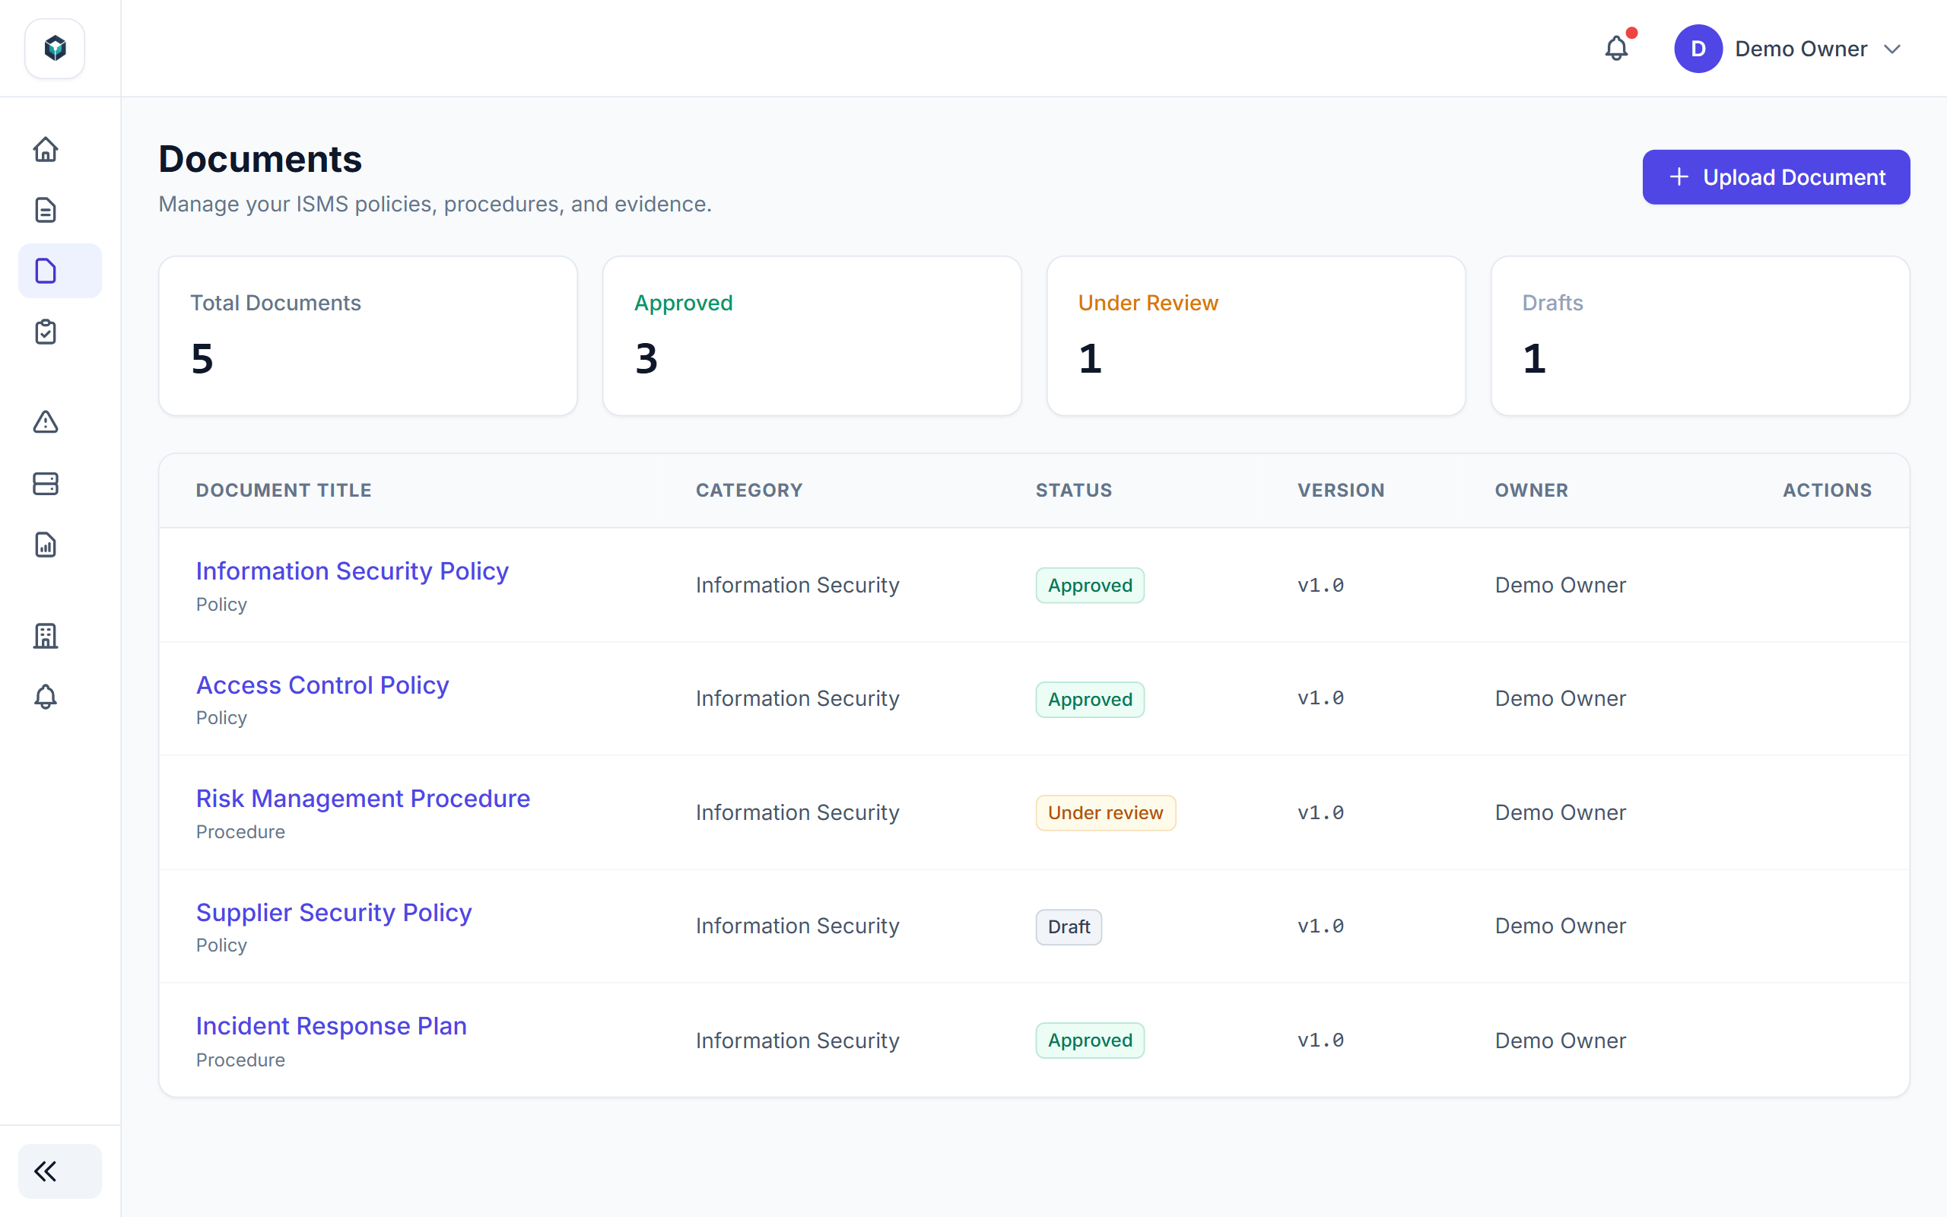
LIVE DEMO • AUDIT ARTIFACTS
Live Prototype: Statement of Applicability (SoA) & Document DMS
Visual verification of Clause 6.1.3(d) SoA matrix (Phase 4) and versioned policy library (Phase 5)
Statement of Applicability (SoA): Applicability, Justifications & Bulk Approval
Document Management System (DMS): Semantic Versions & Control Mapping
💡 ONE-CLICK AUDITOR EVIDENCE GENERATION: Both the Statement of Applicability matrix and the Document Compliance inventory can be exported on-demand to branded PDFs or multi-sheet Excel workbooks for external certification audits.
Student: Kaswan Sangeeta Bhimsingh (Roll No: 17) | Guide: Prof. Harsh Barot | Silver Oak College of Computer Application | Laravel 11 SaaS
Slide 11 / 16
Notes:
These screenshots highlight our Statement of Applicability matrix with approval badges and version comparison, alongside our Document Management System tracking policy versions and review states.

Slide 12
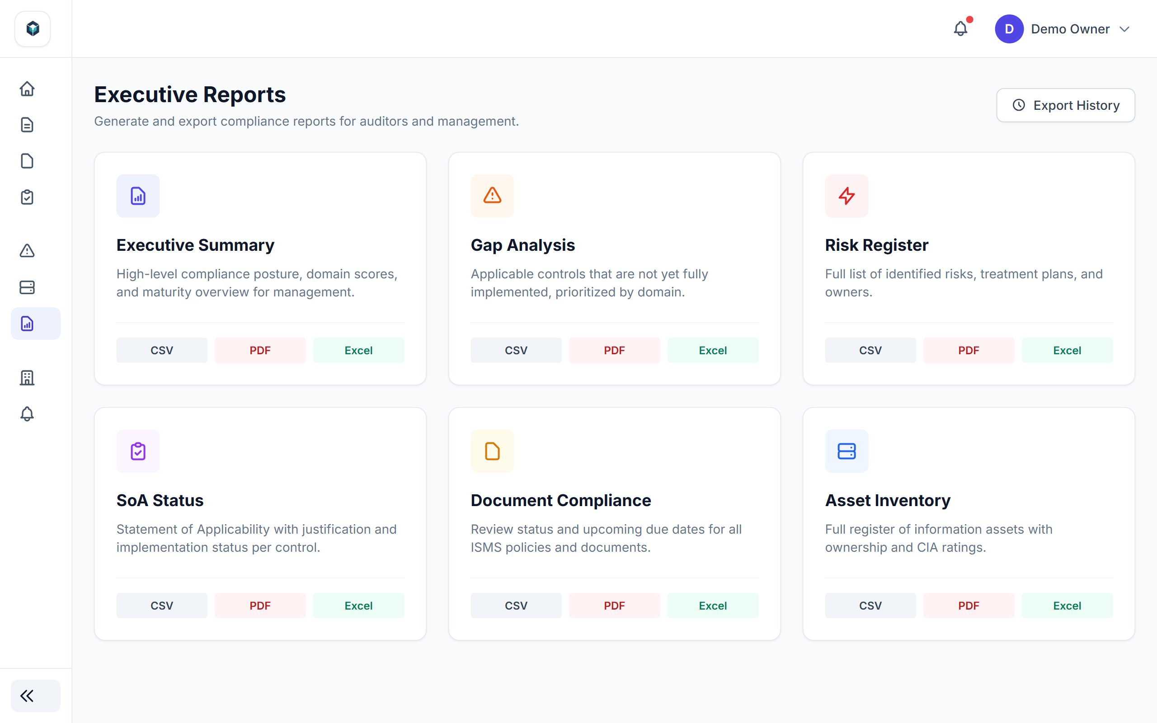
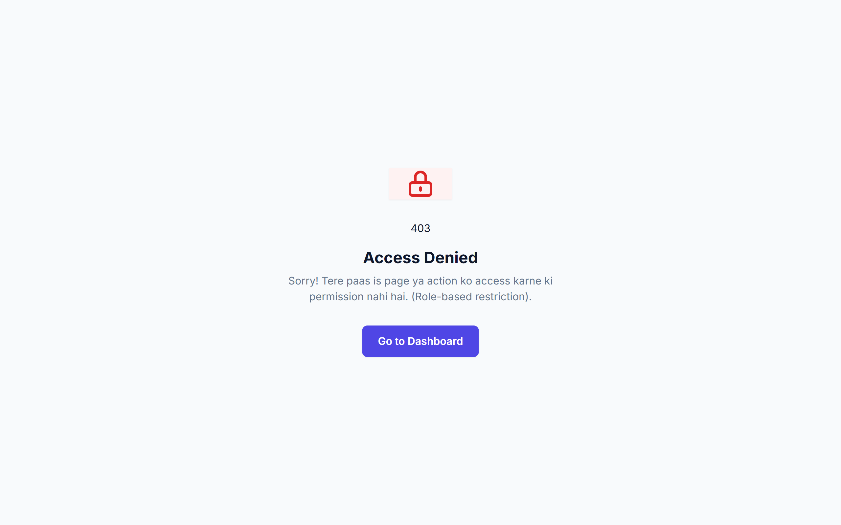
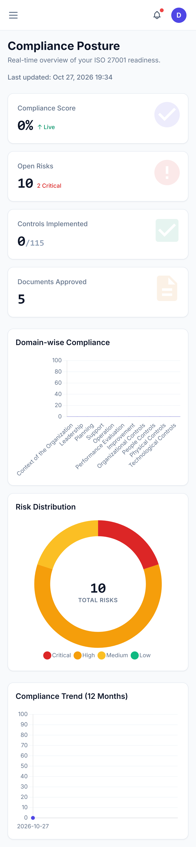
LIVE DEMO • REPORTS & RBAC
Live Prototype: Reports Bento Grid, 403 RBAC Guard & Mobile UI
Visual proof of multi-format report center, Viewer role authorization block, and mobile drawer responsiveness
Reports Bento Grid: 6 Report Types (CSV / PDF / XLSX)
Security Proof: Custom 403 Access Denied for Viewer Role
Mobile Responsive Viewport & Drawer Navigation
💡 VERIFIED ROLE-BASED ACCESS CONTROL & RESPONSIVE ERGONOMICS: When a user with the 'viewer' role attempts to create or modify an Asset or Risk, AssetPolicy and RiskPolicy intercept the request and render the custom 403 Access Denied view.
Student: Kaswan Sangeeta Bhimsingh (Roll No: 17) | Guide: Prof. Harsh Barot | Silver Oak College of Computer Application | Laravel 11 SaaS
Slide 12 / 16
Notes:
Here we demonstrate three critical Phase 6 and Phase 8 deliverables: the 6-report Bento Grid export center, the custom 403 Access Denied page blocking unauthorized Viewer mutations, and mobile responsiveness.

Slide 13
QUALITY ASSURANCE
Comprehensive Automated Testing Matrix (71/71 Passing)
100% Pass Rate Across 71 PHPUnit Feature & Unit Tests (169 Assertions Verified)
Phase / Module Suite | Test Classes Executed | Key Verification Scenarios Covered | Tests / Asserts | Status
Phase 1: Auth & Profile | AuthenticationTest, RegistrationTest, ProfileTest, PasswordResetTest | Breeze login, registration, email verification, password reset & profile updates | 25 Tests / 58 Asserts | 100% PASS ✔
Phase 1: Multi-Tenancy | TenantCreationTest, UserInvitationTest, ExampleTest | Organization onboarding, token invitation acceptance, role assignment & tenant isolation | 4 Tests / 15 Asserts | 100% PASS ✔
Phase 2: Assessments | AssessmentCreationTest, ProgressCalculationTest, ResponseUpdateTest | Assessment wizard CRUD, 115 control initialization, single/bulk updates & weighted score | 8 Tests / 20 Asserts | 100% PASS ✔
Phase 3: Asset & Risk Core | AssetCRUDTest, RiskScoreCalculationTest, TreatmentPlanTest | Asset CIA valuation, Likelihood × Impact (1–25) calculation & severity band mapping | 12 Tests / 19 Asserts | 100% PASS ✔
Phase 4: SoA Engine | SoAGenerationTest, ApprovalWorkflowTest, SoAExportTest, VersionComparisonTest | Auto-SoA generation from responses, single/bulk approval, JSON version diffing & exports | 5 Tests / 16 Asserts | 100% PASS ✔
Phase 5: Document DMS | DocumentUploadTest, VersionControlTest, ReviewWorkflowTest | Tenant-isolated storage, semantic version history, reviewer approval & control mapping | 3 Tests / 7 Asserts | 100% PASS ✔
Phase 6: Reporting & Charts | DashboardTest, ReportGenerationTest | Executive dashboard KPI metrics, null-tenant 403 guard, and CSV/PDF/XLSX report exports | 6 Tests / 15 Asserts | 100% PASS ✔
Phase 7: Risk v2 & Jobs | RiskRegisterTest, RiskTreatmentWorkflowTest, RiskHeatmapTest, RiskNotificationTest, ScheduledSnapshotTest | Dedicated Risk CRUD, 4 treatment strategies, 5x5 heatmap JSON, notifications & daily snapshot job | 8 Tests / 21 Asserts | 100% PASS ✔
💡 CONTINUOUS REGRESSION SAFETY ACROSS 8 PHASES: Every new phase was validated against the entire cumulative PHPUnit test suite using RefreshDatabase and model factories, ensuring zero regressions from Phase 1 (29 tests) to Phase 7/8 (71 tests, 169 assertions).
Student: Kaswan Sangeeta Bhimsingh (Roll No: 17) | Guide: Prof. Harsh Barot | Silver Oak College of Computer Application | Laravel 11 SaaS
Slide 13 / 16
Notes:
Quality assurance was enforced at every phase handoff. Our test suite grew from 29 tests in Phase 1 to 71 passing tests and 169 assertions by Phase 7, verifying tenant isolation, scoring math, and exports.

Slide 14
RETROSPECTIVE
Engineering Challenges & Production Bug Resolutions
Real-world architectural hurdles encountered across Phases 1–8 and how they were resolved
HTML Form Nesting Bug (Update Triggering Delete)
Placing the Delete <form> inside the Update <form> caused browser submit events to delete records on edit. Resolved by moving the delete form outside and binding the button via HTML5 form='delete-form'.
Global TenantScope on Child & Catalogue Tables
Applying TenantScope to AssessmentResponse and ISO Control tables caused SQL column errors because they lack direct tenant_id columns. Resolved by adding a Schema::hasColumn('tenant_id') guard and scoping via parent Assessment.
Phase 3 vs Phase 7 Route & Foreign Key Collision
Extending risk_treatment_plans for the dedicated Risk model conflicted with Phase 3 treatments.store routes and NOT NULL FKs. Resolved by making risk_assessment_id nullable and namespacing Phase 7 routes under risks.treatments.*.
Asset Owner String vs Eloquent Relationship Crash
Calling Asset::with('owner') on the Executive Dashboard threw a relation exception because assets.owner stores a string name. Resolved by removing invalid eager loading in ReportRepository and defensive model checks.
Shared Hosting (InfinityFree) Vite & Document Root
Standard Laravel public/ folder structure and lingering public/hot files caused 404 asset errors in production. Resolved by shifting public entry points into htdocs/, compiling production Vite bundles, and removing hot file.
💡 PRODUCTION DEBUGGING & DEFENSIVE ENGINEERING: Resolving these 15+ cross-phase integration bugs—ranging from HTML5 form attribute binding to defensive repository queries—ensured a rock-solid production deployment.
Student: Kaswan Sangeeta Bhimsingh (Roll No: 17) | Guide: Prof. Harsh Barot | Silver Oak College of Computer Application | Laravel 11 SaaS
Slide 14 / 16
Notes:
During development and Phase 8 polishing, we diagnosed and fixed several critical engineering bugs, including nested HTML form deletion issues, TenantScope column checks, and route name collisions.

Slide 15
FUTURE ROADMAP
Architectural Lessons & Phase 9 Roadmap (REST API & Cloud)
Next-generation enterprise capabilities ready to plug into our existing Service & DTO architecture
🔌
REST API v1 (Laravel Sanctum)
🕵️
Granular Audit Trail & Security
☁️
Cloud Telemetry & Automation
• Zero Business Logic Rewrite: Thin /api/v1/ controllers will directly invoke existing Service & DTO classes.
• Sanctum Token Auth: Scoped API tokens per tenant with configurable rate limiting.
• JSON API Resources: Standardized AssessmentResource, RiskResource, and SoAResource payloads.
• OpenAPI / Swagger Docs: Complete Postman collection and interactive Swagger specification.
• Owen-it Auditing UI: Visual diff viewer showing old_values vs new_values for every control & risk change.
• Multi-Factor Auth (MFA): TOTP authenticator app enforcement for Owner and Admin roles.
• Enterprise SSO: SAML 2.0 and OAuth2 (Microsoft Entra ID / Google Workspace) login integration.
• Unified Risk Model Cleanup: Deprecating legacy Phase 3 risk table in favor of the Phase 7 Risk engine.
• Automated Evidence Collection: AWS IAM, GitHub & Azure connectors to auto-verify Annex A.8 technical controls.
• Web-Cron & Queue Workers: Dedicated Redis + Supervisor workers and token-authenticated web cron triggers.
• Slack & MS Teams Webhooks: Real-time channel alerts when critical risks or overdue treatments occur.
• AI Control Copilot: LLM-assisted gap remediation advice and policy draft generation.
💡 WHY CLEAN ARCHITECTURE PAYS OFF IN PHASE 9: Because 100% of our compliance scoring, SoA generation, and risk calculations already live in Service classes accepting DTOs, building the Phase 9 REST API requires only thin API controllers and Sanctum middleware.
Student: Kaswan Sangeeta Bhimsingh (Roll No: 17) | Guide: Prof. Harsh Barot | Silver Oak College of Computer Application | Laravel 11 SaaS
Slide 15 / 16
Notes:
Looking ahead to Phase 9, our strict Service-Repository-DTO architecture makes exposing a full Laravel Sanctum REST API, visual audit trail UI, and automated cloud evidence integrations effortless.

Slide 16
ENTERPRISE CAPSTONE • ALL 8 DEVELOPMENT PHASES COMPLETED
THANK YOU! QUESTIONS & LIVE DEMO
Live Production URL: https://ismsaudit.infinityfree.io
GitHub Repository: https://github.com/sangeetakaswan-dev/isms-tool
Demo Credentials: owner@demo.com | assessor@demo.com | viewer@demo.com (Password: password)
ISMS Audit Platform Brand Identity
PHASE 1–2 • CORE
PHASE 3 & 7 • RISK
PHASE 4–5 • AUDIT
PHASE 6 & 8 • LIVE
Multi-Tenant RBAC
115 ISO Controls & Scoring
Asset CMDB + 5×5 Matrix
4 Treatment Strategies
Auto-SoA + Version Diff
Document DMS & Mapping
6 Strategy Reports + Charts
71 Tests + Vanta UI Live
✔ Phase 1 to Phase 8 Reports Complete | ✔ 71/71 PHPUnit Tests (169 Assertions) | ✔ Live HTTPS Production Deployment
Student: Kaswan Sangeeta Bhimsingh (Roll No: 17) • Guide: Prof. Harsh Barot • Silver Oak College of Computer Application
Department of Computer Applications
Student: Kaswan Sangeeta Bhimsingh (Roll No: 17) | Guide: Prof. Harsh Barot | Silver Oak College of Computer Application | Laravel 11 SaaS
Slide 16 / 16
Notes:
Thank you Sir/Ma'am. The platform is live at ismsaudit.infinityfree.io and all 71 automated tests are passing. I am now ready for your questions and a live demonstration.

