Slide 1
Global Supply Chain Management Platform
A System for Companies to Work Together
Team: DigiMinds
Members:
Sangeeta Singh (NUID: 002082071)
Jamie Gist (NUID: 003182426)
Jafaeth Gomez (NUID: 003189253)

Slide 2
The Problem We Are Solving
Modern supply chains involve many companies:
• Products are made in factories
• Stored in warehouses
• Sold in stores
Current Problems:
• Companies use different computer systems
• Hard to see where orders are
• Slow communication between companies
• Mistakes happen because of poor coordination

Slide 3
Our Solution
One system where all companies can:
✓ See what's happening in real-time
✓ Send messages to each other easily
✓ Track orders from start to finish
✓ Work together more efficiently
Result: Faster, cheaper, and more reliable supply chain

Slide 4
Three Types of Companies
Manufacturing Companies
• Make products
• Check quality
• Order materials
Logistics Companies
• Store products in warehouses
• Ship products to customers
• Track deliveries
Retail Companies
• Sell products to customers
• Manage inventory
• Track sales
System Administrators
• Set up companies
• Create user accounts
• View reports

Slide 5
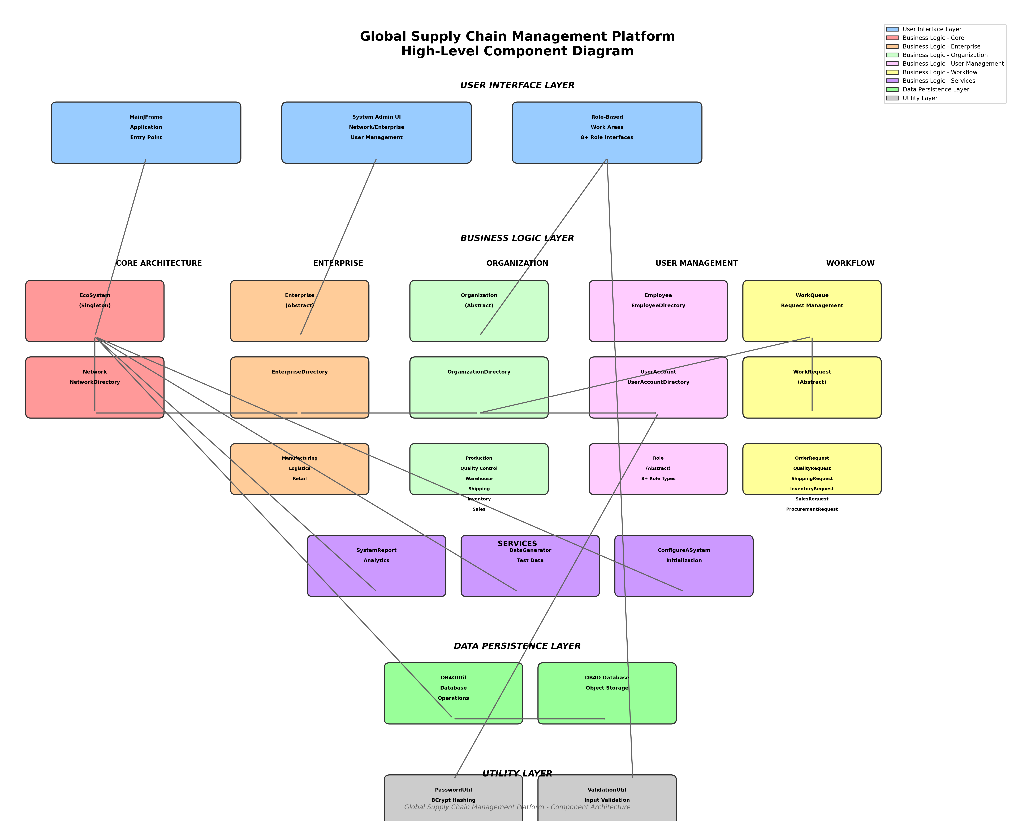
System Architecture
The system is organized in layers:
User Interface → Business Logic → Data Storage

Slide 6
Key Features
🔐 Secure login system - passwords are encrypted
🏢 Company and department management
📋 Work request system - send requests between departments
🌐 Cross-company communication
📦 Order tracking from start to finish
📊 Reports and statistics
🤖 Automatic test data generation

Slide 7
How the System is Organized
Like a tree structure:
EcoSystem (Top Level)
└── Networks (Groups of Companies)
└── Enterprises (Individual Companies)
└── Organizations (Departments)
└── Employees and Work Requests
Each level manages the level below it

Slide 8
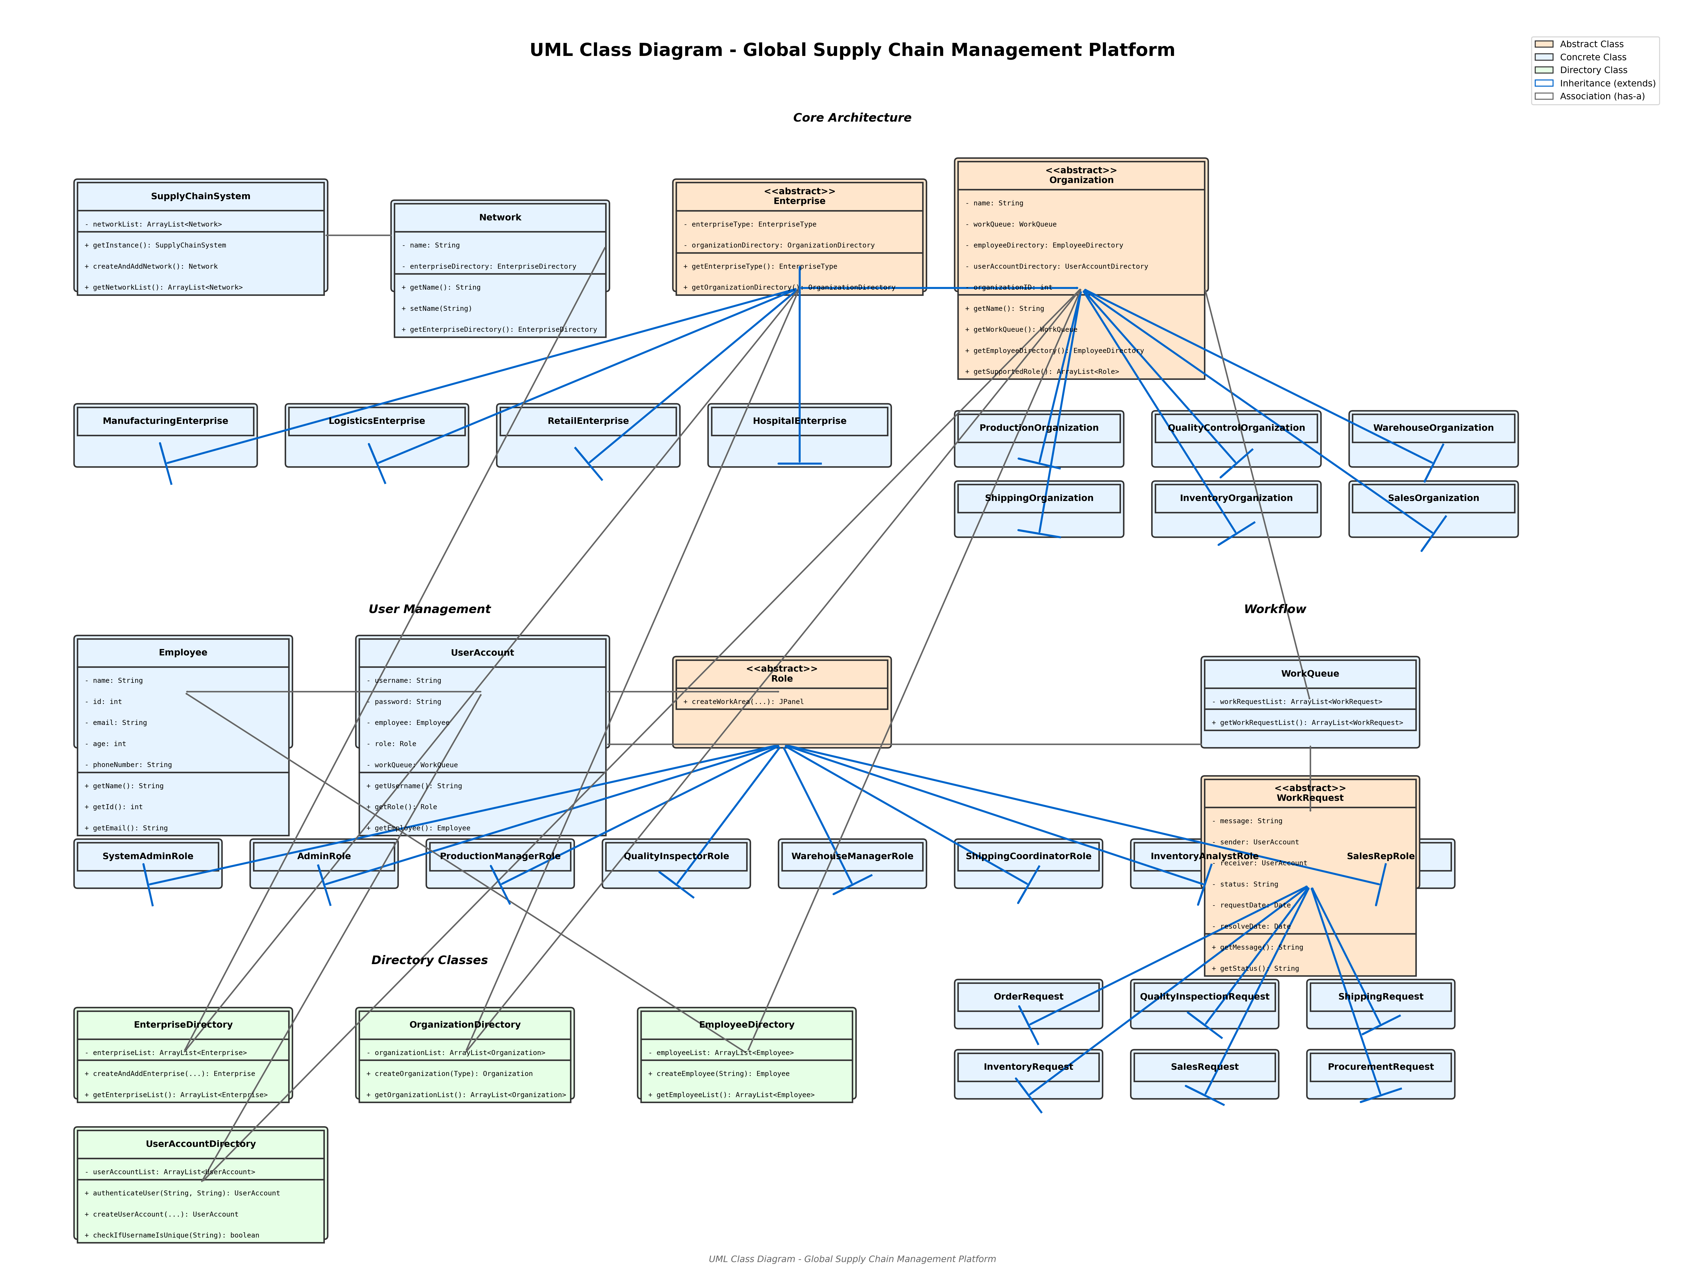
System Design - Class Diagram

Slide 9
Who Uses This System?
Production Managers
• See production orders
• Manage manufacturing
Quality Inspectors
• Check product quality
• Approve products
Warehouse Managers
• Manage inventory
• Handle storage
Shipping Coordinators
• Coordinate deliveries
• Track shipments
Sales Representatives
• Create sales orders
• Track customer orders
System Administrators
• Manage the system
• View reports

Slide 10
Technology Used
Java Programming Language
• Works on Windows, Mac, Linux
Java Swing
• Creates windows and forms
DB4O Database
• Stores all information safely
BCrypt Security
• Encrypts passwords securely
Maven Build Tool
• Organizes code automatically
JavaFaker
• Creates test data

Slide 11
Why Each Company is Important
Manufacturing Company
• Makes the products
• Ensures quality
• Without it: No products to sell
Logistics Company
• Stores and ships products
• Gets products to customers
• Without it: Products can't reach customers
Retail Company
• Sells to customers
• Knows what customers want
• Without it: No connection to market

Slide 12
Working Together Creates More Value
The whole is greater than the sum of parts:
Manufacturing + Logistics
→ Products are made AND delivered
→ Result: Products available where needed
Logistics + Retail
→ Inventory matches customer demand
→ Result: No stockouts or overstock
All Three Together
→ Real-time coordination
→ Result: Efficient, cost-effective, happy customers

Slide 13
Security Features
Keeping the system safe:
Password Protection
• Passwords are encrypted (BCrypt)
• Strong password requirements
• Cannot be easily stolen
User Authentication
• Each user must log in
• Each user has specific permissions
• Only see what they need to see
Input Validation
• All user input is checked
• Prevents errors and security issues

Slide 14
Reporting and Analytics
System administrators can view:
📊 How many companies are in the system
👥 How many employees and users
📋 How many work requests by type
✅ Status of all requests (pending, completed, etc.)
📈 Performance metrics
This helps understand how the system is being used

Slide 15
Test Data Generation
The system can automatically create sample data:
🏢 Sample companies (Manufacturing, Logistics, Retail)
🏬 Sample departments within each company
👤 Sample employees with realistic names
🔐 Sample user accounts for testing
📦 Sample work requests and orders
This allows testing without entering everything manually

Slide 16
Benefits of This System
For Companies:
• Faster order processing
• Better visibility
• Fewer mistakes
• Lower costs
For Employees:
• Easier to do their job
• Clear communication
• Less confusion
For Customers:
• Faster delivery
• Better quality products
• More reliable service
Overall Result:
• More efficient supply chain
• Better coordination
• Higher satisfaction

Slide 17
Key Achievements
What makes this project special:
🌟 Multiple companies can work together in one system
🌟 Real-time communication and tracking
🌟 Secure and reliable
🌟 Easy to use for all types of employees
🌟 Works on different computer systems
🌟 Complete solution with documentation
Demonstrates how technology can help companies
work together better

Slide 18
Conclusion
This system successfully solves the problem:
✓ Creates one system for all companies
✓ Enables real-time communication
✓ Tracks orders from start to finish
✓ Makes the supply chain faster and more efficient
Key Message:
When companies work together through this system,
they create more value than working alone
Result: Better for companies, employees, and customers

Slide 19
Thank You!
Questions?

