Slide 1
Object Oriented Modular Framework for Advanced JavaScript and AJAX Programming

Slide 2
Objectives
Develop a JavaScript Software Development Kit (JsSDK) to
  Help the Java community to build AJAX applications with less effort
  Extend the MVC architecture of Web Applications to the client-side JavaScript modules.
  Reduce interdependency between User Experience Engineers and Application Developers
  Improve maintainability and reduce cost of AJAX development
  Encourage Object Oriented Programming in JavaScript
  Build reusable browser independent JavaScript libraries and applications
  In both AJAX and non-AJAX mode of a Web application
    Retain Features, Look-n-Feel and Usability
    Reuse View Templates and Application APIs
  Give opportunity to build Commercial JavaScript libraries.

Slide 3
Agenda
What is AJAX ?
Technologies Used
What is JsSDK ?
An Illustration of JsSDK
Summary
Questions ?

Slide 4
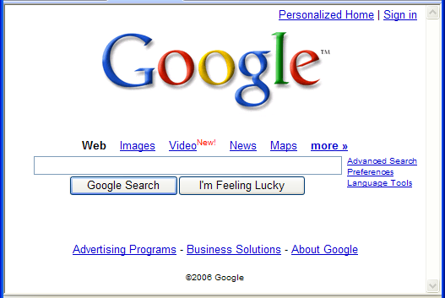
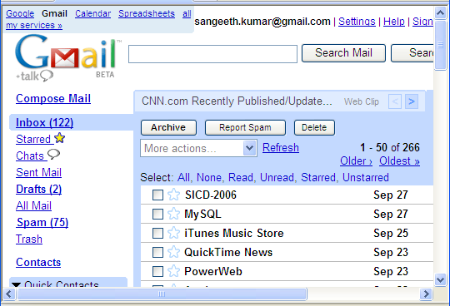
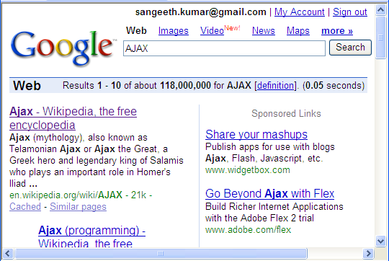
What is AJAX ?
Non-AJAX application
AJAX application
Web
Browser
1
Web Browser sends a “REQUERST” to get a Web page
Web
Server
Web
Browser
1
Web Browser sends a “REQUERST” to get a Web page from gmail.google.com
Web
Server
Web Server replies a Web page as the “RESPONSE”
Web Server replies “RESPONSE” as a Web page
2
+
2
js
js
js
3
3
JavaScript which was sent along with the main page request the Web Server to get recent e-mails
Web Browser sends the search request with a user typed keyword Eg. “AJAX”
Web Server replies the Search Result Page as a “RESPONSE”
Web Server replies all the recent e-mail data either as JavaScript code, XML or any Textual format
4
4
What is AJAX ?

Slide 5
Technologies Used
Java 2 Platform 5.0
  Programming language provided by Sun Microsystems. (http://www.sun.com)
Java Servlet, Java Server Pages & Java Standard Tag Library
  Server-side Web Development technology Provided by Sun Microsystems (http://www.sun.com)
JavaScript
  Predominantly used for dynamic Web Applications originally developed in Netscape Communications Corporation (http://www.netscape.com/)
Direct Web Remoting (DWR)
  allows Javascript in a browser to interact with Java on a Web Server and helps you manipulate web pages with the results.
  Developed by Getahead (http://getahead.ltd.uk)
Technologies Used

Slide 6
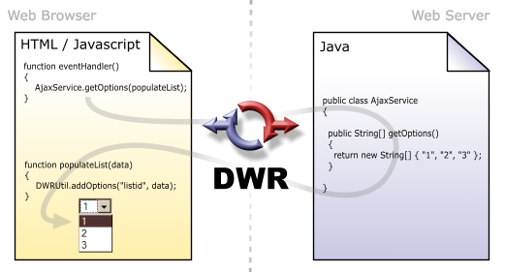
Technologies Used: contd…
Remote Service
  Java classes which encapsulate application business logic and process input data, irrespective of who and where the caller is.
  They do not implement or extend any special interfaces or classes.
  Example: The class named “AjaxService” shown in the adjacent figure is an example for a Remote Service.
Interface
  Class signature of these Remote Services.
  Example: From JavaScript code the Remote Service is being called using the same signature with the help of Interface and JavaScript Stub.
Courtesy: http://getahead.ltd.uk/dwr/
Technologies Used

Slide 7
What is JsSDK?
Acronym for JavaScript Software Development Kit
An Object Oriented JavaScript and AJAX programming toolkit
Components of JsSDK is shown below
JavaScript Language
JavaScript Language
Development Tools
jsc
jsp2js
jsdoc
JsSDK
User interface, util, logging
and other
Base Libraries
Networking
Lang & Util
DWR
JsSDK
API
Forms
Logging
Collections
Web Browsers
NetscapeTM
Internet ExplorerTM
MozillaTM
FirefoxTM
Note: JSDoc (http://jsdoc.sourceforge.net/) and DWR (http://getahead.ltd.uk/dwr) are 3rd Party Solutions. DWR Engine as been slightly customized to suit the needs of JsSDK
What is JsSDK ?

Slide 8
JsSDK: Stack
Sun Microsystems JSP technology is used as the GUI Templating language
JsSDK provides tools to translate JSP 2.0 compliant templates into JavaScript (on the fly or build time)
Netscape’s JavaScript is the primary language for development.
JsSDK’s JavaScript compiler resolves all dependencies on View, Interfaces and other JavaScript packages and generates unified JavaScript code named “jso”.
JsSDK provides directives like $import, $importView, $importInterface and $export
Java Server Pages (JSP)
Provided by Sun Microsystems
GUI Template Framework
JSP to JS Translator
JsSDK
Related
JavaScript
JavaScript Compiler
JsSDK
Related
JS Object Code
Web Browser
Web Browser Supporting JavaScript
What is JsSDK ?

Slide 9
JsSDK: Application Architecture
Java 2 Platform
JsSDK & DWR
libraries
Application APIs
Resources
images,
scripts,
stylesheets…
Application
Views
Other Application
Specific Servlets
JsSDK
Servlet
DWR*
Servlet
JSP & Servlet Engine
Web Server
Internet
Web Browser
JsSDK.core
Interfaces
Application Code
What is JsSDK ?

Slide 10
JsSDK: Building Blocks
Assemblies
  Reusable JsSDK compliant JavaScript libraries
  Includes reusable JavaScript classes
Views
  Shared UI templates written in JSP 2.0 with JSTL 1.1 or higher.
Event Handlers
  JavaScript code to handle user actions on the Views.
Interfaces
  JavaScript interfaces to access Remote Services using DWR engine. (Note – The DWR engine packaged with JsSDK is slightly modified to suit the needs of JsSDK)
What is JsSDK ?

Slide 11
JsSDK: Importing Building Blocks
Importing = Loading + Linking (resources like Assemblies, Views and Interfaces).
  Loading = Downloading the resource to be “imported”.
  Linking = Including the downloaded resource into the unified JavaScript code named “jso”.
Importing is done with the help of the following directives introduced in JsSDK.
  $import – to import assemblies.
  $importInterface – to import remote interaces.
  $importView – to import JSP 2.0 view templates.
  $export – to expose symbols from an assembly.
Importing can be performed in two ways
  Compile-time
  Run-time
    $importXXX directives provided in JsSDK request the WebServer to return the required assemblies, interfaces and views.
What is JsSDK ?

Slide 12
JsSDK: Compile-time Importing
js
JavaScript compiler while parsing the source code it interprets the $importXXX directives and accordingly loads and links all the imported building blocks and generate one single js code named “jso”.
JSO is a compressed, optimized, unified, browser Independent, standalone JavaScript code.
Sub components of JavaScript Compiler are
  Packager - merges all the imported Assemblies, Interfaces and Views with the help of JSParser, JSPtoJSTranslator, Service Stub Generator
  JSParser – parses JS code using LL(1) grammar which I developed.
  JSLexer - tokenizes the input JS source.
  JSPtoJSTranslator - used by Packager to translate JSP 2.0 source to JavaScript 1.3 code.
  ServiceStub Generator - generate JsSDK compliant DWR Stub in JavaScript 1.3.
Avoids run-time overhead of “window.eval” execution for loading each imported resource.
Recommended for Production Releases
Application
JavaScript Source
<< imports >>
js
js
JSLexer
JSParser
Packager
Service Stub
Generator
js
JsSDK Assemblies
Javascript compiler
JSP to JS
Translator
js
js
js
User Assemblies
jso
jsp
User Views
Optimizer
java
User Remote
Service
Application JavaScript
Object code
jso
What is JsSDK ?

Slide 13
JsSDK: Run-time Importing
Java 2 Platform
JsSDK & DWR
libraries
Application APIs
Application
Views
$importXXX directive internally initiate a HTTP request to JsSDK’s Core Servlet
Core Servlet based on the request returns an assembly, interface or view.
Useful during Development time.
Not recommended for production releases as it adds the overhead of “window.eval” execution to import each resource.
Helps in debugging
JsSDK Core Servlet
JSP & Servlet Engine
Web Server
Internet
Web Browser
JsSDK.core.js
Application Code
What is JsSDK ?

Slide 14
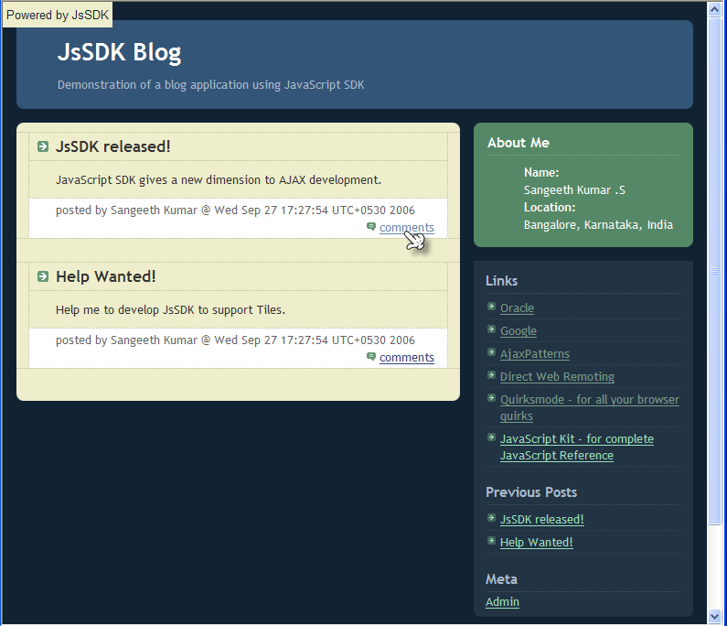
Blog: An Illustration of JsSDK
Webblog Application
Web Server
Internet
Web Browser
js
js
js
Page
JsSDK libraries, User libraries,
Remote Service Stubs, View JS, and View Event Handler JavaScript code
View
An Illustration of JsSDK

Slide 15
Blog: Page Code in JSP
<%@ page language="java" contentType="text/html; charset=ISO-8859-1“
pageEncoding="ISO-8859-1"%>
<%@ taglib prefix="c" uri="http://java.sun.com/jstl/core_rt" %>
<!DOCTYPE html PUBLIC "-//W3C//DTD XHTML 1.0 Strict//EN"
"http://www.w3.org/TR/xhtml1/DTD/xhtml1-strict.dtd">
<html xmlns="http://www.w3.org/1999/xhtml" xml:lang="en" lang="en">
<head>
<meta http-equiv="Content-Type" content="text/html; charset=ISO-8859-1"/>
<title>JsSDK Blog - ${param.title}</title>
<link href="styles/style.css" type="text/css" rel="stylesheet"/>
<c:if test="${jssdkver != null}">
<script type="text/javascript“
src="${pageContext.request.contextPath}/jssdk">
</script>
<script type="text/javascript"
src="scripts/blogger.js">
</script>
</c:if>
</head>
<body>
<div id="content">
<jsp:include page="header.jsp"/>
<div id="main">
<div id="main2">
<div id="main3">
<jsp:include page="${param.content}"/>
</div>
</div>
</div>
<div id="sidebar">
<jsp:include page="profile.jsp"/>
<div class="box">
<div class="box2">
<div class="box3">
<h2 class="sidebar-title">Links</h2>
<div id="links">
<jsp:include page="snippet_links.jsp"/>
</div>
<h2 class="sidebar-title">Previous Posts</h2>
<div id="recently">
<jsp:include page="snippet_previous_posts.jsp"/>
</div>
<h2 class="sidebar-title">Meta</h2>
<a name="cmdAdmin" href="${pageContext.request.contextPath}/admin">
Admin
</a>
</div>
</div>
</div>
</div>
<jsp:include page="footer.jsp"/>
</div>
</body>
</html>
Typical way of including the Application source code in an HTML page
An Illustration of JsSDK

Slide 16
Blog: Client JS Code using JsSDK
Application package
// Define application package
var blogger = new Package();
// Local variables
var contentArea;
// Import required assemblies
$import("js.ui.event");
$import("js.dwr.core");
$import("js.ui.toolkit");
$import("js.util.bean");
// Import required service interfaces
$importInterface("blogger.BlogService");
. . .
// Import required views
$importView("blogger.homeView",
"snippet_main.jsp",
"blogger_main_view_eventHandler");
$importView("blogger.commentsView",
"snippet_comments.jsp",
"blogger_comments_view_eventHandler");
. . .
// Helper functions
function changeTitle(newTitle) {
document.title = "JsSDK Blog - " + newTitle;
}
function findMessage(messageId) {
. . .
}
. . .
// View Event Handlers
function blogger_main_view_eventHandler() {
changeTitle("Home");
new js.ui.toolkit.Command("cmdComment",
function(event,srcElement){
var messageId =
srcElement.getAttribute("messageId");
var message = findMessage(messageId);
if (message) {
pageContext["message"] = message;
blogger.commentsView.show(contentArea);
}
});
. . .
}
function blogger_comments_view_eventHandler() {
. . .
}
js.ui.EventManager.addEventHandler(
js.ui.EventManager.EVENT_ONLOAD,
function(event) {
showLogo();
js.dwr.core.DWRUtil.useLoadingMessage(
"Processing...");
contentArea =
document.getElementById("main3");
blogger.BlogService.getMessages(function(data){
pageContext["previousPosts"] = data ;
blogger.homeView.show(contentArea);;
}); }
);
Required Assemblies
Event
Handler for
Views
Required Interfaces
Required Views
Actions to be performed once the application is loaded
Helper Functions
An Illustration of JsSDK

Slide 17
Blog: Assembly
// js.ui.toolkit Assembly
$export("js.ui.toolkit.Command");
$export("js.ui.toolkit.View");
$import("js.ui.event");
// View class Definition
js.ui.toolkit.View = function(renderer,eventHandler) {
this.renderer = renderer;
this.show = View_show;
this.eventHandler = eventHandler;
}
function View_show(container) {
if (this.renderer) {
var html = this.renderer(pageContext);
container.innerHTML = html;
if (this.eventHandler) {
this.eventHandler();
}
}
}
// Command class definition
js.ui.toolkit.Command = function(id,onclick) {
this.id = id;
var elements = window.document.getElementsByName(id);
if (elements) {
for(var i=0;i<elements.length;i++) {
js.ui.EventManager.addClickEventHandler(elements[i],
onclick);
}
}
}
Collection of reusable classes.
May import one or more Assemblies, Views or Interfaces.
Exports one or more Classes
Example: exports 2 classes namely Command and View and it imports js.ui.event Assembly
An Illustration of JsSDK

Slide 18
BLog: Views
Independent GUI Elements in a Page are called as Views
Figure shows six views in a page which are
  Main View
  Header View
  Profile View
  Link View
  Message View
  Admin View
2
1
3
4
5
6
An Illustration of JsSDK

Slide 19
Blog: View code
The source code of the View #1 shown in the previous slide. The language used is JSP 2.0 with JSTL 1.1
<%-- Core with EL --%>
<%@ taglib prefix="c" uri="http://java.sun.com/jstl/core_rt" %>
<c:forEach items="${previousPosts}" var="post">
<div class="post">
<a name="postIndex"></a>
<h3 class="post-title">${post.title}</h3>
<div class="post-body">
<p>${post.body}</p>
</div>
<p class="post-footer">
<em>posted by ${post.author} @ ${post.time}
</em> &nbsp;
<a name="cmdComment" messageId="${post.id}" class="comment-link"
href="${pageContext.request.contextPath}/comment?messageId=${post.id}"> comments
</a>
</p>
</div>
</c:forEach>
An Illustration of JsSDK

Slide 20
JSP to JS Translation using JsSDK
function process_snippet_main_jsp_view(pageContext, pageScope,requestScope,sessionScope,applicationScope,param,paramValues,header,headerValues,initParam,cookie) {
var html = "";
var previousPosts = pageContext["previousPosts"];
var post; var post_src = previousPosts;
for(var i2 in post_src) {
post = post_src[i2];
html += " ";html += "<div class=\"post\">";
html += ""; html += "<a name=\"postIndex\">";
html += "</a>";html += " ";
html += "<h3 class=\"post-title\">";
html += "" + (post.title) + "";html += "</h3>";
html += " ";html += "<div class=\"post-body\">";
html += " ";html += "<p>";
html += "" + (post.body) + "";html += "</p>";
html += " ";html += "</div>";
html += " ";html += "<p class=\"post-footer\">";
html += " ";html += "<em>";
html += "posted by " + (post.author) + " @ " + (post.time) + "";html += " ";html += "</em>";html += " ";
html += "&nbsp;";html += " ";
html += "<a name=\"cmdComment\" messageId=\"" + (post.id) + "\" class=\"comment-link\" href=\"" + (pageContext.request.contextPath) + "/comment?messageId=" + (post.id) + "\">";html += "comments";
html += " ";html += "</a>";html += " ";
html += "</p>";html += " ";html += "</div>";
}
return html;
}
$import("js.ui.toolkit");
$export("blogger.homeView");
blogger.homeView = new js.ui.toolkit.View(
process_snippet_main_jsp_view,
blogger_main_view_eventHandler);
Used by $importView
Translates the View code to JavaScript.
Code shown is the JavaScript representation of sample View code shown in the previous slide.
Can translate at Run-time as well as at Compile-time.
Supports only JSP 2.0 with JSTL 1.1 or higher.
Supports EL
Supports predefined objects like pageContext etc..
An Illustration of JsSDK

Slide 21
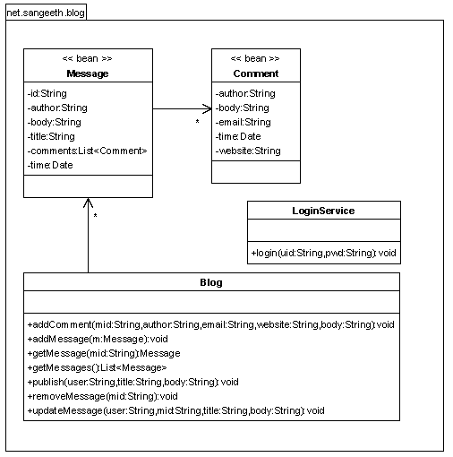
Service & Interface Definition
<?xml version="1.0" encoding="UTF-8"?>
<!DOCTYPE dwr PUBLIC "-//GetAhead Limited//DTD Direct Web Remoting 1.0//EN" "http://www.getahead.ltd.uk/dwr/dwr10.dtd">
<dwr>
<allow>
<convert converter="bean“
match="net.sangeeth.blog.Message"/>
<convert converter="bean“
match="net.sangeeth.blog.Comment"/>
<create creator="new“
javascript="blogger.BlogService“
class="net.sangeeth.blog.Blog">
<include method="getMessage"/>
<include method="getMessages"/>
<include method="removeMessage"/>
<include method="addComment"/>
<include method="updateMessage"/>
<include method="publish"/>
</create>
<create creator="new“
javascript="blogger.BlogLoginService“
class="net.sangeeth.blog.LoginService">
<include method="login"/>
</create>
</allow>
</dwr>
Object Model of a Simple Blogger Application which includes two services namely Blog and LoginService
The Interfaces for Blog and LoginService are defined using DWR Descriptor file
An Illustration of JsSDK

Slide 22
Stub Generation using JsSDK
$import("js.dwr.core");
$export("blogger.BlogService");
blogger.BlogService = function () { }
blogger.BlogService._path = '/blogger1.0/dwr';
blogger.BlogService.getMessages = function(callback) {
js.dwr.core.DWREngine._execute(blogger.BlogService._path,
'blogger.BlogService', 'getMessages', callback);
}
blogger.BlogService.removeMessage = function(p0, callback) {
js.dwr.core.DWREngine._execute(blogger.BlogService._path,
'blogger.BlogService', 'removeMessage', p0, callback);
}
blogger.BlogService.addComment = function(p0, p1, p2, p3, p4,
callback) {
js.dwr.core.DWREngine._execute(blogger.BlogService._path,
'blogger.BlogService', 'addComment', p0, p1, p2, p3, p4, callback);
}
blogger.BlogService.updateMessage = function(p0, p1, p2, p3, callback) {
js.dwr.core.DWREngine._execute(blogger.BlogService._path, 'blogger.BlogService', 'updateMessage', p0, p1, p2, p3, callback);
}
blogger.BlogService.getMessage = function(p0, callback) {
js.dwr.core.DWREngine._execute(blogger.BlogService._path,
'blogger.BlogService', 'getMessage', p0, callback);
}
blogger.BlogService.publish = function(p0, p1, p2, callback) {
js.dwr.core.DWREngine._execute(blogger.BlogService._path, 'blogger.BlogService', 'publish', p0, p1, p2, callback);
}
Used by $importInterface
Uses DWR descriptor file to generate the Stubs
Adds $import(“js.dwr.core”) directive
Includes $export(“<base package>.<classname>”) directive.
Generated Stub imports “js.dwr.core” assembly in order to use JsSDK’s flavour of DWR APIs.
JavaScript Stub Source code of blogger.BlogService
An Illustration of JsSDK

Slide 23
Summary
I have successfully built JsSDK which
  Provides JavaScript APIs to dynamically include JSP pages into client-side JavaScript modules
  Provides JavaScript APIs to make remote calls to Java classes with the help of modified DWR.
  Provides tools to generate compressed JavaScript code.
  Enables developers to develop commercial quality JavaScript libraries and “import” them dynamically into applications.
  Includes Browser Independent Event Handling APIs
  Helps to extend the Model-View-Controller architecture of Web Applications to the client-side JavaScript modules.
  Helps Java community to develop AJAX applications with less effort.
  Reduces interdependency between UI Engineers and Application Developers
  Encourages Object Oriented Programming in JavaScript
  Improves maintainability and reduce cost of AJAX development
Summary

Slide 24
Future Scope
Complete Support for JSTL
Optimizing DWR marshalling and unmarshalling mechanism
Support PHP and JSON
Improved Code Optimizer

Slide 25
Thank You !

