Slide 1
CONTEXTUAL Question Answering WITH HOTPOTQA
CS6120 Spring 2021 Project
Srinidhi Gopalakrishnan
Sai Divya Sangeetha Bhagavatula

Slide 2
Problem Definition
The question answering task provides a quantifiable method to test the intelligence of NLP systems.
The difficulty of the task increases when we introduce multi-hop questions for which the system requires a large amount of context to answer the question.
Model develops the intuition to learn supporting facts that lead to the answer.
Question
Context around question
Para 1
Para 2
Para 3 ….
Answer Prediction from Context (Yes, No, Answer Span)

Slide 3
Multi-Hop Reasoning
Question Type | Question | Method | Context
Single-hop | What is 2018’s highest grossing movie? | Locate the Movie | Straightforward, one paragraph
Multi-hop | When was the highest grossing movie of 2018 released? | Locate the Movie -> Find the date | Long, noisy, multi-paragraph contexts

Slide 4
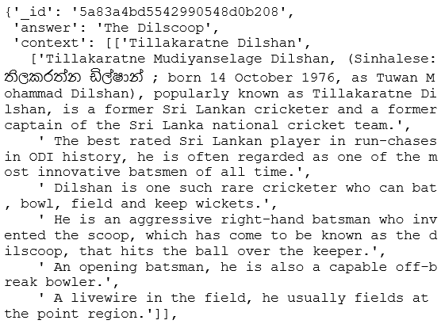
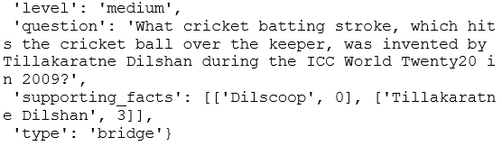
HOTPOTQA DATASET
Sample:
Wikipedia based Question Answering dataset containing 113k question-answer pairs
Features of the data
No requirement for pre-existing knowledge
Questions require finding answer from multiple documents / contexts
Contains supporting facts required for reasoning
The training set has distractor facts that help the model identify the true supporting facts from false ones
Challenging enough for QA system
20% yes/no questions, 80% rest

Slide 5
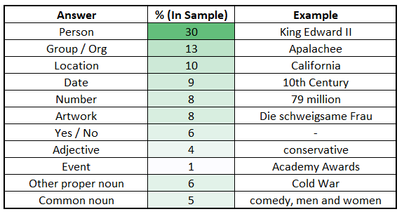
Types of Answers in Dataset

Slide 6

Pre-Processing the Text
Performed sentence and word tokenization on questions, answers and supporting paragraphs
Find the best answer in paragraphs and extract start and end tokens of all words and answer
Fill questions with no answer as ‘random’
Collected ‘GloVe’ word embeddings and randomly allocated character embeddings (will be trained later)
All the preprocessing performed on train and test set
Embeddings and start-end tokens extracted are fed to model as an input

Slide 7
MODEL ARCHITECTURE
Linear
Yes / No / Answer Span
RNN
Linear
Answer End Token
Derived character embeddings of the text by running a 1D convolution layer with max-pooling
Used Bi-GRU to map question and passage embeddings to context-aware embeddings
In Bi-Directional Attention Flow model, attention between question word and context word is computed
Output is concatenated and passed through Linear ReLU layer
Self attention is performed on the passage itself without using query-context attention
RNN
Linear
Answer Start Token
RNN
RNN
0/1 - Is supporting fact?
Self-Attention
RNN
Bi-Attention
RNN
RNN
Char Conv
Word Emb
Char Conv
Word Emb
Paragraphs Questions

Slide 8
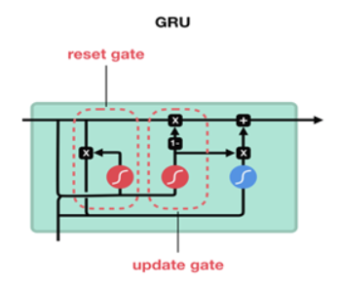
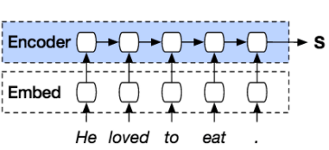
Gated Recurrent Units as Encoders
GRU
GRU
GRU
GRU
GRU
GRUs preferred over LSTMs because they aren’t as computationally expensive and are preferred over vanilla RNNs because they avoid vanishing / exploding gradients.
In first half of architecture, used to encode questions and passages to context-aware outputs and in second half, used to decode output of attention nodes to answer outputs.

Slide 9
Attention LAYER
Used to identify specific information in context relevant to the question, that is, query-aware context representation
Input : words in the context and question
Output: Summary of context, focussed on question
Returns weighted mean of words in context, that are chosen according to relevance of each word in the context
Computed at each time step, along with representations from previous layers
Both Attention and GRU layers are bidirectional

Slide 10
Experiments
Sampling of train data due to large size and training of model on CPU
Modification of number of hidden layers and nodes in RNNs
Different batch sizes
Evaluation on test set with and without distractor paragraphs
Evaluation metrics: Exact Match (EM), Precision, Recall, F1 Score
Precision, Recall, F1
Precision: Number of words predicted correctly among predicted tokens
Recall: Number of words predicted correctly among ground truth tokens
F1 Score: 2PR/P+R
Exact Match
# Instances Actual Answer = Predicted Answer after normalizing text
Normalizing Text: Remove articles and punctuation, make lowercase, fix white spaces

Slide 11
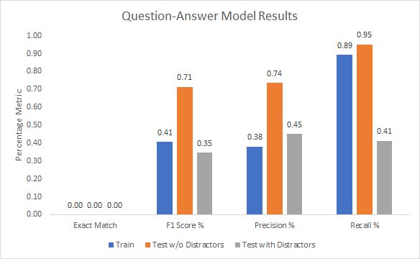
Final Results
Model performs better on data without distractors but has very poor performance overall.

Slide 12
Improvements and Future Work
Since we worked with close to 1% sample of train data, we could not achieve a robust model so we will need to train using GPUs / Google Colab on a larger sample size.
Plug in of a model like BERT after prediction of supporting facts from the baseline to enhance performance of answer prediction.
Tuning of model parameters, experimentation with different architectures and embeddings.
Create an online chatbot with model in the backend, thus having the ability to answer any question, given it is provided the right supporting facts.

Slide 13
References
Title: Simple and Effective Multi-Paragraph Reading Comprehension, Authors: Christopher Clark, Matt Gardner [link to paper]
Title: A Dataset for Diverse, Explainable Multi-hop Question Answering, Authors: Zhilin Yang, Peng Qi [link to paper]
Title: Multi-hop Question Answering on HotpotQA, Authors: Chris Wang, Yilun Xu, Qingyang Wang [link to paper]
Link to our code : https://github.com/srinidhig/QA_chatbot

Slide 14
Thank You!
Questions?

