Slide 1
NLP Sentiment and Classification Analysis
Team Members
Ms.Iqra Irfan Shaikh
Disha Nitin Phalle
Essanthapuram Abhishek Goud
Pradnyan Manohar Thakare
Gudelli Mahesh
Mr Shivansh Diyodhar
Dr. Sangeetha Prabhu

Slide 2
Business Objective:
Extracting customer reviews on a product ( around 1000 reviews), doing sentiment analysis, and then building a classification model to predict the sentiment.

Slide 3
Project Flow:
Data Preprocessing: Clean and prepare the gathered data for analysis, ensuring it's uniform, accurate, and suitable for segmentation examination.
Feature Engineering: Feature engineering is the process of transforming raw data into informative features that improve the performance of machine learning algorithms by capturing relevant patterns and relationships within the data.
Feature Selection: Feature selection is the process of identifying and choosing a subset of relevant features from a larger set of features in a dataset, aiming to improve model performance, reduce computational complexity, and mitigate overfitting by selecting the most informative and discriminative features.

Slide 4
Project Flow:
Model Development: Model development is the process of constructing and refining mathematical or computational representations that predict outcomes or patterns based on input data, often involving iterative optimization and validation procedures.
Model Evaluation: Model evaluation ensures accuracy, reliability, and performance of predictive analytics for business decisions
Model Deployment: The process of operationalizing machine learning models within production environments, ensuring scalability, reliability, and integration with existing systems

Slide 5
Missing Values:
The analysis reveals the presence of null values within the multiple features.
To manage these null values, the records or observations containing null values from the dataset are removed.

Slide 6
Duplicates:
The analysis reveals the presence of duplicate values in the dataset.
To manage these duplicate values, the duplicate records or observations were removed from the dataset.
Each observation is unique throughout the entire dataset.

Slide 7
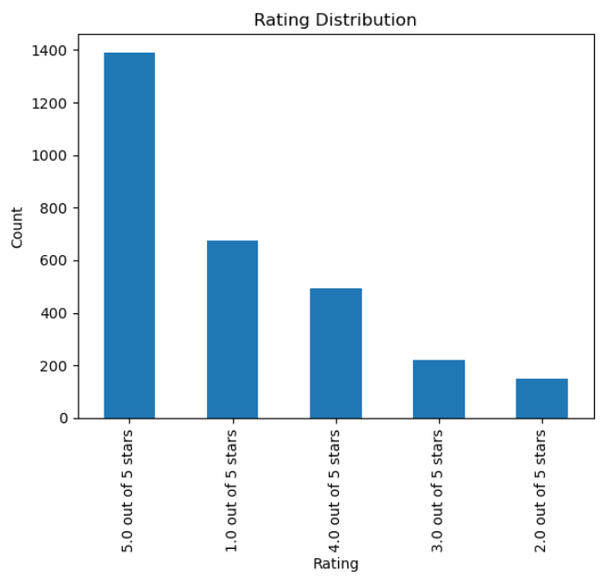
Visualization:
Highest number of ratings: The highest number of ratings is for 5 stars, indicating that a significant portion of users are satisfied with the product or service.
Distribution of ratings: The chart shows a right-skewed distribution, that most ratings are concentrated on the higher end of the scale. This suggests that the product or service is generally well-received by users.
Fewer lower ratings: There are fewer ratings for lower star ratings, such as 1 and 2 stars, indicating that fewer users were dissatisfied with the product or service.

Slide 8
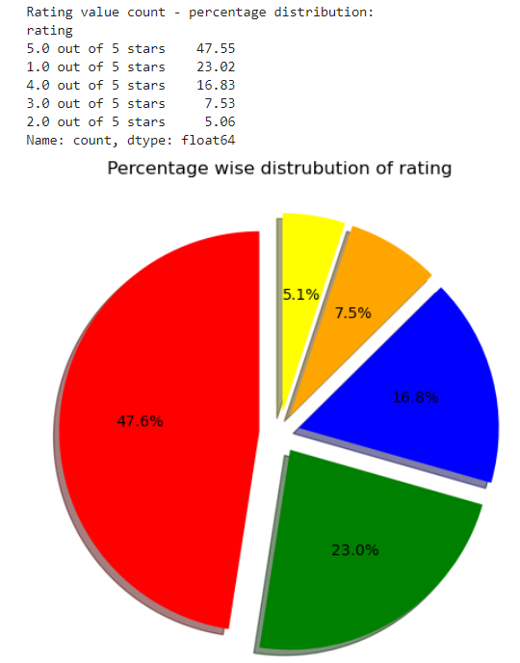
Visualization:
Highest number of ratings: The highest percentage of ratings is for 5 stars, indicating that a significant portion of users are satisfied with the product or service.
Distribution of ratings: The chart shows a right-skewed distribution, that most ratings are concentrated on the higher end of the scale. This suggests that the product or service is generally well-received by users.
Fewer lower ratings: There are fewer ratings for lower star ratings, such as 1 and 2 stars, indicating that fewer users were dissatisfied with the product or service.

Slide 9
Splitting Data:
The train_test_split function is used to split the data into training and testing sets, with 75% of the data reserved for training and a random state set to 100 for reproducibility.
The x_train and y_train sets are used to train a model, and the x_test and y_test sets are used to evaluate the model's performance

Slide 10
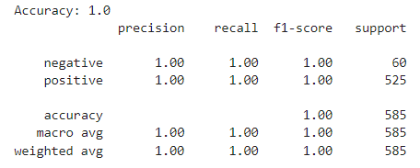
Logistic Regression model

Slide 11
Deployment:
The Sentiment Analysis App was developed and deployed using Streamlit and utilized Hugging Face’s RoBERTa model for sentiment classification.
Deployment Environment
Streamlit: Used for app development and user interface creation.
Hugging Face Transformers: Loaded the pre-trained sentiment analysis model.
PyTorch: Framework for model inference and processing.
NLTK: Utilized for natural language processing tasks such as stopword removal and stemming.

Slide 12
Challenges:
Data Imbalance: The dataset had more positive reviews than negative ones.
Model Loading Time: Loading large models like RoBERTa took significant time.
Latency Issues: Larger reviews caused some lag in real-time processing.
Preprocessing Complexity: Managing text noise, special characters, and negations was difficult.
Model Generalization: Ensuring the model accurately predicted sentiment across diverse review datasets from uploaded files.
Deployment Challenges: Challenges in smoothly combining Streamlit, NLTK, and PyTorch for real-time sentiment analysis.

Slide 13

Summary:
Checked Null Values.
Checked Duplicates.
Feature Engineering.
Model Development.
Model Evaluation.
Model Deployment.

Slide 14

Thank You

