Slide 1
FOOD SAFETY USING BLOCKCHAIN TECHNOLOGY
By
M. Sangeetha
(179X1A0582)
k. Haritha
(179X1A0549)

Slide 2
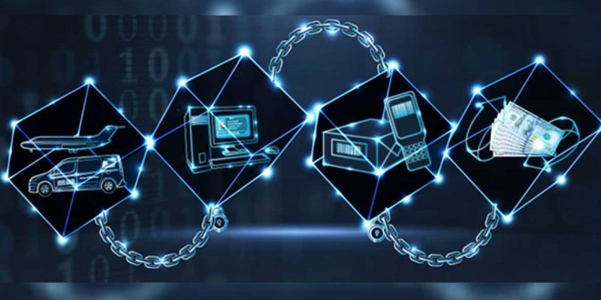
what is blockchain ?
Originally block chain is a growing list of records, called blocks, that are linked using cryptography. Each block contains a cryptographic hash of the previous block, a timestamp, and transaction data. By design, a blockchain is resistant to modification of the data.

Slide 3
Applications :
Asset Management: Trade Processing and Settlement
Blockchain Internet-of-Things (IoT)
Payments: Cross-Border Payments
Blockchain Healthcare
Insurance: Claims processing
Personal Identification

Slide 4
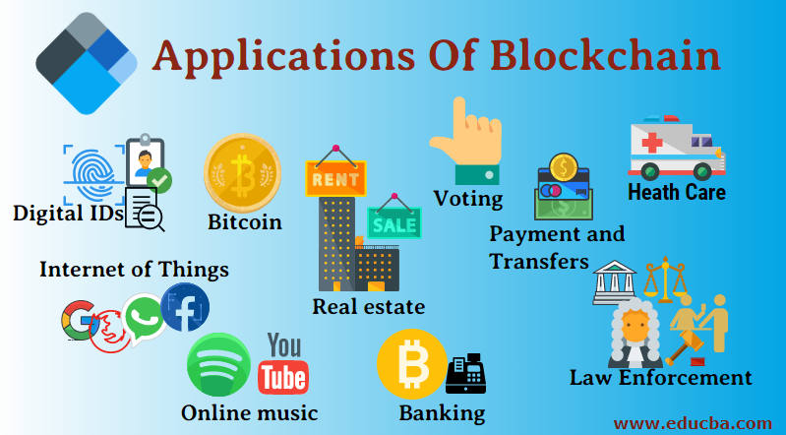

Slide 5
Food safety
What ?
Providing consumers, suppliers, manufacturers carriers, retailers, and regulators greater transparency on their goods
Increasing ability for key participants to meet new regulatory pressures.
How ?
Digitize the existing food safety process and product information on blockchain creating a single historical record.
Vendors create new levels of trust through information sharing.

Slide 6
problems in food supply chain
FOOD FRAUD - substitution,tampering,misrepresentation.
ILLEGAL PRODUCTION – particularly in seafood industry.
FOODBORNE ILLNESS – 1 in 6 Americans fall sick from contaminated food and/or beverage per year.
FOOD RECALL/LOSS – major fallout of abuse in food supply chain.

Slide 7
how blockchains can help
A blockchain is a shared, traceable and transparent ledger for record-keeping.
Information is captured in each transaction along a supply chain, which is agreed on by the business network members, and made permanent once consensus is reached.
Blockchains increase:
1. TRANSPARENCY
2. EFFICIENCY
3. FOOD SAFETY

Slide 8
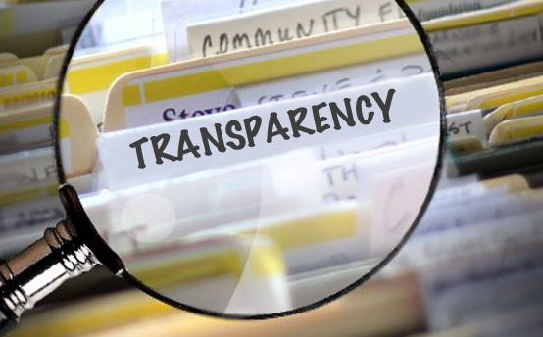
transparency
Digital tracking and storage of all product information at all stages of supply chain
– Farm origination data, growing / raising conditions
– Factory/processing data
– Batch numbers
– Expiration dates
– Storage temperatures and conditions
– Shipping data
Strengthens safeguards related to food authenticity, thus avoiding food fraud
Consumer confidence increases because producers and any related parties are held accountable.

Slide 9
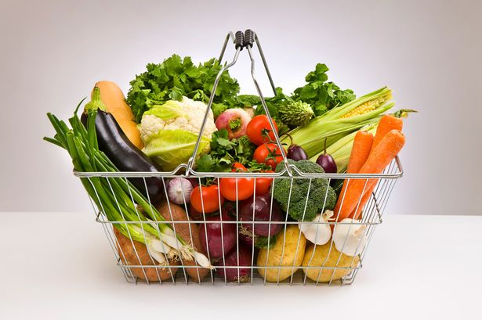
efficiecy
Blockchains improve how food is tracked, transported, and sold
Inaccuracies caused by traditional paper tracking and manual inspection systems
Retailers can better manage product shelf-life
Streamlines distribution process
Cuts costs & reduces food waste

Slide 10
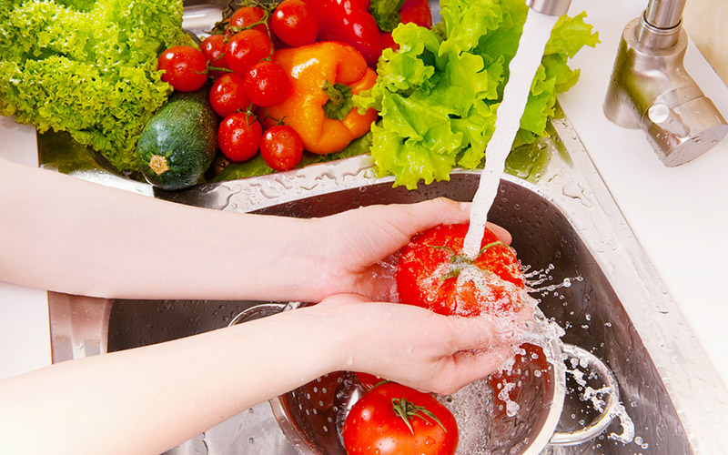
food safety
Blockchains could create huge progress in food safety cutting costs and saving lives.
Fewer contamination incidents.
Faster detection of problems.

Slide 11
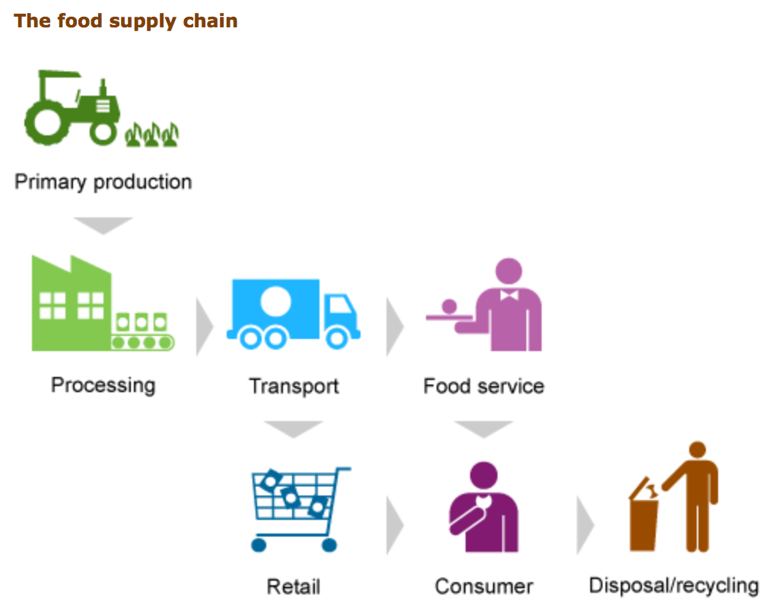

Slide 12
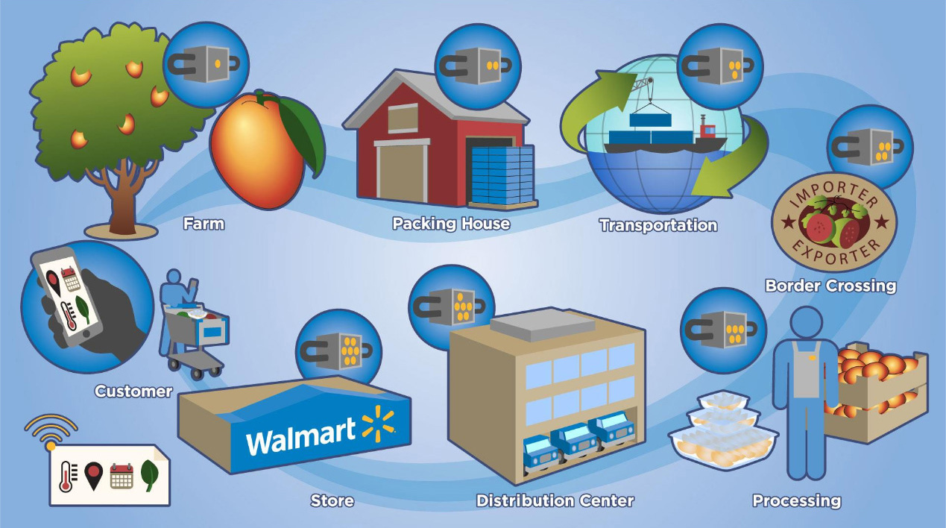
Life of a mango … from tree to shelf

Slide 13
looking ahead .. .. ..
Number of firms entering blockchain supply chain arena is steadily increasing.
Blockchains offer practical solutions to a currently impractical system.
At an inflection point: could arrive at a more transparent food system, depends on who has the leverage to impose their will…
Successful tracking systems offer better communication.

Slide 14
challenges
BUT…there are still many challenges that must be worked out.
- Authentication and Permissioning
- Payment systems
- Is the industry ready for more transparency?

Slide 15
thank you

