Slide 1

RISK AND PERFORMANCE ANALYSIS OF MICROSOFT AND COMPARABLE STOCKS

Slide 2

Introduction
Objective: To analyze the stock performance and risk of selected companies, focusing on Microsoft (MSFT).
Key Companies: Microsoft (MSFT), Apple (AAPL), Nvidia (NVDA), Intel (INTC), PepsiCo (PEP), Walmart (WMT), Costco (COST).
Methodology:
Log returns calculation.
Risk assessment using Bollinger Bands.
Correlation analysis.
Monte Carlo simulations for future price projection.

Slide 3
Company | Mean_Log_Return | SD_Log_Return
AAPL | 0.000911427 | 0.017972242
MSFT | 0.000933317 | 0.017087133
INTC | -5.39363E-05 | 0.022500713
PEP | 0.000345851 | 0.011733925
WMT | 0.000524127 | 0.013314729
COST | 0.000846739 | 0.013591986
NVDA | 0.002264841 | 0.030459914
Mean Log Returns & Standard Deviation (Q1 & Q2)
Mean Log Returns:
Nvidia (NVDA): Highest return.
Intel (INTC): Negative return, indicating weak performance.
Microsoft (MSFT) and Apple (AAPL): Consistent growth.
Standard Deviation:
Nvidia (NVDA) and Intel (INTC): High volatility.
PepsiCo (PEP) and Walmart (WMT): Low volatility, indicating stable price movement.

Slide 4
Stock Performance Comparison
Company | Mean_Log_Return | SD_Log_Return
AAPL | 0.000911427 | 0.017972242
MSFT | 0.000933317 | 0.017087133
INTC | -5.39363E-05 | 0.022500713
PEP | 0.000345851 | 0.011733925
WMT | 0.000524127 | 0.013314729
COST | 0.000846739 | 0.013591986
NVDA | 0.002264841 | 0.030459914
Nvidia (NVDA): Most attractive for risk-seeking investors due to high returns, despite high volatility.
PepsiCo (PEP) & Walmart (WMT): Better for risk-averse investors due to stable returns and low volatility.
Microsoft (MSFT): Consistent growth with moderate volatility, attractive for balanced risk.

Slide 5
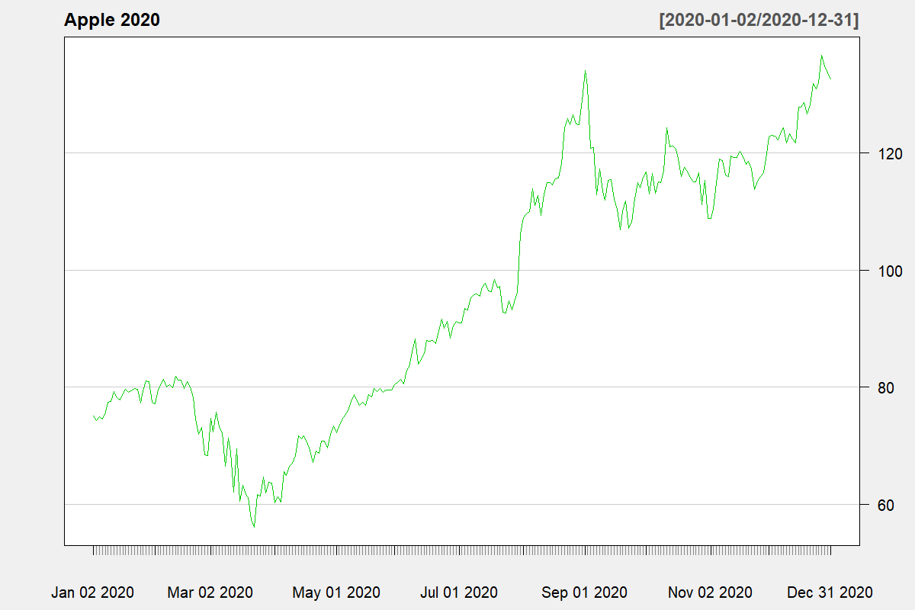
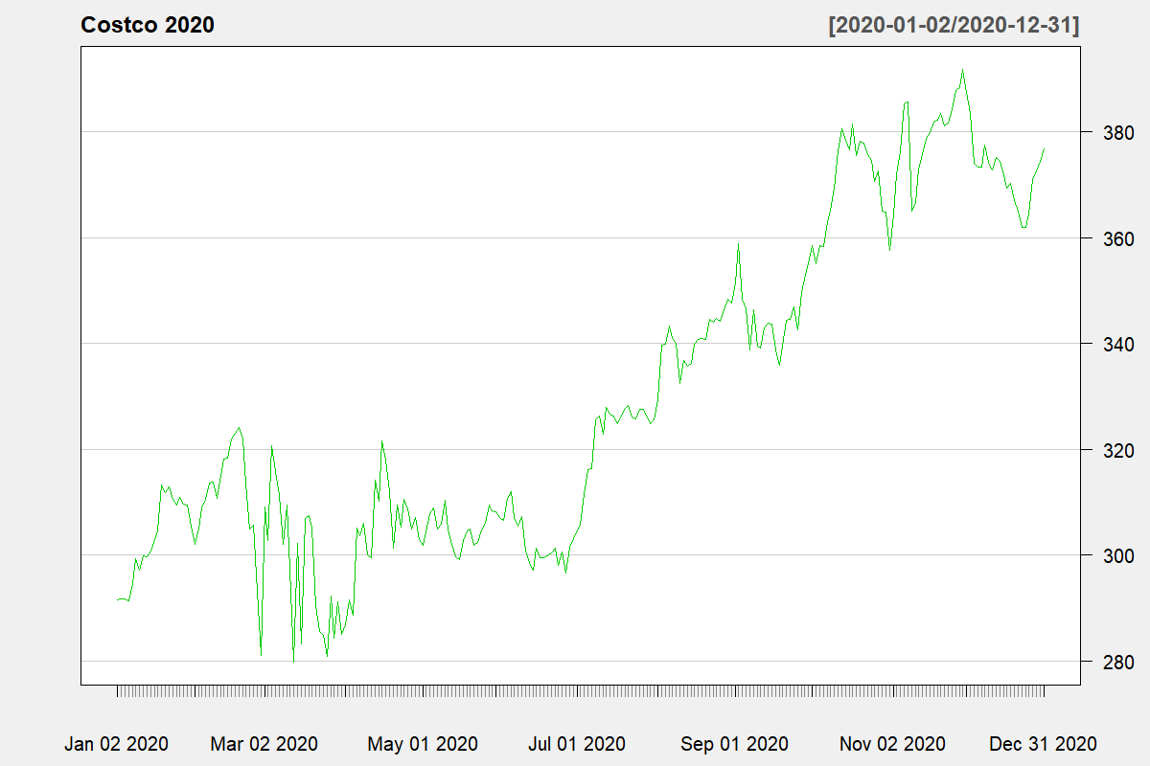
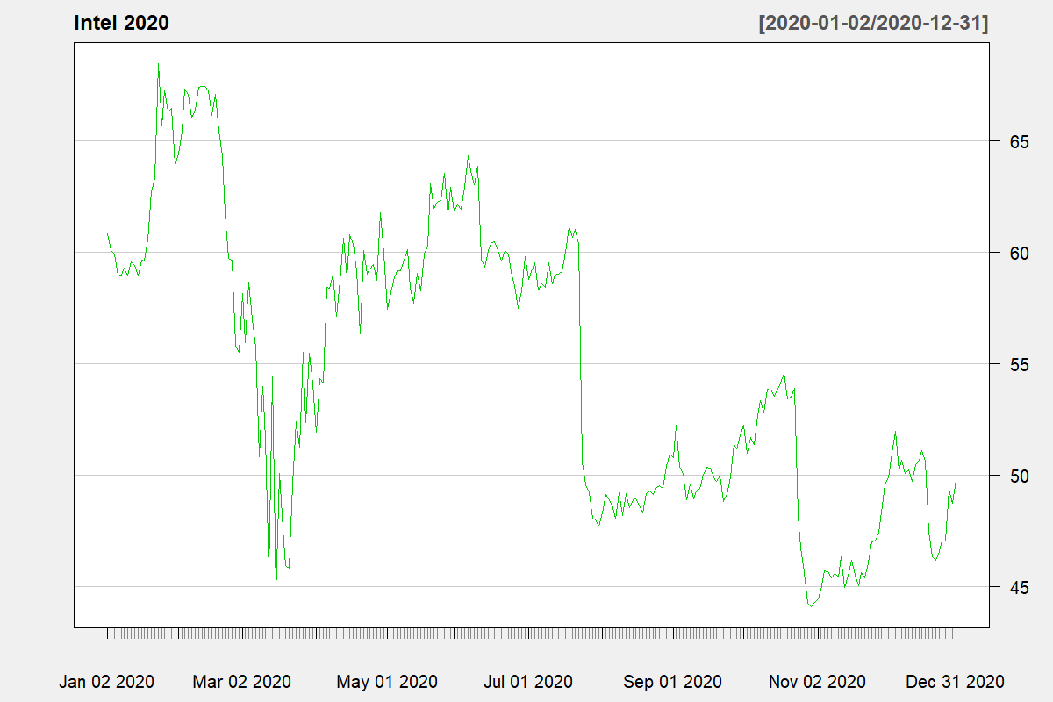
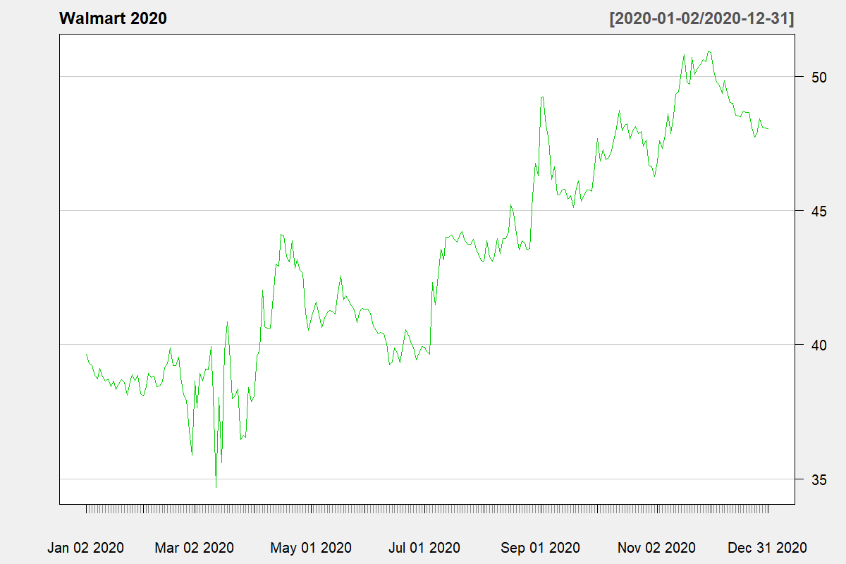
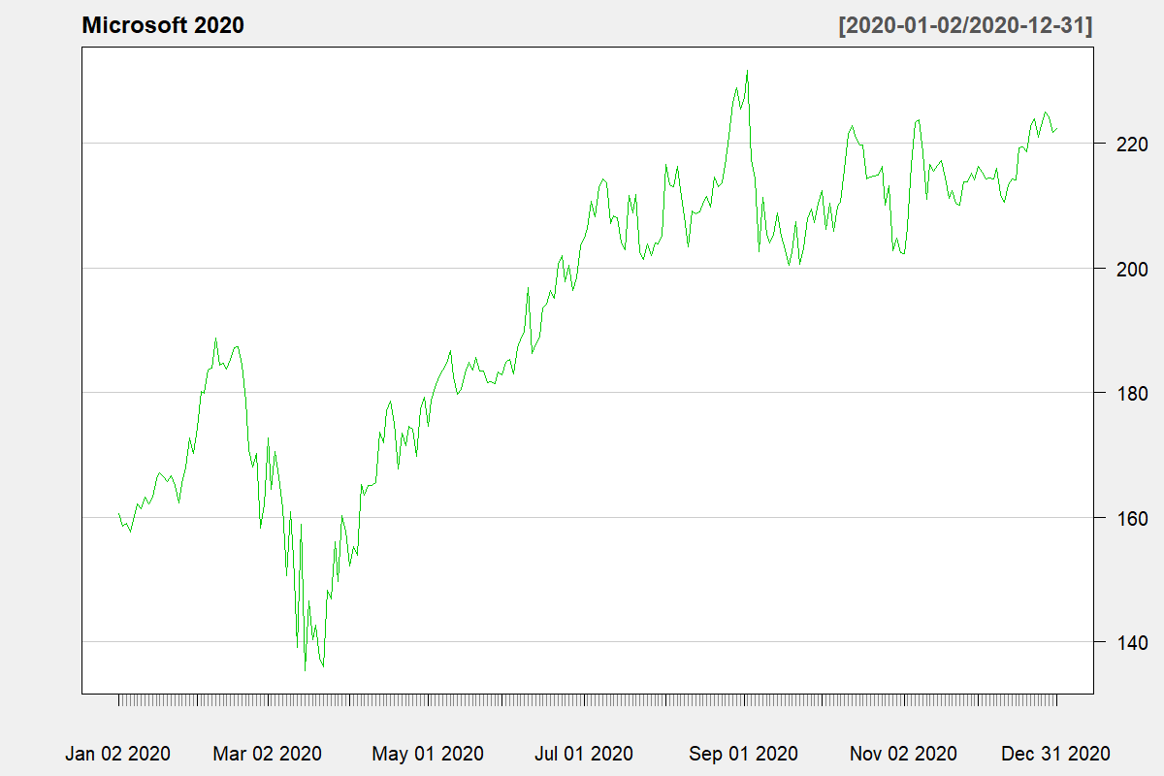
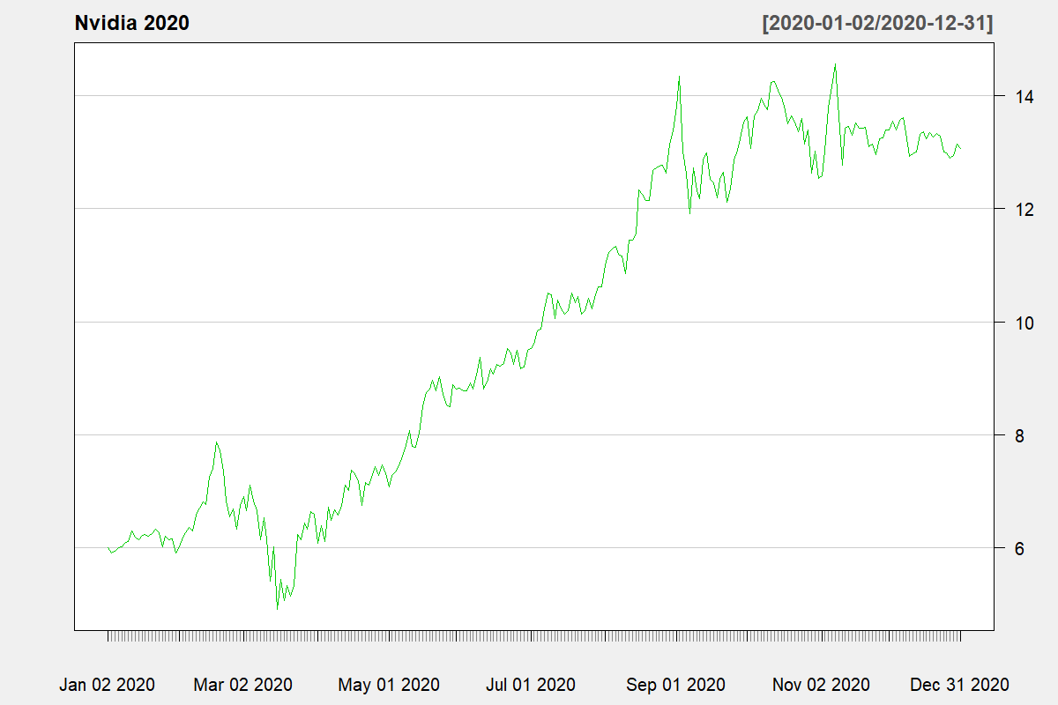
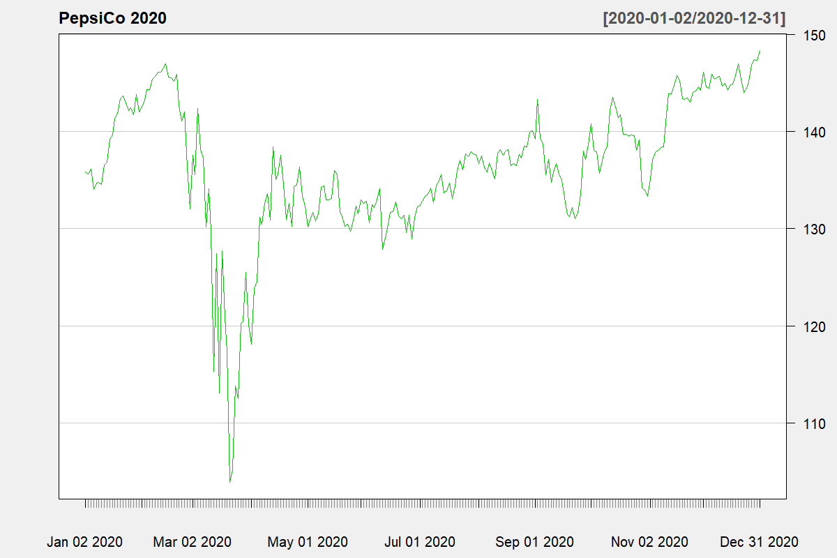
Bollinger Bands Analysis (2020 Data)
Key Observations
Microsoft: Upward trend, significant volatility during 2020. (Image: MSFT 2020 Bollinger Bands)
Apple: Strong upward momentum, price mostly above middle band. (Image: AAPL Bollinger Bands)
Nvidia: Highest volatility, rapid growth in late 2020. (Image: NVDA Bollinger Bands)
Intel: High fluctuations, weaker performance in 2020. (Image: INTC Bollinger Bands)

Slide 6
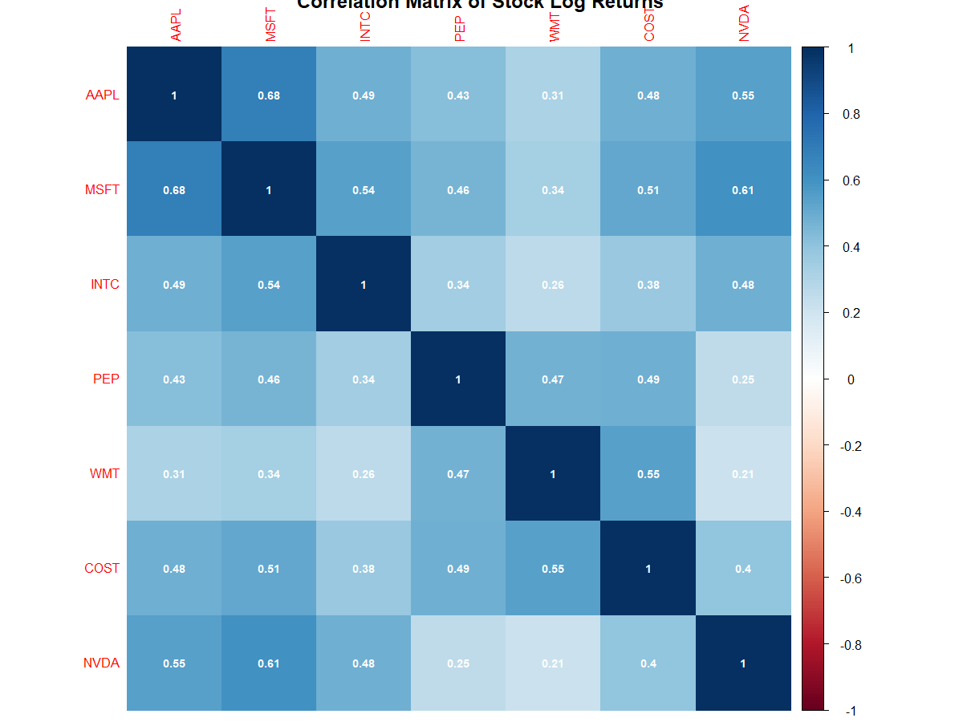
Correlation Analysis
Key Insights:
Strong correlation between Microsoft (MSFT), Apple (AAPL), and Nvidia (NVDA).
Lower correlation between tech companies and consumer goods companies like PepsiCo (PEP) and Walmart (WMT).
Diversification Potential: Investing across different sectors (tech vs. consumer goods) reduces risk.

Slide 7
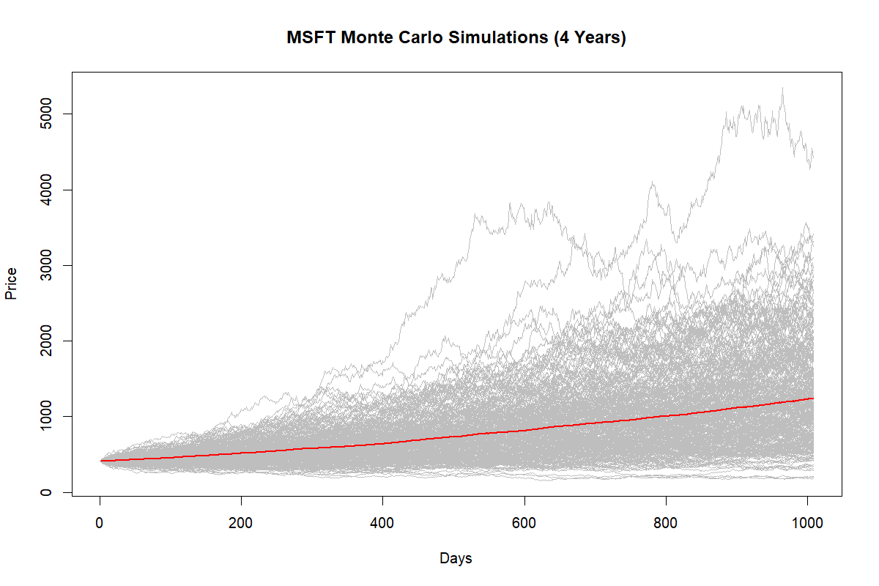
Monte Carlo Simulation
Objective:
Simulate MSFT prices over the next 4 years using 300 simulations.
Result: Most paths show price increase, with some extreme growth scenarios.
Recommendation: Microsoft stock is a solid buy for investors with moderate to high risk tolerance.

Slide 8

Trading Strategy
Strategy: Buy-and-Hold approach for Microsoft, based on strong historical and projected performance.
Risk Mitigation: Complement this strategy with Stop-Loss Orders based on Bollinger Bands to protect against high volatility periods.
Rationale: Leverages long-term growth while managing risk through targeted stop-loss levels.
Notes:
Summarize the evaluation: "In conclusion, Group 7 produced a well-structured report with clear summaries and valid criticisms of the three articles. Their use of examples was creative, and the questions raised for the authors were insightful."
Highlight areas for improvement: "However, the report could benefit from more depth in its critical analysis, especially in exploring potential solutions and using real-world case studies. Refining the questions for the authors to seek more practical insights would also enhance the quality of the reflection."
Offer a final suggestion: "For future work, incorporating more dynamic frameworks like machine learning or predictive analytics would help them provide more forward-looking critiques."

Slide 9

Conclusion
Microsoft: Strong buy due to consistent growth, supported by Bollinger Bands and Monte Carlo simulations.
Nvidia: High potential returns for risk-seeking investors.
Diversification: Combining tech stocks with consumer sector stocks like PepsiCo and Walmart helps manage portfolio risk.
Final Recommendation: Microsoft remains a top choice for growth-oriented investors with moderate risk tolerance.

Slide 10
Thank you

