Slide 1

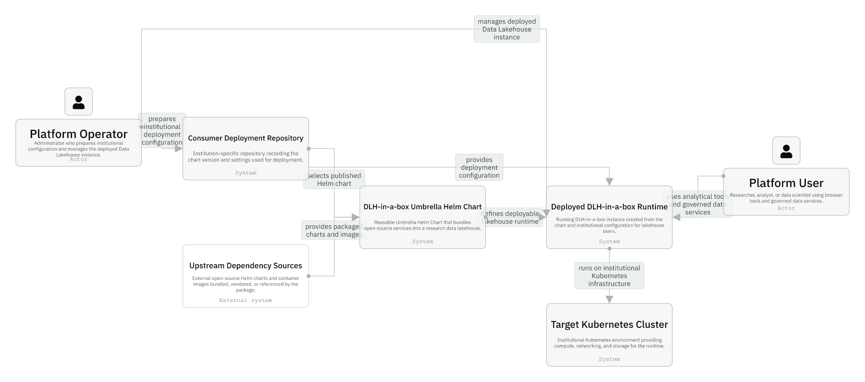
Session 01 / DLH-in-a-box handover
Repository Orientation And Product Mental Model
One hour handover deck
The repo is a reusable umbrella chart product, not a deployment repository or cluster bootstrap kit.
40-45 min narrative / 10-15 min checkpoint / 5 min Q&A
Session 01 / Repository Orientation And Product Mental Model
Handover synthesis from published repository docs.
01
Notes:
Session 01: Repository Orientation And Product Mental Model Slide 01: Repository Orientation And Product Mental Model Presenter script: Open by framing this as the first hour for developers who have never touched the work. The core handover message: they are inheriting a packaging and integration surface for a data lakehouse runtime. Point out that this series stays inside the published repository surface. Source: Handover synthesis from published repository docs.

Slide 2
Session 01
Session path
What this hour covers
Problem and boundary
Session rhythm
1
40-45 min narrative
10-15 min checkpoint
5 min Q&A
2
Repo shape
3
First-success path
4
Where to change things
Presenter notes carry the script and demo prompts.
Session 01 / Repository Orientation And Product Mental Model
Handover session structure.
02
Notes:
Session 01: Repository Orientation And Product Mental Model Slide 02: Session path Presenter script: Set expectations: this is not a Kubernetes or Helm basics class. The goal is to give maintainers a map they can use when incidents or change requests arrive. Source: Handover session structure.

Slide 3
Session 01
The one-sentence product story
What the repository publishes
One Helm chart named dlh-in-a-box.
One Helm chart named dlh-in-a-box.
One install surface for login, query services, storage, browser tools, and access control.
A reusable chart product consumed by institution-specific deployment repositories.
A set of examples, scripts, and docs that define the supported operating lanes.
Session 01 / Repository Orientation And Product Mental Model
Source: root README; manual, What This Repository Is For.
03
Notes:
Session 01: Repository Orientation And Product Mental Model Slide 03: The one-sentence product story Presenter script: Do not start with the component list. Start with the decision this repo removes: teams do not wire every product together from scratch. Emphasize that the repository is valuable because the integration decisions are encoded and testable. Source: Source: root README; manual, What This Repository Is For.

Slide 4
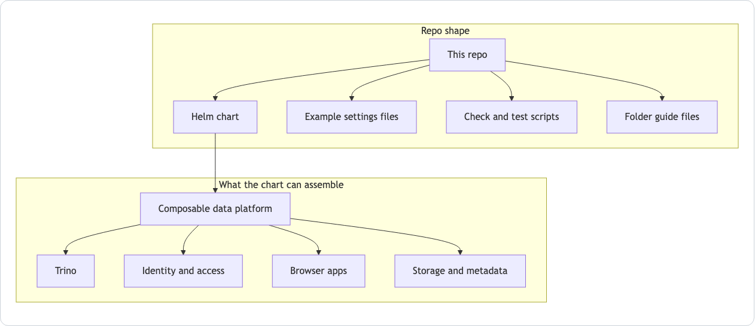
Session 01
Repo shape: source, examples, scripts, guides
The chart is the deployable product.
Examples document supported install shapes.
Scripts and workflows keep local and CI validation aligned.
Guides explain ownership at the directory boundary.
Session 01 / Repository Orientation And Product Mental Model
Source: README.md Mermaid diagram.
04
Notes:
Session 01: Repository Orientation And Product Mental Model Slide 04: Repo shape: source, examples, scripts, guides Presenter script: Use the diagram as the first mental map. The left side is repository material; the right side is what the chart can assemble. Tell the audience that every later deck is a zoom into one part of this map. Source: Source: README.md Mermaid diagram.

Slide 5
Session 01
Context: product, consumer repo, runtime
Operators prepare institutional configuration.
Consumer repos select chart versions and provide settings.
The chart defines a generic lakehouse runtime.
Users experience the deployed runtime, not this source repo directly.
Session 01 / Repository Orientation And Product Mental Model
Source: IcePanel 01-context.
05
Notes:
Session 01: Repository Orientation And Product Mental Model Slide 05: Context: product, consumer repo, runtime Presenter script: This is the handover's most important distinction: chart product versus runtime instance. If a future question mentions Sanger or icddr,b specifics, ask whether it belongs here or in a consumer deployment repository. Source: Source: IcePanel 01-context.

Slide 6
Session 01
What this repo is and is not
It is | It is not
A Helm umbrella chart product | A cluster bootstrap toolkit
A reproducible package of upstream and local chart material | A replacement for upstream product documentation
A values contract plus examples and validation | A source of real production secrets or DNS
A maintainer workflow with CI parity | An institution's governance approval process
Session 01 / Repository Orientation And Product Mental Model
Source: README.md; manual boundary sections.
06
Notes:
Session 01: Repository Orientation And Product Mental Model Slide 06: What this repo is and is not Presenter script: Read this slide slowly. Many future mistakes come from assuming the chart owns infrastructure or policy decisions that it deliberately does not own. Source: Source: README.md; manual boundary sections.

Slide 7
Session 01
First success is deliberately small
Recommended newcomer path
Start with examples/values-local.yaml.
Start with examples/values-local.yaml.
Refresh dependencies before rendering or installing.
Use make smoke-install only when validating auth-heavy behavior.
Treat values-local-auth.yaml as the smoke profile, not the easiest manual start.
Session 01 / Repository Orientation And Product Mental Model
Source: README.md; manual One True First-Success Path.
07
Notes:
Session 01: Repository Orientation And Product Mental Model Slide 07: First success is deliberately small Presenter script: This corrects a common newcomer trap. make local-install currently points at the auth-heavy local profile. The handover audience should know both paths, but only one is the first manual success path. Source: Source: README.md; manual One True First-Success Path.

Slide 8
Session 01
Guided checkpoint: orient a new maintainer
Commands / prompts
Checkpoint questions
./hack/helm-dependency-update.sh
helm template dlh charts/dlh-in-a-box -f examples/values-local.yaml >/tmp/dlh-local.yaml
helm lint charts/dlh-in-a-box -f examples/values-local.yaml
Can they say which files explain the install path?
Can they explain why smoke-install is a stronger but heavier path?
Can they find the chart guide and template guide without searching randomly?
Session 01 / Repository Orientation And Product Mental Model
Guided demo/checkpoint for live handover delivery.
08
Notes:
Session 01: Repository Orientation And Product Mental Model Slide 08: Guided checkpoint: orient a new maintainer Presenter script: Do not require a live cluster for this checkpoint. The purpose is orientation and confidence. If running live, stop after render/lint unless you intentionally want a cluster install. Source: Guided demo/checkpoint for live handover delivery. Demo/checkpoint cue: Treat this as optional live material. If time or tooling is unavailable, discuss the commands and expected reasoning instead.

Slide 9
Session 01
If you need to change X, start here
Change request | Start with
Chart metadata, dependency list, publish version | charts/dlh-in-a-box/Chart.yaml
Shared defaults or public values contract | charts/dlh-in-a-box/values.yaml and values.schema.json
Supported install profile | examples/*.yaml
Local validation or smoke behavior | hack/*.sh
CI or release behavior | .github/workflows/*.yaml
Session 01 / Repository Orientation And Product Mental Model
Source: README.md; manual Contributor Change Map.
09
Notes:
Session 01: Repository Orientation And Product Mental Model Slide 09: If you need to change X, start here Presenter script: This is not a complete change map, just the triage version for session one. Reinforce the habit: find ownership first, then edit. Source: Source: README.md; manual Contributor Change Map.

Slide 10
Session 01
Session 01 landing
What the inheriting team should now be able to do
They can describe the repo in one sentence.
They can distinguish chart product from deployed runtime.
They know the safest first manual path.
They have a first lookup map for future changes.
Leave-behind
Use the PPTX notes as a presenter script and source-map.md as the reference trail.
Session 01 / Repository Orientation And Product Mental Model
Handover session wrap-up.
10
Notes:
Session 01: Repository Orientation And Product Mental Model Slide 10: Session 01 landing Presenter script: Close by previewing session two: the architecture model turns this orientation into a more precise runtime and packaging map. Source: Handover session wrap-up.

