Slide 1

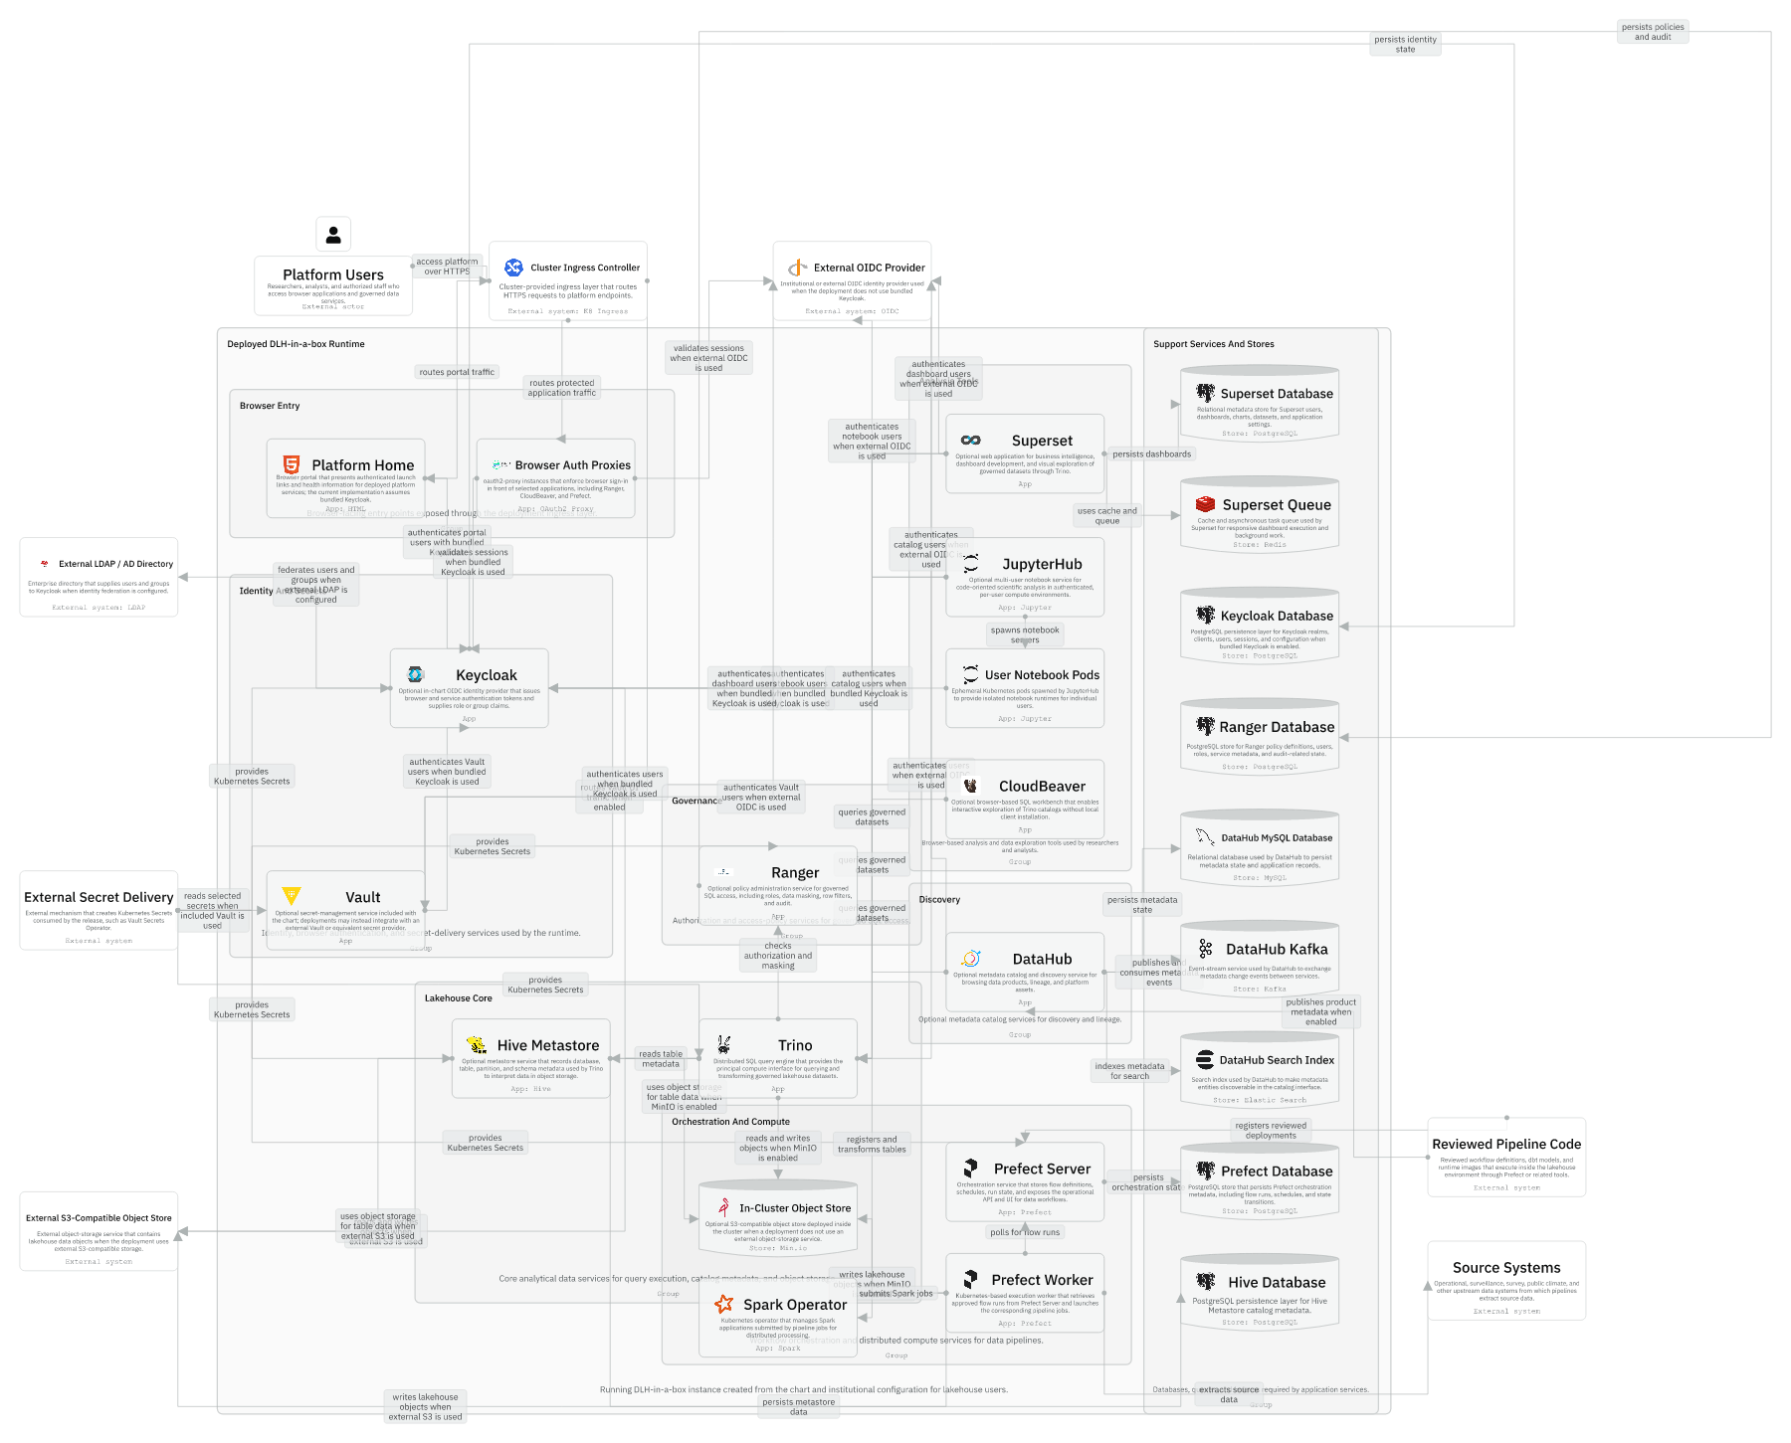
Session 02 / C4 and IcePanel handover
Architecture Model And Runtime Topology
One hour handover deck
The model separates chart product, published package, consumer configuration, and deployed runtime.
40-45 min narrative / 10-15 min checkpoint / 5 min Q&A
Session 02 / Architecture Model And Runtime Topology
Handover synthesis from published repository docs.
01
Notes:
Session 02: Architecture Model And Runtime Topology Slide 01: Architecture Model And Runtime Topology Presenter script: Open with the promise: after this session, architecture diagrams should reduce confusion rather than add a new artifact to maintain. Source: Handover synthesis from published repository docs.

Slide 2
Session 02
Session path
What this hour covers
Modelling rules
Session rhythm
1
40-45 min narrative
10-15 min checkpoint
5 min Q&A
2
Packaging view
3
Runtime view
4
How diagrams support changes
Presenter notes carry the script and demo prompts.
Session 02 / Architecture Model And Runtime Topology
Handover session structure.
02
Notes:
Session 02: Architecture Model And Runtime Topology Slide 02: Session path Presenter script: Explain that the model is intentionally generic and excludes deployment-specific infrastructure except as external context. Source: Handover session structure.

Slide 3
Session 02
The model is scoped to the reusable chart
What belongs in this architecture view
DLH-in-a-box as a Helm chart product.
DLH-in-a-box as a Helm chart product.
The generic runtime instantiated by the chart.
Upstream dependency sources and packaged artifacts.
Owned component diagrams for chart source, Hive, Trino patch points, validation, and publish automation.
Session 02 / Architecture Model And Runtime Topology
Source: IcePanel model, Modelling Rules.
03
Notes:
Session 02: Architecture Model And Runtime Topology Slide 03: The model is scoped to the reusable chart Presenter script: Use this slide to prevent scope creep. The architecture model is not the Sanger or icddr,b deployment architecture. Source: Source: IcePanel model, Modelling Rules.

Slide 4
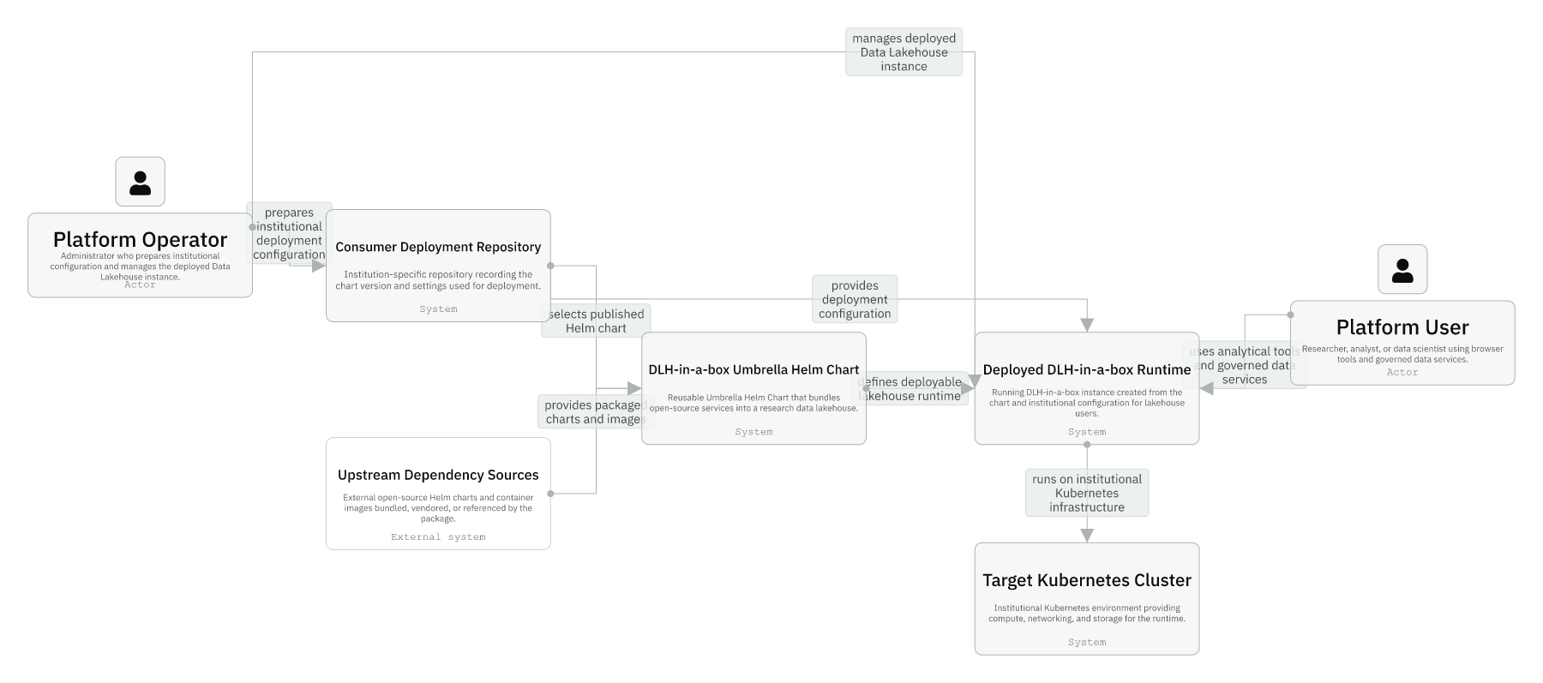
Session 02
Level 1: context and consumers
Consumer repositories select chart versions.
Institutional settings live outside the chart product.
The runtime is the system operators and users experience.
Session 02 / Architecture Model And Runtime Topology
Source: IcePanel 01-context.
04
Notes:
Session 02: Architecture Model And Runtime Topology Slide 04: Level 1: context and consumers Presenter script: Point to the direction of flow: upstream dependencies feed the chart; consumer repos configure it; the runtime runs on a target cluster. Source: Source: IcePanel 01-context.

Slide 5
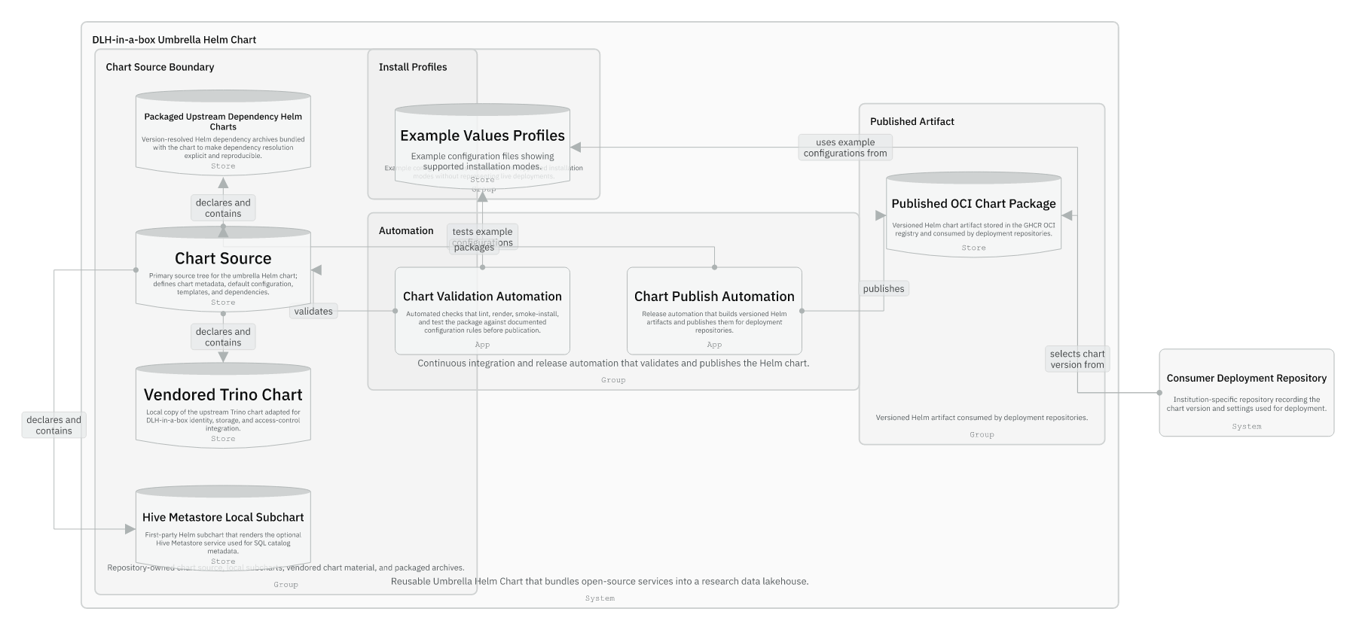
Session 02
Level 2A: chart product and packaging
Chart source declares dependencies and templates.
Packaged upstream archives make resolution reproducible.
Validation and publish automation protect the package before release.
The OCI package is what deployment repos consume.
Session 02 / Architecture Model And Runtime Topology
Source: IcePanel 02-chart-product-and-packaging.
05
Notes:
Session 02: Architecture Model And Runtime Topology Slide 05: Level 2A: chart product and packaging Presenter script: This is the maintainers' build-and-release view. Use it when someone changes dependency versions or package contents. Source: Source: IcePanel 02-chart-product-and-packaging.

Slide 6
Session 02
Level 2B: runtime deployed by the chart
Trino sits at the centre of the query plane.
Identity and browser entrypoints sit above runtime tools.
Prefect, Spark, and optional apps surround the core data path.
Support stores belong near the services that own them.
Session 02 / Architecture Model And Runtime Topology
Source: IcePanel 03-runtime-deployed-by-the-chart.
06
Notes:
Session 02: Architecture Model And Runtime Topology Slide 06: Level 2B: runtime deployed by the chart Presenter script: This is the operational view. It is dense, so narrate around the central Trino/data-plane cluster first. Source: Source: IcePanel 03-runtime-deployed-by-the-chart.

Slide 7
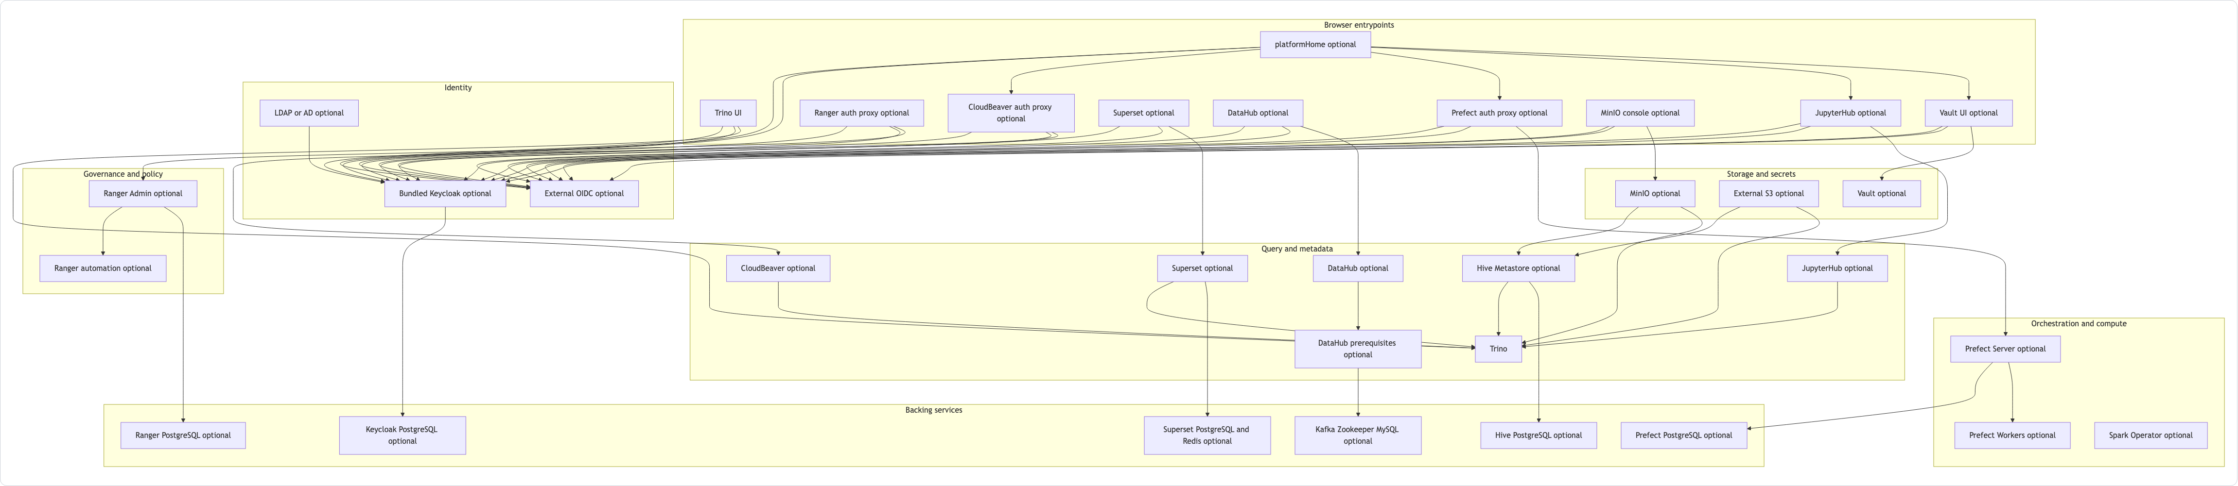
Session 02
Manual view: everything enabled
The chart is modular; not every install enables every component.
Browser entrypoints, identity, governance, query, orchestration, and storage are separate lanes.
Optional services are still part of the model because examples can turn them on.
Session 02 / Architecture Model And Runtime Topology
Source: manual Platform Architecture Mermaid.
07
Notes:
Session 02: Architecture Model And Runtime Topology Slide 07: Manual view: everything enabled Presenter script: Use this as a friendlier bridge between prose docs and the more formal IcePanel runtime view. Source: Source: manual Platform Architecture Mermaid.

Slide 8
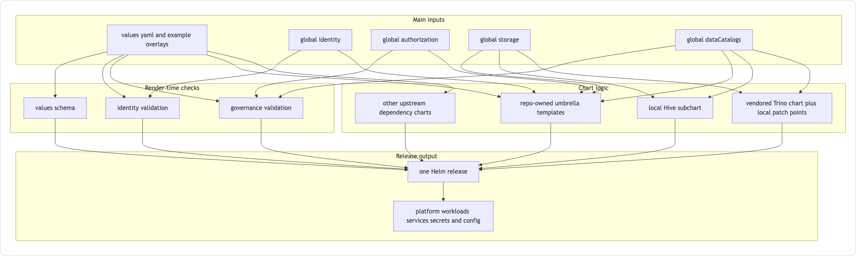
Session 02
How the chart assembles the runtime
Values drive validation, templates, dependency charts, and rendered resources.
Example overlays exercise supported combinations.
CI tests rendering and packaging rather than pretending one deployment shape covers all cases.
Session 02 / Architecture Model And Runtime Topology
Source: manual How The Chart Assembles The Runtime Mermaid.
08
Notes:
Session 02: Architecture Model And Runtime Topology Slide 08: How the chart assembles the runtime Presenter script: This is the transition from architecture to implementation. Session four will go deeper into this path. Source: Source: manual How The Chart Assembles The Runtime Mermaid.

Slide 9
Session 02
Use the right diagram for the question
Question | Best diagram
Who consumes the chart? | Context
What gets packaged and published? | Chart product and packaging
What runs in a cluster? | Runtime deployed by the chart
Where is local chart logic? | Chart source components
How is CI or publish wired? | Validation and publish automation
Session 02 / Architecture Model And Runtime Topology
Source: IcePanel model diagram set.
09
Notes:
Session 02: Architecture Model And Runtime Topology Slide 09: Use the right diagram for the question Presenter script: Give maintainers permission to choose a diagram based on the question instead of opening the largest one first. Source: Source: IcePanel model diagram set.

Slide 10
Session 02
Guided checkpoint: trace one feature through the model
Commands / prompts
Checkpoint questions
Open docs/architecture/dlh-in-a-box-icepanel-model.md
Find the Level 2 runtime object for Trino
Follow its relationships to Hive, storage, identity, and Ranger
Can the developer explain whether the change belongs in chart source, a subchart, or consumer settings?
Can they name the external systems versus repo-owned material?
Session 02 / Architecture Model And Runtime Topology
Guided demo/checkpoint for live handover delivery.
10
Notes:
Session 02: Architecture Model And Runtime Topology Slide 10: Guided checkpoint: trace one feature through the model Presenter script: Run this as a whiteboard exercise if not using a laptop. Pick Trino because it touches the most important boundaries. Source: Guided demo/checkpoint for live handover delivery. Demo/checkpoint cue: Treat this as optional live material. If time or tooling is unavailable, discuss the commands and expected reasoning instead.

Slide 11
Session 02
Session 02 landing
What the inheriting team should now be able to do
They know why there are separate product and runtime views.
They can choose the diagram that answers a maintainer question.
They understand why deployment-specific infrastructure is mostly outside this model.
Leave-behind
Use the PPTX notes as a presenter script and source-map.md as the reference trail.
Session 02 / Architecture Model And Runtime Topology
Handover session wrap-up.
11
Notes:
Session 02: Architecture Model And Runtime Topology Slide 11: Session 02 landing Presenter script: Preview session three: now that the topology is clear, the next handover shows how install profiles choose runtime shapes. Source: Handover session wrap-up.

