Slide 1

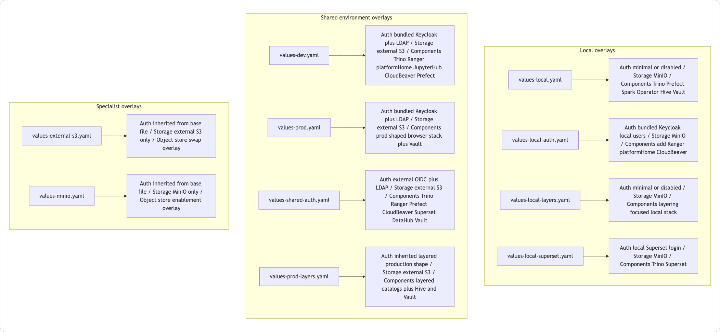
Session 03 / Values overlays and first success
Install Profiles And First Successful Deployment
One hour handover deck
Examples are not samples in a bag; they are the documented install profiles the repo maintains.
40-45 min narrative / 10-15 min checkpoint / 5 min Q&A
Session 03 / Install Profiles And First Successful Deployment
Handover synthesis from published repository docs.
01
Notes:
Session 03: Install Profiles And First Successful Deployment Slide 01: Install Profiles And First Successful Deployment Presenter script: Open by explaining that many problems are caused by starting with the wrong values file. Source: Handover synthesis from published repository docs.

Slide 2
Session 03
Session path
What this hour covers
Prerequisites
Session rhythm
1
40-45 min narrative
10-15 min checkpoint
5 min Q&A
2
Profile taxonomy
3
Local versus shared
4
Demo checkpoints
Presenter notes carry the script and demo prompts.
Session 03 / Install Profiles And First Successful Deployment
Handover session structure.
02
Notes:
Session 03: Install Profiles And First Successful Deployment Slide 02: Session path Presenter script: This session should leave developers able to pick an overlay before running Helm. Source: Handover session structure.

Slide 3
Session 03
Prerequisites are operational, not optional
Before any install path
A working Kubernetes cluster and current kubectl context.
A working Kubernetes cluster and current kubectl context.
Helm installed; CI currently uses Helm v3.12.0.
Enough cluster capacity for several services and jobs.
Docker and kind only when using the disposable local path or Mermaid rendering.
Session 03 / Install Profiles And First Successful Deployment
Source: manual Prerequisites.
03
Notes:
Session 03: Install Profiles And First Successful Deployment Slide 03: Prerequisites are operational, not optional Presenter script: Stress current kube context. Many apparent chart failures are actually wrong-context failures. Source: Source: manual Prerequisites.

Slide 4
Session 03
Example files fall into two classes
Full profiles are meant to stand alone.
Specialist overlays modify one concern and must be layered after a base profile.
Local profiles can carry disposable credentials.
Shared profiles expect real DNS, TLS, secrets, and identity inputs.
Session 03 / Install Profiles And First Successful Deployment
Source: examples/README.md Mermaid.
04
Notes:
Session 03: Install Profiles And First Successful Deployment Slide 04: Example files fall into two classes Presenter script: This is the main teaching diagram for the session. Talk through local, shared, and specialist columns. Source: Source: examples/README.md Mermaid.

Slide 5
Session 03
Which profile should I start with?
Profile | Use when | Caveat
values-local.yaml | Fastest local first success | Does not test browser auth flows
values-local-auth.yaml | Smoke test login, proxies, Ranger | Use make smoke-install normally
values-dev.yaml | Shared development baseline | Needs real hostnames, secrets, LDAP
values-prod.yaml | Production-shaped baseline | Still not turnkey production
values-shared-auth.yaml | External OIDC exists | Does not bundle Keycloak
Session 03 / Install Profiles And First Successful Deployment
Source: examples/README.md.
05
Notes:
Session 03: Install Profiles And First Successful Deployment Slide 05: Which profile should I start with? Presenter script: Use this as a decision table. Keep the key caveat visible: local-auth is not the easiest first manual profile. Source: Source: examples/README.md.

Slide 6
Session 03
The first manual path is intentionally smaller
What values-local.yaml proves
Trino plus Hive plus MinIO wiring.
Trino plus Hive plus MinIO wiring.
Prefect server and worker local setup.
Spark Operator and Vault defaults.
Core rendering and install flow without browser SSO complexity.
Session 03 / Install Profiles And First Successful Deployment
Source: examples/README.md; manual first-success path.
06
Notes:
Session 03: Install Profiles And First Successful Deployment Slide 06: The first manual path is intentionally smaller Presenter script: The point is not to prove every feature. The point is to get a known-good local release with the least identity complexity. Source: Source: examples/README.md; manual first-success path.

Slide 7
Session 03
The smoke path is intentionally stronger
What values-local-auth.yaml proves
Bundled Keycloak with local demo users.
Bundled Keycloak with local demo users.
OIDC client wiring and oauth2-proxy entrypoints.
Ranger bootstrap and local-user sync.
platformHome launchpad and protected app access.
Session 03 / Install Profiles And First Successful Deployment
Source: README.md; hack/smoke-install.sh guide.
07
Notes:
Session 03: Install Profiles And First Successful Deployment Slide 07: The smoke path is intentionally stronger Presenter script: The smoke path validates integration that simple local installs deliberately skip. Source: Source: README.md; hack/smoke-install.sh guide.

Slide 8
Session 03
Secrets and inputs by profile class
Class | Secret posture | Maintainer habit
Disposable local | Inline demo values may exist | Keep them local-only and documented
Auth-heavy smoke | Script seeds demo Secrets | Do not run plain Helm and expect success
Shared dev/prod | External secret delivery expected | Never add inline real secrets
Specialist storage | Inherits base auth and app shape | Layer after the full profile
Session 03 / Install Profiles And First Successful Deployment
Source: examples/README.md; security-check.sh.
08
Notes:
Session 03: Install Profiles And First Successful Deployment Slide 08: Secrets and inputs by profile class Presenter script: Connect this slide to the security check. The repo enforces that non-local examples stay free of inline sensitive values. Source: Source: examples/README.md; security-check.sh.

Slide 9
Session 03
Guided checkpoint: choose and render a profile
Commands / prompts
Checkpoint questions
./hack/helm-dependency-update.sh
helm template dlh charts/dlh-in-a-box -f examples/values-local.yaml >/tmp/dlh-local.yaml
helm template dlh charts/dlh-in-a-box -f examples/values-dev.yaml -f examples/values-external-s3.yaml >/tmp/dlh-dev-s3.yaml
Can they explain which one is standalone and which one is layered?
Can they name what the local render proves and what it skips?
Session 03 / Install Profiles And First Successful Deployment
Guided demo/checkpoint for live handover delivery.
09
Notes:
Session 03: Install Profiles And First Successful Deployment Slide 09: Guided checkpoint: choose and render a profile Presenter script: This demo is safe without a cluster. If rendering shared profiles fails, discuss missing external inputs rather than treating it as a chart defect. Source: Guided demo/checkpoint for live handover delivery. Demo/checkpoint cue: Treat this as optional live material. If time or tooling is unavailable, discuss the commands and expected reasoning instead.

Slide 10
Session 03
Common first-time failures
Most failures have a short cause list
Dependencies or Chart.lock are stale.
Dependencies or Chart.lock are stale.
kubectl points at the wrong cluster.
The cluster is too small for the chosen profile.
The auth-heavy local profile was run without the smoke script's demo Secrets.
Session 03 / Install Profiles And First Successful Deployment
Source: README.md; manual Troubleshooting.
10
Notes:
Session 03: Install Profiles And First Successful Deployment Slide 10: Common first-time failures Presenter script: This is a practical incident slide. Encourage maintainers to ask these four questions before diving into templates. Source: Source: README.md; manual Troubleshooting.

Slide 11
Session 03
Session 03 landing
What the inheriting team should now be able to do
They can choose the right values file for a goal.
They know full profiles versus specialist overlays.
They understand why first-success and smoke paths are different.
Leave-behind
Use the PPTX notes as a presenter script and source-map.md as the reference trail.
Session 03 / Install Profiles And First Successful Deployment
Handover session wrap-up.
11
Notes:
Session 03: Install Profiles And First Successful Deployment Slide 11: Session 03 landing Presenter script: Preview session four: next we open the chart internals that make these profiles render into resources. Source: Handover session wrap-up.

