Slide 1

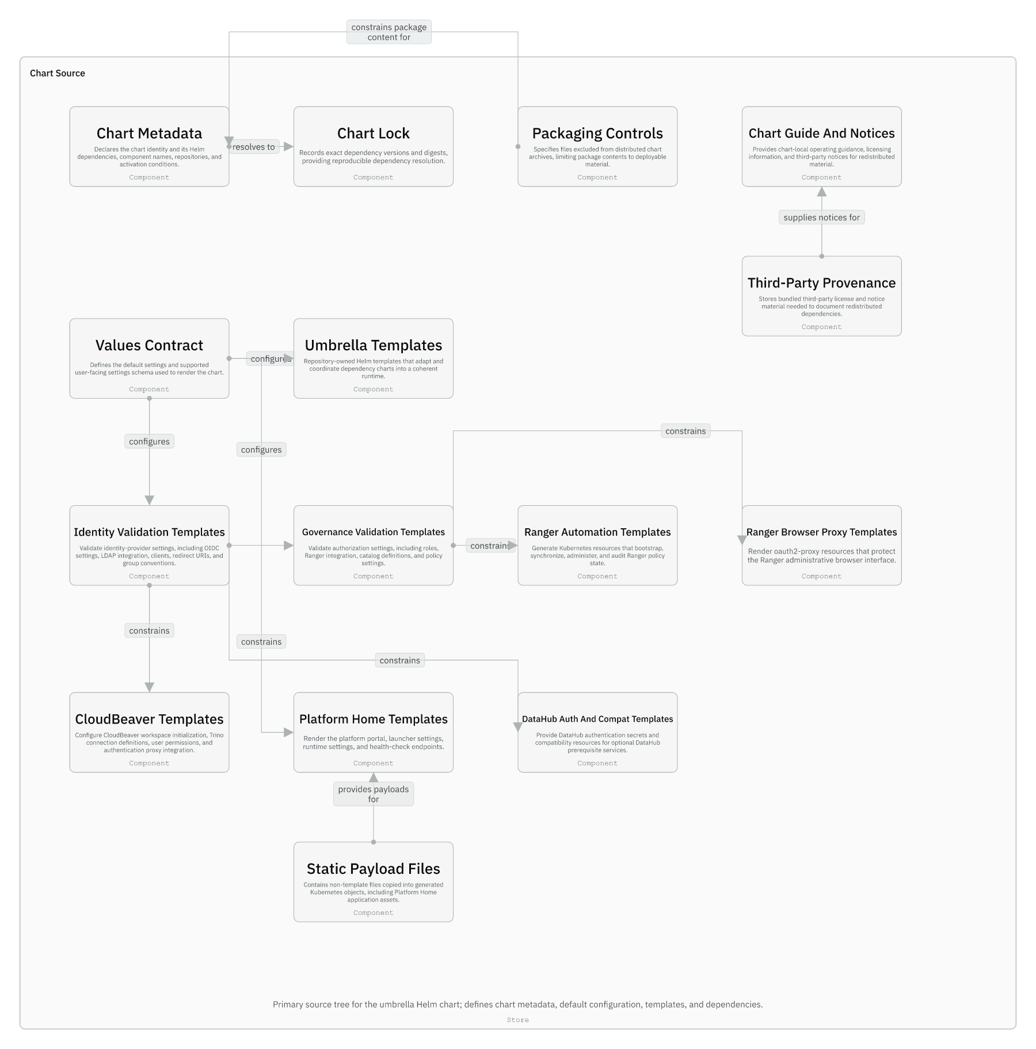
Session 04 / How the chart works
Chart Internals, Values Contract, And Render Flow
One hour handover deck
The chart is a shared contract plus umbrella-owned glue around upstream dependencies.
40-45 min narrative / 10-15 min checkpoint / 5 min Q&A
Session 04 / Chart Internals, Values Contract, And Render Flow
Handover synthesis from published repository docs.
01
Notes:
Session 04: Chart Internals, Values Contract, And Render Flow Slide 01: Chart Internals, Values Contract, And Render Flow Presenter script: Open by saying: this is the hour where maintainers learn where not to edit as much as where to edit. Source: Handover synthesis from published repository docs.

Slide 2
Session 04
Session path
What this hour covers
Ownership layers
Session rhythm
1
40-45 min narrative
10-15 min checkpoint
5 min Q&A
2
Values categories
3
Validation templates
4
Lookup behavior
Presenter notes carry the script and demo prompts.
Session 04 / Chart Internals, Values Contract, And Render Flow
Handover session structure.
02
Notes:
Session 04: Chart Internals, Values Contract, And Render Flow Slide 02: Session path Presenter script: The goal is not to memorize files. The goal is to understand the render path. Source: Handover session structure.

Slide 3
Session 04
Chart source components
Chart.yaml and Chart.lock define packaged dependency state.
values.yaml and values.schema.json define the public input surface.
templates/ contains umbrella-owned behavior.
third_party/ and notices travel with packaged material.
Session 04 / Chart Internals, Values Contract, And Render Flow
Source: IcePanel 04-chart-source-components.
03
Notes:
Session 04: Chart Internals, Values Contract, And Render Flow Slide 03: Chart source components Presenter script: This diagram is intentionally file-heavy. Use it as an ownership map rather than a runtime diagram. Source: Source: IcePanel 04-chart-source-components.

Slide 4
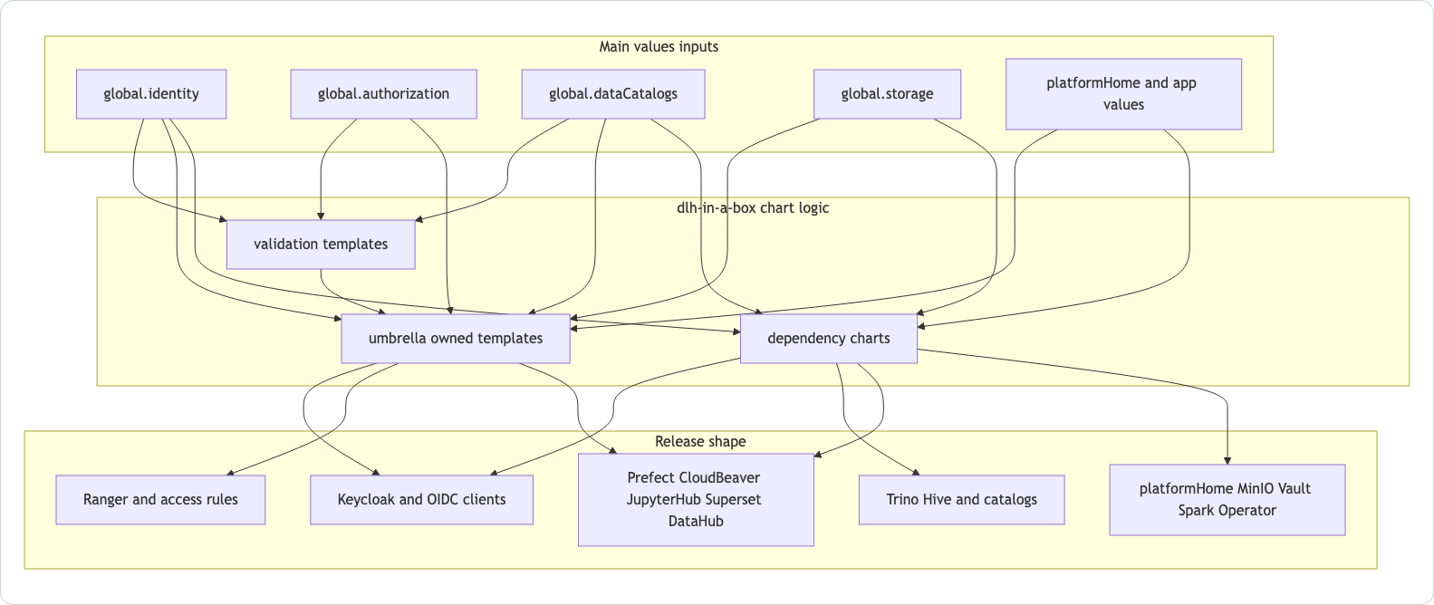
Session 04
Values drive validation, templates, and dependencies
global.identity, global.authorization, global.storage, and global.dataCatalogs are cross-component contracts.
App-specific sections configure repo-owned wrappers.
Dependency sections pass through upstream chart values.
Session 04 / Chart Internals, Values Contract, And Render Flow
Source: charts/dlh-in-a-box/README.md Mermaid.
04
Notes:
Session 04: Chart Internals, Values Contract, And Render Flow Slide 04: Values drive validation, templates, and dependencies Presenter script: Explain that values.yaml is large because it has two jobs: local contract plus upstream pass-through. Source: Source: charts/dlh-in-a-box/README.md Mermaid.

Slide 5
Session 04
Read values.yaml by category
Category | Examples | What changes
Shared contract | global.identity, global.authorization, global.storage, global.dataCatalogs | Cross-component behavior
Repo-owned apps | platformHome, cloudbeaver, auth proxy sections | Umbrella-specific logic
Dependency pass-through | keycloak, minio, superset, jupyterhub, datahub | Upstream chart configuration
Local subcharts | hive, hivePostgresql | First-party metastore behavior
Session 04 / Chart Internals, Values Contract, And Render Flow
Source: chart guide, How Values Are Organized.
05
Notes:
Session 04: Chart Internals, Values Contract, And Render Flow Slide 05: Read values.yaml by category Presenter script: This is the reading strategy maintainers should use before touching values. Source: Source: chart guide, How Values Are Organized.

Slide 6
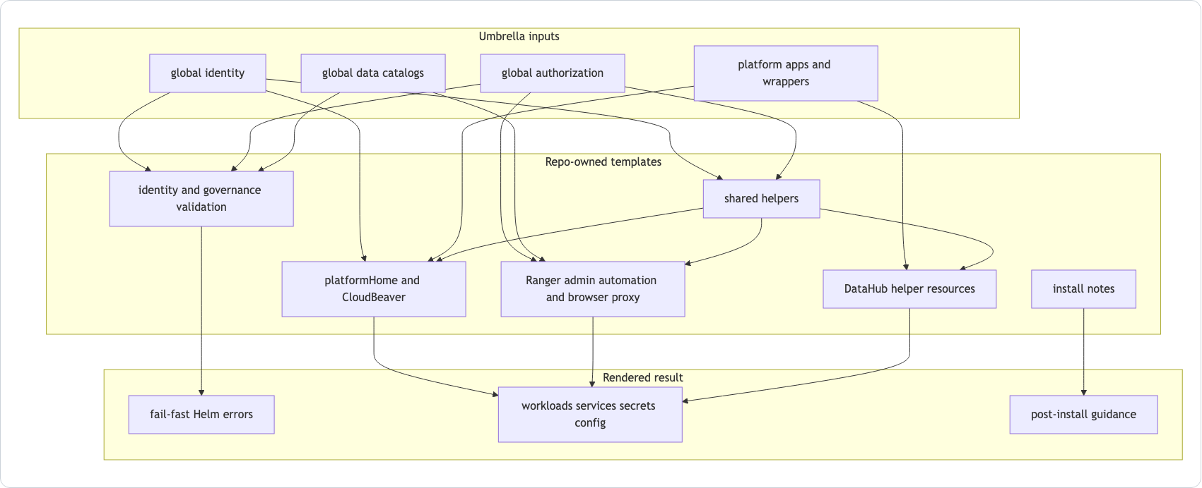
Session 04
Umbrella templates coordinate the runtime
Validation templates fail fast on unsupported combinations.
platformHome, CloudBeaver, Ranger, and DataHub helpers adapt upstream services.
Template behavior is often where product assumptions live.
Session 04 / Chart Internals, Values Contract, And Render Flow
Source: templates/_README.txt Mermaid.
06
Notes:
Session 04: Chart Internals, Values Contract, And Render Flow Slide 06: Umbrella templates coordinate the runtime Presenter script: Warn that the most behavior-heavy files are templates, not always separate application source files. Source: Source: templates/_README.txt Mermaid.

Slide 7
Session 04
Fail-fast validation lives in more than schema
File | What it blocks
values.schema.json | Input shape and allowed structural forms
identity-validation.yaml | Unsupported identity modes, missing client wiring, app auth inconsistencies
governance-validation.yaml | Broken platform roles, incomplete governance metadata, unsafe authorization settings
Session 04 / Chart Internals, Values Contract, And Render Flow
Source: manual Values Model And Render Flow.
07
Notes:
Session 04: Chart Internals, Values Contract, And Render Flow Slide 07: Fail-fast validation lives in more than schema Presenter script: Make clear that schema validation is necessary but not sufficient. Source: Source: manual Values Model And Render Flow.

Slide 8
Session 04
Helm lookup makes upgrade renders different
Upgrade-sensitive behavior
CloudBeaver can read existing Secrets for rollout checksums.
CloudBeaver can read existing Secrets for rollout checksums.
DataHub auth material is preserved across upgrades.
DataHub prerequisite compatibility can mirror existing MySQL Secrets.
Trino helpers can read existing S3 credentials for generated catalogs.
Session 04 / Chart Internals, Values Contract, And Render Flow
Source: manual Render-Time lookup Behavior.
08
Notes:
Session 04: Chart Internals, Values Contract, And Render Flow Slide 08: Helm lookup makes upgrade renders different Presenter script: This is one of the subtle maintainer topics. Offline helm template is not always the same as an in-cluster upgrade. Source: Source: manual Render-Time lookup Behavior.

Slide 9
Session 04
Guided checkpoint: trace a values rule
Commands / prompts
Checkpoint questions
Open charts/dlh-in-a-box/values.yaml
Open charts/dlh-in-a-box/values.schema.json
Open charts/dlh-in-a-box/templates/identity-validation.yaml
Render one positive and one negative contract fixture with ./hack/render-contract.sh
Can they explain whether a rule belongs in schema or a validation template?
Can they explain what a render-contract fixture is proving?
Session 04 / Chart Internals, Values Contract, And Render Flow
Guided demo/checkpoint for live handover delivery.
09
Notes:
Session 04: Chart Internals, Values Contract, And Render Flow Slide 09: Guided checkpoint: trace a values rule Presenter script: If running live, render-contract can take a little time. The teaching value is the positive versus negative contract distinction. Source: Guided demo/checkpoint for live handover delivery. Demo/checkpoint cue: Treat this as optional live material. If time or tooling is unavailable, discuss the commands and expected reasoning instead.

Slide 10
Session 04
Behavior-heavy files worth reading first
Area | Start file
platformHome launchpad and helper API | templates/platform-home.yaml
Ranger automation and audits | templates/ranger-automation.yaml
CloudBeaver bootstrap and trust behavior | templates/cloudbeaver.yaml
DataHub auth and prerequisite compatibility | templates/datahub-auth-secrets.yaml; datahub-prerequisites-compat.yaml
Ranger browser boundary | templates/ranger-browser-proxy.yaml
Session 04 / Chart Internals, Values Contract, And Render Flow
Source: manual Component Guide.
10
Notes:
Session 04: Chart Internals, Values Contract, And Render Flow Slide 10: Behavior-heavy files worth reading first Presenter script: Tell maintainers to start from the guide, not from a full-tree search. The guide names the files that carry product behavior. Source: Source: manual Component Guide.

Slide 11
Session 04
Session 04 landing
What the inheriting team should now be able to do
They can read values by ownership category.
They know schema is not the full validation story.
They can explain why lookup affects upgrade behavior.
They know the main behavior-heavy template entrypoints.
Leave-behind
Use the PPTX notes as a presenter script and source-map.md as the reference trail.
Session 04 / Chart Internals, Values Contract, And Render Flow
Handover session wrap-up.
11
Notes:
Session 04: Chart Internals, Values Contract, And Render Flow Slide 11: Session 04 landing Presenter script: Preview session five: identity is the most cross-cutting part of that render flow. Source: Handover session wrap-up.

