Slide 1

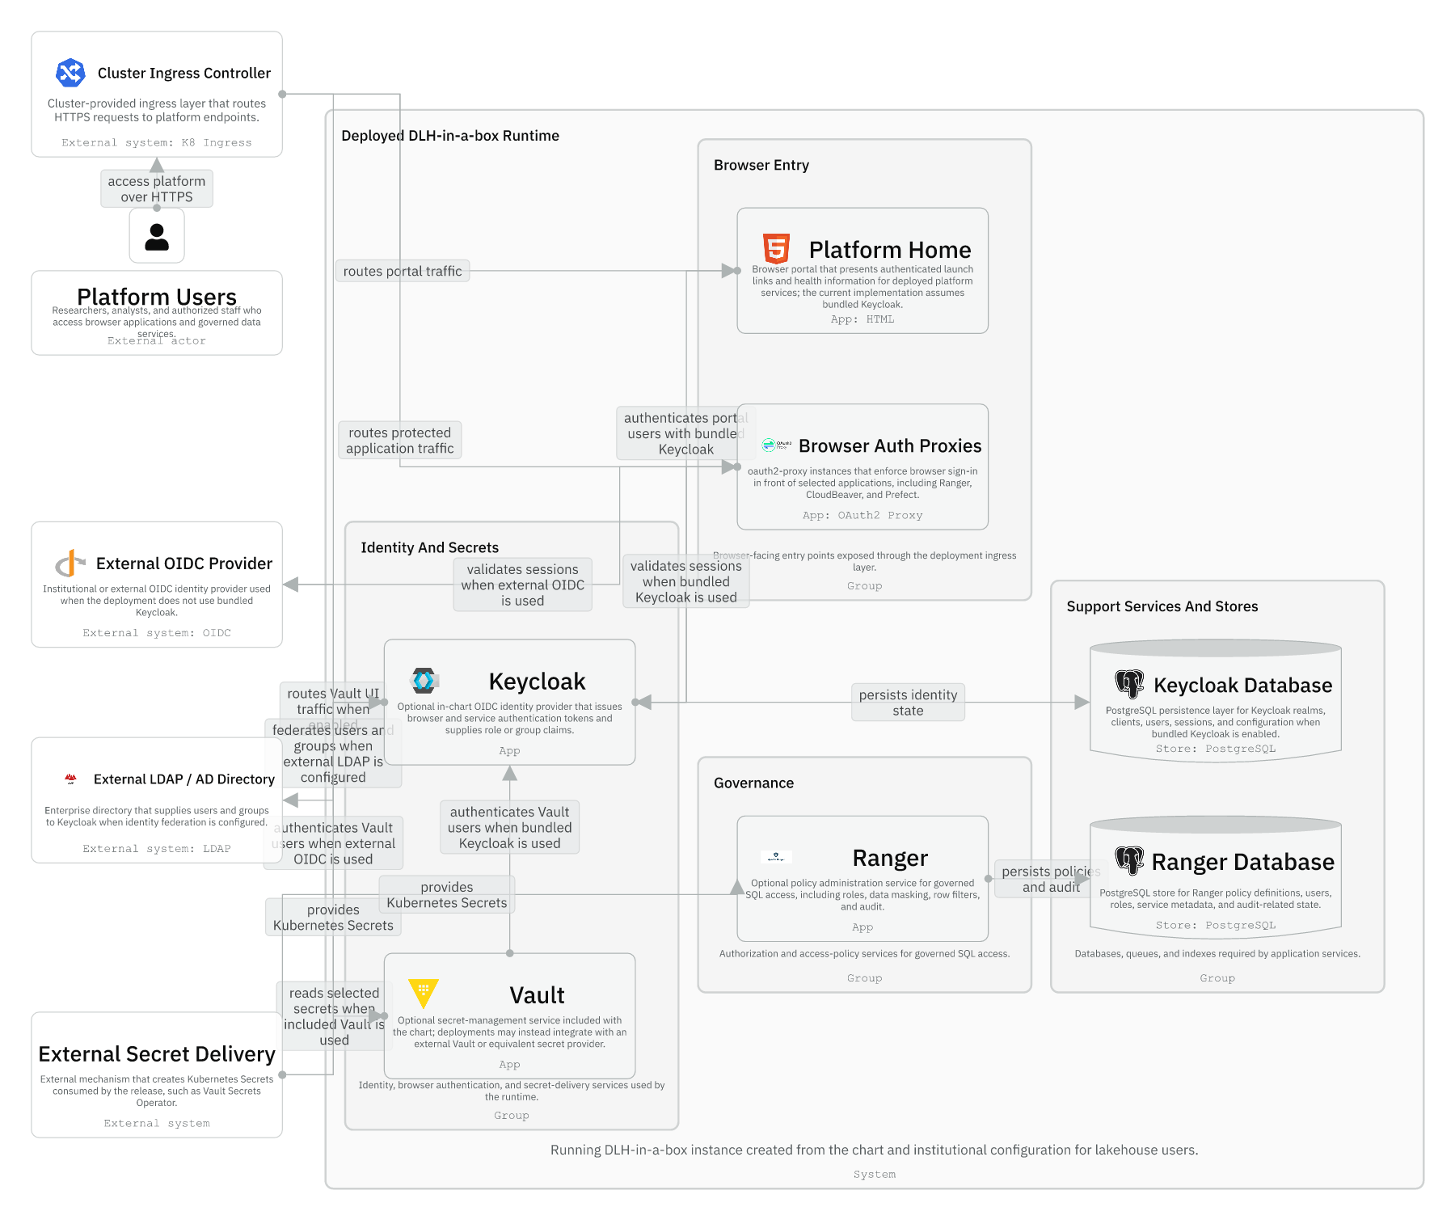
Session 05 / Auth modes and entrypoints
Identity And Browser Access
One hour handover deck
The chart orchestrates a system-wide identity contract rather than configuring each browser app independently.
40-45 min narrative / 10-15 min checkpoint / 5 min Q&A
Session 05 / Identity And Browser Access
Handover synthesis from published repository docs.
01
Notes:
Session 05: Identity And Browser Access Slide 01: Identity And Browser Access Presenter script: Open by acknowledging this is the area most likely to confuse newcomers. Source: Handover synthesis from published repository docs.

Slide 2
Session 05
Session path
What this hour covers
Two identity axes
Session rhythm
1
40-45 min narrative
10-15 min checkpoint
5 min Q&A
2
Browser entrypoints
3
Direct OIDC versus proxy
4
Local auth-heavy story
Presenter notes carry the script and demo prompts.
Session 05 / Identity And Browser Access
Handover session structure.
02
Notes:
Session 05: Identity And Browser Access Slide 02: Session path Presenter script: The payoff is being able to debug auth issues by asking which axis or boundary is involved. Source: Handover session structure.

Slide 3
Session 05
Runtime identity, access, and secrets
Keycloak or external OIDC issues browser identity.
Secrets may be supplied externally or by included services.
Browser auth proxies protect selected apps.
Trino, Ranger, and app runtimes consume identity differently.
Session 05 / Identity And Browser Access
Source: IcePanel 10-runtime-identity-access-secrets.
03
Notes:
Session 05: Identity And Browser Access Slide 03: Runtime identity, access, and secrets Presenter script: Use this as the high-level runtime map. It is dense; narrate top-down from user entry to service access. Source: Source: IcePanel 10-runtime-identity-access-secrets.

Slide 4
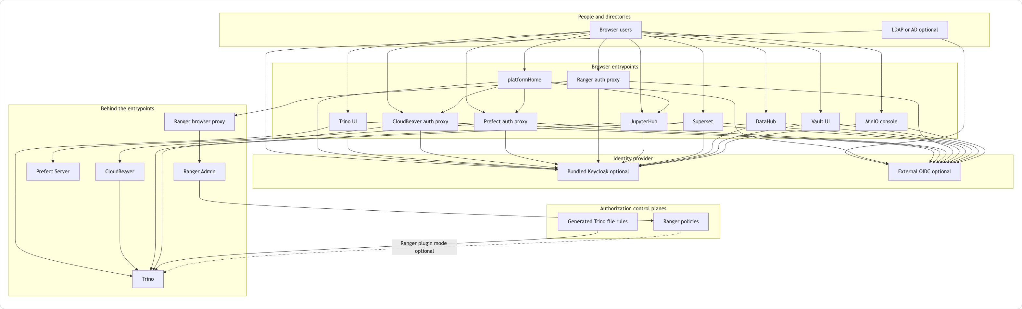
Session 05
Auth and control flow
Users enter through browser-facing applications.
Apps either handle OIDC directly or sit behind oauth2-proxy.
Ranger policies and generated file rules are authorization control planes.
Session 05 / Identity And Browser Access
Source: manual Auth And Control Flow Mermaid.
04
Notes:
Session 05: Identity And Browser Access Slide 04: Auth and control flow Presenter script: This diagram shows why app-by-app auth debugging can be misleading. The chart wires a shared flow. Source: Source: manual Auth And Control Flow Mermaid.

Slide 5
Session 05
Identity has two independent axes
Axis | Setting | Meaning
Provider | bundledKeycloak | The chart deploys Keycloak and manages clients
Provider | externalOidc | An existing OIDC provider is consumed
Directory | externalLdap | Users and groups come from LDAP or AD
Directory | keycloakLocal | Keycloak manages local demo users
Session 05 / Identity And Browser Access
Source: chart guide Identity Model.
05
Notes:
Session 05: Identity And Browser Access Slide 05: Identity has two independent axes Presenter script: Do not let the audience collapse provider and directory into one question. They are separate axes. Source: Source: chart guide Identity Model.

Slide 6
Session 05
Supported combinations that matter
Provider | Directory | Use case
bundledKeycloak | externalLdap | Default shared dev and prod pattern
bundledKeycloak | keycloakLocal | Local auth-heavy smoke and demo pattern
externalOidc | externalLdap | Escape hatch when an external IdP exists
Session 05 / Identity And Browser Access
Source: manual Supported Combinations.
06
Notes:
Session 05: Identity And Browser Access Slide 06: Supported combinations that matter Presenter script: Also mention the restrictions: platformHome currently requires bundled Keycloak, and local Keycloak users plus LDAP-backed Ranger usersync are mutually exclusive. Source: Source: manual Supported Combinations.

Slide 7
Session 05
Which apps use which browser boundary?
App | Pattern | Why
Trino UI | Direct OIDC | Trino handles login itself
JupyterHub, Superset, DataHub | Direct OIDC | Each app has its own OIDC client wiring
CloudBeaver | oauth2-proxy | Proxy owns browser sign-in
Prefect | oauth2-proxy | Proxy protects browser UI
Ranger browser access | oauth2-proxy plus browser proxy | Ranger Admin is not exposed directly as the main surface
Session 05 / Identity And Browser Access
Source: manual Which Apps Use Direct OIDC.
07
Notes:
Session 05: Identity And Browser Access Slide 07: Which apps use which browser boundary? Presenter script: This table is the fastest way to debug 'why does this app behave differently?' Source: Source: manual Which Apps Use Direct OIDC.

Slide 8
Session 05
platformHome is special
Current implementation constraint
It is a launchpad UI and helper API rendered by templates/platform-home.yaml.
It is a launchpad UI and helper API rendered by templates/platform-home.yaml.
It currently uses the Keycloak JavaScript adapter directly.
That means platformHome requires bundled Keycloak today.
Most code lives inline in the template rather than files/platform-home/.
Session 05 / Identity And Browser Access
Source: manual Component Guide; chart guide restrictions.
08
Notes:
Session 05: Identity And Browser Access Slide 08: platformHome is special Presenter script: Call this out because it is a likely future change request and a common surprise. Source: Source: manual Component Guide; chart guide restrictions.

Slide 9
Session 05
The local auth-heavy story is intentionally different
Smoke path identity shape
Bundled Keycloak is enabled.
Bundled Keycloak is enabled.
Keycloak manages local users directly.
Ranger LDAP usersync is disabled.
Demo Secrets are seeded by smoke-install.sh.
Session 05 / Identity And Browser Access
Source: manual Local Auth-Heavy Story.
09
Notes:
Session 05: Identity And Browser Access Slide 09: The local auth-heavy story is intentionally different Presenter script: This explains why a plain Helm install of values-local-auth.yaml is not equivalent to make smoke-install. Source: Source: manual Local Auth-Heavy Story.

Slide 10
Session 05
Guided checkpoint: classify an auth problem
Commands / prompts
Checkpoint questions
Ask: provider mode or directory mode?
Ask: direct OIDC app or oauth2-proxy app?
Ask: browser login problem or backend authorization problem?
Then inspect values, validation output, generated client settings, and relevant app template.
Can the developer place CloudBeaver, Trino UI, and platformHome on the right boundary?
Can they explain why a local auth smoke issue may involve seeded Secrets?
Session 05 / Identity And Browser Access
Guided demo/checkpoint for live handover delivery.
10
Notes:
Session 05: Identity And Browser Access Slide 10: Guided checkpoint: classify an auth problem Presenter script: Use a hypothetical incident instead of a live cluster if needed: CloudBeaver login fails, Trino UI works, platformHome is enabled. Source: Guided demo/checkpoint for live handover delivery. Demo/checkpoint cue: Treat this as optional live material. If time or tooling is unavailable, discuss the commands and expected reasoning instead.

Slide 11
Session 05
Session 05 landing
What the inheriting team should now be able to do
They can separate provider mode from directory mode.
They know which apps use direct OIDC versus proxy boundaries.
They understand the platformHome bundled-Keycloak constraint.
They can triage auth issues by boundary instead of by product name alone.
Leave-behind
Use the PPTX notes as a presenter script and source-map.md as the reference trail.
Session 05 / Identity And Browser Access
Handover session wrap-up.
11
Notes:
Session 05: Identity And Browser Access Slide 11: Session 05 landing Presenter script: Preview session six: identity is only half the access story; authorization and Ranger are next. Source: Handover session wrap-up.

