Slide 1

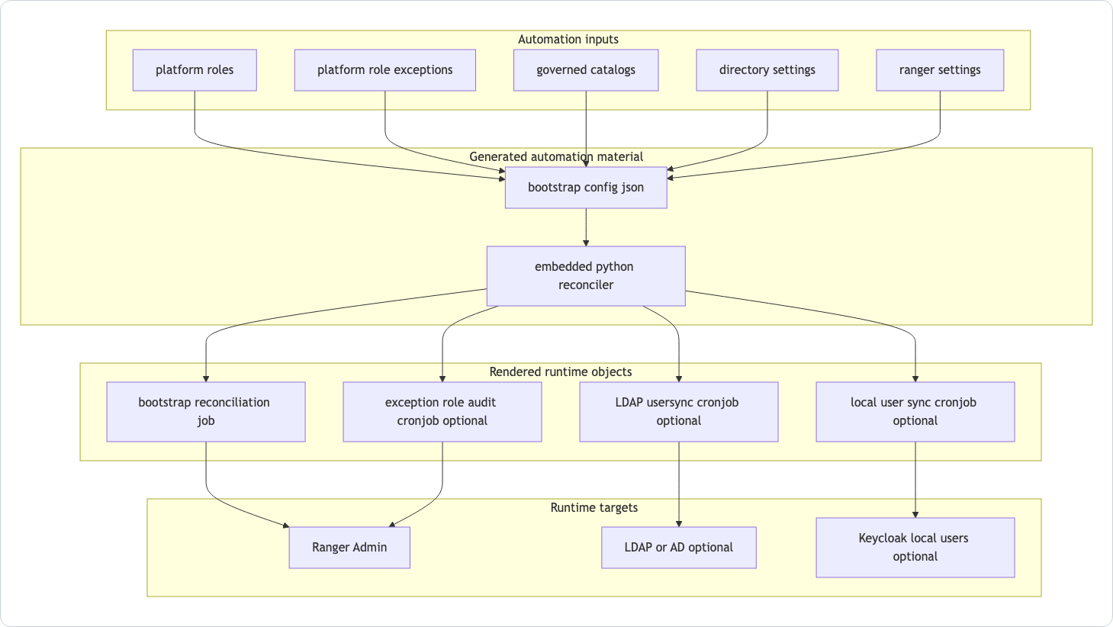
Session 06 / Roles, policies, and enforcement
Governance, Authorization, And Ranger
One hour handover deck
Ranger can exist as a governance service even when Trino is still authorized by generated file rules.
40-45 min narrative / 10-15 min checkpoint / 5 min Q&A
Session 06 / Governance, Authorization, And Ranger
Handover synthesis from published repository docs.
01
Notes:
Session 06: Governance, Authorization, And Ranger Slide 01: Governance, Authorization, And Ranger Presenter script: Open with the subtlety: Ranger enabled does not automatically mean Trino queries are authorized by the Ranger plugin. Source: Handover synthesis from published repository docs.

Slide 2
Session 06
Session path
What this hour covers
Governance concepts
Session rhythm
1
40-45 min narrative
10-15 min checkpoint
5 min Q&A
2
Validation rules
3
Ranger automation
4
Trino enforcement matrix
Presenter notes carry the script and demo prompts.
Session 06 / Governance, Authorization, And Ranger
Handover session structure.
02
Notes:
Session 06: Governance, Authorization, And Ranger Slide 02: Session path Presenter script: This session is partly about terminology. Use precise language throughout. Source: Handover session structure.

Slide 3
Session 06
Governance is part of the chart contract
Not just infrastructure wiring
Platform roles describe durable app and data entitlements.
Platform roles describe durable app and data entitlements.
Direct-user exceptions require approval metadata and expiry.
Governed catalogs carry PI, IRB, consent, and approval metadata.
Ranger bootstrap policies can be reconciled into Ranger.
Session 06 / Governance, Authorization, And Ranger
Source: manual Governance Concepts.
03
Notes:
Session 06: Governance, Authorization, And Ranger Slide 03: Governance is part of the chart contract Presenter script: Explain that these are institution-shaped concepts encoded by current chart validation, not generic Helm ideas. Source: Source: manual Governance Concepts.

Slide 4
Session 06
Core authorization values
Values path | What it means
global.authorization.platformRoles | Named roles mapped into app entitlements and Ranger roles
global.authorization.platformRoleExceptions | Controlled direct-user exceptions with approval metadata
global.dataCatalogs.<name>.governance | Catalog-level metadata that controls whether data may be exposed
global.authorization.ranger.bootstrapPolicies | Policy definitions reconciled into Ranger
Session 06 / Governance, Authorization, And Ranger
Source: chart guide Governance And Authorization Model.
04
Notes:
Session 06: Governance, Authorization, And Ranger Slide 04: Core authorization values Presenter script: This table anchors the rest of the session in the values contract. Source: Source: chart guide Governance And Authorization Model.

Slide 5
Session 06
Governance validation prevents unsafe combinations
Representative enforced rules
Every platform role needs a description.
Every platform role needs a description.
App entitlements must use supported app names.
Direct-user exceptions need approval reference, reason, grantor, and expiry.
Restricted data cannot rely on unsafe wildcard access patterns.
Identifiable restricted data needs masking or row-filter policy coverage.
Session 06 / Governance, Authorization, And Ranger
Source: manual What The Governance Validation Layer Enforces.
05
Notes:
Session 06: Governance, Authorization, And Ranger Slide 05: Governance validation prevents unsafe combinations Presenter script: Do not present this as an exhaustive code listing. Present it as the shape of safety rails maintainers must preserve. Source: Source: manual What The Governance Validation Layer Enforces.

Slide 6
Session 06
Ranger automation flow
Values become generated bootstrap configuration.
Embedded Python reconciles Ranger state.
Jobs and CronJobs handle bootstrap, usersync, local-user sync, and exception audits.
The runtime target may be Ranger, LDAP or AD, or local Keycloak users.
Session 06 / Governance, Authorization, And Ranger
Source: manual Ranger Automation Flow Mermaid.
06
Notes:
Session 06: Governance, Authorization, And Ranger Slide 06: Ranger automation flow Presenter script: This is one of the behavior-heavy template areas. Connect it to templates/ranger-automation.yaml. Source: Source: manual Ranger Automation Flow Mermaid.

Slide 7
Session 06
Where authorization actually happens
Situation | Ranger Admin? | Trino query authorization
Ranger disabled | No | Generated file-based Trino rules
Ranger enabled; ranger.trino=false | Yes | Generated file-based Trino rules
Ranger enabled; ranger.trino=true; compatible Trino image | Yes | Ranger plugin path
Session 06 / Governance, Authorization, And Ranger
Source: manual Trino And Ranger Control Matrix.
07
Notes:
Session 06: Governance, Authorization, And Ranger Slide 07: Where authorization actually happens Presenter script: This is the key slide. Say it twice: Ranger as governance admin and Ranger as Trino query-time enforcement are related but not identical. Source: Source: manual Trino And Ranger Control Matrix.

Slide 8
Session 06
Ranger templates are behavior-heavy
Where to read code
templates/ranger-automation.yaml embeds reconciliation logic.
templates/ranger-automation.yaml embeds reconciliation logic.
templates/_ranger-admin.tpl owns bootstrap text templates.
templates/ranger-admin.yaml renders runtime shell resources.
templates/ranger-browser-proxy.yaml protects browser access.
Session 06 / Governance, Authorization, And Ranger
Source: manual Component Guide; templates guide.
08
Notes:
Session 06: Governance, Authorization, And Ranger Slide 08: Ranger templates are behavior-heavy Presenter script: Use this as an ownership handoff. These files need careful review when access behavior changes. Source: Source: manual Component Guide; templates guide.

Slide 9
Session 06
Guided checkpoint: diagnose 'Ranger is enabled but Trino still uses file rules'
Commands / prompts
Checkpoint questions
Check global.authorization.ranger.enabled
Check global.authorization.ranger.trino.enabled
Check the Trino image/plugin compatibility expectation
Inspect rendered access-control config for coordinator
Can the developer explain why Ranger Admin may be present but not query-time enforcing?
Can they find the template path that renders Trino access control?
Session 06 / Governance, Authorization, And Ranger
Guided demo/checkpoint for live handover delivery.
09
Notes:
Session 06: Governance, Authorization, And Ranger Slide 09: Guided checkpoint: diagnose 'Ranger is enabled but Trino still uses file rules' Presenter script: This checkpoint should become a stock troubleshooting playbook for future maintainers. Source: Guided demo/checkpoint for live handover delivery. Demo/checkpoint cue: Treat this as optional live material. If time or tooling is unavailable, discuss the commands and expected reasoning instead.

Slide 10
Session 06
Session 06 landing
What the inheriting team should now be able to do
They know the governance values that matter.
They understand why validation is strict for governed data.
They can explain Ranger automation at a high level.
They can distinguish Ranger Admin from Trino enforcement.
Leave-behind
Use the PPTX notes as a presenter script and source-map.md as the reference trail.
Session 06 / Governance, Authorization, And Ranger
Handover session wrap-up.
10
Notes:
Session 06: Governance, Authorization, And Ranger Slide 10: Session 06 landing Presenter script: Preview session seven: now follow the actual query, storage, and metadata path. Source: Handover session wrap-up.

