Slide 1

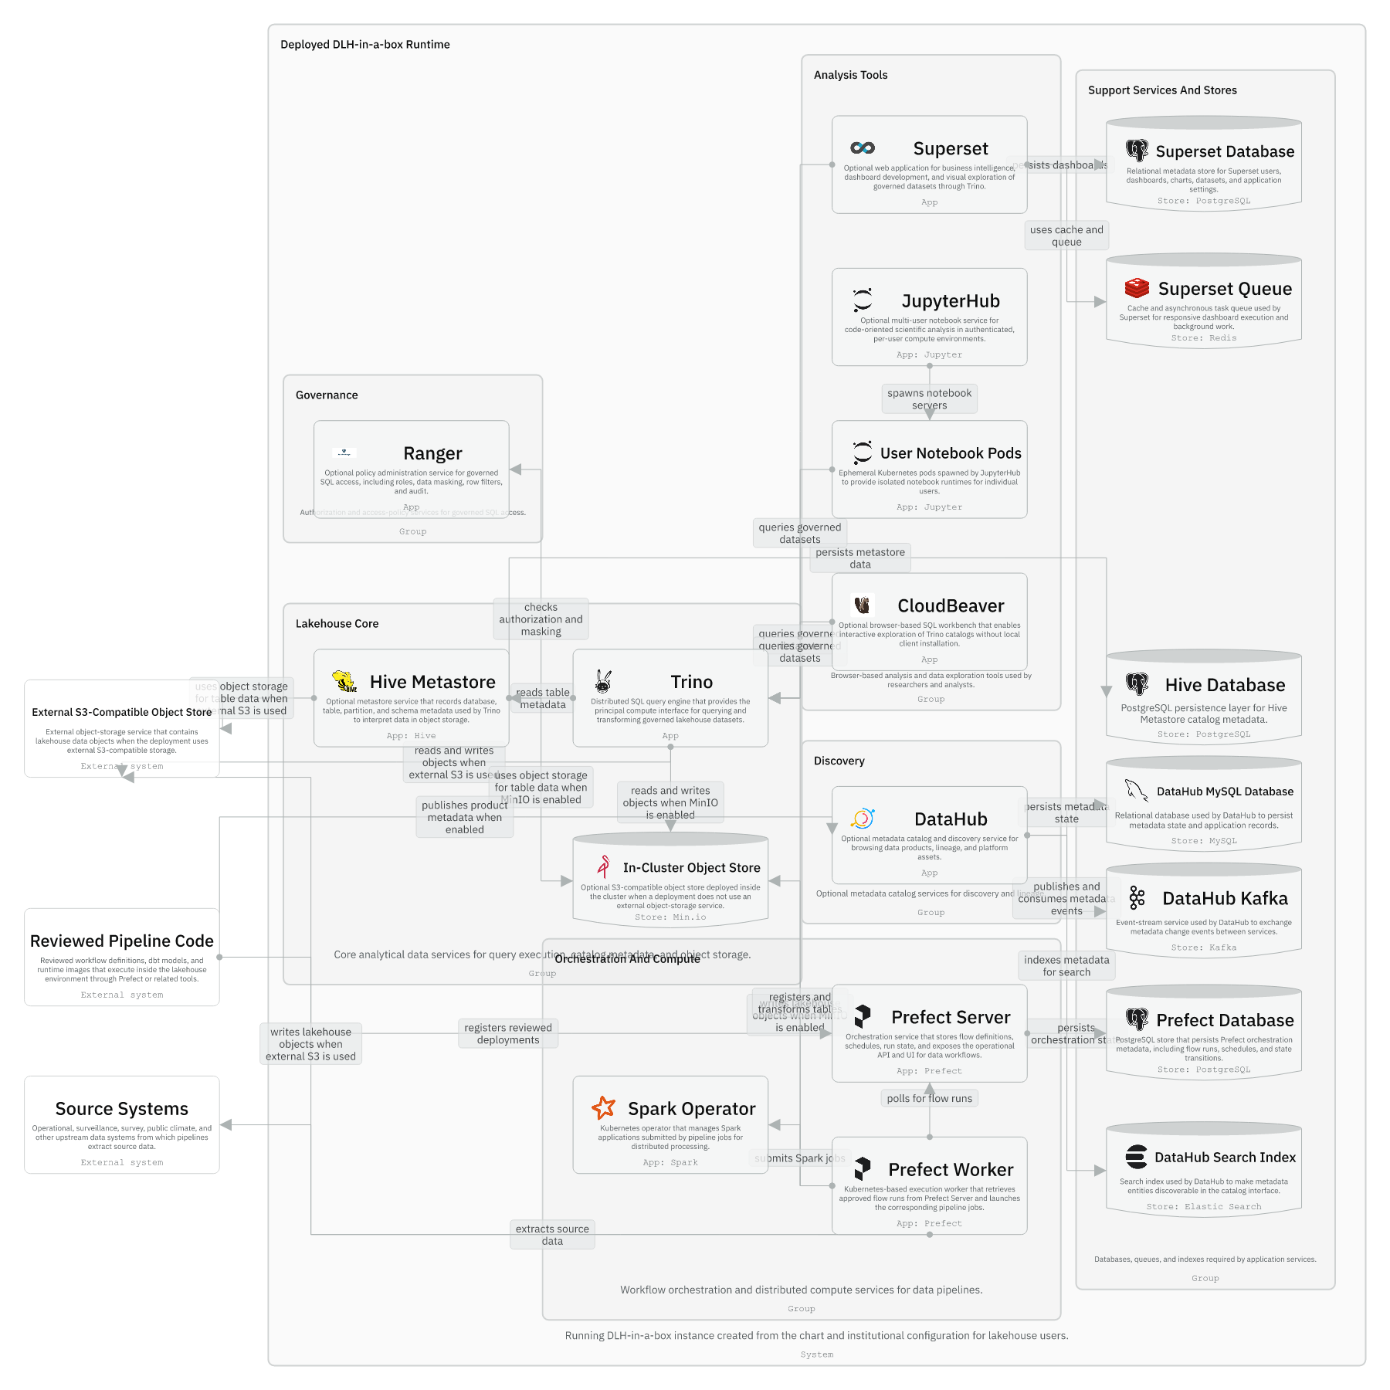
Session 07 / Data plane and surrounding tools
Query, Storage, Metadata, And App Runtime
One hour handover deck
global.dataCatalogs is the shared input that becomes Hive resources, Trino catalogs, governance validation, and Ranger policy inputs.
40-45 min narrative / 10-15 min checkpoint / 5 min Q&A
Session 07 / Query, Storage, Metadata, And App Runtime
Handover synthesis from published repository docs.
01
Notes:
Session 07: Query, Storage, Metadata, And App Runtime Slide 01: Query, Storage, Metadata, And App Runtime Presenter script: Open with the values key. If maintainers understand global.dataCatalogs, much of the data plane becomes easier. Source: Handover synthesis from published repository docs.

Slide 2
Session 07
Session path
What this hour covers
Data path
Session rhythm
1
40-45 min narrative
10-15 min checkpoint
5 min Q&A
2
Hive subchart
3
Trino patch points
4
Storage modes
Presenter notes carry the script and demo prompts.
5
Consumer apps
Session 07 / Query, Storage, Metadata, And App Runtime
Handover session structure.
02
Notes:
Session 07: Query, Storage, Metadata, And App Runtime Slide 02: Session path Presenter script: This session is where runtime architecture connects to the chart's deepest local patch points. Source: Handover session structure.

Slide 3
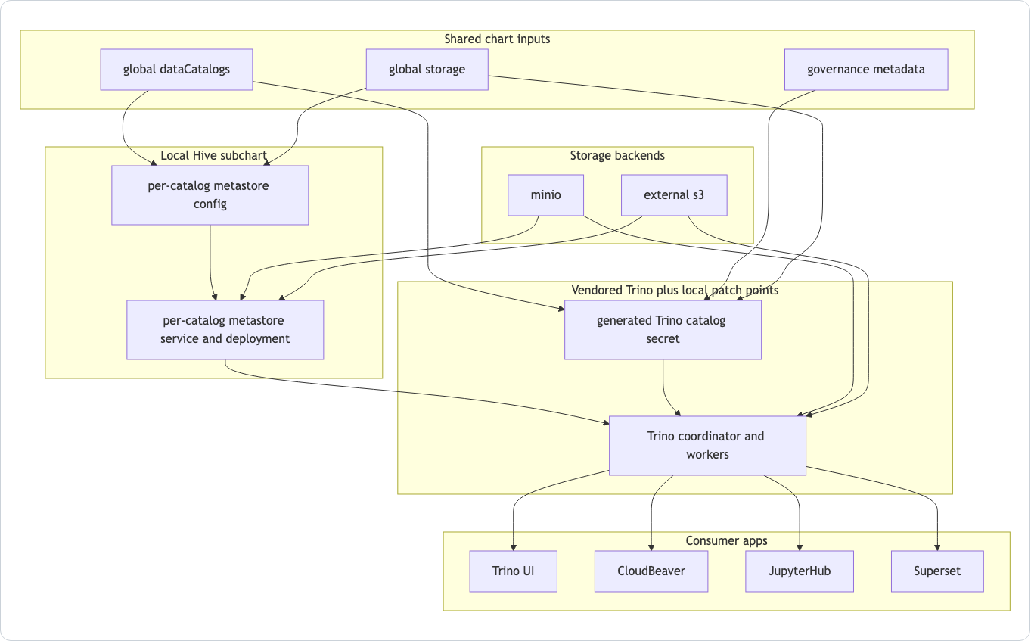
Session 07
Data path from values to consumers
Catalogs drive Hive configuration and Trino catalog secrets.
Storage settings wire Hive and Trino to MinIO or external S3.
Governance metadata also feeds validation and access configuration.
Tools consume data through Trino rather than each inventing a separate path.
Session 07 / Query, Storage, Metadata, And App Runtime
Source: manual Data Path Diagram.
03
Notes:
Session 07: Query, Storage, Metadata, And App Runtime Slide 03: Data path from values to consumers Presenter script: This is the main data-plane diagram. Walk from left to right: inputs, generated paths, storage backends, consumers. Source: Source: manual Data Path Diagram.

Slide 4
Session 07
Runtime data, analysis, and orchestration
Prefect workers run pipelines and can submit Spark jobs.
Trino queries data and registers/transforms tables.
CloudBeaver, JupyterHub, and Superset query through Trino.
DataHub is optional discovery, not the query engine.
Session 07 / Query, Storage, Metadata, And App Runtime
Source: IcePanel 11-runtime-data-analysis-orchestration.
04
Notes:
Session 07: Query, Storage, Metadata, And App Runtime Slide 04: Runtime data, analysis, and orchestration Presenter script: Use this to show how operational workloads and human tools both meet at the data plane. Source: Source: IcePanel 11-runtime-data-analysis-orchestration.

Slide 5
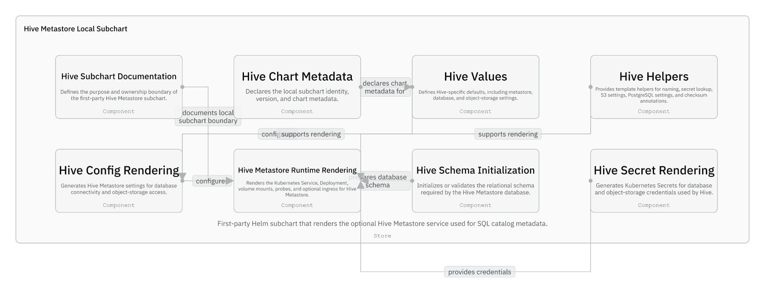
Session 07
Hive local subchart
The Hive subchart is fully repo-owned.
It can render one metastore service and deployment per catalog.
It owns metastore config, database credentials, object storage credentials, and schema initialization.
Session 07 / Query, Storage, Metadata, And App Runtime
Source: IcePanel 07-hive-metastore-local-subchart.
05
Notes:
Session 07: Query, Storage, Metadata, And App Runtime Slide 05: Hive local subchart Presenter script: Stress ownership: Hive is not just an upstream archive here; it is a first-party subchart. Source: Source: IcePanel 07-hive-metastore-local-subchart.

Slide 6
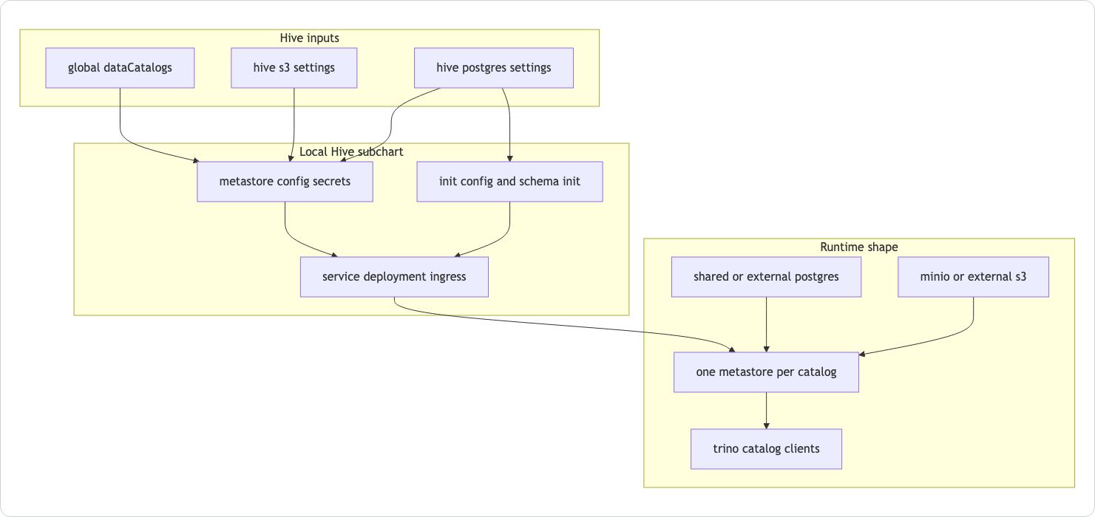
Session 07
Hive flow from catalog input to metastore runtime
Catalog iteration is the core pattern.
Storage wiring supports MinIO or S3.
PostgreSQL backs metastore state.
Schema initialization can happen through init containers and hook jobs.
Session 07 / Query, Storage, Metadata, And App Runtime
Source: Hive subchart README Mermaid.
06
Notes:
Session 07: Query, Storage, Metadata, And App Runtime Slide 06: Hive flow from catalog input to metastore runtime Presenter script: This diagram is more implementation-adjacent than the IcePanel view. It is useful when changing the subchart. Source: Source: Hive subchart README Mermaid.

Slide 7
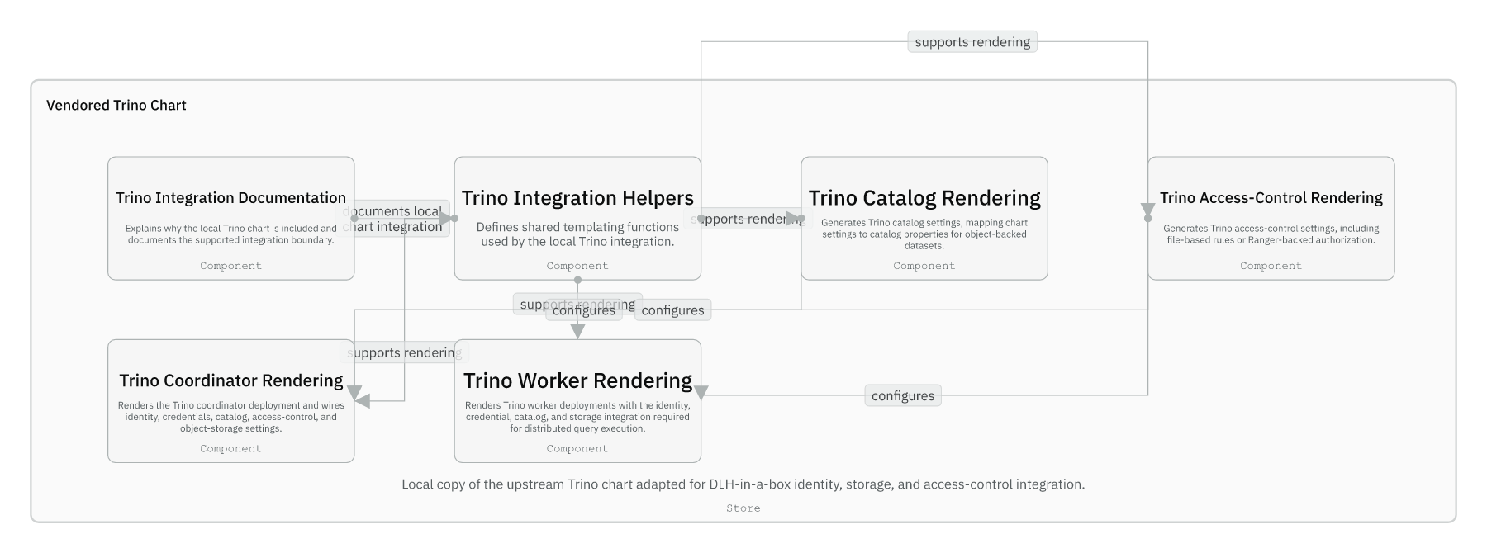
Session 07
Vendored Trino chart patch points
Most of the Trino chart is upstream material.
Local patch points generate catalogs, access-control config, secret mounts, and identity wiring.
Coordinator and worker deployments consume the generated settings.
Session 07 / Query, Storage, Metadata, And App Runtime
Source: IcePanel 06-vendored-trino-chart.
07
Notes:
Session 07: Query, Storage, Metadata, And App Runtime Slide 07: Vendored Trino chart patch points Presenter script: This is where the ownership boundary matters most. Do not edit nearby upstream files casually. Source: Source: IcePanel 06-vendored-trino-chart.

Slide 8
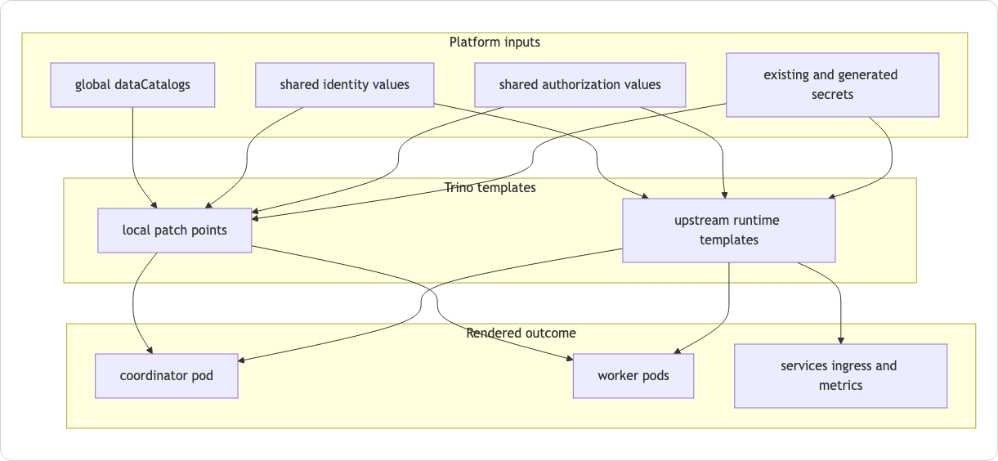
Session 07
Trino patch model
Helpers support catalog, access-control, coordinator, and worker rendering.
Generated catalog config comes from global.dataCatalogs and storage settings.
Authorization can be file-based or Ranger-backed.
Session 07 / Query, Storage, Metadata, And App Runtime
Source: Trino template patch guide Mermaid.
08
Notes:
Session 07: Query, Storage, Metadata, And App Runtime Slide 08: Trino patch model Presenter script: Link this directly to the patch-point files listed in the Trino guide. Source: Source: Trino template patch guide Mermaid.

Slide 9
Session 07
Storage modes
Mode | What changes | Maintainer concern
MinIO | Chart deploys in-cluster S3-compatible storage | Good local default; not a production secret story
External S3 | Hive and Trino point at an existing backend | Needs real endpoint, credentials, TLS, and governance context
Existing Secret | Generated catalogs may read credentials via lookup | Offline render and in-cluster upgrade can differ
Session 07 / Query, Storage, Metadata, And App Runtime
Source: manual Storage Modes and lookup behavior.
09
Notes:
Session 07: Query, Storage, Metadata, And App Runtime Slide 09: Storage modes Presenter script: This table brings sessions four and seven together: storage is both a values decision and an upgrade-time lookup concern. Source: Source: manual Storage Modes and lookup behavior.

Slide 10
Session 07
Where DataHub fits
Optional discovery layer
DataHub is not Trino and not Hive Metastore.
DataHub is not Trino and not Hive Metastore.
Its role here is metadata discovery and search.
The chart carries compatibility templates for auth and prerequisite secret/service shape.
Deployments decide whether DataHub is part of their runtime.
Session 07 / Query, Storage, Metadata, And App Runtime
Source: manual Where DataHub Fits; chart guide.
10
Notes:
Session 07: Query, Storage, Metadata, And App Runtime Slide 10: Where DataHub fits Presenter script: This corrects a common architecture overread: DataHub is optional and deployment-controlled in this chart. Source: Source: manual Where DataHub Fits; chart guide.

Slide 11
Session 07
Guided checkpoint: trace a catalog
Commands / prompts
Checkpoint questions
Find global.dataCatalogs in charts/dlh-in-a-box/values.yaml
Follow it to Hive templates under charts/dlh-in-a-box/charts/hive/templates
Follow it to Trino catalog rendering under charts/dlh-in-a-box/charts/trino/templates
Check which example overlays enable MinIO or external S3
Can the developer name the generated Hive and Trino outputs?
Can they explain how storage mode changes both paths?
Session 07 / Query, Storage, Metadata, And App Runtime
Guided demo/checkpoint for live handover delivery.
11
Notes:
Session 07: Query, Storage, Metadata, And App Runtime Slide 11: Guided checkpoint: trace a catalog Presenter script: This is the core implementation handover for the data plane. Encourage maintainers to trace one concrete catalog, not every catalog. Source: Guided demo/checkpoint for live handover delivery. Demo/checkpoint cue: Treat this as optional live material. If time or tooling is unavailable, discuss the commands and expected reasoning instead.

Slide 12
Session 07
Session 07 landing
What the inheriting team should now be able to do
They can trace global.dataCatalogs through runtime resources.
They understand why Hive is first-party and Trino is vendored with patch points.
They can place DataHub and analysis apps around, not inside, the core query path.
Leave-behind
Use the PPTX notes as a presenter script and source-map.md as the reference trail.
Session 07 / Query, Storage, Metadata, And App Runtime
Handover session wrap-up.
12
Notes:
Session 07: Query, Storage, Metadata, And App Runtime Slide 12: Session 07 landing Presenter script: Preview session eight: the final handover is how to maintain, validate, and release the repo safely. Source: Handover session wrap-up.

