Slide 1

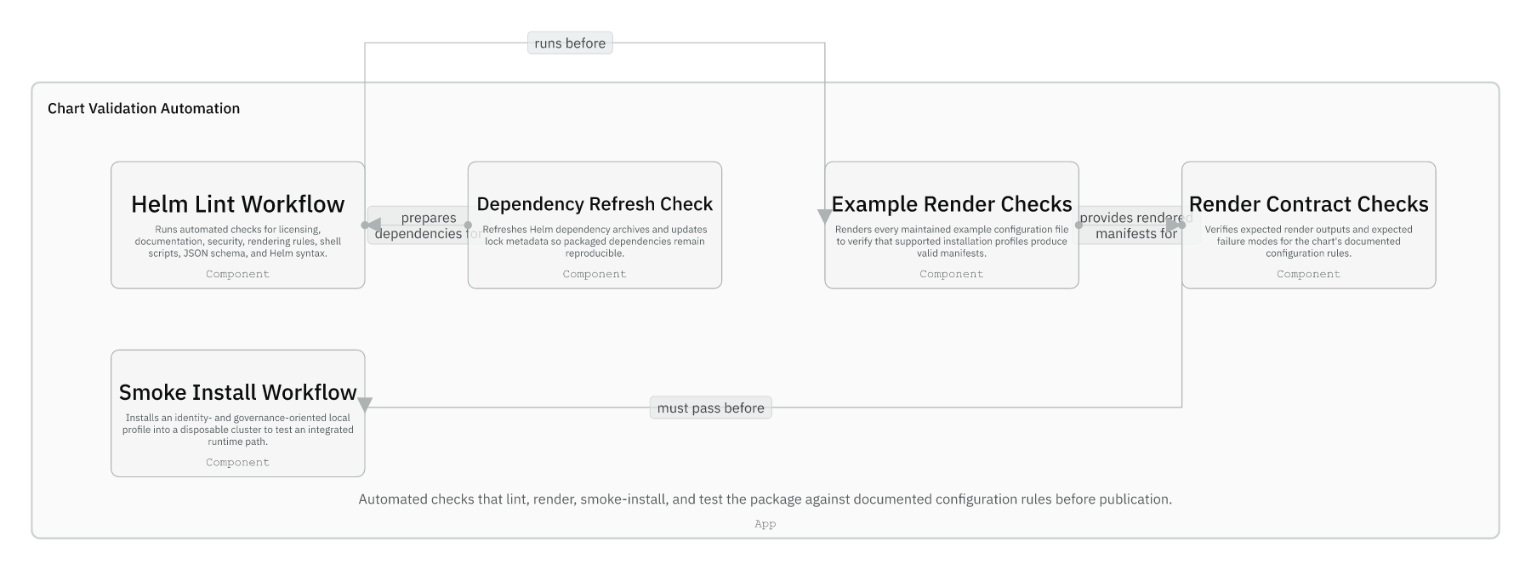
Session 08 / Keeping the repo healthy
Maintainer Workflow, CI, Releases, And Change Ownership
One hour handover deck
The maintainer habit is ownership first, local parity second, CI third.
40-45 min narrative / 10-15 min checkpoint / 5 min Q&A
Session 08 / Maintainer Workflow, CI, Releases, And Change Ownership
Handover synthesis from published repository docs.
01
Notes:
Session 08: Maintainer Workflow, CI, Releases, And Change Ownership Slide 01: Maintainer Workflow, CI, Releases, And Change Ownership Presenter script: Open by framing this as the operational survival kit for the team after handover. Source: Handover synthesis from published repository docs.

Slide 2
Session 08
Session path
What this hour covers
Change ownership
Session rhythm
1
40-45 min narrative
10-15 min checkpoint
5 min Q&A
2
Local validation
3
CI parity
4
Dependency and release flow
Presenter notes carry the script and demo prompts.
Session 08 / Maintainer Workflow, CI, Releases, And Change Ownership
Handover session structure.
02
Notes:
Session 08: Maintainer Workflow, CI, Releases, And Change Ownership Slide 02: Session path Presenter script: The aim is to make future changes boring and reviewable. Source: Handover session structure.

Slide 3
Session 08
Validation automation
Dependency refresh, docs checks, lint, render-contract, template, package, and smoke paths cover different risks.
Render-contract checks prove both allowed and disallowed settings.
Smoke install is separate because it needs a disposable cluster.
Session 08 / Maintainer Workflow, CI, Releases, And Change Ownership
Source: IcePanel 08-chart-validation-automation.
03
Notes:
Session 08: Maintainer Workflow, CI, Releases, And Change Ownership Slide 03: Validation automation Presenter script: This is the validation architecture. Session eight turns it into a maintainer routine. Source: Source: IcePanel 08-chart-validation-automation.

Slide 4
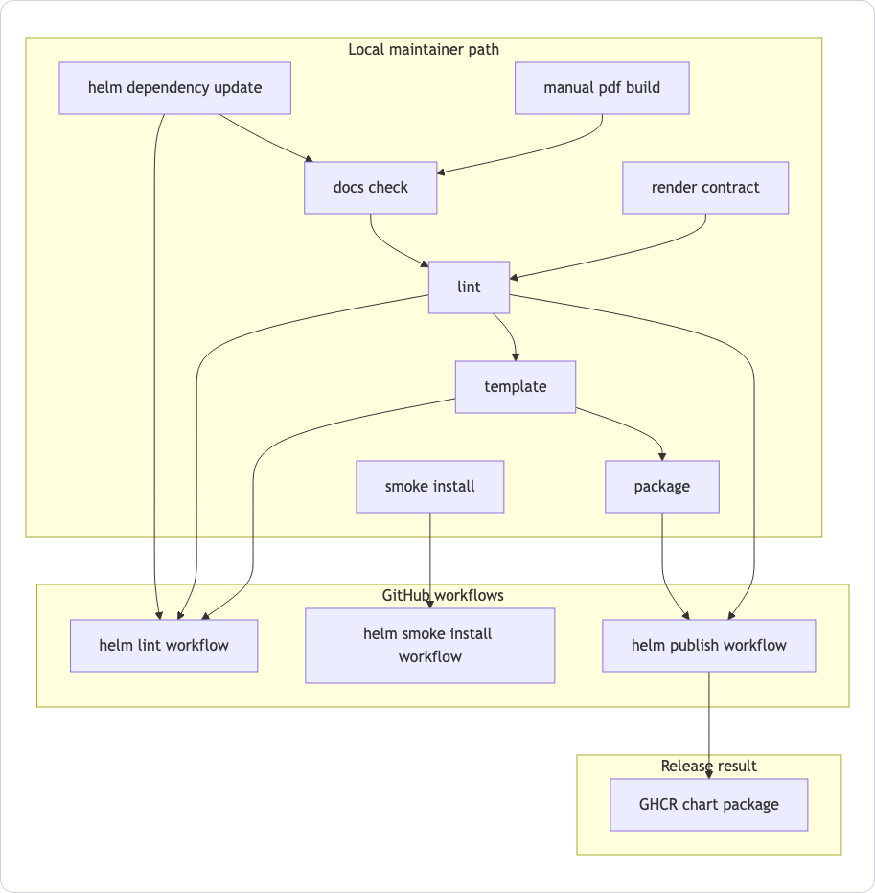
Session 08
Local validation and CI flow
Local scripts are the source of CI parity.
helm-lint workflow refreshes deps, lints, renders, and packages.
Smoke workflow validates the auth-heavy cluster path.
Publish workflow packages and pushes release artifacts.
Session 08 / Maintainer Workflow, CI, Releases, And Change Ownership
Source: manual Local Validation Flow Mermaid.
04
Notes:
Session 08: Maintainer Workflow, CI, Releases, And Change Ownership Slide 04: Local validation and CI flow Presenter script: Use this to discourage fixing CI by editing workflow YAML first. Usually debug the local script first. Source: Source: manual Local Validation Flow Mermaid.

Slide 5
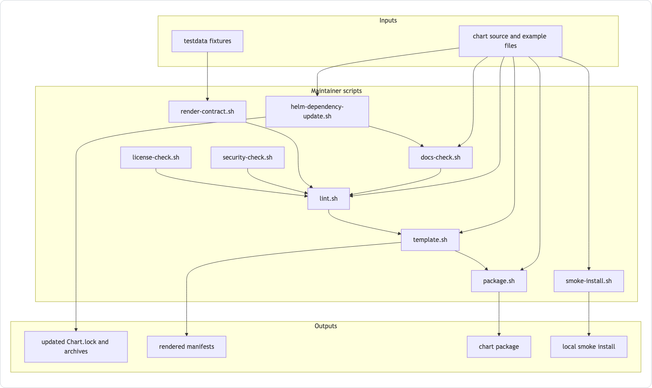
Session 08
Maintainer script flow
hack/lint.sh is the main local validation entrypoint.
docs-check enforces guide coverage, links, and Mermaid validity.
render-contract catches both positive renders and expected failures.
package and smoke-install cover release and cluster integration concerns.
Session 08 / Maintainer Workflow, CI, Releases, And Change Ownership
Source: hack/README.md Mermaid.
05
Notes:
Session 08: Maintainer Workflow, CI, Releases, And Change Ownership Slide 05: Maintainer script flow Presenter script: Connect this to the recent CI fix pattern: docs-check caught missing guide files before Helm did anything interesting. Source: Source: hack/README.md Mermaid.

Slide 6
Session 08
Main local commands
Command | What it proves
./hack/helm-dependency-update.sh | Chart.lock and packaged archives match Chart.yaml
./hack/docs-check.sh | Guide coverage, local links, and Mermaid diagrams validate
./hack/render-contract.sh | Supported renders succeed and unsafe values fail
./hack/lint.sh | Main local validation path passes
./hack/template.sh | Maintained example overlays render
./hack/package.sh | The chart can be packaged
./hack/smoke-install.sh | Auth-heavy local path installs and becomes ready
Session 08 / Maintainer Workflow, CI, Releases, And Change Ownership
Source: manual Main Local Commands.
06
Notes:
Session 08: Maintainer Workflow, CI, Releases, And Change Ownership Slide 06: Main local commands Presenter script: This slide is a checklist, not a command tutorial. Use it to choose the smallest meaningful check. Source: Source: manual Main Local Commands.

Slide 7
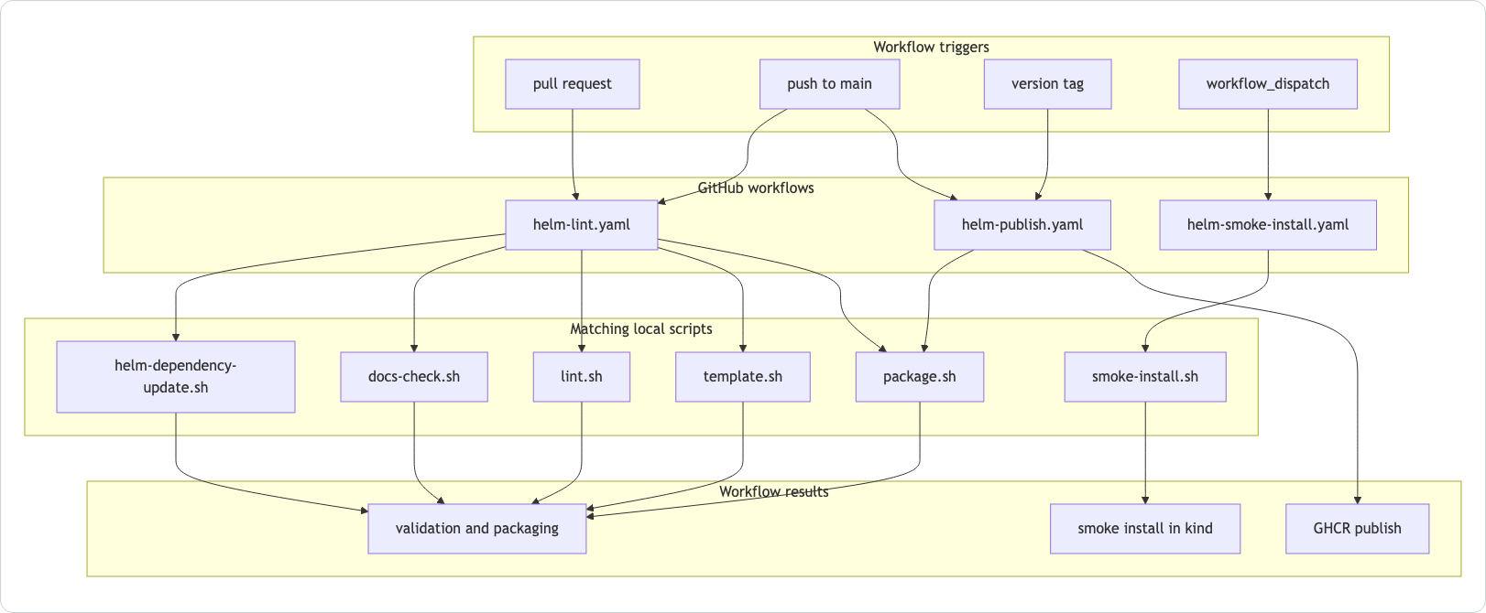
Session 08
GitHub workflow inventory
PRs and main pushes run the lint workflow.
Smoke install is manual workflow_dispatch.
Main and version tags can publish packages.
Workflows intentionally call local scripts.
Session 08 / Maintainer Workflow, CI, Releases, And Change Ownership
Source: .github/workflows/README.md Mermaid.
07
Notes:
Session 08: Maintainer Workflow, CI, Releases, And Change Ownership Slide 07: GitHub workflow inventory Presenter script: Point out the trigger differences. Smoke is manual and cluster-based; lint is the normal PR gate. Source: Source: .github/workflows/README.md Mermaid.

Slide 8
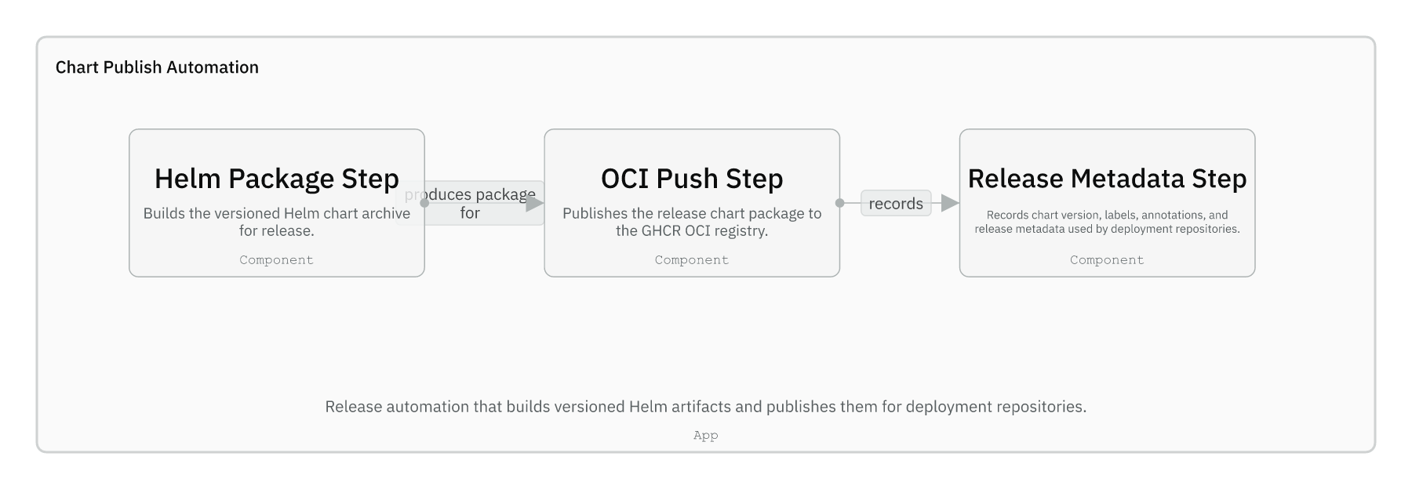
Session 08
Publish automation
Package step builds versioned chart archives.
OCI push publishes to GHCR.
Main pushes produce prerelease-style versions.
vX.Y.Z tags publish stable versions only when Chart.yaml matches.
Session 08 / Maintainer Workflow, CI, Releases, And Change Ownership
Source: IcePanel 09-chart-publish-automation; workflows guide.
08
Notes:
Session 08: Maintainer Workflow, CI, Releases, And Change Ownership Slide 08: Publish automation Presenter script: This is the release steward view. It matters less for every contributor, but maintainers must know the tag rule. Source: Source: IcePanel 09-chart-publish-automation; workflows guide.

Slide 9
Session 08
Dependency changes move together
When this changes | Move these together
Chart.yaml dependency version | Chart.lock and packaged archives
Bundled third-party material | THIRD_PARTY_NOTICES.md and third_party provenance
Vendored Trino source | Patch-point docs and validation fixtures as needed
Validation rule | Examples and render-contract fixtures
Session 08 / Maintainer Workflow, CI, Releases, And Change Ownership
Source: chart guide; charts guide; third_party guide.
09
Notes:
Session 08: Maintainer Workflow, CI, Releases, And Change Ownership Slide 09: Dependency changes move together Presenter script: This is the antidote to partial dependency updates. Make the audience say the files that move together. Source: Source: chart guide; charts guide; third_party guide.

Slide 10
Session 08
Guided checkpoint: prepare a safe change
Commands / prompts
Checkpoint questions
Identify the ownership boundary first
Choose the narrowest validation command
Run ./hack/lint.sh before opening or updating a PR
Use smoke-install only for auth-heavy integrated runtime changes
Can the developer pick a check for a docs-only change?
Can they pick a check for a values validation change?
Can they describe when a dependency update is incomplete?
Session 08 / Maintainer Workflow, CI, Releases, And Change Ownership
Guided demo/checkpoint for live handover delivery.
10
Notes:
Session 08: Maintainer Workflow, CI, Releases, And Change Ownership Slide 10: Guided checkpoint: prepare a safe change Presenter script: Use three hypothetical changes: docs-only, governance rule, dependency version. Ask the team to pick files and checks. Source: Guided demo/checkpoint for live handover delivery. Demo/checkpoint cue: Treat this as optional live material. If time or tooling is unavailable, discuss the commands and expected reasoning instead.

Slide 11
Session 08
Session 08 landing
What the inheriting team should now be able to do
They can make an ownership decision before editing.
They can choose local checks with CI parity.
They know which files move together for dependency and release changes.
They have a complete map for maintaining the repository after handover.
Leave-behind
Use the PPTX notes as a presenter script and source-map.md as the reference trail.
Session 08 / Maintainer Workflow, CI, Releases, And Change Ownership
Handover session wrap-up.
11
Notes:
Session 08: Maintainer Workflow, CI, Releases, And Change Ownership Slide 11: Session 08 landing Presenter script: Close the series by pointing back to docs/handover/source-map.md and the folder-local guides as the ongoing reference set. Source: Handover session wrap-up.

