Slide 1
Recursion
To understand recursion, you must first understand recursion.

Slide 2
What is recursion?
Taking a problem and reducing it to a smaller version of the same problem
The process of repeating items in a self-similar way
A function that calls itself

Slide 3
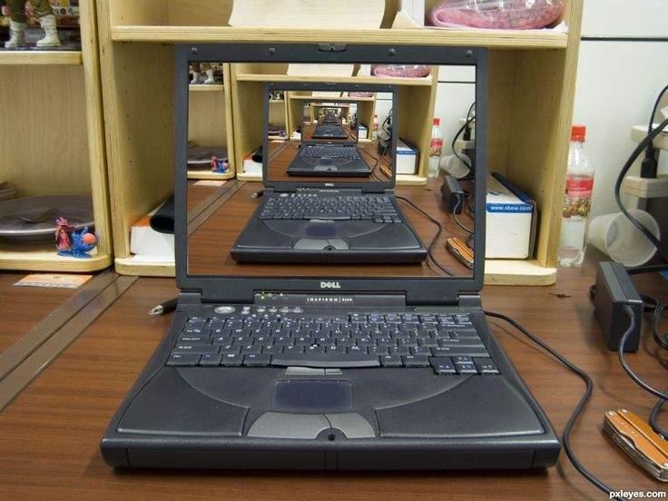

Mise en abyme or Droste effect

Slide 4
Iterative algorithms
Looping constructs like while loops and for loops
Capture computation in a set of state variables that update on each iteration through the loop
Example: integer multiplication
Multiply 2 integers together but you only have addition available

Slide 5
Multiplication – iterative solution
“multiply a * b” is equivalent to “add a to itself b times”
a + a + a + a + …… + a
Captured by 2 state variables
an iteration number (i) starts at b
i ← i – 1 and stop when 0
A current value of computation (result)
result ← result + a

Slide 6
public static int Multiplication (int a, int b)
{
int result = 0;
while (b > 0) ← iteration
{
result = result + a; ← current value of computation, b = b -1; running sum
}
return result; ← current value of iteration variable
}

Slide 7
The Recursive way
a times b is just the same as adding a to itself b times
a * b = a + a + a + a + a + ….. + a
b times
Which is the same as adding a to a itself b minus 1 times
a + a + a + a + …… + a
b – 1 times
a + a * (b – 1) ⬅ recursive deduction
Recursive : think how to reduce a problem to simpler smaller version of the same problem
Base case: keep reducing the problem until you reach a simple case that be solved directly
When b =1, a * b = a

Slide 8
Recursive solution
public static int multiplication (int a, int b)
{
if (b == 1) ← base case
return a;
else
return a + multiplication ( a, b -1 ); ← recursive step
}

Slide 9
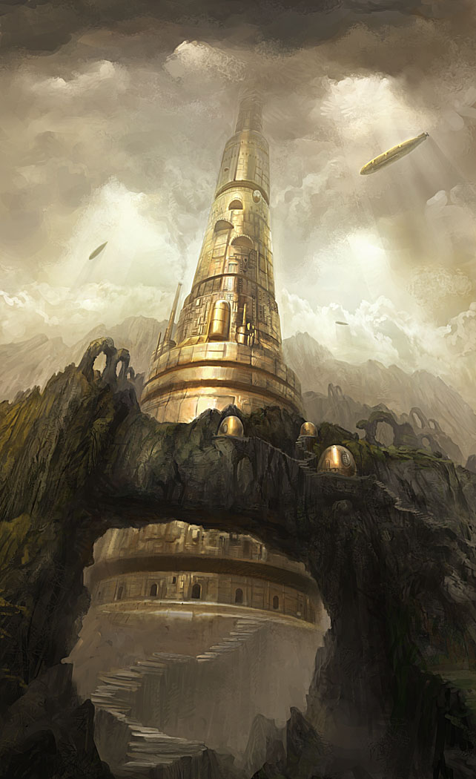
Towers of Hanoi
Legend has it that a group of Eastern monks are the keepers of three towers. On these towers sit 64 jewel encrusted golden rings. At the beginning of time all 64 rings were stacked on one tower with each ring smaller than the one beneath. The monks are to move the rings from this first tower to the third tower one at a time but never moving a larger ring on top of a smaller one. They can only move one ring per day, and once all 64 rings have all been moved, the world will come to an end.

Slide 10
Towers of Hanoi
Think of it recursively
Move a tower of size n
Assume you can move smaller towers
Take a stack of size n – 1
Move it onto the spare one
Move the bottom one over
And then move a stack of size n -1 on top
How do you move the smaller stack? Just the same way.

