Slide 1
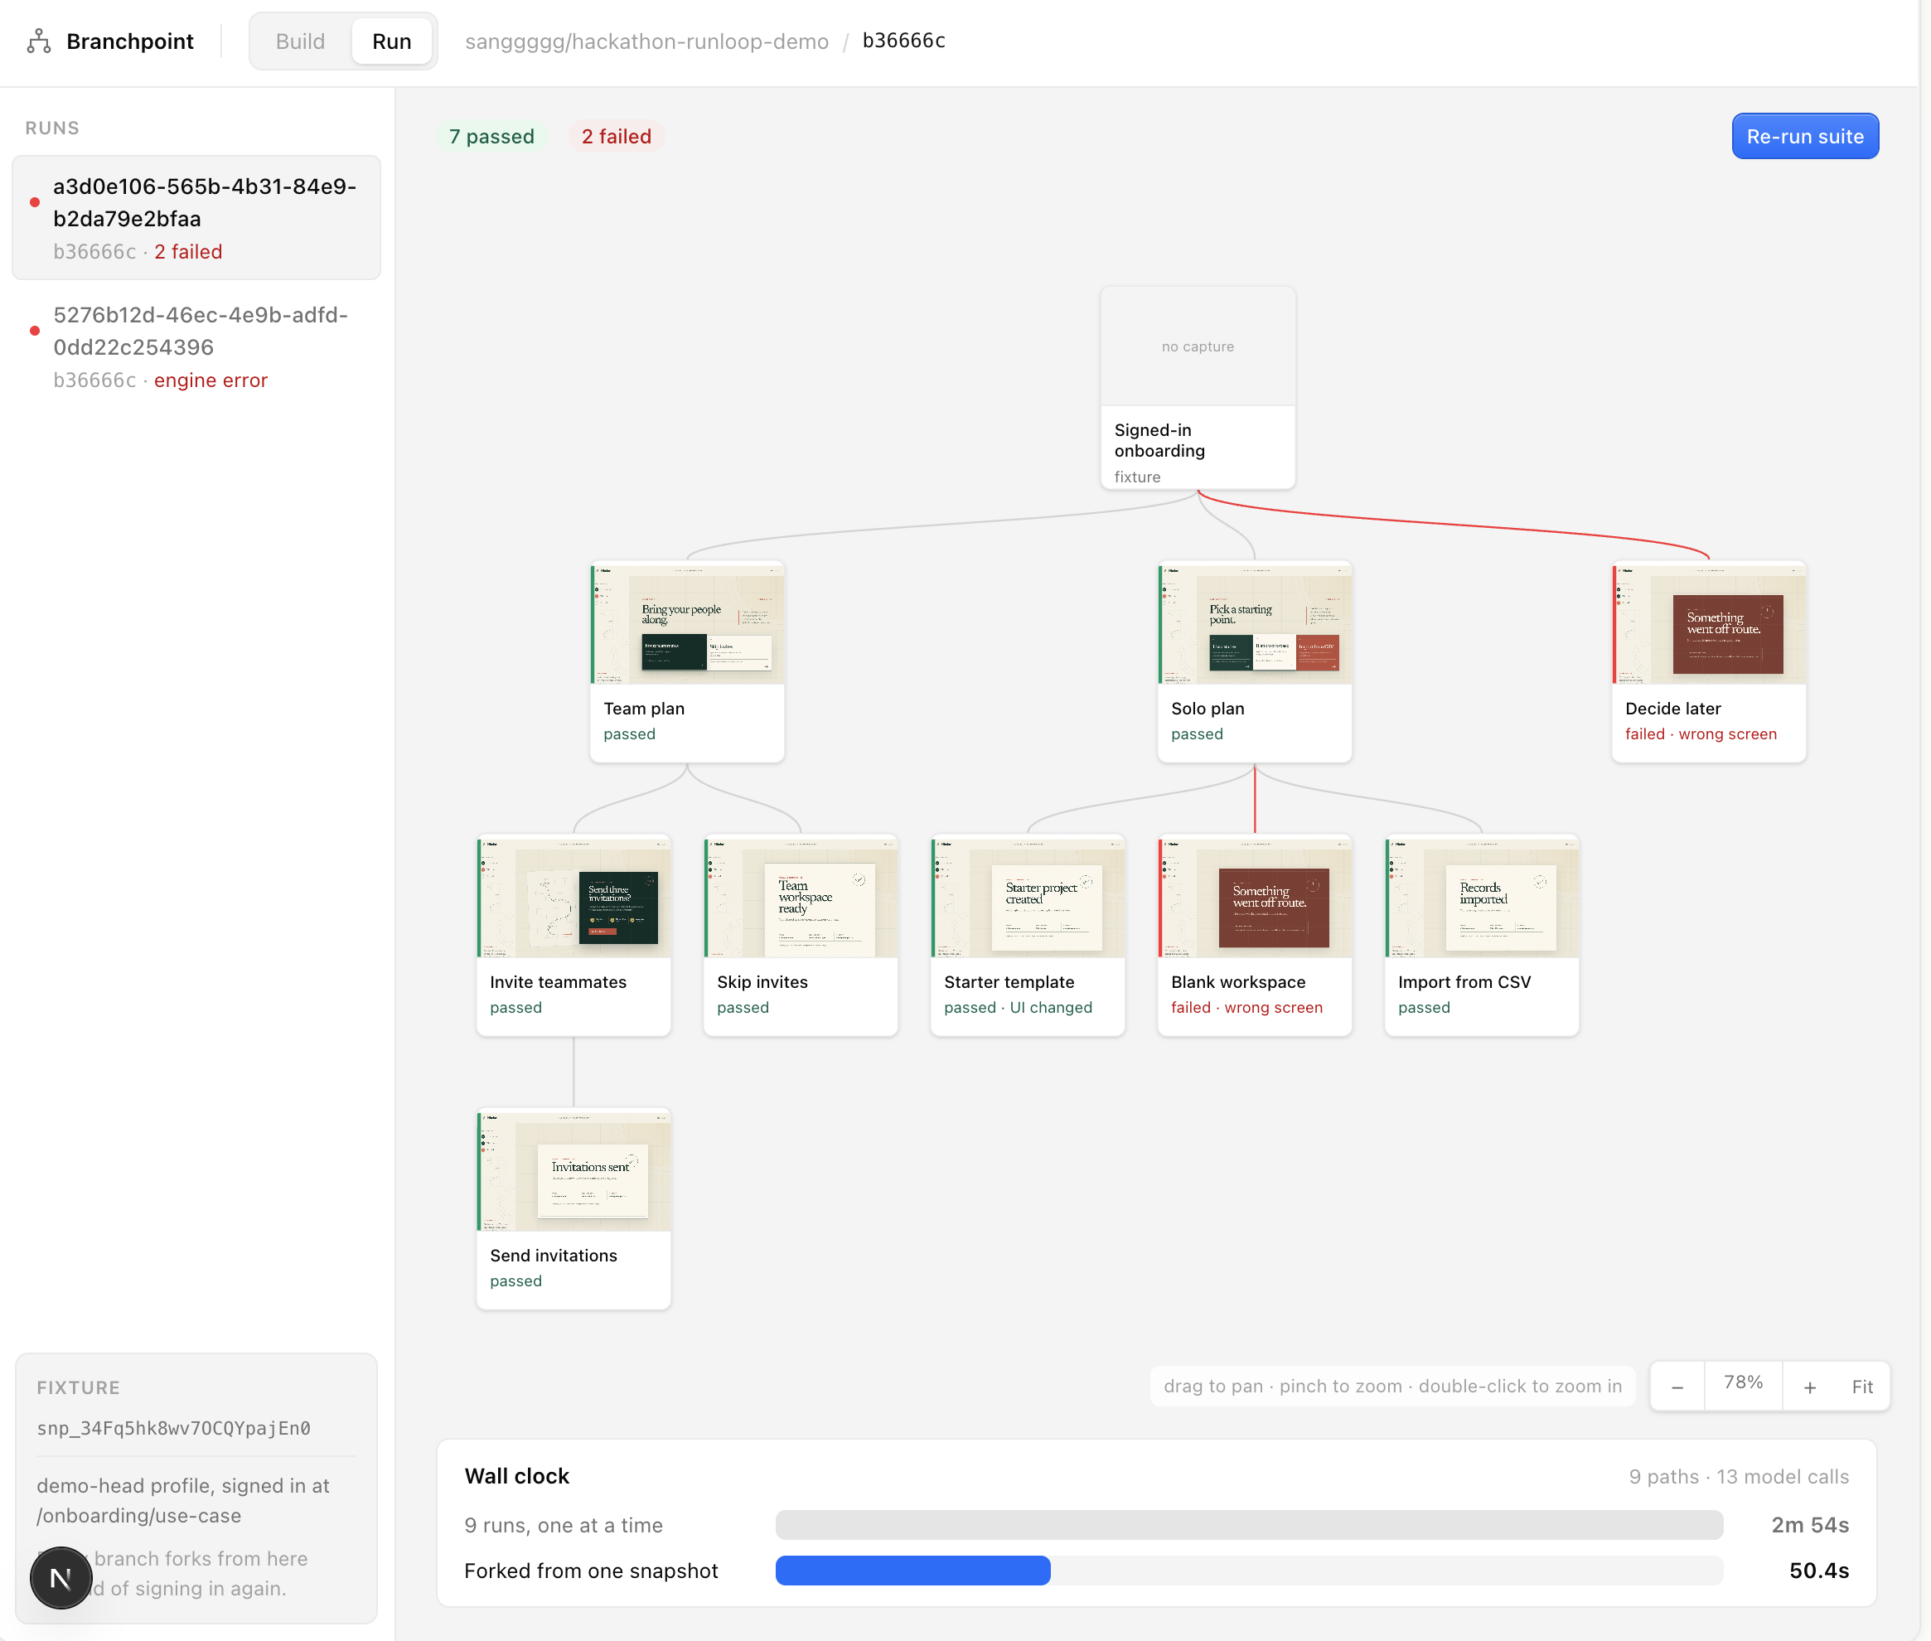
BRANCHPOINT
Browser QA,
branched at runtime.
Run setup once. Fork every scenario
from the exact same state.
Powered by Runloop
Notes:
Opening claim: expensive browser setup should happen once; every scenario should inherit the same state.
The screenshot is the actual Branchpoint Run screen supplied by the presenter, including the nested result tree and measured wall-clock comparison.
[Sources]
- /Users/sangmin/Desktop/hackathon-runloop/README.md
- /Users/sangmin/Desktop/Screenshot 2026-08-29 at 5.39.18 PM.png
[/Sources]

Slide 2
BRANCHPOINT
Fastest wall time. Lowest LLM cost.
3 controlled runs · Trials 1–3 · cold cache before every method
METHOD
ACTIVE SANDBOX
WALL TIME
LLM COST
Branchpoint
200s
66.8s
$0.150
shared prefix · source box + N−1 forks
1 sandbox · sequential
200s
171.6s
$0.198
one box · three complete trajectories
N sandboxes · fan-out
220s
76.1s
$0.188
three boxes · three complete trajectories
vs sequential · wall −61.1% · LLM −24.2% · sandbox equal
vs fan-out · wall −12.2% · sandbox −9.1% · LLM −20.3%
02
Notes:
This pitch view uses the first three consecutive controlled trials (Trials 1–3) and excludes Trials 4–5 from the slide's calculations. The three included trials compared the same Claude Sonnet 5 model, tools, task, three strategy prompts, and task-ready Runloop fixture. Immediately before every method in every trial, a unique nonce invalidated earlier provider prompt-cache entries; within that method, Anthropic's 5-minute ephemeral prompt cache remained enabled. OpenRouter whole-response caching was disabled and a sticky session kept requests on one provider endpoint. Branchpoint explored once, snapshotted, continued on the source devbox for one branch, and created only N-1 forks; sequential reset the task and ran all three complete trajectories on one devbox; fan-out ran three complete trajectories on three devboxes. Primary wall time is start-to-final-verdict. Sandbox time is the sum of Runloop /usage total_active_seconds after shutdown. LLM cost is the actual Anthropic upstream inference cost returned by OpenRouter for this BYOK account, including cache read/write pricing. Three-run means: Branchpoint 66.787s wall, 200 active sandbox-seconds, $0.150097 LLM cost; sequential 171.573s, 200s, $0.197894; fan-out 76.079s, 220s, $0.188262. Every method passed all three 8-test branches in all three included trials. Observed cache-read ratios were 77.99%, 77.39%, and 74.30% respectively.
[Sources]
- /Users/sangmin/Desktop/hackathon-runloop/experiments/three-way-benchmark.py
- /Users/sangmin/Desktop/hackathon-runloop/experiments/three-way-benchmark-trials-1-3.json
- https://docs.runloop.ai/api-reference/devbox/get-resource-usage-for-a-devbox
- https://openrouter.ai/docs/guides/best-practices/prompt-caching
- https://openrouter.ai/docs/cookbook/administration/usage-accounting
[/Sources]

Slide 3
BRANCHPOINT
03
The tree keeps branching as the agent discovers it.
Fork is a runtime event—not a one-shot fan-out.
Invite teammates
Team plan
FORK
#2
3
Skip invites
branchpoints
Starter template
SIGNED-IN
FIXTURE
FORK
#1
Solo plan
FORK
#3
6
Blank workspace
terminal paths
Import from CSV
N−1
Decide later
Skip onboarding
new boxes
at each fork
source box continues
new devbox from snapshot
Notes:
The fixture used in the experiment has three branchpoints: the signed-in root, Team plan, and Solo plan. Those branchpoints resolve into six terminal paths.
At every branchpoint, the current devbox continues as one child and only N−1 sibling devboxes are created from the snapshot.
Nested snapshots also preserve nested LLM transcript prefixes for prompt-cache reuse.
[Sources]
- /Users/sangmin/Desktop/hackathon-runloop/apps/web/lib/fixtures.ts
- /Users/sangmin/Desktop/hackathon-runloop/experiments/three-way-benchmark.py
[/Sources]

Slide 4
BRANCHPOINT
04
Snapshot only at real fork points.
Reuse the current box until a node actually fans out.
Invite teammates
2+ children
Team plan
SNAP
snapshot here
Skip invites
Starter template
1 child
SIGNED-IN
FIXTURE
SNAP
Solo plan
SNAP
stay on same box
Blank workspace
Import from CSV
shared LLM prefix
→ cache reuse
Decide later
Skip onboarding
Notes:
The executor is recursive: snapshot only when the current node has two or more children; a single-child chain stays on the same devbox.
Nested forks create nested cacheable transcript prefixes, so the infrastructure and LLM optimization follow the same execution tree.
[Sources]
- /Users/sangmin/Desktop/hackathon-runloop/docs/build-spec.html — Engine: how a run walks the tree
- /Users/sangmin/Desktop/hackathon-runloop/apps/web/lib/fixtures.ts
[/Sources]

Slide 5
BRANCHPOINT
05
Every commit returns a visual QA tree.
Green = intact · Red = regression · Blue = new path
Invite teammates ✓
Team plan ✓
Stop resetting.
Start branching.
Skip invites ✓
Starter · UI changed
One prepared state.
Every scenario.
SIGNED-IN
FIXTURE
Solo plan ✓
Blank workspace ✕
Import CSV · NEW
$ branchpoint run
--suite nimbus-onboarding
Decide later ✕
Skip onboarding · TBD
Powered by Runloop
Notes:
The result tree maps the actual fixture hierarchy and reports intact journeys, app regressions, newly discovered paths, and unresolved branches.
Close on the execution model: stop recreating state for every scenario; branch from one prepared state instead.
[Sources]
- /Users/sangmin/Desktop/hackathon-runloop/apps/web/lib/fixtures.ts
- /Users/sangmin/Desktop/hackathon-runloop/apps/cli/README.md
[/Sources]

