Slide 1

PowerShell 기본 기능
2020 / 8 / 6
조상호

Slide 2

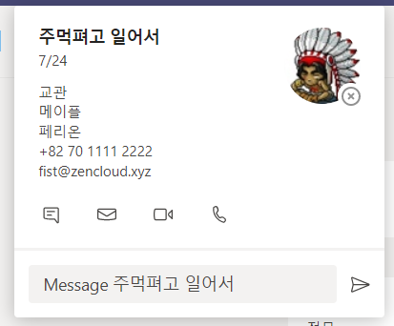


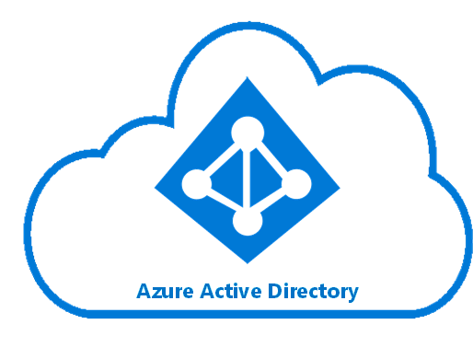
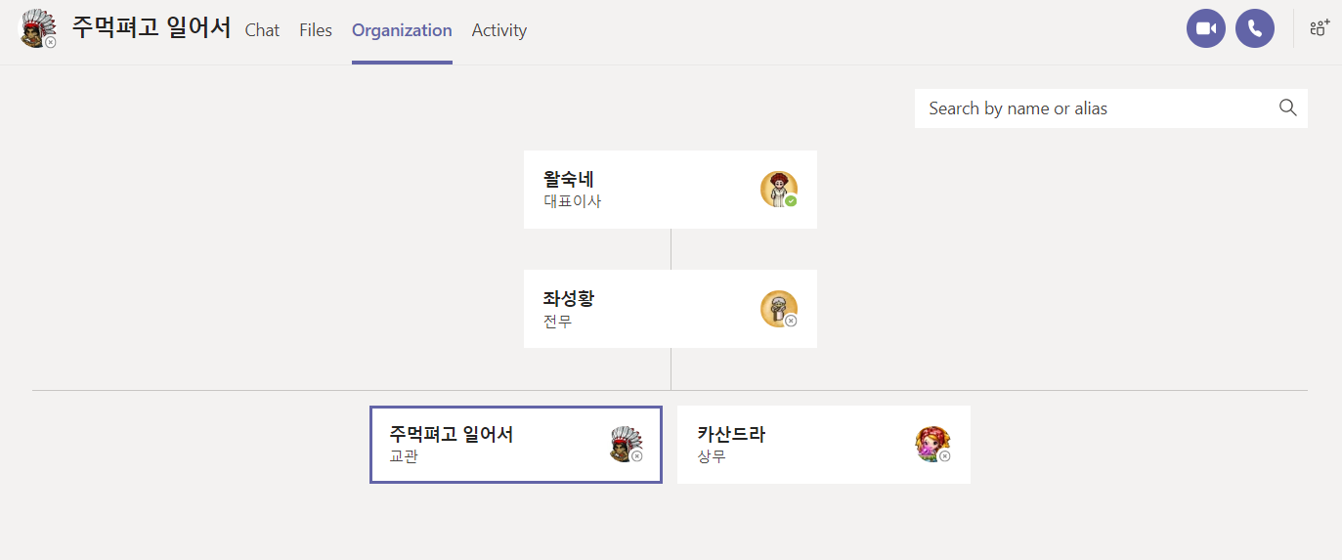
요약
PowerShell Script
인사 DB
CSV

Slide 3
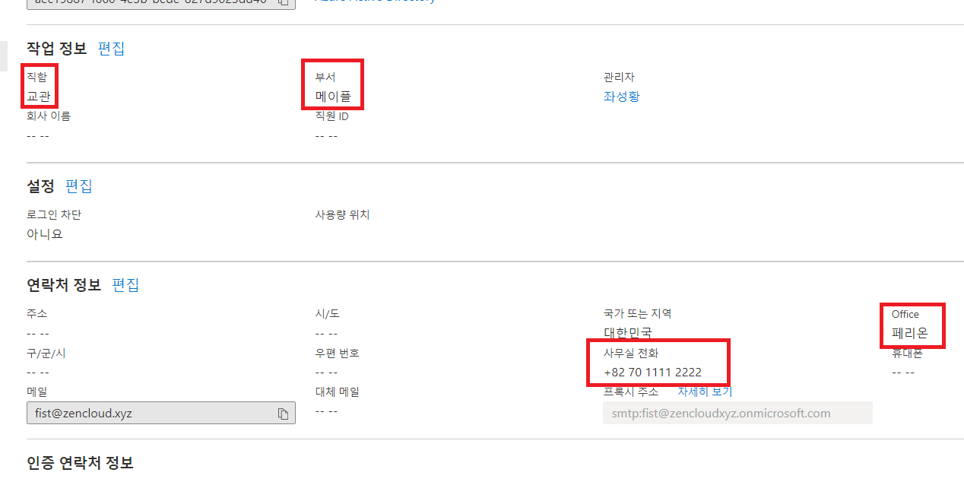
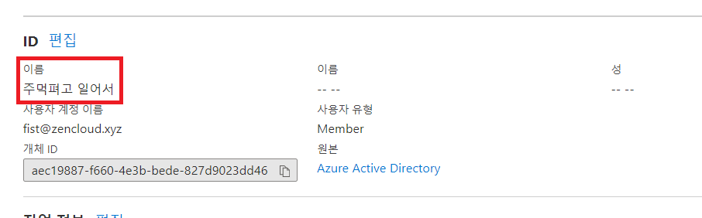
필드
DisplayName
Title
Department
Office
Phone

Slide 4
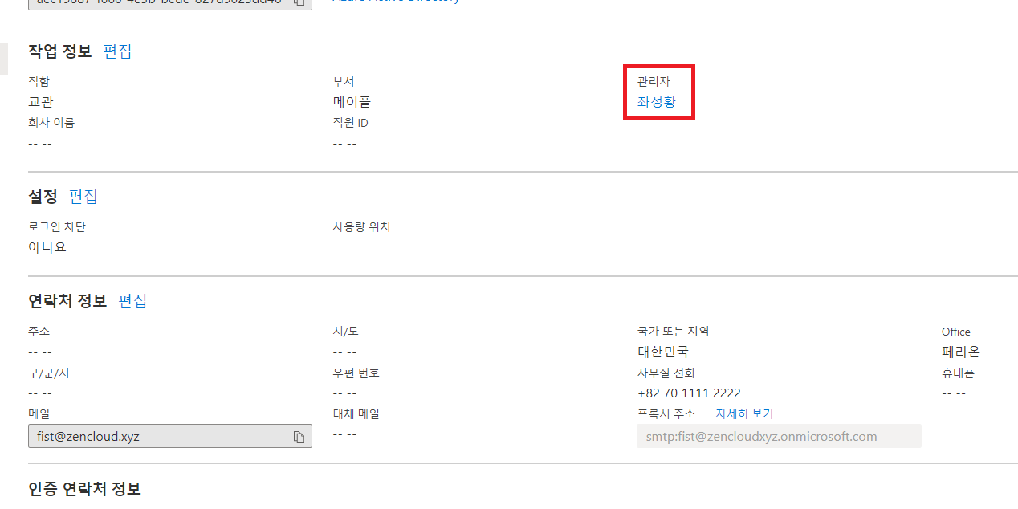
필드
Manager:””
Manager:왈숙네
Manager:좌성황
Manager:좌성황

Slide 5
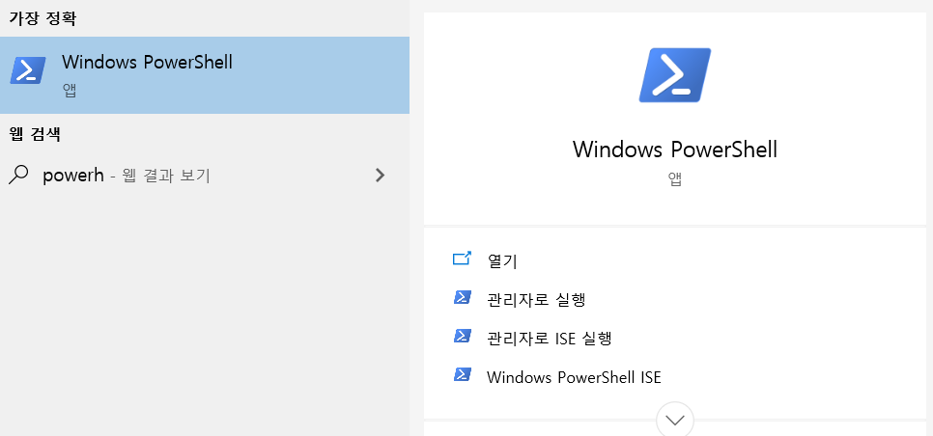
PowerShell
What is PowerShell? -https://docs.microsoft.com/en-us/powershell/scripting/overview?view=powershell-7

Slide 6
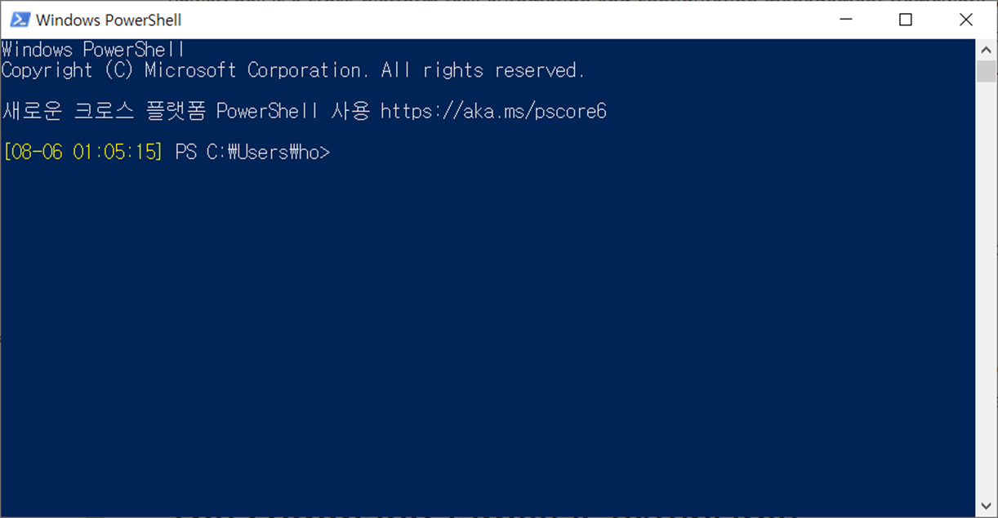
PowerShell
What is PowerShell? -https://docs.microsoft.com/en-us/powershell/scripting/overview?view=powershell-7

Slide 7
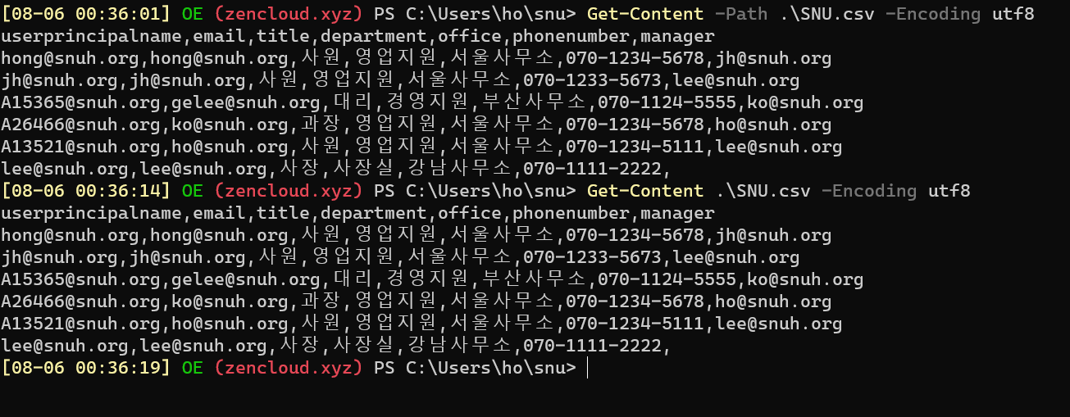
PowerShell Cmdlet
Get-Content #cat
Notes:
#CSV Sample
userprincipalname,email,title,department,office,phonenumber,manager
hong@contoso.org,hong@contoso.org,사원,영업지원,서울사무소,070-1234-5678,jh@contoso.org
jh@contoso.org,jh@contoso.org,사원,영업지원,서울사무소,070-1233-5673,lee@contoso.org
A15365@contoso.org,gelee@contoso.org,대리,경영지원,부산사무소,070-1124-5555,ko@contoso.org
A26466@contoso.org,ko@contoso.org,과장,영업지원,서울사무소,070-1234-5678,ho@contoso.org
A13521@contoso.org,ho@contoso.org,사원,영업지원,서울사무소,070-1234-5111,lee@contoso.org
lee@contoso.org,lee@contoso.org,사장,사장실,강남사무소,070-1111-2222,

Slide 8
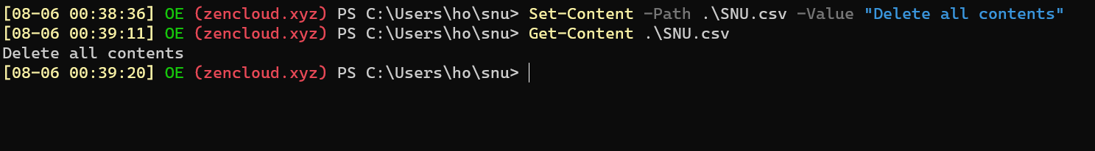
PowerShell Cmdlet
Set-Content #cat > snu.csv

Slide 9
PowerShell Cmdlet
명사
동사
Get-Content –Path “SNU.csv”
목적어
Cmdlet Overview -https://docs.microsoft.com/ko-kr/powershell/scripting/developer/cmdlet/cmdlet-overview?view=powershell-7

Slide 10
PowerShell Cmdlet
동사
명사
Set-Content –Path “SNU.csv” –Value “test”
목적어 1
목적어 2
Cmdlet Overview -https://docs.microsoft.com/ko-kr/powershell/scripting/developer/cmdlet/cmdlet-overview?view=powershell-7

Slide 11
PowerShell Cmdlet
Set-User –Identity fist@zencloud.xyz –Manager jumo@zencloud.xyz
Cmdlet Overview -https://docs.microsoft.com/ko-kr/powershell/scripting/developer/cmdlet/cmdlet-overview?view=powershell-7

Slide 12
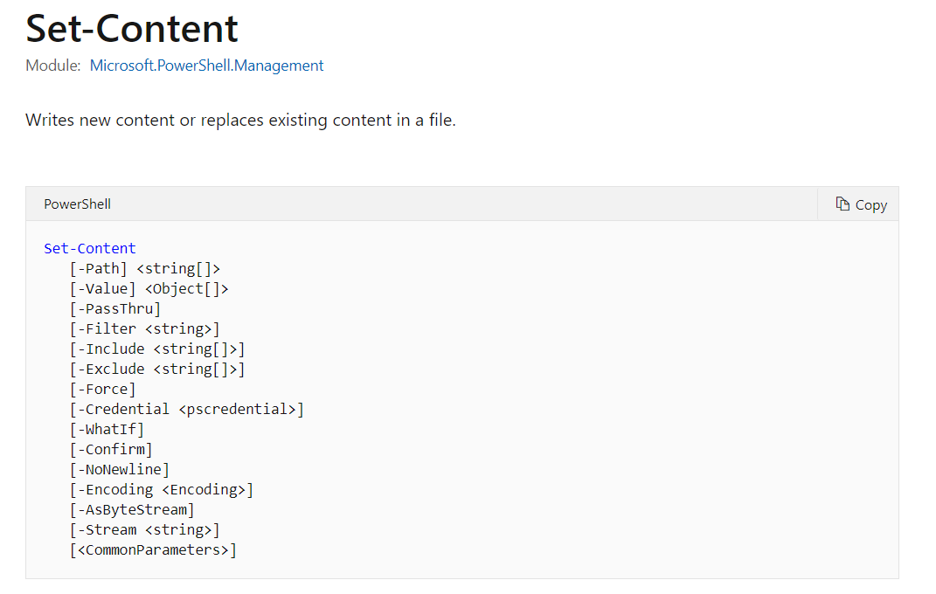
PowerShell Cmdlet – Man page
Set-Content - https://docs.microsoft.com/en-us/powershell/module/microsoft.powershell.management/set-content?view=powershell-7

Slide 13
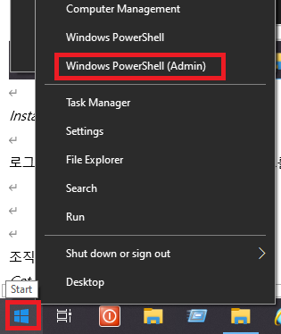
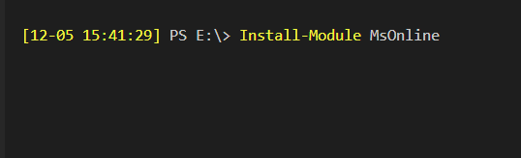
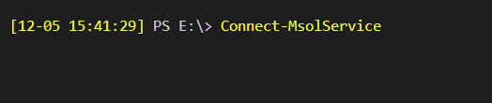
PowerShell 연결 – Office 365
관리자 권한 PowerShell 실행
Install-Module MSOnline #최초 1회 모듈 설치
Connect-MsolSerivce
Connect to Microsoft 365 with PowerShell - https://docs.microsoft.com/ko-kr/office365/enterprise/powershell/connect-to-office-365-powershell

Slide 14
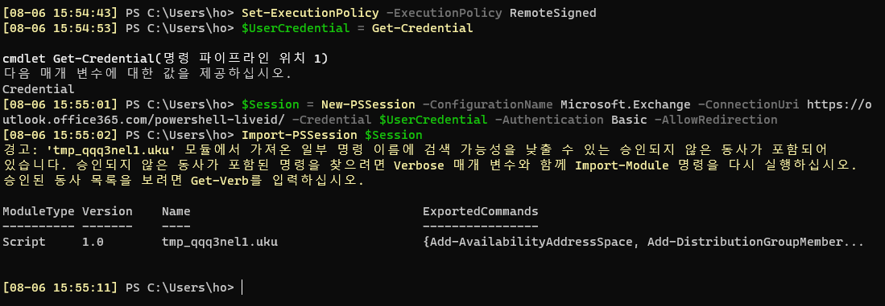
PowerShell 연결 – Exchange Online
관리자 권한 PowerShell 실행
Set-ExecutionPolicy -ExecutionPolicy RemoteSigned
$UserCredential = Get-Credential
$Session = New-PSSession -ConfigurationName Microsoft.Exchange -ConnectionUri
https://outlook.office365.com/powershell-liveid/ -Credential $UserCredential -Authentication Basic -AllowRedirection
Import-PSSession $Session
Connect to Exchange Online PowerShell with Basic authentication - https://docs.microsoft.com/ko-kr/powershell/exchange/connect-to-exchange-online-powershell?view=exchange-ps

Slide 15
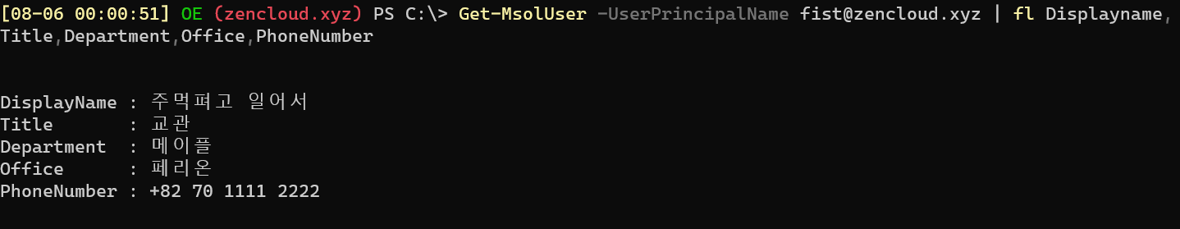
필드
Get-MsolUser - https://docs.microsoft.com/en-us/powershell/module/msonline/get-msoluser?view=azureadps-1.0

Slide 16
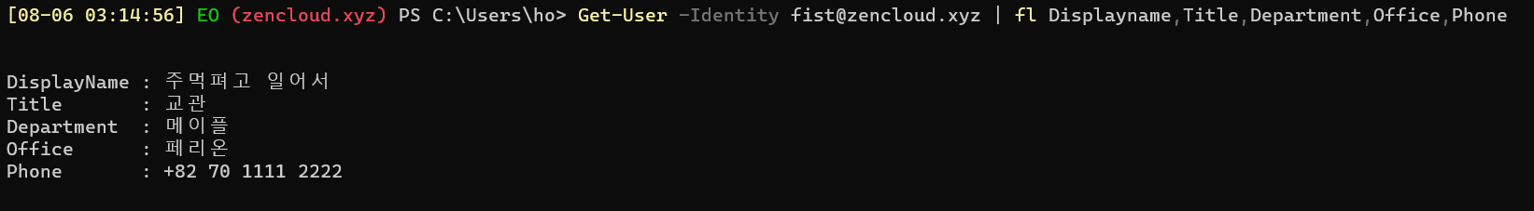
필드
Get-User - https://docs.microsoft.com/en-us/powershell/module/exchange/get-user?view=exchange-ps

Slide 17
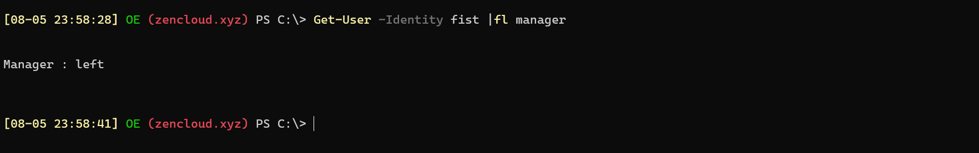
필드
Get-User - https://docs.microsoft.com/en-us/powershell/module/exchange/get-user?view=exchange-ps

Slide 18
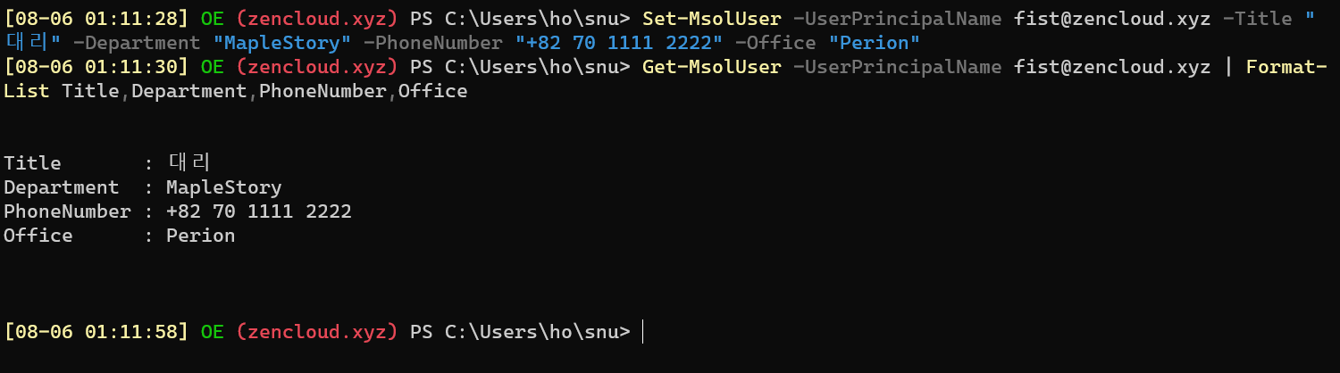
속성 변경
Set-MsolUser -UserPrincipalName fist@zencloud.xyz –Title
"대리" -Department "MapleStory" -PhoneNumber "+82 70 1111 2222" -Office "Perion"
Set-MsolUser - https://docs.microsoft.com/en-us/powershell/module/msonline/set-msoluser?view=azureadps-1.0
Format-List - https://docs.microsoft.com/en-us/powershell/module/microsoft.powershell.utility/format-list?view=powershell-7

Slide 19
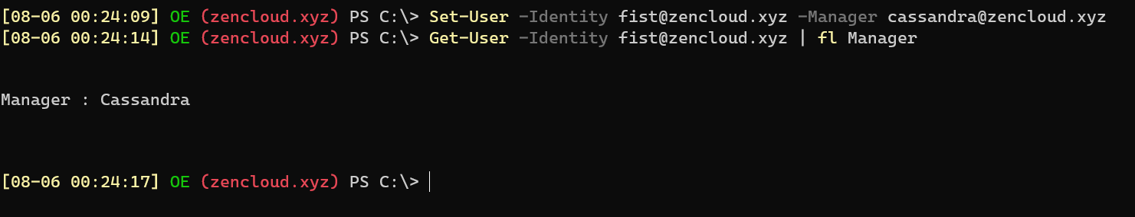
속성 변경
Set-User -Identity fist@zencloud.xyz -Manager Cassandra@zencloud.xyz
Set-User - https://docs.microsoft.com/ko-kr/powershell/module/exchange/set-user?view=exchange-ps

Slide 20
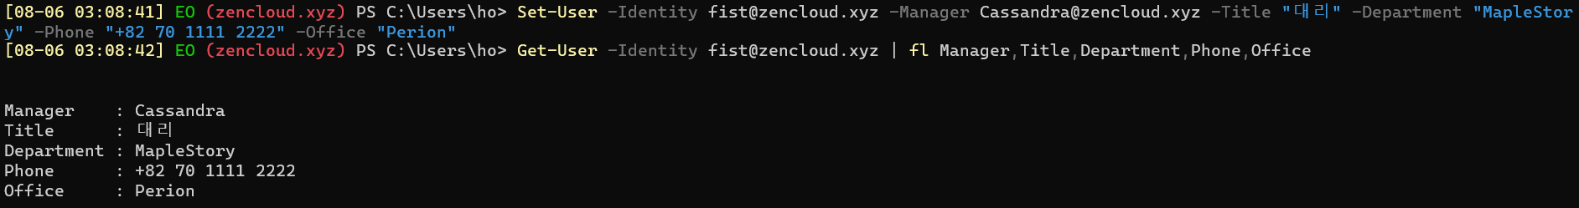
속성 변경
Set-User -Identity fist@zencloud.xyz -Manager Cassandra@zencloud.xyz -Title
"대리" -Department "MapleStory" -Phone "+82 70 1111 2222" -Office "Perion"
Set-User - https://docs.microsoft.com/ko-kr/powershell/module/exchange/set-user?view=exchange-ps

Slide 21
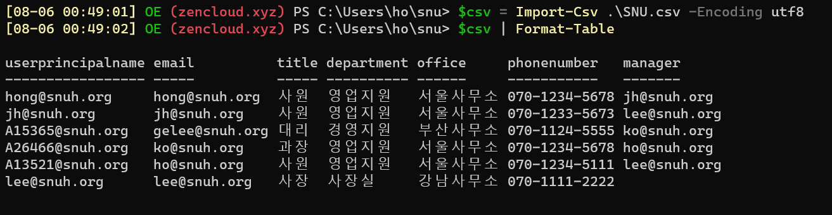
CSV import
$csv = Import-Csv ./SNU.csv –Encoding UTF8
Import-Csv - https://docs.microsoft.com/en-us/powershell/module/microsoft.powershell.utility/import-csv?view=powershell-7
Format-Table - https://docs.microsoft.com/en-us/powershell/module/microsoft.powershell.utility/format-table?view=powershell-7

Slide 22
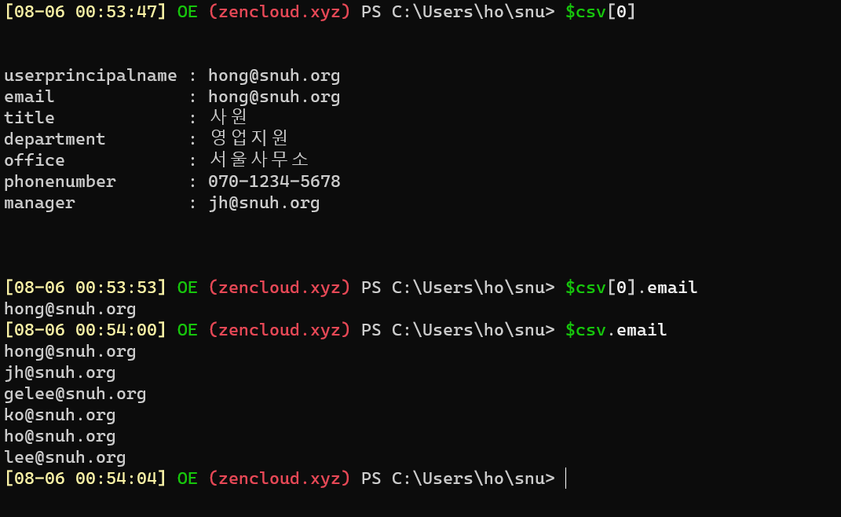
CSV import
가져온 CSV 데이터에 접근
Import-Csv - https://docs.microsoft.com/en-us/powershell/module/microsoft.powershell.utility/import-csv?view=powershell-7

Slide 23
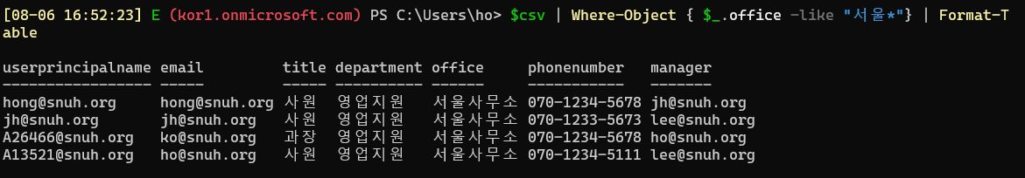
Where-Object
데이터 필터링
$csv | Where-Object { $_.office -like "서울*"} | Format-Table # Office 속성이 “서울”로 시작하는 데이터
Where-Object-https://docs.microsoft.com/en-us/powershell/module/microsoft.powershell.core/where-object?view=powershell-7

Slide 24
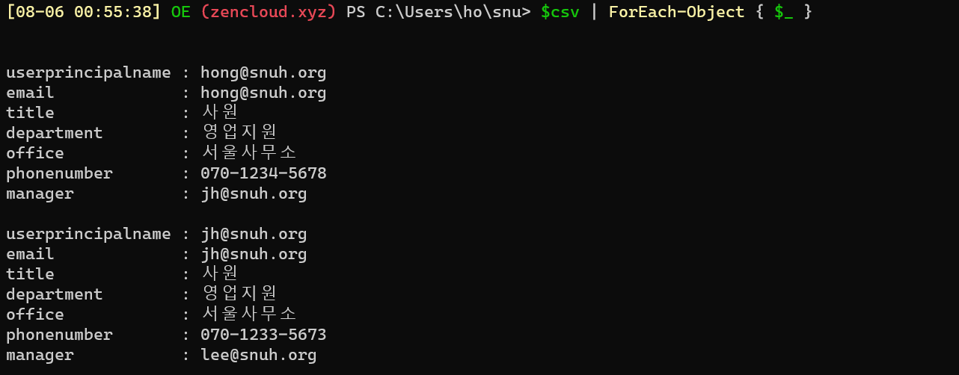
Foreach
$csv | ForEach-Object { $_ }
ForEach-Object - https://docs.microsoft.com/en-us/powershell/module/microsoft.powershell.core/foreach-object?view=powershell-7

Slide 25
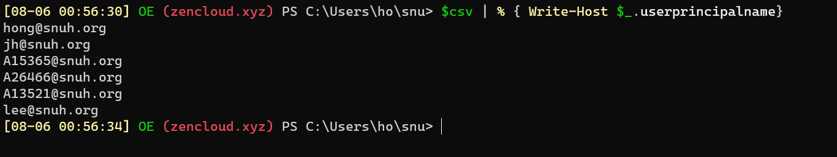
Foreach
$csv | % { Write-Host $_.userprincipalname}
ForEach-Object - https://docs.microsoft.com/en-us/powershell/module/microsoft.powershell.core/foreach-object?view=powershell-7

Slide 26
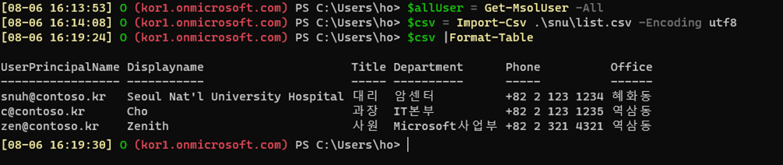
비교
$allUser = Get-MsolUser –All #모든 사용자 리스트 가져오기
$csv = Import-Csv .\snu\list.csv –Encoding utf8 #CSV 가져오기
$csv | Format-List #CSV 확인
ForEach-Object - https://docs.microsoft.com/en-us/powershell/module/microsoft.powershell.core/foreach-object?view=powershell-7

Slide 27
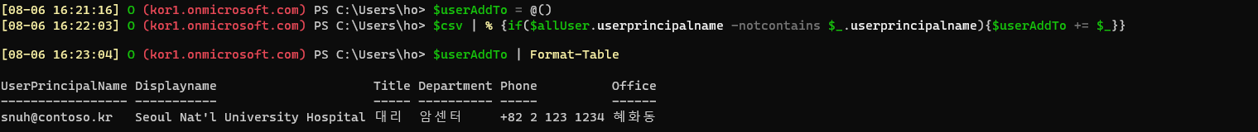
비교
$userAddTo = @() #빈 배열 생성
$csv | % {if($allUser.userprincipalname -notcontains $_.userprincipalname){$userAddTo += $_}}
#csv 목록의 UserPrincipalName 과 $allUser.UserPrincipalName을 비교해서, $allUser 목록에 없는 사용자는 $userAddto에 추가
$userAddTo = @() #추가할 사용자 확인
ForEach-Object - https://docs.microsoft.com/en-us/powershell/module/microsoft.powershell.core/foreach-object?view=powershell-7

Slide 28
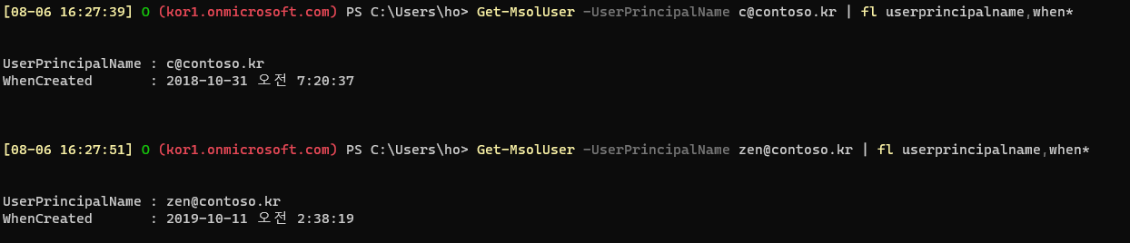
비교
c@contoso.kr, zen@contoso.kr은 이미 존재하는 계정이므로 $userAddTo에 추가되지 않음
ForEach-Object - https://docs.microsoft.com/en-us/powershell/module/microsoft.powershell.core/foreach-object?view=powershell-7

Slide 29
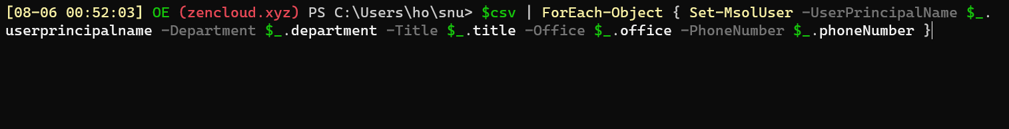
일괄 속성 변경
$csv | ForEach-Object { Set-MsolUser -UserPrincipalName $_.userprincipalname -Department $_.department –Title
$_.title -Office $_.office -PhoneNumber $_.phoneNumber }
Set-MsolUser - https://docs.microsoft.com/en-us/powershell/module/msonline/set-msoluser?view=azureadps-1.0

Slide 30
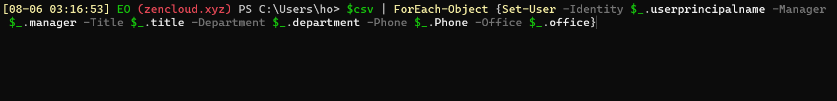
일괄 속성 변경
$csv | ForEach-Object {Set-User -Identity $_.userprincipalname -Manager $_.manager -Title
$_.title -Department $_.department -Phone $_.Phone -Office $_.office}
Set-MsolUser - https://docs.microsoft.com/en-us/powershell/module/msonline/set-msoluser?view=azureadps-1.0

Slide 31
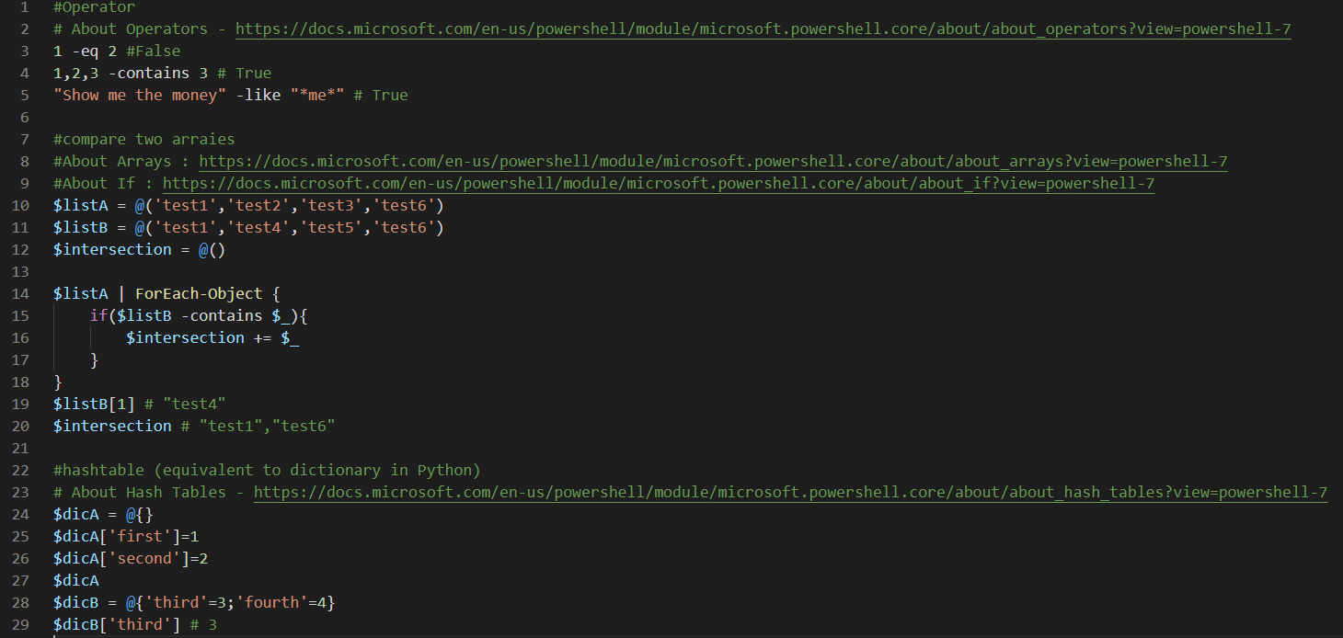
Notes:
기본 연산자 / 배열 / 딕셔너리 사용 예시
#Operator
# About Operators - https://docs.microsoft.com/en-us/powershell/module/microsoft.powershell.core/about/about_operators?view=powershell-7
1 -eq 2 #False
1,2,3 -contains 3 # True
"Show me the money" -like "*me*" # True
#compare two arraies
#About Arrays : https://docs.microsoft.com/en-us/powershell/module/microsoft.powershell.core/about/about_arrays?view=powershell-7
#About If : https://docs.microsoft.com/en-us/powershell/module/microsoft.powershell.core/about/about_if?view=powershell-7
$listA = @('test1','test2','test3','test6')
$listB = @('test1','test4','test5','test6')
$intersection = @()
$listA | ForEach-Object {
if($listB -contains $_){
$intersection += $_
}
}
$listB[1] # "test4"
$intersection # "test1","test6"
#hashtable (equivalent to dictionary in Python)
# About Hash Tables - https://docs.microsoft.com/en-us/powershell/module/microsoft.powershell.core/about/about_hash_tables?view=powershell-7
$dicA = @{}
$dicA['first']=1
$dicA['second']=2
$dicA
$dicB = @{'third'=3;'fourth'=4}
$dicB['third'] # 3

Slide 32
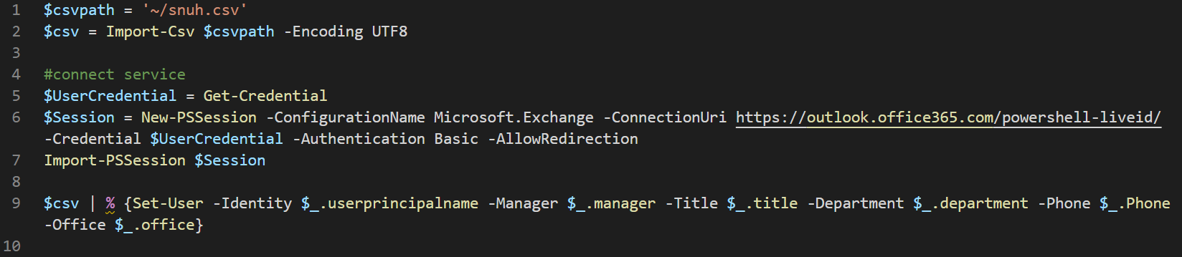
Notes:
Exchange Online PowerShell에 접속하여 사용자 속성 수정
$csvpath = '~/contoso.csv'
$csv = Import-Csv $csvpath -Encoding UTF8
#connect service
$UserCredential = Get-Credential
$Session = New-PSSession -ConfigurationName Microsoft.Exchange -ConnectionUri https://outlook.office365.com/powershell-liveid/ -Credential $UserCredential -Authentication Basic -AllowRedirection
Import-PSSession $Session
$csv | % {Set-User -Identity $_.userprincipalname -Manager $_.manager -Title $_.title -Department $_.department -Phone $_.Phone -Office $_.office}

Slide 33
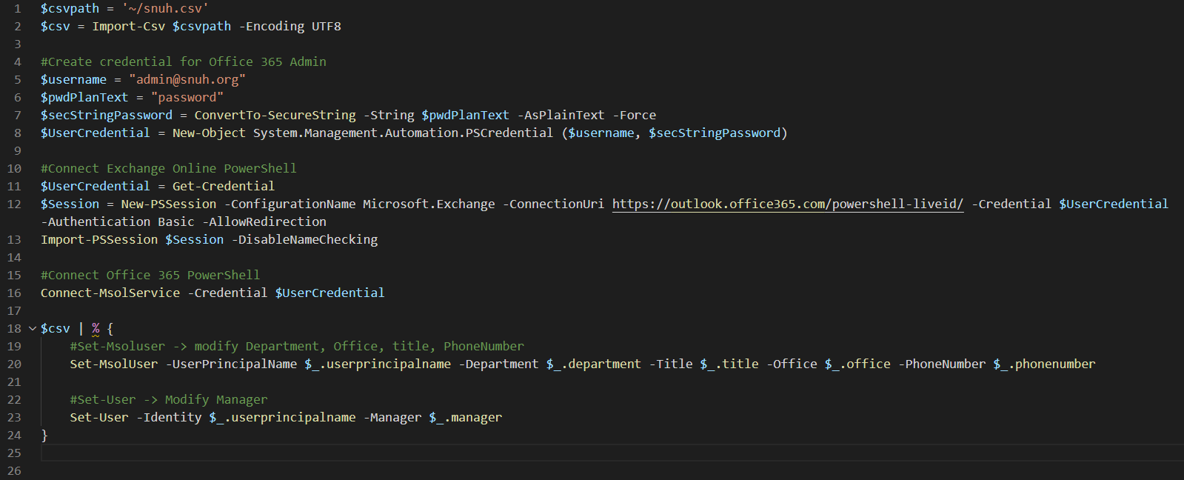
Notes:
Exchange Online / Office 365 PowerShell에 접속하여 사용자 속성 수정 (하나의 창에서 두 서비스에 동시 접속 가능)
$csvpath = '~/contoso.csv'
$csv = Import-Csv $csvpath -Encoding UTF8
#Create credential for Office 365 Admin
$username = "admin@contoso.org"
$pwdPlanText = "password"
$secStringPassword = ConvertTo-SecureString -String $pwdPlanText -AsPlainText -Force
$UserCredential = New-Object System.Management.Automation.PSCredential ($username, $secStringPassword)
#Connect Exchange Online PowerShell
$UserCredential = Get-Credential
$Session = New-PSSession -ConfigurationName Microsoft.Exchange -ConnectionUri https://outlook.office365.com/powershell-liveid/ -Credential $UserCredential -Authentication Basic -AllowRedirection
Import-PSSession $Session -DisableNameChecking
#Connect Office 365 PowerShell
Connect-MsolService -Credential $UserCredential
$csv | % {
#Set-Msoluser -> modify Department, Office, title, PhoneNumber
Set-MsolUser -UserPrincipalName $_.userprincipalname -Department $_.department -Title $_.title -Office $_.office -PhoneNumber $_.phonenumber
#Set-User -> Modify Manager
Set-User -Identity $_.userprincipalname -Manager $_.manager
}

Slide 34
참고 자료
사용자 생성 / 제거 / 라이선스 관리를 위한 cmdlet
MSOnline - https://docs.microsoft.com/en-us/powershell/module/msonline/?view=azureadps-1.0#msonline
New-MsolUser - https://docs.microsoft.com/en-us/powershell/module/msonline/new-msoluser?view=azureadps-1.0
Create Microsoft 365 user accounts with PowerShell - https://docs.microsoft.com/ko-kr/office365/enterprise/powershell/create-user-accounts-with-office-365-powershell
Remove-MsolUser - https://docs.microsoft.com/en-us/powershell/module/msonline/remove-msoluser?view=azureadps-1.0
Delete Microsoft 365 user accounts with PowerShell - https://docs.microsoft.com/ko-kr/office365/enterprise/powershell/delete-and-restore-user-accounts-with-office-365-powershell
Set-MsolUserLicense - https://docs.microsoft.com/en-us/powershell/module/msonline/set-msoluserlicense?view=azureadps-1.0
Assign Microsoft 365 licenses to user accounts with PowerShell - https://docs.microsoft.com/ko-kr/office365/enterprise/powershell/assign-licenses-to-user-accounts-with-office-365-powershell
View Microsoft 365 account license and service details with PowerShell - https://docs.microsoft.com/ko-kr/office365/enterprise/powershell/view-account-license-and-service-details-with-office-365-powershell
View Microsoft 365 licenses and services with PowerShell - https://docs.microsoft.com/ko-kr/office365/enterprise/powershell/view-licenses-and-services-with-office-365-powershell
Set-MsolUserPrincipalName - https://docs.microsoft.com/en-us/powershell/module/msonline/set-msoluserprincipalname?view=azureadps-1.0
Set-MsolUserPassword - https://docs.microsoft.com/en-us/powershell/module/msonline/set-msoluserpassword?view=azureadps-1.0

