Slide 1
Lecture 4-Python(Functions)
by-Pratik Sanghvi

Slide 2
Why functions ?
Most of the time, while writing program you will repeat the code. In order to avoid repetition and make the program structured, you can use functions
Functions alter the execution of the program flow
Creating new functions gives you an opportunity to name a group of statements, which makes your program easier to read and debug

Slide 3
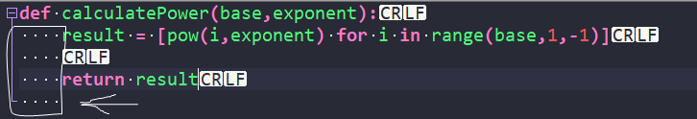
Function Calls
What is a function ? a function is a named sequence of statements that performs a computation
A function call is a simple execution of a function in a statement eg: type(32). Here type is a function
The result of the function is called the return value

Slide 4
Type Conversion functions
These are built in functions which help you to convert value from one type to another
Eg: int(), float(), str(),bool(), bin()
Eg: int(‘32’) → 32 , str(3.14159) → '3.14159'
Note: Usually ValueError is encountered while using these type conversion functions. So be careful with the value you are passing to these functions.

Slide 5
Math Functions
All the Math functions are stored in the math module
Module can be imported with statement import math
On printing the math module we get the following output:
Print(math) → <module 'math' (built-in)>
One of the examples of the math functions are:
math.sqrt(2) / 2.0 → 0.707106781187

Slide 6
Composition
This topic emphasizes on how we compose our program using constructs like variables, expressions, statements and values
One such case is that argument to the function can be composed of quite complex expressions
Eg: x = math.sin(degrees / 360.0 * 2 * math.pi)
Composition focuses on how you can legally compose the program by following the syntactical rules. Like on the left side of ‘=’ you can only have a variable etc.

Slide 7
Adding new functions
New and custom functions can be created using the def keyword
Eg: def addNumbers(a,b): return a+b
The rules for function names are the same as for variable names: letters, numbers and some punctuation marks are legal, but the first character can’t be a number
The empty parenthesis after a function indicates no arguments to that function
The first line of the function is called the header and the rest is called body
The function header must be terminated with a “:” and the body should be indented by 4 spaces

Slide 8
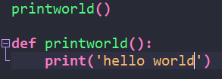
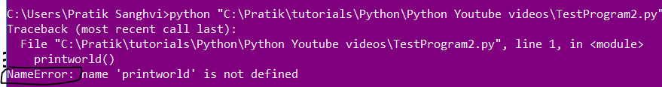
Definitions and Uses
The point to be emphasized here is that the function should be defined before it is used.
If you make a function call before defining it, you will get a NameError message in the program
Program
Error message

Slide 9
Flow of Execution
Execution always begins at the first statement of the program
Statements are executed one at a time, in order from top to bottom
A function call is like a detour in the flow of execution. It jumps to the function body, executes it and then returns back
So whenever you read a program, read it by keeping the flow of execution in mind
This is the errored program from last slide. We are getting this error because
The statement execution is from top to bottom starting from first line.
Note: Trace module can be useful for tracing the flow of the program[LINK]

Slide 10
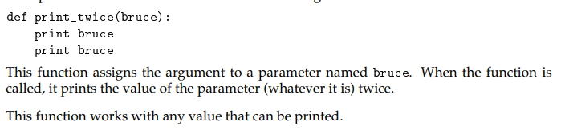
Parameters and arguments
When you call a function, the values passed to it is called as arguments
Inside the function the values are assigned to variables called parameters
Example of a function with parameter bruce

Slide 11
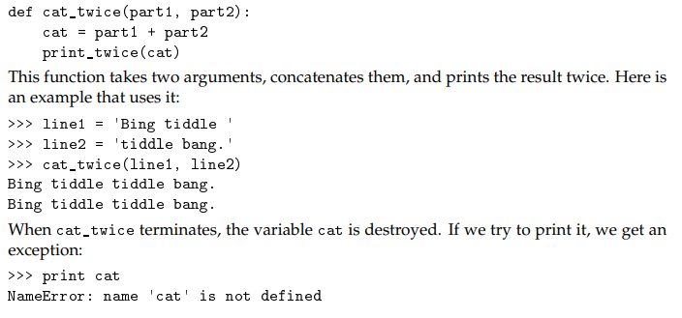
Variables and parameters are local
When you create a variable inside a function, it is local, which means that it only exists inside the function
When trying to print cat, we encounter error because the scope of the cat variable is only limited to the function definition body.
If you want to access the variables inside a function, then return the value back with a return statement.

Slide 12
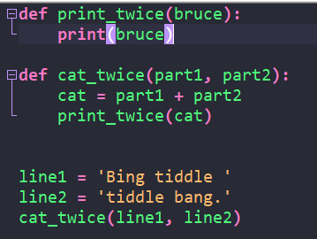
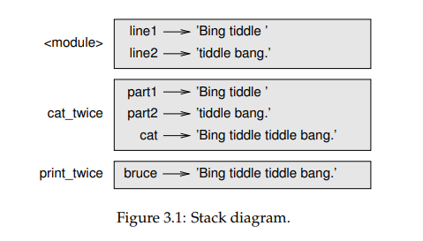
Stack Diagrams
Stack diagrams show the value of each variable, but they also show the function each variable belongs to.
Each function is represented by a frame
A frame is a box with the name of a function beside it and the parameters and variables of the function inside it
Notes:
Note: when python displays error , then also the sequence of the function starts from the outer most to the inner most.

Slide 13
Fruitful function and void functions
Functions which return result are called fruitful functions eg: math.sin(), math.cos()
Void functions are the ones which return none or nothing eg: print()
A user can define both void and fruitful functions

Slide 14
Importing with from
In a python program imports can be made at any line
There are two types of imports: a. using import b. using from
Generally we import modules using the import keyword
But if we want to import some specific modules we can use the
From<module> import <function name> construct
Eg: from sklearn.preprocessing.text import CountVectorizer
Note: The advantage of importing everything from the math module is that your code can be more concise. The disadvantage is that there might be conflicts between names defined in different modules, or between a name from a module and one of your variables.

Slide 15
Return Values
In Python functions, you can return values using return keyword
But you can also return multiple values separated with comma
Eg: def calcValues(bag, product): return total, discount, price
When there are multiple values in the return statement, the return object will be a tuple which you need to unpack
Eg: Total, discount, price = calcValues(bag, product)
You can have multiple return statements in a function

Slide 16
Incremental development
Incremental development is to develop code by adding only few statements at a time
The goal of incremental development is to avoid long debugging sessions by adding and testing only a small amount of code at a time.
The key aspects of the process are:
1. Start with a working program and make small incremental changes. At any point, if
there is an error, you should have a good idea where it is.
2. Use temporary variables to hold intermediate values so you can display and check
them.
3. Once the program is working, you might want to remove some of the scaffolding or
consolidate multiple statements into compound expressions, but only if it does not
make the program difficult to read.

Slide 17
Composition for a function
The ability to call one function within another is called composition
Here the cat_twice function calls print_twice function.
We can say that the cat_twice function follows the composition principle.

Slide 18
Boolean functions
These are the functions which return a Boolean value
Eg: str.isalpha()
isalpha() checks whether the string contains only letters and no special symbols
It will return true or false based on the evaluation of the function

Slide 19
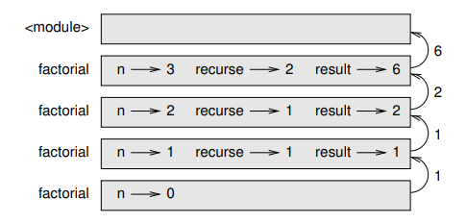
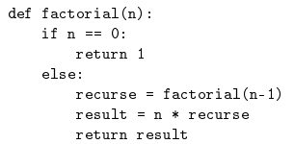
More recursion
Recursive function is a function which calls itself
Recursive function
Stack Diagram

Slide 20
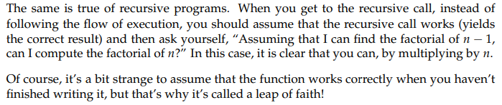
Leap of Faith
Leap of faith basically means that assuming a function call works correctly and then moving ahead in the flow of execution
We are practicing this leap of faith concept through the use of functions like math.pow or math.sin etc
Writing recursive program can be easier by assuming that the recursive call works and then moving ahead with the other part of the program

Slide 21
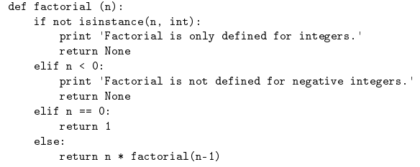
Checking types
Checking the type of the argument or the type of a variable is known as checking types
We need to check the type because in many cases we want to stop our processing when a certain type of element or value is reached. Or we want to exit the function call when a proper input is not provided
We can use the isinstance() and type() function to check the type of the variable
Problem of infinite recursion solved
Notes:
Bring up the comparison of the isinstance and type functions

