Slide 1
3 Layer Deep Neural Network
Activation Function | epochs | Xavier Initilization |  | He Initialization |  | Kumar Initialization
 |  | Training accuracy | Testing accuracy | Training accuracy | Testing accuracy | Training accuracy | Testing accuracy
Sigmoid | 3000 | 55.13% | 66.0% | 54.33% | 66.0% | 59.89% | 76.0%
relu | 3000 | 82.25% | 74.0% | 86.29% | 78.0%

Slide 2
2 Layer Deep Neural Network
Activation Function | epochs | Learning rate | He Initialization
 |  |  | Training accuracy | Testing accuracy
Sigmoid | 5000 | 0.5 | 64.09% | 84.0%
 | 10000 | 0.5 | 86.75% | 72.0%
 | 5000 | 0.1 | 58.0% | 76.0%
 | 10000 | 0.1 | 62.94% | 82.0%

Slide 3
Deep Neural Network
Activation Function | Layers | epochs | Learning rate
 |  |  |  | Training accuracy | Testing accuracy
Sigmoid | 2 | 500 | 0.1 | 57.92% | 64.0%
 | 3 | 500 | 0.1 | 55.64% | 70.0%
 | 5 | 500 | 0.1 | 52.32% | 66.0%

Slide 4
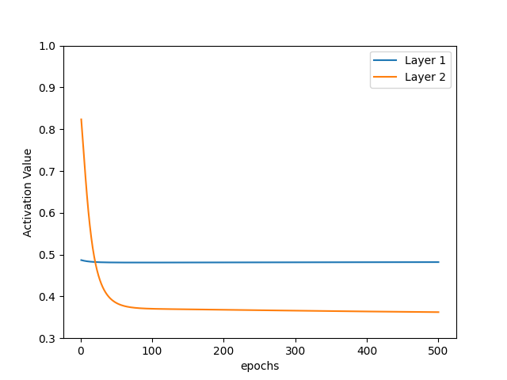
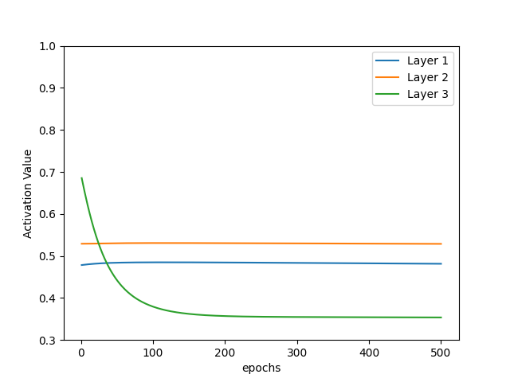
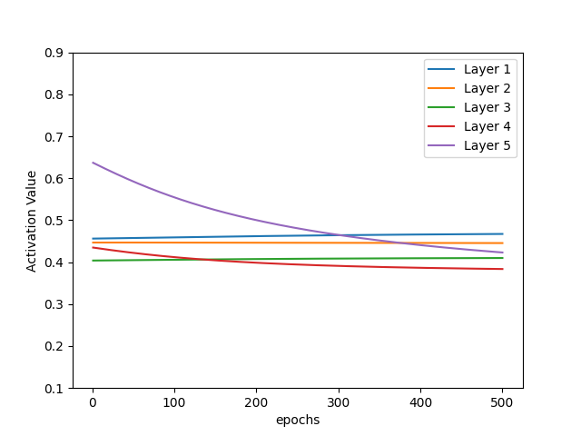
Deep Neural Network
Sigmoid
Sigmoid
Sigmoid

Slide 5
Deep Neural Network
Activation Function | Layers | epochs | Learning rate
 |  |  |  | Training accuracy | Testing accuracy
Sigmoid | 3 | 500 | 0.1 | 56.32% | 64%
relu | 3 | 500 | 0.1 | 62.63% | 74%

Slide 6
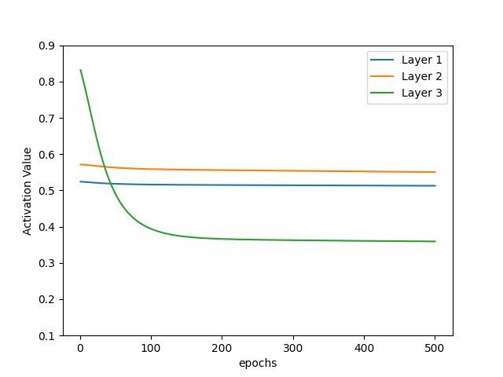
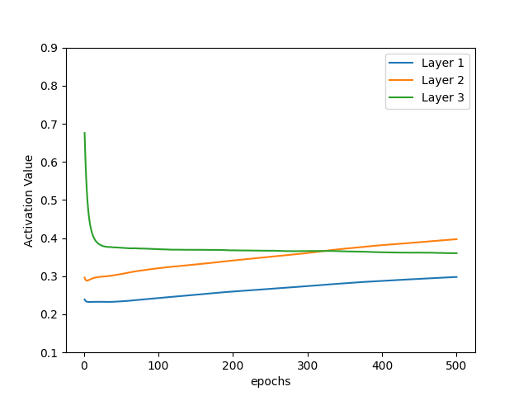
Deep Neural Network
Sigmoid
relu

Slide 7
Deep Neural Network
Activation Function | Layers | epochs | Learning rate
 |  |  |  | Training accuracy | Testing accuracy
Sigmoid | 5 | 500 | 0.1 | 52.32% | 66.0%
relu | 5 | 500 | 0.1 | 59.94% | 70.0%

Slide 8
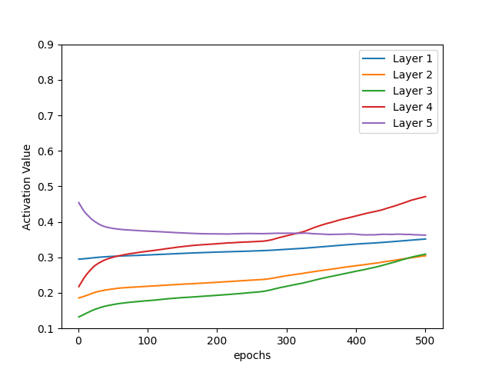
Deep Neural Network
Sigmoid
relu

Slide 9
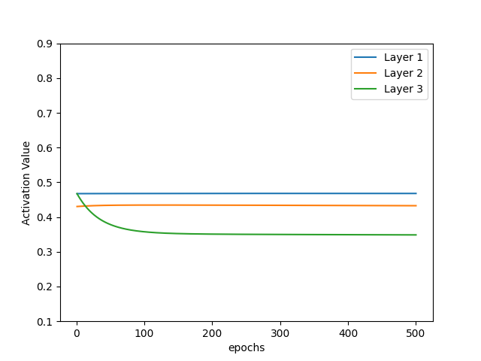
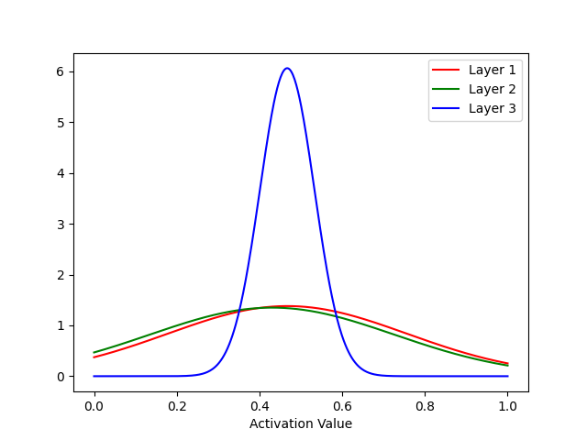
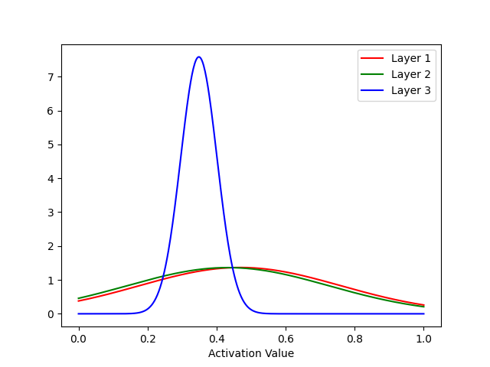
Activation values in DNN
Activation Function | Layers | epochs | Learning rate | Kumar Initialization
 |  |  |  | Training accuracy | Testing accuracy
Sigmoid | 3 | 500 | 0.1 | 55.76% | 72.0%
Epochs 0
Epochs 500

Slide 10
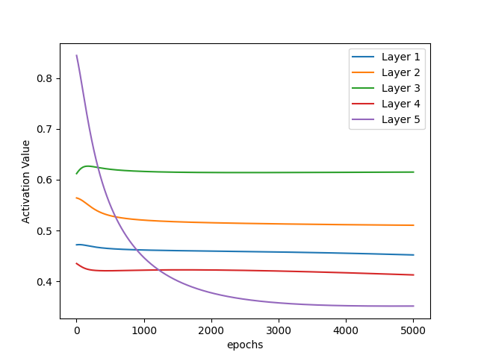
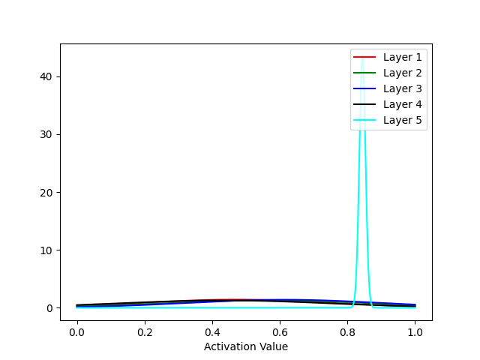
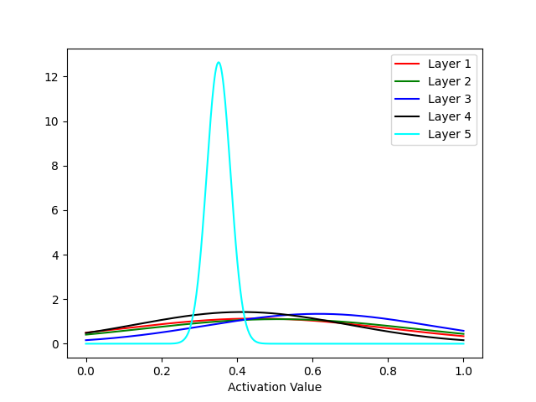
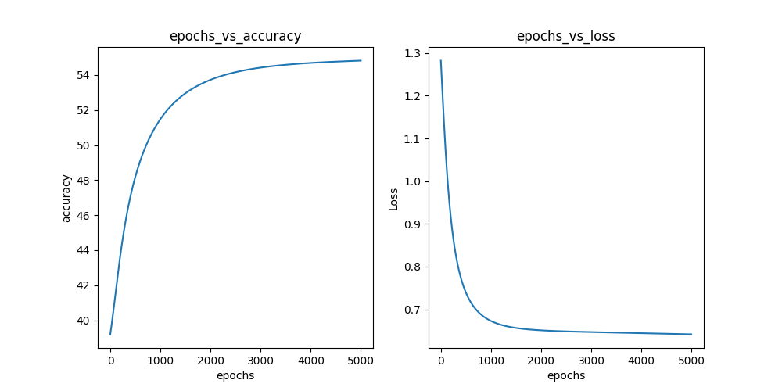
Activation values in DNN
Activation Function | Layers | epochs | Learning rate | Kumar Initialization
 |  |  |  | Training accuracy | Testing accuracy
Sigmoid | 5 | 5000 | 0.1 | 54.82% | 66.0%
Epochs 0
Epochs 500

Slide 11
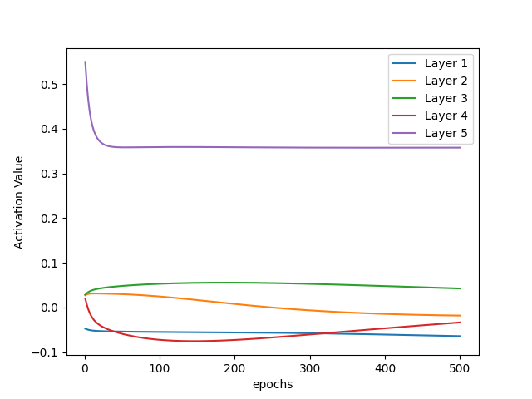
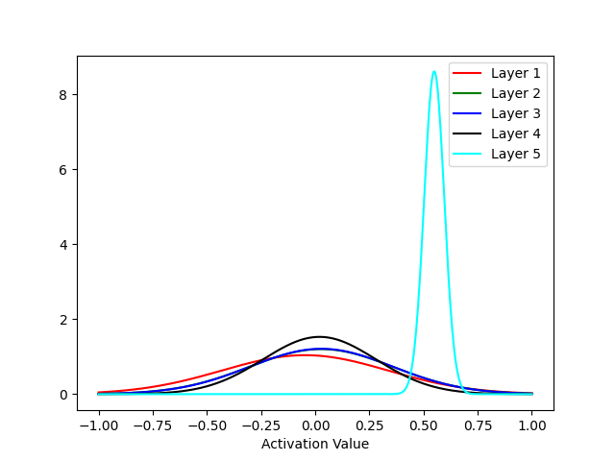
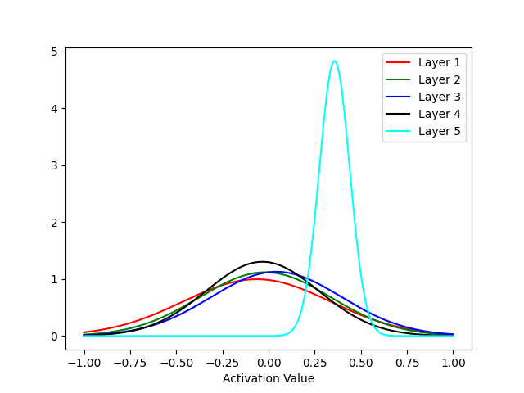
Activation values in DNN
Activation Function | Layers | epochs | Learning rate | Xavier Initialization
 |  |  |  | Training accuracy | Testing accuracy
Tanh | 5 | 500 | 0.1 | 58.66% | 40.0%
Epochs 0
Epochs 500

Slide 12
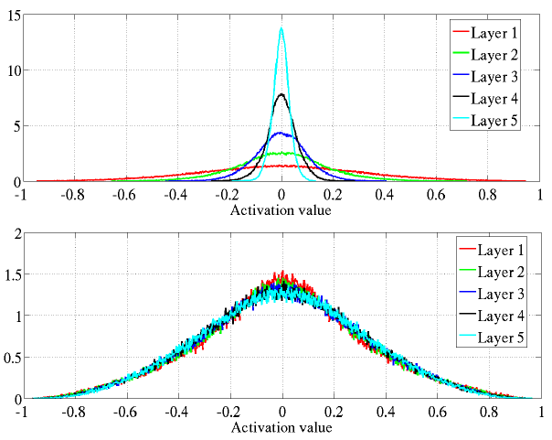
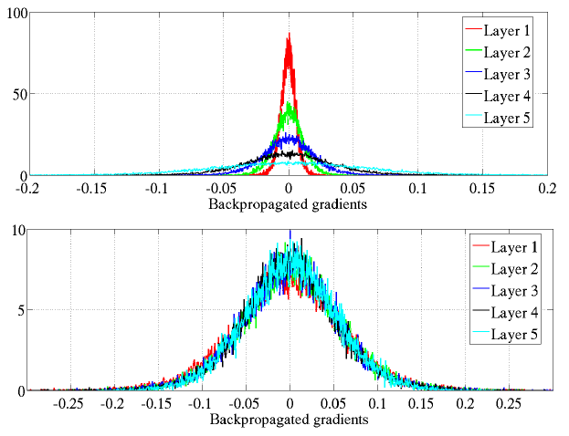
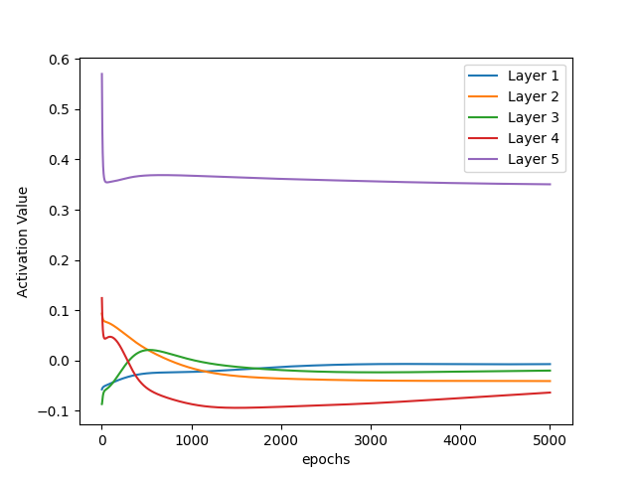
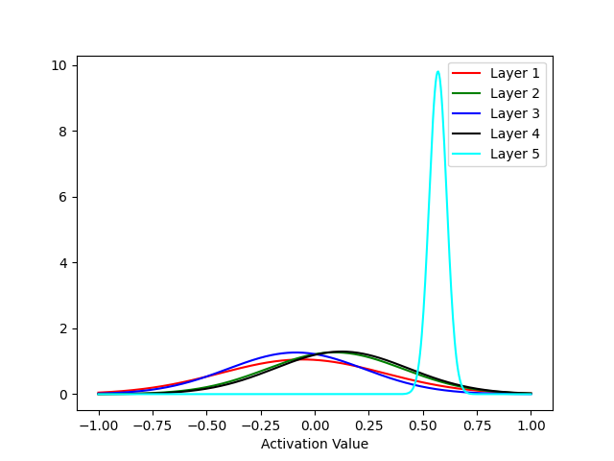
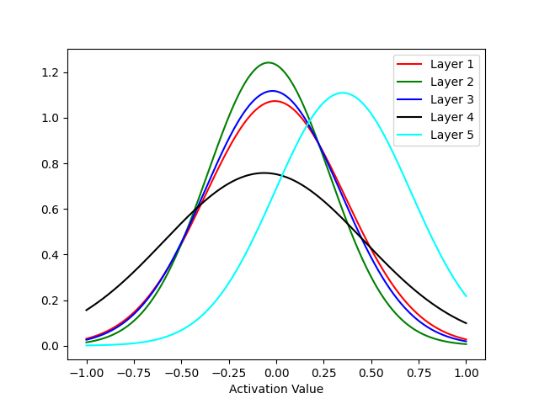
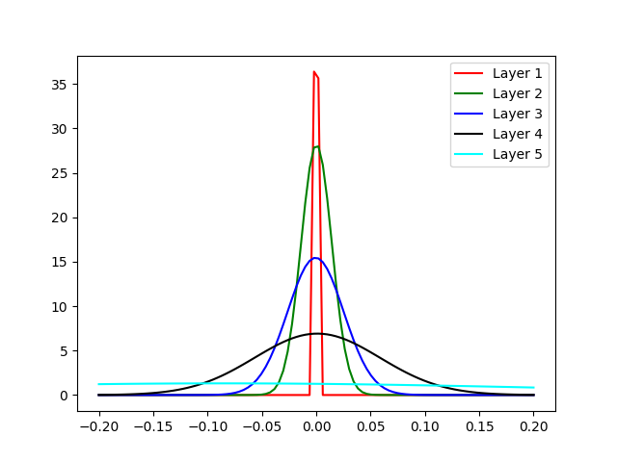
Activation values in DNN
Activation Function | Layers | epochs | Learning rate | Xavier Initialization
 |  |  |  | Training accuracy | Testing accuracy
Tanh | 5 | 5000 | 0.1 | 88.00% | 76.0%
Mean activation values
Epochs 0
Epochs 5000
Backpropogation gradients

Slide 13
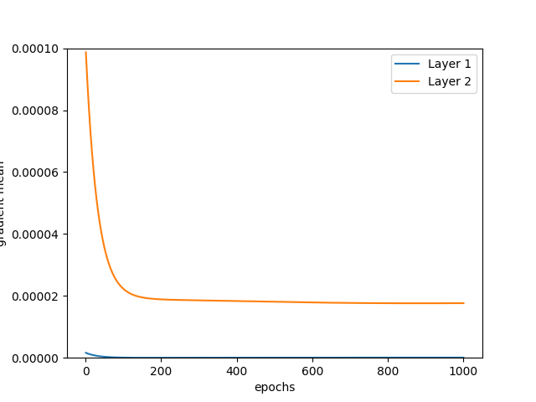
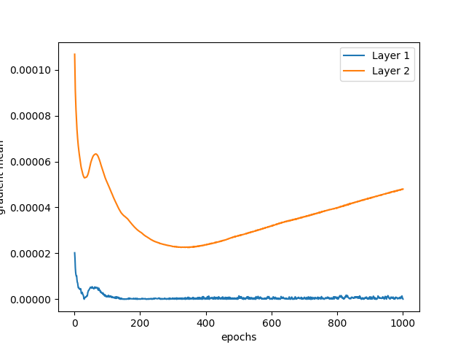
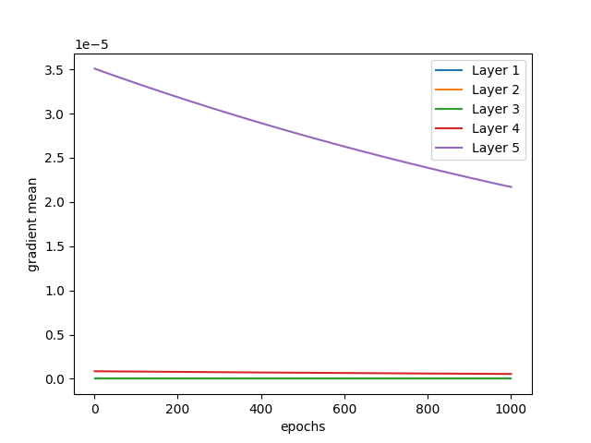
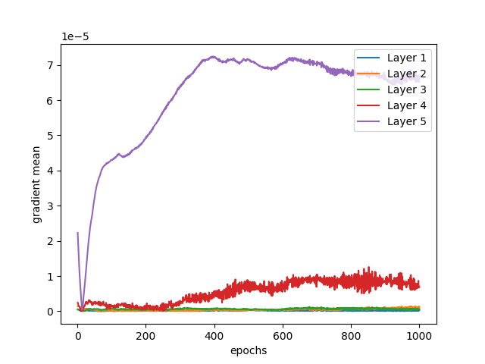
Backpropogation Gradient mean
Sigmoid
relu
Vanishing Gradient Problem

Slide 14
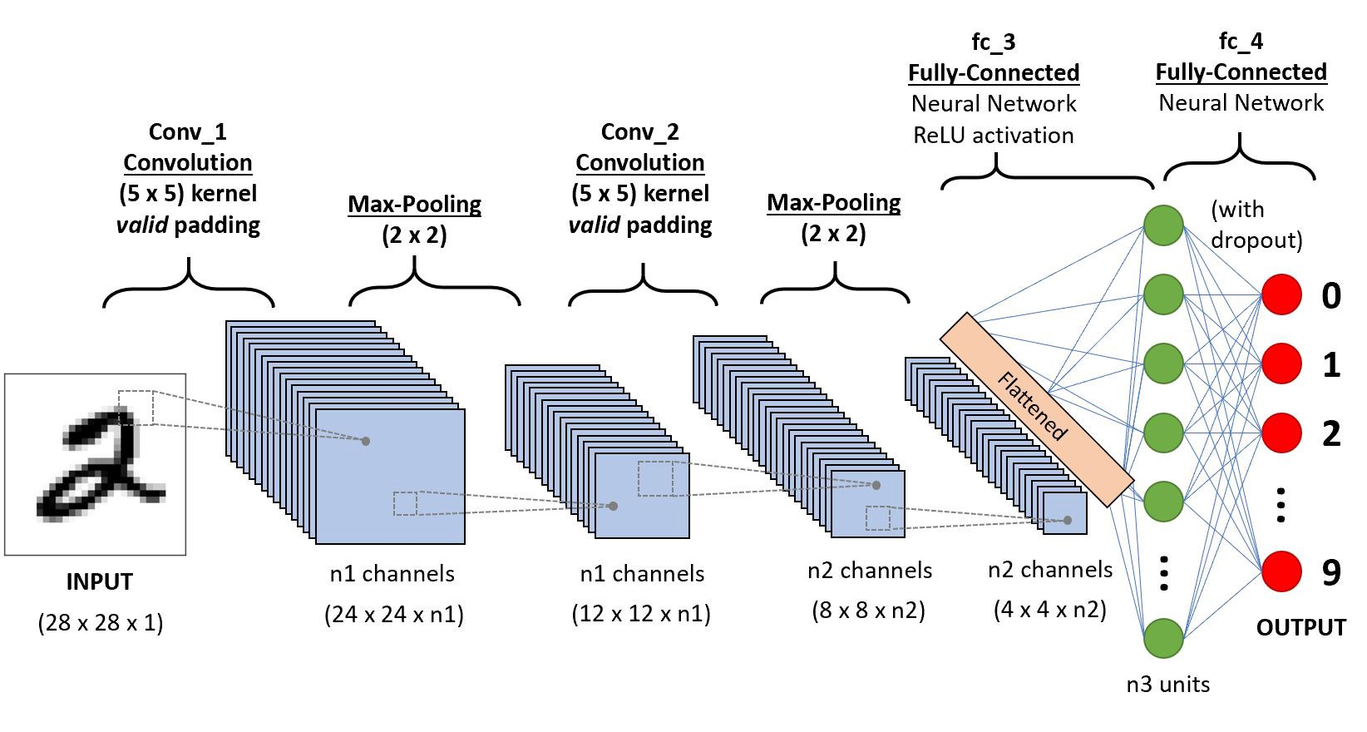
Convolution Neural Network

