Slide 1
Lab 1. Warming up
Booting xv6 & executing applications

Slide 2
xv6
xv6 book
https://pdos.csail.mit.edu/6.828/2018/xv6/book-rev11.pdf
xv6 source codes
Github: https://github.com/mit-pdos/xv6-public
For our projects: https://github.com/moonjupark/xv6edk2
xv6 source codes for UEFI booting
You can download them from the class homepage.

Slide 3
UEFI bootloader for xv6
Download MyLoaderPkg
From the class homepage
Build the bootloader

Slide 4
Modifications
kernel.ld
.stab removed for kernel image load in UEFI loader
console.c
xv6 assumes using CGA ➔ removed.
graphic_putc added for VGA output.
mp.c → mp_uefi.c
Boot parameters from UEFI
pci.c
Support for PCI (not working well yet)

Slide 5
Build xv6
Download modified source codes
From github
Build
make kernelmemfs

Slide 6
Running xv6 on QEMU
Assumption : EDK2 & xv6 are on the same directory.
Make directories: image/efi/boot/
$ mkdir –p image/efi/boot
Copy bootloader
$ cp Build/MyLoaderPkg/X64/DEBUG_GCC5/X64/loader.efi image/efi/boot/bootx64.efi
Copy kernel
$ cp xv6/kernelmemfs image/kernel
Run
$ ./run.sh
Note: for some reason, i8254 timer doesn’t work correctly.

Slide 7
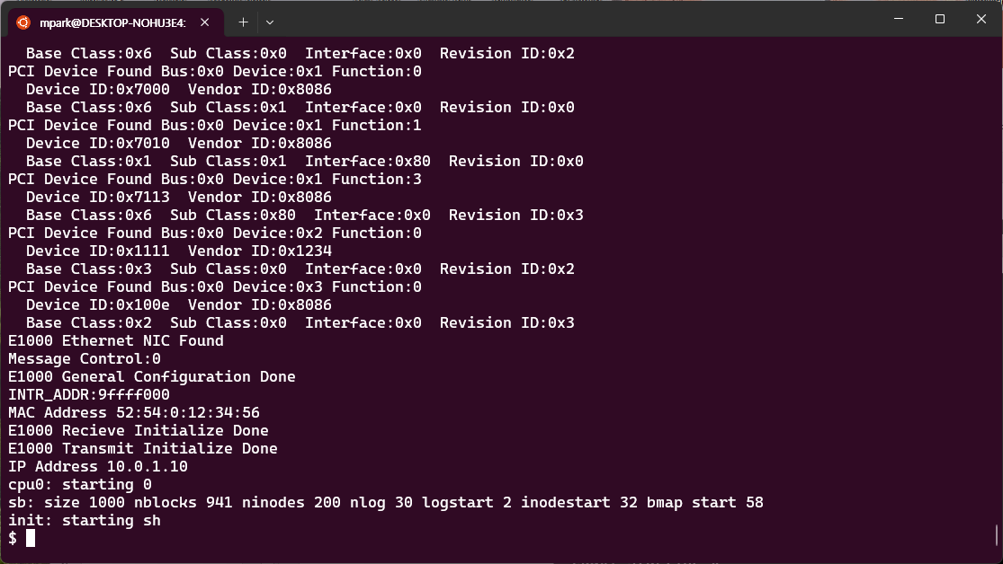
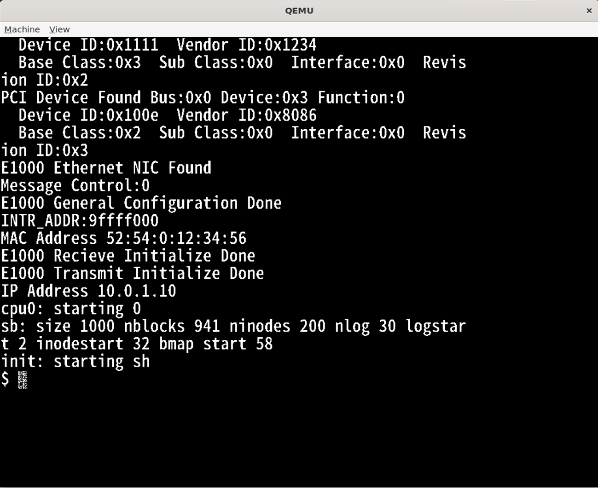

Slide 8
run.sh
qemu-system-x86_64 -bios /usr/share/ovmf/OVMF.fd \
-drive if=ide,file=fat:rw:image,index=0,media=disk \
-m 2048 -smp 4 \
-serial mon:stdio \
-vga std
xv6 only supports IDE, which is not supported in modern PCs.
File system is contained in the kernel image ➔ we use only memory file system.

Slide 9
Try:
$ ls
. 1 1 512
.. 1 1 512
README 2 2 1844
cat 2 3 12129 ...
$ echo Hello!
Hello!
$ cat README
xv6 is a re-implementation of Dennis Ritchie's and Ken Thompson's Unix Version 6 (v6). xv6 loosely follows the structure and style of v6, ...
$ grep run README
To build xv6 on an x86 ELF machine (like Linux or FreeBSD), run "make".
Then run "make TOOLPREFIX=i386-jos-elf-". ...
$ cat README | grep run | wc
6 70 376
$ echo My New File >newfile
$ cat newfile
My New File

Slide 10
Debugging with GDB
dbgrun.sh
In another terminal,
Change directory where “kernelmemfs” file exists.
$ gdb kernelmemfs
…
(gdb) set archi i386:x86-64
…
(gdb) target remote localhost:4321
…
(gdb)
qemu-system-x86_64 -bios /usr/share/ovmf/OVMF.fd \
-drive if=ide,file=fat:rw:image,index=0,media=disk \
-S -m 2048 -smp 4 \
-gdb tcp::4321 \
-serial mon:stdio \
-vga std

Slide 11
(gdb) b exec
Breakpoint 1 at 0x80100b80: file exec.c, line 12.
(gdb) c
Continuing.
[Switching to Thread 1.2]
Thread 3 hit Breakpoint 1, exec (path=0x9fefced0 "\034", argv=0x80) at exec.c:20
20 struct proc *curproc = myproc();
(gdb)
exec of the first user program, /init
(gdb) c
Continuing.
[Switching to Thread 1.4]
Thread 3 hit Breakpoint 1, exec (path=0x9fefbed0 "\366\a", argv=0x80) at exec.c:20
struct proc *curproc = myproc();
(gdb)
exec of the shell (sh) from /init

Slide 12
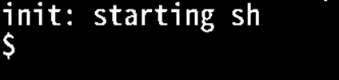
(gdb) c
Continuing.
You can see the prompt ($) now.
Type in :
$ cat README
Thread 3 hit Breakpoint 1, exec (path=0x9fe32ed0 "\340\031", argv=0x80) at exec.c:20
20 struct proc *curproc = myproc();
(gdb)

Slide 13
User programs in xv6
Programs cannot be compiled on xv6.
You need to make a program and then include it to the memory file system.
Let’s make “Hello, world”

Slide 14
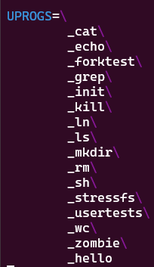
Hello, world in xv6
We cannot use stdio.h.
Use the following header files.
“types.h” : header file for variable types
“user.h” : header file for system calls
“fcntl.h” : header file for file IO
You need to add your program in the Makefile (UPROGS)
Add program

Slide 15
Hello, world
#include "types.h"
#include "user.h"
int main(int argc, char *argv[]) {
printf(1,"Hello world!\n");
exit();
}
Rebuild xv6 and run.
Then, test your program.

Slide 16
To-do
Make hello2 application
Expected output
$ hello2
Hello world!
My student # is 20250315.
Make your student # appear here.

