Slide 1
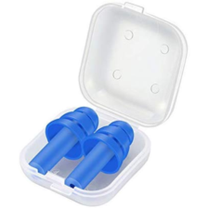
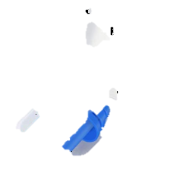
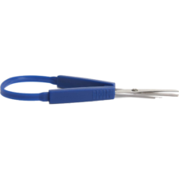
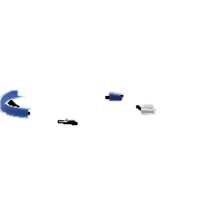
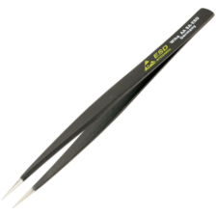
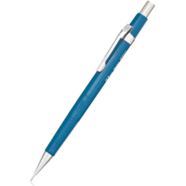
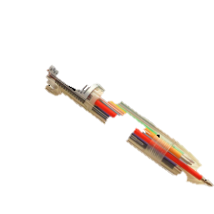

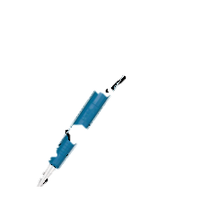
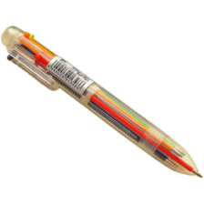
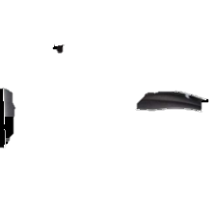
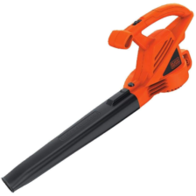
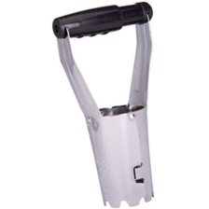
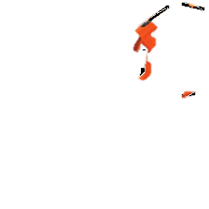
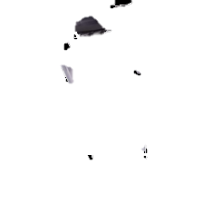
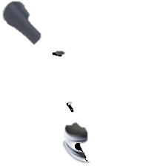
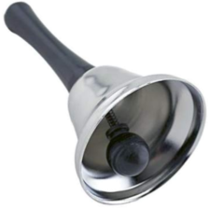
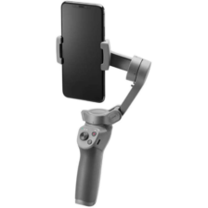
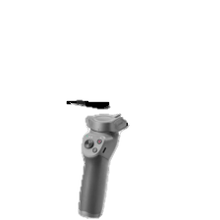
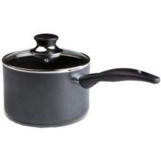
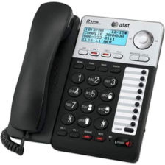
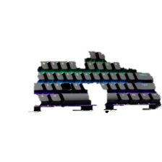
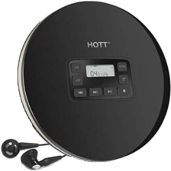
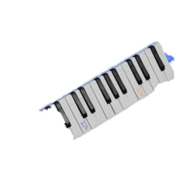
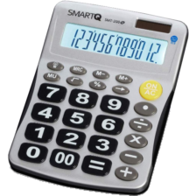
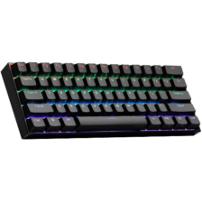
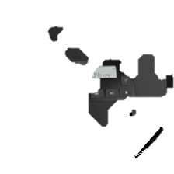
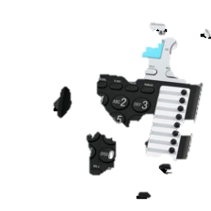
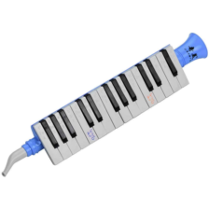
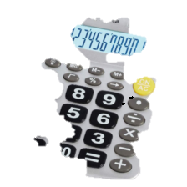
Pinch
Clench
Poke
Notes:
31FbMgDhKlL._AC_ clench
31J9xFzlXqL._AC_ clench
41o-sVepMUL._AC_SL1000_ clench
41tbcx2sahL._AC_ clench
51-53z1P0FL._AC_SL1000_ clench
514gzmi1QJL._AC_SL1000__clench
710pBGy8oHL._AC_SL1500__clench
41saa941GaL._AC__poke
51+TZljEsVL._AC__poke
51ENMZUkOKL._AC_SL1000__poke
61a1UoyFY-L._AC_SL1161__poke
61NrWLtBXFL._AC_SL1500__poke
31RflKv7wYL._AC_ pinch
51KtBPeFLQL._AC_SL1020__pinch
51NSMwA7K+L._AC_SL1500__pinch
51NYsWLGVKL._AC_SL1000__pinch
51xcrJdRq7L._SL1000__pinch

Slide 2
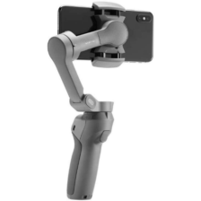
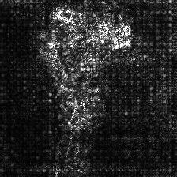
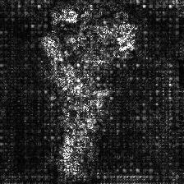
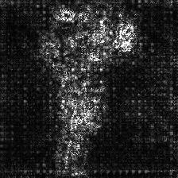
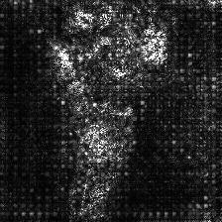
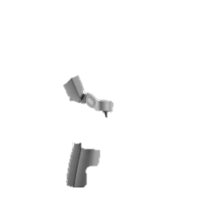
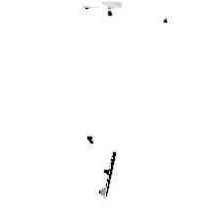
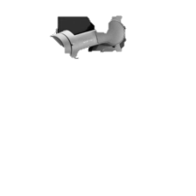
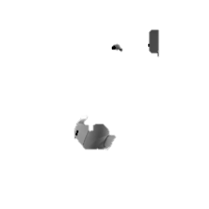
Hand action plausibility prediction
Resnet152
Size
Fine-tuned
Pinch: 50
Clench: 88
Poke: 47
Resnet152
Palm: 39
Fixed
Gradient-based saliency map
Pinch
Clench
Poke
Palm
Segmentation
Notes:
4121R74lizL._AC_SL1000_

Slide 3
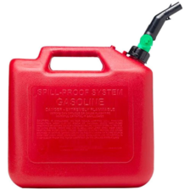
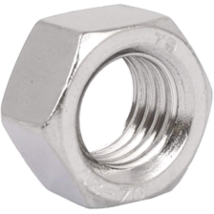

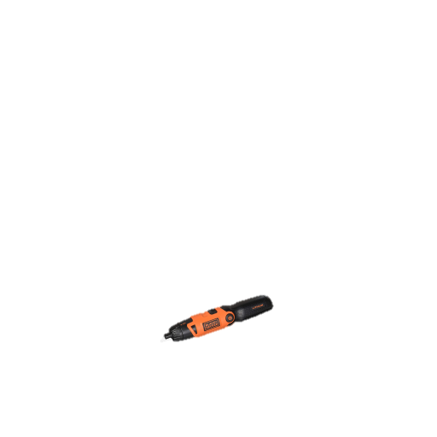
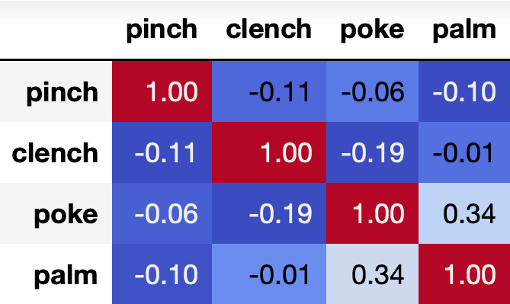
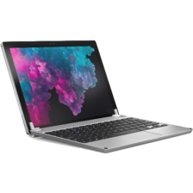
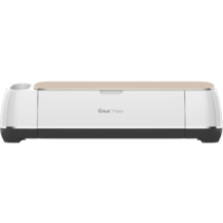
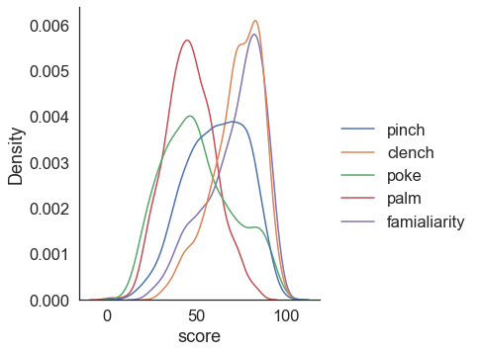

a.
b.
e.
 | Pinch | Clench | Poke | Palm | Fam.
$$\overline{σ}$$ | 26.33 | 21.18 | 28.93 | 31.40 | 23.99
c.
Pinch:34 Clench: 92
Poke: 43 Palm: 47
Familiarity: 92
Pinch:83 Clench: 63
Poke: 35 Palm: 32
Familiarity: 79
d.
Size information
N. of pixels
Pixel length of the longer side
Pixel length of the shorter side
Pinch:44 Clench: 76
Poke: 83 Palm: 62
Familiarity: 89
Pinch:48 Clench: 73
Poke: 63 Palm: 84
Familiarity: 64
Notes:
51+9od456tL
61s9xtlBnxL._AC_SL1100_
717ISNRXiKL._AC_SL1500_
41s8LhmXUfL._AC_SL1000_

Slide 4
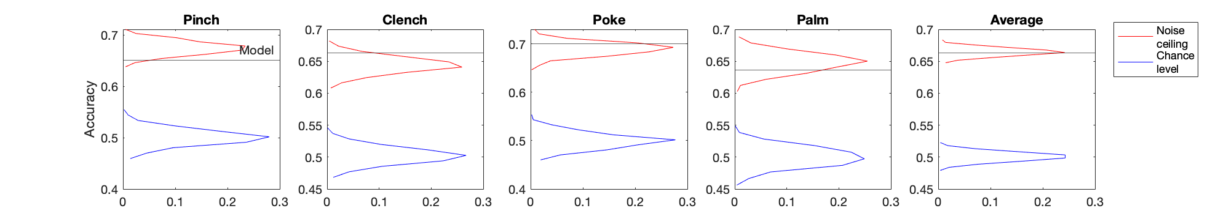
Frequency

Slide 5
5-fold CV Average over 4 actions | RMSE | Pearson correlation | Accuracy
Resnet152+2path+size | 14.55 | 0.468 | 66.29%
Resnet152+2path | 14.55 | 0.459 | 66.20%
Resnet152+size | 14.75 | 0.448 | 65.53%
Resnet152 | 14.78 | 0.452 | 65.06%
Resnet50 | 14.66 | 0.450 | 64.95%
Resnet18 | 14.90 | 0.374 | 62.48%
VGG19 | 14.86 | 0.445 | 64.29%
VGG11 | 15.03 | 0.416 | 63.62%
AlexNet | 15.37 | 0.372 | 63.03%

Slide 6
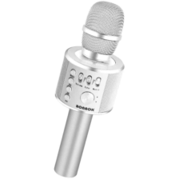
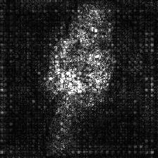
 | Pinch | Clench | Poke | Palm
GT | 67.9 | 75.7 | 34.6 | 42.6
Pred. | 48.5 | 74.2 | 73.8 | 50.3
 | Pinch | Clench | Poke | Palm
GT | 67.9 | 75.7 | 34.6 | 42.6
Pred. | 48.5 | 74.2 | 73.8 | 50.3
 | Pinch | Clench | Poke | Palm
GT | 67.9 | 75.7 | 34.6 | 42.6
Pred. | 48.5 | 74.2 | 73.8 | 50.3

Slide 7
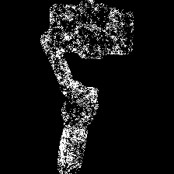
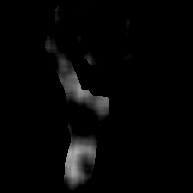





Foreground masking
Prediction
Pinch:50 Clench: 88
Poke: 48 Palm: 39
Blurring
Thresholding
Grabcut
Saliency maps
Normalization
Clench segment

Slide 8

















Pinch
Clench
Poke
Palm
a.
b.
Notes:
Comparison of segmentation when prediction is accurate vs inaccurate(highest predicted action != highest gt action)

Slide 9

















a.
Pinch
Clench
Poke
Palm
b.
Pinch
Clench
Poke
Palm
Notes:
Comparison of segmentation when prediction is accurate vs inaccurate(highest predicted action != highest gt action)
11r0o+qOxwL pinch
21P+J98R04L._AC_ clench
31fVQj6yKzL._AC_ poke
41GfOHbwSKL._SL1000_ clench
31HFEGlMOQL._AC_ clench pinch
31kmclFrrcL._AC_ clench pinch
31q7lTCx3zL._AC_ poke pinch
31YGme9PyDL._AC_ clench pinch
31Z2Mpp75PL._AC_ clench pinch
41Bove1QBqL._AC_SL1000_ pinch clench

Slide 10

1.0
b.
a.
0.8
***
0.6
Accuracy
0.4
Mean
Chance level
0.2
0.0
Notes:
Example images which accuracy is lower than chance level

