Slide 1
Lightning Network
Measuring Channel Capacity
10/05/2019

Slide 2
Funding Transactions Balance
The Node Balance is calculated as:
Sum(InChannelsCapacity)-Sum(OutChannelsCapacity)
Total Nodes Number: 4119
Positive Balance Nodes: 1870
Negative Balance Nodes: 2215
0 Balance Nodes: 34
Total Network Balance: 0

Slide 3
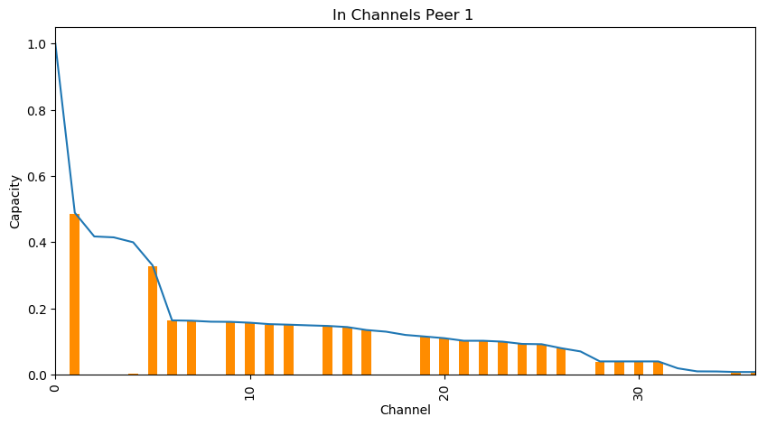
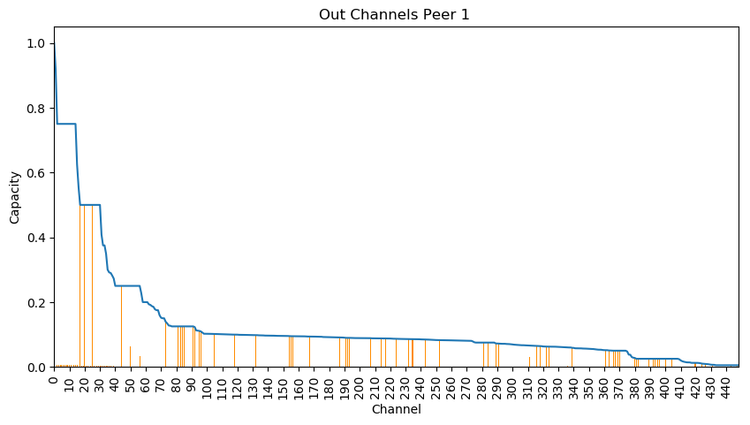
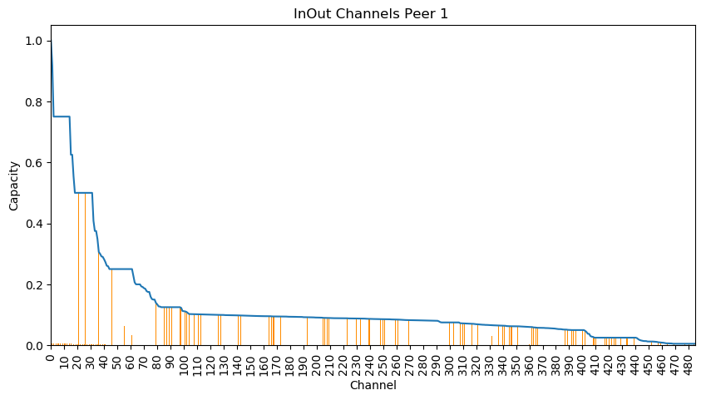
Mainnet Result: Peer1 MostConnectedPeer
In Balance: Sum Capacity: 15158149 sat = 763.93€ Sum EstimatedCapacity: 7853751 sat= 395.81€ Expense: 7304398 sat= 368.12€ Out Balance: Sum Capacity: 226833780 sat = 11 431.83€ Sum EstimatedCapacity: 30475695 sat =1 535.90€ Expense: 196358085 sat = 9 895.94€
Peer1Balance: -9 527.82€

Slide 4
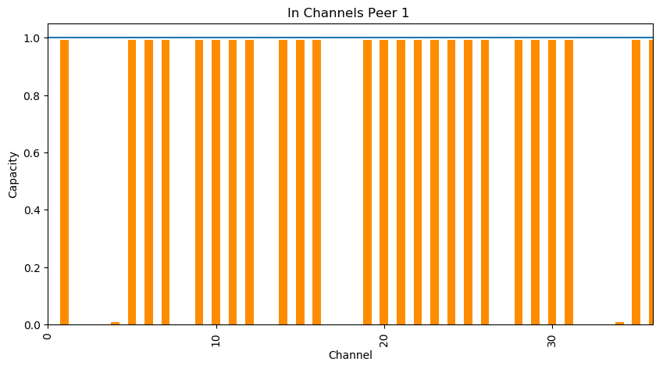
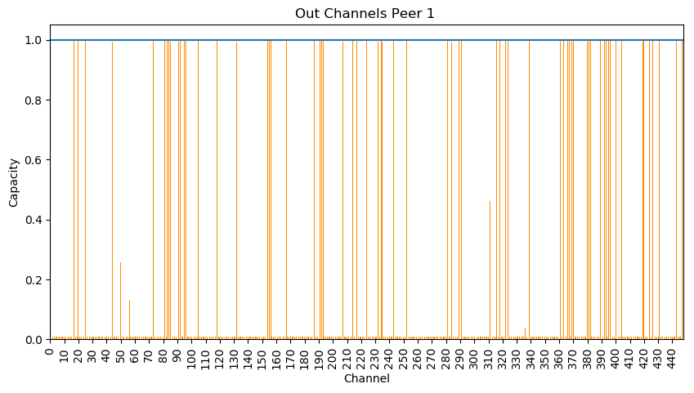
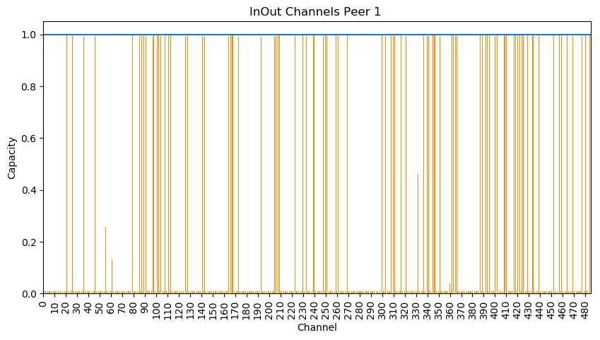
Mainnet Result: Peer1 MostConnectedPeer
In Balance: Sum Capacity: 15158149 sat = 763.93€ Sum EstimatedCapacity: 7853751 sat= 395.81€ Expense: 7304398 sat= 368.12€ Out Balance: Sum Capacity: 226833780 sat = 11 431.83€ Sum EstimatedCapacity: 30475695 sat =1 535.90€ Expense: 196358085 sat = 9 895.94€
Peer1Balance: -9 527.82€

Slide 5
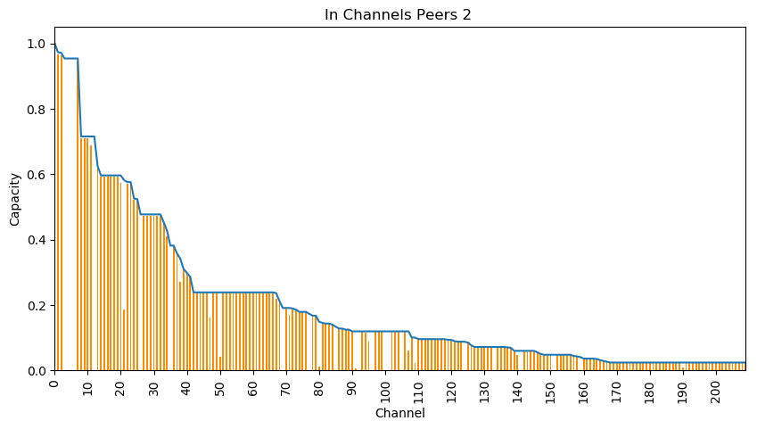
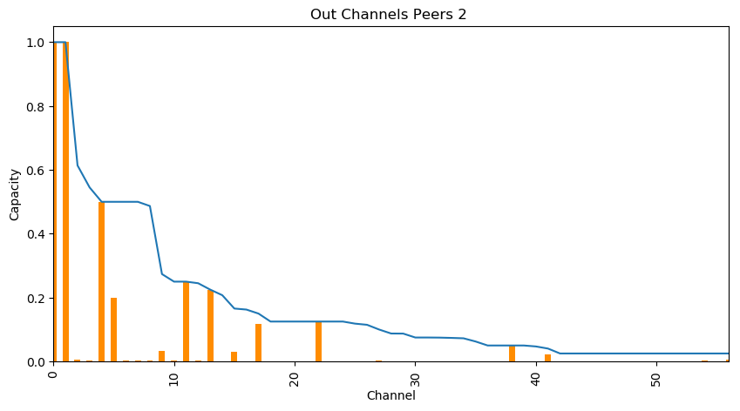
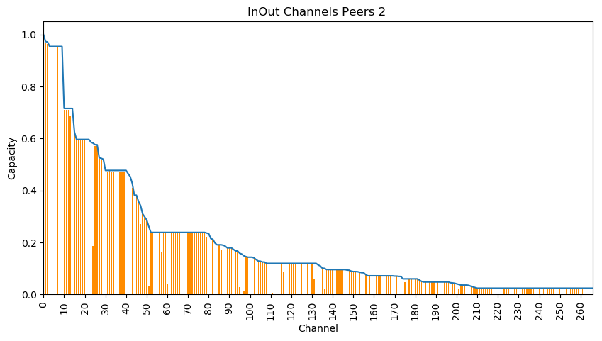
Mainnet Result: Peer2 TopCapacityPeer
In Balance: Sum Capacity: 177418045 sat = 8 941.41€ Sum EstimatedCapacity: 138336283 sat= 6 971.79€ Expense: 39081762 sat= 1 969.62€ Out Balance: Sum Capacity: 40216271 sat = 2 026.80€ Sum EstimatedCapacity: 14421171 sat =726.79€ Expense: 25795100 sat = 1 300.01€
Peer2Balance: +368.61 €

Slide 6
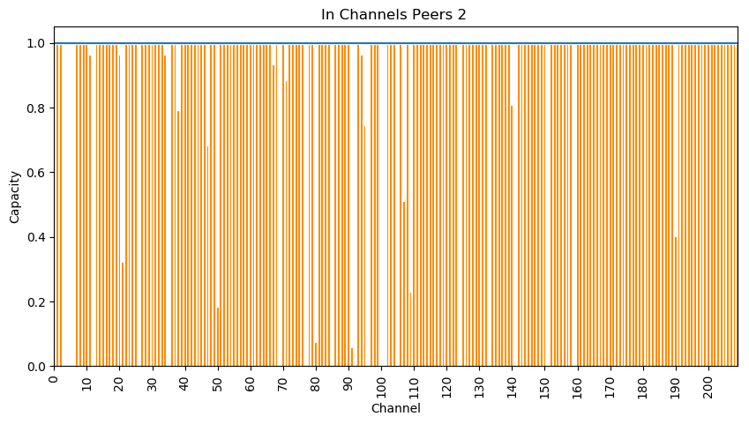
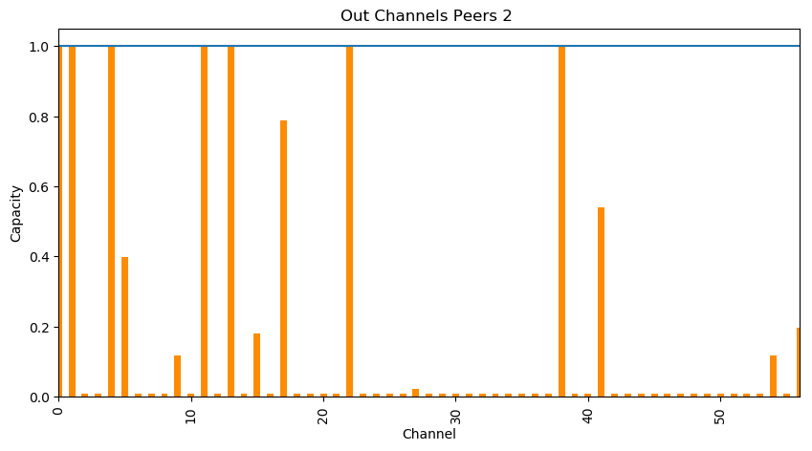
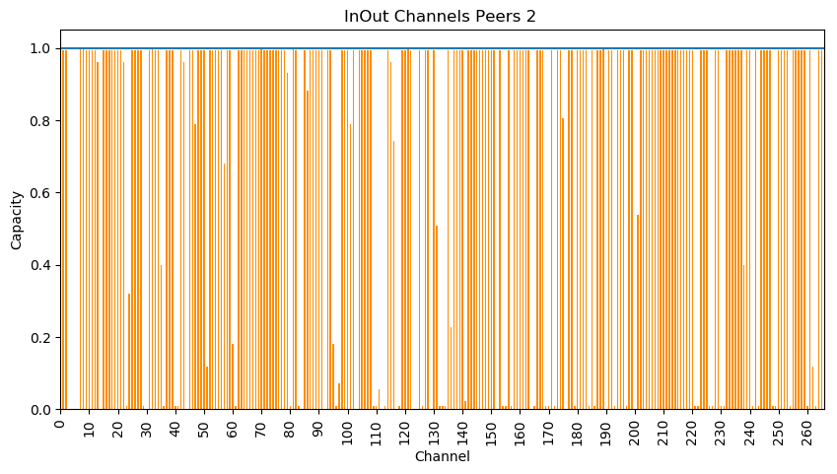
Mainnet Result: Peer2 TopCapacityPeer
In Balance: Sum Capacity: 177418045 sat = 8 941.41€ Sum EstimatedCapacity: 138336283 sat= 6 971.79€ Expense: 39081762 sat= 1 969.62€ Out Balance: Sum Capacity: 40216271 sat = 2 026.80€ Sum EstimatedCapacity: 14421171 sat =726.79€ Expense: 25795100 sat = 1 300.01€
Peer2Balance: +368.61 €

Slide 7
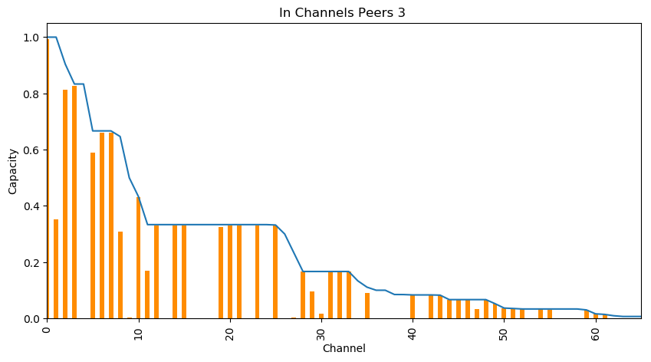
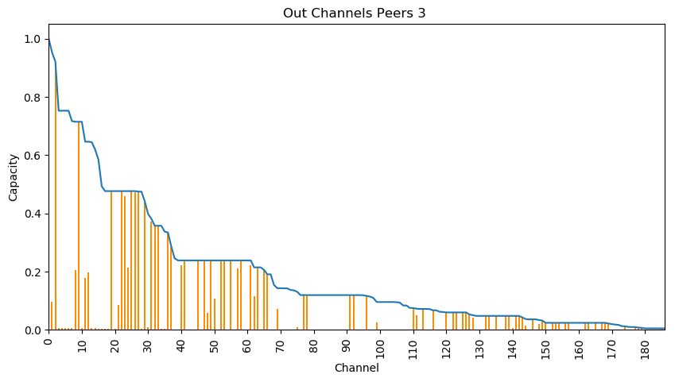
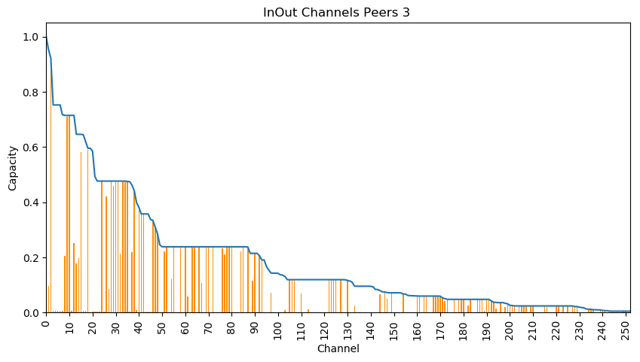
Mainnet Result: Peer3 TopCapacityPeer
In Balance: Sum Capacity: 49227427 sat = 2 480.93€ Sum EstimatedCapacity: 30400770 sat= 1 532.12€ Expense: 18826657 sat= 948.81€ Out Balance: Sum Capacity: 150713781 sat = 7 595.58€ Sum EstimatedCapacity: 56004105 sat =2 822.46€ Expense: 94709676 sat = 4 773.12€
Peer3Balance: -3824.31€

Slide 8
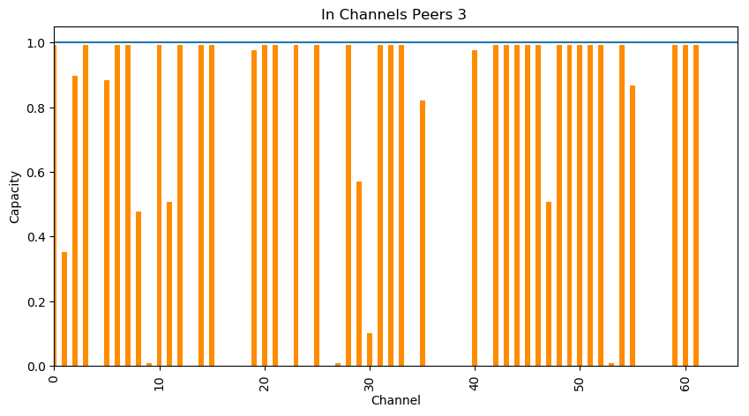
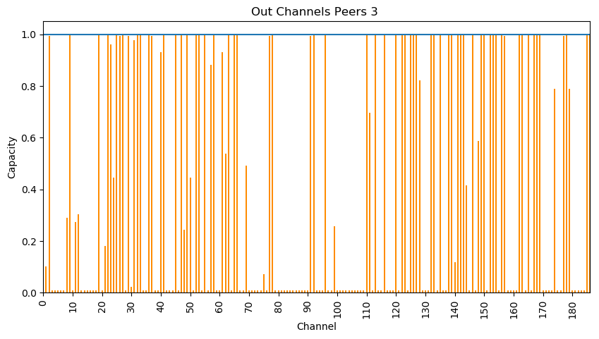
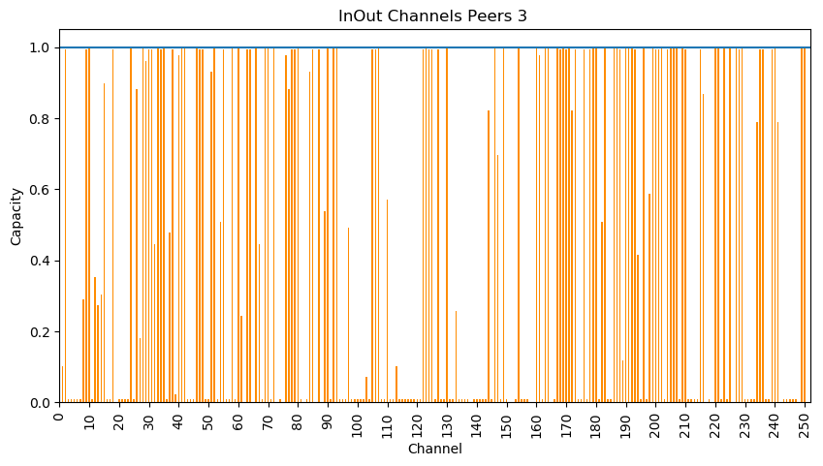
Mainnet Result: Peer3 TopCapacityPeer
In Balance: Sum Capacity: 49227427 sat = 2 480.93€ Sum EstimatedCapacity: 30400770 sat= 1 532.12€ Expense: 18826657 sat= 948.81€ Out Balance: Sum Capacity: 150713781 sat = 7 595.58€ Sum EstimatedCapacity: 56004105 sat =2 822.46€ Expense: 94709676 sat = 4 773.12€
Peer3Balance: -3824.31€

Slide 9
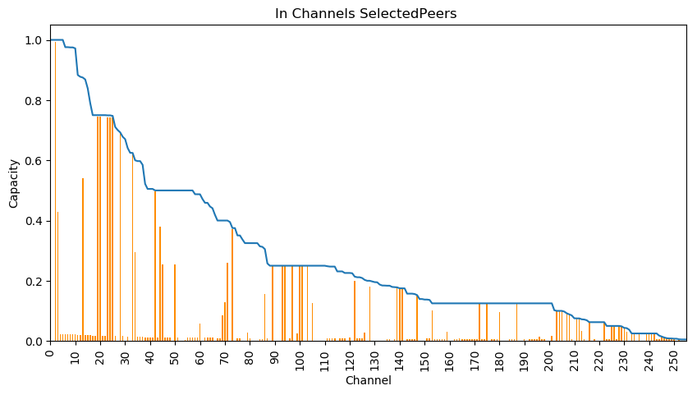
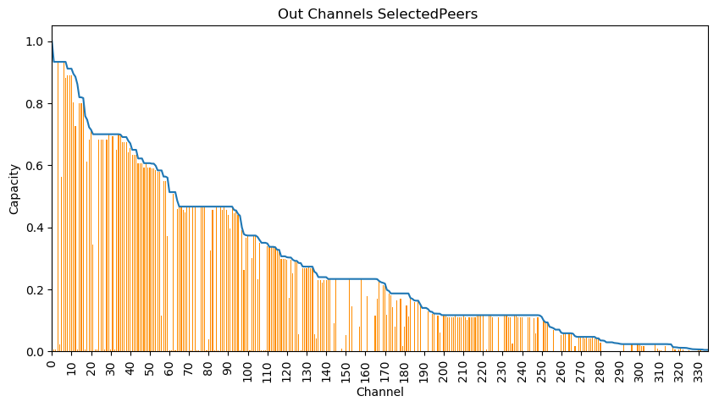
Mainnet Result: Selected Peers Ni
In Balance: Sum Capacity: 297751081 sat = 15 005.88€ Sum EstimatedCapacity: 63223521 sat= 3 186.30€ Expense: 234527560 sat= 11 819.58€ Out Balance: Sum Capacity: 408260020 sat = 20 575.25€ Sum EstimatedCapacity: 287665777 sat = 14 497.61€ Expense: 120594243 sat = 6 077.64€
PeerNiBalance: +5741.94€

Slide 10
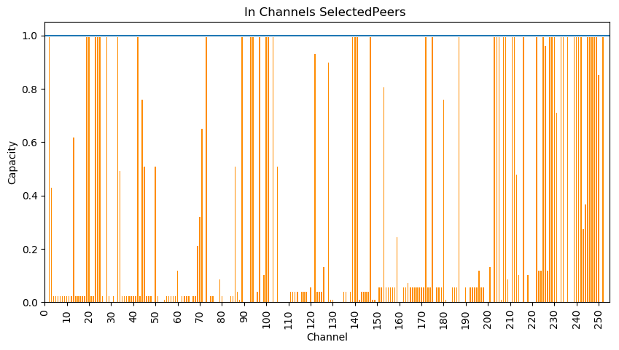
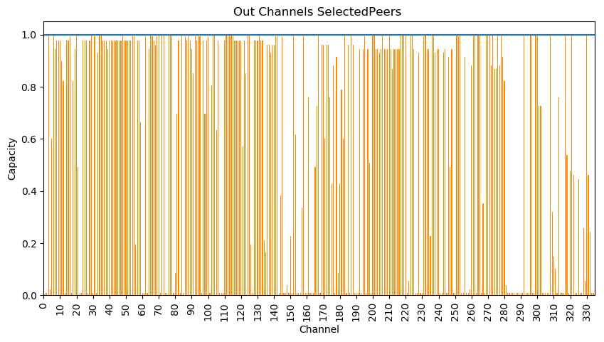
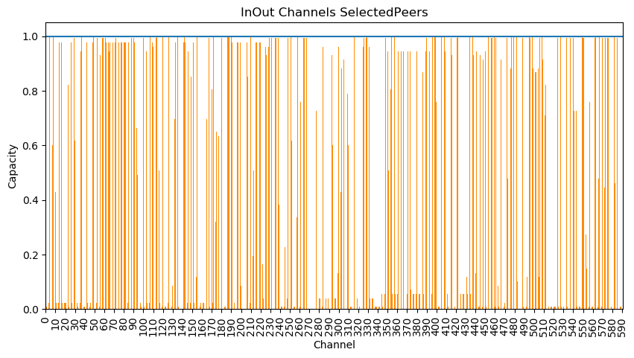
Mainnet Result: Selected Peers Ni
In Balance: Sum Capacity: 297751081 sat = 15 005.88€ Sum EstimatedCapacity: 63223521 sat= 3 186.30€ Expense: 234527560 sat= 11 819.58€ Out Balance: Sum Capacity: 408260020 sat = 20 575.25€ Sum EstimatedCapacity: 287665777 sat = 14 497.61€ Expense: 120594243 sat = 6 077.64€
PeerNiBalance: +5741.94€

Slide 11
Channel Intersection Stats
Number of Channel 14.
Expected Results:
A: λ12 + λ21 = Λ
B: λ12 + λ21 <= Λ + Λ*2/100
C: λ12 + λ21 >= Λ + Λ*2/100 →Local and Remote Balance have changed in Time
N.B. InOut referring to MostConnected and TopCapacity Peers
Results:
A: 0
B: 5 →36%
C: 9 → 64%
Results In Out:
A In Out: 0
B In: 3 →22%
B Out: 2 →14%
C In: 8 →57%
C Out: 1 →7%

Slide 12
Channel Intersection Stats
Number of Channel 14.
Expected Results:
A: λ12 + λ21 = Λ
B: λ12 + λ21 <= Λ + Λ*4/100
C: λ12 + λ21 >= Λ + Λ*4/100 →Local and Remote Balance have changed in Time
N.B. InOut referring to MostConnected and TopCapacity Peers
Results:
A: 0
B: 6 →42%
C: 8 → 58%
Results In Out:
A In Out: 0
B In: 4 →29%
B Out: 2 →14%
C In: 7 →50%
C Out: 1 →7%

Slide 13
Channel Intersection Stats
Number of Channel 14.
Expected Results:
A: λ12 + λ21 = Λ
B: λ12 + λ21 <= Λ + Λ*10/100
C: λ12 + λ21 >= Λ + Λ*10/100 →Local and Remote Balance have changed in Time
N.B. InOut referring to MostConnected and TopCapacity Peers
Results:
A: 0
B: 7 →50%
C: 7 → 50%
Results In Out:
A In Out: 0
B In: 5 →36%
B Out: 2 →14%
C In: 6 →43%
C Out: 1 →7%

Slide 14
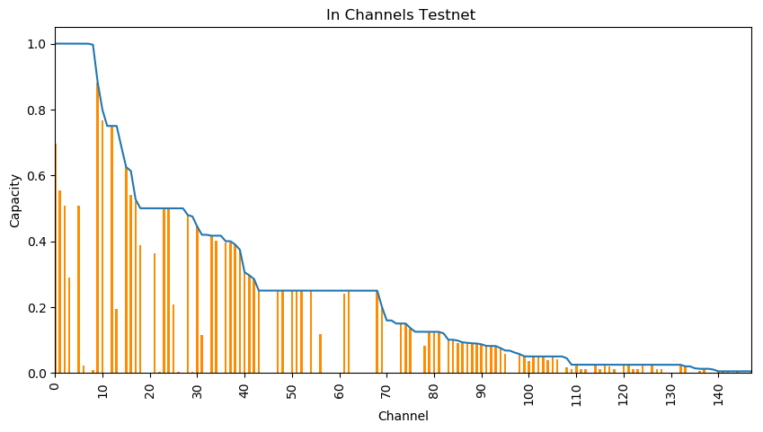
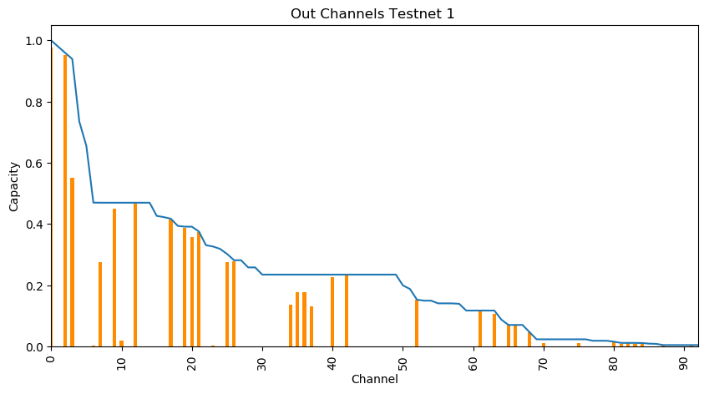
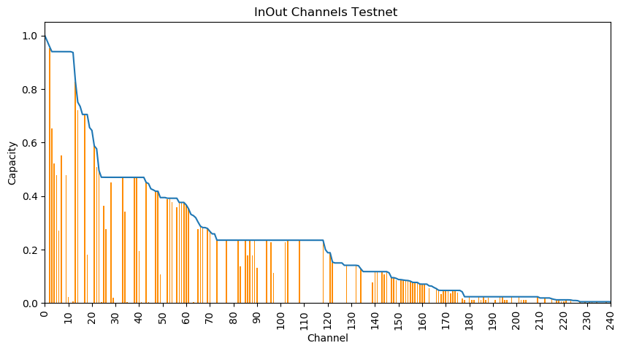
Testnet Result
In Balance: Sum Capacity: 140923199 sat = 7 102.16€ Sum EstimatedCapacity: 31977532 sat= 1 611.58€ Expense: 108945667 sat= 5 490.58€ Out Balance: Sum Capacity: 159750959 sat = 8 051.03€ Sum EstimatedCapacity: 75121643 sat = 3 785.94€ Expense: 84629316 sat = 4 265.10€
TestnetNodesBalance: +1225.48€

Slide 15
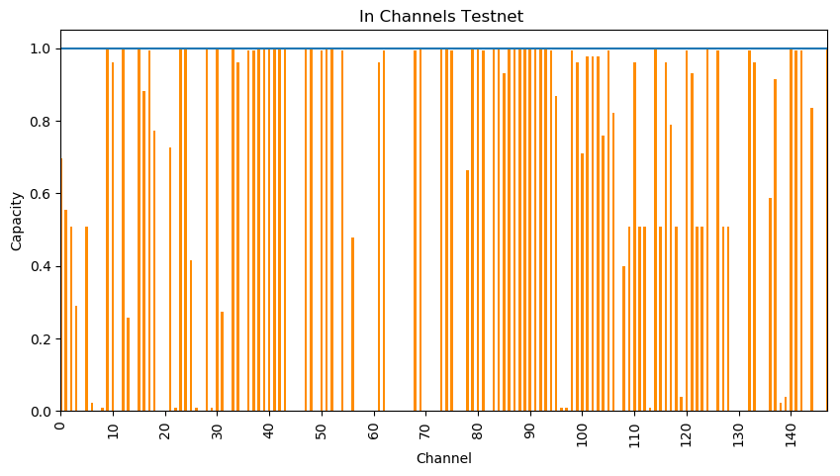
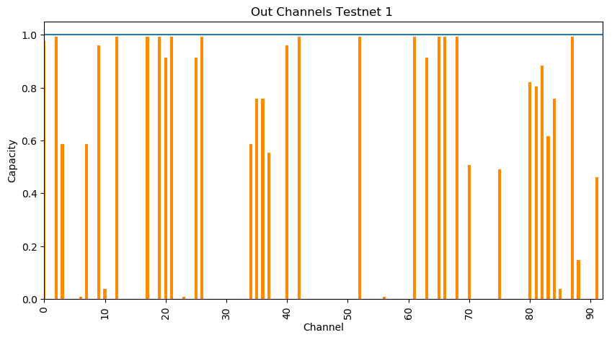
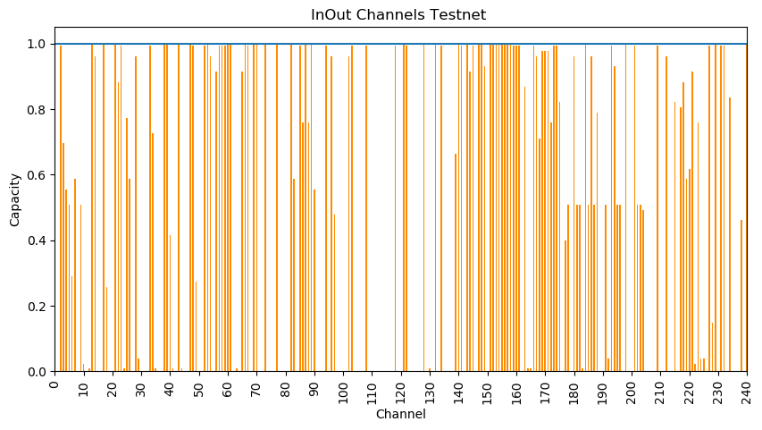
Testnet Result
In Balance: Sum Capacity: 140923199 sat = 7 102.16€ Sum EstimatedCapacity: 31977532 sat= 1 611.58€ Expense: 108945667 sat= 5 490.58€ Out Balance: Sum Capacity: 159750959 sat = 8 051.03€ Sum EstimatedCapacity: 75121643 sat = 3 785.94€ Expense: 84629316 sat = 4 265.10€
TestnetNodesBalance: +1225.48€

Slide 16
Routing info view from different nodes
Considering the last update message
Node 1 has: 37343 channels
Node 2 has: 38294 channels
Node1 and Node2 have the same channel_ID for: 37107 channels
Node1 and Node2 have the same channels info for: 11638 channels Node1 and Node2 share the same info for the 31,36 % of the channels

Slide 17
Routing info view from different nodes
Considering the last update message
Node 1 channel:
{'channel_id': '565298510345994240', 'chan_point': 'b1a212591a43fc85582b55cb73bfe2040178e9582f8bb9b0513a6669328a9c66:0', 'last_update': 1556980405, 'node1_pub': '02ad6fb8d693dc1e4569bcedefadf5f72a931ae027dc0f0c544b34c1c6f3b9a02b', 'node2_pub': '033cfe09030dff97391e08cd08c77834efcb44b706bee7ac7d0866b02ed67f356a', 'capacity': '44000', 'node1_policy': {'time_lock_delta': 144, 'min_htlc': '1000', 'fee_base_msat': '0', 'fee_rate_milli_msat': '1', 'disabled': True}, 'node2_policy': {'time_lock_delta': 1000, 'min_htlc': '1000', 'fee_base_msat': '900', 'fee_rate_milli_msat': '1', 'disabled': False}}
Node 2 channel:
{'channel_id': '565298510345994240', 'chan_point': 'b1a212591a43fc85582b55cb73bfe2040178e9582f8bb9b0513a6669328a9c66:0', 'last_update': 1557153205, 'node1_pub': '02ad6fb8d693dc1e4569bcedefadf5f72a931ae027dc0f0c544b34c1c6f3b9a02b', 'node2_pub': '033cfe09030dff97391e08cd08c77834efcb44b706bee7ac7d0866b02ed67f356a', 'capacity': '44000', 'node1_policy': {'time_lock_delta': 144, 'min_htlc': '1000', 'fee_base_msat': '0', 'fee_rate_milli_msat': '1', 'disabled': True}, 'node2_policy': {'time_lock_delta': 1000, 'min_htlc': '1000', 'fee_base_msat': '900', 'fee_rate_milli_msat': '1', 'disabled': False}}

Slide 18
Routing info view from different nodes
Considering the last update message
Node 1 channel:
{'channel_id': '565265524997750785', 'chan_point': 'aa7029ec7f0e242e10a8cae60c92addb9125221de1ae0e1190bc0372fe0f471c:1', 'last_update': 1556985107, 'node1_pub': '028bbe4e7a85ccff3987deee238fd69732a8e9e621d7e594398062d8bec2a3c571', 'node2_pub': '0327049d8d63f0c40193cdf3afc61817c8647808a4e482de0716fcef74e6d92ebf', 'capacity': '16777216', 'node1_policy': None, 'node2_policy': {'time_lock_delta': 6, 'min_htlc': '1000', 'fee_base_msat': '1000', 'fee_rate_milli_msat': '1', 'disabled': True}}
Node 2 channel:
{'channel_id': '565265524997750785', 'chan_point': 'aa7029ec7f0e242e10a8cae60c92addb9125221de1ae0e1190bc0372fe0f471c:1', 'last_update': 1521849892, 'node1_pub': '028bbe4e7a85ccff3987deee238fd69732a8e9e621d7e594398062d8bec2a3c571', 'node2_pub': '0327049d8d63f0c40193cdf3afc61817c8647808a4e482de0716fcef74e6d92ebf', 'capacity': '16777216', 'node1_policy': {'time_lock_delta': 144, 'min_htlc': '1000', 'fee_base_msat': '1000', 'fee_rate_milli_msat': '1', 'disabled': False}, 'node2_policy': {'time_lock_delta': 6, 'min_htlc': '1000', 'fee_base_msat': '1000', 'fee_rate_milli_msat': '1', 'disabled': True}}

Slide 19
Routing info view from different nodes
Escluding the last update message
Node 1 has: 37343 channels
Node 2 has: 38294 channels
Node1 and Node2 have the same channels_ID for: 37107 channels
Node1 and Node2 have the same channels info for: 33430 channels
Node1 and Node2 share the same info for the 90 % of the channels

Slide 20
Routing info view from different nodes
Escluding the last update message
Node 1 channel:
{'channel_id': '567095112389623808', 'chan_point': '60893b92a8343d064015ce5f430916a21b097df1e03938af7ce23baed0edb238:0', 'node1_pub': '0233a6255a6832f8d7e7e1e99464e76f86cfff021d18ef59f3fd46aa3e59f95c8f', 'node2_pub': '0327049d8d63f0c40193cdf3afc61817c8647808a4e482de0716fcef74e6d92ebf', 'capacity': '100000', 'node1_policy': None, 'node2_policy': {'time_lock_delta': 144, 'min_htlc': '1', 'fee_base_msat': '1000', 'fee_rate_milli_msat': '1', 'disabled': True}}
Node 2 channel:
{'channel_id': '567095112389623808', 'chan_point': '60893b92a8343d064015ce5f430916a21b097df1e03938af7ce23baed0edb238:0', 'node1_pub': '0233a6255a6832f8d7e7e1e99464e76f86cfff021d18ef59f3fd46aa3e59f95c8f', 'node2_pub': '0327049d8d63f0c40193cdf3afc61817c8647808a4e482de0716fcef74e6d92ebf', 'capacity': '100000', 'node1_policy': {'time_lock_delta': 144, 'min_htlc': '1000', 'fee_base_msat': '1000', 'fee_rate_milli_msat': '100', 'disabled': False}, 'node2_policy': {'time_lock_delta': 144, 'min_htlc': '1', 'fee_base_msat': '1000', 'fee_rate_milli_msat': '1', 'disabled': True}}

Slide 21
Routing info view from different nodes
Escluding the last update message
Node 1 channel:
{'channel_id': '566644312499093504', 'chan_point': '3fe25ac30145f95f86b6365a68a87cce5079bb52eb8dd00a42b9c20f02e45d9a:0', 'node1_pub': '02262bbc21c171bc91a1d6bbf89571c95873849b9a60d3ea9671b777d852d39ecd', 'node2_pub': '03e28223dc9b962d824c4a41dd6a2d178a72004594b87aa28cbfdf63e551fbef33', 'capacity': '4447046', 'node1_policy': {'time_lock_delta': 144, 'min_htlc': '1000', 'fee_base_msat': '1000', 'fee_rate_milli_msat': '1', 'disabled': False}, 'node2_policy': {'time_lock_delta': 144, 'min_htlc': '1000', 'fee_base_msat': '100', 'fee_rate_milli_msat': '1', 'disabled': False}}
Node 2 channel:
{'channel_id': '566644312499093504', 'chan_point': '3fe25ac30145f95f86b6365a68a87cce5079bb52eb8dd00a42b9c20f02e45d9a:0', 'node1_pub': '02262bbc21c171bc91a1d6bbf89571c95873849b9a60d3ea9671b777d852d39ecd', 'node2_pub': '03e28223dc9b962d824c4a41dd6a2d178a72004594b87aa28cbfdf63e551fbef33', 'capacity': '4447046', 'node1_policy': {'time_lock_delta': 144, 'min_htlc': '1000', 'fee_base_msat': '1000', 'fee_rate_milli_msat': '1', 'disabled': False}, 'node2_policy': {'time_lock_delta': 144, 'min_htlc': '1000', 'fee_base_msat': '100', 'fee_rate_milli_msat': '1', 'disabled': True}}

Slide 22
Which daemon is a lightning node running?
By the lightning network protocol there is no direct means to detect which implementation is used by another node.
We could use indirect hints for example the standard cltv deltas or channel fees are different for the various implementations. However this would not work because I could obviously run clightning with the default config of lnd.
Right now there is now way to detect the lightning implementation.

