Slide 1
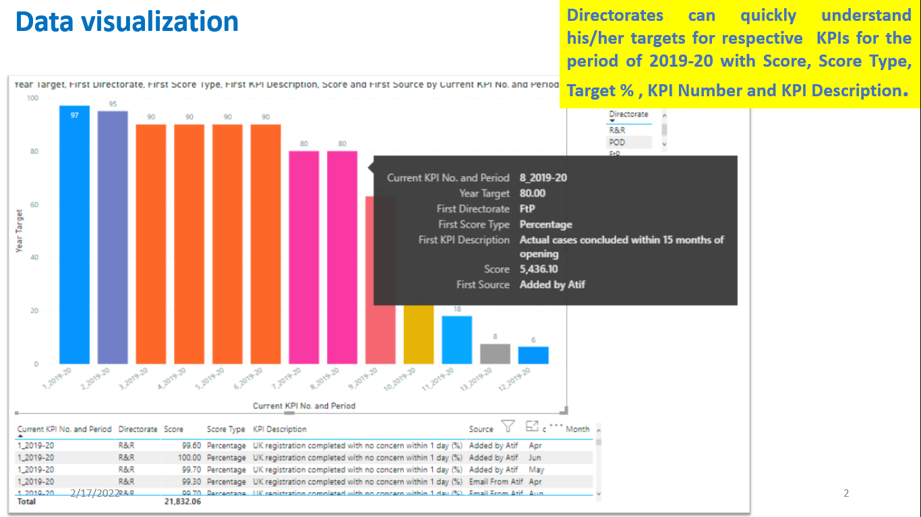
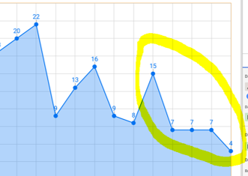
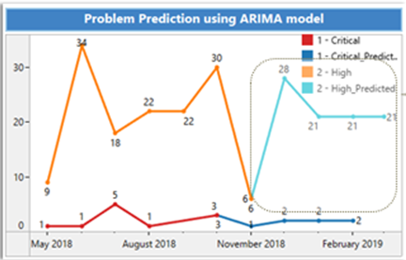
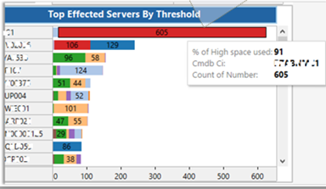
Sanjay Gilki’s
Designed and Developed few Key Visualizations, Actionable Insights, fore-sights and Recommendations using Descriptive, Diagnostic, Predictive and Prescriptive Analytics.

Slide 3
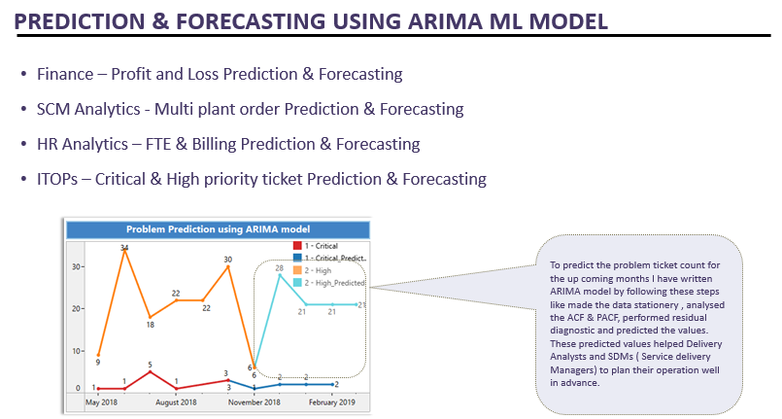

Slide 4
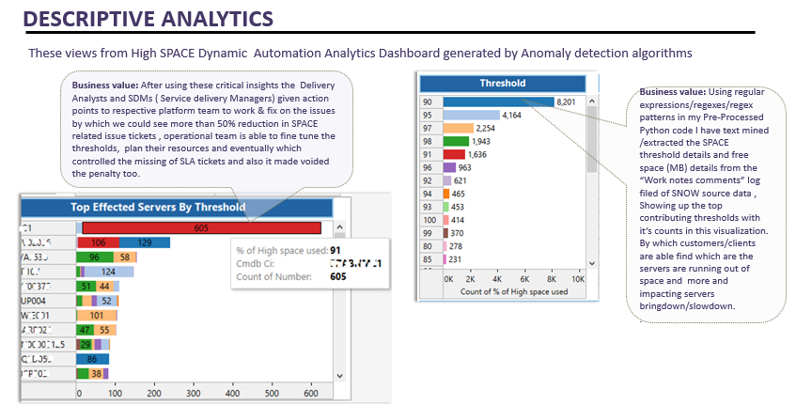

Slide 5
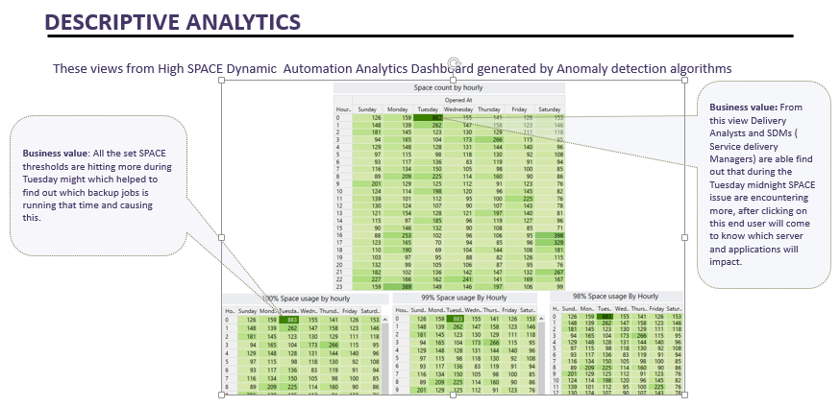

Slide 6
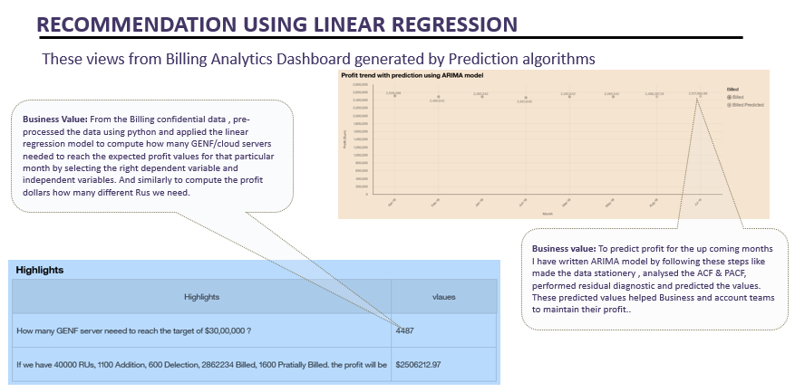

Slide 7
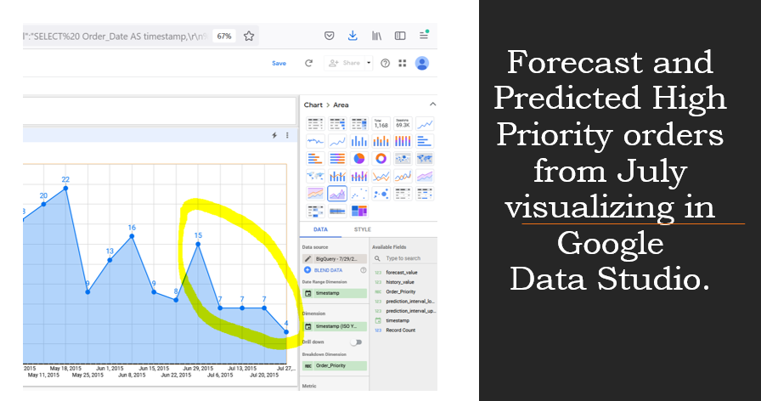
Using GCP Cloud - Google Storage & BigQuery ML for Prediction and Forecasting

Slide 8
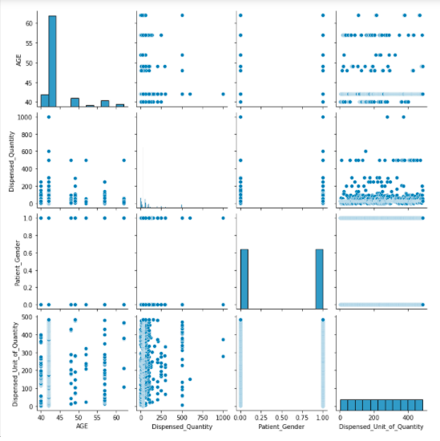
Selection OF machine learning MODEL or algorithm FOR KEY Insights
Step 1 : Prepare required data set for Deeper EDA for
model selection
Step 2 : Find Anomalies by cross mapper analysis
Step 3 : Strategically select the right model to address
the DS /ML/ DL use case insights

Slide 9
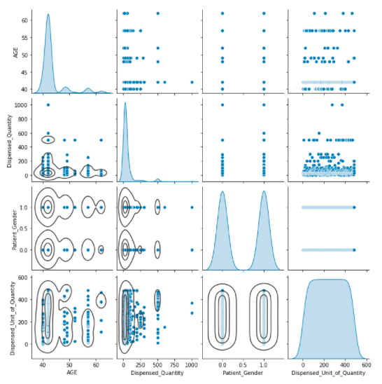
seaborn statistical data visualization
Seaborn is a Python data visualization library based on matplotlib.
It provides a high-level interface for drawing attractive and informative statistical graphics.

Slide 10
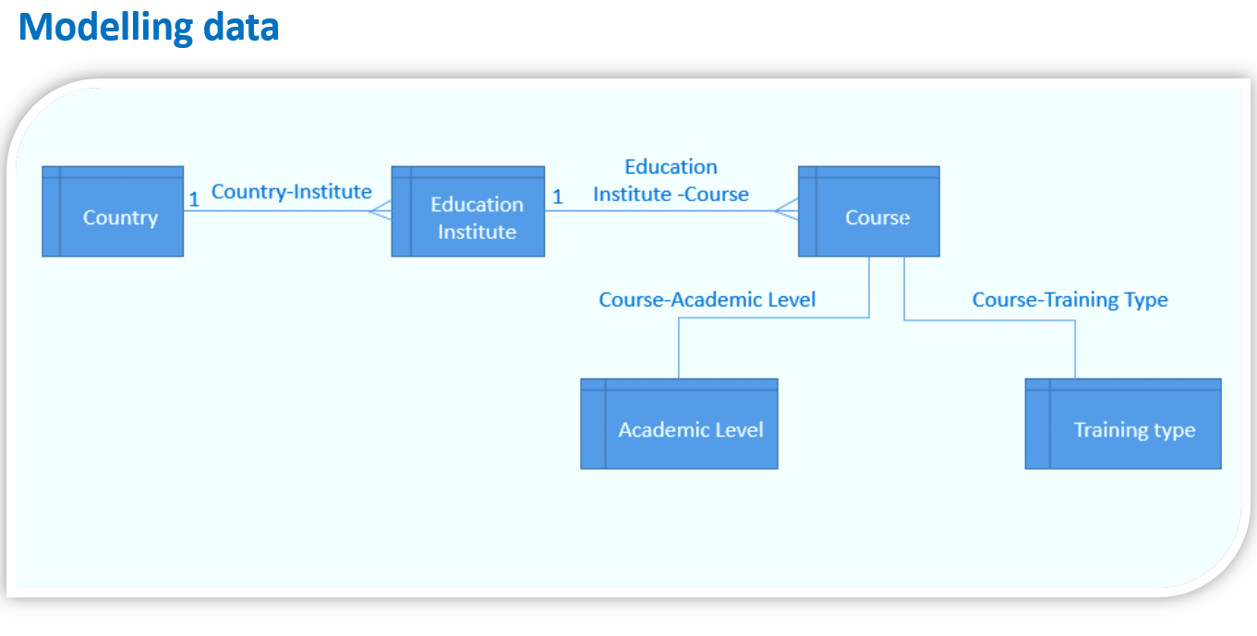

Slide 11
Thank You
Notes:
In Slide Show mode, click the arrow to enter the PowerPoint Getting Started Center.

