Slide 1

AI INTERNSHIP PROJECT · NAVIOTECH SOLUTION
Breast Cancer Classification using Neural Networks
Predicting whether a breast tumour is benign or malignant with TensorFlow / Keras
Sangini Agrawal
AI Intern · September 2026 batch
October 2026
Notes:
Introduce yourself and the project: a neural network that reads 30 measurements of breast-tumour cells and predicts whether the tumour is benign or malignant. Built in Python with TensorFlow/Keras as part of the Naviotech AI internship.

Slide 2

Problem statement
2.4 million
The challenge
women diagnosed with breast cancer worldwide in 2024
Early detection lowers mortality, but reviewing fine-needle aspirate (FNA) samples under a microscope is manual, slow and can vary between experts.
694,000
deaths from breast cancer worldwide in 2024
Problem to solve
Given 30 measurements of a tumour's cell nuclei, automatically classify it as benign or malignant with high accuracy, and most importantly without missing cancers.
41.9%
five-year survival in low-income countries (87.3% in high-income)
Source: World Health Organization, Global Breast Cancer Initiative (July 2026)
Notes:
Breast cancer is the most common cancer in women. WHO estimates 2.4 million diagnoses and 694,000 deaths in 2024. Mortality falls when cancer is caught early, but microscope review is manual and subjective. My goal: an AI model that classifies tumours from FNA measurements, prioritising sensitivity so that cancers are not missed.

Slide 3





Project objectives
Build an intelligent prediction system
A neural network that labels a tumour benign or malignant
Success criterion
> 90%
Understand classification algorithms
Neural networks, plus four classical ML baselines for comparison
classification accuracy required by the project guide
Apply healthcare data analysis
Explore, clean and pre-process real diagnostic measurements
Achieved
Apply neural networks to real data
96.5%
TensorFlow / Keras on the Breast Cancer Wisconsin dataset
on 114 unseen test patients
Evaluate with clinical metrics
Accuracy, precision, recall, F1-score, confusion matrix, ROC-AUC
Notes:
These five objectives come from the project guide. The success criterion was classification accuracy above 90%. The final model reached 96.5% on unseen patients.

Slide 4
Dataset: Breast Cancer Wisconsin (Diagnostic)
Source | UCI ML Repository (Wolberg et al., 1995), bundled in scikit-learn
Patients | 569 (one fine-needle aspirate each)
Features | 30 numeric: 10 nucleus properties × mean, standard error, worst
Properties | radius, texture, perimeter, area, smoothness, compactness, concavity, concave points, symmetry, fractal dimension
Target | 0 = Malignant, 1 = Benign
Data quality | 0 missing values, 0 duplicate rows
37.3% malignant · 62.7% benign → moderately imbalanced, so splits are stratified and malignant recall is tracked
Notes:
The dataset comes from the University of Wisconsin. Each of the 569 rows is one patient. Ten properties of the cell nuclei were measured from a digitised image, and for each one the mean, standard error and worst value are stored, giving 30 features. There are 212 malignant and 357 benign cases. The data is clean: no missing values and no duplicates.

Slide 5
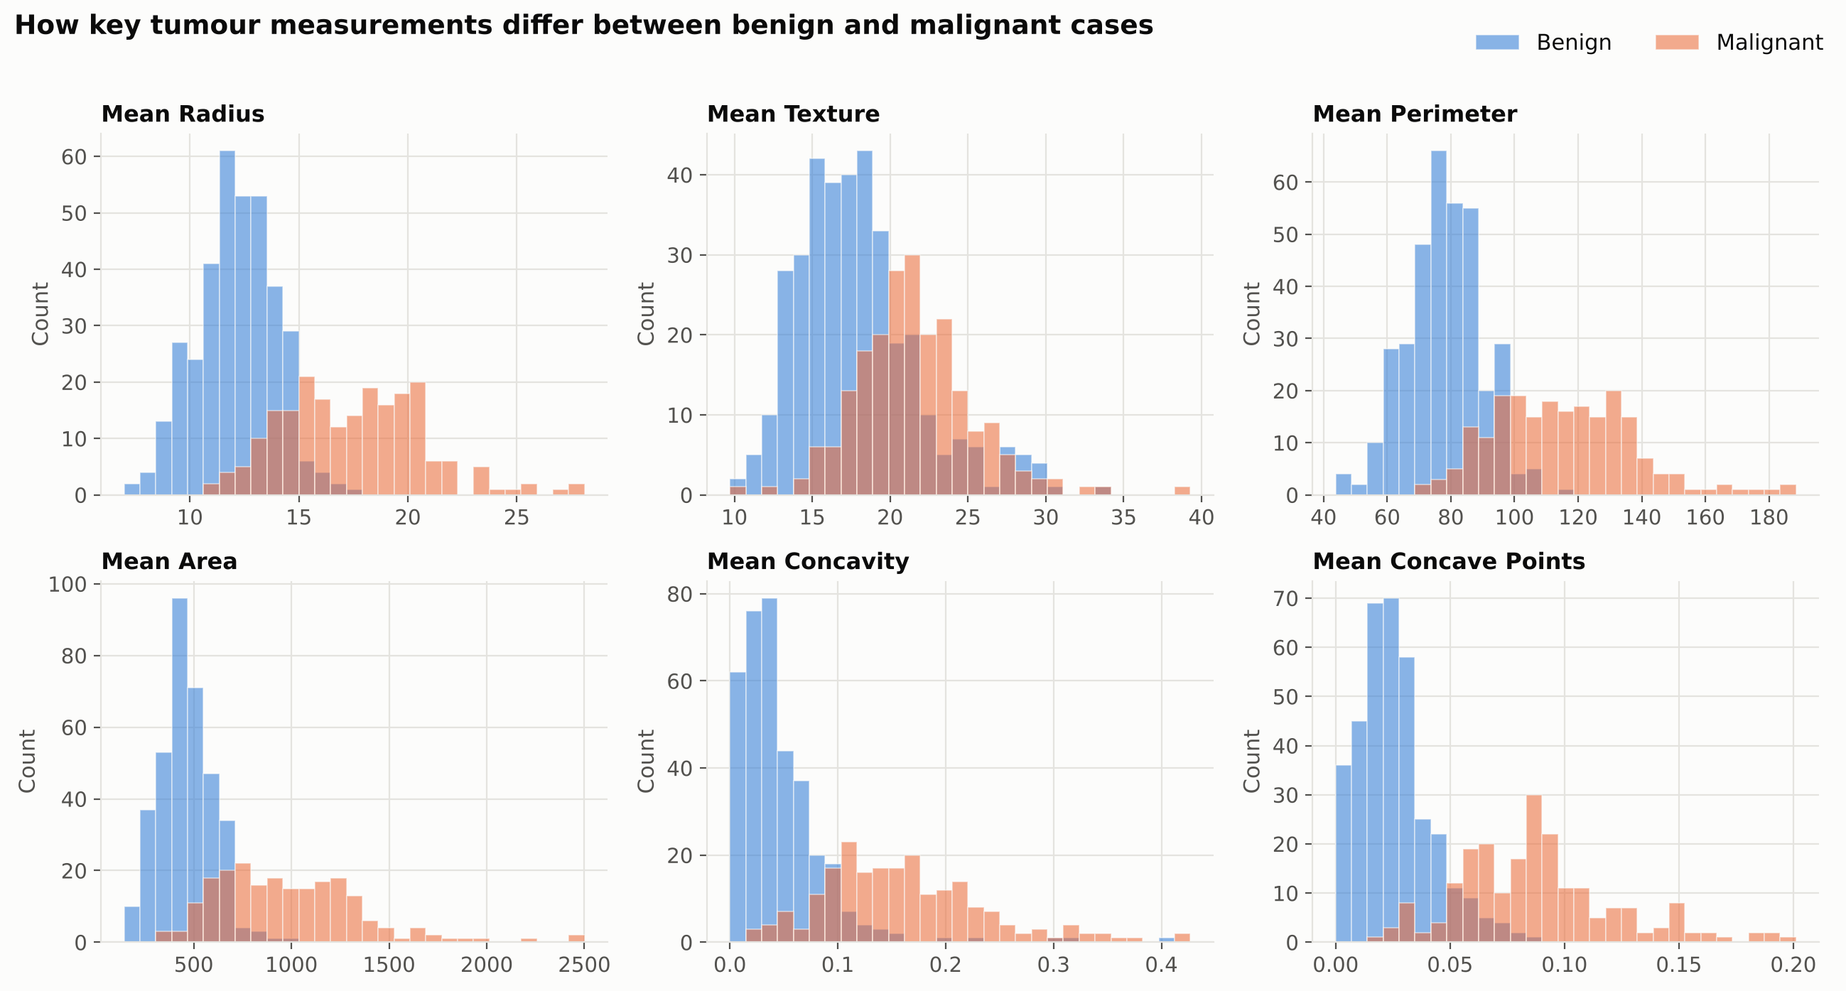
Exploratory analysis: what separates the two classes
Size
Malignant nuclei are larger: mean radius 17.5 vs 12.1, mean area 978 vs 463
Shape
Malignant cells have more concave (indented) boundaries: concave points 0.088 vs 0.026
Redundancy
Radius, perimeter and area are 0.99 correlated, so they all describe size
Orange = malignant, blue = benign. Overlap is small on size and concavity, so high accuracy is achievable.
Notes:
Histograms of six key features. Malignant tumours are clearly larger and more irregular. The correlation heatmap in the report shows radius, perimeter and area are almost perfectly correlated. These clear differences explain why a relatively small network can reach high accuracy.

Slide 6

Methodology: a seven-phase workflow
1
2
3
4
5
6
7
Data collection
Data cleaning
Preprocessing
Network design
Training
Evaluation
Prediction system
Load 569 patients from scikit-learn
Check missing values and duplicates
Stratified split + feature scaling
Dense layers, ReLU, Dropout, Softmax
Adam optimiser with early stopping
Clinical metrics, 5-fold CV, baselines
Diagnose a new patient's sample
Tools: Python 3 · TensorFlow / Keras · scikit-learn · NumPy · Pandas · Matplotlib · Seaborn · Google Colab / Jupyter · Git & GitHub
Notes:
The project follows the seven phases in the Naviotech project guide, from data collection through to a working prediction system. Everything is implemented in Python, with TensorFlow/Keras for the network and scikit-learn for data handling, metrics and baseline models.

Slide 7



Data preprocessing
Training: 364 patients (64%)
Validation: 91 patients (16%)
Test: 114 patients (20%)
Fits the network weights
Watched by early stopping
Used once, for final results
Stratified split
Standardisation
No data leakage
Each subset keeps the 37 / 63 malignant–benign ratio, so the test set is representative.
Features range from ≈ 0.05 (smoothness) to ≈ 2,500 (area). StandardScaler rescales each to mean 0, std 1 so no feature dominates training.
The scaler is fitted on training data only, then applied to validation and test data. Labels are already 0/1, ready for sparse categorical cross-entropy.
Notes:
First 20% of patients are set aside as the test set and not touched until the end. Of the rest, 20% form a validation set that early stopping monitors. Splits are stratified. Because the features have very different scales, StandardScaler puts them all on the same scale; it is fitted on training data only, to avoid leaking information from the test set.

Slide 8
Neural network architecture
Input
30 features
Hidden 1
Dense · 16
ReLU
Dropout
20% (training only)
Hidden 2
Dense · 8
ReLU
Output
Dense · 2
Softmax
Optimiser | Adam, learning rate 0.001
Loss function | Sparse categorical cross-entropy
Batch size / max epochs | 32 / 100
Early stopping | val_loss, patience 10, restore best weights
Trainable parameters | 650
Design choices
ReLU learns non-linear patterns
Dropout reduces over-fitting
Softmax gives P(malignant) + P(benign) = 1 (the starter code's sigmoid was replaced)
Small size chosen: bigger networks did not do better
Notes:
The network takes 30 standardised features, passes them through two hidden layers of 16 and 8 neurons with ReLU, with 20% dropout after the first, and ends in 2 softmax neurons that output the probability of each class. Only 650 parameters. Adam optimiser, sparse categorical cross-entropy loss. I replaced the sigmoid output in the starter code with softmax, which is the correct pairing for this loss. I tried a few bigger sizes too, but they were not better, so I kept the small one.

Slide 9
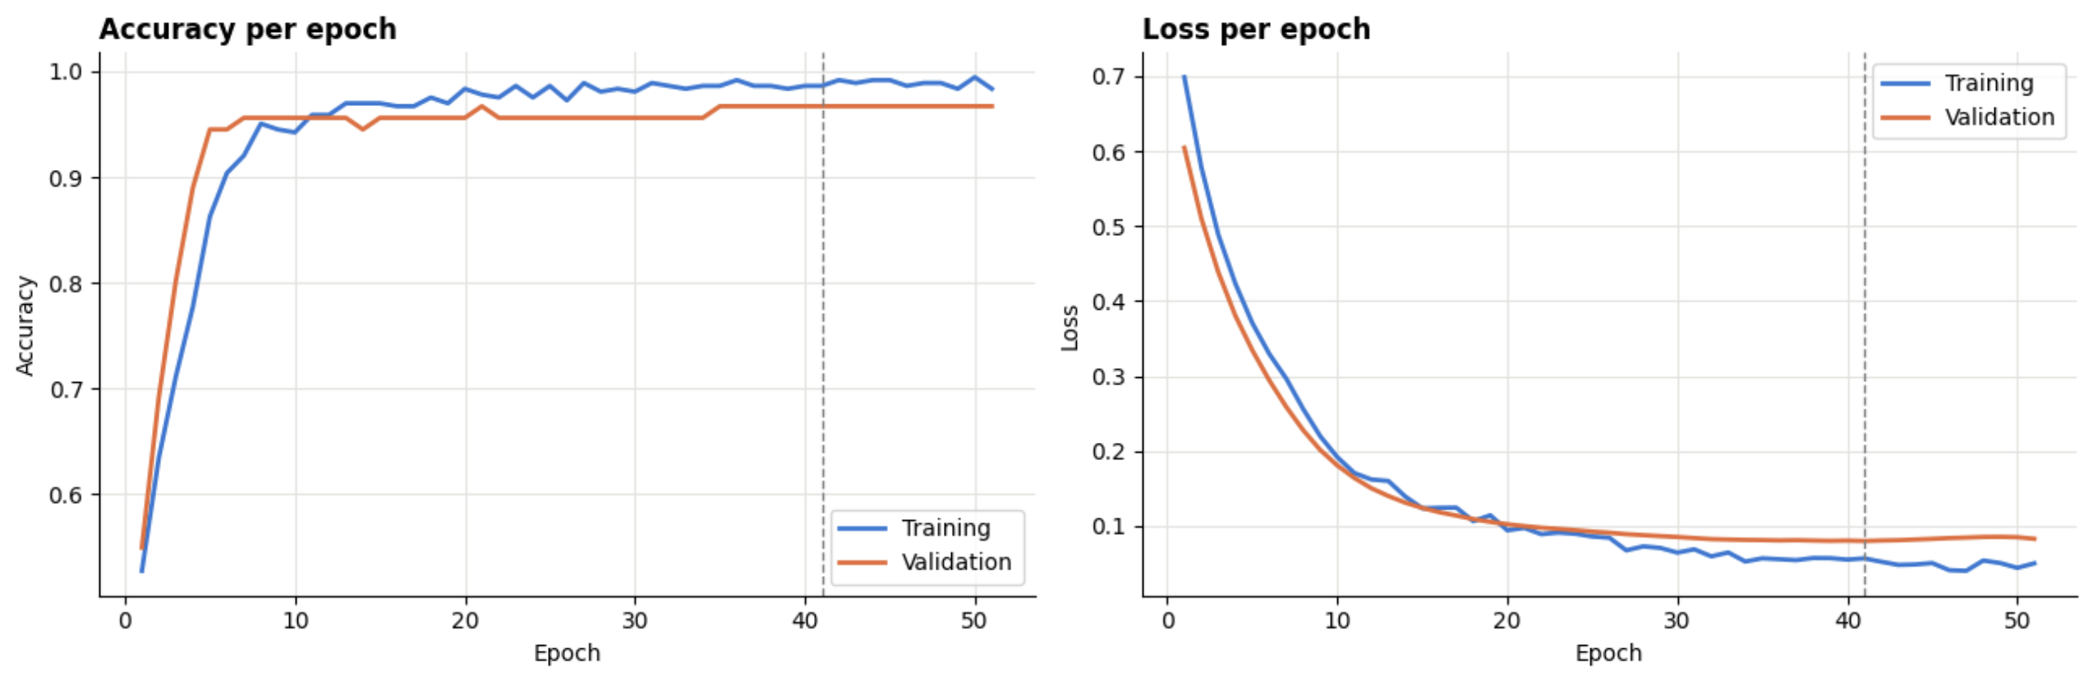
Implementation: training the model
51 epochs
training stopped automatically by early stopping
Epoch 41
best validation loss; these weights were restored
98.6% / 96.7%
training / validation accuracy at the best epoch
Notes:
Training and validation curves rise and fall together and stay close, which means the model is not over-fitting. Early stopping watched the validation loss; it stopped improving after epoch 41, training stopped at epoch 51, and the best weights were restored automatically.

Slide 10
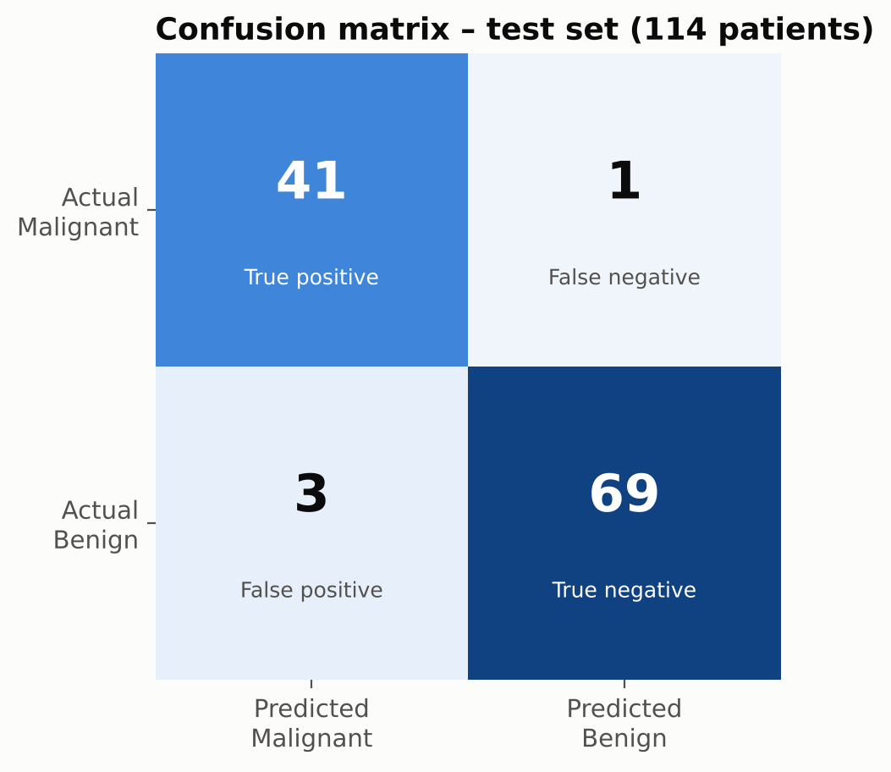
Results on 114 unseen test patients
96.5%
97.6%
0.994
97.7%
Accuracy
target > 90%
Sensitivity
41 of 42 cancers detected
ROC-AUC
1.0 = perfect ranking
5-fold CV accuracy
± 0.9% across folds
Reading the confusion matrix
41 malignant tumours correctly flagged (true positives)
69 benign tumours correctly cleared (true negatives)
1 cancer missed (false negative): the costliest error, kept to a minimum
3 benign cases flagged for review (false positives): safer than missing a cancer
Precision 93.2% · F1 95.3% · Specificity 95.8%
Notes:
The model reached 96.5% accuracy on 114 patients it had never seen, well above the 90% target. More importantly, sensitivity is 97.6%: it caught 41 of 42 cancers. The ROC-AUC of 0.994 shows it ranks malignant cases above benign ones almost perfectly. Cross-validation over all 569 patients gives 97.7%, confirming the result is not a lucky split.

Slide 11
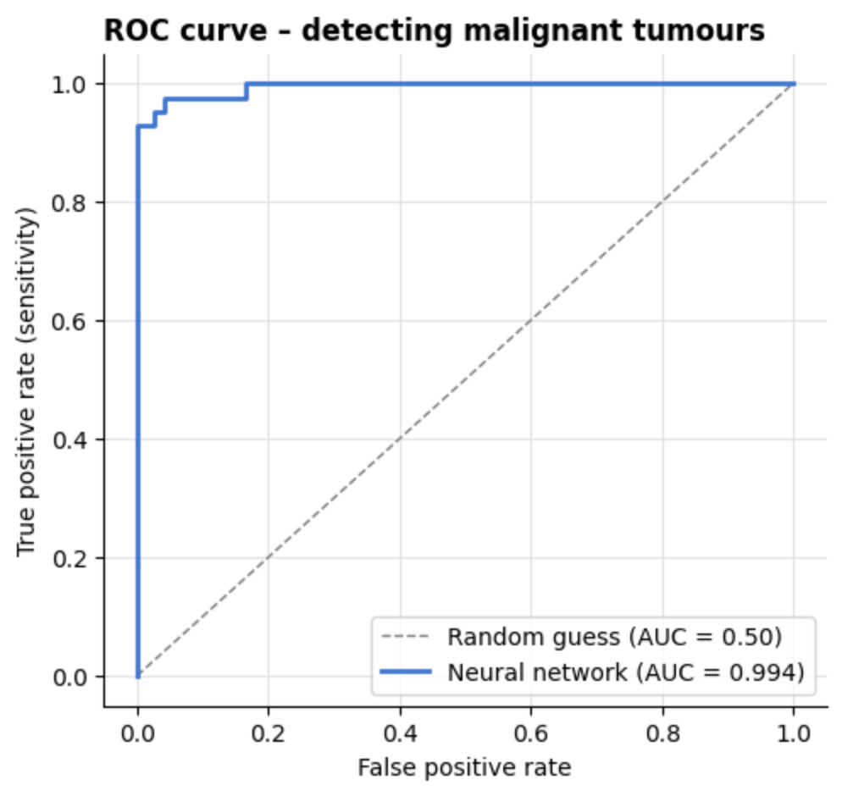
Evaluation in detail
Class | Precision | Recall | F1-score | Patients
Malignant | 93.2% | 97.6% | 95.3% | 42
Benign | 98.6% | 95.8% | 97.2% | 72
Macro average | 95.9% | 96.7% | 96.3% | 114
Precision: Of the tumours called malignant, how many really were
Recall (sensitivity): Of the real cancers, how many the model caught
F1-score: Balance of precision and recall (harmonic mean)
ROC-AUC: How well the model ranks malignant above benign at every threshold
Notes:
The ROC curve hugs the top-left corner, far from the diagonal of random guessing. The table is the classification report for each class. Precision answers 'when the model says cancer, is it right?'; recall answers 'of all cancers, how many did it find?'. In screening, recall for malignant tumours matters most.

Slide 12



Comparison with classical machine learning
Model | Test accuracy | Recall (malignant) | F1 (malignant) | ROC-AUC | 5-fold CV accuracy
Neural Network (ours) | 96.49% | 97.62% | 95.35% | 0.994 | 97.72% ± 0.89%
Logistic Regression | 98.25% | 97.62% | 97.62% | 0.996 | 97.37% ± 1.66%
Support Vector Machine (RBF) | 98.25% | 97.62% | 97.62% | 0.995 | 97.72% ± 1.63%
K-Nearest Neighbours (k=5) | 95.61% | 92.86% | 93.98% | 0.979 | 96.31% ± 1.79%
Random Forest (200 trees) | 94.74% | 92.86% | 92.86% | 0.994 | 95.43% ± 1.02%
Ties for best sensitivity
Same malignant recall (97.6%) as the strongest baselines
Most consistent
Lowest variation across CV folds (± 0.9%)
Key finding
On small, well-separated tabular data, simple linear models are just as strong
Notes:
To check whether a neural network was a sensible choice, I trained four classical models on exactly the same data. All reach 95 to 98%. The network ties for the best sensitivity and is the most consistent across cross-validation folds. Logistic regression and SVM are equally accurate on this small dataset, which I found interesting: deep learning helps more on large or image data.

Slide 13
Predictive system: diagnosing a new sample
30 raw measurements
# Notebook
predict_tumour(input_data)
Prediction: BENIGN (confidence 99.9%)
predict_tumour(dataset.data[0])
Prediction: MALIGNANT (confidence 100.0%)
# Command line
$ python -m src.predict --values "17.99,..."
$ python -m src.predict --csv patients.csv
Same StandardScaler as training
Trained neural network
Softmax probabilities
argmax → diagnosis
Educational tool: supports, never replaces, a doctor's diagnosis.
Notes:
The predictive system takes the 30 measurements of a new sample, applies the same scaler used in training, runs the network and returns the diagnosis with its probability. It works inside the notebook and as a command-line tool that also accepts a CSV of many patients. It is an educational tool, not a medical device.

Slide 14


Conclusion and future scope
Conclusion
Future scope
A 650-parameter network reached 96.5% test accuracy, above the 90% target
It caught 41 of 42 cancers (sensitivity 97.6%)
5-fold cross-validation (97.7% ± 0.9%) confirms the result is stable
One cancer was missed with high confidence, so it should support doctors, not replace them
Classical models are equally strong on this small, tabular dataset
Train on larger, multi-hospital datasets
Explain each prediction with SHAP values
Tune the decision threshold for even higher sensitivity
Use CNNs directly on histopathology images
Deploy as a web app (Streamlit / Flask) for clinicians
Notes:
To conclude: the project met its target with a small, stable neural network that rarely misses a cancer. Next steps would be more diverse data, explanations for each prediction, threshold tuning, image-based models and a simple web app.

Slide 15


Thank you
Questions and discussion
github.com/sangini-agrawal/breast-cancer-classification-nn
sanginiagrawal21@gmail.com
Notes:
Thank the audience and the Naviotech team. Share the GitHub repository and invite questions.

