Slide 1
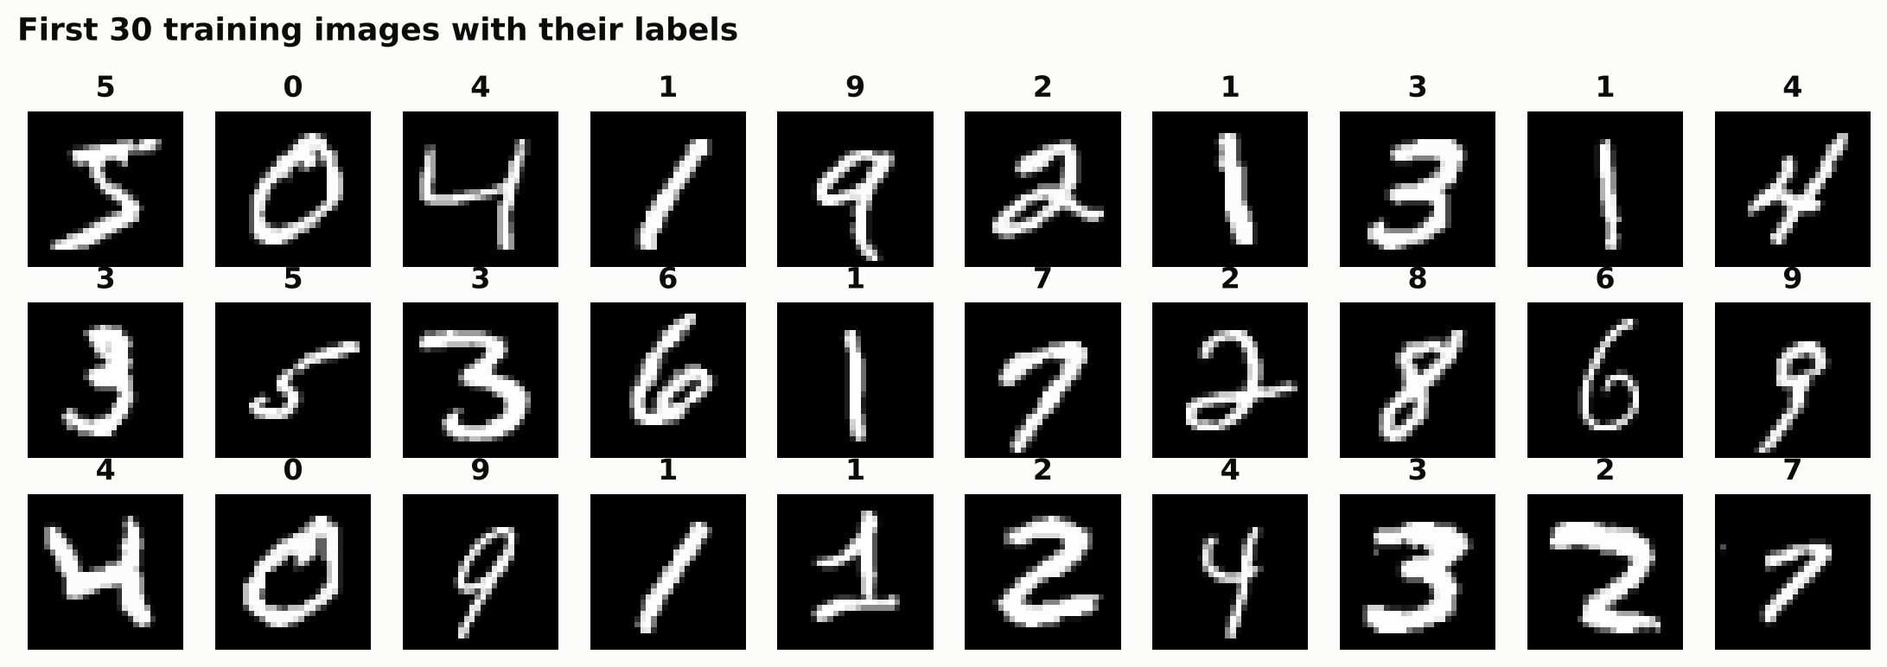
AI INTERNSHIP PROJECT · NAVIOTECH SOLUTION
Handwritten Digit Recognition using Neural Networks
Teaching a computer to read handwritten digits 0–9 with TensorFlow / Keras and the MNIST dataset
Sangini Agrawal
AI Intern · September 2026 batch
October 2026
Notes:
Introduce the project: a neural network that recognises handwritten digits, trained on the MNIST dataset of 70,000 images, plus a system where a user can draw or upload their own digit.

Slide 2





Problem statement
Why it matters
The challenge
Everyone writes differently: slant, thickness, size, loops and open or closed shapes all vary. A '4' can look like a '9', a '7' like a '2'.
Huge amounts of information are still handwritten: cheques, postal codes, exam sheets and paper forms. Reading them by hand is slow, costly and error-prone.
Bank cheque processing
Postal code recognition
Problem to solve
Given a 28 × 28 grayscale image of a single handwritten digit, automatically identify which digit (0–9) it is with more than 95% accuracy, and let users test the system with their own handwriting.
OCR and form processing
Educational tools
Notes:
Handwriting is everywhere: cheques, postcodes, forms, exam papers. Reading it automatically saves time and errors. The difficulty is that everyone writes differently. The problem: recognise a single handwritten digit from a 28 by 28 image with over 95% accuracy, and let users try it with their own handwriting.

Slide 3





Project objectives
Understand neural network fundamentals
Target
Neurons, layers, activations, loss, optimisers
> 95%
Learn image classification techniques
Images as pixel grids; dense networks and CNNs
accuracy (project guide)
Train a model on the MNIST dataset
Achieved
60,000 training and 10,000 test images
99.19%
97.93%
Evaluate accuracy and performance
Accuracy, precision, recall, F1, confusion matrix
Deploy a digit recognition system
CNN · dense network
Users draw or upload a digit and get a prediction
Notes:
These five objectives come straight from the project guide. The target was over 95% accuracy. The dense neural network reached 97.93% and the improved convolutional network 99.19%.

Slide 4
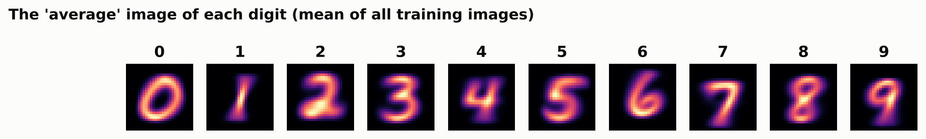
The MNIST dataset
Source | LeCun, Cortes & Burges; built into Keras
Images | 70,000 handwritten digits
Size | 28 × 28 pixels, grayscale
Pixel values | 0 (black) to 255 (white)
Split | 60,000 training · 10,000 test
Classes | 10 digits, 5,421–6,742 training images each
81% of all pixels are pure black background; the digit occupies the centre 20 × 20 area.
Top: the first 30 training images. Bottom: the 'average' of every image of each digit.
Notes:
MNIST is the classic benchmark for handwritten digits: 70,000 small grayscale images, 60,000 for training and 10,000 for testing, roughly balanced across the ten digits. Each image is a 28 by 28 grid of numbers from 0 to 255. Most pixels are black background.

Slide 5
Exploring the data
Balanced classes
Every digit has 5,421–6,742 training images, so accuracy is a fair measure.
Mostly background
81% of pixels are pure black; the information sits in the strokes.
Clear shapes, big variety
Average images show each digit clearly, but individual samples vary in slant, thickness and style.
Notes:
The digits are roughly balanced, with digit 1 the most common and 5 the least. Most pixels are background. The average images show clear digit shapes, but individual handwriting varies a lot, which is what makes this a learning problem.

Slide 6

Methodology: six phases
1
2
3
4
5
6
Data collection
Preprocessing
Model development
Model training
Testing & evaluation
Prediction
Load MNIST and explore samples
Normalise to 0–1, reshape, validation split
Dense network and CNN
Adam, early stopping, track accuracy and loss
10,000 unseen images, full metrics
Users draw or upload their own digit
Tools: Python · TensorFlow / Keras · NumPy · Pandas · Matplotlib · scikit-learn · Pillow · Google Colab / Jupyter · Git & GitHub · HTML/JavaScript (browser demo)
Notes:
The work follows the six phases in the project guide: collect and explore the data, preprocess it, design the network, train it, evaluate it on unseen images, and build a prediction system that accepts the user's own handwriting.

Slide 7



Data preprocessing
Training: 54,000
Val: 6,000
Test: 10,000
Training images fit the weights · validation images drive early stopping · test images give the final score, once
Normalisation
Validation split
Reshape & labels
Pixel values 0–255 are divided by 255, giving 0–1. Small, similar-sized inputs make training faster and more stable.
6,000 training images (stratified) are held out for early stopping. The starter guide validated on the test set; keeping them separate makes the test score fair.
Dense network: each 28×28 image is flattened to 784 values. CNN: 28×28 → 28×28×1 (one channel). Labels stay as integers 0–9.
Notes:
Pixels are scaled from 0 to 255 down to 0 to 1. I hold out 6,000 training images as a validation set for early stopping, so the 10,000 test images are only used once. The dense network flattens each image to 784 numbers; the CNN keeps the 2D grid with one channel.

Slide 8
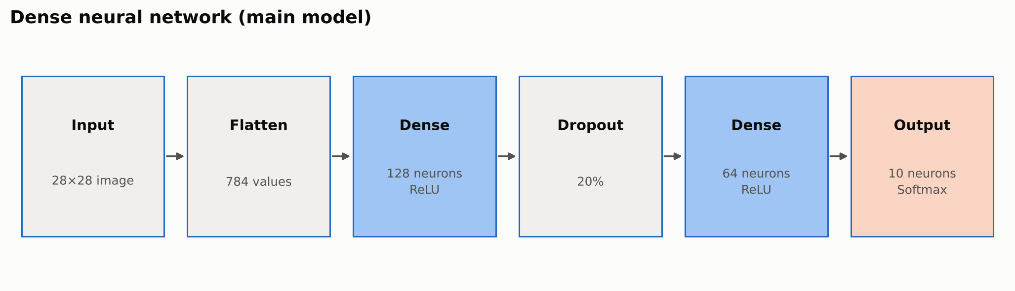
Model 1: dense neural network
Layer | Output | Parameters
Flatten | 784 | 0
Dense, ReLU | 128 | 784×128 + 128 = 100,480
Dropout 20% | 128 | 0
Dense, ReLU | 64 | 128×64 + 64 = 8,256
Dense, Softmax | 10 | 64×10 + 10 = 650
Total |  | 109,386
Design choices
ReLU lets the network learn non-linear patterns
Dropout reduces over-fitting
Softmax gives 10 probabilities that sum to 1 (replaces the starter's sigmoid)
Adam optimiser, sparse categorical cross-entropy loss
Notes:
The main model is a dense network as described in the project guide. Flatten turns the 28 by 28 image into 784 numbers, two hidden layers of 128 and 64 ReLU neurons learn stroke patterns, dropout reduces over-fitting, and a softmax layer of 10 neurons outputs one probability per digit. It has 109,386 parameters.

Slide 9
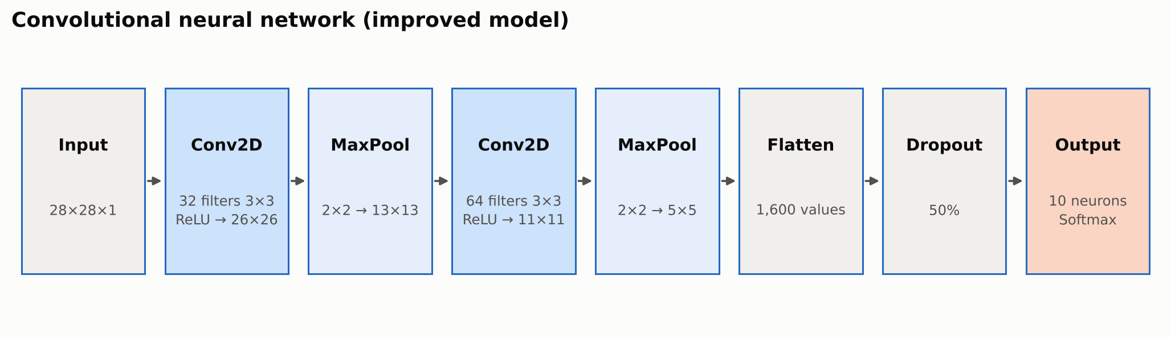



Model 2: convolutional neural network
Convolution
Max pooling
Weight sharing
A 3×3 filter slides over the image and lights up where it finds its pattern: an edge, a curve, a loop end.
Keeps the strongest signal in each 2×2 block, halving the size and tolerating small shifts.
The same filter is reused everywhere, so the CNN needs only 34,826 parameters, 3× fewer than the dense network.
Notes:
A dense network sees the image as a flat list and doesn't know which pixels are neighbours. A convolutional network slides small 3 by 3 filters over the image to detect local shapes wherever they appear, then max pooling shrinks the image while keeping the strongest signals. Because filters are shared across the image, the CNN needs far fewer parameters.

Slide 10
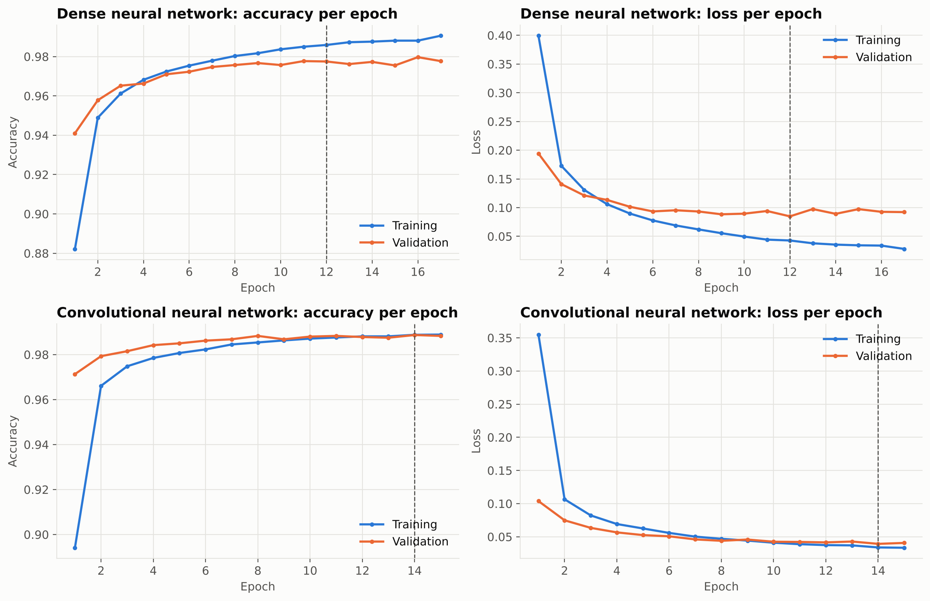
Implementation: training the models
17 → epoch 12
Dense network: early stopping, best weights kept
15 → epoch 14
CNN: ran all 15 epochs, best at epoch 14
97.8% / 98.9%
validation accuracy at the best epoch (dense / CNN)
Batch 128 · Adam
learning rate 0.001, up to 30 / 15 epochs
Notes:
Both models learn quickly: validation accuracy passes 97% within a few epochs. Early stopping watched the validation loss and stopped the dense network after 17 epochs, keeping the weights from epoch 12. The CNN used all 15 epochs and its best epoch was 14. The CNN's training and validation curves stay close together, so it over-fits very little.

Slide 11
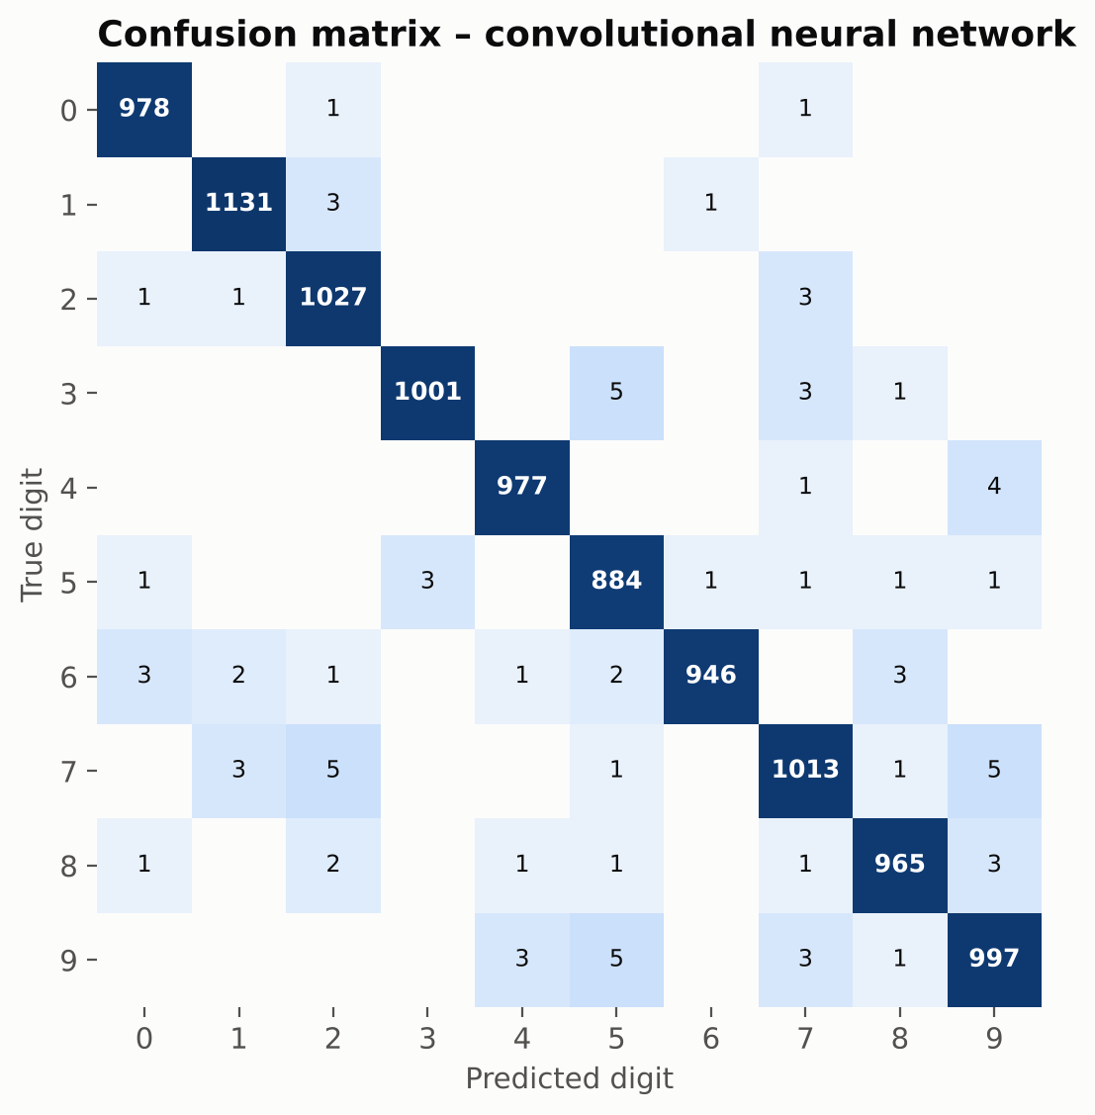
Results on 10,000 unseen test images
99.19%
97.93%
0.992
98.5%
CNN accuracy
81 mistakes in 10,000
Dense network accuracy
207 mistakes in 10,000
CNN macro F1-score
precision and recall ≈ 0.992
Hardest digit for the CNN: 7
sometimes read as 9 or 2
Reading the confusion matrix
Rows are the true digit, columns the prediction; the dark diagonal is correct answers
CNN's most common mistakes: 9→5 (5), 7→9 (5), 7→2 (5)
Dense network's: 4→9 (14), 9→4 (9), 8→3 (8)
The CNN is better on every digit and makes less than half the errors (207 → 81)
Both models clearly exceed the 95% target
Notes:
On 10,000 test images the CNN reached 99.19% and the dense network 97.93%, both well above the 95% target. Precision, recall and F1 are all around 0.99 for the CNN. The confusion matrix shows the remaining mistakes are between similar-looking digits.

Slide 12
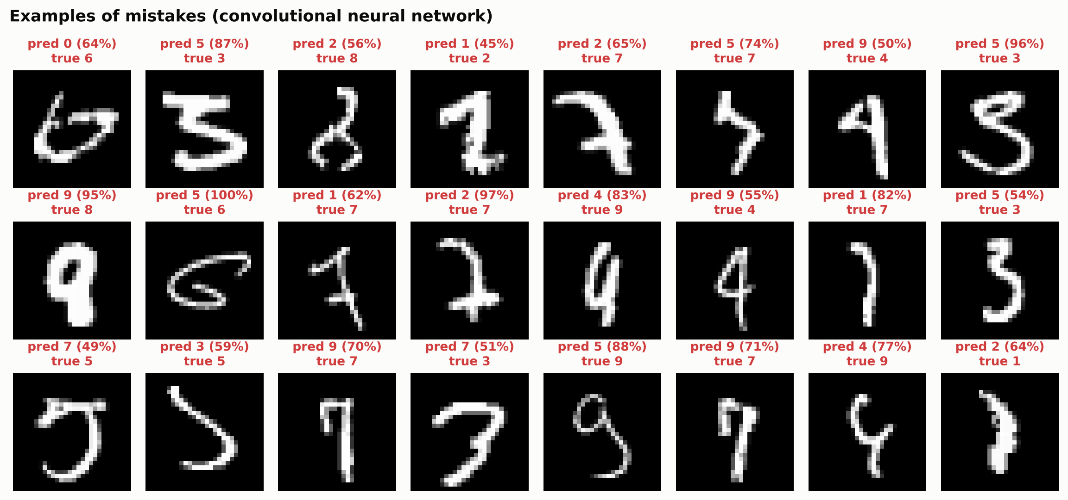
Error analysis: where and why it fails
93.5%
of test images get ≥ 99% confidence
and those are right 99.97% of the time
80%
of the CNN's mistakes
have confidence below 90%: the model 'knows' when it is unsure
Ambiguous writing
Many errors are hard even for people
4s that look like 9s, 7s that look like 2s or 9s
Notes:
These are some of the CNN's mistakes. A lot of them are badly written, and I could not read some of them myself. The model's confidence is also useful: most images get over 99% confidence and are almost always right, while most mistakes come with low confidence. In a real system, low-confidence digits could be sent to a human.

Slide 13



Comparison with classical machine learning
Model | Test accuracy | Errors / 10,000 | Published (LeCun et al., 1998)
Convolutional neural network | 99.19% | 81 | LeNet-5 CNN: 99.05%
Dense neural network | 97.93% | 207 | 2-layer NN (300 units): 95.3%
K-Nearest Neighbours (k=3) | 96.99% | 301 | k-NN (L2): 95.0%
Random Forest (100 trees) | 96.96% | 304 | –
Logistic Regression | 92.45% | 755 | Linear classifier: 88.0%
CNN is best
Its filters beat every method that uses flat pixels
Fewer parameters
CNN 34,826 vs dense 109,386
Compared with research
The CNN is slightly better than LeNet-5 (1998)
Notes:
I compared both networks with three classical algorithms on the same pixels. Logistic regression draws straight boundaries and reaches about 92%. k-nearest neighbours and random forest reach about 97%. The dense network beats them, and the CNN is best with only 81 errors. My CNN is even slightly better than LeNet-5 from the classic 1998 paper by LeCun and colleagues.

Slide 14
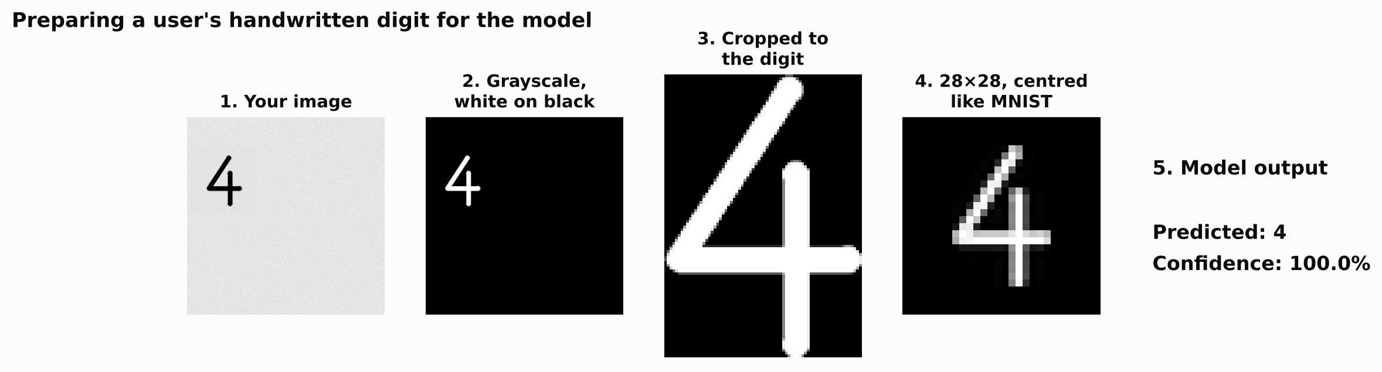
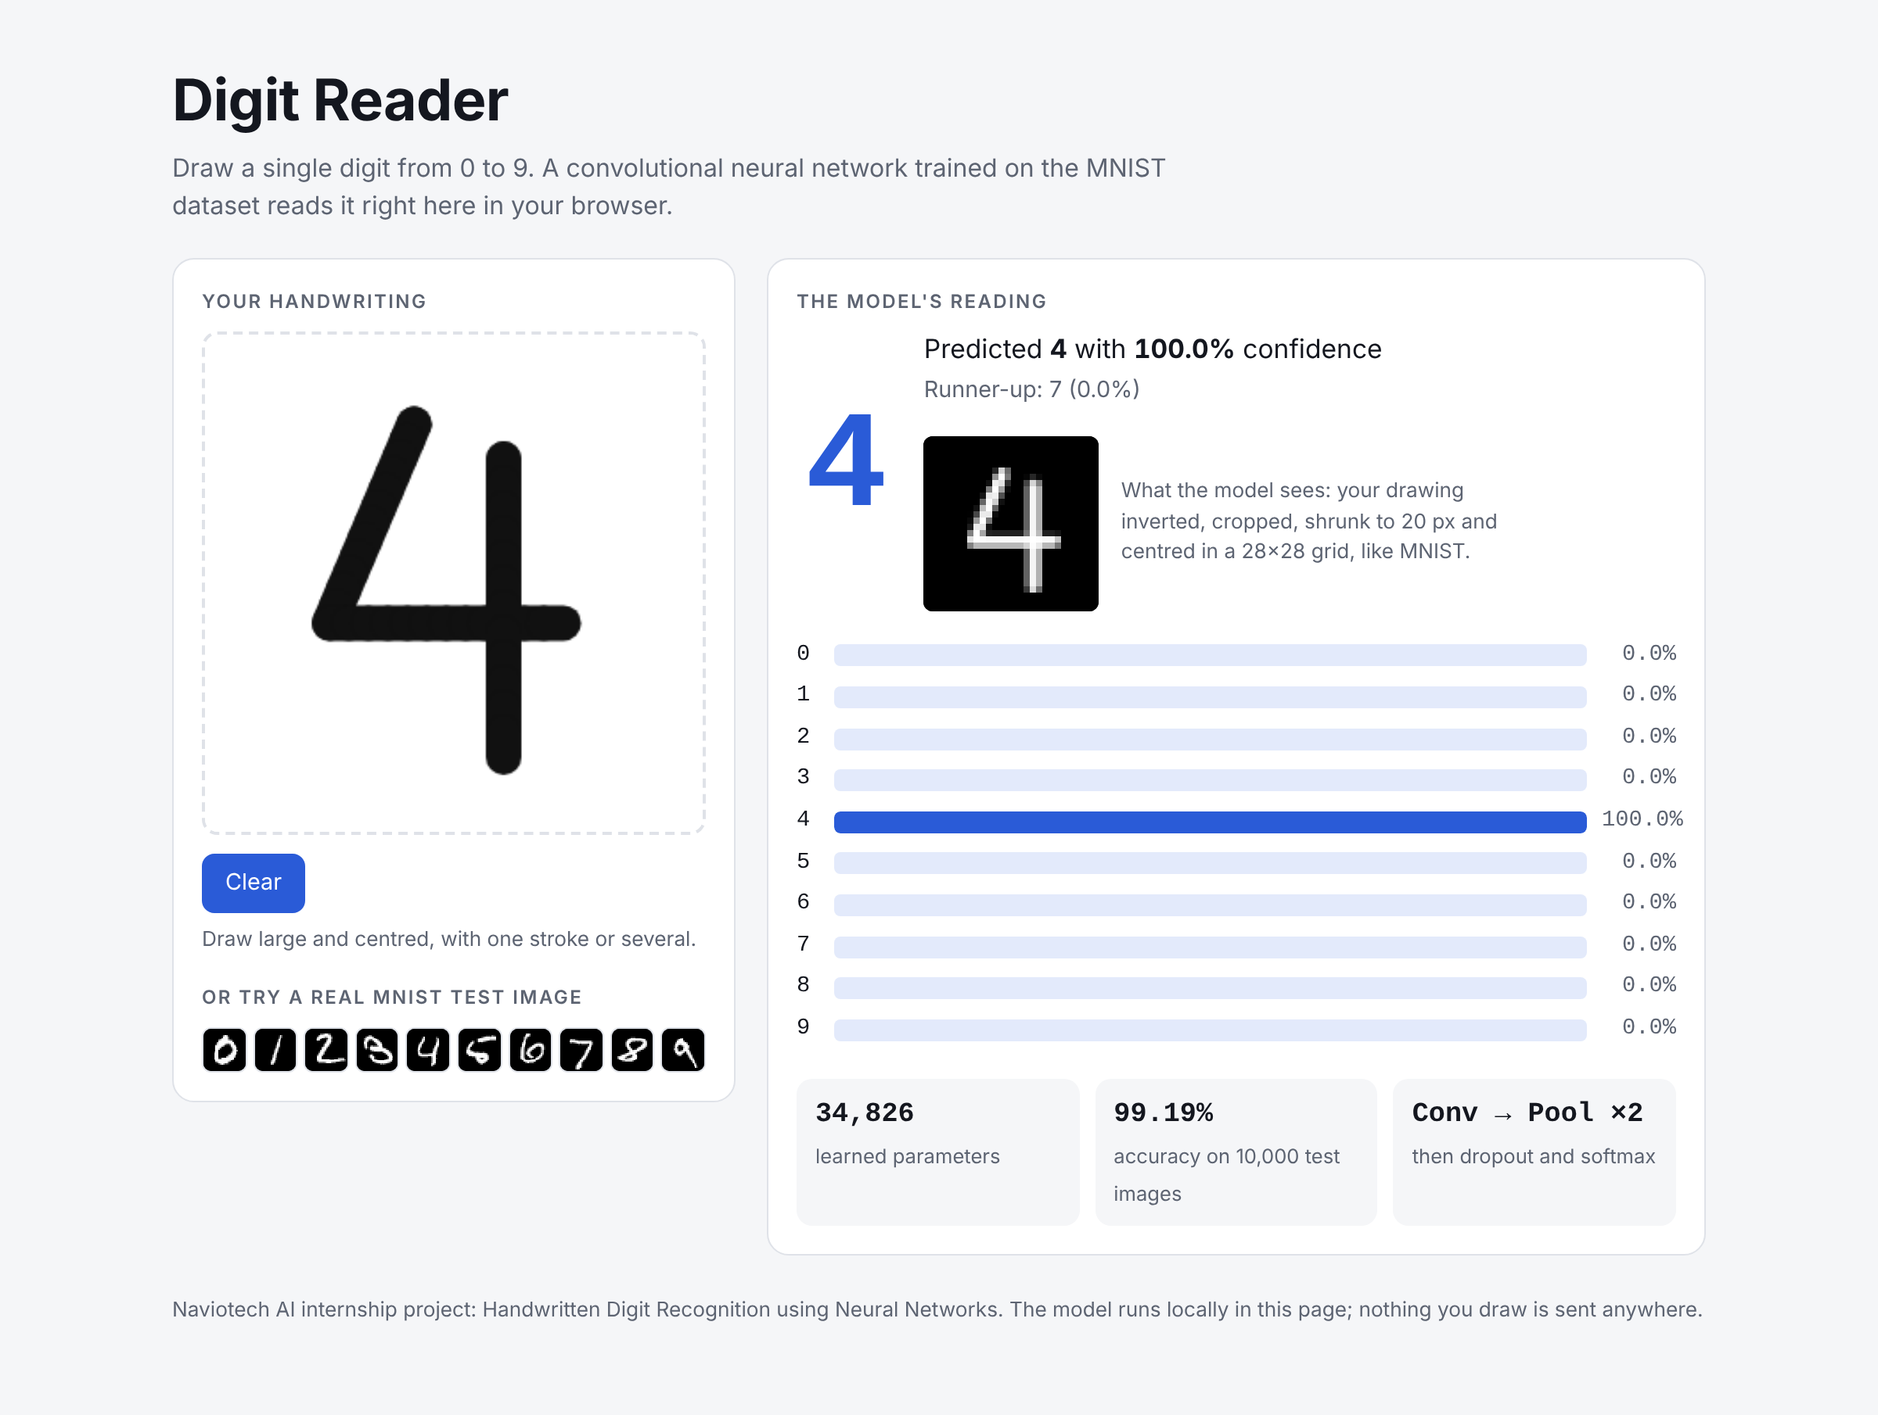
Prediction system: reading your handwriting
16 / 30
photo-style digits read correctly with MNIST-style preprocessing
vs 4 / 30
with the starter code's plain resize
Three ways to try it
Colab: draw on a canvas with mouse or finger
Upload a photo of a digit on paper, or run python -m src.predict --image
Browser demo: draw and see the CNN's answer instantly, offline
Notes:
To let users test their own handwriting, the image is prepared the same way MNIST was: inverted to white on black, background removed, cropped, resized to fit 20 by 20 pixels and centred by its centre of mass in a 28 by 28 grid. On 30 photo-style test images this got 16 right, against only 4 with a plain resize. Very small, faint digits on noisy paper are still hard for it. Users can draw in Colab, upload a photo, use the command line, or use the browser demo shown on the right.

Slide 15


Conclusion and future scope
Conclusion
Future scope
Dense network: 97.93%; CNN: 99.19%. Both beat the 95% target
The CNN makes less than half the errors with 3× fewer parameters
Confidence scores flag most mistakes
Preparing user images like MNIST is important for real handwriting
Data augmentation: rotations, shifts, distortions
Deeper CNNs with batch normalisation
Multi-digit numbers and letters (EMNIST)
Reject unclear input using confidence
Mobile app with TensorFlow Lite
Thank you · Questions? github.com/sangini-agrawal/mnist-digit-classification-nn
Notes:
To conclude: both networks beat the target; the CNN is the most accurate with fewer parameters; its confidence scores flag likely mistakes; and proper preprocessing lets it read real handwriting. Next steps would be data augmentation, deeper networks, multi-digit recognition and a mobile app. Thank you, I'm happy to take questions.

