Slide 1
SANGITAA M
Final Project

Slide 2
PROJECT TITLE
Advancing Emotion Recognition from Facial Expressions using Deep Convolutional Neural Network
2

Slide 3


AGENDA
PROBLEM STATEMENT
PROJECT OVERVIEW
END USERS
SOLUTION AND VALUE PROPOSITION
NOVELTY
MODELLING
RESULTS
3/21/2024 Annual Review

Slide 4

PROBLEM STATEMENT
The problem entails accurately detecting human emotions from facial expressions using computational methods.
Understanding human emotions is pivotal for numerous applications, including human-computer interaction, mental health monitoring, and affective computing.
Emotion detection enables personalized user experiences, assists in mental health diagnosis, and enhances the effectiveness of emotion-aware systems.
Challenges:
- Variability in Facial Expressions
- Lighting Conditions
- Occlusions

Slide 5

PROJECT OVERVIEW
Developing a Convolutional Neural Network (CNN) model for emotion detection using facial expressions.
Incorporation of image augmentation techniques during the training process to enhance the model's robustness and generalization capabilities
To accurately classify emotions from facial images and implement real-time emotion detection.
Training the model on the FER2013 dataset and integrating it with OpenCV for real-time inference.

Slide 6

WHO ARE THE END USERS?
Potential users of the emotion detection system: Researchers, psychologists, software developers, mental health professionals, and individuals interested in affective computing.
Applications: Human-computer interaction, sentiment analysis, personalized user experiences, mental health diagnosis, and emotion-aware systems.

Slide 7

YOUR SOLUTION AND ITS VALUE PROPOSITION
Solution: Developing a CNN model capable of accurately detecting emotions from facial expressions in real-time.
Value Proposition:
Improved human-computer interaction.
Enhanced user experiences in applications.
Assistive technology for mental health professionals.
Insights into user behavior and emotions for researchers.

Slide 8

THE WOW IN YOUR SOLUTION
Integration of OpenCV with CNN model for real-time emotion detection.
Implementation of image augmentation techniques to enhance model robustness.
Development of a comprehensive pipeline for emotion detection, including data preprocessing, model training, and real-time inference.
3/21/2024 Annual Review
8

Slide 9
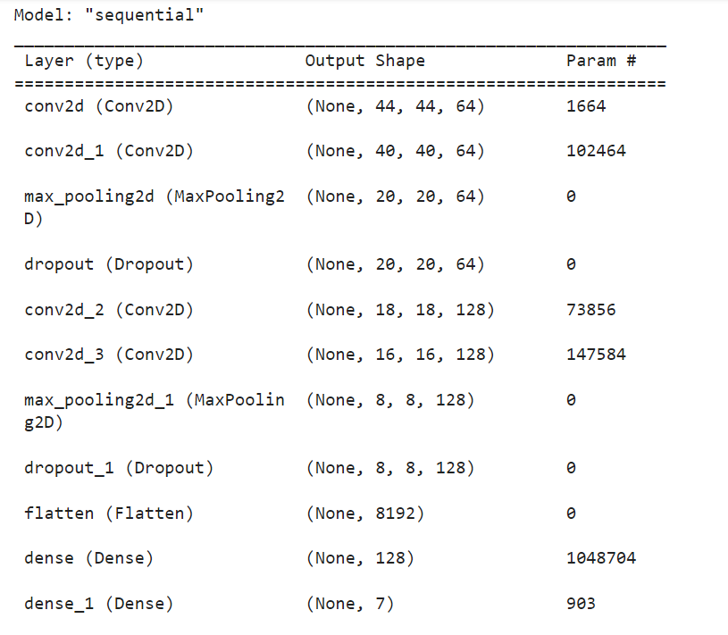
MODELLING
CNN MODEL:
9

Slide 10
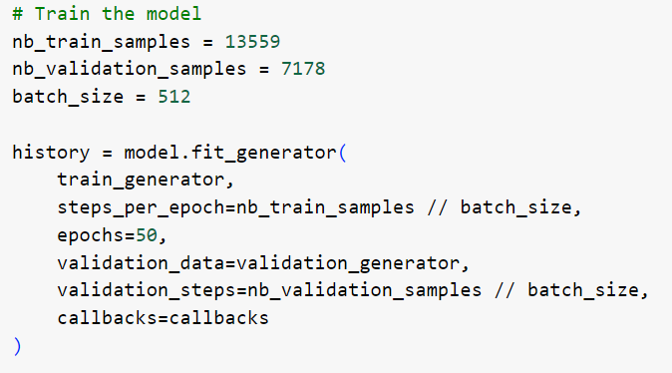

RESULTS
Demo Link
10

