Slide 1
Employee Attrition & Workforce Analytics
Power BI Data Analytics Project
HR Analytics Dashboard
Data-driven insights to understand employee turnover

Slide 2
Project Overview
Analyze employee workforce data using Power BI.
Measure employee attrition and identify high-risk workforce segments.
Explore department, job role, salary, overtime, satisfaction and tenure patterns.
Build an interactive dashboard for HR decision support.

Slide 3
Business Problem
High employee turnover can increase recruitment and training costs.
HR teams need visibility into where attrition is concentrated.
Manual reports make it difficult to compare departments and employee segments.
The dashboard provides a single interactive view of workforce and attrition metrics.

Slide 4
Objectives
Calculate total employees, attrition and attrition rate.
Compare attrition across departments and job roles.
Analyze the relationship between attrition and overtime, salary, satisfaction and tenure.
Create interactive filters for HR exploration.
Generate actionable recommendations from observed patterns.

Slide 5
Dataset & Key Variables
Records: 500 employees.
Core fields: Employee ID, Age, Gender, Department, Job Role, Education.
Workforce fields: Years at Company, Job Level, Monthly Salary, Overtime.
Engagement fields: Job Satisfaction, Performance Rating, Training.
Target field: Attrition (Yes/No).

Slide 6
Data Preparation
Imported the HR dataset into Power BI.
Checked data types and missing/duplicate records.
Created Age Group and Tenure Group categories.
Created DAX measures for workforce KPIs.
Structured visuals around HR business questions.

Slide 7
Key KPIs
Total Employees: 500
Total Attrition: 79
Attrition Rate: 15.8%
Average Monthly Salary: ₹82,275
Average Age: 40.1 years
Average Years at Company: 9.5

Slide 8
Dashboard Pages
Page 1 — HR Overview: executive KPIs and workforce trends.
Page 2 — Employee Analysis: salary, satisfaction, overtime and tenure.
Page 3 — Attrition Insights: focused analysis for HR decision-making.
Interactive slicers allow users to drill into departments, roles and employee segments.

Slide 9
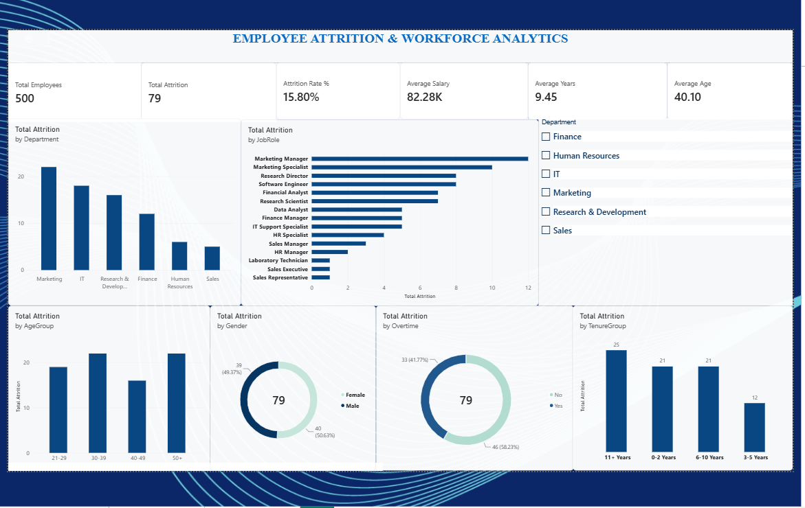

Slide 10
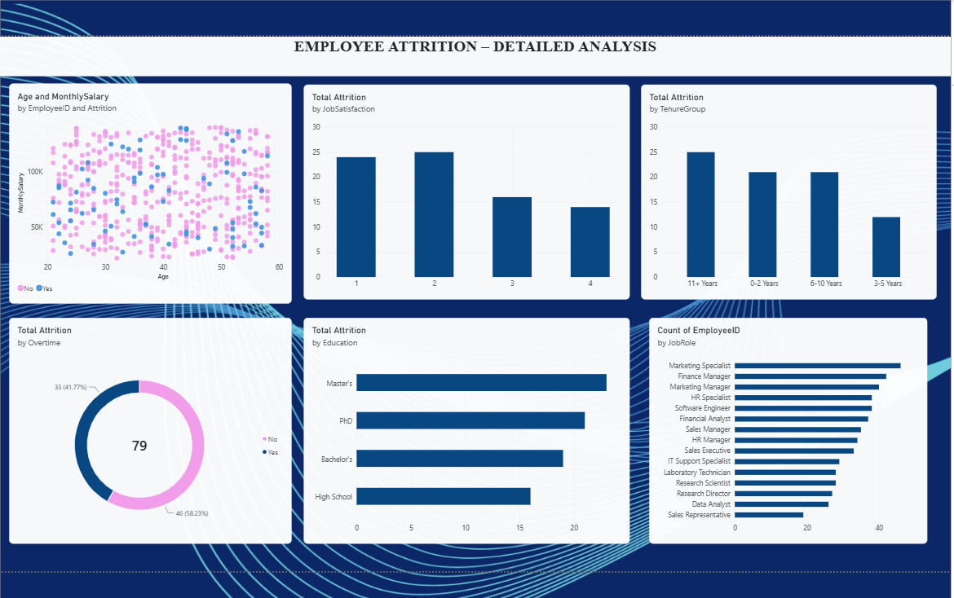

Slide 11
Key Insights from the Dataset
Marketing shows the highest department-level attrition rate at approximately 25.6%.
Employees working overtime show a higher observed attrition rate (20.8%) than non-overtime employees (13.5%).
Lower job satisfaction groups generally show higher observed attrition in this practice dataset.
Early-tenure employees are a key segment to monitor because attrition is concentrated more strongly in shorter-tenure groups.

Slide 12
Business Recommendations
Prioritize retention reviews for departments and roles with elevated attrition.
Monitor overtime workload and evaluate workload-balancing initiatives.
Use employee satisfaction surveys and manager check-ins for low-satisfaction groups.
Strengthen onboarding and early-career support for new employees.
Track attrition KPIs regularly through the Power BI dashboard.

Slide 13
Conclusion
Power BI converts workforce data into an interactive HR decision-support dashboard.
The analysis highlights where attrition is concentrated and which employee factors are associated with turnover.
The dashboard can be extended with real company data, time-based HR trends and predictive attrition modeling.
Insights should be interpreted as associations, not proof that a factor directly causes attrition.

Slide 14
Thank You
Employee Attrition & Workforce Analytics

