Slide 1
Hackathon

Slide 2
Credit Fraud
Input rows : 227845
Input cols : 30
Preprocessing:
Removed Duplicates : 6398
Balancing using Under sampling technique
Scaling (error increased)
Accuracy score:
Logistic Regression : 95.8
Random forest : 98.042
Xgb : 96.3

Slide 3
Credit Score
Input cols : 305
Preprocessing:
Removed Duplicates
Removed rows with more than 50% Nan
Filled Nan with median for others(for continous variable)
Feature selection using Random forest and correlation
RMSE score:
0 Linear 47.136841 47.179417
1 Dtree 60.427870 60.504280
2 RF 30.651830 27.482052
3 XGB 36.049162 35.835422
4 KNN 52.850000 52.000000
5 Lasso 49.784223 49.798623
6 Ridge 47.136729 47.179418
7 EN 53.330904 53.201901

Slide 4
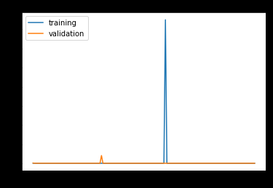
model.add(Dense(20, input_dim=284))
model.add(Activation('elu'))
model.add(Dense(100))
model.add(Activation('elu'))
model.add(Dense(50))
model.add(Activation('elu'))
model.add(Dense(30))
model.add(Activation('elu'))
model.add(Dense(1))
Deep Learning
RMSE : 35.72

Slide 5
Sentiment Analysis
Preprocessing
Strip html tags
Remove accented char
Lower
contractions
Accuracy
Logistic Reg using BOW : 93
RF using BOW : 87
RF TF-IDF : 87
Word to vec and Deep learning : 88

