Slide 1
单标签分类评价指标介绍
https://github.com/sangjianshun/Master-School/blob/master/SingleClassEvaluationIndex.py
业务背景
模型
是否是垃圾邮件
1
0.7
一封邮件
0 | 0.1
0 | 0.2
0 | 0.2
0 | 0.3
0 | 0.6
0 | 0.7
0 | 0
0 | 0
0 | 0
0 | 0
0 | 1
0 | 1
1 | 0.6
1 | 0.8
1 | 0.2
1 | 0.9
1 | 1
1 | 1
1 | 0
1 | 1

Slide 2
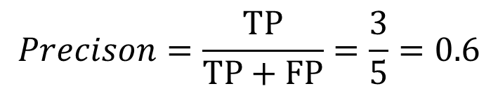
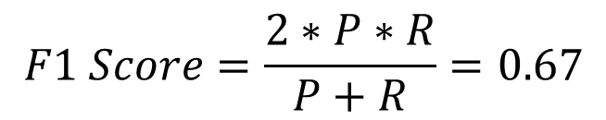
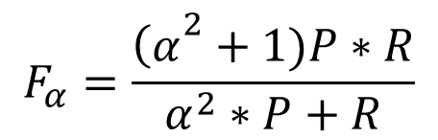
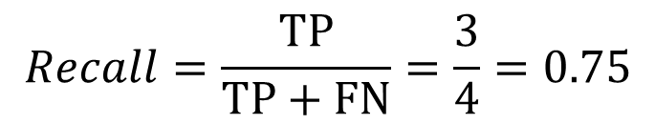
单标签分类评价指标介绍
混淆矩阵（Confusion Matrix）
 | 标签类别
预 测 类 别 |  | Positive | Negative | Total
 | Positive | TP | FP | 预测为正
 | Negative | FN | TN | 预测为负
 | Total | 所有正例 | 所有负例 | 样本数
$$Precison=\frac{TP}{TP+FP}=\frac{3}{5}=0.6$$
$$Recall=\frac{TP}{TP+FN}=\frac{3}{4}=0.75$$
$$F_{α}=\frac{{\left(α\right.}^{2}+1)P∗R}{α^{2}∗P+R}$$
0 | 0
0 | 0
0 | 0
0 | 0
0 | 1
0 | 1
1 | 1
1 | 1
1 | 0
1 | 1
TP=3 | FP=2
FN=1 | TN=4
$$F1 Score=\frac{2∗P∗R}{P+R}=0.67$$

Slide 3
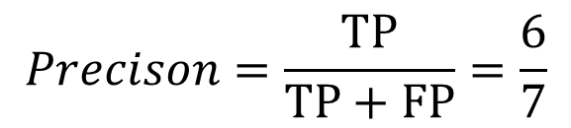
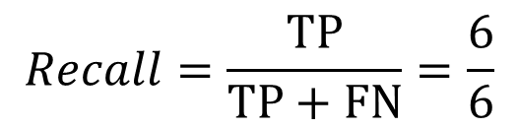
单标签分类评价指标介绍
精确率和召回率存在的问题
1 | 1
1 | 1
1 | 1
1 | 1
1 | 1
1 | 1
$$Precison=\frac{TP}{TP+FP}=\frac{6}{7}$$
0 | 1
TP=6 | FP=1
FN=0 | TN=0
$$Recall=\frac{TP}{TP+FN}=\frac{6}{6}$$

Slide 4
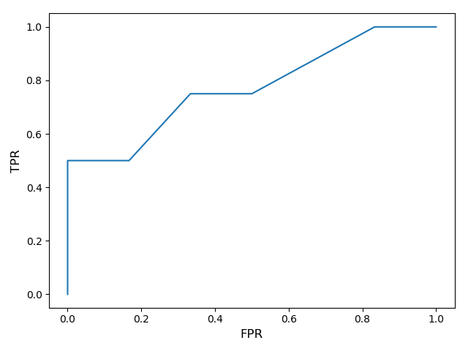
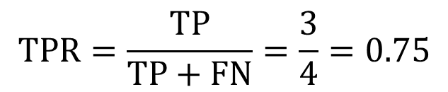
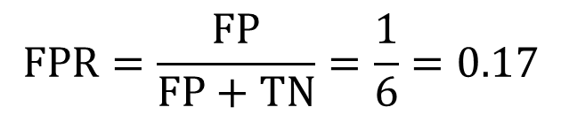
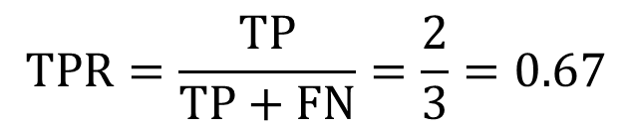
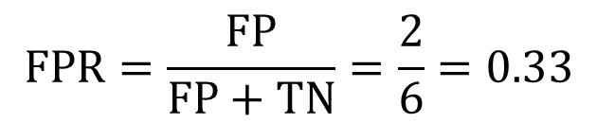
单标签分类评价指标介绍
ROC曲线（AUC）
0 | 0.1
0 | 0.2
0 | 0.2
0 | 0.3
0 | 0.6
0 | 0.7
0 | 0
0 | 0
0 | 0
0 | 0
0 | 1
0 | 1
$$TPR=\frac{TP}{TP+FN}=\frac{3}{4}=0.75$$
1 | 0.6
1 | 0.8
1 | 0.2
1 | 0.9
1 | 1
1 | 1
1 | 0
1 | 1
阈值0.5
TP=3 | FP=2
FN=1 | TN=4
$$FPR=\frac{FP}{FP+TN}=\frac{2}{6}=0.33$$
0 | 0
0 | 0
0 | 0
0 | 0
0 | 0
0 | 1
$$TPR=\frac{TP}{TP+FN}=\frac{2}{3}=0.67$$
1 | 0
1 | 1
1 | 0
1 | 1
阈值0.65
TP=2 | FP=1
FN=2 | TN=5
$$FPR=\frac{FP}{FP+TN}=\frac{1}{6}=0.17$$

Slide 5
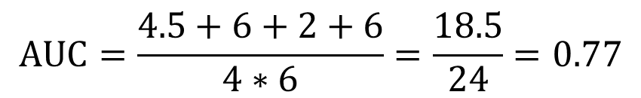
单标签分类评价指标介绍
AUC的计算
0 | 0.1
0 | 0.2
0 | 0.2
0 | 0.3
0 | 0.6
0 | 0.7
1 | 0.6
1 | 0.8
1 | 0.2
1 | 0.9
$$AUC=\frac{4.5+6+2+6}{4∗6}=\frac{18.5}{24}=0.77$$
for pos1 in pos: for neg1 in neg: if pos1>neg1: count += 1 elif pos1==neg1: count+=0.5 else: break

