Slide 1
X的平方根
https://github.com/sangjianshun/Master-School/blob/master/mySqrt.py
问题描述
3
1.732

Slide 2
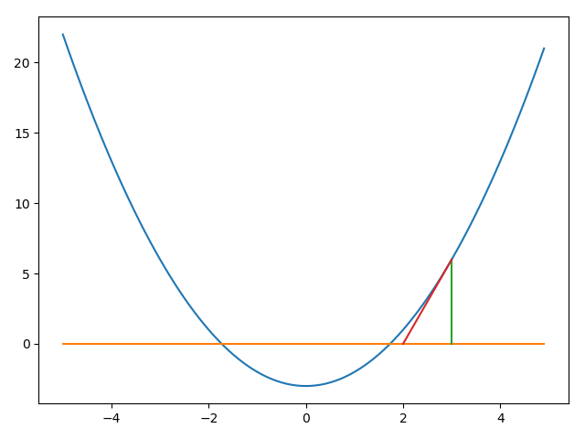
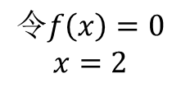
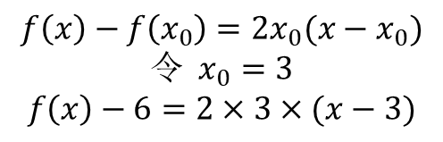



X的平方根
牛顿迭代法
$$\sqrt{3}=x$$
$$3=x^{2}$$
$f\left(x\right)=x^{2}−3=$0
$$f\left(x\right)−f\left(x_{0}\right)=2x_{0}(x−x_{0})$$
$${令 x}_{0}=3$$
$$f\left(x\right)−6=2×3×(x−3)$$
$$令f\left(x\right)=0$$
$$x=2$$

Slide 3
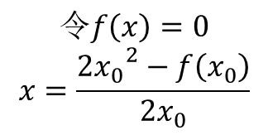
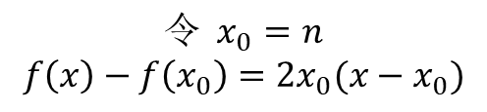



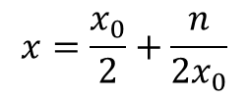
X的平方根
牛顿迭代法
$$\sqrt{n}=x$$
$$n=x^{2}$$
$f\left(x\right)=x^{2}−n=$0
$${令 x}_{0}=n$$
$$f\left(x\right)−f\left(x_{0}\right)=2x_{0}(x−x_{0})$$
$$令f\left(x\right)=0$$
$$x=\frac{{2x_{0}}^{2}−f\left(x_{0}\right)}{2x_{0}}$$
def sqrt(number,r=0.001): x0 = number x1 = x0/2 + number/(2*x0) while abs(x1-x0) > r: x0 = x1 x1 = x0/2 + number/(2*x0) return x1
$$x=\frac{x_{0}}{2}+\frac{n}{2x_{0}}$$

