Slide 1
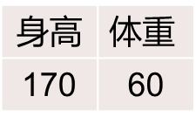
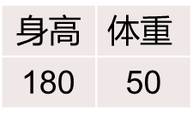
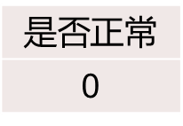
Logistic Regression
https://github.com/sangjianshun/Master-School/blob/master/logisticRegression.py
业务背景
身高 | $$体重$$
170 | 60
是否正常
1
身高 | $$体重$$
180 | 50
$是否$正常
0

Slide 2
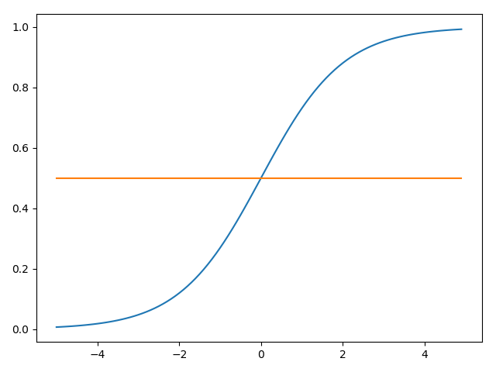
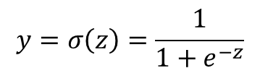
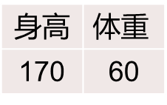

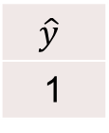
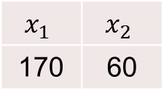
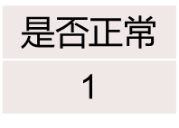
Logistic Regression
前向计算流程
抽象
身高 | $$体重$$
170 | 60
$是否$正常
1
$$x_{1}$$ | $$x_{2}$$
170 | 60
$$\hat{y}$$
1
$$z=170w_{1}+60w_{2}+b$$
$$y=σ\left(z\right)=\frac{1}{1+e^{−z}}$$

Slide 3






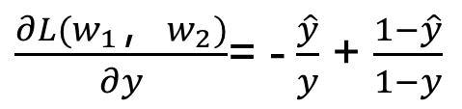

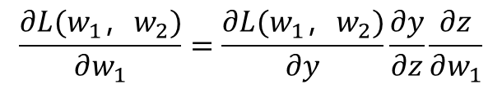
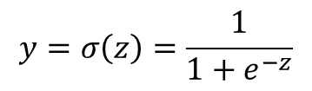
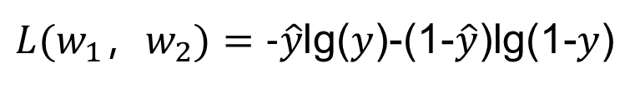
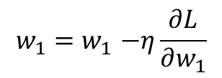
Logistic Regression
反向更新参数
$$z=w_{1}x_{1}+w_{2}x_{2}+b$$
$\hat{y}=$1
0 | 1
1-$\hat{y}$ | $$\hat{y}$$
损失函数：Cross Entropy
$$y=σ\left(z\right)=\frac{1}{1+e^{−z}}$$
$y=$0.6
0.4 | 0.6
1-$y$ | $$y$$
$L(w_{1}，w_{2})=-\hat{y}$lg($y$)-(1-$\hat{y}$)lg(1-$y$)
$$\frac{∂L(w_{1}，w_{2})}{∂w_{1}}=\frac{∂L(w_{1}，w_{2})}{∂y}\frac{∂y}{∂z}\frac{∂z}{∂w_{1}}$$
$\frac{∂L(w_{1}，w_{2})}{∂y}$= -$\frac{\hat{y}}{y}$ + $\frac{1−\hat{y}}{1−y}$
$\frac{∂L}{∂w_{1}}$=($y$-$\hat{y}$) $x_{1}$
for i in range(epoch): for j in range(len(x)): fx = LR(x,w,b) w = w - eta * (fx - y[j])*x[j] b = b - eta * (fx - y[j])
$\frac{∂y}{∂z}$= $y$(1- $y$)
$$w_{1}{=w}_{1}−η\frac{∂L}{∂w_{1}}$$

