Slide 1
University of Minnesota
Department level Ethnicity 2013 - 2014
By Sharvari Sangle
sangl003@umn.edu

Slide 2
Abstract
This analysis is basically to understand if there is a pattern in choosing education trade and ethnicity.
Being an international student I know how cultural background can change the way you think. I have personally experienced this and always had a question about how human behavior can be influenced by the culture or the upbringing of a person.
While growing up and learning Indian history, I found the relation between how a doctor’s son will be doctor or how children follow or are supposed to follow what their ancestors did.
Eventually, development and evolving led people to choose different trades and the pattern changed over time.
This analysis can help us understand how ethnicity of a person can lead to change in choosing education and the patterns in it.
This can allow us to understand the reasons behind the human behavior. Example Asians are more leaned to choose science, engineering or mathematical trades.
Is this because of the culture, environment or the job opportunities available around or anatomy of the brain - that they are good in specific area?
There can be many different reasons and to start looking for answers, one can start from analyzing the relationship between Ethnicity and education one chooses to help solve these mysteries.

Slide 3
Objective
Purpose of the analysis is not to racially discriminate any ethnicity group.
To learn about the diverse population around the campus
To visualize the Ethnicity patterns
To study the pattern respect to the level of studies and departments
To analyze the relationship between the ethnicity and the level of education one chooses

Slide 4
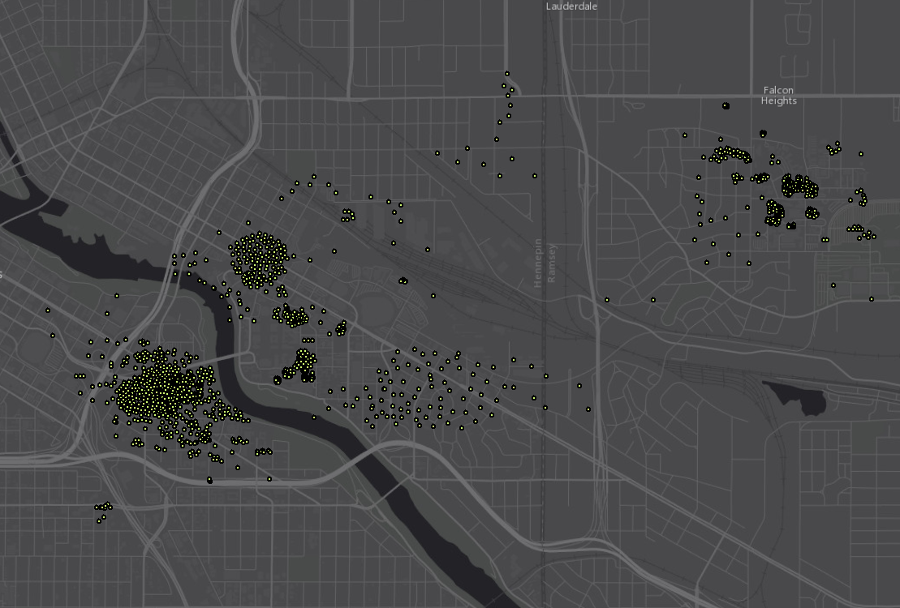
Data source
Data is from the OIT department of University. The U policy on student data privacy does not allow to share the records with ethnicity head count below 5.
This data represents and approximate visualization and can be used as a general reference map.

Slide 5
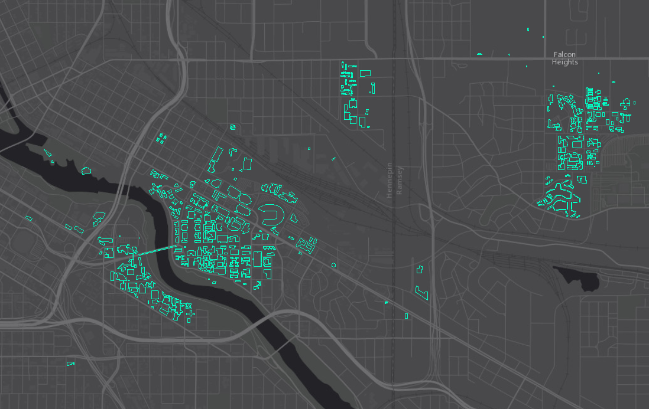
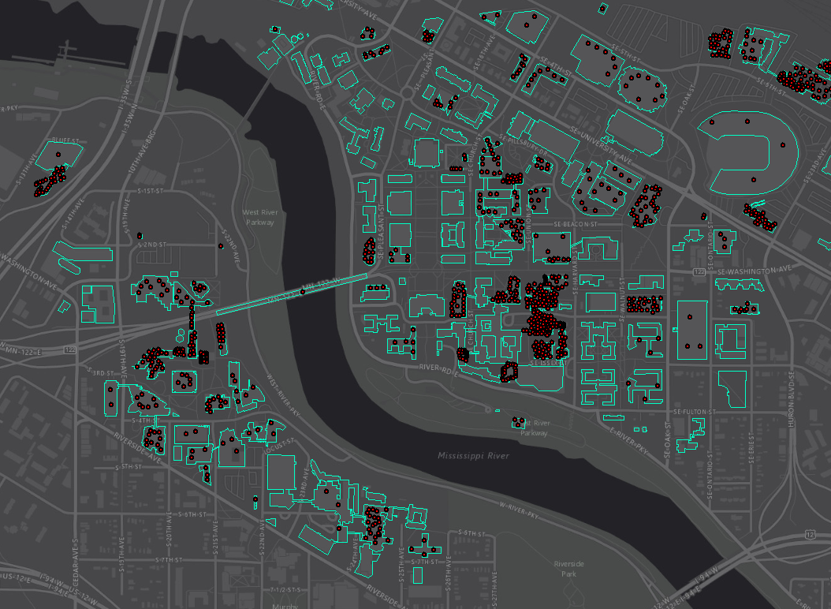
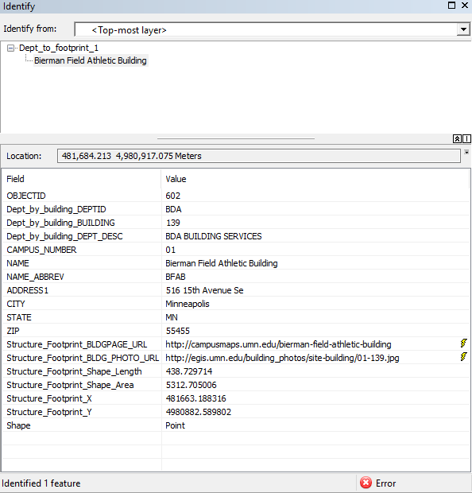
Data curation
Building footprint
Department footprint
The centroid of the footprints were created and joined with department information.
Missing department were created by heads up digitization.

Slide 6
Data analysis

Slide 7
Data analysis

Slide 8
Data analysis

Slide 9
Data analysis

Slide 10
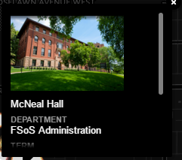
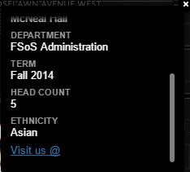
Carto dB & GitHub Customization
Simple and easy
Using html tags - info windows are customized.
GitHub is used to host the application on a separate html page, to remove the interaction with Carto dB.
Hosting web map in new web page, gave a user friendly interface.
GitHub’s project page allows to provide summary to give background information on the map keeping the two things separate yet related.

Slide 11
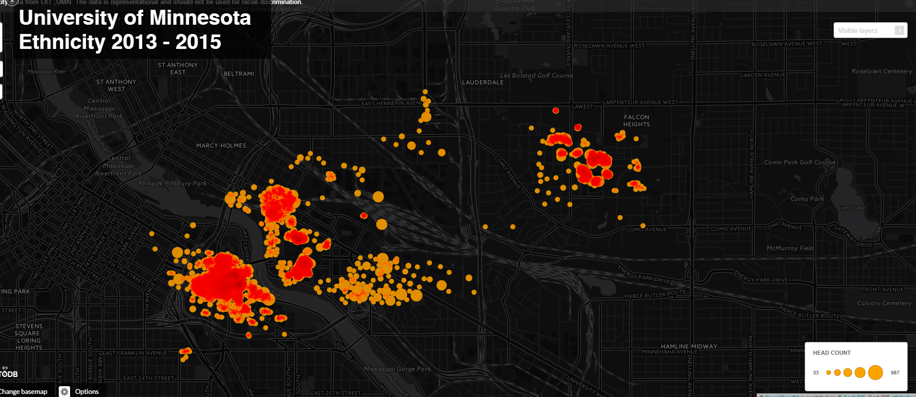
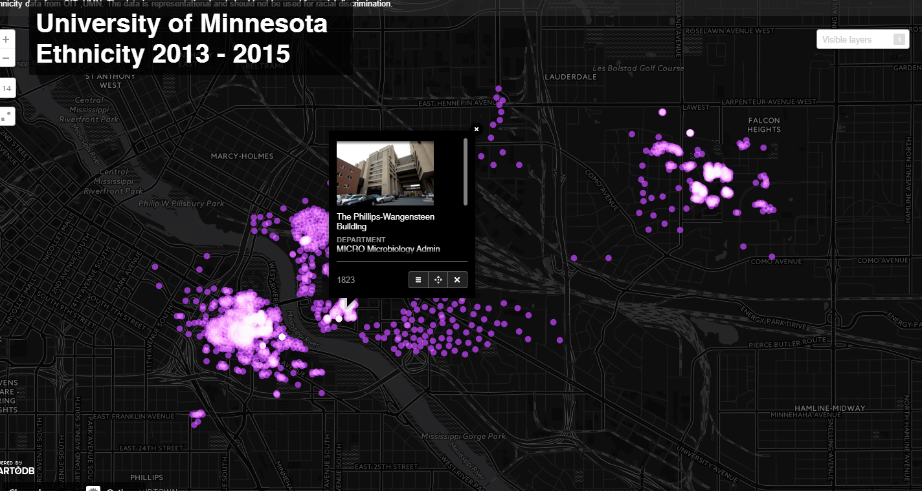
Demo
Web app

Slide 12
Future scope
Would like to keep the data simple and accurate
By developing a platform using JavaScript or Leaflet which will allow to show the records in a hierarchical pattern as given below.
A1
Am Indian
Asian
Building A
Grad
429
B1
White
Black
C1

Slide 13
Questions?
Thank you!

