Slide 1
OCV/AOCV introduction
FTV/DSD/ACD/ACT4 – Peter

Slide 2
AGENDA
Background of OCV/AOCV
How to apply OCV/AOCV in fstaH
Case study: Analyze timing path with AOCV (39A PJ)

Slide 3
Background of OCV/AOCV

Slide 4
1.1 Variation source/ on chip variation
During manufacturing, people realize that
Process (P) and environmental parameters may not uniform in different portions of a die. Some of them are:
Impurity concentration densities
Oxide thickness
Diffusion depth variation
Erosion and dishing in CMP process
Lens aberration
Different portions of a die may be different at voltage (V) and temperature (T) values
PVT put together makes one corner for timing analysis
These variations is called on-chip variation (OCV) affect wire delay, cell delay in different portions of a chip in different manners

Slide 5
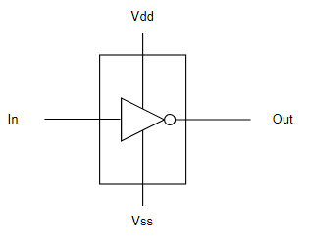
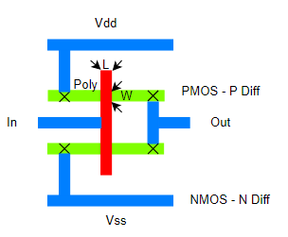
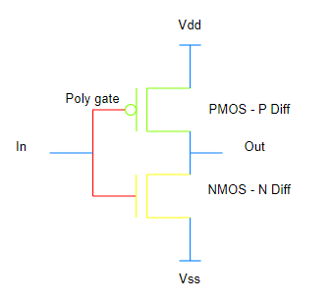
Example of process variation: Etching & oxide thickness
Gate length (L) defined as node
28nm = minimum gate length
Etching process

Slide 6

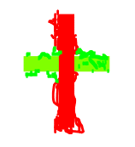
Example of process variation: Etching & oxide thickness
Etching process
L
Ideal mask
L
Actual mask
W
W

Slide 7
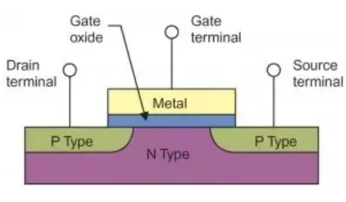
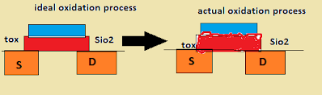
Example of process variation: Etching & oxide thickness
Occurs similarly with oxide thickness
Variation

Slide 8
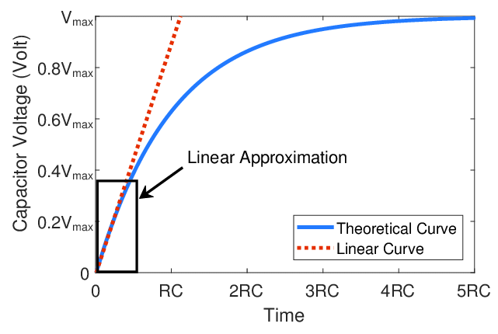
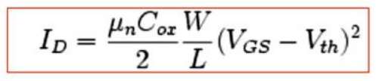
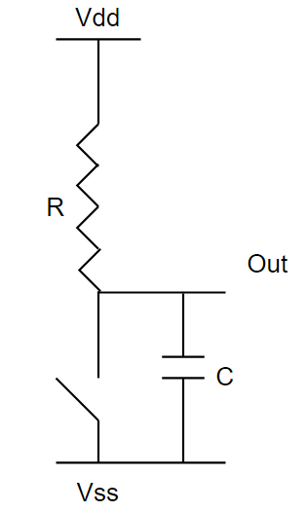
Example of process variation: Etching & oxide thickness
I_{drain} varies because of variation
W, L, Cox affects I_{drain} → affect delay value ???

Slide 9
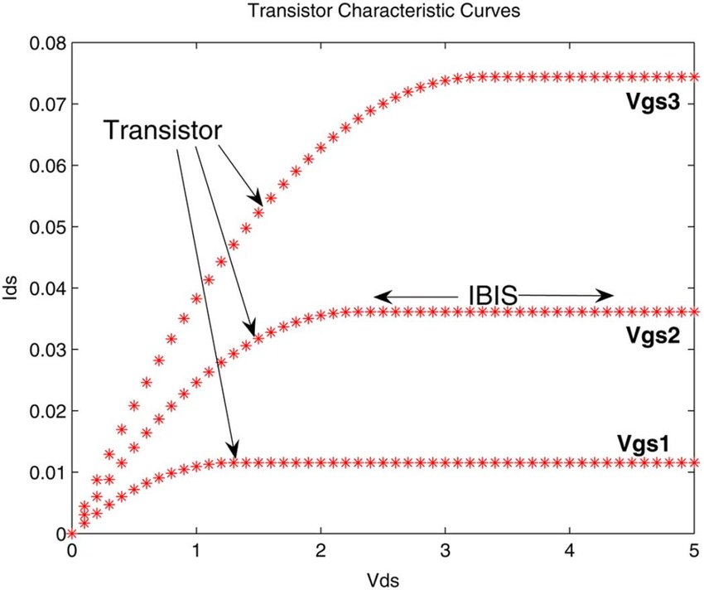
Example of process variation: Etching & oxide thickness
R curve is not this linear
Resistance (R) increase → time to charge (T) is huge (R is not constant but varies with I_{d})
Propagation delay = 50% input ~ 50% output
T
T = f(R) = f (I_{d}) = f (tox, W, L)

Slide 10
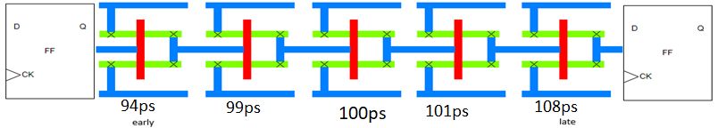
Derate for variation
early = 6%
late = 8%
Early, late value can be collect in foundry
Big variation with portions have different structure
Little variation with portions have similar structure

Slide 11
1.2 Timing derate
1.2.1 OCV
1.2.2 AOCV

Slide 12
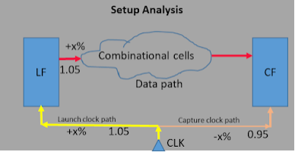
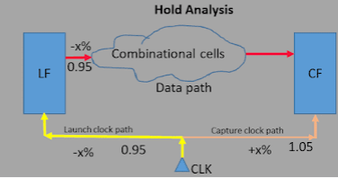
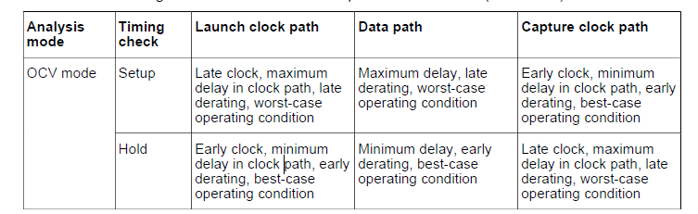
1.2.1 OCV
In OCV (On-chip Variation), a fixed timing derate factor is applied to all cells in the design.
Fab process variations could either increase or decrease the delay of cells. Tool considers early or lately derate based on the path and the type of analysis

Slide 13
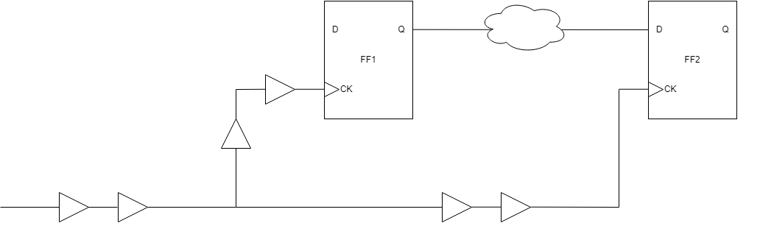
1.2.1 OCV
Setup check
Tlaunch = 0.25 + 0.75 + 1.7 = 2.7
Tcapture = 0.25 + 0.6 + 2.5 – 0.2 = 3.15
→ Slack = 3.15 – 2.7 = 0.45 (MET)
1.7
0.75
Tperiod = 2
Tsetup = 0.2
Thold = 1.25
0.25
0.6

Slide 14
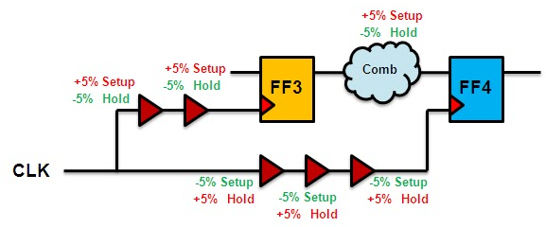
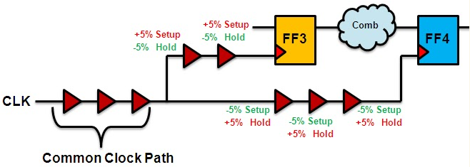
CPPR (Common Path Pessimism Removal)
CPPR Adjustment = late - early

Slide 15
1.2.1 OCV
SETUP check:
worst case = min delay in capture path - max delay in launch path
late derate value applied on launch path + Tsetup value
early derate value applied on capture path
In common clock path, CRPR is added in setup and subtract in hold
set_timing_derate –early 0.9
set_timing_derate –late 1.2
Setup check
Tlaunch = (0.25 + 0.75 + 1.7)*1.2 = 2.7*1.2 = 3.24
Tcapture = 0.25*0.9 + CRPR + 0.6*0.9 + 2 – 0.2*1.2 = 2.6
CRPR = (1.2 – 0.9)*0.25 = 0.075
→ Slack = 2.6 – 3.24 = -0.64 (VIO)
1.7
0.75
Tperiod = 2
Tsetup = 0.2
Thold = 1.25
0.25
0.6

Slide 16
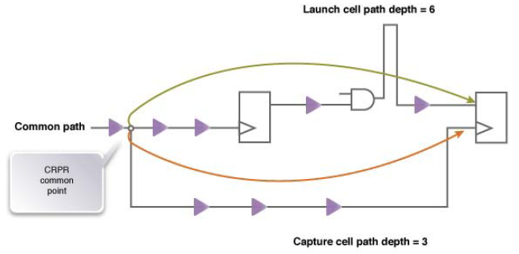
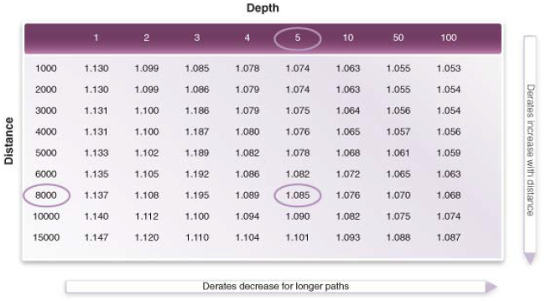
1.2.2 AOCV
In AOCV (Advanced OCV) derate is applied on each cell based on path depth and distance of the cell in the timing path and it also varies with cell type and drive strength of the cell.
AOCV derate depends on Distance, Path depth, Cell type.
That why run OCV in pre-STA and AOCV in post-STA

Slide 17
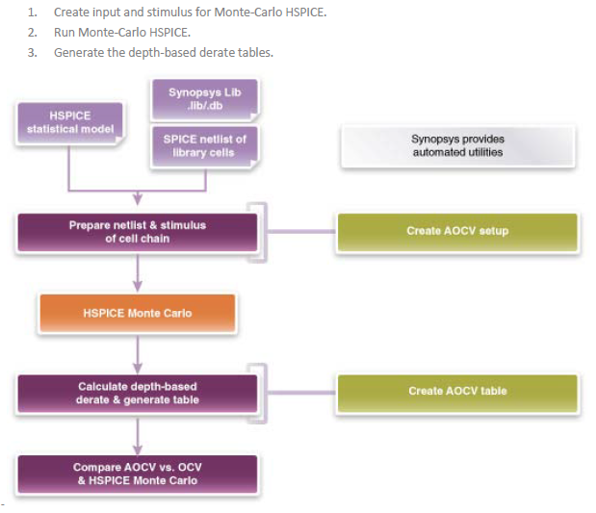
1.2.2 AOCV

Slide 18
Generate AOCV Index Folder
##AOCV mode needs to generate aocv table index at first (Function SDC)
%> fstaH –group $SDC aocvwg aocvwcgc aocvbg aocvbcgh –gen_aocv_index
%> fstaH –cpf $CPF aocv –gen_aocv_index
$DESIGN_AOCV
##scenario_name
$clock_slew $clock_loading $data_slew $data_loading
AOCVWG_CMAX125C 240 10 240 10
AOCVWCGC_CMAXM40C 180 10 240 10
AOCVBG_CMAXM40C 150 10 120 10
AOCVBG_CMINM40C 180 10 120 10
AOCVBCGH_RCMAX125C 300 10 180 10
aocv table index
aocv table folders
fsj0c_dru/
2.0/
ffg0p99v0c/
ffg0p99v125c/
ffg0p99vm40c/
ssg0p81v0c/
ssg0p81v125c/
ssg0p81vm40c/
core/
spc/
clock_early/
clock_late/
data_early/
data_late/
*.tbl

Slide 19
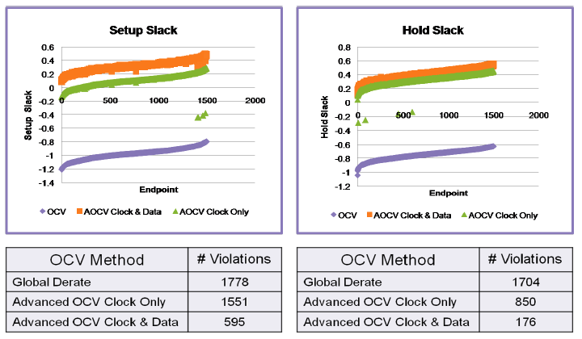
1.2.2 AOCV

Slide 20
Apply OCV/AOCV in fstaH

Slide 21
OCV/AOCV run file setting
#!/bin/csh -f
unsetenv LM_LICENSE_FILE
source ~cadman/env/vnc8.env
#source ~cadman/env/FTC.env
source /home/ASICQA/ada/proj/FSJ0AS039A/FE/env/FTC.env
#source ~cadman/env/primetime.env
source /home/ASICQA/ada/proj/FSJ0AS039A/FE/env/primetime.env
fstaH -group <module_name> ocvwg ocvwcgc –ip
#fstaH -group <module_name> aocvwcgc -ip -ptsi -drc -gen_clock_latency

Slide 22
Case study: Analyze timing path with AOCV (39A PJ)

Slide 23
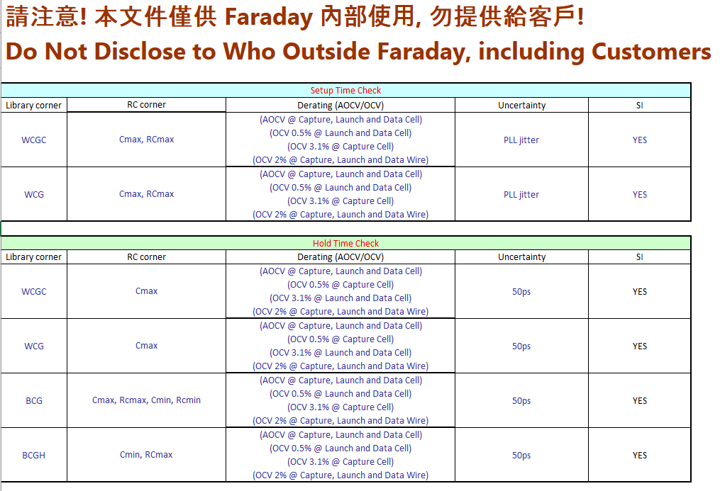
Sign-off
Pre-STA (TDI, FDI, postDFT)
Execute setup check, GBA mode
Execute OCV
Post-STA (post-layout)
Execute both setup & hold check, PBA mode
Execute AOCV

Slide 24
Sign-off
From this table, we may think that with option “ocv*” in run file. We will get derate value 0.5%, 3.1% and 2% in timing result of pre-STA but it’s not
(this result is reflected at post-STA stage)

Slide 25
Timing result

Slide 26
References
https://www.vlsi4freshers.com/2020/03/ocv-aocv-pocv-in-vlsi.html
https://solvnetplus.synopsys.com/s/article/PrimeTime-Advanced-On-Chip-Variation-OCV-Technology-1576148259174
PrimeTime user manual

Slide 27
THANKS FOR WATCHING

Slide 28
Confidential information
The material is being disclosed to you pursuant to a non-disclosure agreement between you or your employer and Faraday. Information disclosed in this presentation may be used only as permitted under such an agreement.
Legal notice
The information contained in this presentation is intended to provide a general guide as to which product is suited for a given requirement and shows suggested product applications. Specified functions and properties for products are only valid when handling instructions and other stated conditions and recommendations have been considered and followed. All descriptions, illustrations and dimensions in the information represent general particulars and do not form part of any contract. All information is provided “as is”, with no guarantee of completeness, accuracy, timeliness or of the results obtained from the use of the information, and without warranty of any kind, express or implied, including but not limited to warranties of performance. All information is subject to change without prior notice. Faraday assumes no responsibility whatsoever for any errors or inaccuracies about the information.

