Slide 1
fstaH aocv table index
Oct.2018
Ming/ DMD.LDF

Slide 2
Generate AOCV Index Folder
##AOCV mode needs to generate aocv table index at first (Function SDC)
%> fstaH –group $SDC aocvwg aocvwcgc aocvbg aocvbcgh –gen_aocv_index
%> fstaH –cpf $CPF aocv –gen_aocv_index
$DESIGN_AOCV
##scenario_name
$clock_slew $clock_loading $data_slew $data_loading
AOCVWG_CMAX125C 240 10 240 10
AOCVWCGC_CMAXM40C 180 10 240 10
AOCVBG_CMAXM40C 150 10 120 10
AOCVBG_CMINM40C 180 10 120 10
AOCVBCGH_RCMAX125C 300 10 180 10
aocv table index
aocv table folders
fsj0c_dru/
2.0/
ffg0p99v0c/
ffg0p99v125c/
ffg0p99vm40c/
ssg0p81v0c/
ssg0p81v125c/
ssg0p81vm40c/
core/
spc/
clock_early/
clock_late/
data_early/
data_late/
*.tbl

Slide 3
CPF AOCV Mode Usage
##Generate CPF mode aocv table index (Function SDC)
%> fstaH –cpf $CPF aocv –gen_aocv_index
Note : CPF view naming must include “*COM” like below ,
WCGCOM, WCGCCOM, BCGCOM, BCGHCOM,
WCCOM, WCCCOM, BCCOM, BCHCOM, TYPCOM
View name
aocv table index
*WCGCOM*
*WCGCCOM
*BCGCOM*
*BCGCOM*
*BCGHCOM*
WG_CMAX125C 240 10 240 10
WCGC_CMAXM40C 180 10 240 10
BG_CMAXM40C 150 10 120 10
BG_CMINM40C 180 10 120 10
BCGH_RCMAX125C 300 10 180 10
aocv table index 會根據 CPF view naming去轉換成對應的corner name

Slide 4
Read AOCV Index Folder
Post-layout (sign-off)
Global Corner : WG, WCGC, BG, and BCGH (with AOCV & OCV)
fstaH command:
%> fstaH –group $SDC aocvwg aocvwcgc aocvbg aocvbcgh –ptsi –nonip/-ip
%> fstaH –cpf $CPF aocv –ptsi –nonip/-ip
$DESIGN_AOCV
fstaH needs to read this folder before running AOCV mode
aocv table index
aocv table folders

Slide 5
Flat netlist (block) AOCV table index reading
##Run flat netlist in multiple AOCV mode
%> fstaH –group $SDC aocv*
%> fstaH –cpf $CPF aocv
Top Netlist
Top
Block
netlist
Block
$Top.v
$Top_AOCV
*.tbl (AOCV 2.0)
$Top.aocv_index
$Top.v, $Block.v
$Top_flat_AOCV
$Top.aocv_index
$Block.aocv_index
*.tbl (AOCV 3.0)
$Block.v
$Block_AOCV
*.tbl (AOCV 2.0)
$Block.aocv_index
fstaH 發現目錄下同時存在兩個AOCV folder以上, 會自動切換成multiple AOCV mode
進入multiple AOCV mode, fstaH會先建立 $Top_flat_AOCV folder當作給flat netlist使用的aocv table index
fstaH 會根據不同netlist的aocv table index, 去assign對應的aocv table

Slide 6
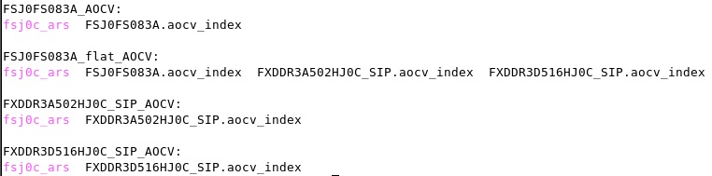
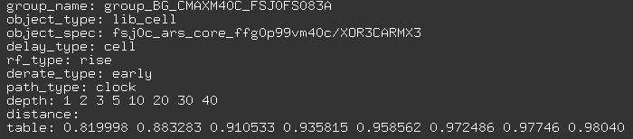
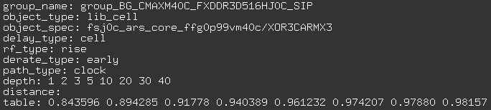
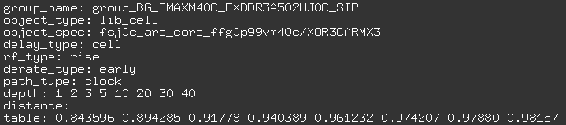
(AOCV3.0) flatten w/ $block_AOCV
TOP
AOCV 3.0
BLOCK1
BLOCK2
Notes:
set_aocvm_table_group at primetime

Slide 7
Flat netlist (harden IP) AOCV table index reading
Top Netlist
Top
IP_cp
netlist
IP
$Top.v
$Top_AOCV
*.tbl (AOCV 2.0)
$Top.aocv_index
$Top.v, $IP_cp.v
$Top_flat_AOCV
$Top.aocv_index
$.aocv_index
*.tbl (AOCV 3.0)
$IP_cp.v
$IP_cp_AOCV
*.tbl (AOCV 2.0)
$IP.aocv_index
object_type: lib_cell
object_spec: fsj0p_crs_core_ffg0p99vm40c/XOR3PCRMX3
delay_type: cell
rf_type: rise
derate_type: late
path_type: clock
depth: 1 2 3 5 10 20 30 40
distance:
table: 1.14968 1.1159 1.10093 1.08592 1.07082 1.061 1.05742 1.05528
object_spec: FXDDR4AFD622NSHJ0P_cp_ffg0p99vm40c/FXDDR4AFD622NSHJ0P_XOR3PCRMX3
Notes:
sed -i -e 's:fsj0p_crs_core_ssg0p81v125c/:FXDDR4DFD622NSHJ0P_cp_ssg0p81v125c/FXDDR4DFD622NSHJ0P_:g' ./fsj0p_crs/2.0/ssg0p81v125c/core/clock_late/aocv_30p_1f.tbl

Slide 8
If check out IP_cp without IP_cp_AOCV…
mv IP_AOCV IP_cp_AOCV
Script to parser *tbl at *_cp_AOCV/
/home/dmd_proj/minghui/sta/script/sed_tbl_corelib_to_ipcp.tcl
object_type: lib_cell
object_spec: fsj0p_crs_core_ffg0p99vm40c/XOR3PCRMX3
delay_type: cell
rf_type: rise
derate_type: late
path_type: clock
depth: 1 2 3 5 10 20 30 40
distance:
table: 1.14968 1.1159 1.10093 1.08592 1.07082 1.061 1.05742 1.05528
object_spec: $IP_cp_ffg0p99vm40c/$IP_XOR3PCRMX3

Slide 9
Flat netlist (block+ hard IP) AOCV table index reading
##Run flat netlist in multiple AOCV mode
%> fstaH –group $SDC aocv*
%> fstaH –cpf $CPF aocv
Block
netlist
TOP.v
Block.v
Top Netlist
$Block.v
$Block_AOCV
*.tbl (AOCV 2.0)
$Block.aocv_index
IP_cp.v
$Top.v
$Top_AOCV
*.tbl (AOCV 2.0)
$Top.aocv_index
IP_cp
netlist
$Top.v, $Block.v, $IP_cp.v
$Top_flat_AOCV
$Top.aocv_index
$Block.aocv_index
$IP.aocv_index
*.tbl (AOCV 3.0)
$IP_cp.v
$IP_cp_AOCV
*.tbl (AOCV 2.0)
$IP.aocv_index

Slide 10


(AOCV3.0) flatten w/ ($block_AOCV +$IP_AOCV)
##Run flat netlist in multiple AOCV mode
%> fstaH –group $SDC aocv*
%> fstaH –cpf $CPF aocv
TOP_AOCV
BLOCK_AOCV
TOP_flat_AOCV
IP_cp_AOCV
% ls FSJ0FS172A_flat_AOCV/fsj0p_cls/2.0/ssg0p81v125c/core/clock_early/
aocv_30p_1f_FSJ0FS172A.tbl aocv_30p_1f_FXDDR4DFD622NSHJ0P.tbl aocv_30p_1f_FXDDR4AFD622NSHJ0P.tbl
WG_CMAX125C__flat.tbl WG_RCMAX125C__flat.tbl
group_name: group_WG_RCMAX125C_FSJ0FS172A
object_type: lib_cell
object_spec: fsj0p_cls_core_ssg0p81v125c/AN2B1PCLMX0P4
(depth derating table….)
group_name: group_WG_RCMAX125C_FXDDR4AFD622NSHJ0P
object_type: lib_cell
object_spec: fsj0p_cls_core_ssg0p81v125c/AN2B1PCLMX0P4
(depth derating table….)
group_name: group_WG_RCMAX125C_FXDDR4DFD622NSHJ0P
object_type: lib_cell
object_spec: FXDDR4DFD622NSHJ0P_cp_ssg0p81v125c/FXDDR4DFD622NSHJ0P_AN2B1PCLMX0P4
(depth derating table….)
TOP.v
*flat.tbl
block.v
IP_cp.v

Slide 11
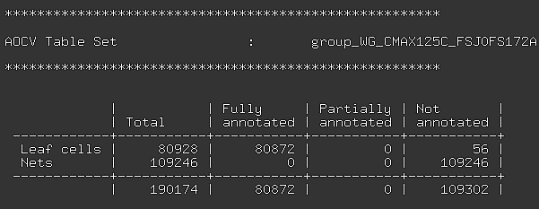
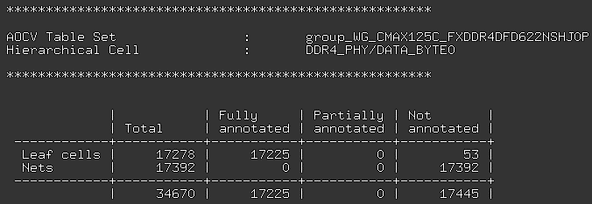
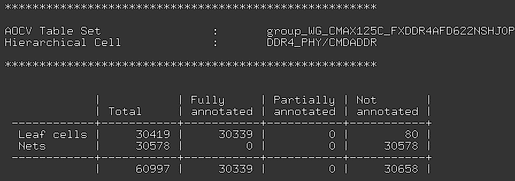
Check (setup/hold)time_derating.log
TOP.v
IP_cp.v
block.v

Slide 12
List AOCV table non-annotated cell
In AOCV mode, fstaH generates “aocv_no_annotated.log” for all *core*.lib and $IP_cp_pvt/$IP_*
Not include $IP_cp_pvt/$IP_(FX*|FZ*|OX*|WL*|PO*|VCC*|GND*|ZTR*)
aocv_no_annotated.log

Slide 13
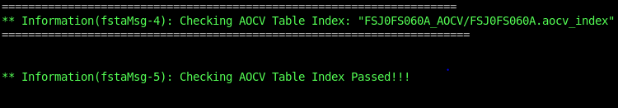
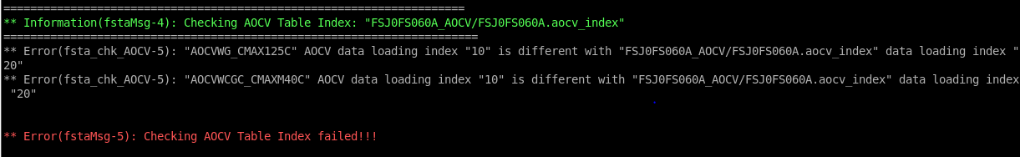
Check AOCV Index Folder
##You can check aocv table index quality by this command
%> fstaH –group $SDC aocvwg aocvwcgc aocvbg aocvbcgh –chk_aocv_index
%> fstaH –cpf $CPF aocv –chk_aocv_index
$DESIGN_AOCV
Passed!
aocv table index
QA
aocv table folders
Failed!

Slide 14
28nm Case Demo (generating)
% fstaH -group FSJ0FS060A aocvwg aocvwcgc aocvbg aocvbcgh -gen_aocv_index
FSJ0FS060A_AOCV
FSJ0FS060A.aocv_index
fsj0c_dru

Slide 15
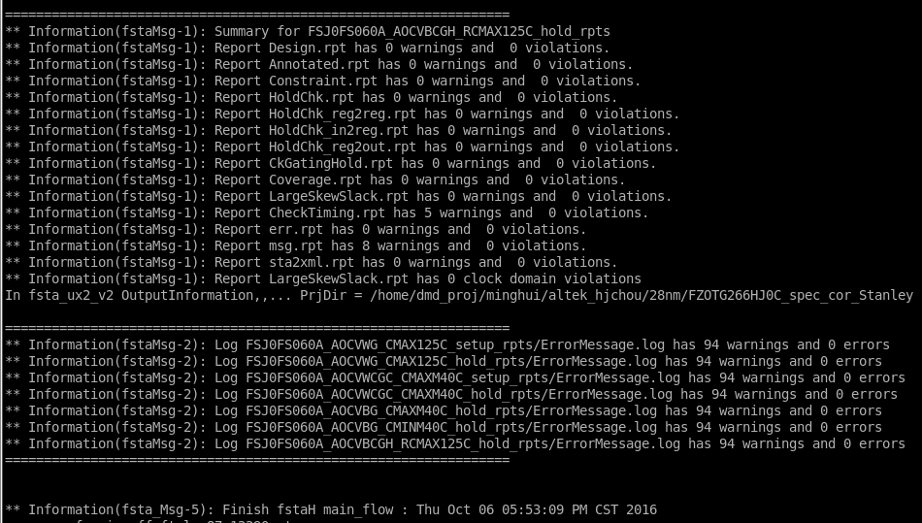
28nm Case Demo (reading)
% fstaH -group FSJ0FS060A aocvwg aocvwcgc aocvbg aocvbcgh –ptsi –nonip/-ip

Slide 16
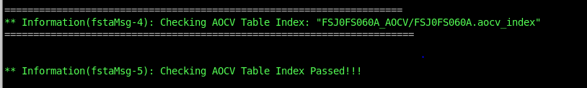
28nm Case Demo (checking)
% fstaH -group FSJ0FS060A aocvwg aocvwcgc aocvbg aocvbcgh -chk_aocv_index

