Slide 1
ETM2106 issue
LDF / Ollie

Slide 2
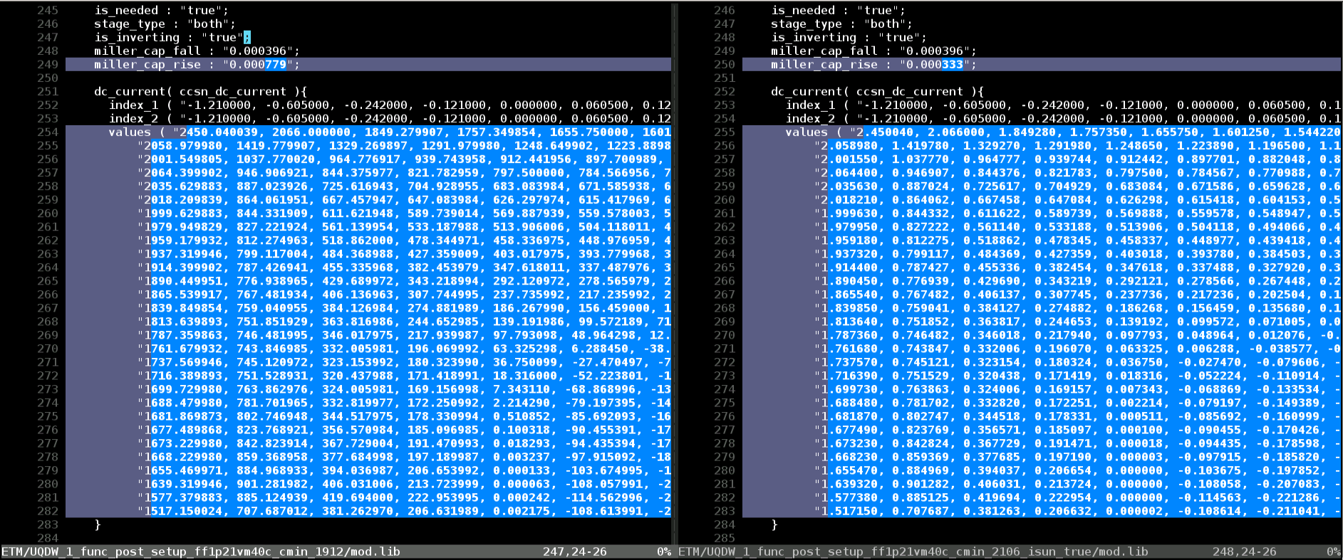
Issue 1
Description
The ccsn_dc_currnet values in the ETM generated by pt1912-SP5-2 is 1000 times as the values in the ETM generated by pt2106-SP5-1

Slide 3
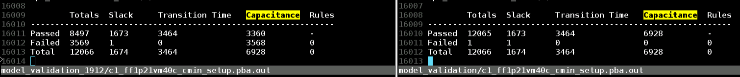
Issue 1 (con’t)
Validation results of ETM1912-SP5-2 and ETM2106-SP5-1
Description from Synopsys AE
The unit of ccsn_dc_current in ETM1912-SP5-2 is wrong
The error has been fixed starting from pt1912-SP5-3 and pt2009-SP3
Option for controlling whether extracted timing models include CCS timing
extract_model_with_ccs_timing
default false
takes extra run-time for calculating ccs_timing

Slide 4
Issue 1 (con’t)
input lib
if input lib is ccsnlib
NO
FETM ccs_timing in flow
On-going
YES
primetime
extract_model
primetime
extract_model
ETM.ccsnlib
ETM.lib

Slide 5
Issue 1 (con’t)
input lib
if input lib is ccsnlib
NO
Controlled by user?
user-specified option in fetm.control
GEN_CCSN_MODEL = NO
YES
GEN_CCSN_MODEL
NO
YES
primetime
extract_model
primetime
extract_model
ETM.ccsnlib
ETM.lib

Slide 6
Issue 2

Slide 7
Confidential information
The material is being disclosed to you pursuant to a non-disclosure agreement between you or your employer and Faraday. Information disclosed in this presentation may be used only as permitted under such an agreement.
Legal notice
The information contained in this presentation is intended to provide a general guide as to which product is suited for a given requirement and shows suggested product applications. Specified functions and properties for products are only valid when handling instructions and other stated conditions and recommendations have been considered and followed. All descriptions, illustrations and dimensions in the information represent general particulars and do not form part of any contract. All information is provided “as is”, with no guarantee of completeness, accuracy, timeliness or of the results obtained from the use of the information, and without warranty of any kind, express or implied, including but not limited to warranties of performance. All information is subject to change without prior notice. Faraday assumes no responsibility whatsoever for any errors or inaccuracies about the information.

