Slide 1
genpglib.tcl
LDF/Ollie

Slide 2
Script usage
Description
genpglib.tcl
A script for generating pgmap, pglib and pgdb
Flow chart
genpglib.tcl
control file
-genpgmap
pgmap
non-pg lib
-genpglib
(design cmpiler)
pglib
-genpgdb
(library compiler)
pgdb

Slide 3
Script usage
Syntax
-control $control_file_name
-top $top_name
-genpgmap
-genpglib
-genpgdb
Example
# gen pgmap
genpglib.tcl -top ${top_name} -control ${control_file_name} \
-genpgmap
# gen pglib & pgdb
genpglib.tcl -top ${top_name} -control ${control_file_name} \
-genpglib -genpgdb

Slide 4
Script usage
Input
linked or copied library ETM/*lib
netlist
Output
pgmap ${TOP}_${corner}.pgmap
design compiler script ETM/script/*.gpglib.dc
library compiler script ETM/script/*.gpgdb.lc
pglib ETM/*.pglib

Slide 5
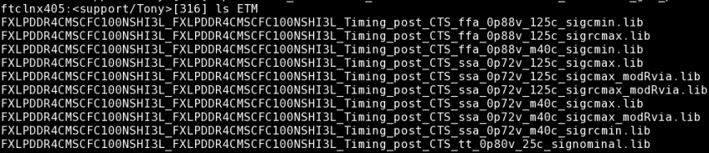
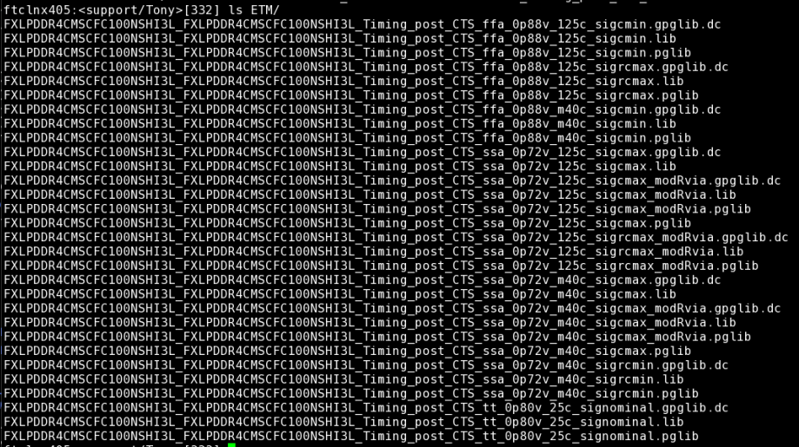
Script usage
Input
Output

Slide 6
Script usage
Flow steps
Prepare a control file
Create a directory named ETM and link or copy all the .lib into it
Run script with the following command
source ~cadman/env/FTCDEV.env
source ~cadman/env/fetm.env
genpglib.tcl -top ${top_name} -control ${control_file_name} -genpgmap -genpglib
4. The .pglib will be generated by script and put in the directory ETM

Slide 7
Control file template
NETLIST = ${NETLIST_FILE} TOP = ${TOP_NAME} [CORNER_BEGIN] CORE_LIB = ${CORE_LIB_FILE} IO_LIB = ${IO_LIB_FILE} MACRO_LIB = ${MACRO_LIB_FILE} SPEF = ${SPEF_FILE} # CORNERMODE = [CORNER_END] #VOLTAGE_MAP_BEGIN # voltage_name ssa nn ffa VCC 1.10 1.00 0.90 GND 0.00 0.00 0.00 #VOLTAGE_MAP_END
The red information above is used for script parsing netlist and checking the connection of each port
The blue information above is used for script declaring the power/ground definition in pglib.
The red information above can be found in fetm control file

Slide 8
Control file example
NETLIST = FXLPDDR4CMSCFC100NSHI3L.v TOP = FXLPDDR4CMSCFC100NSHI3L [CORNER_BEGIN] CORE_LIB = IO_LIB = MACRO_LIB = /auto/s_FinFET/14LPP/libman/common/std_cell/arm/ARM_14LPP_HardIP_sc9mcpp84_base_rvt_c14/new/lib/ARM_14LPP_HardIP_sc9mcpp84_14lpp_base_rvt_c14_ssa_sigcmax_max_0p72v_m40c.lib /auto/s_FinFET/14LPP/libman/common/std_cell/arm/ARM_14LPP_HardIP_sc9mcpp84_base_lvt_c14/new/lib/ARM_14LPP_HardIP_sc9mcpp84_14lpp_base_lvt_c14_ssa_sigcmax_max_0p72v_m40c.lib /auto/s_ipd_proj/LPDDR/FXLPDDR4CCFC100HI3L/workspace/sridhar/0.1.0/FXLPDDR4CCFC100HI3L/others/release_to_APR/analog_phy/lib/pg/FXLPDDR4CCFC100NSHI3L_ssa_sigcmax_0p72v_m40c.pglib SPEF = FXLPDDR4CMSCFC100NSHI3L.spef.SigCmaxDP_ErPlus_m40c.gz CORNERMODE = [CORNER_END] #VOLTAGE_MAP_BEGIN # voltage_name ssa nn ffa GND 0.00 0.00 0.00 GNDA 0.00 0.00 0.00 GNDIO_DDR 0.00 0.00 0.00 VCC08K 0.72 0.80 0.88 VCC18A_REG 1.62 1.80 1.98 VCCIO_DDR 0.99 1.10 1.21 VDD 0.72 0.80 0.88 VSS 0.00 0.00 0.00 #VOLTAGE_MAP_END
example

