Slide 1
Merging Extracted Models
LDF / Ollie

Slide 2
Contents
Introduction
Merged ETM Example
Merged ETM usage
Script Usage
Merging Model Issue
Reference
Appendix

Slide 3
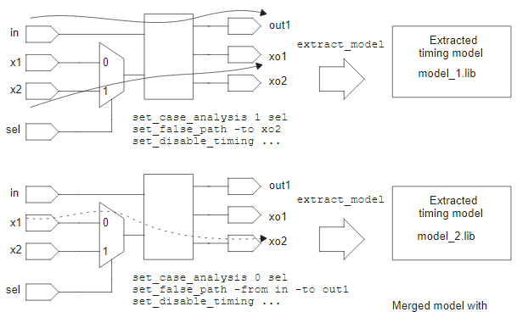
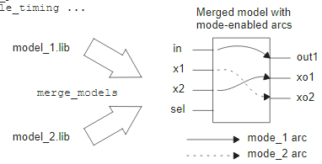
Introduction
Merging model overview
Users can use the merge_models command to merge multiple single-mode ETM .lib files into a single multiple-mode ETM .lib file. The resulting merged ETM can then be set to its available modes by using the set_mode command in the PrimeTime tool.
The models being merged must be consistent, with the same I/O pins, operating conditions (process/voltage/temperature), and so on.

Slide 4
Introduction
Merging multiple modes into a mode group
To create a merged model that merges multiple modes into a single mode group
The resulting merged.lib contains mode-specific arcs where the model behaviors differ
merge_models \ -group_name {etm_mode} -mode_names {capture shift} -lib_files {capture.lib shift.lib} -output merged.lib -format {lib db}
library(“...”) { ... mode_definition (etm_mode) { mode_value (capture) {} mode_value (shift) {} } ... pin(“...”) { timing() { mode (etm_mode, “capture”); ... } timing() { mode (etm_mode, “shift”); ... } } }
Use the -mode_names option to specify the list of mode names.
Use the -lib_files option to specify the input .lib model files, exactly in the same number and order given in the -mode_names option.

Slide 5
Introduction
Why do we need merged ETM?
To reduce the amount of single mode ETM files
single mode ETM * 3 merged ETM * 1
set link_path “* core.lib \\ IP_capture.lib” read_verilog TOP.v link_design TOP source TOP_capture.sdc
set link_path “* core.lib \\ IP_merged.lib” read_verilog TOP.v link_design TOP
source TOP_capture.sdc set_mode capture
set link_path “* core.lib \\ IP_shift.lib” read_verilog TOP.v link_design TOP source TOP_shift.sdc
source TOP_shift.sdc set_mode shift
source TOP_func.sdc set_mode func
set link_path “* core.lib \\ IP_func.lib” read_verilog TOP.v link_design TOP source TOP_func.sdc

Slide 6
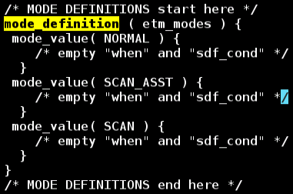
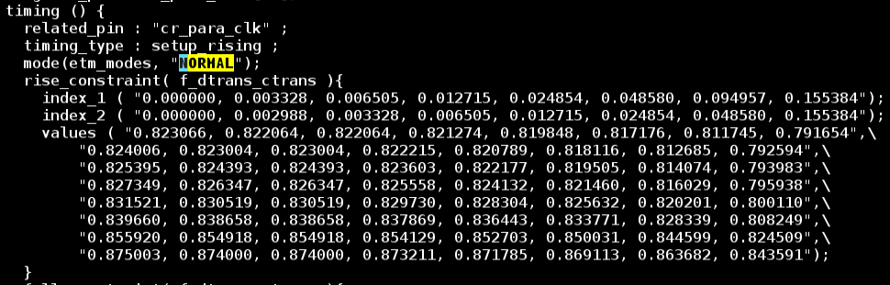
Merged ETM Example
Out-sourcing Merged ETM provided by Synopsys
/home/oip/wrk/tmp/bowen_chen/OIP/SNPS/dwc_12g_phy_umc28hpcp_x4ns_8m1a1u_fc/lib_pg

Slide 7
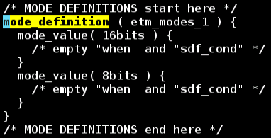
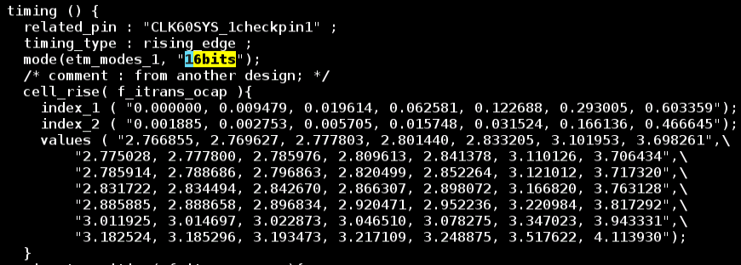
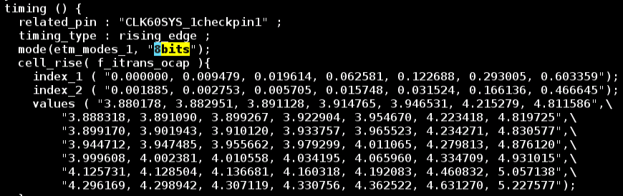
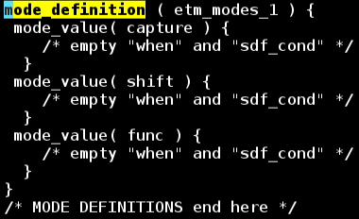
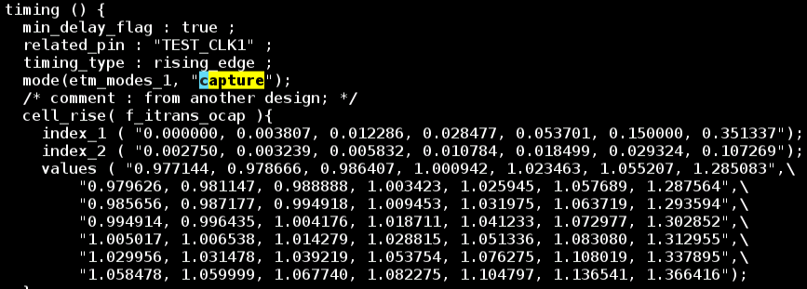
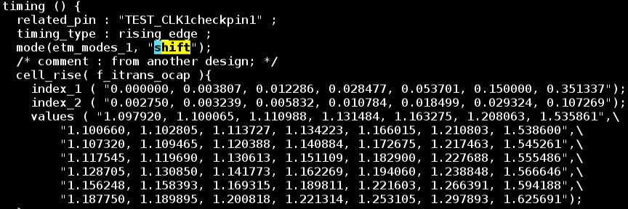
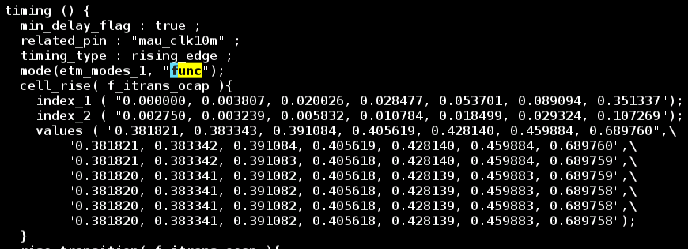
Merged ETM Example
mode_definition and timing arcs in merged ETM
16bits & 8bits
capture, shift and func

Slide 8
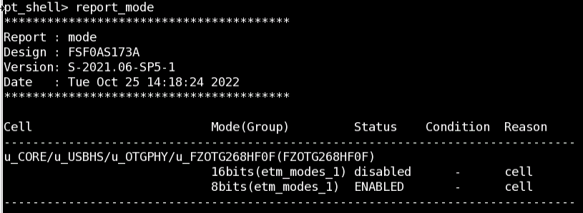
Merged ETM Usage
How to specify the operating mode?
set_mode ${MODE} ${CELL}
set_mode 8bits u_CORE/u_USBHS/u_OTGPHY/u_FZOTG268HF0F
The mode should be specified by “set_mode” in SDC
How to check if the mode is specified correctly?
report_mode

Slide 9
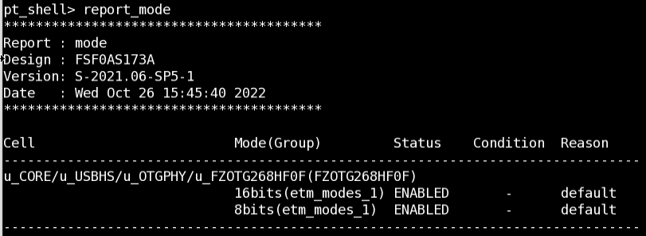
Merged ETM Usage
How does PrimeTime switch operating mode if there is no set_mode in SDC?
The operating modes are both ENABLED if there is no set_mode in SDC

Slide 10
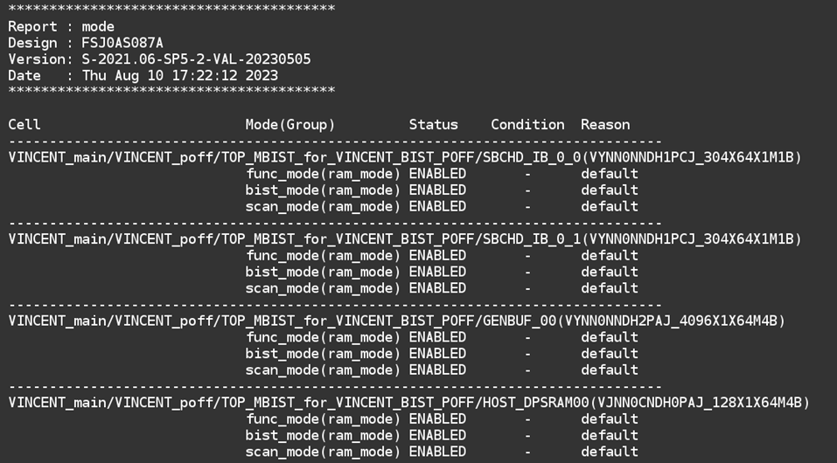
Merged ETM Usage
fstaH checks if there are multiple enabled mode in SDC, and prints a ReportMode.rpt

Slide 11
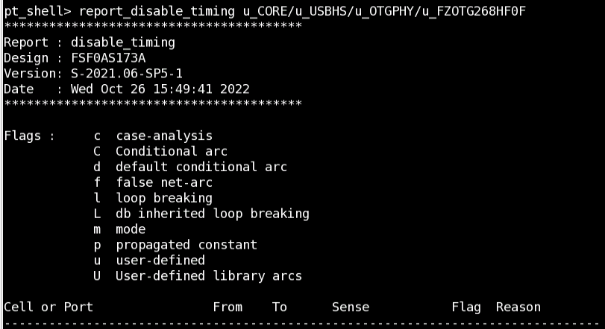
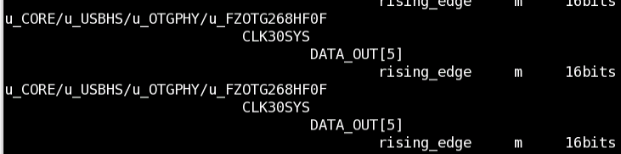
Merged ETM Usage
Another commands to check if the mode is specified correctly
report_disable_timing
With “set_mode 8bits”, the report_disable_timing returns that the timing arcs of 16bits are disabled by the mode
“Flag: m” indicates that the timing arc is disabled by “set_mode”

Slide 12
Merged ETM Usage
Does Primetime accept “set_mode” if there is no merged ETM loaded?
Primetime returns WARNING: UITE-132
Summary
User should apply set_mode to get the desired mode timing from merged ETM
read_lib ${merged_ETM}
16bits Enabled
8bits Enabled
set_mode 8bits ${CELL}
16bits disabled
8bits Enabled
Primetime picks the worst timing for STA
Primetime picks the ENABLED timing for STA

Slide 13
Script Usage
Script
/home/eda/FTC_CADTOOL/EXE/merge_model.tcl
Syntax
merge_model.tcl
[-top ${TOP}] Specify the TOP name of single mode ETM
[-runpt] If this option is specified, script runs primetime
[-gendb] If this option is specified, script generate merged ETM by format of {lib db}
[-val] If this option is specified, script validates merged ETM (extra input required)
[-vnc] If this option is specified, script goes primetime dmsa flow with VNC
Example
merge_model.tcl -top ${top_name}
merge_model.tcl -top ${top_name} -runpt
merge_model.tcl -top ${top_name} -runpt -gendb
merge_model.tcl -top ${top_name} -runpt -gendb -val

Slide 14
Script Usage
Note
source primetime.env if the argument ‘-runpt’ is specified.
Validation flow is optional since that there is no merged table in merged ETM, so the validating report will be all PASS
Refer to appendix 1.* for the detailed information of validating flow
When to use
For IP, the merging models steps will be completed by IPT check-in flow
For partition blocks, the merging steps should be complete by users with merge_model.tcl

Slide 15
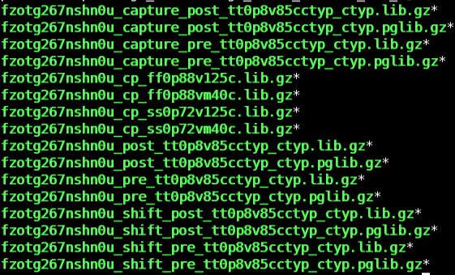
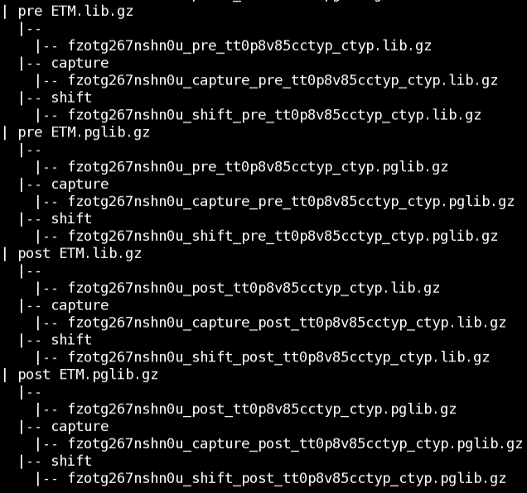
Script Usage
(pre|post)_(lib|pglib) can be put into the directory and will be classified by script automatically
single mode ETM collected and classified by script

Slide 16
Flow chart
** NOTE **
The mode names in merged ETM are determined by single mode ETM filename
-top
-val
-runpt
Step 1
Search ETM files in the current directory
flow chart
find stage
(pre/post)
find etm format
(.lib, .pglib, …)
find corner mode & PVT_RC
find mode (mode = file_name - top - stage - cornermode - pvt_rc - format)
Step 2
Check corner consistency between single mode ETM files
Step 3
Write merging ETM PrimeTime script
Step 4
Launch PrimeTime for merging ETM
Step 5
Check and rename the merged ETM
Step 6
Validate merged ETM

Slide 17


Input & Output
Input
single mode ETM
Command
/home/eda/FTC_CADTOOL/EXE/merge_model.tcl -top lds_cpu -runpt
Output
merging_${stage}_${etmFormat}.pt merging ETM Primetime script
merged_${stage}_${etmFormat} merged ETM directory (-runpt)

Slide 18
VNC Primetime DMSA flow
Command
-vnc
-vnc_group ${GROUP_NAME}
-vnc_multiproc ${MULTIPROC_NUM}
-vnc_multicore ${MULTICORE_NUM}
Example
merge_model.tcl -top ${top_name} -runpt -vnc
merge_model.tcl -top ${top_name} -runpt -vnc -vnc_multiproc 8 -vnc_multicore 8
Run time
reduce ~73% run-time with VNC default setting
VNC default setting
VNC_PT_OS7
4
4
 | ETM information |  |  | VNC flow | Local
cpu_top | post pglib | 5 modes | 31 corners | 1(H)16(M)28(S) | 4(H)24(M)18(S)
fzotg267nshn0u | pre lib pre pglib post lib post pglib | 3 modes | 20 corners 20 corners 62 corners 62 corners | 0(H)31(M)37(S) | 1(H)56(M)42(S)

Slide 19


Example - 1
Input
Command
/home/eda/FTC_CADTOOL/EXE/merge_model.tcl -top fzotg267nshn0u -runpt -gendb
Output

Slide 20
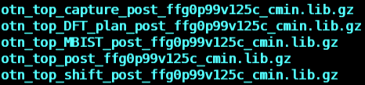

Example - 2
Input
Command
/home/eda/FTC_CADTOOL/EXE/merge_model.tcl -top otn_top -runpt -gendb
Output

Slide 21
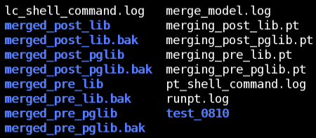
Example - 3
Input
Command
/home/eda/FTC_CADTOOL/EXE/merge_model.tcl -top fzotg267nshn0u -runpt -gendb
Output

Slide 22

Merging Model Issue
Library file is invalid for merging
Primetime returned
Solution
Check if the input libraries are merged ETM. The merged ETM can not be merged again.
How to check if the ETM is a merged ETM?
grep if there is a keyword of “mode_definition” in ETM
% grep "mode_definition" otn_top_post_ffg0p99v125c_cmin.lib
# Returned nothing means this is not a merged ETM
% grep "mode_definition" merged_post_lib/otn_top_post_ffg0p99v125c_cmin.lib
mode_definition ( etm_modes_1 ) {
# If there is a “mode_definition” in ETM means this is a merged ETM

Slide 23
Merging Model Issue
Found Different values defined for attribute (MODEL-18)
Area
Cell Leakage Power
Found inconsistent content (MODEL-20), (MODEL-23)
Related PG pin
Voltage Map
Generated Clock
Capacitance
Solution for issue 2 & 3:
Re-gen ETM
Refer to Appendix 1.* for more detailed information of merging model issue

Slide 24
Summary
single mode ETM + merge_model = merged ETM
library(“IP_capture”) {
...
pin(“...”) {
timing() {
** capture timing **
}
}
...
}
library(“IP_merged”) {
...
mode_definition (etm_mode) {
mode_value (capture) {}
mode_value (shift) {}
}
...
pin(“...”) {
timing() {
mode (etm_mode, “capture”);
** capture timing **
}
timing() {
mode (etm_mode, “shift”);
** shift timing **
}
}
}
merge_model
library(“IP_shift”) {
...
pin(“...”) {
timing() {
** shift timing **
}
}
...
}

Slide 25
Summary
library(“IP_merged”) {
...
pin(“...”) {
timing() {
mode (etm_mode, “capture”);
** capture timing **
}
timing() {
mode (etm_mode, “shift”);
** shift timing **
}
}
}
merged ETM + set_mode = single mode ETM
DISABLED
library(“IP_merged”) {
...
mode_definition (etm_mode) {
mode_value (capture) {}
mode_value (shift) {}
}
...
pin(“...”) {
timing() {
mode (etm_mode, “capture”);
** capture timing **
}
timing() {
mode (etm_mode, “shift”);
** shift timing **
}
}
}
set_mode capture
library(“IP_merged”) {
...
pin(“...”) {
timing() {
mode (etm_mode, “capture”);
** capture timing **
}
timing() {
mode (etm_mode, “shift”);
** shift timing **
}
}
}
DISABLED
set_mode shift

Slide 26
Reference
https://spdocs.synopsys.com/dow_retrieve/qsc-t/dg/ptolh/T-2022.03/ptolh/Content/ptug/ptug/hierarchical_analysis/etm/options/merging_extracted_models.htm
U:\DesignKitUsage\fetm\Merging_Extracted_Models.pdf
Testcase and QA result provided by IPT/Ann

Slide 27
QA

Slide 28
Thanks

Slide 29
Appendix - 1.1
How to validate a merged ETM?
We can validate a merged ETM by comparing the interface timing difference between single mode ETM and merged ETM.
How to build single mode ETM wrapper and merged ETM wrapper?
PrimeTime generates a test design containing an instance of the extracted timing model as well as the extracted model itself.
What related files are required for merged ETM validation?
single mode ETM, mode.sdc, mod_test.db, fetm working directory of single mode ETM
How to review the validation report?
Check the interface timing difference
Since there is no merged table in merged ETM, the interface timing difference should be zero

Slide 30
Appendix - 1.2
flow chart
mode.sdc
mode_ETM
pt_shell
write_interface_timing
mode.tim
pt_shell
compare_interface_timing
mode.sdc
set_mode …
merged_ETM
pt_shell
write_interface_timing
merged.tim
merged_ETM_validation.rpt
Input files
mode.sdc
mode_ETM
merged_ETM
test.db
Output files
mode.tim
merged_ETM.tim
merged_ETM_validation.rpt

Slide 31
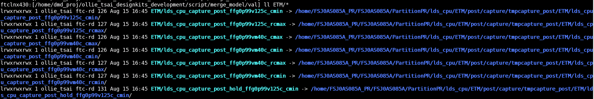
Appendix - 1.3
All of the input can be found in fetm working dir
Input
mode SDC
${fetm_dir}/${TOP}_${mode}.sdc
/home/FSJ0AS085A_PR/FSJ0AS085A/PartitionPR/lds_cpu/ETM/post/capture/lds_cpu_capture.sdc
test.db
${fetm_dir}/${tmp_dir}/ETM/${TOP}_${mode}_${PVT}_${RC}/mod_test.db
/home/FSJ0AS085A_PR/FSJ0AS085A/PartitionPR/lds_cpu/ETM/post/capture/tmpcapture_post/ETM/lds_cpu_capture_post_tt0p9v25c_typ/mod_test.db
User should link the ${fetm_dir}/${tmp_dir}/ETM dir to the merging model dir

Slide 32
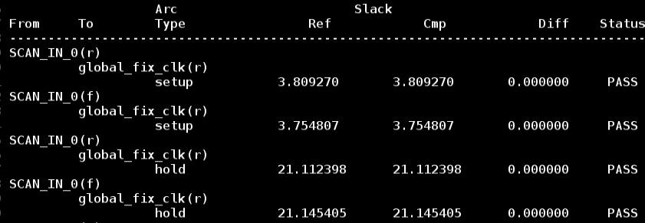
Appendix - 1.4
Output
model_validation/${TOP}_${mode}_${stage}_${PVT}_${RC}.rpt
/home/dmd_proj/ollie_tsai_designkits_development/script/merge_model/val/model_validation/lds_cpu_capture_post_ffg0p99v125c_cmin.rpt
Report
Since there is no merged table in merged ETM, the interface timing difference should be zero and status should be PASS

Slide 33
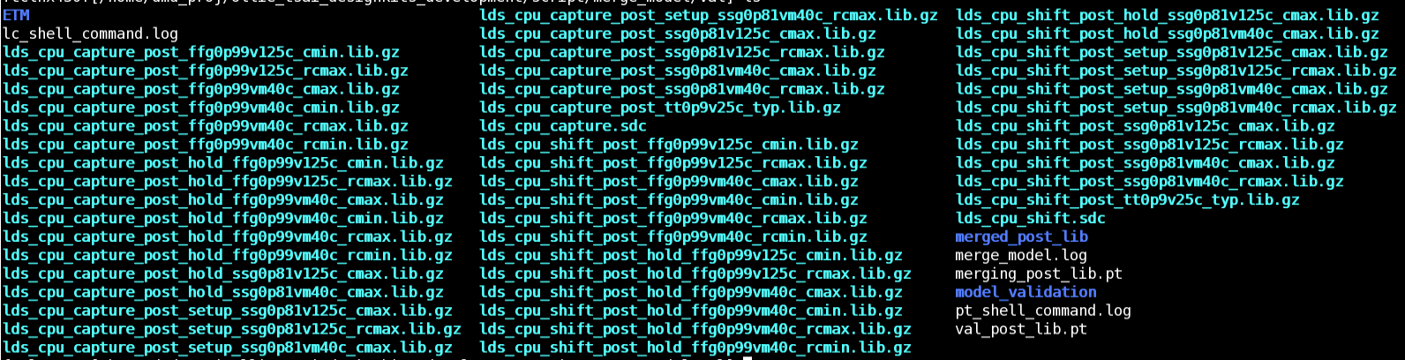
Appendix - 1.5
Steps
link all the single mode ETM to merging model dir
link all the mode SDC to merging model dir
mkdir ETM
link all the ${fetm_dir}/${tmp_dir}/ETM/* to ETM/.
merge_model.tcl -top ${TOP} -runpt -val
The validating report will be in model_validation dir
inputs
outputs

Slide 34
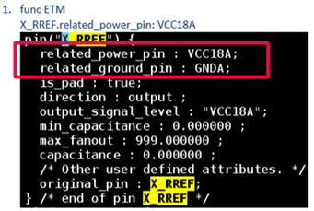
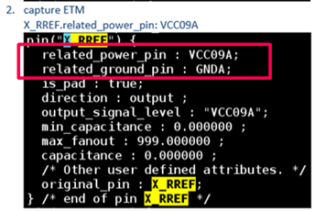
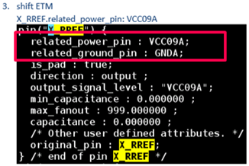
Appendix - 2.1
Inconsistent Related PG pin
Primetime returned
related_power_pin of ‘X_RREF’ in single mode ETM
Solution
Ask AC & RD check the PGPIN in PGMAP and re-gen ETM
Error: Found pin 'X_RREF' in the models defined with different related PG pin, cannot merge them. (MODEL-20)

Slide 35
Appendix - 2.2
Inconsistent Voltage Map
Primetime returned
voltage_map of ‘VCC10R’ in single mode ETM
Solution
Ask AC & RD check the voltage in powervalue.list and re-gen ETM
Error: Found PG pin 'VCC10R' in the models defined with different voltage value, cannot merge them. (MODEL-20)
$ zgrep "voltage_map ( VCC10R" FXCMM0016HJ0P*_post_ffg0p99v0c_cmin.pglib.gz
FXCMM0016HJ0P_capture_post_ffg0p99v0c_cmin.pglib.gz: voltage_map ( VCC10R, 1.050000 );
FXCMM0016HJ0P_shift_post_ffg0p99v0c_cmin.pglib.gz: voltage_map ( VCC10R, 1.050000 );
FXCMM0016HJ0P_post_ffg0p99v0c_cmin.pglib.gz: voltage_map ( VCC10R, 1.100000 );

Slide 36


Appendix - 2.3
Inconsistent Area
Primetime returned
Area in single mode ETM
capture func
Solution
Ask AC & RD re-gen ETM with same setting (PT version) and design content (netlist, lib)
Area is calculated by Primetime, and can be reviewed by command:
get_attriburte [get_design $DESIGN]
Error: Found different values defined for attribute 'area', 478500.000000 and 461301.500000 in the models, cannot merge them. (MODEL-18)

Slide 37
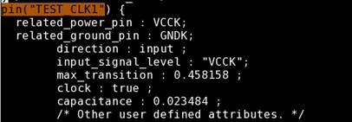
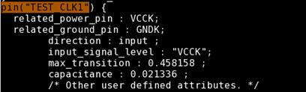
Appendix - 2.4
Inconsistent Capacitance
Primetime returned
Capacitance in single mode ETM
Solution
Ask AC & RD re-gen ETM
Capacitance is calculated by Primetime
Error: Cannot merge pin 'TEST_CLK1' with different 'capacitance' 0.021336 and 0.023484 in the models. (MODEL-23)

Slide 38
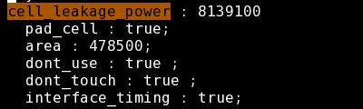
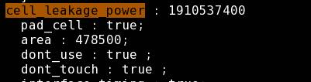

Appendix - 2.5
Inconsistent Cell Leakage Power
Primetime returned
single mode ETM
Solution
Ask AC & RD re-gen ETM
The lib attribute, cell_leakage_power, is added by fetm according to powerdownfile
Error: Found different values defined for attribute 'cell_leakage_power', 1910537344.000000 and 8139100.000000 in the models, cannot merge them. (MODEL-18)

Slide 39
Appendix - 2.6
Library file is invalid for merging
Primetime returned
Solution
Check if the input libraries are merged ETM. The merged ETM can not be merged again.
How to check if the ETM is a merged ETM?
grep if there is a keyword of “MODE DEFINITION” in ETM
% grep "MODE DEFINITION" otn_top_post_ffg0p99v125c_cmin.lib
# Returned nothing means this is not a merged ETM
% grep "MODE DEFINITION“ merged_post_lib/otn_top_post_ffg0p99v125c_cmin.lib
/* MODE DEFINITIONS start here */
/* MODE DEFINITIONS end here */
# If there is a “MODE DEFINITION” in ETM means this is a merged ETM

Slide 40
Appendix - 2.7
Inconsistent definition of generated clock
Primetime returned
Solution
Ask AC & RD checks the clock definition in mode SDC and re-gen ETM

Slide 41
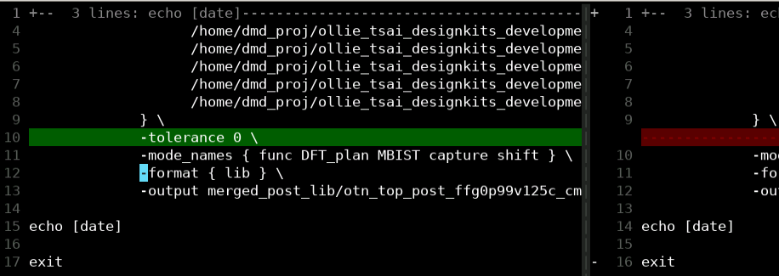
Appendix 3.1
Updated on 2023/09/01
There is a new argument, “-tolerance 0”, in merging*.pt
There is be a 0.04 tolerance by default, which brings merged values
In this update, the tolerance is set to be 0, there will be no merged values
If there are same values between multiple modes, there will be a merged table
timing () {
min_delay_flag : true ;
timing_type : min_clock_tree_path ;
timing_sense : positive_unate ;
mode(etm_modes_1, "capture shift");
/* comment : from another design; */
cell_rise( f_itrans ){
index_1 ( "0.000000, 0.004385, 0.015721, 0.037370, 0.071099, 0.150000, 0.469074");
values ( "0.070790, 0.072780, 0.076824, 0.081551, 0.086487, 0.093953, 0.111418");
}
cell_fall( f_itrans ){
index_1 ( "0.000000, 0.004385, 0.015721, 0.037370, 0.071099, 0.150000, 0.469074");
values ( "0.074075, 0.075893, 0.079613, 0.083946, 0.088340, 0.094877, 0.107735");
}
} /* end of arc sdh_sys_clk_sdh_sys_clk_mlat_min_2842*/

Slide 42
Appendix 4.1
Current Faraday IP check-out rule
Note
For 55nm or below, there will be only pglib in both “RD check-in IP flow lib” and “project-based check-out IP lib flow”
For those users who want to have 55nm or below IP lib, they could try:
Ask IPT to check-out IP package of older version
Ask IP RD to share a local IP database
 | 55nm and below | others
lib content | merged ETM | merged ETM
lib type | .pglib | .lib / .pglib

Slide 43
Enhancement History
2023/08/10 Fix the incorrect merged ETM file name issue
2023/08/11 Remove the ERROR msg which checks if there is only one ETM in the directory
2023/08/14 Add new option "-gendb" for generating merged.db automatically
2023/09/01 Add new argument "-tolerance 0" to merging*.pt, there will be no merged value in merged ETM (but still merged table if the values of modes are totally the same)
2023/09/19 Add checking PT and VNC setting steps
2023/09/19 enhance for VNC flow
2023/10/04 add option: -vnc_group, -vnc_multiproc, -vnc_multicore
2023/10/04 filter primetime WARNING message in merge_model.log
2023/10/11 enhance pvt_rc parser, ffgnp/ssgnp can be recognized correctly now
2023/10/20 enhance lsf flow
2023/10/27 new proc pplib and checkETMAttribute for post-processing missing is_pad into merged.pglib
2023/11/03 missing output_signal_level will be post-processed into merged.pglib and merged.lib
2023/11/27 new proc sanity_check, script checks single_mode/merged ETM by LC::check_library
2023/12/01 missing input_signal_level will be post-processed into merged.lib

Slide 44
Confidential information
The material is being disclosed to you pursuant to a non-disclosure agreement between you or your employer and Faraday. Information disclosed in this presentation may be used only as permitted under such an agreement.
Legal notice
The information contained in this presentation is intended to provide a general guide as to which product is suited for a given requirement and shows suggested product applications. Specified functions and properties for products are only valid when handling instructions and other stated conditions and recommendations have been considered and followed. All descriptions, illustrations and dimensions in the information represent general particulars and do not form part of any contract. All information is provided “as is”, with no guarantee of completeness, accuracy, timeliness or of the results obtained from the use of the information, and without warranty of any kind, express or implied, including but not limited to warranties of performance. All information is subject to change without prior notice. Faraday assumes no responsibility whatsoever for any errors or inaccuracies about the information.

Slide 45
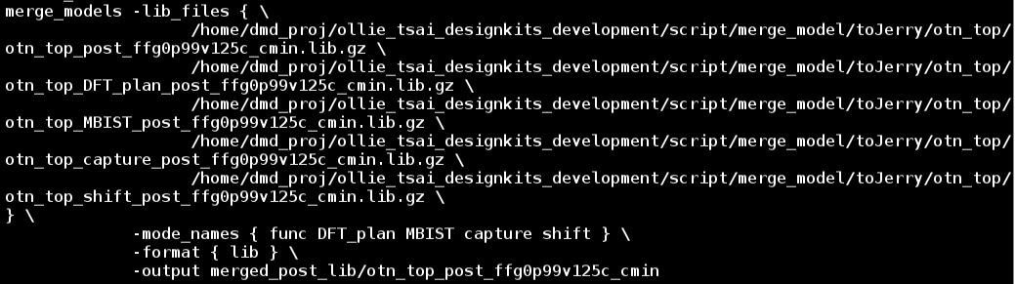
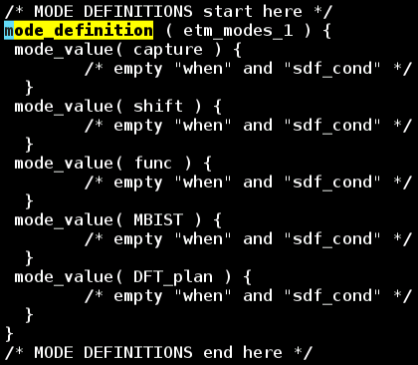
Merged ETM Example
merge_models command
mode_definition in merged ETM

