Slide 1
Outline Topic: Static timing analysis.
What is STA?
Timing path
Cell delay & Net delay
Setup time, Hold time
Timing derate
Read Timing Report
Fix violation
Q&A

Slide 2
1. What is STA?

Slide 3
1. What is STA ?
Static timing analysis (STA) is a method of validating the timing performance of a design by checking all possible paths for timing violations
STA involves 3 main steps:
Breaks a design down into timing paths.
Calculates the signal propagation delay along each path
Checks for violations of timing constraints inside the design and at the input/output interface.

Slide 4
2. Timing path

Slide 5
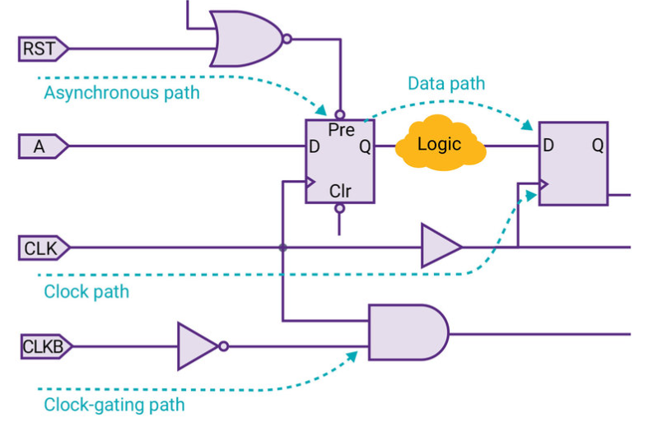
2. Timing paths
Timing path: is a route from a start point to an end point, includes 4 types:
Data path
Clock path
Clock gating path
Asynchronous path

Slide 6
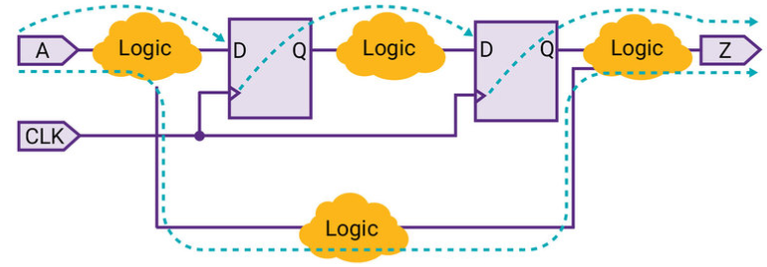
2. Timing paths
Data path
Path1
Path2
Path3
Path4
Path1: from Input port to Data input of flip-flop (In2Reg)
Path2: from Clock pin of flip-flop to Data input of flip-flop (Reg2Reg)
Path3: from Clock pin of flip-flop to Output port (Reg2Out)
Path4: from Input port to Output port (In2Out)

Slide 7
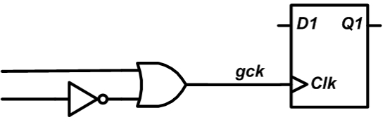
2. Timing paths
Clock path: from a clock input port or cell pin to the clock pin of a flip-flop; for data setup and hold checks
Data path
D
Q
D
Q
Launch path
Capture path
1
Common point
2
Clock gating path: from an input port to a clock-gating element; for clock-gating setup and hold checks.
CLK
Clock gating path

Slide 8
2. Timing paths
Asynchronous path: from an input port to an asynchronous set or clear pin of a sequential element, it independent from the clock path
RST
A
Asynchronous path
Pre
D
Q

Slide 9
3. Path delay calculation

Slide 10
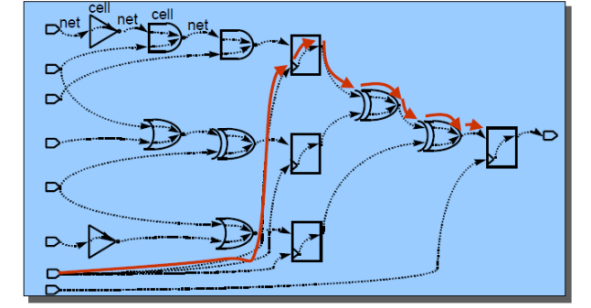
3. Path delay calculation
The actual path delay is the sum of net and cell delays along that timing path

Slide 11
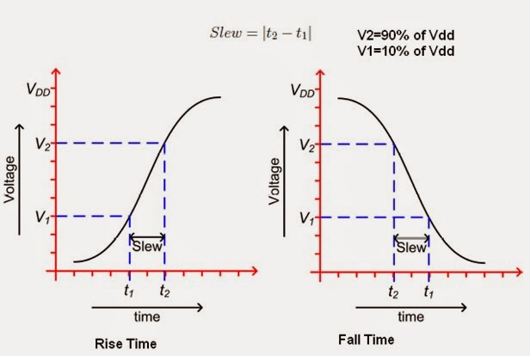
3. Path delay calculation
Cell delay: delay from input to output of a cell, is calculate by using 2-dimensional table interpolation with input slew and output load as indexes
Slew of a signal is a measuring rising and falling transition rate
2-D delay table example :
Slew \ Load | 0.2 | 0.3 | 0.4
0.0 | 2 | 3.5 | 6
0.2 | 3 | 5.6 | 8
Slew = 0.2
C_{load}= 0.3fF
5.6ns

Slide 12
cell
3. Path delay calculation
Net delay: delay from the output of a cell to the input of the next cell in a timing path
A
cell
net
B
R
W
H
C
L
(A) A net
(B) Elmore model
Net delay = RC

Slide 13
4. Setup Time, Hold Time

Slide 14
4. Setup time, Hold time
4.1. Setup, hold time
4.2. Setup check
4.3. Hold check
4.4. Timing violation

Slide 15
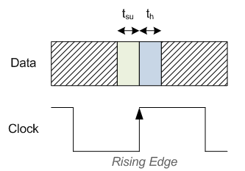
4.1. Setup Time and Hold Time
Setup time is the amount of time required for the input to a Flip-Flop to be stable before a clock edge.
Hold time is the minimum amount of time required for the input to a Flip-Flop to be stable after a clock edge.

Slide 16
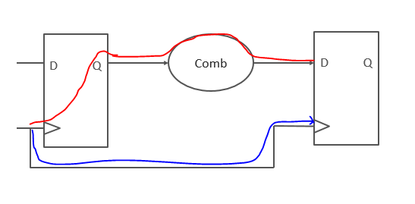
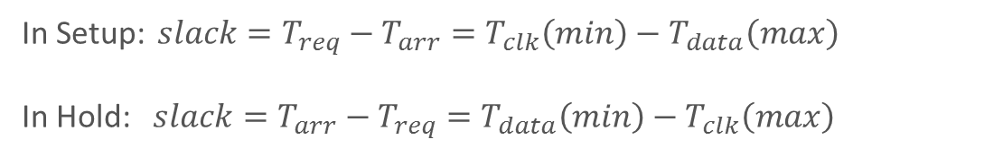
4.1. Setup Time and Hold Time
Data_path
Clock_path
In Setup: ${slack=T}_{req}−T_{arr}=T_{clk}\left(min\right)−T_{data}\left(max\right)$
In Hold: ${slack=T}_{arr}−T_{req}=T_{data}\left(min\right)−T_{clk}\left(max\right)$

Slide 17
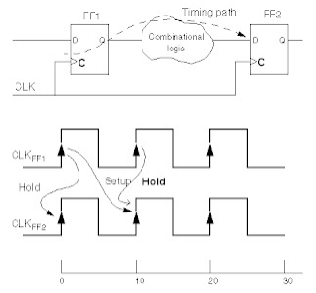
4.2. Setup Time and Hold Time
reg2reg timing check
Setup is checked at next clock edge
Hold is checked at same clock edge

Slide 18
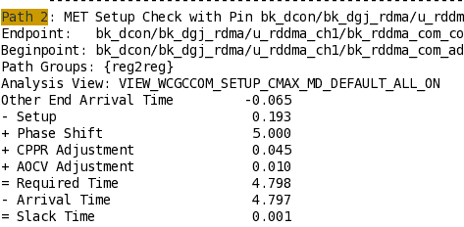
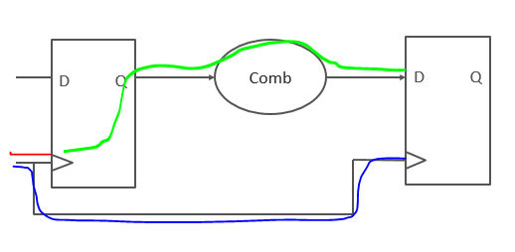
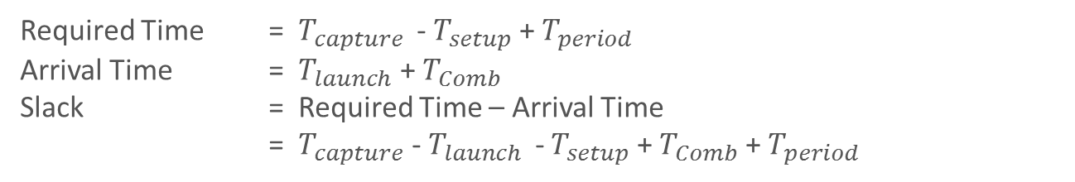
4.2. Setup Time Check
reg2reg
Required Time = $T_{capture }$ - $T_{setup}$ + $T_{period}$
Arrival Time = $T_{launch}$ + $T_{Comb}$
Slack = Required Time – Arrival Time
= $T_{capture}$ - $T_{launch }$ - $T_{setup}$ + $T_{Comb}$ + $T_{period}$

Slide 19
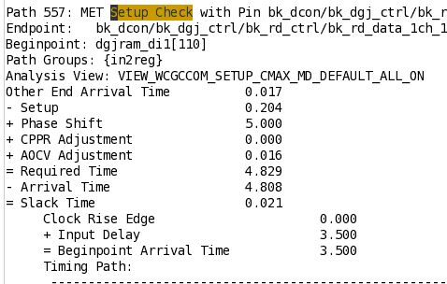
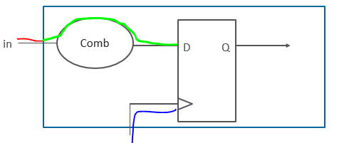
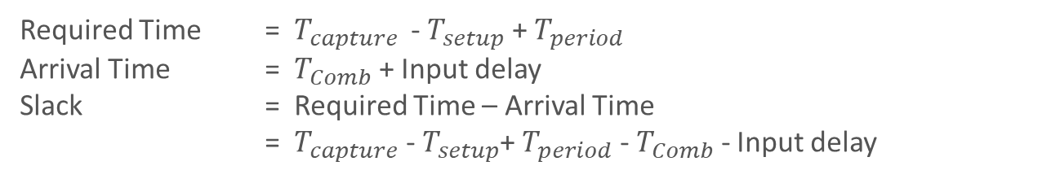
4.2. Setup Time Check
in2reg
Required Time = $T_{capture }$ - $T_{setup}$+ $T_{period}$
Arrival Time = $T_{Comb}$ + Input delay
Slack = Required Time – Arrival Time
= $T_{capture}$ - $T_{setup}$+ $T_{period}$ - $T_{Comb}$ - Input delay

Slide 20
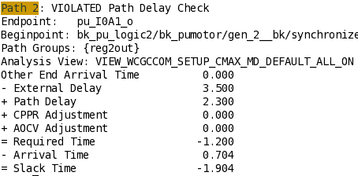
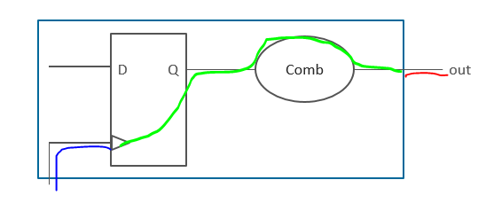
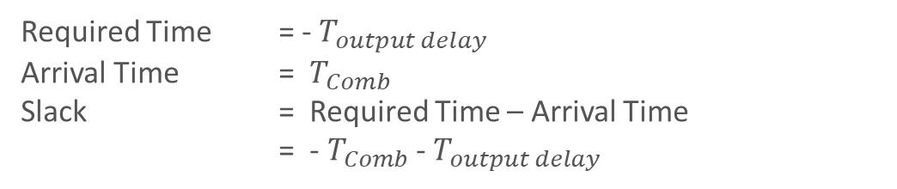
4.2. Setup Time Check
reg2out
Required Time = - $T_{output delay}$
Arrival Time = $T_{Comb}$
Slack = Required Time – Arrival Time
= -$T_{Comb}$ - $T_{output delay}$

Slide 21
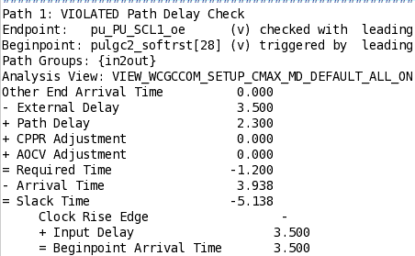
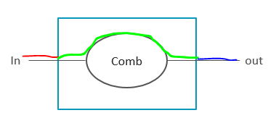
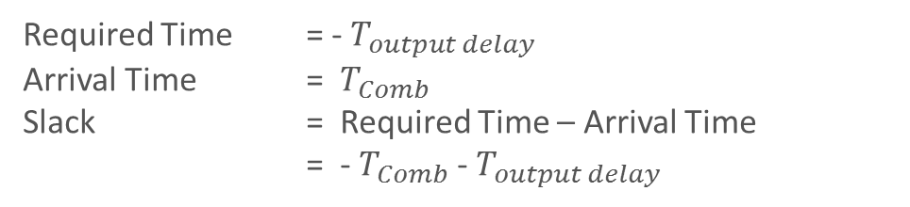
4.2. Setup Time Check
in2out
Required Time = - $T_{output delay}$
Arrival Time = $T_{Comb}$
Slack = Required Time – Arrival Time
= - $T_{Comb}$ - $T_{output delay}$

Slide 22
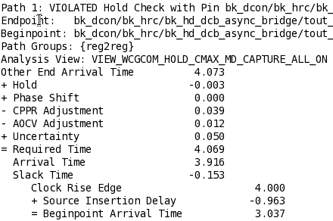
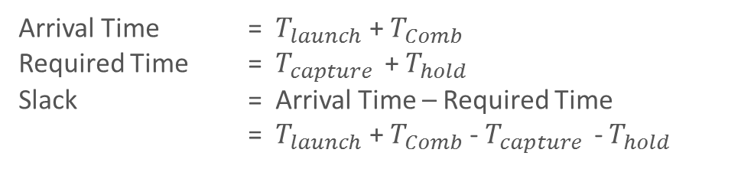
4.3. Hold Time Check
reg2reg
Arrival Time = $T_{launch}$ + $T_{Comb}$
Required Time = $T_{capture }$ + $T_{hold}$
Slack = Arrival Time – Required Time
= $T_{launch}$ + $T_{Comb}$ - $T_{capture }$ - $T_{hold}$

Slide 23
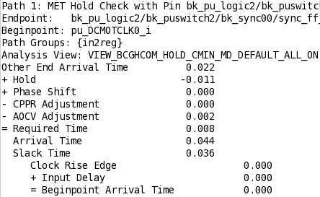
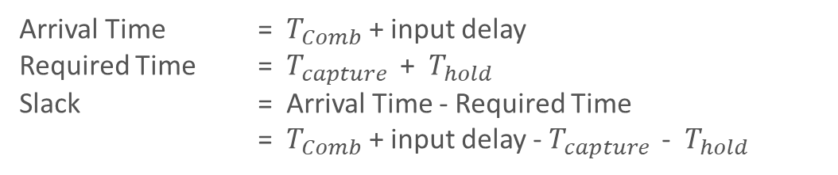
4.3. Hold Time Check
in2reg
Arrival Time = $T_{Comb}$ + input delay
Required Time = $T_{capture }$ + $T_{hold}$
Slack = Arrival Time - Required Time
= $T_{Comb}$ + input delay - $T_{capture }$- $T_{hold}$

Slide 24
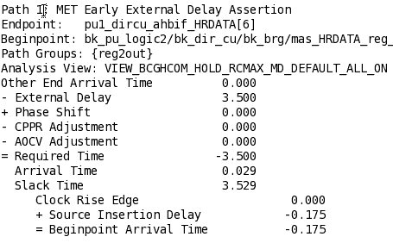
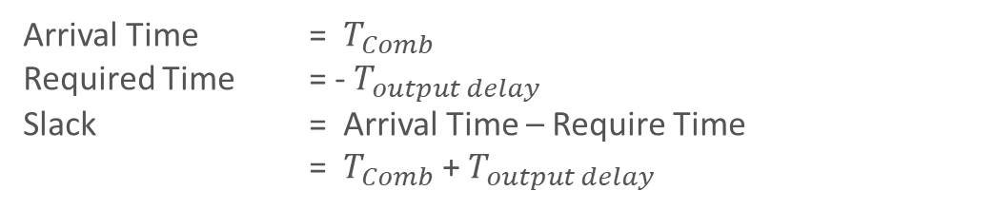
4.3. Hold Time Check
reg2out
Arrival Time = $T_{Comb}$
Required Time = - $T_{output delay}$
Slack = Arrival Time – Require Time
= $T_{Comb}$ + $T_{output delay}$

Slide 25
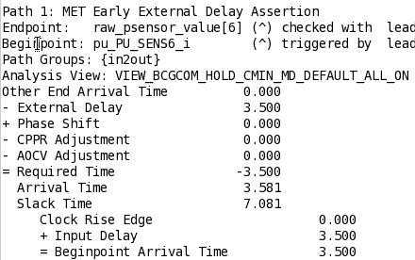
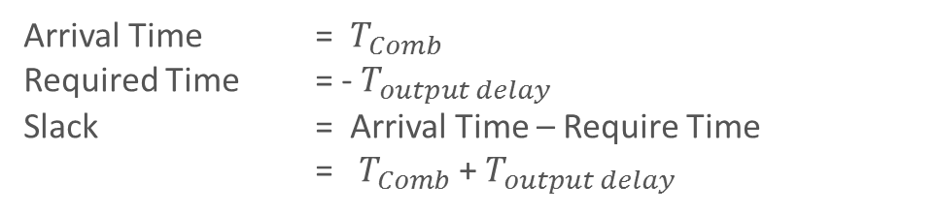
4.3. Hold Time Check
in2out
Arrival Time = $T_{Comb}$
Required Time = - $T_{output delay}$
Slack = Arrival Time – Require Time
= $T_{Comb}$ + $T_{output delay}$

Slide 26
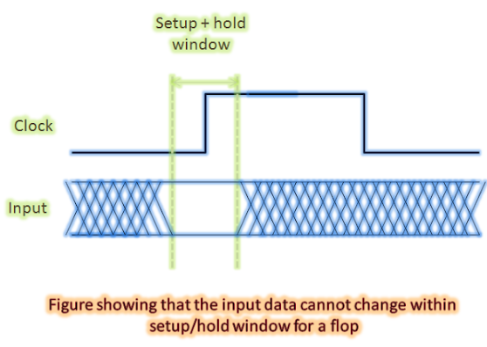
4.4. Timing Violation
Timing MET ⬄ Slack > 0
Timing VIOLATED ⬄ Slack < 0

Slide 27
5. Timing derate

Slide 28
5. Timing derate
5.1. OCV
5.2. AOCV
5.3. CPPR
5.4. Worst case

Slide 29
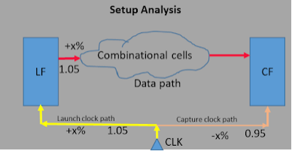
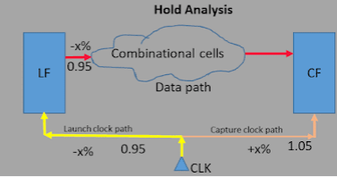
5.1. OCV
In OCV (On-chip Variation), a fixed timing derate factor is applied to all cells in the design.
Fab process variations could either increase or decrease the delay of cells. Tool considers early or lately derate based on the path and the type of analysis

Slide 30
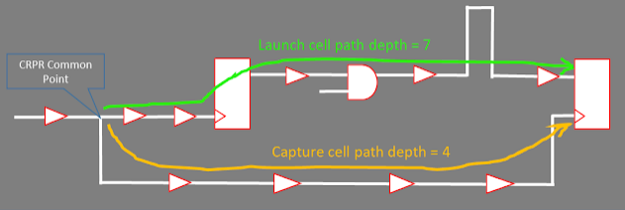
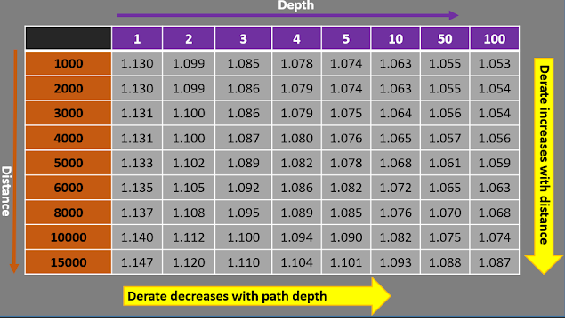
5.2. AOCV
In AOCV (Advanced OCV) derate is applied on each cell based on path depth and distance of the cell in the timing path and it also varies with cell type and drive strength of the cell.
AOCV derate depends on Distance, Path depth, Cell type.

Slide 31
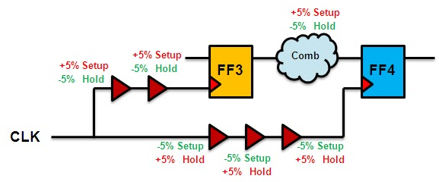
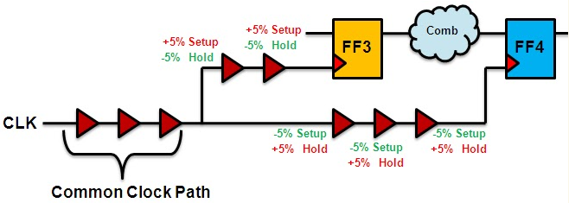
5.3. CPPR (Common Path Pessimism Removal)
CPPR Adjustment = late - early

Slide 32
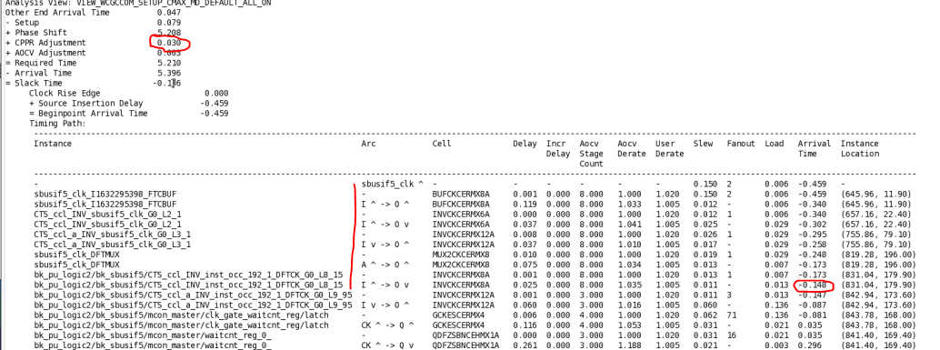
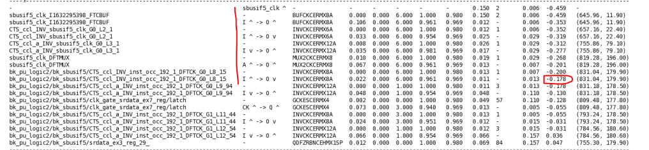
4.3. CPPR
late – early=0.03
Late = -0.148
Early= -0.178

Slide 33
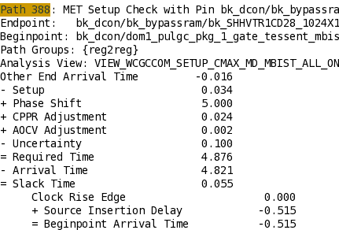
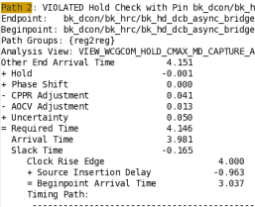
5.4. Worst case
Setup case
Hold case
In Setup, tool automatically adds CPPR, AOCV Adjustment in Required Time but subtract in Hold

Slide 34
6. Reading timing report

Slide 35
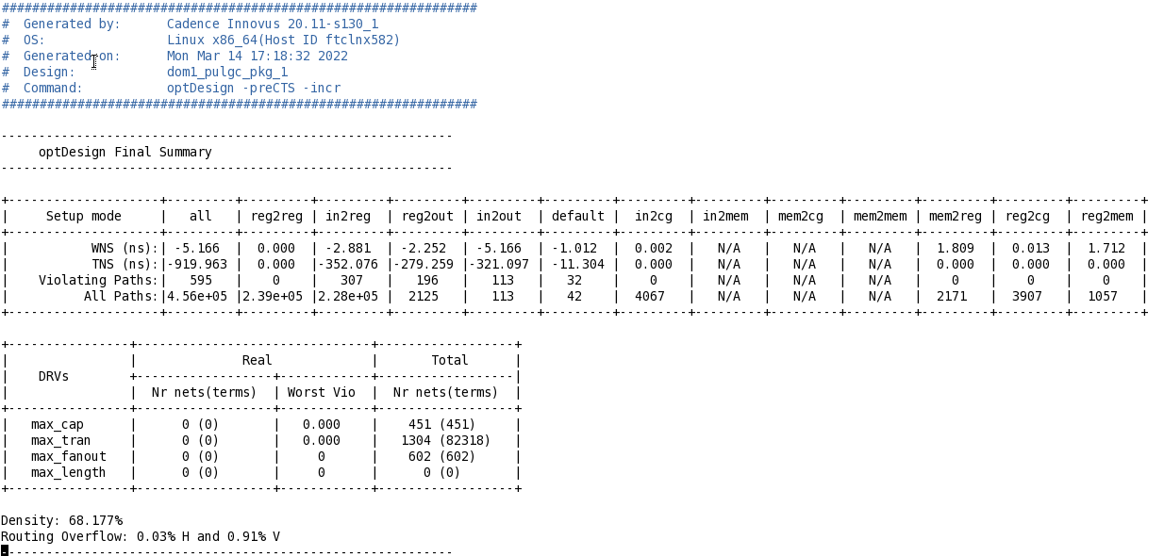
6. Read timing report
WNS (worst negative slack): Worst path ...path having max slack. Points to the path having the maximum negative slack.
TNS (total negative slack): Total number of negative slack (violated) paths. From the value of TNS, we can know the severity of the slack in total design and whether to proceed or not with the current design model.
Summary report

Slide 36
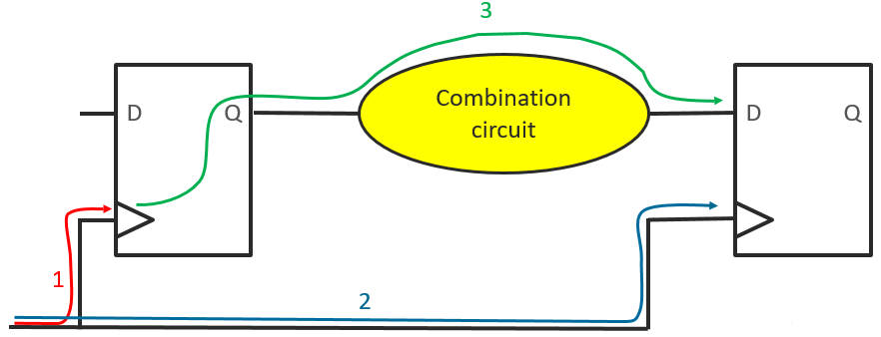
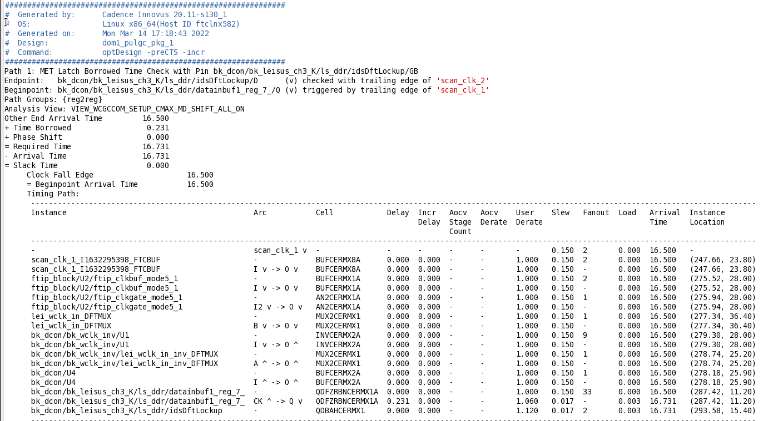
6. Read timing report
Reg2reg
Launch clock path
Capture clock path
Data path
Required time =TOther end path + Time borrowed – Setup
Arrival time = Tclockpath + Tdatapath Slack = Required time – Arrival time

Slide 37
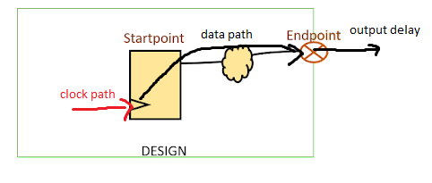
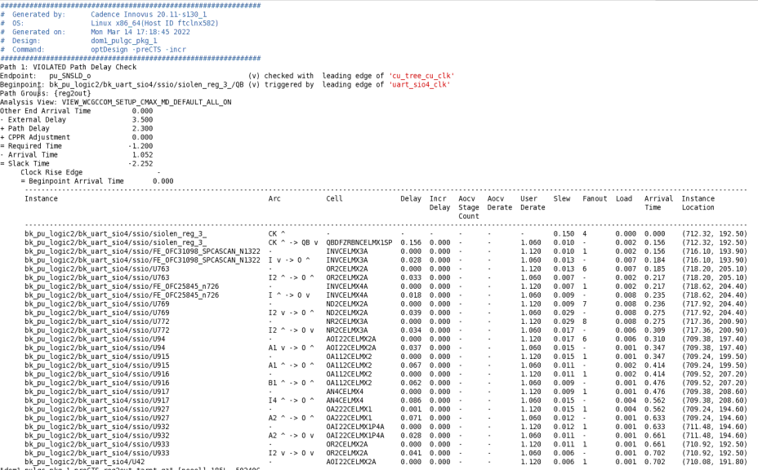
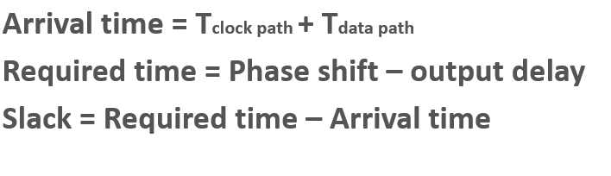
6. Read timing report
Reg2out
Clock name
violation

Slide 38
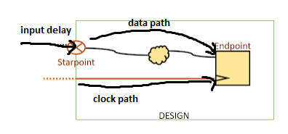
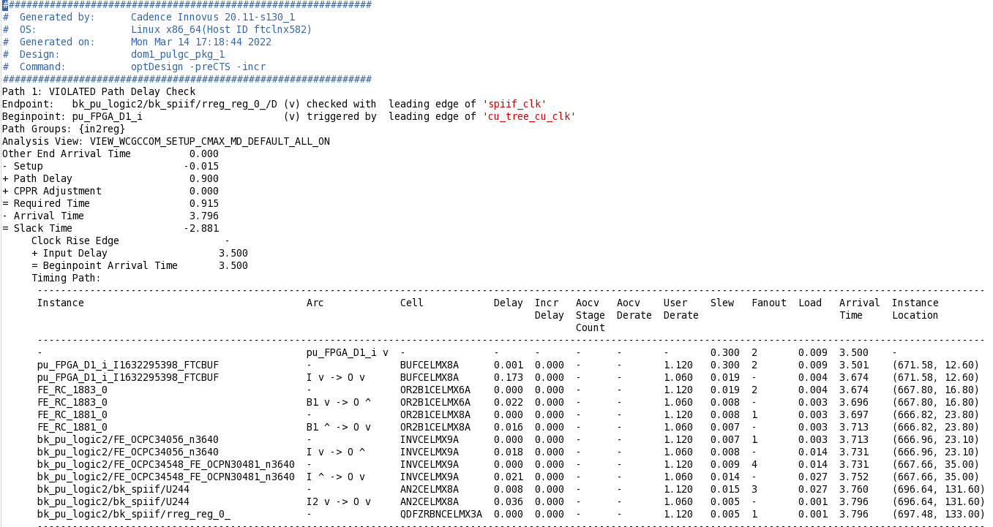
6. Read timing report
In2reg
Required time = Path delay - Setup
Arrival time = data_path + Input delay
Slack time = Required time - Arrival time

Slide 39
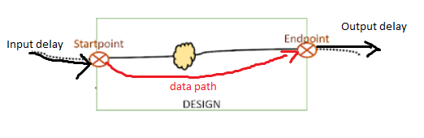
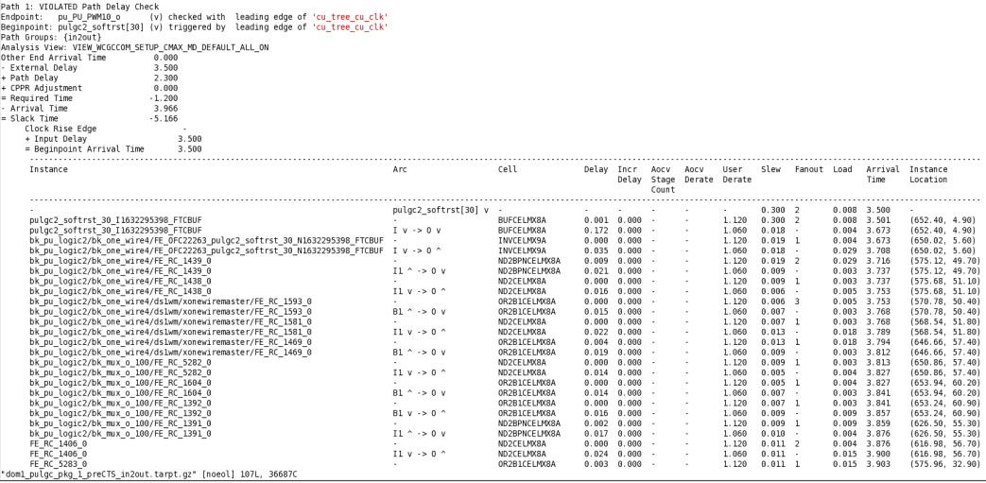
6. Read timing report
In2out
Require time = Path delay - Output delay
Arrival time = data_path + Input delay
Slack time = Required time - Arrival time

Slide 40


6. Read timing report
Pre-CTS
Post-CTS
➔ Increase Density

Slide 41
7. Fix violation

Slide 42
7.1. Fix setup time violation
Reduce the amount of buffering in the data path
Replace buffers with 2 inverters place farther apart in data path
Upsize cell
Insert Buffers
Adjust cell position in layout

Slide 43
7.1. Fix setup time violation
Reduce the amount of buffering in the path
It will reduce the cell delay but increase the wire delay. So if we can reduce more cell delay in comparison to wire delay, the delay will decrease.

Slide 44

7.1. Fix setup time violation
Replace buffers with 2 inverters place farther apart

Slide 45

7.1. Fix setup time violation
Upsize cell
Normally larger cell has higher speed. But some special cell may have larger cell slower than normal cell.
Negative effect: Higher power consumption and more area used in the layout.

Slide 46

7.1. Fix setup time violation
Insert Buffers
Insert buffer decrease the transition time, which decrease the wire delay.
Negative effect: Area will increase and increase the power consumption.

Slide 47

7.1. Fix setup time violation
Adjust cell position in layout
Adjusting the cell position produces a significant change in stage delay. Gate delays and cell delays are smaller than wire delays and their positioning of gates between two cells can change the transition time.

Slide 48
7.2. Fix hold time violation
Two ways to fix hold violation
Adding delays
Decreasing the size of certain cells in the data paths.

Slide 49

7.2. Fix hold time violation
Adding delays. (Add buffer/inverter)
Buffers which are chosen to fix hold are of low drive strength cells so as to provide large delay.

Slide 50
7.2. Fix hold time violation
Decreasing the size of certain cells in the data paths
It is better to reduce the cells closer to the capture FF because there is less likely hood of affecting other path and causing new errors.
Note
First try to fix setup violation as much as possible. Then later on start fixing hold violation
Adding buffer may cause setup violation in other path, so we need to analysis carefully.

Slide 51
THANKS FOR WATCHING

Slide 52
7. Q&A

Slide 53
Confidential information
The material is being disclosed to you pursuant to a non-disclosure agreement between you or your employer and Faraday. Information disclosed in this presentation may be used only as permitted under such an agreement.
Legal notice
The information contained in this presentation is intended to provide a general guide as to which product is suited for a given requirement and shows suggested product applications. Specified functions and properties for products are only valid when handling instructions and other stated conditions and recommendations have been considered and followed. All descriptions, illustrations and dimensions in the information represent general particulars and do not form part of any contract. All information is provided “as is”, with no guarantee of completeness, accuracy, timeliness or of the results obtained from the use of the information, and without warranty of any kind, express or implied, including but not limited to warranties of performance. All information is subject to change without prior notice. Faraday assumes no responsibility whatsoever for any errors or inaccuracies about the information.

