Slide 1
Model Description
Advanced AI(CSE750200)
Term project
2019310290 Sangman Jung

Slide 2
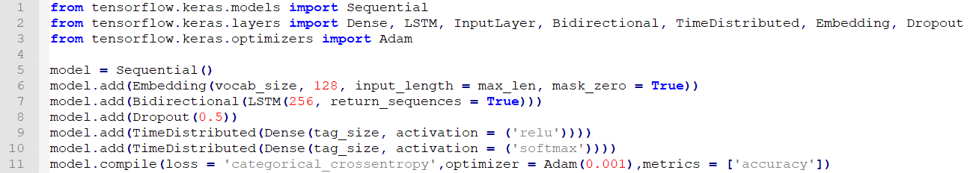
LSTMmodel.py
Library : Keras
Hypothesis model : Bidirectional LSTM
Activation : dence = Relu , output = Softmax
Loss function : Categorical cross entropy
Optimizer : Adam, lr = 0.001

Slide 3
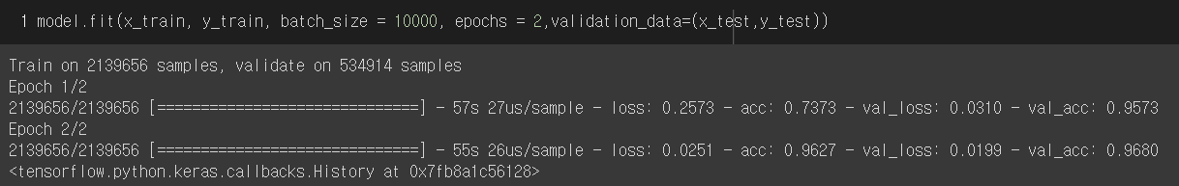
Model accuracy
My laptop (only CPU) / training accuracy : 0.9694, batch size = 10000, epochs = 2
Google CoLab (GPU) / accuracy of (train, valid) : (0.9627,0.9680), used train.txt only (train_test_split in sklearn), batch size and epochs is the same as above.

Slide 4
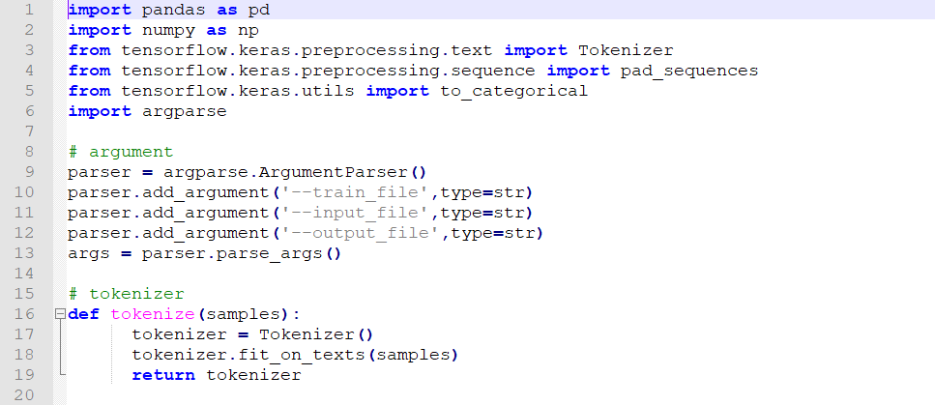
train.py (1)
Library import
Argument parser in terminal
Define the tokenizer

Slide 5
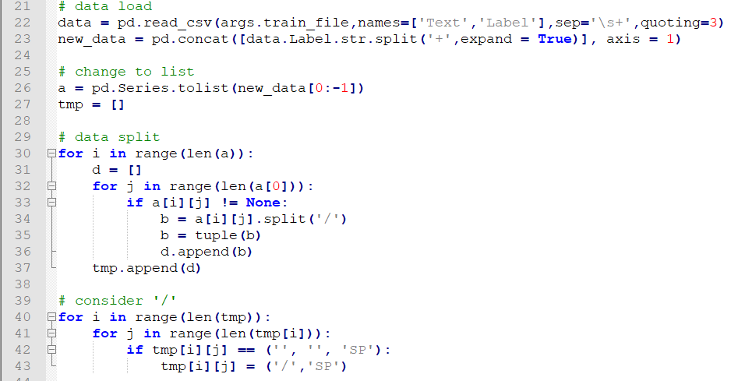
train.py (2)
Data load and change to list type using Pandas
Split the loaded data
This code is the exception if ‘/’ exists in the word

Slide 6
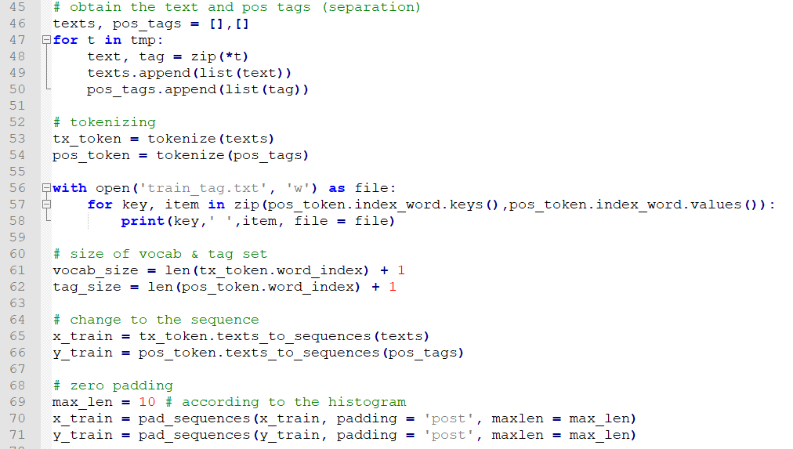
train.py (3)
Separate words and tags
Save the tokenized sets in order to make the index of words and tags
It would be used in test.py as tag index
Convert to sequence data and add zero padding

Slide 7
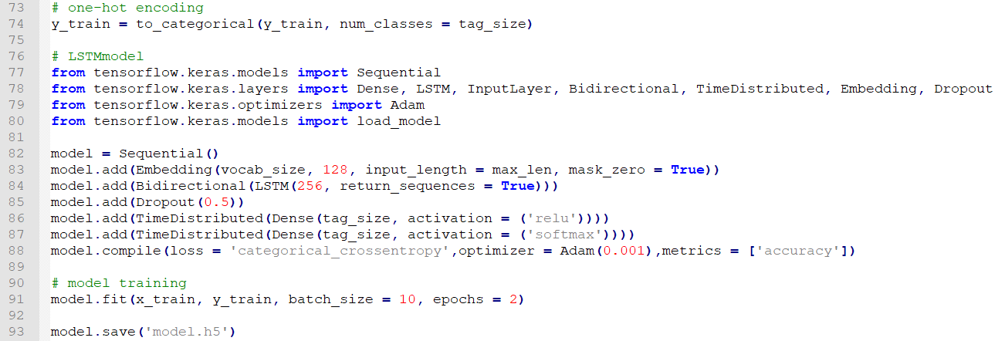
train.py (4)
One hot encoding & model import part
Save the train model

Slide 8
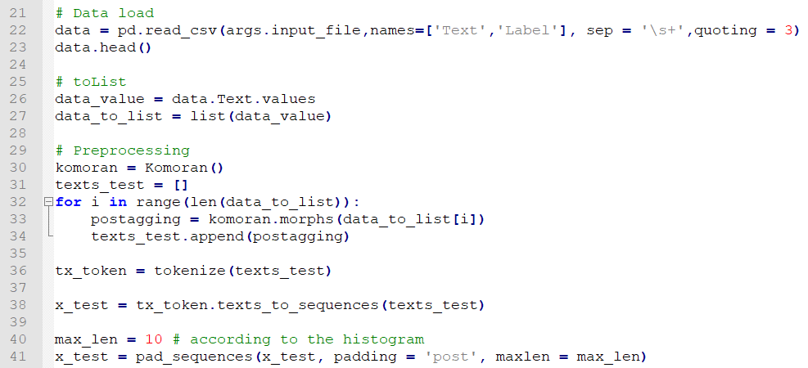
test.py (1)
Package importing and data loading is similar to train.py, but the different thing is this used konlpy for tokenizing

Slide 9
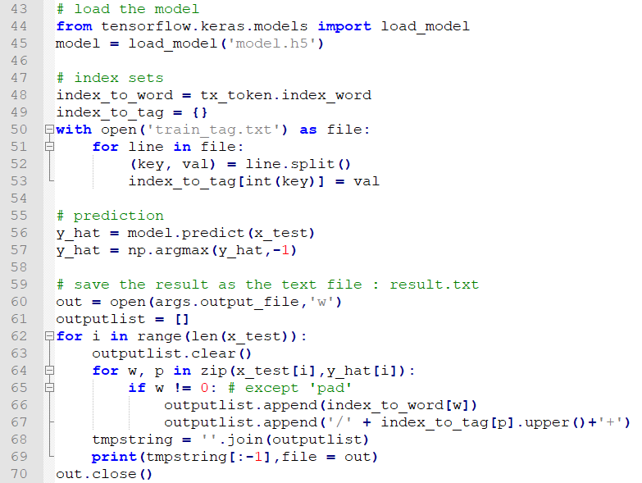
test.py (2)
Load the model after excute train.py
Load POS tag index set in train.py
Model prediction part
Save as .txt file named by
result.txt

