Slide 1
Application of Topological Data Analysis for Biomechanical Dataset
Sangman Jung
sangmanjung@khu.ac.kr
Supervisor: Prof. Kyungsoo Kim
November 23, 2020
Department of Mathematics
Graduate School
Kyung Hee University
M.S Thesis Presentation
Sangman Jung, KHU
1 / 41

Slide 2
Table of Contents
Chapter 1. Introduction
1.1 Data analysis methodologies
1.2 Research motivation
Chapter 2. Analysis Methods
2.1 Topological data analysis
2.2 Conventional analysis methods
Chapter 3. Development of GUI Program
Chapter 4. Application
4.1 Biomechanical dataset
4.2 Results
Chapter 5. Conclusion
References
Sangman Jung, KHU
M.S Thesis Presentation
2 / 41

Slide 3
Chapter 1. Introduction
M.S Thesis Presentation
Sangman Jung, KHU
3 / 41

Slide 4
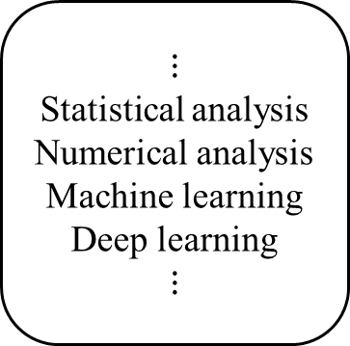
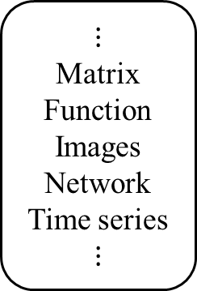
1.1 Data analysis methodologies
Data Analysis
Methodologies
Input
$$⋮$$
Matrix
Function
Images
Network
Time series
$$⋮$$
$$⋮$$
Statistical analysis
Numerical analysis
Machine learning
Deep learning
$$⋮$$
Preprocessing
Output
Interpretations
Need to obtain
more accurate output
Big Data
Need to extract key factors of the data
Merging
Several
Methods
M.S Thesis Presentation
Sangman Jung, KHU
4 / 41

Slide 5
1.2 Research motivation
TDA
Big Data
Merging
Several
Methods
Need to extract key factors of the data
Unsupervised Learning
Supervised Learning
PCA, K-means, Dendrogram, etc.
SVM, CNN, Random Forest, etc.
M.S Thesis Presentation
Sangman Jung, KHU
5 / 41

Slide 6
1.2 Research motivation
Why we use TDA:
The recently proposed data analysis method
Extracts some topological features for the data
Effective in finding hidden features
Purpose:
To obtain the hidden features of each subject.
To quantify similarities or dissimilarities between subjects.
M.S Thesis Presentation
Sangman Jung, KHU
6 / 41

Slide 7
Chapter 2. Analysis Methods
M.S Thesis Presentation
Sangman Jung, KHU
7 / 41

Slide 8
2.1 Topological data analysis
Input data
Point clouds
Topological structure
construction
Feature
selection
Visualization
M.S Thesis Presentation
Sangman Jung, KHU
8 / 41

Slide 9


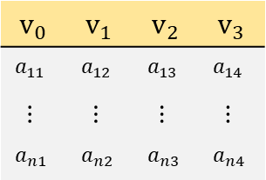


2.1 Topological data analysis
Input data
$$v_{0}$$ | $$v_{1}$$ | $$v_{2}$$ | $$v_{3}$$
$$a_{11}$$ | $$a_{12}$$ | $$a_{13}$$ | $$a_{14}$$
$$⋮$$ | $$⋮$$ | $$⋮$$ | $$⋮$$
$$a_{n1}$$ | $$a_{n2}$$ | $$a_{n3}$$ | $$a_{n4}$$
$$v_{1}$$
$$v_{0}$$
$$v_{3}$$
$$v_{2}$$
Point clouds
Input data
Point clouds
Topological structure
construction
Feature
selection
Visualization
M.S Thesis Presentation
Sangman Jung, KHU
9 / 41

Slide 10










2.1 Topological data analysis
Input data
$$v_{0}$$ | $$v_{1}$$ | $$v_{2}$$ | $$v_{3}$$
$$a_{11}$$ | $$a_{12}$$ | $$a_{13}$$ | $$a_{14}$$
$$⋮$$ | $$⋮$$ | $$⋮$$ | $$⋮$$
$$a_{n1}$$ | $$a_{n2}$$ | $$a_{n3}$$ | $$a_{n4}$$
$$v_{1}$$
$$v_{0}$$
$$v_{3}$$
$$v_{2}$$
Point clouds
Input data
Point clouds
Topological structure
construction
$$ε=0$$
$$ε=0.1$$
$$ε=0.3$$
$$ε=0.5$$
$$ε=0.8$$
$$ε$$
$$⋯$$
$$⋯$$
Feature
selection
$$\left(β_{0},β_{1},β_{2}\right)=(4,0,0)$$
$$\left(β_{0},β_{1},β_{2}\right)=(2,1,0)$$
Topological structure construction & Feature selection
Visualization
M.S Thesis Presentation
Sangman Jung, KHU
10 / 41

Slide 11
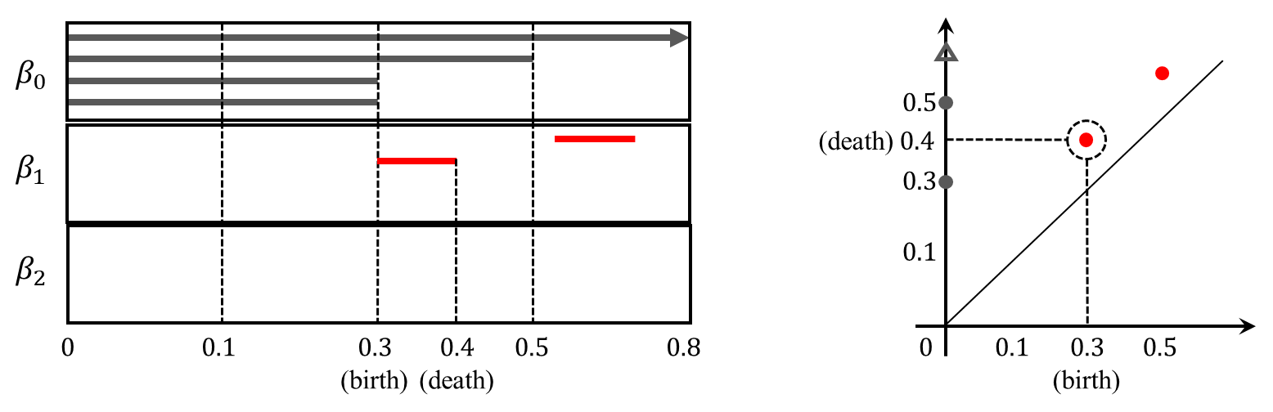
2.1 Topological data analysis
Input data
$$v_{0}$$ | $$v_{1}$$ | $$v_{2}$$ | $$v_{3}$$
$$a_{11}$$ | $$a_{12}$$ | $$a_{13}$$ | $$a_{14}$$
$$⋮$$ | $$⋮$$ | $$⋮$$ | $$⋮$$
$$a_{n1}$$ | $$a_{n2}$$ | $$a_{n3}$$ | $$a_{n4}$$
$$v_{1}$$
$$v_{0}$$
$$v_{3}$$
$$v_{2}$$
Point clouds
Input data
Point clouds
Topological structure
construction
$$ε=0$$
$$ε=0.1$$
$$ε=0.3$$
$$ε=0.5$$
$$ε=0.8$$
$$ε$$
$$⋯$$
$$⋯$$
Feature
selection
$$\left(β_{0},β_{1},β_{2}\right)=(4,0,0)$$
$$\left(β_{0},β_{1},β_{2}\right)=(2,1,0)$$
Topological structure construction & Feature selection
Visualization
M.S Thesis Presentation
Sangman Jung, KHU
11 / 41

Slide 12




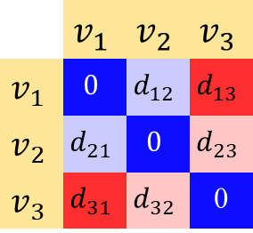
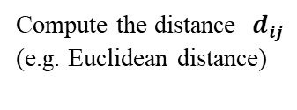



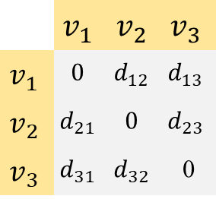

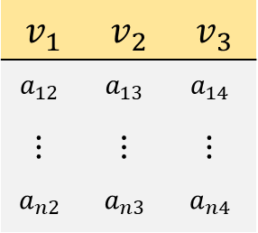
2.1 Topological data analysis
Input data
Point clouds construction:
$$v_{1}$$ | $$v_{2}$$ | $$v_{3}$$
$$a_{12}$$ | $$a_{13}$$ | $$a_{14}$$
$$⋮$$ | $$⋮$$ | $$⋮$$
$$a_{n2}$$ | $$a_{n3}$$ | $$a_{n4}$$
 | $$v_{1}$$ | $$v_{2}$$ | $$v_{3}$$
$$v_{1}$$ | $$0$$ | $$d_{12}$$ | $$d_{13}$$
$$v_{2}$$ | $$d_{21}$$ | $$0$$ | $$d_{23}$$
$$v_{3}$$ | $$d_{31}$$ | $$d_{32}$$ | 0
Point clouds
Compute the distance $d_{ij}$
(e.g. Euclidean distance)
$$d_{ij}=d_{ji}$$
Topological structure
construction
Input data
Distance matrix
(Point clouds)
$$v_{1}$$
$$d_{12}$$
 | $$v_{1}$$ | $$v_{2}$$ | $$v_{3}$$
$$v_{1}$$ | $$0$$ | $$d_{12}$$ | $$d_{13}$$
$$v_{2}$$ | $$d_{21}$$ | $$0$$ | $$d_{23}$$
$$v_{3}$$ | $$d_{31}$$ | $$d_{32}$$ | 0
Feature
selection
$$v_{2}$$
$$d_{13}$$
$$d_{23}$$
Visualization
$$v_{3}$$
Graph representation
Heatmap representation
M.S Thesis Presentation
Sangman Jung, KHU
12 / 41

Slide 13
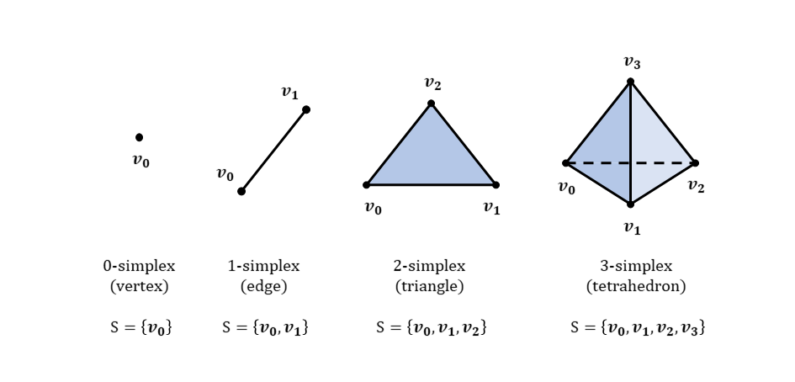
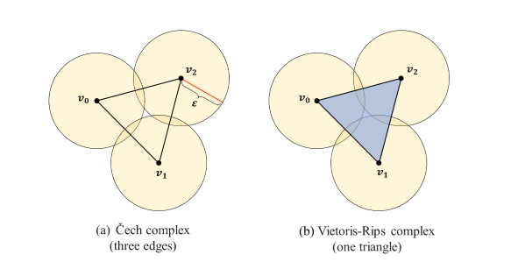




2.1 Topological data analysis
Input data
Topological structure construction:
Point clouds
Topological structure
construction
Topological structure construction
Feature
selection
$$ε=0$$
$$ε=0.1$$
$$ε=0.3$$
$$ε=0.5$$
$$ε=0.8$$
$$ε$$
Visualization
$$⋯$$
$$⋯$$
$$\left(β_{0},β_{1},β_{2}\right)=(4,0,0)$$
$$\left(β_{0},β_{1},β_{2}\right)=(2,1,0)$$
Feature selection
M.S Thesis Presentation
Sangman Jung, KHU
13 / 41

Slide 14
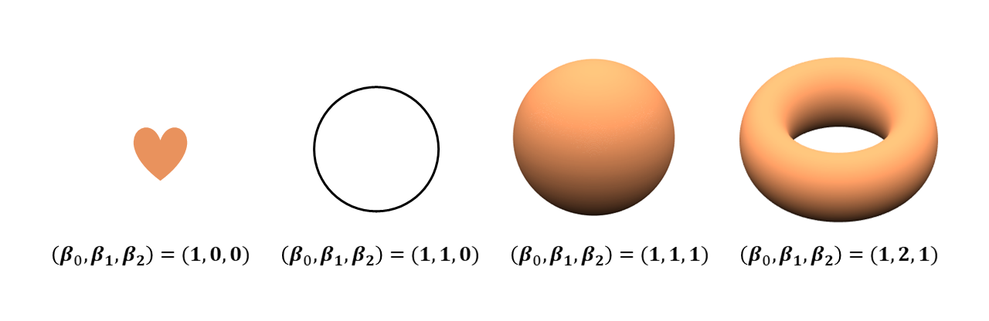

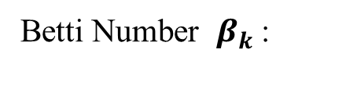


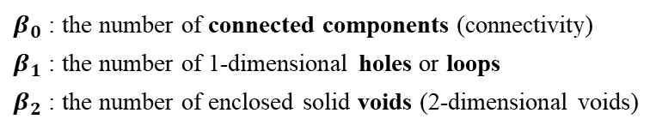

2.1 Topological data analysis
Input data
Feature selection:
Point clouds
$$ε=0$$
$$ε=0.1$$
$$ε=0.3$$
$$ε=0.5$$
$$ε=0.8$$
$$ε$$
Topological structure
construction
$$⋯$$
$$⋯$$
$$\left(β_{0},β_{1},β_{2}\right)=(4,0,0)$$
$$\left(β_{0},β_{1},β_{2}\right)=(2,1,0)$$
Betti Number $β_{k}$:
$β_{0}$ : the number of connected components (connectivity)
$β_{1}$ : the number of 1-dimensional holes or loops
$β_{2}$ : the number of enclosed solid voids (2-dimensional voids)
(intuitively)
Feature
selection
Visualization
M.S Thesis Presentation
Sangman Jung, KHU
14 / 41

Slide 15
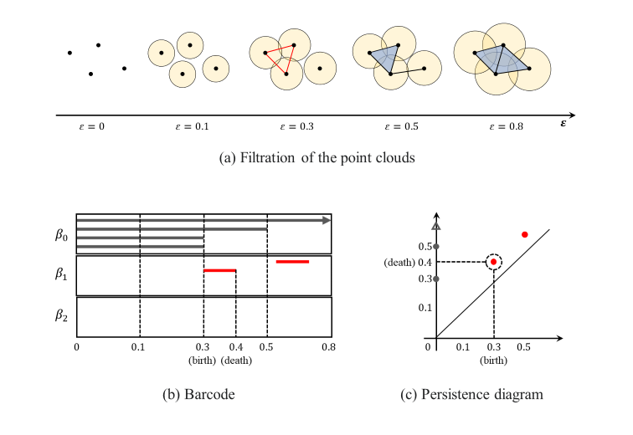


2.1 Topological data analysis
Input data
Visualization:
Point clouds
Topological structure
construction
$$\left(β_{0},β_{1},β_{2}\right)=(4,0,0)$$
$$\left(β_{0},β_{1},β_{2}\right)=(2,1,0)$$
Feature
selection
Visualization
Barcode
Persistence diagram
M.S Thesis Presentation
Sangman Jung, KHU
15 / 41

Slide 16
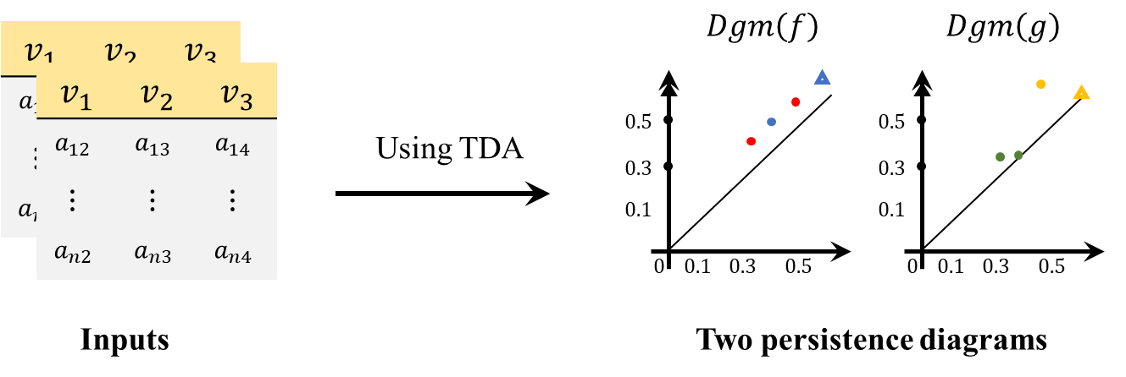
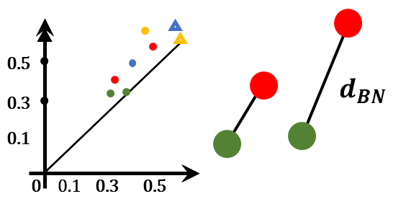
2.1 Topological data analysis
The case of multiple dataset:
Compute the bottleneck distance between two persistence diagrams:
$$d_{BN}\left(Dgm\left(f\right),Dgm\left(g\right)\right)=\inf_{γ}{\sup_{1≤i≤m}{{\left\|x_{i}^{f}−γ\left(x_{i}^{f}\right)\right\|}_{∞}}}$$
$f, g : ℝ→ℝ$, a bijection $γ :Dgm(f)→Dgm(g)$ where $Dgm(f)$, $Dgm(g)$ are the persistence diagrams of $f, g,$ respectively. Assume that $m=n$ where $\left|Dgm(f)\right|=m, \left|Dgm(g)\right|=n$.
Compute the bottleneck distance
M.S Thesis Presentation
Sangman Jung, KHU
16 / 41

Slide 17
2.2 Conventional analysis methods
We used the following methods with TDA:
The single linkage dendrogram in hierarchical clustering analysis
Multidimensional scaling for the dimensionality reduction
M.S Thesis Presentation
Sangman Jung, KHU
17 / 41

Slide 18
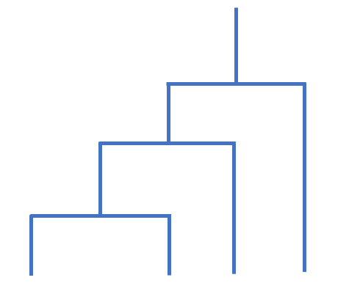














2.2 Conventional analysis methods
We used the following methods with TDA:
Single linkage dendrogram
Multidimensional scaling
Dendrogram :
The diagram that shows the hierarchical relationship between objects such as stem of a tree.
$$((A⋃B)⋃C)⋃D$$
$$((A⋃B)⋃C)⋃D$$
$$(A⋃B)⋃C$$
$$(A⋃B)⋃C$$
$$A⋃B$$
$$C$$
$$D$$
$$A⋃B$$
$$A$$
$$B$$
$$A$$
$$B$$
$$C$$
$$D$$
M.S Thesis Presentation
Sangman Jung, KHU
18 / 41

Slide 19

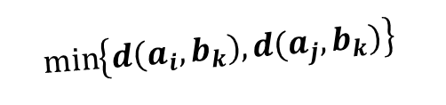



2.2 Conventional analysis methods
We used the following methods with TDA:
Single linkage dendrogram
Multidimensional scaling
Single linkage method :
The linkage method that merges based on the minimum value of each cluster.
$$a_{i}$$
$$b_{k}$$
$$\min_{}\left\{d\left(a_{i},b_{k}\right),d(a_{j},b_{k})\right\}$$
$$A$$
$$B$$
M.S Thesis Presentation
Sangman Jung, KHU
19 / 41

Slide 20
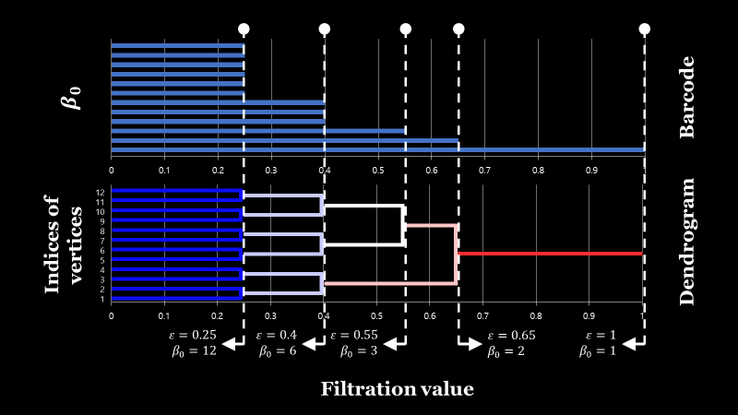
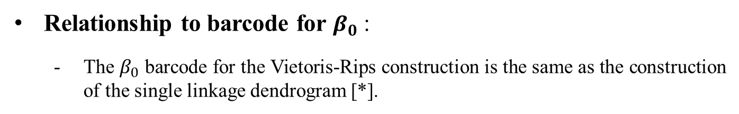
2.2 Conventional analysis methods
Relationship to barcode for $β_{0}$ :
The $β_{0}$ barcode for the Vietoris-Rips construction is the same as the construction of the single linkage dendrogram [*].
[*] Lee, H., Kang, H., Chung, M. K., Kim, B. N., & Lee, D. S. (2012). Persistent brain network homology from the perspective of dendrogram. IEEE transactions on medical imaging, 31(12), 2267-2277.
M.S Thesis Presentation
Sangman Jung, KHU
20 / 41

Slide 21
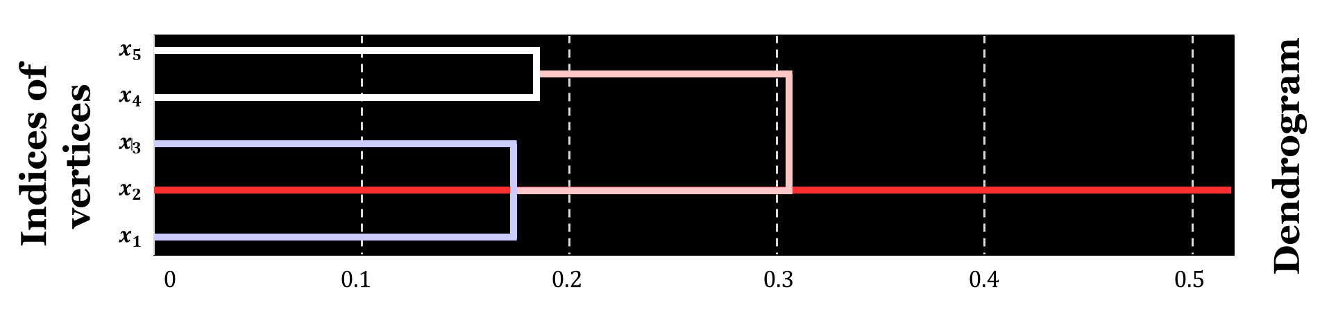
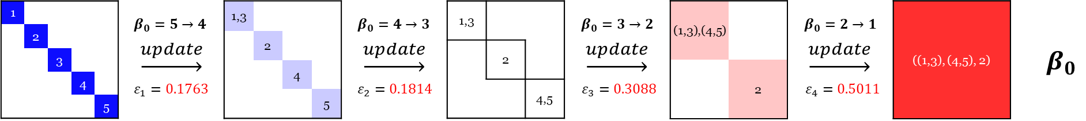
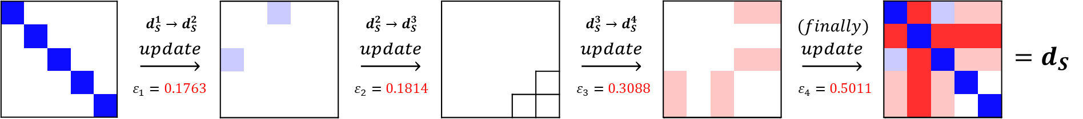
2.2 Conventional analysis methods
Practical use of the information of the dendrogram:
Barcode for $β_{0}$ with clustering information:
Single linkage dendrogram as a matrix form:
M.S Thesis Presentation
Sangman Jung, KHU
21 / 41

Slide 22
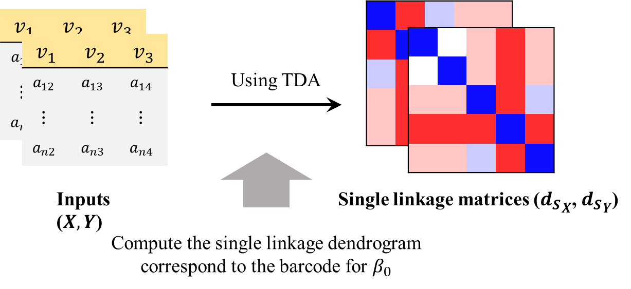
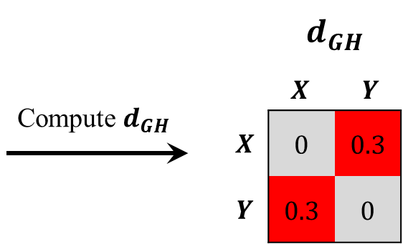
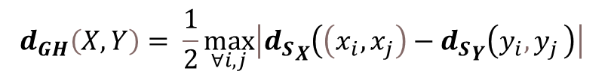
2.2 Conventional analysis methods
The case of multiple dataset:
Compute the Gromov-Hausdorff distance (GH distance) between two single linkage matrices ${d_{S}}_{X}$ and ${d_{S}}_{Y}$:
$$d_{GH}\left(X,Y\right)= \frac{1}{2}\max_{∀i,j}\left|\left.{d_{S}}_{X} ( \left(x_{i},x_{j}\right)−{d_{S}}_{Y} ( y_{i}{,y}_{j}\right)\right|$$
GH distance matrix form
M.S Thesis Presentation
Sangman Jung, KHU
22 / 41

Slide 23
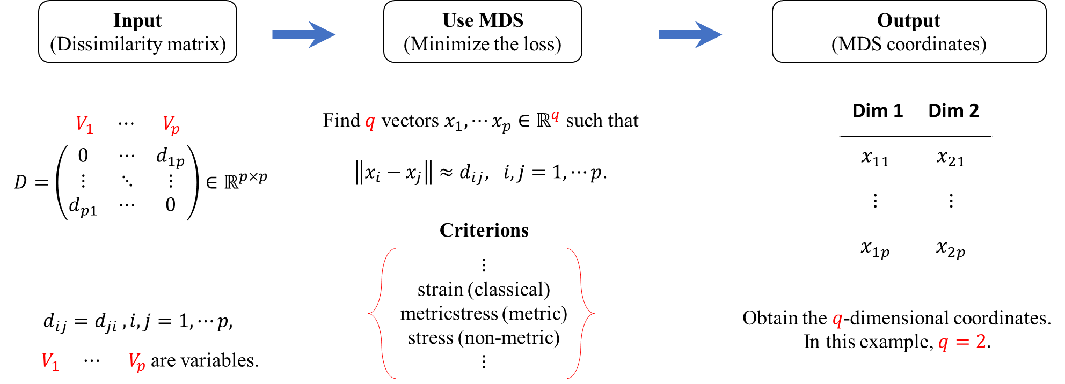


2.2 Conventional analysis methods
Multidimensional Scaling (MDS) :
$$V_{1}$$
$$V_{p}$$
M.S Thesis Presentation
Sangman Jung, KHU
23 / 41

Slide 24
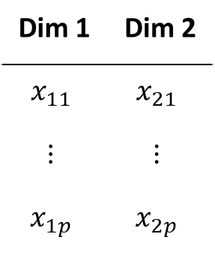




2.2 Conventional analysis methods
Multidimensional Scaling (MDS) :
Output
$$V_{1}$$
Dim 2
$$V_{p}$$
$${(x}_{1i},x_{2i})$$
$$V_{i}$$
Dim 1
M.S Thesis Presentation
Sangman Jung, KHU
24 / 41

Slide 25
Chapter 3. Development of GUI program
M.S Thesis Presentation
Sangman Jung, KHU
25 / 41

Slide 26
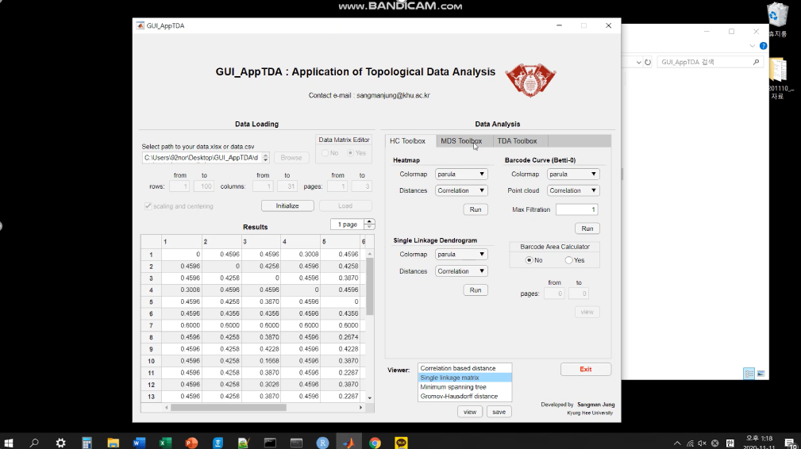
The video for the execution of GUI_AppTDA
M.S Thesis Presentation
Sangman Jung, KHU
26 / 41

Slide 27
Chapter 4. Application
M.S Thesis Presentation
Sangman Jung, KHU
27 / 41

Slide 28

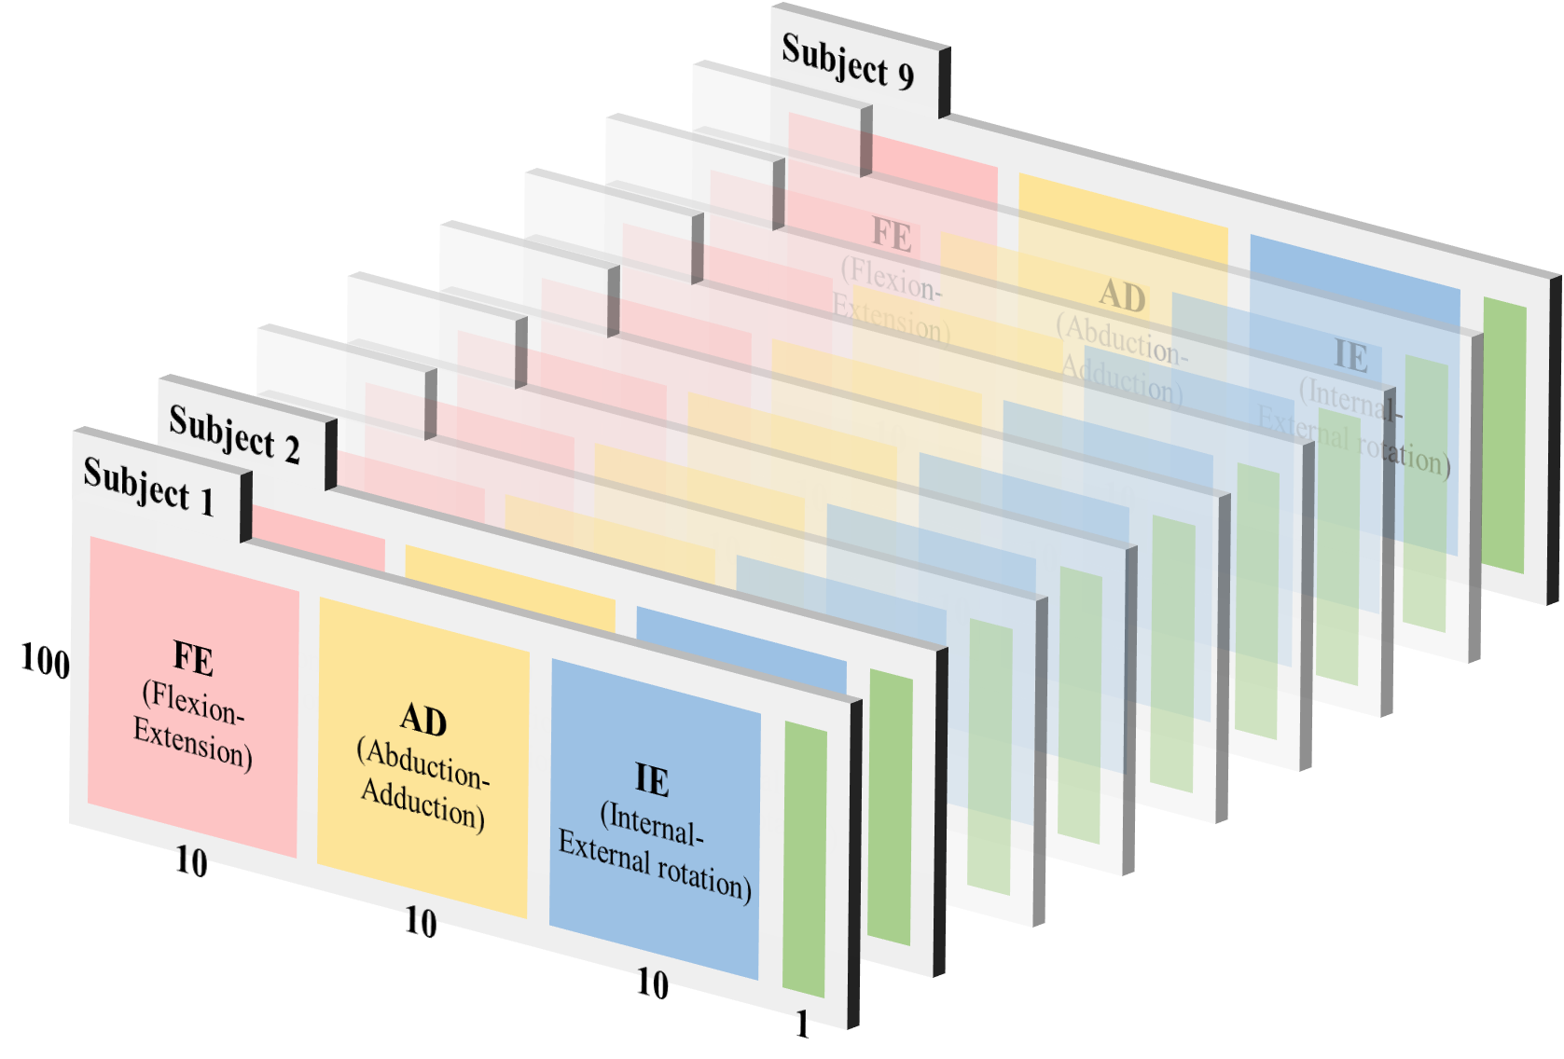
4.1 Biomechanical Dataset
Measure:
10 joint angles of 3 movements FE (굽힘/폄) , AD (벌림/모음) , IE (내/외부 회전)
X-factor : the difference between the rotation angles for the upper and lower bodies while the golfer takes a backswing
Golf swing motion
(it is normalized 100 sec)
(Left + Right)
Shoulder, Elbow, Hip, Knee
Upper Trunk
Lower Trunk
Data size:
X-factor
seconds $×$ (anlges $+$ X-factor) $×$ subjects $=$ $100×(30+1)×9$
M.S Thesis Presentation
Sangman Jung, KHU
28 / 41

Slide 29
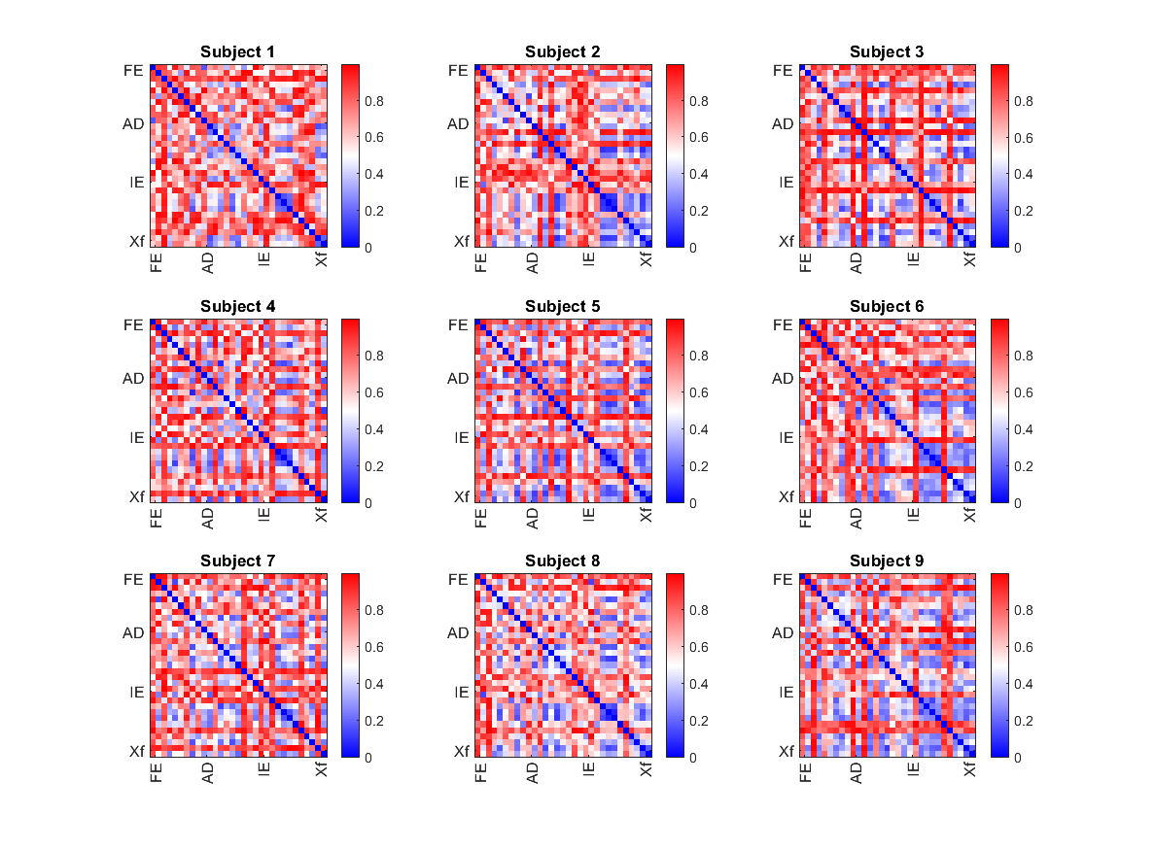
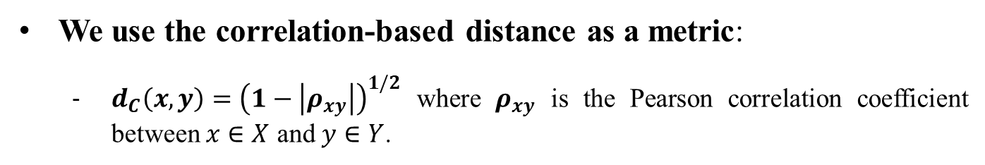
4.2 Result
We use the correlation-based distance as a metric:
$d_{C}\left(x,y\right)={\left(1−\left|ρ_{xy}\right|\right)}^{1/2}$ where $ρ_{xy}$ is the Pearson correlation coefficient between $x∈X$ and $y∈Y$.
M.S Thesis Presentation
Sangman Jung, KHU
29 / 41

Slide 30
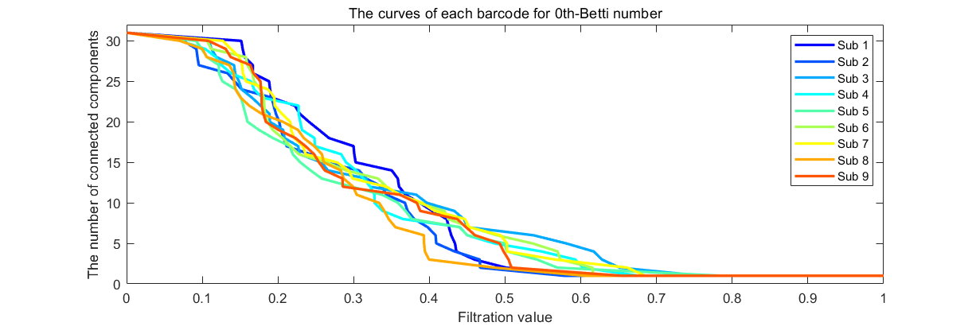
4.2 Result
Barcode for $β_{0}$ as a curve representation:
Subject 3 is the least connected and subject 8 is the fastest.
Only 1 through 10 connected components (in 31 connected components) are dominant at the difference between subjects.
M.S Thesis Presentation
Sangman Jung, KHU
30 / 41

Slide 31
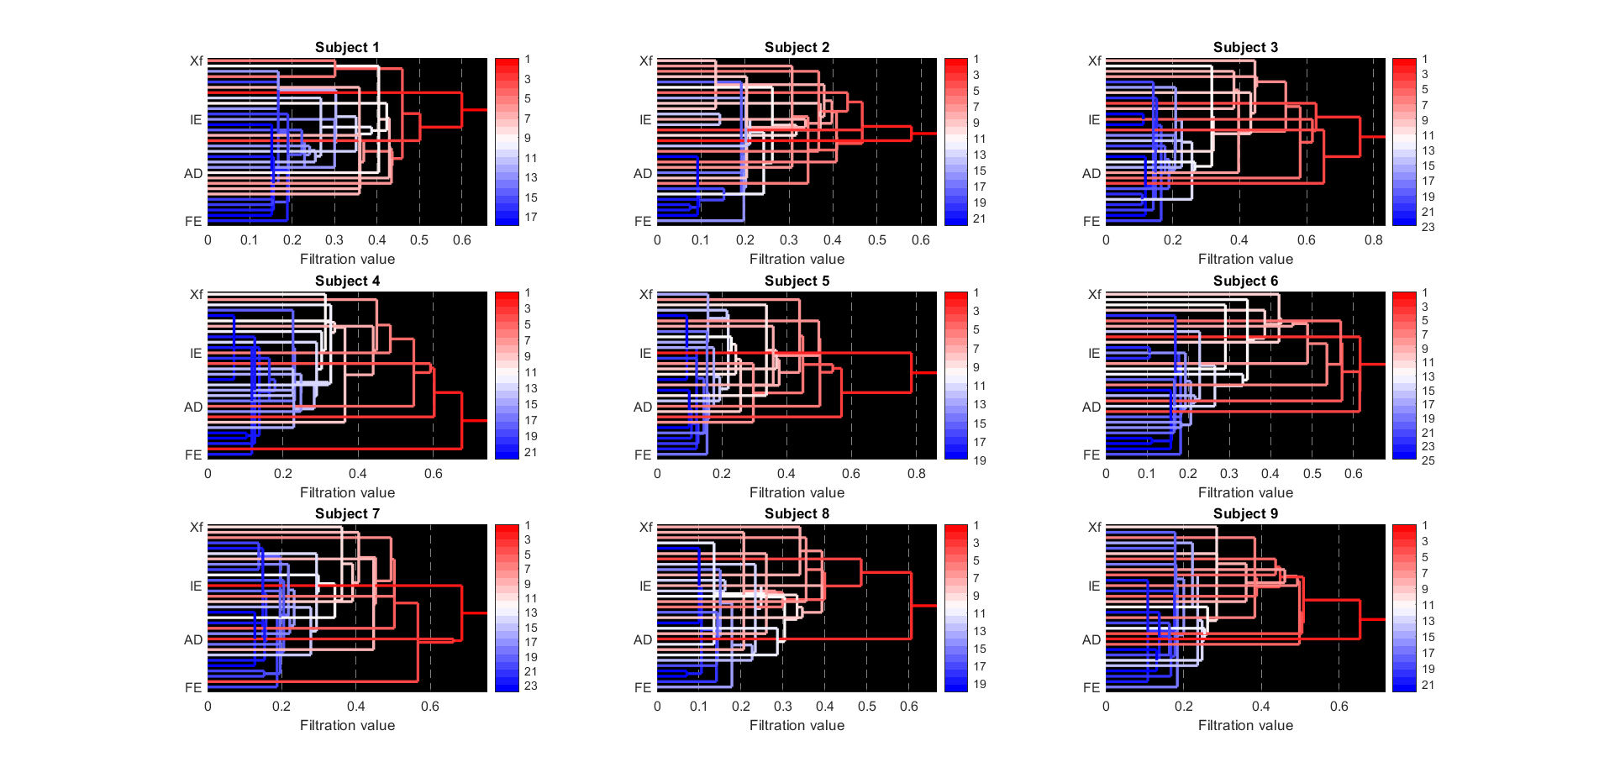
4.2 Result
Single linkage dendrogram (SLD):
The right body parts (8,9,10,18,25,26,29,30) cause the difference between subjects.
M.S Thesis Presentation
Sangman Jung, KHU
31 / 41

Slide 32
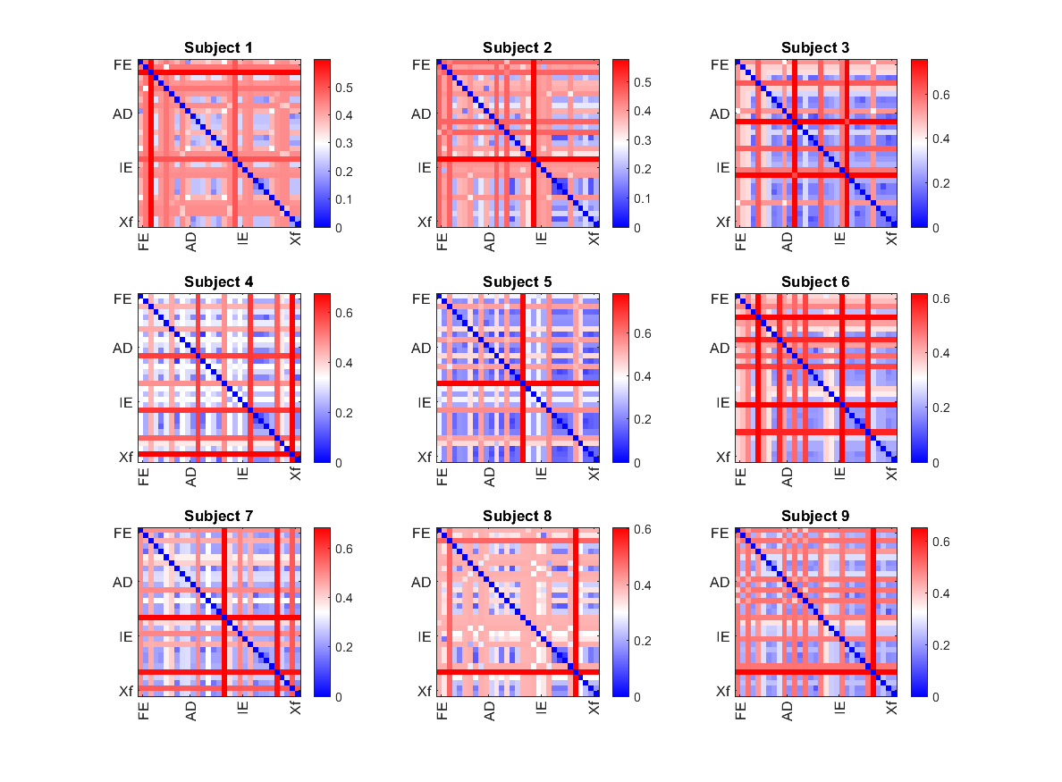
4.2 Result
Single linkage matrix:
M.S Thesis Presentation
Sangman Jung, KHU
32 / 41

Slide 33
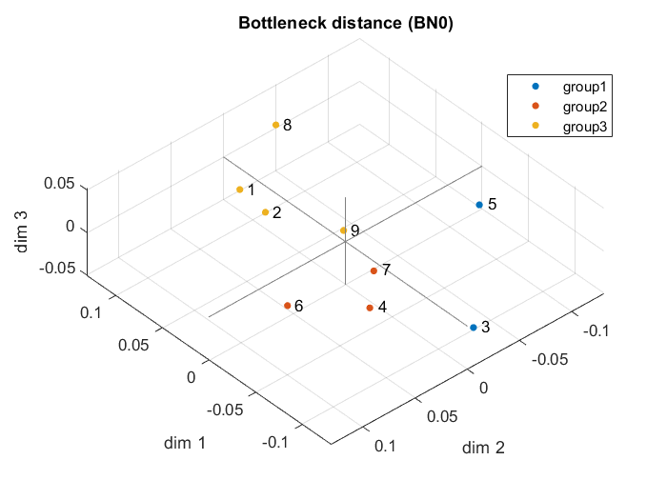
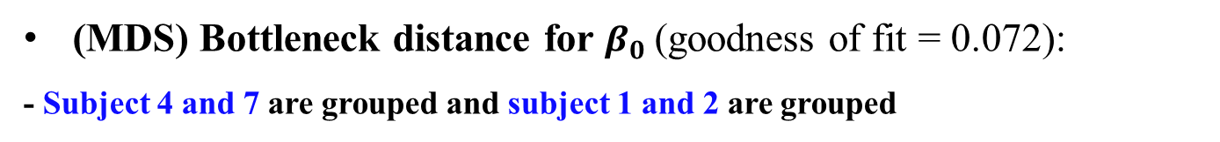
4.2 Result
(MDS) Bottleneck distance for $β_{0}$(goodness of fit = 0.072):
- Subject 4 and 7 are grouped and subject 1 and 2 are grouped
Clustering method : K-means clustering ($k=3$)
M.S Thesis Presentation
Sangman Jung, KHU
33 / 41

Slide 34
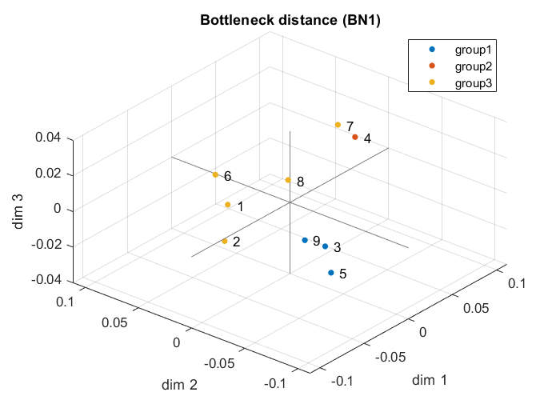
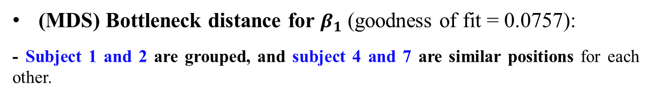
4.2 Result
(MDS) Bottleneck distance for $β_{1}$ (goodness of fit = 0.0757):
- Subject 1 and 2 are grouped, and subject 4 and 7 are similar positions for each other.
Clustering method : K-means clustering ($k=3$)
M.S Thesis Presentation
Sangman Jung, KHU
34 / 41

Slide 35

4.2 Result
(MDS) Gromov-Hausdorff distance (goodness of fit = 0.0963):
- Subject 4 and 7 are grouped and subject 1 and 2 are grouped
Clustering method : K-means clustering ($k=3$)
M.S Thesis Presentation
Sangman Jung, KHU
35 / 41

Slide 36
Chapter 5. Conclusion
M.S Thesis Presentation
Sangman Jung, KHU
36 / 41

Slide 37
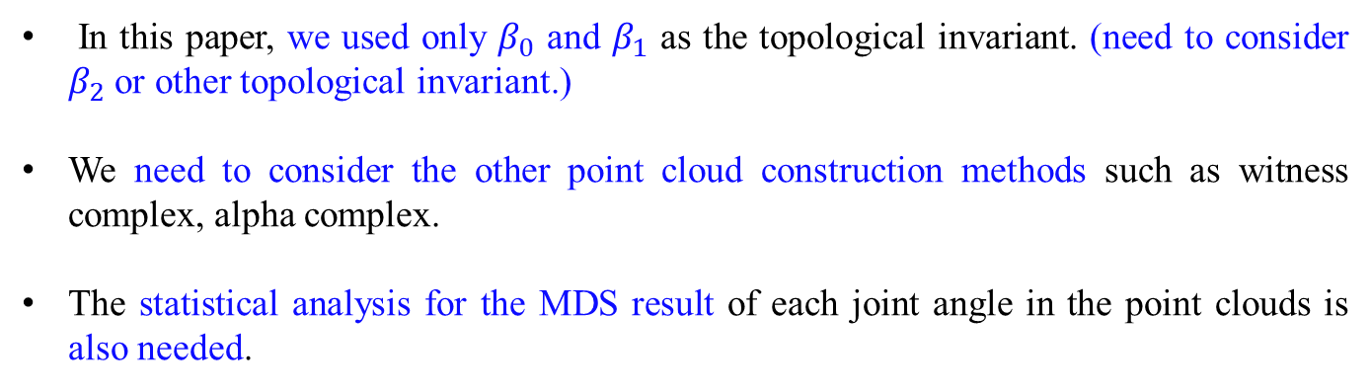
Chapter 5. Conclusion
Contribution
We applied TDA which is the new framework of data analysis based on the computational topology to the actual dataset. (with the conventional analysis methods)
We developed the GUI program for TDA in the MATLAB environment. This program focused on the convenience to use and the accessibility
Future work
In this paper, we used only $β_{0}$ and $β_{1}$ as the topological invariant. (need to consider $β_{2}$ or other topological invariant.)
We need to consider the other point cloud construction methods such as witness complex, alpha complex.
The statistical analysis for the MDS result of each joint angle in the point clouds is also needed.
M.S Thesis Presentation
Sangman Jung, KHU
37 / 41

Slide 38
References
[1] Sagiroglu, S., & Sinanc, D. (2013, May). Big data: A review. In 2013 international conference on collaboration technologies and systems (CTS) (pp. 42-47). IEEE.
[2] Alpaydin, E. (2020). Introduction to machine learning. Massachusetts, USA: MIT press.
[3] Bengio, Y., Goodfellow, I., & Courville, A. (2017). Deep learning (Vol. 1). Massachusetts, USA: MIT press.
[4] Han, J., Pei, J., & Kamber, M. (2011). Data mining: concepts and techniques. Elsevier.
[5] Carlsson, G. (2009). Topology and data. Bulletin of the American Mathematical Society, 46(2), 255-308.
[6] Mémoli, F. (2011, August). Metric structures on datasets: stability and classification of algorithms. In International Conference on Computer Analysis of Images and Patterns (pp. 1-33). Springer, Berlin, Heidelberg.
[7] Zerzucha, P., & Walczak, B. (2012). Concept of (dis) similarity in data analysis. TrAC Trends in Analytical Chemistry, 38, 116-128.
[8] Ghrist, R. (2008). Barcodes: the persistent topology of data. Bulletin of the American Mathematical Society, 45(1), 61-75.
[9] Edelsbrunner, H., & Harer, J. (2008). Persistent homology-a survey. Contemporary mathematics, 453, 257-282.
[10] Cohen-Steiner, D., Edelsbrunner, H., & Harer, J. (2007). Stability of persistence diagrams. Discrete & computational geometry, 37(1), 103-120.
[11] Adams, H., & Tausz, A. (2015). Javaplex tutorial. Retrieved from http://goo.gl/5uaRoQ
[12] Maria, C., Boissonnat, J. D., Glisse, M., & Yvinec, M. (2014, August). The Gudhi library: Simplicial complexes and persistent homology. In International Congress on Mathematical Software (pp. 167-174). Springer, Berlin, Heidelberg.
[13] Chazal, F., & Michel, B. (2017). An introduction to Topological Data Analysis: fundamental and practical aspects for data scientists. arXiv preprint arXiv:1710.04019.
[14] Fasy, B. T., Kim, J., Lecci, F., & Maria, C. (2014). Introduction to the R package TDA. arXiv preprint arXiv:1411.1830.
M.S Thesis Presentation
Sangman Jung, KHU
38 / 41

Slide 39
References
[15] Otter, N., Porter, M. A., Tillmann, U., Grindrod, P., & Harrington, H. A. (2017). A roadmap for the computation of persistent homology. EPJ Data Science, 6(1), 17.
[16] Ferri, M. (2017). Persistent topology for natural data analysis—A survey. In Towards Integrative Machine Learning and Knowledge Extraction (pp. 117-133). Springer, Cham.
[17] Pun, C. S., Xia, K., & Lee, S. X. (2018). Persistent-Homology-based Machine Learning and its Applications--A Survey. arXiv preprint arXiv:1811.00252.
[18] Lee, H., Chung, M. K., Kang, H., Kim, B. N., & Lee, D. S. (2011, March). Discriminative persistent homology of brain networks. In 2011 IEEE international symposium on biomedical imaging: from nano to macro (pp. 841-844). IEEE.
[19] Lee, H., Kang, H., Chung, M. K., Kim, B. N., & Lee, D. S. (2012). Persistent brain network homology from the perspective of dendrogram. IEEE transactions on medical imaging, 31(12), 2267-2277.
[20] Carlsson, G., & Mémoli, F. (2010). Characterization, stability and convergence of hierarchical clustering methods. The Journal of Machine Learning Research, 11, 1425-1470.
[21] Mémoli, F. (2008, June). Gromov-Hausdorff distances in Euclidean spaces. In 2008 IEEE Computer Society Conference on Computer Vision and Pattern Recognition Workshops (pp. 1-8). IEEE.
[22] Borg, I., Groenen, P. J., & Mair, P. (2012). Applied multidimensional scaling. Springer Science & Business Media.
[23] Cho, K. D., Lee, E. J., Seo, T. H., Kim, K. R., & Koo, J. Y. (2012). General Research; Visualization of Bottleneck Distances for Persistence Diagram. 응용통계연구, 25(6), 1009-1018.
[24] Gamble, J., & Heo, G. (2010). Exploring uses of persistent homology for statistical analysis of landmark-based shape data. Journal of Multivariate Analysis, 101(9), 2184-2199.
M.S Thesis Presentation
Sangman Jung, KHU
39 / 41

Slide 40
References
[25] Delory, B. M., Li, M., Topp, C. N., & Lobet, G. (2018). archiDART v3. 0: A new data analysis pipeline allowing the topological analysis of plant root systems. F1000Research, 7.
[26] Costa, J. P., & Škraba, P. (2015). A topological data analysis approach to the epidemiology of influenza. In SIKDD15 Conference Proceedings.
[27] Hajij, M., Jonoska, N., Kukushkin, D., & Saito, M. (2018). Graph based analysis for gene segment organization in a scrambled genome. arXiv preprint arXiv:1801.05922.
[28] Zomorodian, A. (2005). Topology for computing (Vol. 16). Cambridge university press.
[29] Zomorodian, A. (2010). Fast construction of the Vietoris-Rips complex. Computers & Graphics, 34(3), 263-271.
[30] Edelsbrunner, H., & Harer, J. (2010). Computational topology: an introduction. American Mathematical Soc.
[31] De Silva, V., & Ghrist, R. (2007). Coverage in sensor networks via persistent homology. Algebraic & Geometric Topology, 7(1), 339-358.
[32] Hatcher, A. (2002). Algebraic topology. Cambridge university press.
[33] Aktas, M. E., Akbas, E., & El Fatmaoui, A. (2019). Persistence homology of networks: methods and applications. Applied Network Science, 4(1), 61.
[34] Moon, C., Giansiracusa, N., & Lazar, N. A. (2018). Persistence terrace for topological inference of point cloud data. Journal of Computational and Graphical Statistics, 27(3), 576-586.
[35] Zomorodian, A., & Carlsson, G. (2005). Computing persistent homology. Discrete & Computational Geometry, 33(2), 249-274.
[36] Chung, M. K., Lee, H., DiChristofano, A., Ombao, H., & Solo, V. (2019). Exact topological inference of the resting-state brain networks in twins. Network Neuroscience, 3(3), 674-694.
M.S Thesis Presentation
Sangman Jung, KHU
40 / 41

Slide 41
References
[37] Lee, H., Chung, M. K., Kang, H., Kim, B. N., & Lee, D. S. (2011, September). Computing the shape of brain networks using graph filtration and Gromov-Hausdorff metric. In International Conference on Medical Image Computing and Computer-Assisted Intervention (pp. 302-309). Springer, Berlin, Heidelberg.
[38] Wickelmaier, F. (2003). An introduction to MDS. Sound Quality Research Unit, Aalborg University, Denmark, 46(5), 1-26.
[39] Sammon, J. W. (1969). A nonlinear mapping for data structure analysis. IEEE Transactions on computers, 100(5), 401-409.
[40] Chen, J., Ng, Y. K., Lin, L., Jiang, Y., & Li, S. (2019). On triangular Inequalities of correlation-based distances for gene expression profiles. bioRxiv, 582106.
M.S Thesis Presentation
Sangman Jung, KHU
41 / 41

