Slide 1
Sang BookStore
Online Bookstore using Spring Framework

Slide 2
Spring MVC Based Application
Service
DAO
Java Objects (POJOS)
Hibernate
Distributed Database Systems

Slide 3
Java Based Application Server
Java Objects (POJOS)
DAO Classes
JPA Frameworks (Hibernate, Oracle TopLink, OpenJPA, iBatis, etc)
Distributed Database Systems

Slide 4
Spring MVC Based Application
Service
DAO
Java Objects (POJOS)
Hibernate
MySQL

Slide 5
Spring MVC Based Application
Service
BooksService
BookServicesImpl
Java Objects (POJOS)
Books
BooksController
BooksList
BooksStoreController
DAO
BooksDAO
BooksDAOImpl
Hibernate
MySQL

Slide 6
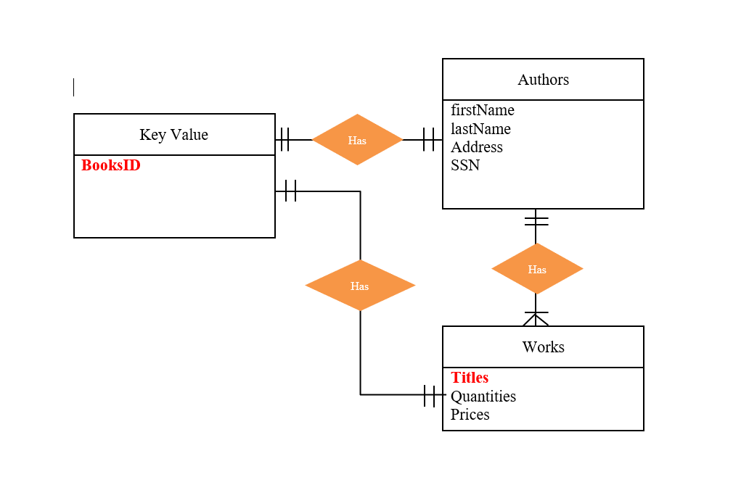
ER chart diagram

Slide 7
github
https://github.com/sangngo1993/SangBookStore

Slide 8
Resources
What is an Entity Relationship Diagram (ERD)?
Spring Framework Introduction

