Slide 1

Distribution management system in pharmaceutical
Supervisor:
Mr. Nguyen Van Sang Team Members:
Truong Vo Thien Vu
Ta Duc Tung
Nguyen Trong Viet

Slide 2
Presentation outline
1. Project Overview
2. Project Management
3. Software Specification
4. Software Design
5. Testing
6. Project Result
7. Demo

Slide 3

Project overview
1. Current Situation
2. Ideas
3. Solution

Slide 4
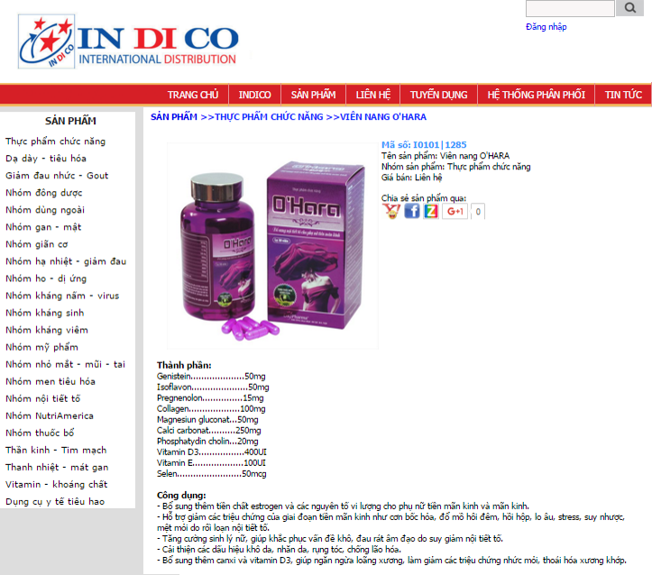
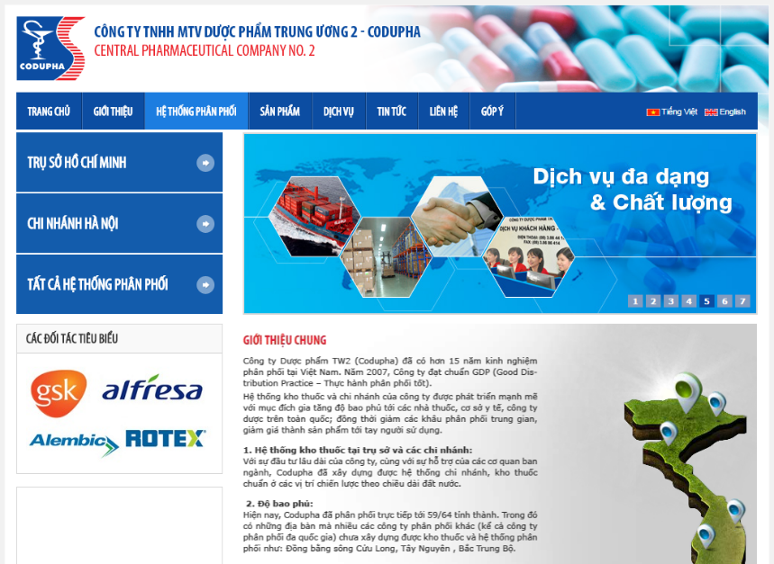
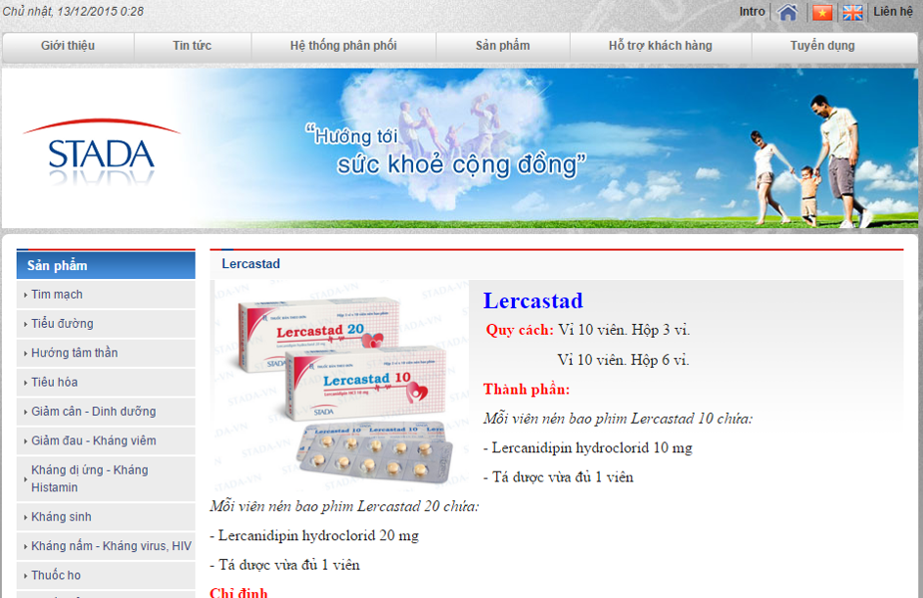
Current situation
Drugstore want to have quick transaction.
Drugstore want to get Product directly from Distributor easily.
Drugstore want to get public and exactly prices.
Most pharmacy company does not user internet for sell online their product.
Drugstore have to contact with Distributor when they need.
Current system: indico.vn, stada.com.vn

Slide 5
Idea
Functional
Manage Order.
Manage Salesman.
Manage Drugstore.
Manage Drug.
Manage Schedule, support deliveryman have shortest path.
Storage Order History, Payment History.
Non-Functional
Steady Running.
Easy to Upgrade and Maintenance.

Slide 6
Solution
Popularity
Rich Class Library
Run on Multi-Devices
Experience
Why choose Website&.NET?

Slide 7

Project management
Project Model
Project Life Cycle
Organization Structure
Master Schedule
Objectives
Deliverables
Tool & Environment

Slide 8
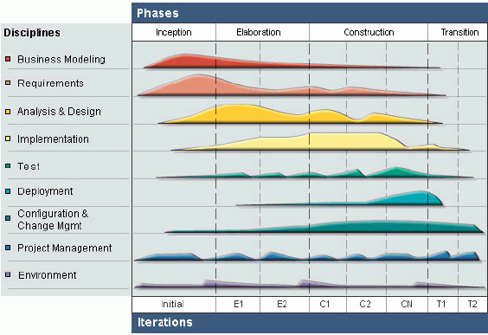
Project model
Rational Unified Process Model

Slide 9
Project model
Why choose RUP?
Develop Iteratively
Support an iterative approach to development that addresses the highest risk items at every stage in the lifecycle, significantly reducing a project’s risk.
Very important for inexperienced team in controlling issues like us.
Manage Requirement
Managing requirements during the whole development process ensures Project Team develops the right system with right requirement.
Verify Software Quality
Testing process is implemented in all the cycles of application development time.
Reduce risks

Slide 10
Project Life cycle
Phase 1: Inception
Study Business Case and Feasibility Study of Project
Complete Project Management Plan
Complete draft ERD of System
Complete draft Screen prototypes
Complete draft Requirements
Determine Project Scope

Slide 11
Project Life cycle
Phase 2: Elaboration
Complete User Requirement Specification
Complete Software Requirement Specification
Complete ERD, final prototypes
Complete Database model
Complete System Architecture Design

Slide 12
Project Life cycle
Phase 3: Construction
Complete Coding and Unit Test
Complete User manual
Complete Function and Regression Test
Phase 4: Transition
Deploy Website
Complete all Reports and Documents
Release Source Code

Slide 13
Project Organization structure
Supervisor Mr. SangNV
Project Manager
SRS Analysis Team TungTD
Design Team VuTVT
VuTVT
Develop Team VuTVT
Test Team TungTD
TungTD
VietNT
VietNT

Slide 14
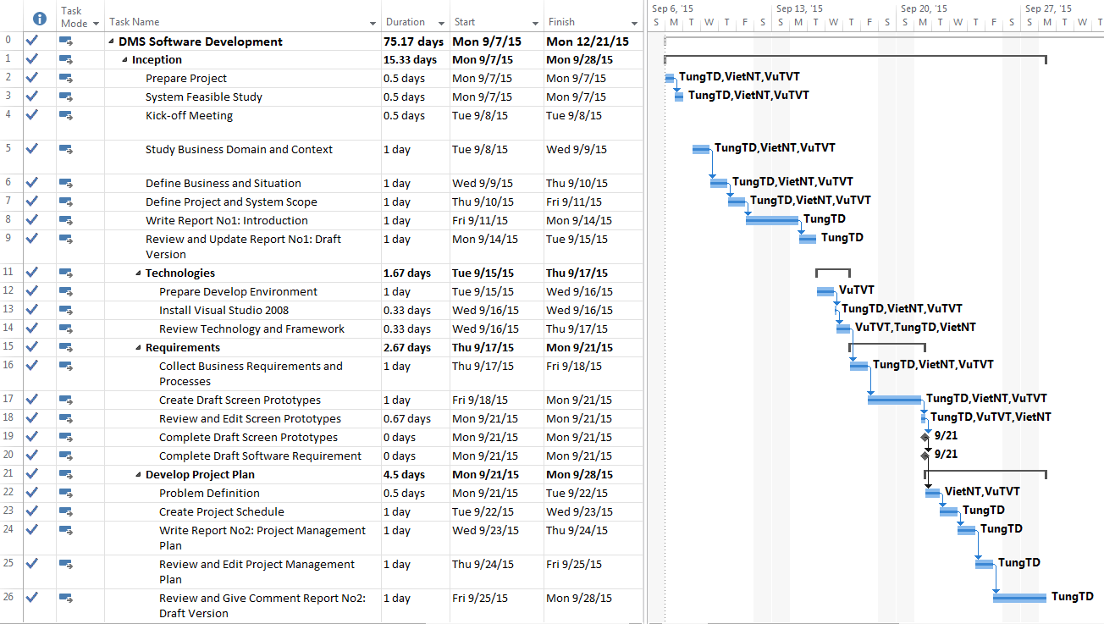
Project schedule master

Slide 15
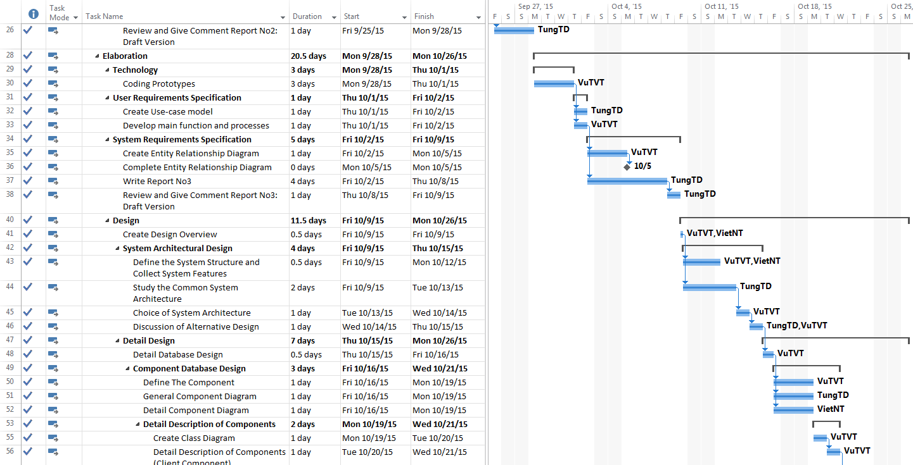
Project schedule master

Slide 16
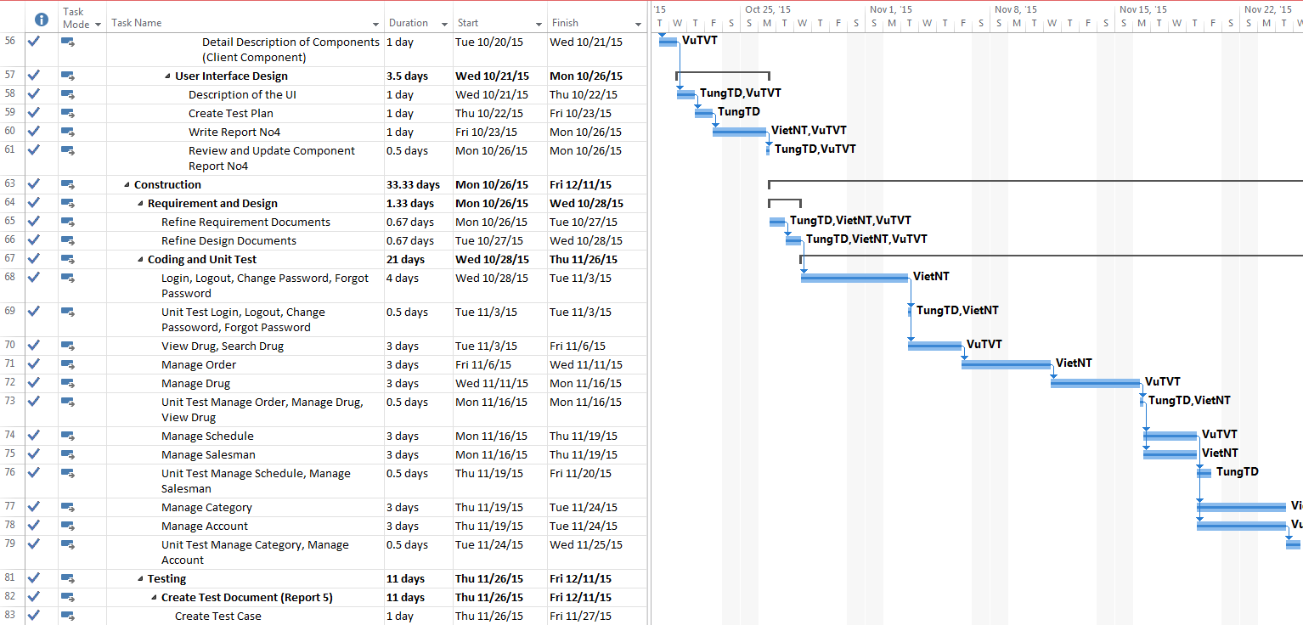
Project schedule master

Slide 17
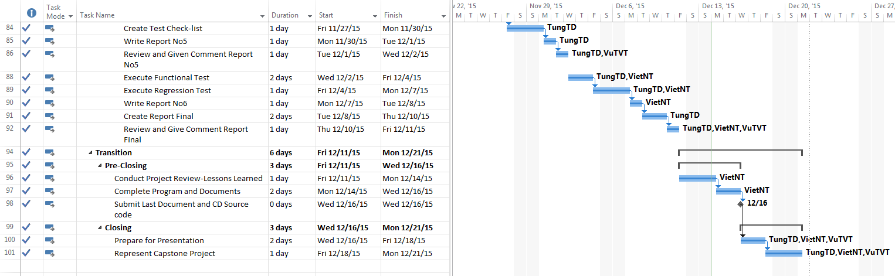
Project schedule master

Slide 18
Risk management
ID | Risk Content | Probability | Effect | Solution
# | People Risks
1 | Team member may not follow deadlines. | HIGH | SERIOUS | Find out reasons Depending on circumstances, may set penalty rule.
2 | Team members are sick, cannot complete task under deadline. | HIGH | SERIOUS | Increase project team’s working effort in “peace period”. Allow all team members clear about what others do, so that they can cover the tasks when necessary.
3 | Conflict between team members. | HIGH | SERIOUS | Setup an open-talk environment in project team. “Do not criticize” is set as a rule. Organize team-building more often. In some cases, manager must use his power to make decisions.
4 | New technology is hard to apply for project | HIGH | SERIOUS | List tasks and check continuously. Evaluate quality and progress weekly. Send email to other member or supervisor to ask for help.
5 | Problems in communication breakdown makes changing time, work and delay plan | HIGH | SERIOUS | We need using words more clearly, improve our communication skills Using note and email to confirm information.

Slide 19
Project object
Metrics | Unit | Committed | Actual | Deviation
Start Date | dd-mm-yyyy | 07-09-2015 | 07-09-2015 | 0 day
End Date | dd-mm-yyyy | 19-12-2015 | 21-12-2015 | 2 days
Duration | Elapsed days | 76 days | 78 days | 2 days
Maximum Team Size | Person | 5 | 3 | 2

Slide 20
Project deliverables
No | Stage | Deliverable/ Milestone | Delivery Date | Delivery Location
1 | Inception | Deliver Report No.1 | 14/09/2015 | Supervisor
2 | Inception | Project plan | 24/09/2015 | Supervisor
3 | Inception | Deliver Report No.2 | 24/09/2015 | Supervisor
4 | Elaboration | Deliver Report No.3 | 08/10/2015 | Supervisor
5 | Elaboration | Deliver Report No.4 | 26/10/2015 | Supervisor
6 | Construction | Complete Coding | 25/11/2015 | Supervisor
7 | Construction | Deliver Report No.5 | 01/12/2015 | Supervisor
8 | Construction | Deliver Report No.6 | 11/12/2015 | Supervisor
9 | Transition | The last Document and CD source code | 16/12/2015 | FU
10 | Transition | Project completed | 21/12/2015 | FU

Slide 21











Project Tool and environment

Slide 22





Communication

Slide 23

Software Specification
System Business Process Overview
Non Functional Requirement
Functional Requirement

Slide 24
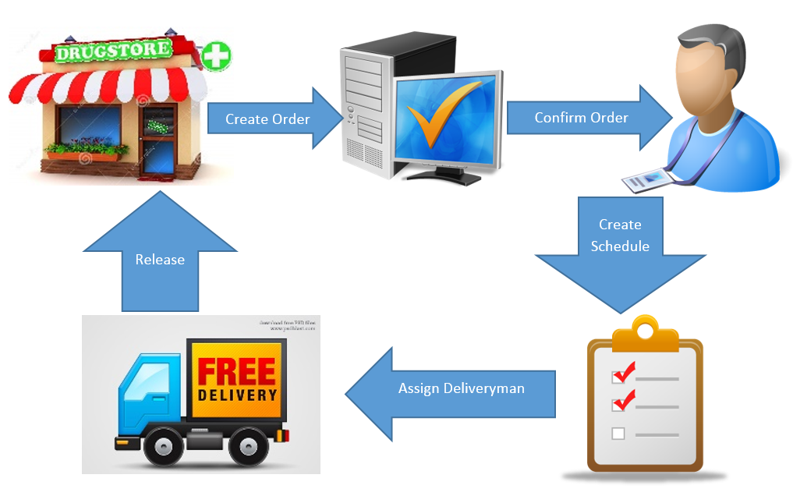
System Business Process overview

Slide 25
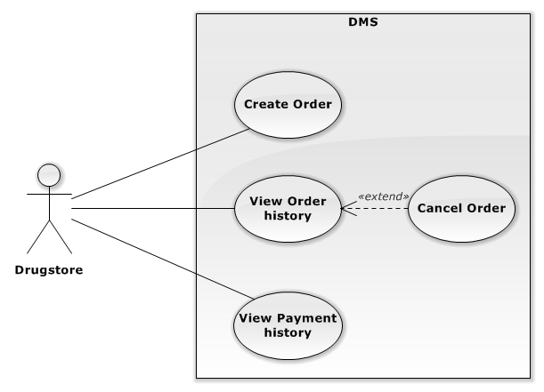
Functional requirement

Slide 26
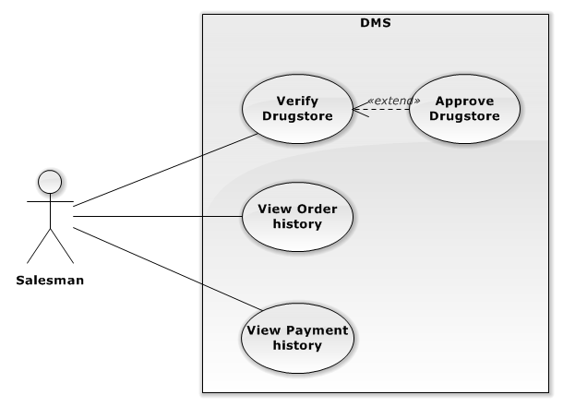
Functional requirement

Slide 27
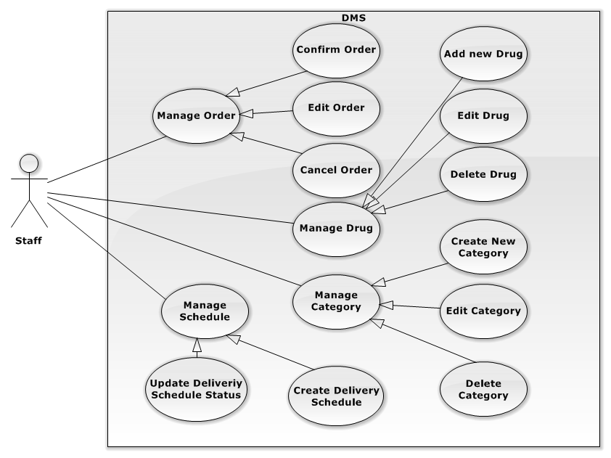
Functional requirement

Slide 28
System overview non functional requirement
Usability
System supports 100% Vietnamese.
User Interface must be easy to learn, even at the first time looking at the screen, user may immediately understand the function of each button or icon.
Performance
Approximate time to start and run: 5-7s.
Approximate time to process action: <3s.
Reliability
Mean time between two failure: 10 days.
Available 95% of time.

Slide 29

Software Design
Architecture Overview
Screen Design
Sequence Diagram
Database Design
Travelling salesman problem
Nearest neighbor algorithm

Slide 30
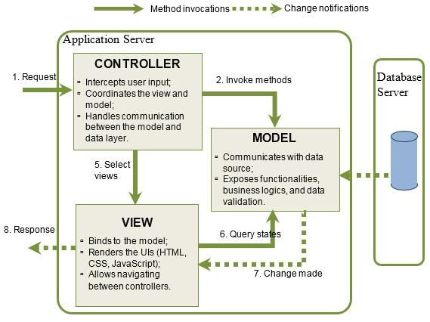
System architecture design

Slide 31
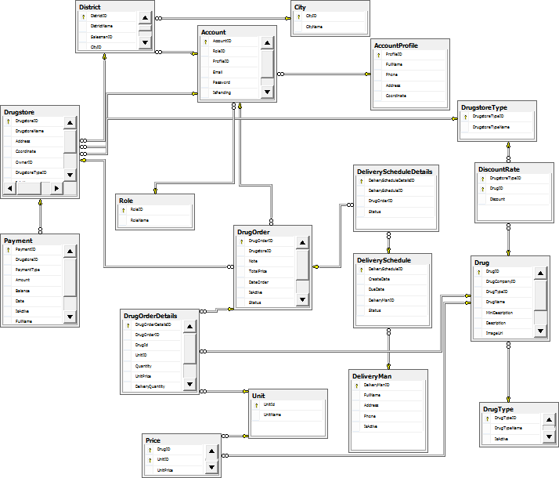
System database design

Slide 32
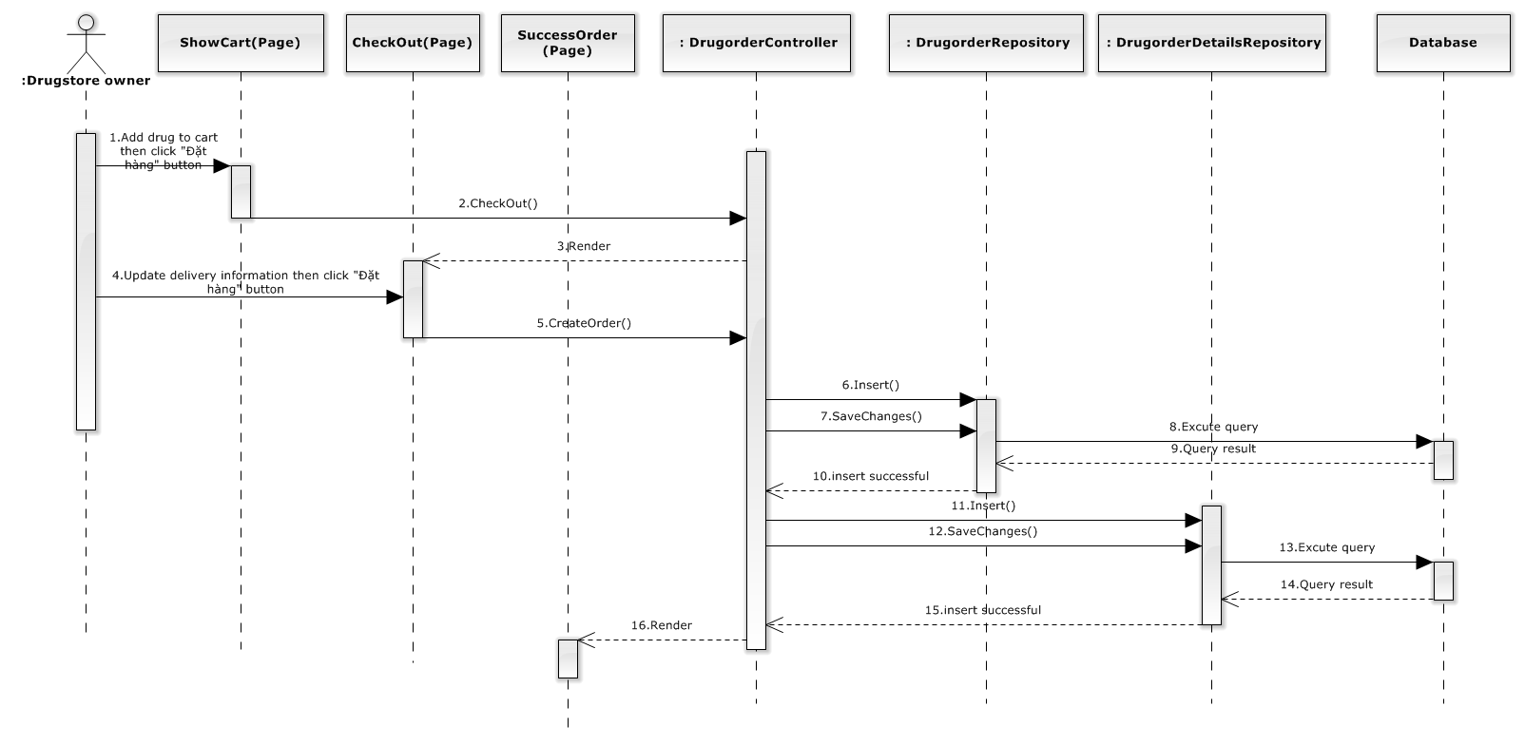
Sequence diagram

Slide 33
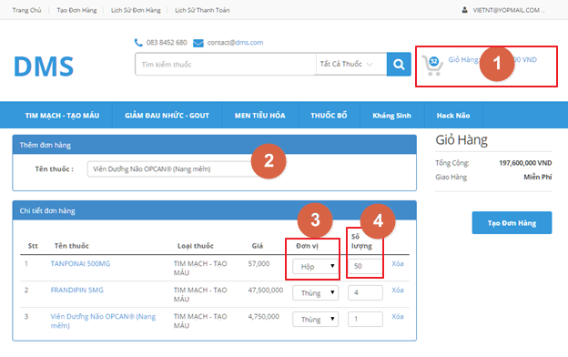
Screen design
No | Object/Control Name | Type | Required | Description
1 | Giỏ hang | Label | N/A | Total amount
2 | Tên thuốc | Textbox | Type | Input Drugname
3 | Đơn vị | Dropdown List | Choose | Unit
4 | Số lượng | Dropdown List | Type | Quantity

Slide 34
Travelling salesman problem
The travelling salesman problem (TSP) asks the following question: Given a list of cities and the distances between each pair of cities, what is the shortest possible route that visits each city exactly once and returns to the origin city?
It is an NP-hard problem in combinatorial optimization, important in operations research and theoretical computer science.

Slide 35
Nearest neighbor algorithm
These are the steps of the algorithm:
Start on an arbitrary vertex as current vertex.
Find out the shortest edge connecting current vertex and an unvisited vertex V.
Set current vertex to V.
Mark V as visited.
If all the vertices in domain are visited, then terminate.
Go to step 2.
The sequence of the visited vertices is the output of the algorithm.

Slide 36
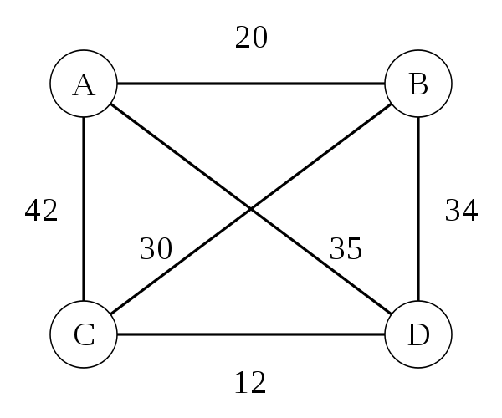
Nearest neighbor algorithm(cnt)

Slide 37
Nearest neighbor algorithm(cnt)
Advantages:
Easy to implement.
Executes quickly.
Disadvantages:
Sometimes miss shorter routes which are easily noticed with human insight
In the worst case, the algorithm results in a tour that is much longer than the optimal tour.

Slide 38

Software Testing
Test Model
Test Result
Test Process
Test Case

Slide 39
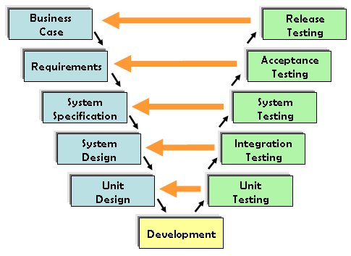
Test model

Slide 40
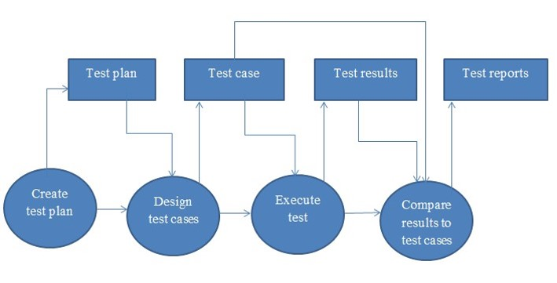
Test process

Slide 41



Test environment

Slide 42
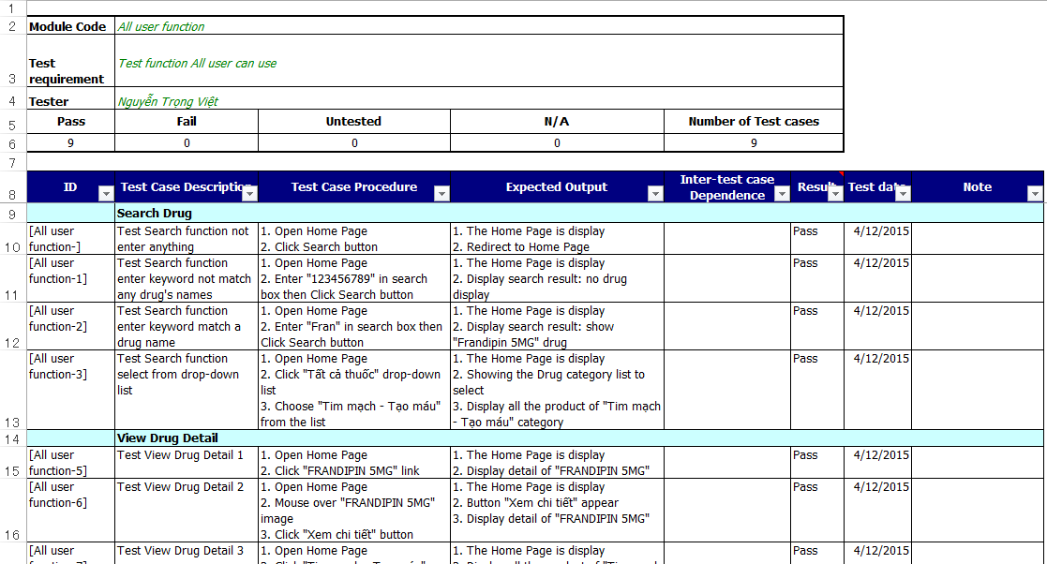
Test Case

Slide 43
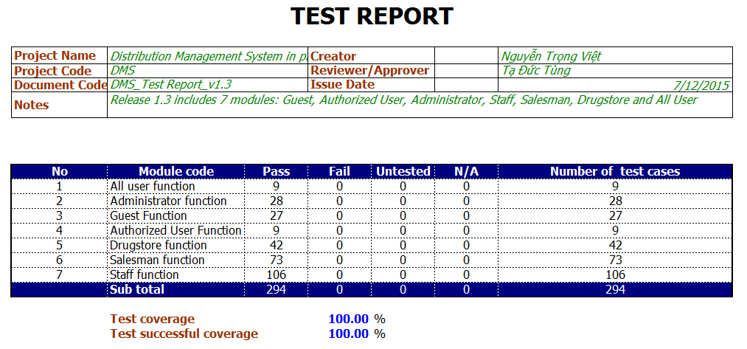
Test result

Slide 44
Project result
After closing project, we achieve goal software:
Drugstore can order Drug from Distributor and view their history transaction easily.
Salesman manage Drugstore easily.
Staff can manage everything easier.
Deliveryman can delivery good with shortest path.
Have more experiences of managing a software project: how to manage plan, time, and risk. These experiences help us a lot in our future work.
How to communicate with other team members and how to do teamwork efficiently.

Slide 45
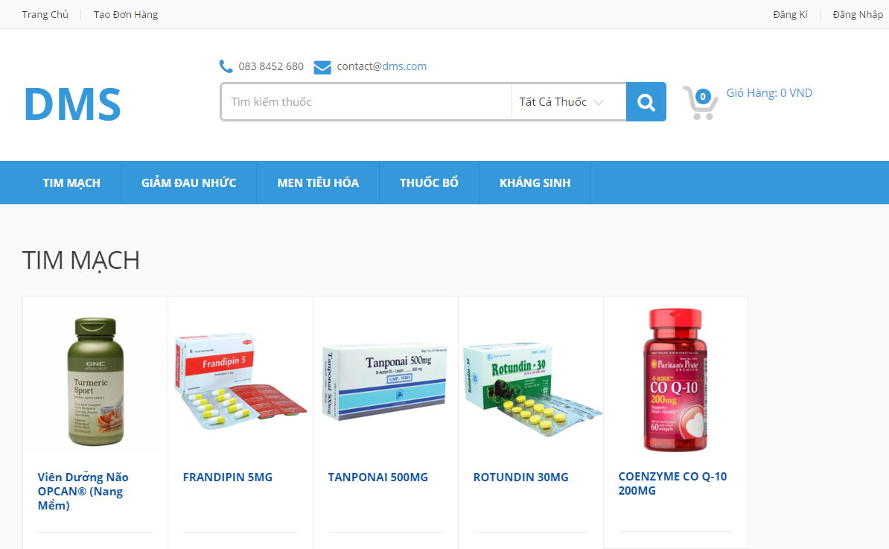
DEMO

