Slide 1

Dandelion
Dandelion Capstone Project Presentation 卒業論文プレゼンテーション
0

Slide 2

About us
Supervisor
指導教員
Team member
チームメンバー
Nguyen Van Sang
Luu Ngoc Manh
Nguyen Minh Huy
Vu Ngoc Trung
Duong Duc Anh
Vu Cong Chinh
Cao Thi Phuong Mai
1

Slide 3


Outlines -アウトライン
1
Introduction
導入
2
Project Management
プロジェクト管理
3
Software Requirement Specification
プロジェクト管理
4
Software Design Description
ソフトウェア要求仕様
5
Quality Control
品質管理
6
Project Result
プロジェクト結果
7
Demo
デモ
8
Q & A
質問と回答
2

Slide 4
Outlines -アウトライン
1
Introduction
導入
2
Project Management
プロジェクト管理
3
Software Requirement Specification
プロジェクト管理
4
Software Design Description
ソフトウェア要求仕様
5
Quality Control
品質管理
6
Project Result
プロジェクト結果
7
Demo
デモ
8
Q & A
質問と回答
Coming up next
Vu Ngoc Trung
1

Slide 5


1
Introduction
導入
1
Introduction
導入
3

Slide 6

1
Introduction
導入
The Idea
A lot of idea
Short of funds to raise
Internet - Easy to show these
A major platform for crowdfunding
Anybody could launch a project
Creative projects making a better world
3

Slide 7
1
Introduction
導入
Objectives
Capstone Project
Practice develop, manage a project
Teamwork
Technical experience
Support people’s dream
Everything
Completely in Vietnamese
4
Notes:
Technical experience : website designing, software testing
Support people’s dream : especially Vietnamese users to create something that they want to see exist in the world
Everything : films, games, and music to art, design, and technology

Slide 8
1
Introduction
導入
Benefit From Project
For our group
Experiences
For Community
Easy join to a community of crowdfunding
Easy search for interesting project and back them
Easier to start a new project idea
5

Slide 9
1
Introduction
導入
Brief description about system
Friendly and attractive interface
User also can send opinion to admin
Technology
Bootstraps
.NET MVC5
AngularJS
...
6

Slide 10
1
Introduction
導入
System features
Client featuresExperiences
Register, login/logout
Search
Create, update, comment,report Project
Back project
Profile
Manage profile’s information
Created, backed, reminded projects
7

Slide 11
1
Introduction
導入
System features
Admin features
Manage user
Manage project
Manage Backing
Manage Categories
Manage Slider
Manage Message
8

Slide 12
1
Introduction
導入
Potential Risks
Lack of experience
Human resources
9

Slide 13
Outlines -アウトライン
1
Introduction
導入
2
Project Management
プロジェクト管理
3
Software Requirement Specification
プロジェクト管理
4
Software Design Description
ソフトウェア要求仕様
5
Quality Control
品質管理
6
Project Result
プロジェクト結果
7
Demo
デモ
8
Q & A
質問と回答
Coming up next
Cao Thi Phuong Mai

Slide 14
2
Project Management
プロジェクト管理
2
Project Management
プロジェクト管理
11

Slide 15
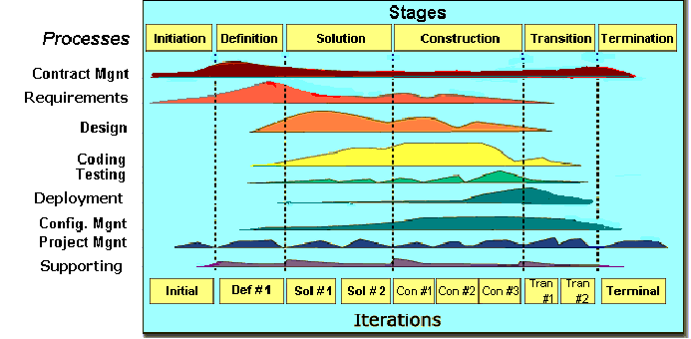
2.1 Software Process Model ソフトウェアプロセスモデル
2
Project Management
プロジェクト管理
FPT Software process model
11

Slide 16
2.1 Software Process Model ソフトウェアプロセスモデル
2
Project Management
プロジェクト管理
Initiation | Identify business functions of the system Determine scope, condition, limitation, project risk List main functions Complete Report #1, Report #2
Solution | Complete SRS Design Document Complete Report #3, Report #4
Construction | Complete Coding and Testing Complete software packages and Report #5, Report #6
Transition | Product will be deployed to the client Finalize coding and testing Prepare document and source code to deliver
Termination | Preparing presentation Complete Project
Project Life Cycle
12

Slide 17
2.2 Project Organization -プロジェクト組織
2
Project Management
プロジェクト管理
Nguyễn Văn Sang
Instructor
Lưu Ngọc Mạnh
Project Manager
Lưu Ngọc Mạnh
Technical Leader
Vũ Ngọc Trung
Developer
Vũ Công Chính
Tester
Nguyễn Minh Huy
Developer
Cao Thị Phương Mai
Test Leader/QA
Dương Đức Anh
Developer
Cao Thị Phương Mai
Developer
Vũ Công Chính
Design Leader
Dương Đức Anh
Designer
13

Slide 18
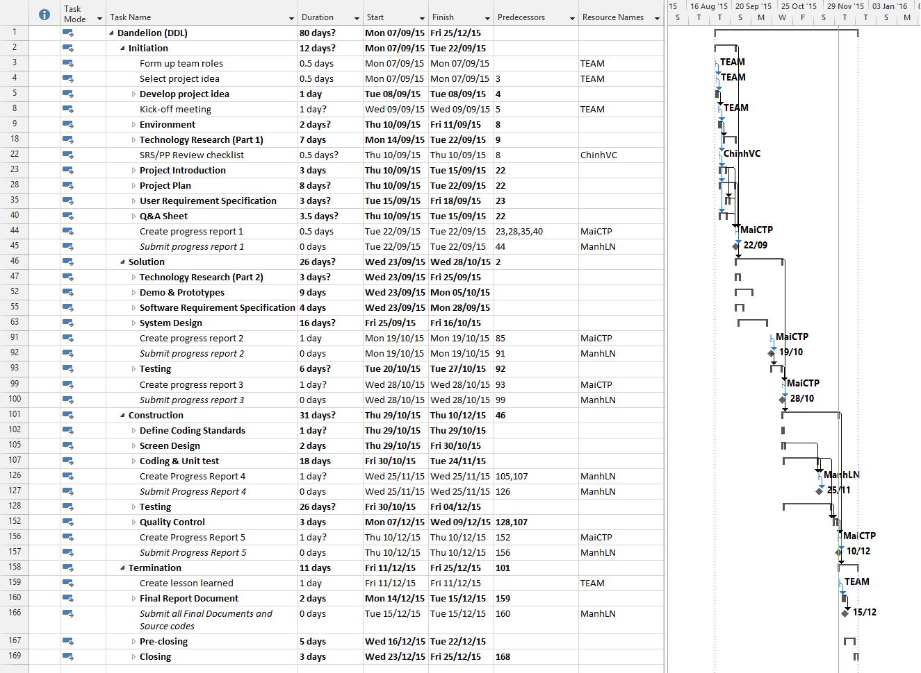
2.3 Project Schedule - プロジェクト計画
2
Project Management
プロジェクト管理
14

Slide 19
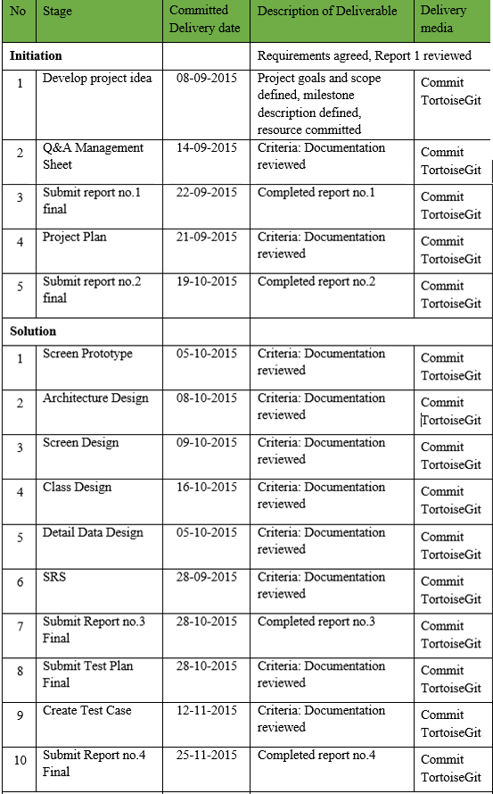
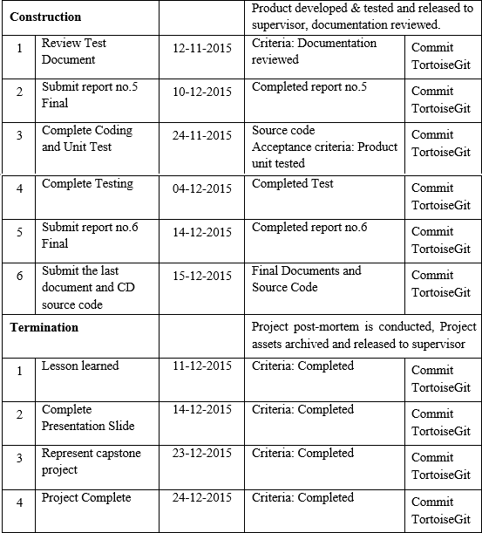
2.4 Objectives & deliverables -目標と成果物
2
Project Management
プロジェクト管理
15

Slide 20










2.5 Tools & Infrastructure ツールと インフラストラクチャ
2
Project Management
プロジェクト管理
Tools
Tools for project management
Tools for developing
TortoiseGit
Word 2013
Excel 2013
Project 2013
Power Point 2013
Visual studio 2013
Chrome
Firefox
Sublime Text
EA
16

Slide 21
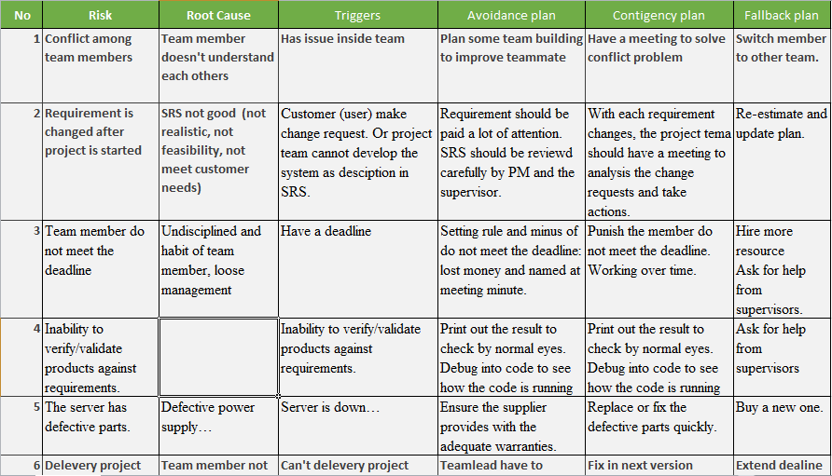
2.6 Risks management -リスク管理
2
Project Management
プロジェクト管理
17

Slide 22
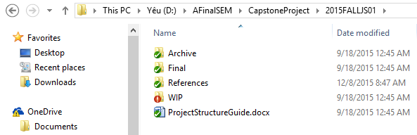
2.7 Configuration management コンフィグレーション管理
2
Project Management
プロジェクト管理
Final: Store sent and delivered documents
References: Store reference documents. For example: templates, technologies document…
WIP: Store documents in progress developing
Plan: Plan of capstone project
Users: Working Folder of Member
Documents: Store whole documents in progress developing
Records: Store documents like Meeting Minutes, Q & A Management…
Folder structure of project
18

Slide 23
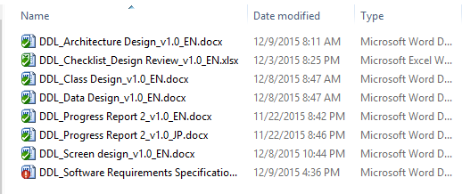
2.7 Configuration management コンフィグレーション管理
2
Project Management
プロジェクト管理
Rule: ProjectCode_Document’s name_v<x.x>_language
ProjectCode: FA{
Document’s name: Architecture Design, Class Design…
v<x.x>: document’s version. For example: v1.0, v1.1,…
Language:
EN: English
JP: Japanese
Naming conventions
19

Slide 24
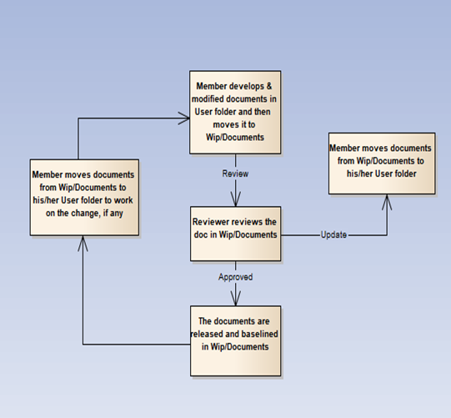
2.7 Configuration management コンフィグレーション管理
2
Project Management
プロジェクト管理
20

Slide 25
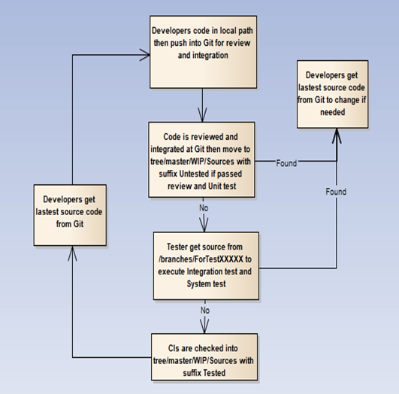
2.7 Configuration management コンフィグレーション管理
2
Project Management
プロジェクト管理
21

Slide 26


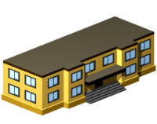






2
Project Management
プロジェクト管理
2.8 Communication management
コミュニケーション管理
Time: 5 hours/day, 5 days/week.
Location: school, home
Communication
Meeting minutes
22

Slide 27
Outlines -アウトライン
1
Introduction
導入
2
Project Management
プロジェクト管理
3
Software Requirement Specification
プロジェクト管理
4
Software Design Description
ソフトウェア要求仕様
5
Quality Control
品質管理
6
Project Result
プロジェクト結果
7
Demo
デモ
8
Q & A
質問と回答
Coming up next
Duong Duc Anh

Slide 28
3
Software Requirement Specification
プロジェクト管理
3
Software Requirement Specification
プロジェクト管理
24

Slide 29


3.1 Business Process -ビジネスプロセ
3
Software Requirement Specification
プロジェクト管理
There are 2 actors:
User
Administrator
25

Slide 30
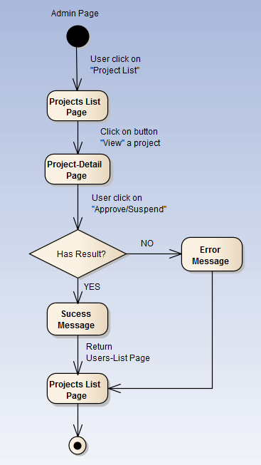
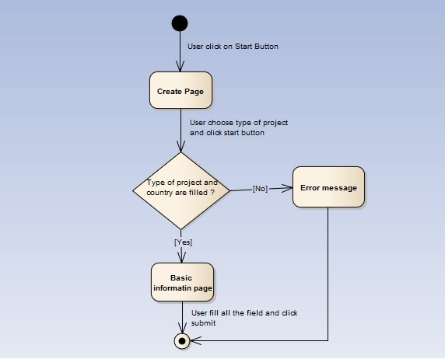
3
Software Requirement Specification
プロジェクト管理
26

Slide 31
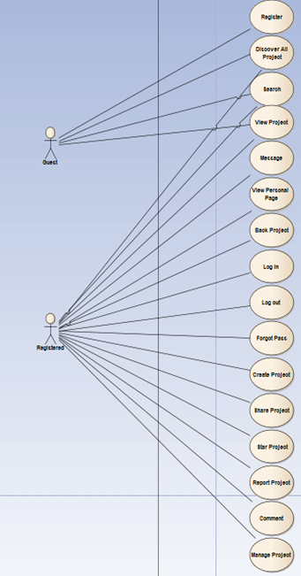
3.3 Functional Requirements - 機能要求
3
Software Requirement Specification
プロジェクト管理
User Module
Account management module
Common module
Project management module
ユーザーのユースケース - User use-case
全部: ユースケース - Total: use-case
26

Slide 32
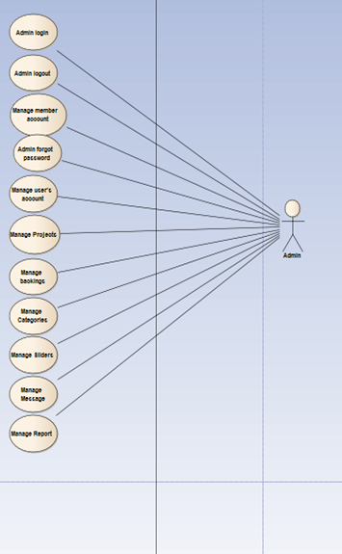
3.3 Functional Requirements - 機能要求
3
Software Requirement Specification
プロジェクト管理
Admin Module
管理のユースケース - Admin use-case
全部 ： ユースケース - Total: use-cases
28

Slide 33
3.4 Non-functional Requirements - 非機能要求
3
Software Requirement Specification
プロジェクト管理
Performance Requirements Availability
The application must be available 95% of time. Users can access to it everywhere from their Web browser with internet connection.
Response time
In term of response time, waiting time of processing will be 2 to 5 seconds; time to process any functions will not exceed 7 seconds.
Maintainability
Coding standards and naming conventions
If some components are reused, the documentations of those components must also be included.
Output of the project must include coding standards and naming conventions documentations. Implementation code must be easy to maintain.
Design
The design of the system must be loosely coupled that chances on some module will not affect others.
29

Slide 34
3.4 Non-functional Requirements - 非機能要求
3
Software Requirement Specification
プロジェクト管理
Usability
- User can complete each function in less than 12 actions
- Output of the project must include coding standards and naming conventions documentations. Implementation code must be easy to maintain
Security Requirements
User authorize
- Each function must be distributed system access and manipulate the individual parts. To edit information, user must declare their username and password before the operation. Functions will be show after users login dependencies user’s role and permission of each user.
Manage Data Layer
- Only Administrator can modify database system
30

Slide 35

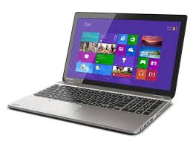

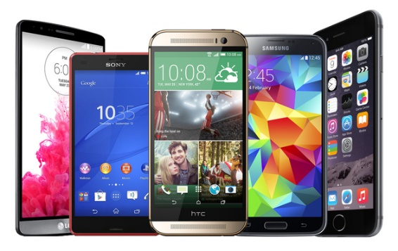
3.4 Non-functional Requirements - 非機能要求
3
Software Requirement Specification
プロジェクト管理
Software Requirements
Chrome
Firefox
Hardware Requirements:
- PC, Laptop , Smartphone with internet connection.
31

Slide 36
Outlines -アウトライン
1
Introduction
導入
2
Project Management
プロジェクト管理
3
Software Requirement Specification
プロジェクト管理
4
Software Design Description
ソフトウェア要求仕様
5
Quality Control
品質管理
6
Project Result
プロジェクト結果
7
Demo
デモ
8
Q & A
質問と回答
Coming up next
Luu Ngoc Manh
Nguyen Minh Huy

Slide 37
4
Software Design Description
ソフトウェア要求仕様
4
Software Design Description
ソフトウェア要求仕様
32

Slide 38
4
Software Design Description
ソフトウェア要求仕様
4.1 TECHNOLOGY AND REASON - テクノロジーと理由
Core Technology:
ASP.Net MVC
AngularJS
Sub Technology:
Bootstrap
WebApi
Reason for choosing:
Consistent with UJD system
Designed according to the MVC Model to separate view, logic and data access components
Many members can use and has experiences using C#
.Net Framework have many plugins and resources which support creating a website using MVC model.
Provide a more fluid user experience akin to a desktop application
33

Slide 39
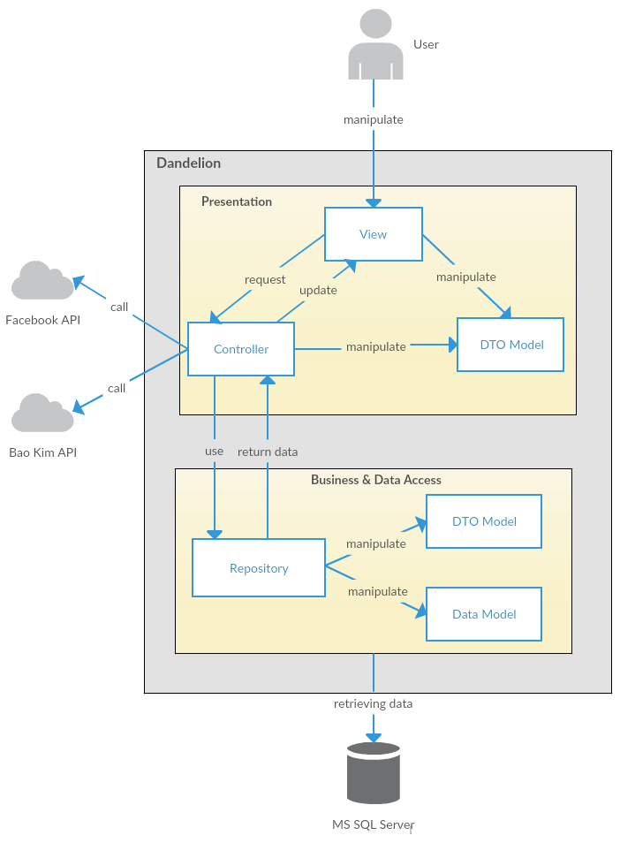
4
Software Design Description
ソフトウェア要求仕様
4.2 ARCHITECTURAL REPRESENTATION –アーキテクチャ表現
DDL System Overall Architecture
DDL システム全体のアーキテクチャ
34

Slide 40
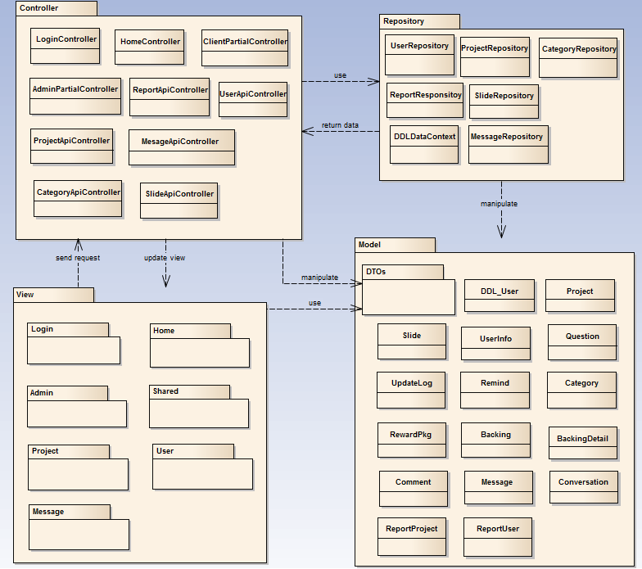
4
Software Design Description
ソフトウェア要求仕様
4.3 Package View - パッケージ ビュ
Package View - パッケージ ビュー
35

Slide 41
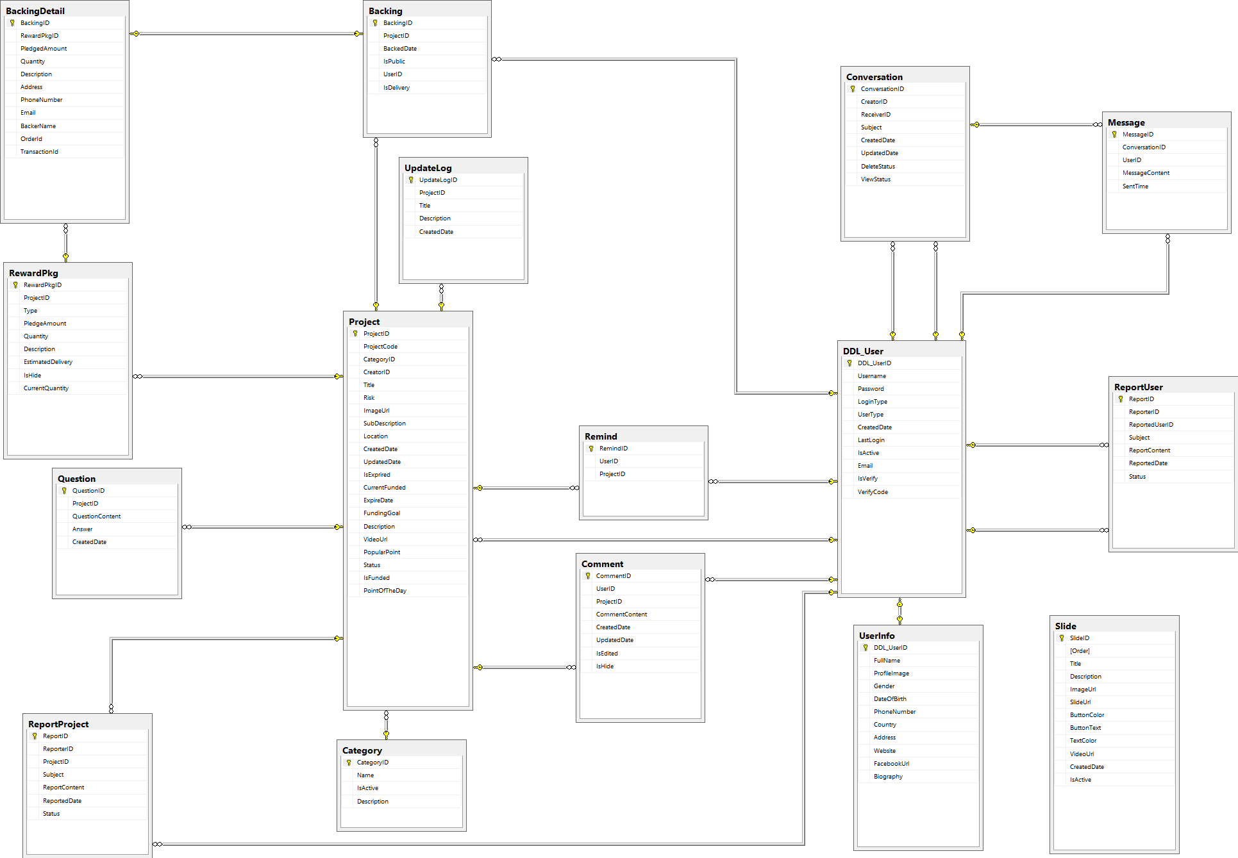
4.4 Database Design -データベース設計
4
Software Design Description
ソフトウェア要求仕様
37

Slide 42
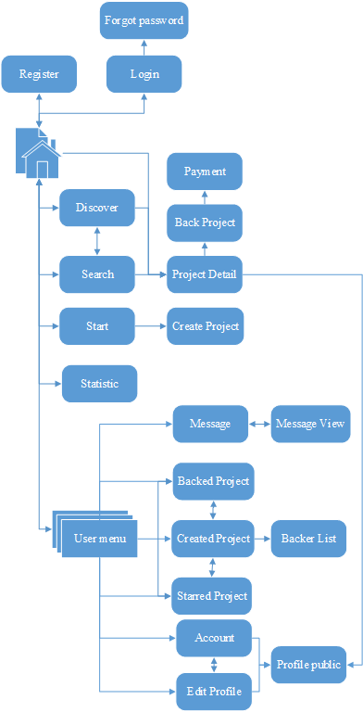
4.5.1 Screen Flow - 画面の流れ
4
Software Design Description
ソフトウェア要求仕様
Main Application screen flow
38

Slide 43
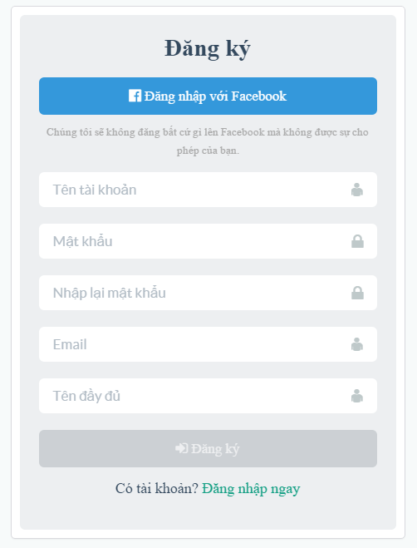
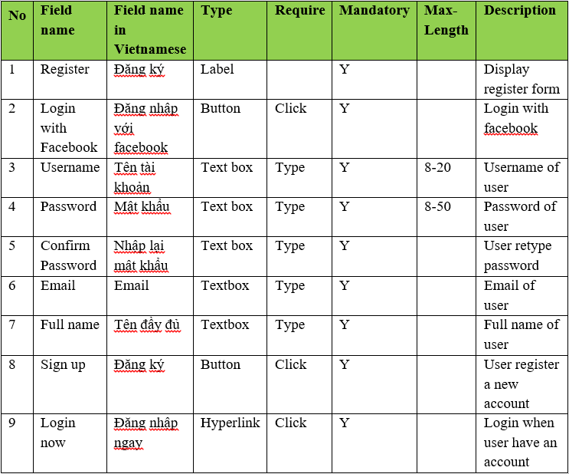
4.5.2 Screen Design - 画面設計
4
Software Design Description
ソフトウェア要求仕様
Register screen design
40

Slide 44
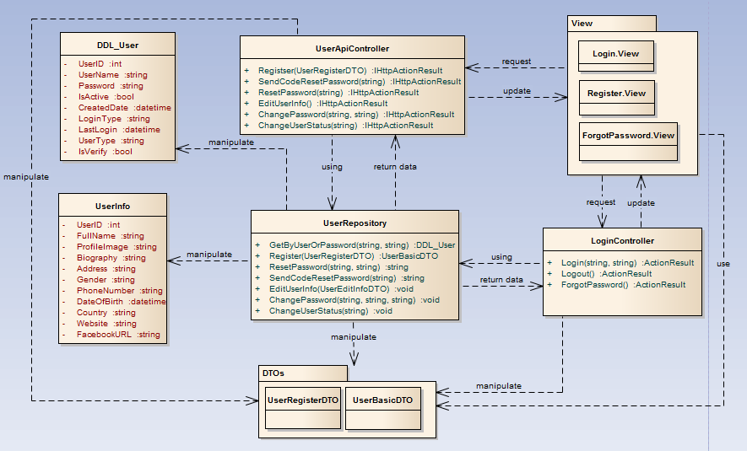
4.5.3 Class Design -クラス設計
4
Software Design Description
ソフトウェア要求仕様
Common functions class diagram
41

Slide 45
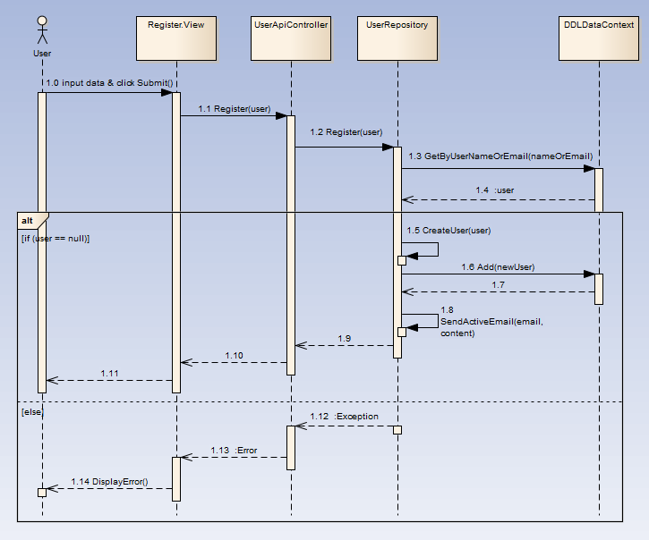
4.5.4 Sequence Diagram -シーケンス図
4
Software Design Description
ソフトウェア要求仕様
Register sequence diagram
43

Slide 46
Outlines -アウトライン
1
Introduction
導入
2
Project Management
プロジェクト管理
3
Software Requirement Specification
プロジェクト管理
4
Software Design Description
ソフトウェア要求仕様
5
Quality Control
品質管理
6
Project Result
プロジェクト結果
7
Demo
デモ
8
Q & A
質問と回答
Coming up next
Vu Cong Chinh

Slide 47
5
Quality Control
品質管理
5
Quality Control
品質管理
46

Slide 48
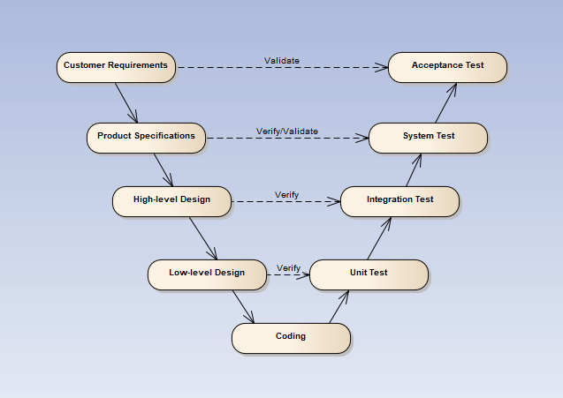
5
Quality Control
品質管理
V-model process
47
Notes:
Testing progress is divided to 5 phases include: Unit test, Component test, Integration test, System test and Acceptance test
Unit test:
Unit testing is used to verify a single minimal unit of source code. The purpose of unit testing is to isolate the smallest testable parts of DDL and verify that they function properly in isolation.
Unit testing is the first level of testing and is perform prior to component testing
Unit testing will be done by developer.
Component test:
Component testing is used to validate a combined many minimal units of source code.
Component testing is performed after unit testing and before integration testing
Component testing will be done by tester
Integration test:
Integration testing is a level of the software testing process where individual units or component are combined and tested as a group.
The purpose is to expose faults in the interaction between integrated units.
Integration testing is performed after component testing
Integration testing will be done by tester

Slide 49
5
Quality Control
品質管理
5.1 Review
5.1.2 SRS
5.1.3 Design
5.1.4 Code
5.2 Testing
5.2.1Test Process
5.2.2Test Report
5.1.5 Test Document
5.1.1 Project Plan
48

Slide 50
5.1 Review
5
Quality Control
品質管理
Self-review
PM review
Peer review
48

Slide 51
5.1 Review
5
Quality Control
品質管理
Question | Yes | No | N/A
Screen design: Does screen designs (if any) satisfy the requirements specified in other documents (SRS, Requirement, Architecture Design) ?
Does it describe GUI of the system as follows:
Does it describe/layout position of all items in GUI? | x
Does it describe processes or actions for GUI? | x
Does it describe relationship between items in GUI and modules or public functions? | x
Are the inputs and outputs for all the interfaces are sufficient and necessary? | x
Class design:
Are there dynamic diagram (sequence, activity diagram) used to describe the complicated method ? | x
Are classes' main interface/methods all clearly described ? | x
Are classes' main attributes all clearly described ? | x
Are all class' general description clearly specified ? | x
Data design:
Have data elements been described in detail with valid value ranges and other data constraints ? | x
Design review
49

Slide 52
5.2.1 Test Process -テストのプロセス
5
Quality Control
品質管理
Base on Project Plan, Project Schedule , SRS to create test plan:
Features to be tested
Acceptance Test Criteria
Environment
Schedules
Responsibilities
Risks and contingencies
…
1
Create Test Plan
2
7
3
4
5
6
Create Test Case
Review Test Case
Execute Test
Log Bug
Re-test
Create Test Report
50

Slide 53
5.2.1 Test Process -テストのプロセス
5
Quality Control
品質管理
Acceptance test criteria:
Statement coverage: 100%
Branch coverage: 100%
Path coverage: 100%
Test Approach:
Unit Test: Developer
Integration Test: Tester
System Test: Tester
Acceptance Test: Customer
Test Environment:
Web :Chrome 40 or above
Firefox 30 or above
1
Create Test Plan
2
7
3
4
5
6
Create Test Case
Review Test Case
Execute Test
Log Bug
Re-test
Create Test Report
51

Slide 54
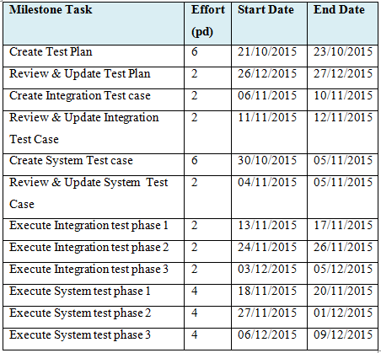
5.2.1 Test Process -テストのプロセス
5
Quality Control
品質管理
1
Create Test Plan
2
7
3
4
5
6
Create Test Case
Review Test Case
Execute Test
Log Bug
Re-test
Create Test Report
52

Slide 55
5.2 Test Process -テストのプロセス
5
Quality Control
品質管理
Base on SRS, create test case:
Unit test case
Integration test case
System test case
Acceptance test case
1
Create Test Plan
2
7
3
4
5
6
Create Test Case
Review Test Case
Execute Test
Log Bug
Re-test
Create Test Report
53

Slide 56
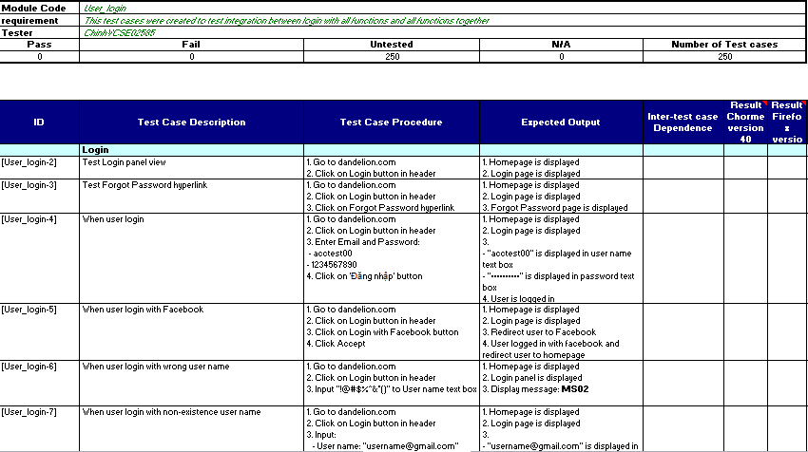
Integration test case コンポーネントのテストケース
5
Quality Control
品質管理
54

Slide 57
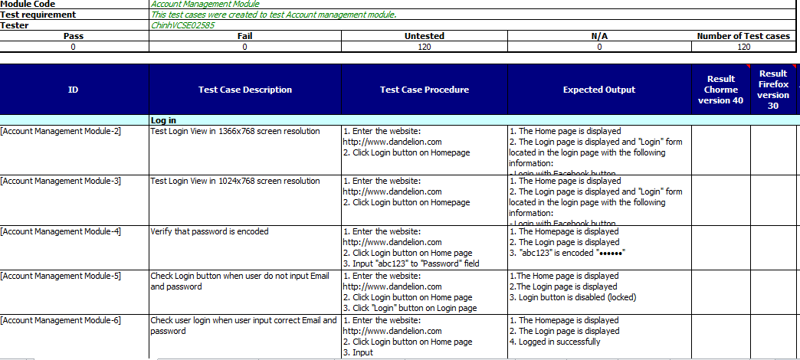
System test case -システムテストケース
5
Quality Control
品質管理
55

Slide 58
5.2 Test Process -テストのプロセス
5
Quality Control
品質管理
Developer self-review:
Unit test case
Tester self-review and peer-review:
Integration test case
System test case
1
Create Test Plan
2
7
3
4
5
6
Create Test Case
Review Test Case
Execute Test
Log Bug
Re-test
Create Test Report
56

Slide 59
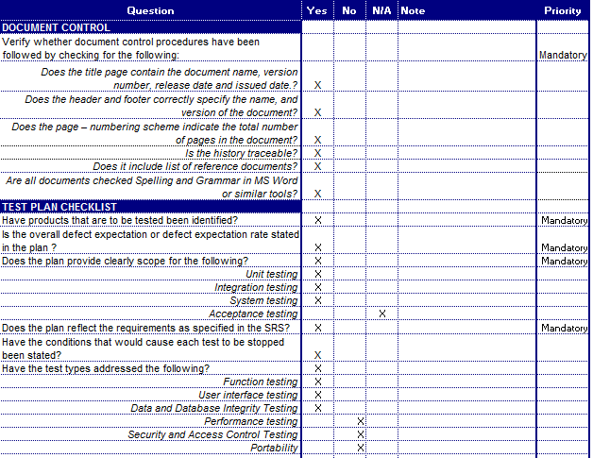
Test case review checklist -テストレビュー
5
Quality Control
品質管理
57

Slide 60
5.2 Test Process -テストのプロセス
5
Quality Control
品質管理
Tester execute test case follow phase:
Unit testing
Integration testing
System testing
1
Create Test Plan
2
7
3
4
5
6
Create Test Case
Review Test Case
Execute Test
Log Bug
Re-test
Create Test Report
58

Slide 61
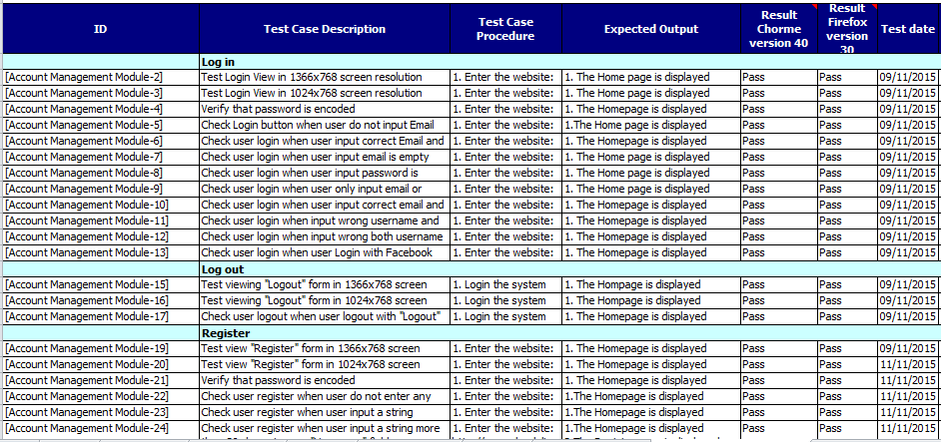
Execute test case -テストケースの実行
5
Quality Control
品質管理
System test result
58

Slide 62
5.2 Test Process -テストのプロセス
5
Quality Control
品質管理
While executing test, tester detect, log bug and assign to appropriate developer.
1
Create Test Plan
2
7
3
4
5
6
Create Test Case
Review Test Case
Execute Test
Log Bug
Re-test
Create Test Report
60

Slide 63
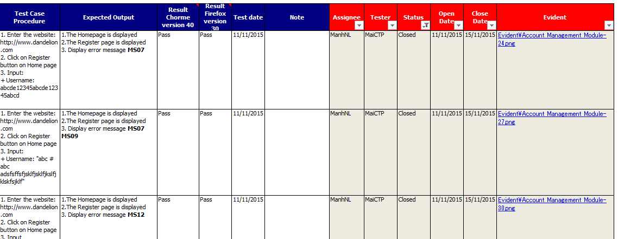
Log bug
5
Quality Control
品質管理
61

Slide 64
5.2 Test Process -テストのプロセス
5
Quality Control
品質管理
When Developer fixed bug, Tester re-test until bug was fixed successfully, then change defect of status to Closed.
1
Create Test Plan
2
7
3
4
5
6
Create Test Case
Review Test Case
Execute Test
Log Bug
Re-test
Create Test Report
62

Slide 65
5.2 Test Process -テストのプロセス
5
Quality Control
品質管理
Tester has responsibility to write test report for each test phase. Finish testing phase, Test leader create Test report
1
Create Test Plan
2
7
3
4
5
6
Create Test Case
Review Test Case
Execute Test
Log Bug
Re-test
Create Test Report
63

Slide 66
5.2.2 Test Report -テストのレポート
5
Quality Control
品質管理
Defects | Logged | %Closed | %Invalid | %Open
Critical | 0 | 0% | 0% | 0%
High | 4 | 0% | 0% | 0%
Medium | 24 | 100% | 0% | 0%
Low | 38 | 100% | 0% | 0%
Total | 66 | 100% | 0% | 0%
Defect Report
64

Slide 67
5.2.2 Test Report -テストのレポート
5
Quality Control
品質管理
Phase | Stage 1 |  | Stage 2 |  | Stage 3 |  | Final
 | Pass | Fail | Pass | Fail | Pass | Fail
Unit Test | 356 | 0 | 356 | 0 | 356 | 0 | 356
Integration Test | 298 | 2 | 300 | 0 | 300 | 0 | 300
System Test | 692 | 110 | 714 | 98 | 812 | 0 | 812
Total | 1346 | 112 | 1370 | 98 | 1468 | 0 | 1468
65

Slide 68
Outlines -アウトライン
1
Introduction
導入
2
Project Management
プロジェクト管理
3
Software Requirement Specification
プロジェクト管理
4
Software Design Description
ソフトウェア要求仕様
5
Quality Control
品質管理
6
Project Result
プロジェクト結果
7
Demo
デモ
8
Q & A
質問と回答
Coming up next
Vu Cong Chinh
0

Slide 69
6
Project Result
プロジェクト結果
6
Project Result
プロジェクト結果
67

Slide 70
6
Project Result
プロジェクト結果
Project summary
Main objective | Develop a system which will provide to users functionality to collect funding for their project and back to get the amazing products from creative projects.
Purpose | Provide a Dandelion online on website.
Source repository | https://github.com/sangnvus/2015FALLJS01.git
 | Plan | Actual
Start date | 07/09/2015 | 07/09/2015
End date | 25/12/2015 | 23/12/2015
Release versions | 1.0 | 1.0
Duration | 80 days | 78 days
Efforts (person day) | 480 | 468
Test cases | 1800 | 1468
Defects | 200-300 | 66
Document pages | ~ 3000 pages | ~ 3500 pages
Lines of code (C#) | ~ 10000 | ~ 15000
Lines of code (HTML) | ~ 5000 | ~ 10000
Lines of code (AngularJS) | ~ 10000 | ~ 13000
LOC (Total) | ~ 25000 | ~ 38000
67

Slide 71
6
Project Result
プロジェクト結果
Project summary
Knowledge:
Work process of FPT Software to develop a project.
Putting the learned knowledge into practice.
Improve skils: teamwork, leader-ship, research and self-study, plan and manage time.
Technical: AngularJS (Single Page Appliction), Azure Web App, WebApi 2.0, ASP.Net MVC5.
Tools: Visual Studio, TortoiseGit, Enterprise Architect, Office tools.
68

Slide 72
Limitation & Expectation -制限と期待
6
Project Result
プロジェクト結果
Current Limitations | Expectation in Future
Some screen can’t display well on Mobile or screen which has resolution lower than 1024x768. Website not support for English language. Not support payment methods for people in other contries. Not support payment by mobile cards. | Support multi-language and other payment method such as visa and master card to get funding from people in other countries. Support payment by mobile cards such as Viettel, Mobi, Vina, … App for Android and IOS which supports members manage their projects and admin can manage system anywhere by smart phone. Expand server to inscrease number of users.
69

Slide 73
Lessons Learnt -学んだ教訓
6
Project Result
プロジェクト結果
70

Slide 74
Outlines -アウトライン
1
Introduction
導入
2
Project Management
プロジェクト管理
3
Software Requirement Specification
プロジェクト管理
4
Software Design Description
ソフトウェア要求仕様
5
Quality Control
品質管理
6
Project Result
プロジェクト結果
7
Demo
デモ
8
Q & A
質問と回答

Slide 75
7
Demo
デモ
7
Demo
デモ

Slide 76
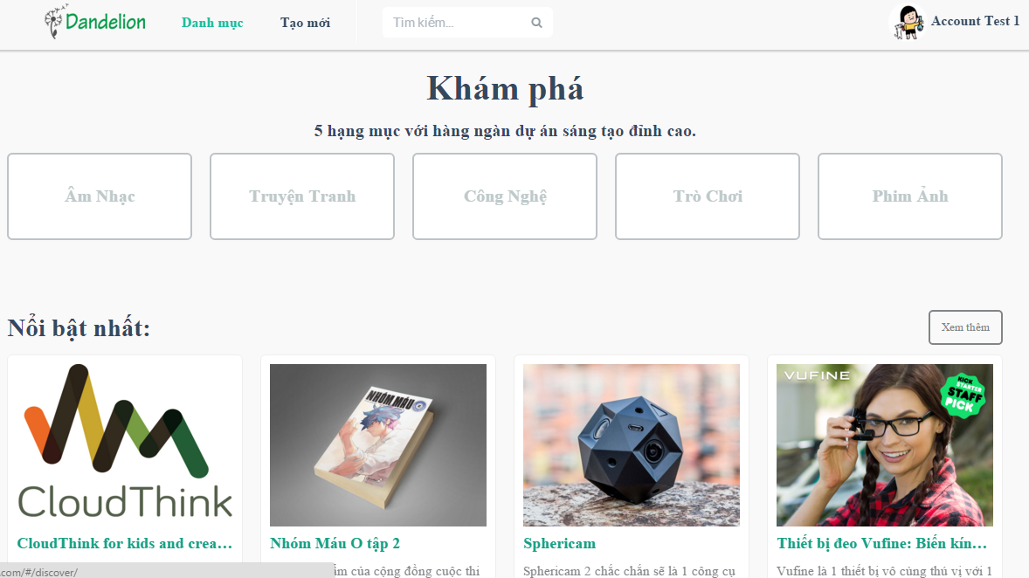
Demo -デモ
7
Demo
デモ
0

Slide 77
Outlines -アウトライン
1
Introduction
導入
2
Project Management
プロジェクト管理
3
Software Requirement Specification
プロジェクト管理
4
Software Design Description
ソフトウェア要求仕様
5
Quality Control
品質管理
6
Project Result
プロジェクト結果
7
Demo
デモ
8
Q & A
質問と回答
0

Slide 78
8
Q & A
質問と回答
8
Q & A
質問と回答
0

Slide 79
Q & A -質問と回答
8
Q & A
質問と回答
0

