Slide 1
卒業プロジェクト - Capstone Project バス利用者支援システム Bus User Support System
スーパーバイザ： Nguyễn Văn Sang
Supervisor
リーダー： Nguyễn Thành Nam
Leader
メンバー： Trịnh Thị Tuyết Mai
Member Bùi Bích Phương
Trần Tú Anh

Slide 2
コンテンツの概要 – Outline of Content
1. 導入 – Introduction
2. プロジェクト管理 – Project Management
3. ソフトウェア要求仕様 – Software Requirement Specification
4. ソフトウェア設計説明書 – Software Design Description
5. 品質管理 – Quality Control
6. プロジェクト結果 – Project Result
7. デモ – Demo
8. 質問と回答 – Q & A

Slide 3
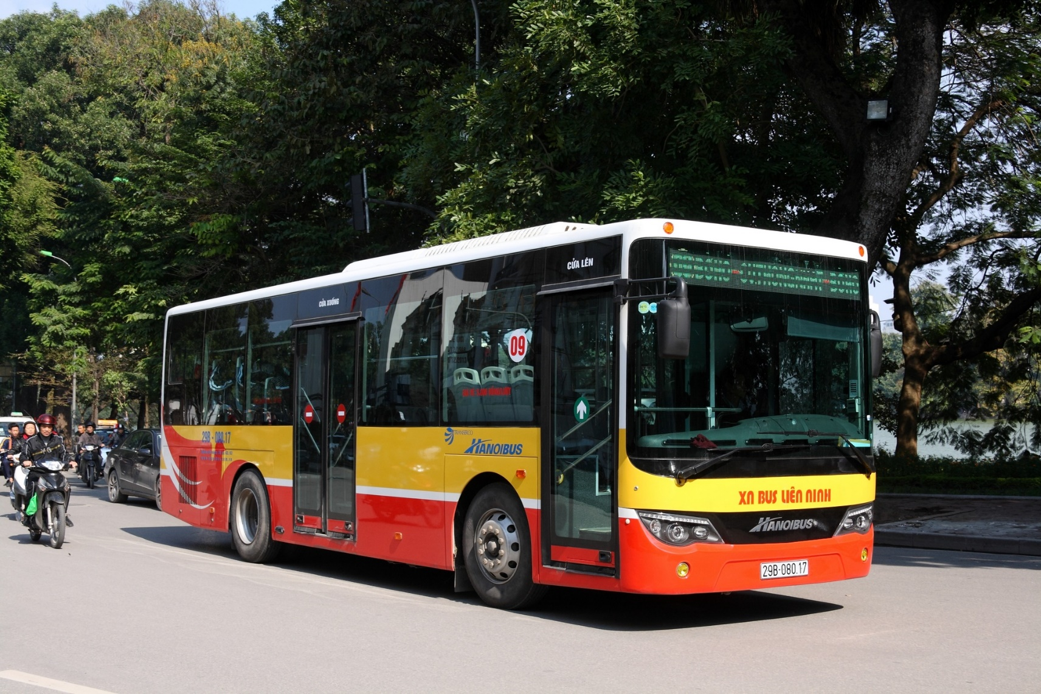
1.導入 - Introduction

Slide 4
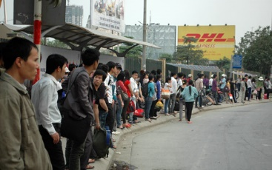
1.1 現在状況 - Current situation

Slide 5
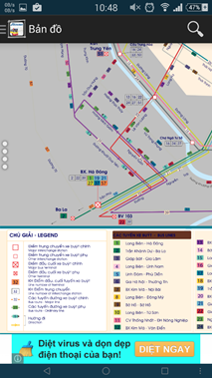
1.2 在のシステム - Existed system Hanoi Bus
The app at allow users to view bus map, locate current gps, look up bus list, find path and… call for a taxi?!?
Advantages:
Support almost needed features
Disadvantages:
Poorly designed, the bus map is nothing more than a high resolution picture of a real map.
Including ads
Out of date and has not been update for quite long

Slide 6
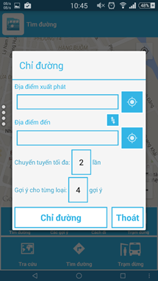
1.2 在のシステム - Existed system Bus Map
The app allow users to view bus map, search for bus, look for bus-stop, find path, see bus list.
Advantages:
- Support almost needed features
- No ads included
Disadvantages:
- Complicate and confusing UI
- Pretty hard to navigate among functions
- Sometimes not function correctly

Slide 7
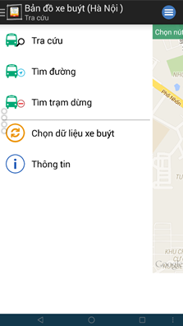
1.2 在のシステム - Existed system Bản đồ xe buýt
The app allow users to view bus map, search for bus, look for bus-stop, find path, see bus list.
Advantages:
- Support almost needed features
- No ads included
Disadvantages:
- Complicate and confusing UI
- Pretty hard to navigate among functions
- Sometimes not function correctly

Slide 8

1.3 アイデア - Idea
Do not need to wait for bus for a long time?
Do not worry about missing a bus?
Do not worry about going over a bus stop?
Want to search for bus in a more easy way?
Want to…

Slide 9

1.4 提案 - Proposal
全ての要件を満たします - Meet all requirements.
通信、グループでの作業、プロジェクト管理をご覧して、 個人的な技術を開発する - Learn about communication, working in groups, project control and develop personal technique…
学んだことについて実践する - Practice about what we’ve learned.
ユーザー集中誘致、バスの利用を高めるために貢献する - Attract the user concentrated, contribute to increase the uses of buses
英語とベトナム語のサポート - Support English & Vietnamese

Slide 10
2. プロジェクト管理 – Project Management
2.1 ソフトウェ アプロセス モデル - Software Process Model
2.2 プロジェクト組織 - Project Organization
2.3 プロジェクト計画 - Project Schedule
2.4 目標 と 成果物 - Objectives & deliverables
2.5 ツールと インフラストラクチャ - Tools & Infrastructure
2.6 リスク管理 - Risks management
2.7 コンフィグレーション管理 - Configuration management
2.8 コミュニケーション管理 - Communication management

Slide 11
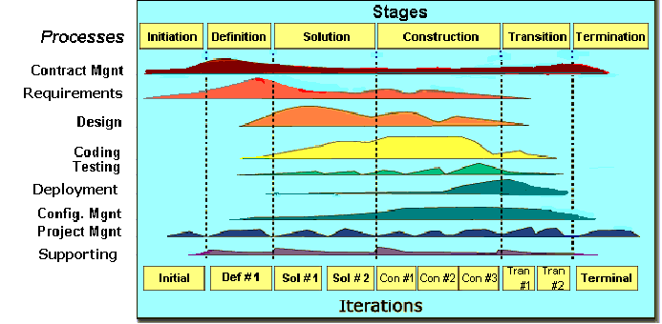
2.1 ソフトウェ アプロセス モデル - Software Process Model
Initiation phase
Solution phase
Construction phase
Termination phase
Fsoft モデル - Fsoft Model

Slide 12
2.2 プロジェクト組織 - Project Organization

Slide 13
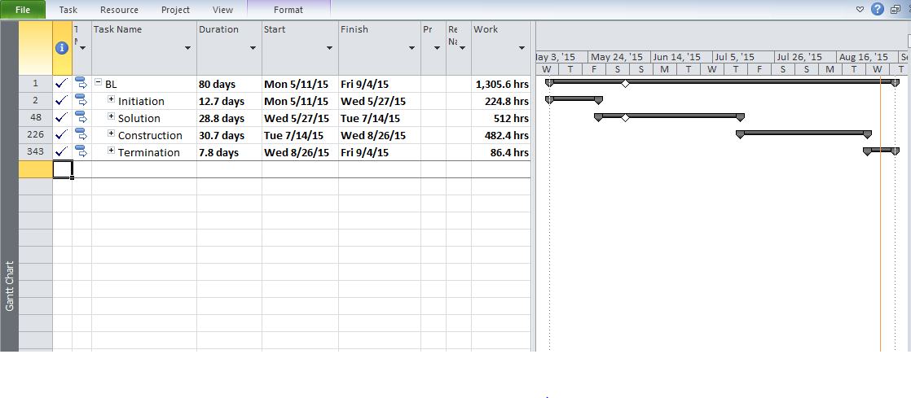
2.3 プロジェクト計画 - Project Schedule

Slide 14
2.4 マイルストーンの成果物 - Objectives & deliverables
No | Stage | Committed Delivery date | Description of Deliverable | Delivery media
Initiation |  |  | Requirements agreed, Report 1 reviewed
1 | Submit Project Introduction | 13-05-2015 | Completed Project Introduction | Commit GitHub
2 | Submit Project Plan Final | 27-05-2015 | Criteria: Documentation reviewed | Commit GitHub
Solution
1 | Architecture Design | 09-06-2015 | Criteria: Documentation reviewed | Commit GitHub
2 | Screen Design | 10-07-2015 | Criteria: Documentation reviewed | Commit GitHub
3 | Class Design | 06-07-2015 | Criteria: Documentation reviewed | Commit GitHub
4 | Data Design | 29-06-2015 | Criteria: Documentation reviewed | Commit GitHub
5 | SRS Final | 05-06-2015 | Criteria: Documentation reviewed | Commit GitHub
Construction |  |  | Product developed & tested and released to supervisor, documentation reviewed.
1 | Submit Test Plan Final | 15-06-2015 | Completed report no.5 | Commit GitHub
2 | Complete Coding and Unit Test | 21-08-2015 | Source code Acceptance criteria: Product unit tested | Commit GitHub
3 | Complete Testing | 24-08-2015 | Completed Test | Commit GitHub
4 | Submit User Manual Final | 27-08-2015 | Completed report no.6 | Commit GitHub
5 | Submit the last document and CD source code | 27-08-2015 | Final Documents and Source Code | Copy to CD and commit
Termination |  |  | Project post-mortem is conducted, Project assets archived and released to supervisor
1 | Represent capstone project | 04-08-2015 | Criteria: Completed | Presentation
2 | Project Complete | 04-09-2015 | Criteria: Completed

Slide 15









2.5 ツールと インフラストラクチャ – Tools & Infrastructure
Astah
Word 2013
Excel 2013
Project 2010
PowerPoint 2013
Chrome
Android Studio
Netbeans
GitHub

Slide 16
2.6 リスク管理 - Risks management
Risk ID | Risk Source | Risk Category | Risk Description | Probability | Impact | Exposure | Priority | Trigger | Risk Status | Mitigation | Contigency | Person in charge
R02 | Human resource | Shortage of Human resource | Member leave team while running project. | 0.2 | 8 | 1.6 | 3 | Member being absent at the meeting minues and cannot contact | Open |  | If risk occurs, PM assigns work to other member. | Team member

Slide 17
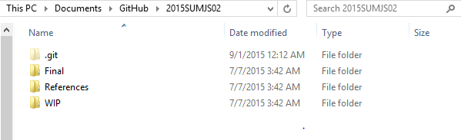
2.7 コンフィグレーション管理 – Configuration management
Final : Store sent documents
References: Store reference documents. For example: templates, technologies document…
WIP: Store documents in progress developing which haven’t reviewed or approved yet.
Plan: Plan of capstone project
Users: Working Folder of Member
Documents: Store whole documents in progress developing

Slide 18
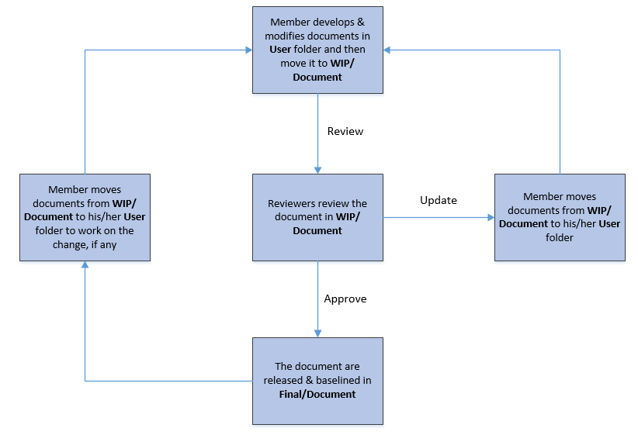
2.7 コンフィグレーション管理 – Configuration management

Slide 19



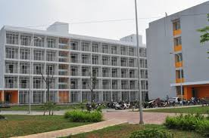
2.8 コミュニケーション管理 - Communication management
Communication
Working time: 8hs/day – 5d/week

Slide 20
3. ソフトウェア要求仕様 - Software Requirement Specification
Non-Functional Requirement
Functional Requirement
3.1 機能要求
3.2 非機能要求

Slide 21
3.1 機能要求 - Functional Requirement
Functional Requirement: 33 use cases
Main function:
Search Bus
Find Path
Manage reminder
Bus track

Slide 22
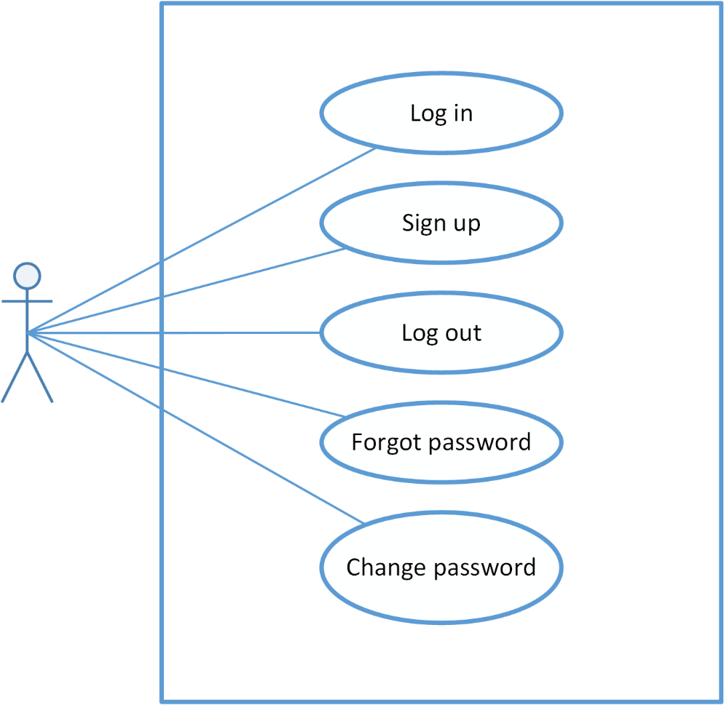
3.1 機能要求 - Functional Requirement Account Management

Slide 23
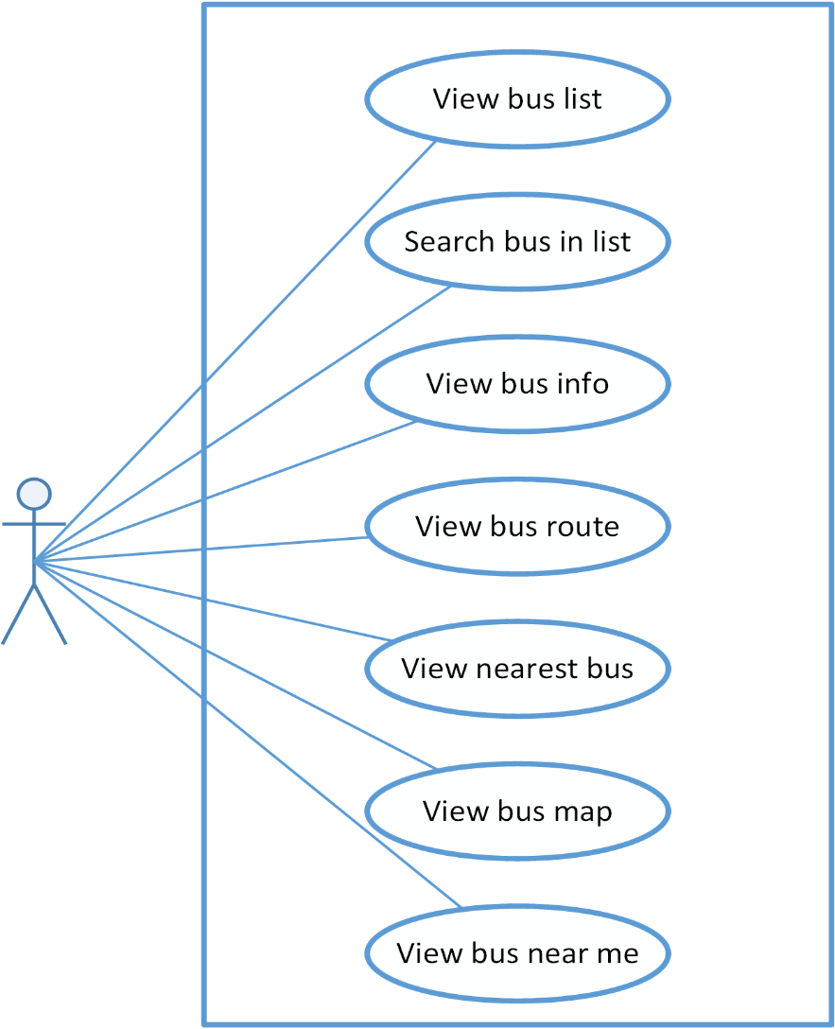
3.1 機能要求 - Functional Requirement Bus

Slide 24
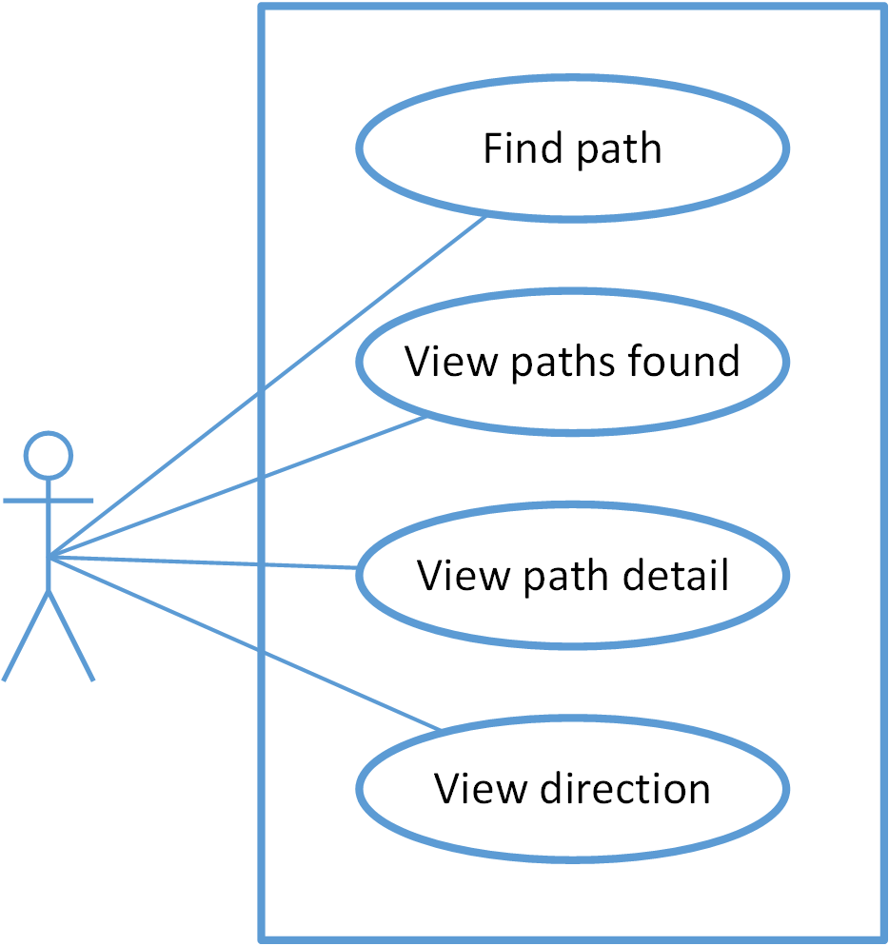
3.1 機能要求 - Functional Requirement Find Path

Slide 25
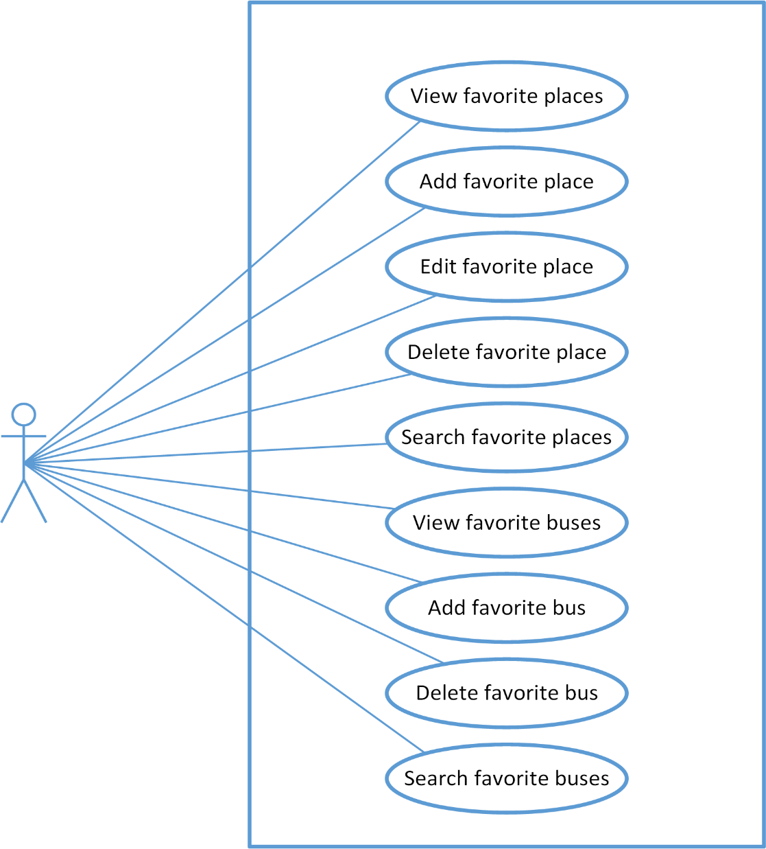
3.1 機能要求 - Functional Requirement Favorites

Slide 26
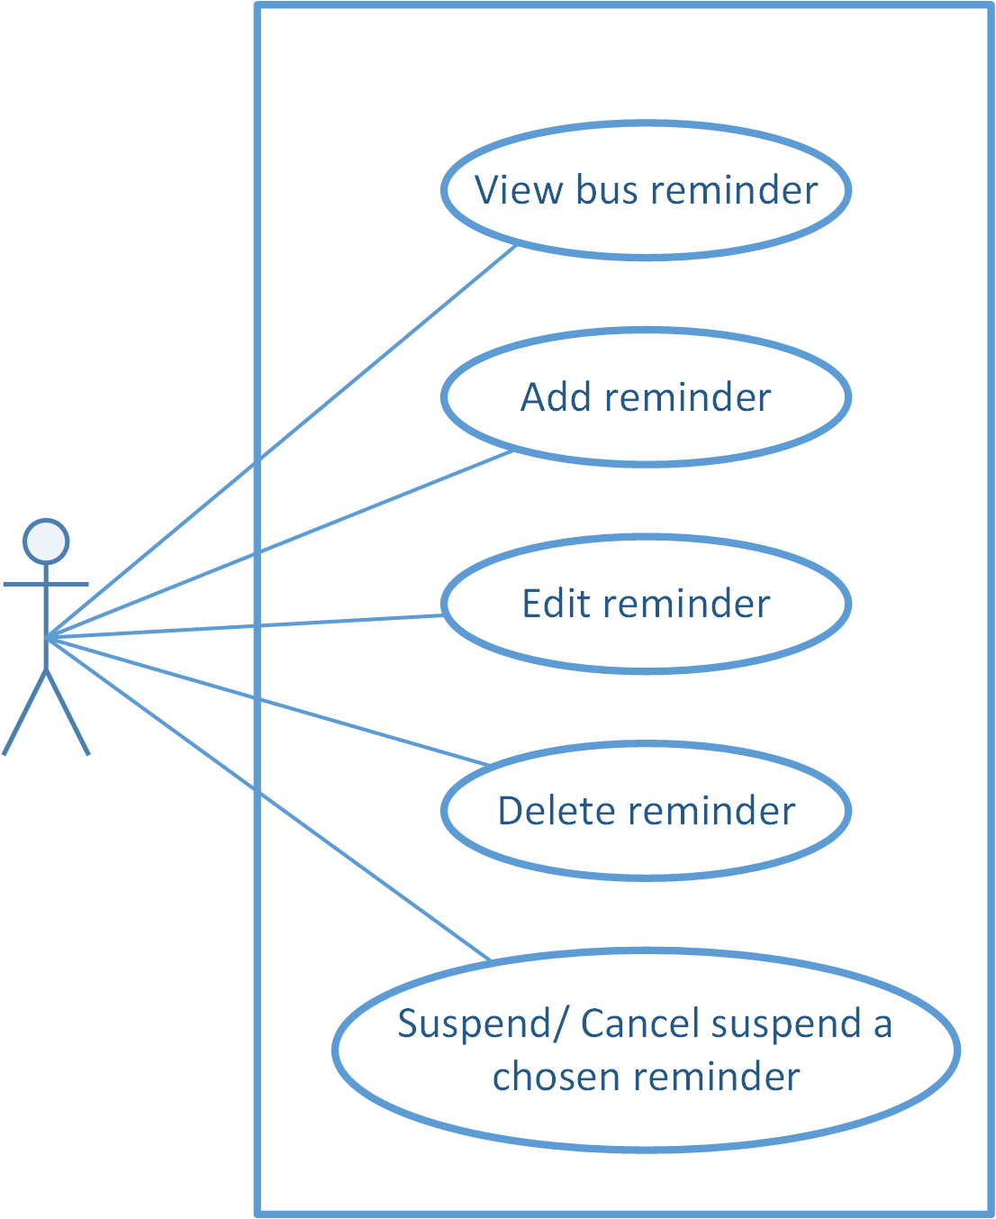
3.1 機能要求 - Functional Requirement Reminder

Slide 27
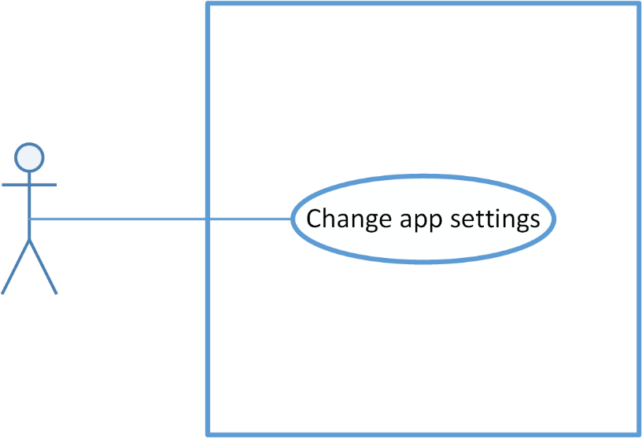
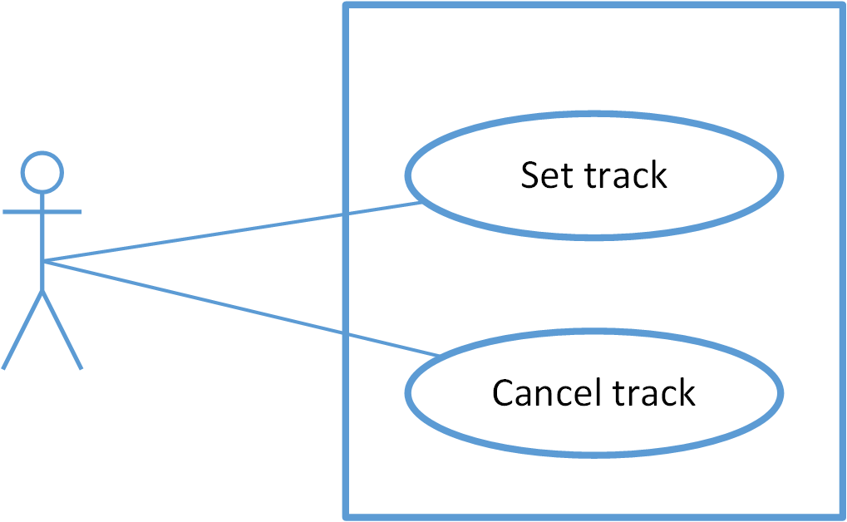
3.1 機能要求 - Functional Requirement
Common
Track

Slide 28
3.2 非機能要求 - Non-functional Requirement
Availability
~95% of time
Reliability
MTBF ~ 480hs
Maximum 2 bugs/function within 2 months.
DB must be backed up.
UI:
Color: elegant
Language: Vietnamese & English
Text: Android default font
Graphics: Big, bold, clear and colorful

Slide 29



3.4 非機能要求 - Non-functional Requirement
ハードウェア要求 - Hardware Requirements
Android 5.0+ スマホ - Smartphone Android 5.0+
モバイルインターネット - Mobile Internet/ Wireless network.

Slide 30
4. ソフトウェア設計記述 - Software Design Description
4.3 パッケージの見る – Package View
4.2 アーキテクチャ表現 – Architecture Representation
4.1 テクノロジーと理由 – Technologies & Reasons
クラス設計 – Class Design
4.4 詳細設計 – Detailed Design
シーケンス線図 – Sequence Diagram
画面フロー – Screen flow
画面設計 – Screen design
データベース設計 – Database design

Slide 31





4.1 テクノロジーと理由 – Technologies & Reasons

Slide 32
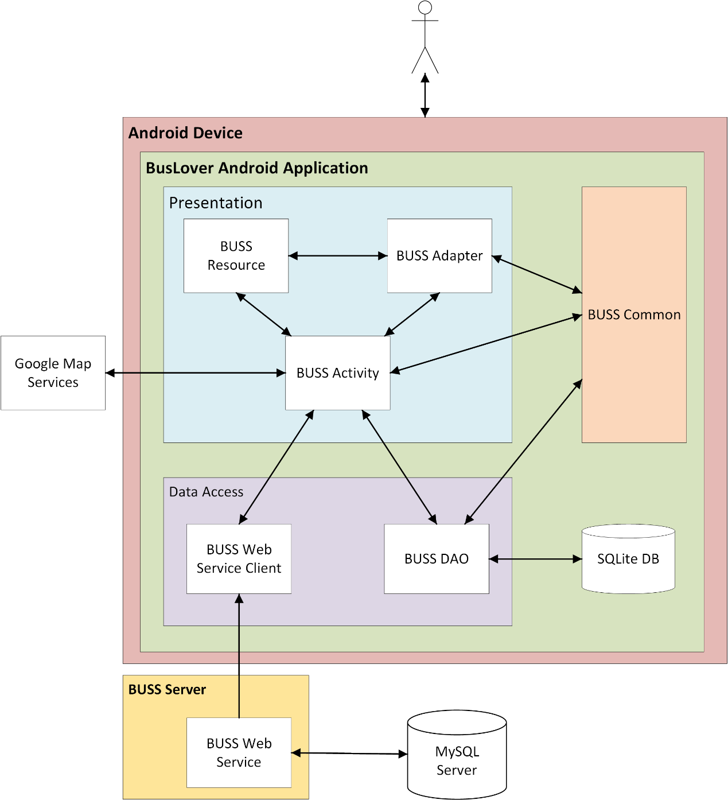
4.2 アーキテクチャ表現 - Architecture Representation

Slide 33
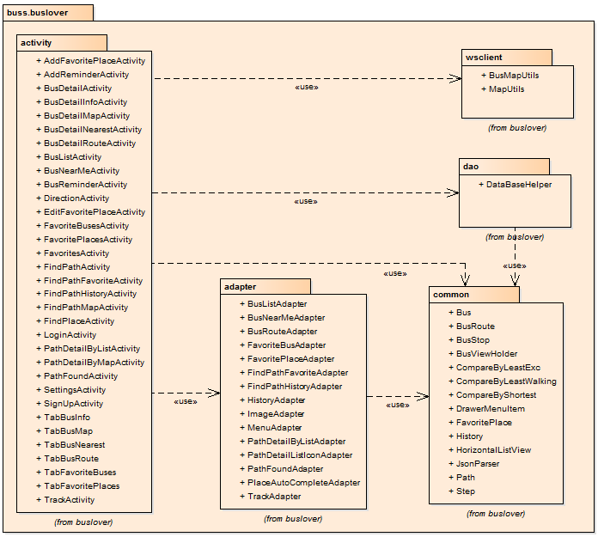
4.2 パッケージの見る - Package View

Slide 34
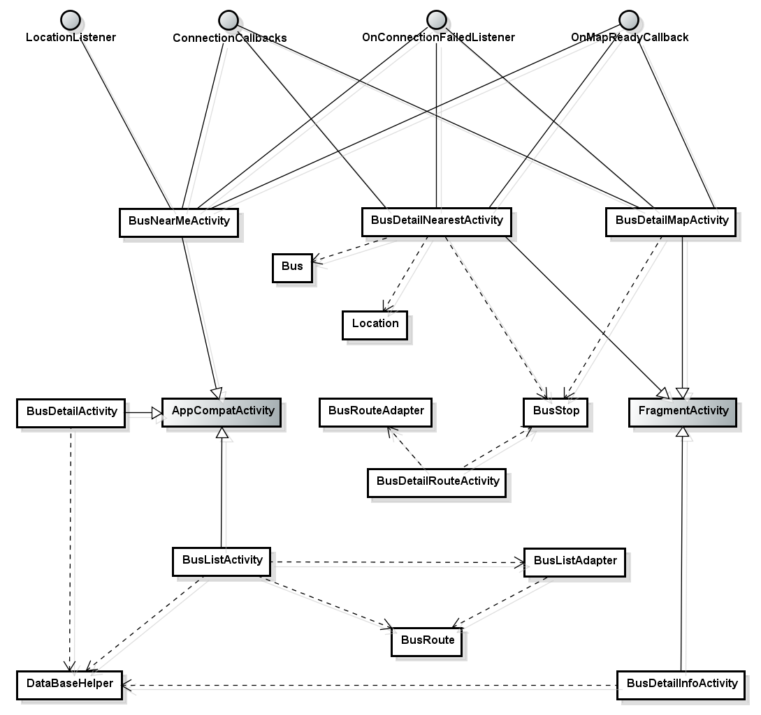
4.4 詳細設計 -クラス設計 - Class Design (Bus)

Slide 35
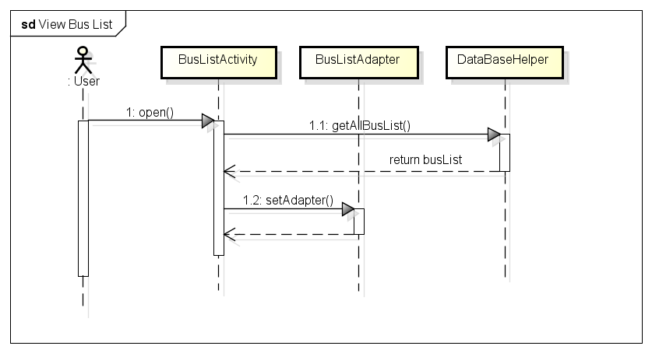
シーケンス線図 - Sequence diagram

Slide 36
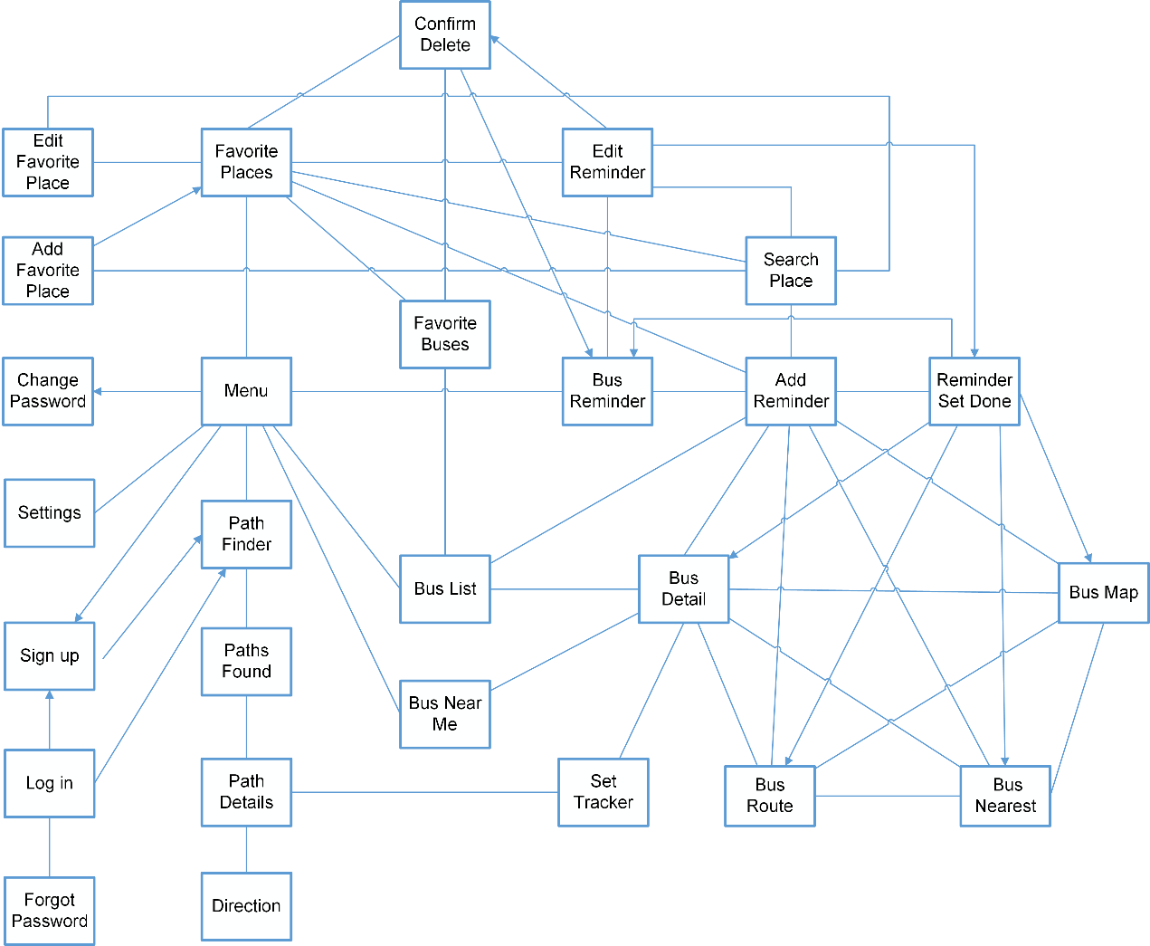
画面フロー (Screen flow)

Slide 37
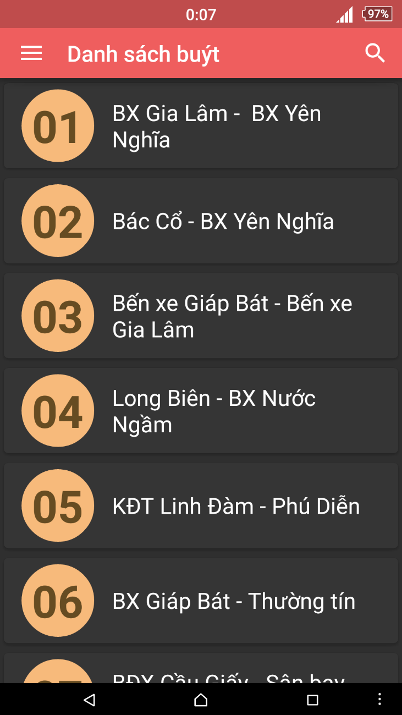
画面設計 - Screen design
No | Field name | Field name in Vietnamese | Type | Require | Mandatory | Length | Description
1 | Bus route | Tuyến xe buýt | List item | Click | Y |  | User taps on Skip button
2 | Search | Tìm kiếm | Button | Click | Y |  | User taps on Search button
3 | Search Text Field | Khung tìm kiếm | Edit Text | Text | Y | 255 | User inputs their key word they want to search with length less than 255 characters
4 | Menu | Menu | Button | Click | Y |  | User taps on Menu button

Slide 38
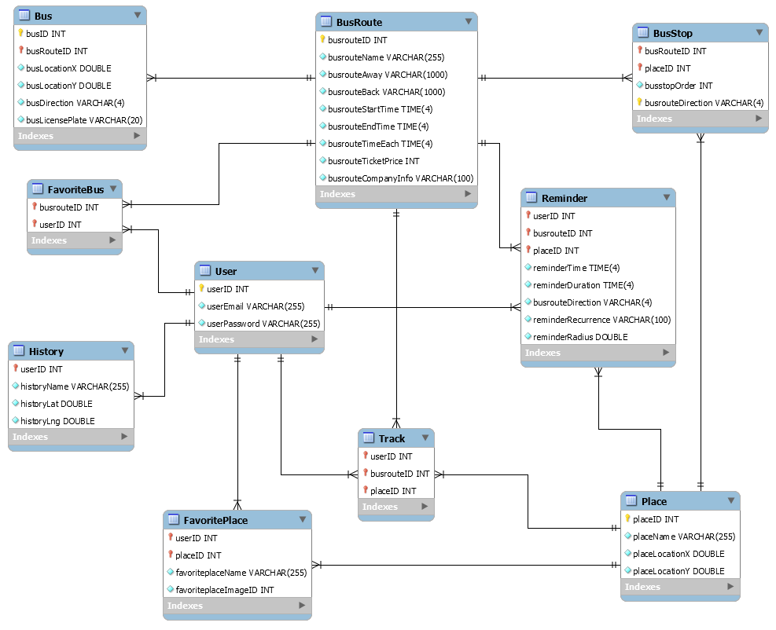
データベース設計 - Database Design

Slide 39
5. 品質管理 – Quality Control
5.4 テスト環境 - Testing environment
5.2 テストプロセス - Testing Process
5.1 テストモデル - Testing Model
5.3 テスト段階 – Test stages
5.5 テストケース - Test case
5.6 テストレポート - Test report

Slide 40
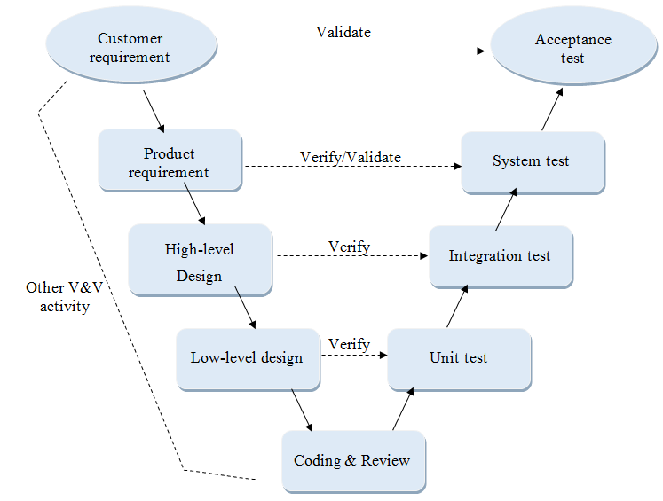
5.1 テストモデル - Testing Model

Slide 41
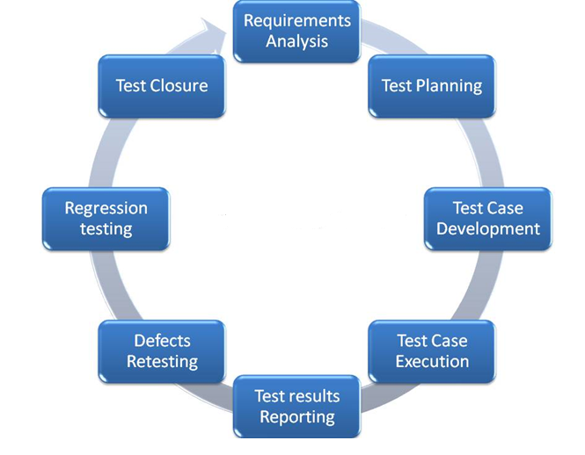
5.2 テストプロセス - Testing Process

Slide 42
5.3 テスト段階 – Test stages
Type of test | Stage of test
 | Unit | Component | Integration | System
Function testing | x | x | x | x
UI testing | x |  |  | x

Slide 43
5.4 テスト環境 - Testing environment
Hardware:
Laptop (Asus, Vaio, Dell) Window 8.1 Pro & Win 7 professional
Mobile (Sony Z3, Zenphone 5, Samsung Note 3) Android 5.0
Software:
Microsoft Word 2013, 2010
Microsoft Excel 2013, 2010
Android Studio with Junit

Slide 44
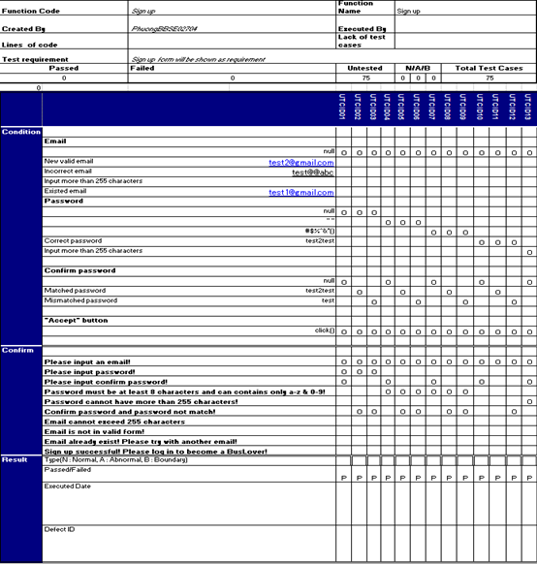
5.5 テストケース - Test case - Component test

Slide 45
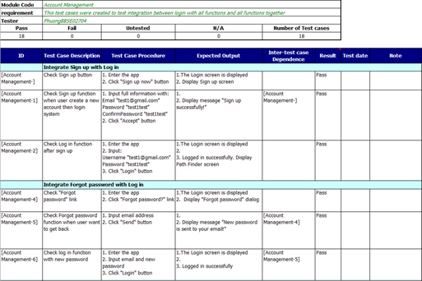
5.5 テストケース - Test case - Integration test

Slide 46
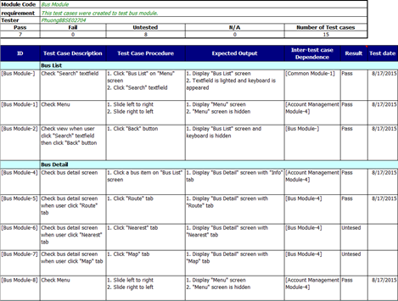
5.5 テストケース - Test case - System test

Slide 47
5.6 テストレポート - Test report
Phase | # Test cases Planned | #Defects Planned | #Test cases Actual | #Defects Actual | % Tests Executed | % Tests Passed | % Tests Fail
Unit Test | 40TC/KLOC | 3 -4 | 30 | 0 | 100% | 100% | 0%
Component Test | 40TC/KLOC | 3 -4 | 184 | 10 | 100% | 100% | 0%
Integration Test | 30TC/KLOC | 2 -3 | 67 | 2 | 100% | 100% | 0%
System Test | 60TC/KLOC | 4 -6 | 130 | 5 | 100% | 100% | 0%
Total | 400 | 16-32 | 411 | 17 | 100% | 100% | 0%

Slide 48
Test report
Phase | Round 1 |  |  |  | Round 2
 | Pass | Fail | Untested | Bug | Pass | Fail | Untested | Bug
Unit Test | 20 | 0 | 10 | 0 | 10 | 0 | 0 | 0
Component Test | 100 | 9 | 75 | 10 | 84 | 0 | 0 | 0
Integration Test | 58 | 3 | 6 | 2 | 9 | 0 | 0 | 0
System Test | 115 | 7 | 8 | 5 | 13 | 0 | 0 | 0
Total | 293 | 19 | 99 | 17 | 118 | 0 | 0 | 0

Slide 49
6. プロジェクト結果 – Project Result
Project Title |  | Bus User Support System
Project Supervisor |  | Nguyễn Văn Sang
Committers (4)
1 | Project Manager | Nguyễn Thành Nam | NamNTSE02942@fpt.edu.vn
2 | Developer | Trịnh Thị Tuyết Mai | MaiTTTSE02630@fpt.edu.vn
3 | Developer | Trần Tú Anh | AnhTTSE02596@fpt.edu.vn
4 | Tester | Bùi Bích Phương | PhuongBBSE02704@fpt.edu.vn
Main objective |  | Develop a system which will support user to use bus more convenience and easily
Purpose |  | Provide a BUSS to users
Source Repository |  | https://github.com/sangnvus/2015SUMJS02
 |  | Plan |  | Actual
Start Date |  | 11/05/2015 |  | 11/05/2015
End Date |  | 28/08/2015 |  | 04/09/2015
Releases version |  | 1.0 |  | 1.0
Duration |  | 75 |  | 80
Effort (person-day) |  | 2400 |  | 2464
Test cases |  | 400 |  | 411
Defects |  | 16-32 |  | 17
Document pages |  | 1000 pages |  | 800 pages
Lines of code |  | ~7000 |  | ~ 9000

Slide 50
制限と期待 – Limitation & Expectation
現在の制限 – Current limitation | 将来的に期待 – Expectation in the future
Lack of interactive features | Add interactive features with FB and social network such as share, like, comment…
Might make user feel not interest after long time using | Creating a mini game like ‘virtual petting’ game, with pets grow up by taking actions from user
 | Allow user to customize BusLover more deeply depend on their needs
Support android 5.0+ only | Support more android version
Support only Vietnamese and English | Support more popular language (Japanese, French, Germany….)
Data might not accurate, do not have enough information | Try to promote this app to companies in order to get rights, information and investment from them

Slide 51
Issues & Lessons Learnt
Issues:
A member left the team.
Data about bus, bus stop and bus route are hard and take too much time to get it all.
Server die, new server does not support some features.
Lack communication between members in project team
PM lack management skills leads to lack of status tracking, which was a part of the reason made the other members did not done their works.
Members can not balance their personal life with the work, which was one of the most reason that affect to working quality.
Lessons learnt:
Man proposes, God disposes.
Necessity is the mother of invention.
Make hay while the sun shines.

Slide 52
7. デモ – Demo

Slide 53
8. 質問と回答 – Q & A

Slide 54
終わり！ The end!
ありがとうございました。
Thank you for listening!

