Slide 1
Angi Project
AGC TRA DA TEAM
Notes:
Transparent light effect
(Basic)
To reproduce one of the shapes on this slide, do the following:
On the Home tab, in the Slides group, click Layout and then click Blank.
On the Home tab, in the Drawing group, click Shapes, and then under Basic Shapes click Oval (first row, second option from the left).
Press and hold SHIFT to constrain the shape to a circle, and then drag to draw a circle on the slide.
On the Home tab, in the bottom right corner of the Drawing group, click the Format Shape dialog box launcher. In the Format Shape dialog box, click Line Color in the left pane, and then select No line in the Line Color pane.
Also in the Format Shape dialog box, click Fill in the left pane, select Gradient fill in the Fill pane, and then do the following:
In the Type list, select Radial.
Click the button next to Direction, and then click From Center (third option from the left).
Under Gradient stops, click Add gradient stop or Remove gradient stop until three stops appear in slider.
Also under Gradient stops, customize the gradient stops that you added as follows:
Select the first stop in the slider, and then do the following:
In the Position box, enter 0%.
Click the button next to Color, and then under Theme Colors click Dark Blue, Text 2, Lighter 60% (third row, fourth option from the left).
In the Transparency box, enter 80%.
Select the second stop in the slider, and then do the following:
In the Position box, enter 50%.
Click the button next to Color, and then under Dark Blue, Text 2, Lighter 40% (fourth row, fourth option from the left).
In the Transparency box, enter 70%.
Select the third stop in the slider, and then do the following:
In the Position box, enter 100%.
Click the button next to Color, and then under Theme Colors click Dark Blue, Text 2, Lighter 40% (fourth row, fourth option from the left).
In the Transparency box, enter 100%.
On the Home tab, in the Drawing group, click Shape Effects, point to Soft Edges, and then click 10 Point.
To reproduce the other shapes on this slide, do the following:
Select the circle on the slide. On the Home tab, in the Clipboard group, click the arrow under Copy, and then click Duplicate. Repeat this process to create a total of 10 circles.
On the slide, drag the circles to position them at random intervals.
For each circle, press and hold SHIFT and then drag the adjustment handles to resize as needed.
To reproduce the different color and transparency effects in each of the shapes, do the following:
Select the shape. On the Home tab, in the bottom right corner of the Drawing group, click the Format Shape dialog box launcher.
In the Format Shape dialog box, click Fill in the left pane, select Gradient fill in the Fill pane. Under the Gradient stops, click Add gradient stop or Remove gradient stop until three stops appear in the slider, and then do the following:
For the first and third (small circle below larger circle) circles from the left:
Select the first stop in the slider, and then do the following:
In the Position box, enter 0%.
Click the button next to Color, and then under Theme Colors click Dark Blue, Text 2, Lighter 60% (third row, fourth option from the left).
In the Transparency box, enter 90%.
Select the second stop in the slider, and then do the following:
In the Position box, enter 50%.
Click the button next to Color, and then under Dark Blue, Text 2, Lighter 40% (fourth row, fourth option from the left).
In the Transparency box, enter 85%.
Select the third stop in the slider, and then do the following:
In the Position box, enter 100%.
Click the button next to Color, and then under Theme Colors click Dark Blue, Text 2, Lighter 40% (fourth row, fourth option from the left).
In the Transparency box, enter 100%.
For the second circle from the left, do not change the Gradient stops settings in the Format Shape dialog box.
For the fourth circle from the left (large circle above third circle):
Select the first stop in the slider, and then do the following:
In the Position box, enter 0%.
Click the button next to Color, and then under Theme Colors click Dark Blue, Text 2, Lighter 60% (third row, fourth option from the left).
In the Transparency box, enter 80%.
Select the second stop in the slider, and then do the following:
In the Position box, enter 50%.
Click the button next to Color, and then under Dark Blue, Text 2, Lighter 40% (fourth row, fourth option from the left).
In the Transparency box, enter 70%.
Select the third stop in the slider, and then do the following:
In the Position box, enter 100%.
Click the button next to Color, and then under Theme Colors click Dark Blue, Text 2, Lighter 60% (third row, fourth option from the left).
In the Transparency box, enter 100%.
For the fifth circle from the left:
Select the first stop in the slider, and then do the following:
In the Position box, enter 0%.
Click the button next to Color, and then under Theme Colors click Dark Blue, Text 2, Lighter 40% (fourth row, fourth option from the left).
In the Transparency box, enter 88%.
Select the second stop in the slider, and then do the following:
In the Position box, enter 50%.
Click the button next to Color, and then under Dark Blue, Text 2, Lighter 40% (fourth row, fourth option from the left).
In the Transparency box, enter 71%.
Select the third stop in the slider, and then do the following:
In the Position box, enter 100%.
Click the button next to Color, and then under Theme Colors click Dark Blue, Text 2, Lighter 40% (fourth row, fourth option from the left).
In the Transparency box, enter 100%.
For the sixth circle from the left:
Select the first stop in the slider, and then do the following:
In the Position box, enter 0%.
Click the button next to Color, click More Colors, and then in the Colors dialog box, on the Custom tab, enter values for Red: 227, Green: 209, Blue: 143.
In the Transparency box, enter 84%.
Select the second stop in the slider, and then do the following:
In the Position box, enter 50%.
Click the button next to Color, click More Colors, and then in the Colors dialog box, on the Custom tab, enter values for Red: 223, Green: 205, Blue: 75.
In the Transparency box, enter 85%.
Select the third stop in the slider, and then do the following:
In the Position box, enter 100%.
Click the button next to Color, click More Colors, and then in the Colors dialog box, on the Custom tab, enter values for Red: 214, Green: 195, Blue: 84.
In the Transparency box, enter 100%.
For the seventh circle from the left:
Select the first stop in the slider, and then do the following:
In the Position box, enter 0%.
Click the button next to Color, and then under Theme Colors click Dark Blue, Text 2, Lighter 60% (third row, fourth option from the left).
In the Transparency box, enter 60%.
Select the second stop in the slider, and then do the following:
In the Position box, enter 50%.
Click the button next to Color, and then under Dark Blue, Text 2, Lighter 40% (fourth row, fourth option from the left).
In the Transparency box, enter 60%.
Select the third stop in the slider, and then do the following:
In the Position box, enter 100%.
Click the button next to Color, and then under Theme Colors click Dark Blue, Text 2, Lighter 40% (fourth row, fourth option from the left).
In the Transparency box, enter 100%.
For the eighth circle from the left, do not change the Gradient stops settings in the Format Shape dialog box.
For the ninth circle from the left (small brown circle below larger blue circle):
Select the first stop in the slider, and then do the following:
In the Position box, enter 0%.
Click the button next to Color, click More Colors, and then in the Colors dialog box, on the Custom tab, enter values for Red: 227, Green: 209, Blue: 143.
In the Transparency box, enter 70%.
Select the second stop in the slider, and then do the following:
In the Position box, enter 50%.
Click the button next to Color, click More Colors, and then in the Colors dialog box, on the Custom tab, enter values for Red: 223, Green: 205, Blue: 75.
In the Transparency box, enter 85%.
Select the third stop in the slider, and then do the following:
In the Position box, enter 100%.
Click the button next to Color, click More Colors, and then in the Colors dialog box, on the Custom tab, enter values for Red: 214, Green: 195, Blue: 84.
In the Transparency box, enter 100%.
For the tenth circle from the left (large blue circle above ninth circle):
Select the first stop in the slider, and then do the following:
In the Position box, enter 0%.
Click the button next to Color, and then under Theme Colors click Dark Blue, Text 2, Lighter 60% (third row, fourth option from the left).
In the Transparency box, enter 80%.
Select the second stop in the slider, and then do the following:
In the Position box, enter 50%.
Click the button next to Color, and then under Dark Blue, Text 2, Lighter 40% (fourth row, fourth option from the left).
In the Transparency box, enter 74%.
Select the third stop in the slider, and then do the following:
In the Position box, enter 100%.
Click the button next to Color, and then under Theme Colors click Dark Blue, Text 2, Lighter 40% (fourth row, fourth option from the left).
In the Transparency box, enter 100%.
To reproduce the background on this slide, do the following:
Right-click the slide background area, and then click Format Background. In the Format Background dialog box, click Fill in the left pane, select Gradient fill in the Fill pane, and then do the following:
In the Type list, select Radial.
Click the button next to Direction, and then click From Center (third option from the left).
Under Gradient stops, click Add gradient stop or Remove gradient stop until two stops appear in the slider.
Also under Gradient stops, customize the gradient stops that you added as follows:
Select the first stop in the slider, and then do the following:
In the Position box, enter 0%.
Click the button next to Color, click More Colors, and then in the Colors dialog box, on the Custom tab, enter values for Red: 65, Green: 68, Blue: 97.
Select the second stop in the slider, and then do the following:
In the Position box, enter 99%.
Click the button next to Color, and then click Black, Text 1 (first row, second option from the left).

Slide 2
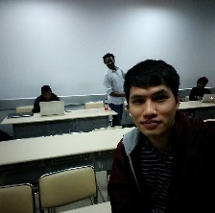




Mr. Nguyen Van Sang
SE03030
Vu Hoang Hieu
SE03451
Soulivong Phimmathong
SE03271
Hoang Van Canh
SE03193 Nguyen Hoang
SE03334
Nguyen Huu Thao

Slide 3
Introduction
Project Management
Software Requirement
Architecture and Technology
Testing
Project Result

Slide 4

Introduction

Slide 5
What’s happening?
General Vietnamese restaurants
Known by only local people
No effective advertisement channel
Lack of customers understanding
Not being professional
No complaint channel
Users problems
Where is it located?
What menus they offer?
How about price?
Etc.
Introduction

Slide 6
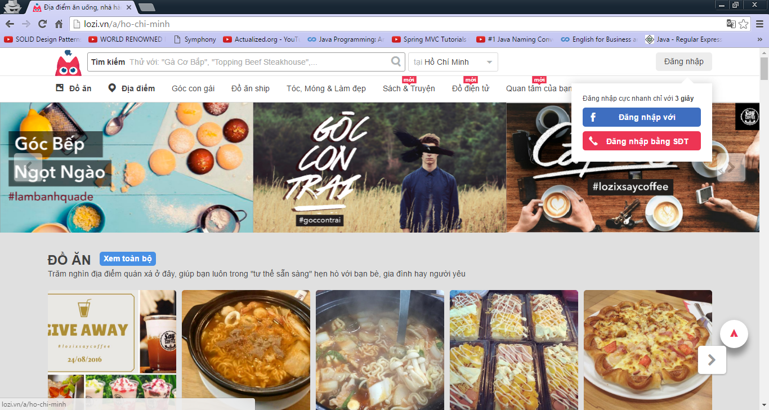
Existing System Limitation
No booking service
No restaurant information in detail
Introduction

Slide 7
Idea
Create a restaurants centric based information in Hanoi
Have restaurants to have a cheap online communication channel
Have customers to come to one place and get all information needed
Introduction

Slide 8
Objective
Fulfill FPT University’s requirements
Develop a web application that connect customers to restaurant owners
Manage a real project
Learn new technologies: Php CodeIgniter framework, bootstrap, JQuery, etc.
Learn how to write software development document
Introduction

Slide 9
Proposal System
Provide simple content management for restaurant owner
Provide restaurants’ information that can be access anytime and anywhere
Introduction

Slide 10
Project management
Process model
Organizational structure
Master schedule
Deliverables
Quality management
Environment and Tool
Project Management

Slide 11
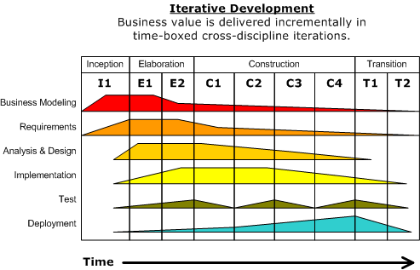
Rational Unified Process (RUB)
Project Management

Slide 12
Why RUP?
Iterative development
Manage Requirements (The business requirements documentation and project management requirements need to be gathered properly from the user in order to reach the targeted goal)
Verify quality (testing is implemented in all phases of development)
Project Management

Slide 13
Project Lifecycle
Collect requirements
Complete report No. 1 Introduction
Create draft screen prototype
Develop software project management plan
Complete Report No. 2 SPMP
Organize project review and lessons learned
Deploy final product.
Prepare Slide and Submit all documentation to FPT University
Have a thesis defense and close the project
Inception
Elaboration
Construction
Transition
Refine and complete Software Architecture and Design
Complete coding phase and Unit test
Complete Integration testing and System testing
Complete Report No. 5 STD
Complete Report No. 6 SUM
Complete user requirement specification
Complete software requirement specification
Complete ERD
Complete Report No. 3 SRS
Develop System Architecture
Complete Report No. 4 SDD
Project Management

Slide 14
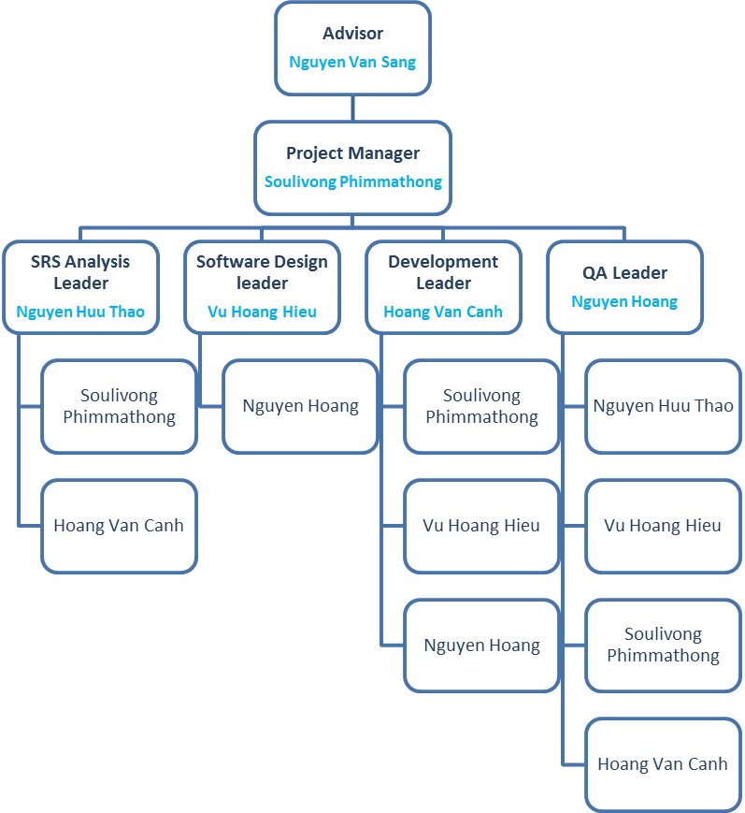
Organizational Structure
Project Management

Slide 15
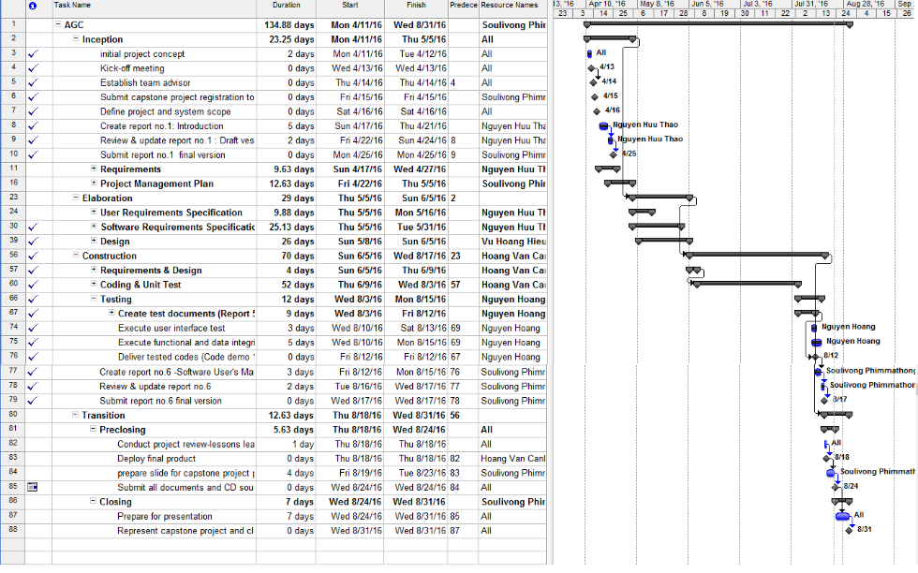
Project Management
Master Schedule

Slide 16
Deliverables
No | Deliverables | Format | Delivery Date | Delivery Method
Internal deliverables
1 | AGC_WorkSchedule | .mpp | 12 May 2016 | GitHub repository
2 | AGC_Risk_Register | .xlsx | 13 May 2016 | GitHub repository
3 | AGC_Test_Cases | .xlsx | 6 Aug 2016 | GitHub repository
4 | AGC_Defect_Logs | .xlsx | 8 Aug 2016 | GitHub repository
External deliverables
1 | Report No.1 Introduction | .docx | 25 Apr 2016 | GitHub repository
2 | Report No. 2 SPMP | .docx | 5 May 2016 | GitHub repository
3 | Report No. 3 SRS | .docx | 15 May 2016 | GitHub repository
4 | Report No. 4 SDD | .docx | 5 Jun 2016 | GitHub repository
5 | Report No.5 STD | .docx | 12 Aug 2016 | GitHub repository
6 | Report No.6 SUM | .docx | 17 Aug 2016 | GitHub repository
7 | The CD - Source Code | .rar | 24 Aug 2016 | Hand directly to FPT Universities
8 | Final documentation | .docx | 24 Aug 2016 | Hand directly to FPT Universities
Project Management

Slide 17









Environment and Tools
Project Management

Slide 18
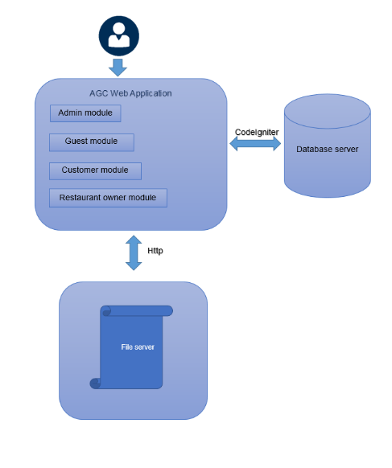
Software Requirement
System Overview
Software Requirement

Slide 19
Functional Requirements
Login
Logout
View restaurant information
Make a table booking
View booking history
View account
Update password
Activate/deactivate use
Activate/deactivate restaurant
Rate restaurant
Delete restaurant
Delete user
Add/delete category
Write/delete/update news
Customer
Admin
Restaurant Owner
Guest
Register
View general information in the system
View restaurant information in detail
Search
Like/comment/share via Facebook
View all users
View all categories
View all restaurant
View all news
View all booking
View detail booking
View statistical data
Add/update/delete restaurant information
Add/update/delete restaurant banner
Set restaurant profile picture
Add/update/delete food information
Update booking status
Software Requirement

Slide 20
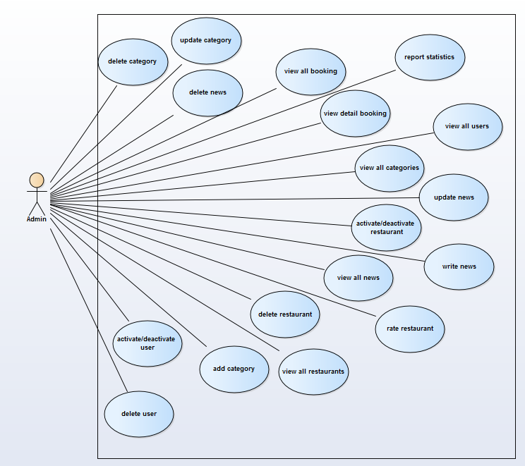
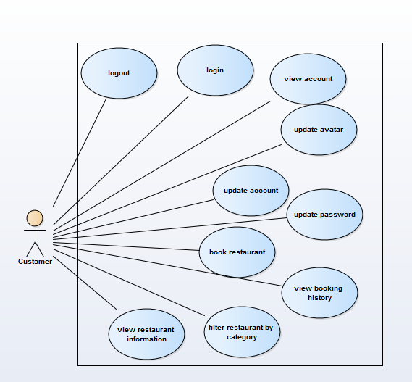
Use Case Diagram
Admin
Customer
Software Requirement

Slide 21
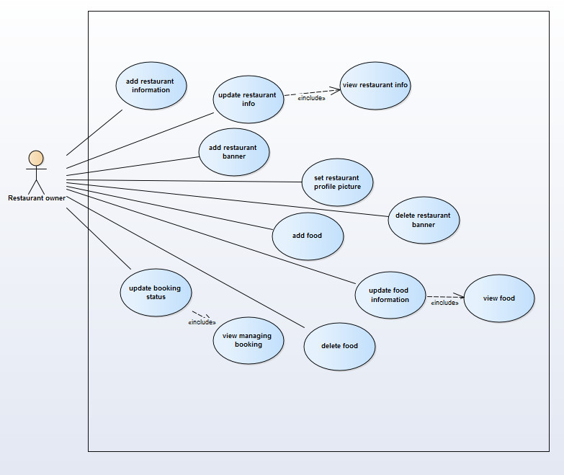
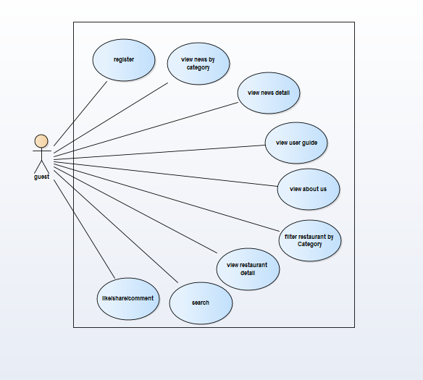
Use Case Diagram
Restaurant Owner
Guest
Software Requirement

Slide 22
Non – Functional Requirements
Availability
24 hours/day
7 days/week
User interface
Arrangement: header, body, footer
Font: Helvatica
Color: background: white, text: black
Security
Prevent all SQL injection
Encrypt password using MD5
Software Requirement

Slide 23
Architecture and Technology
Architecture Presentation
Why CodeIgniter
Package diagram
Entity Relationship Diagram
Architecture and Technology

Slide 24
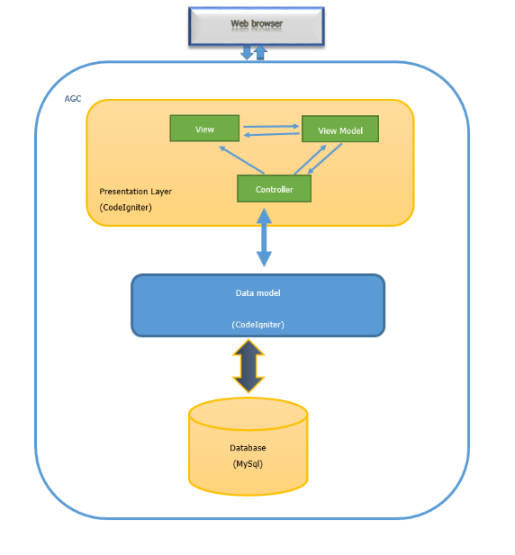
Architecture Presentation
Architecture and Technology

Slide 25
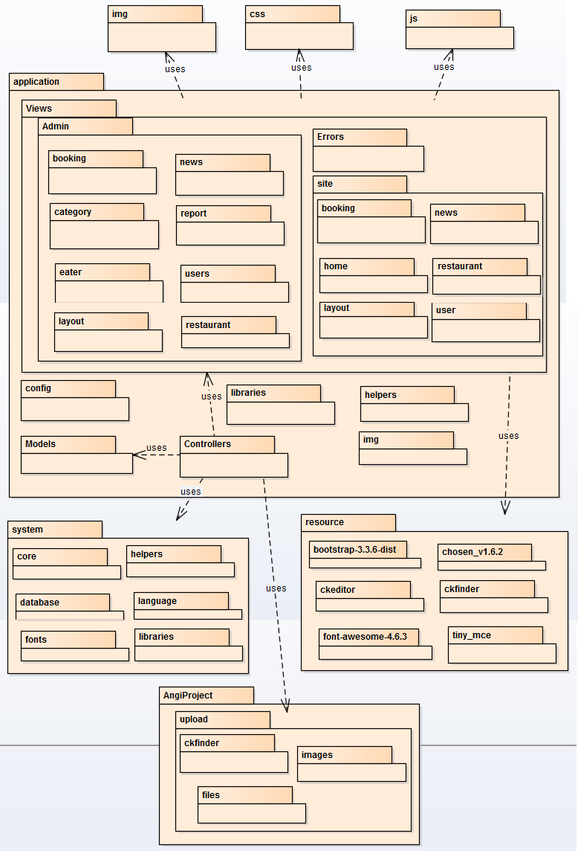
Architecture and Technology
Package Diagram

Slide 26
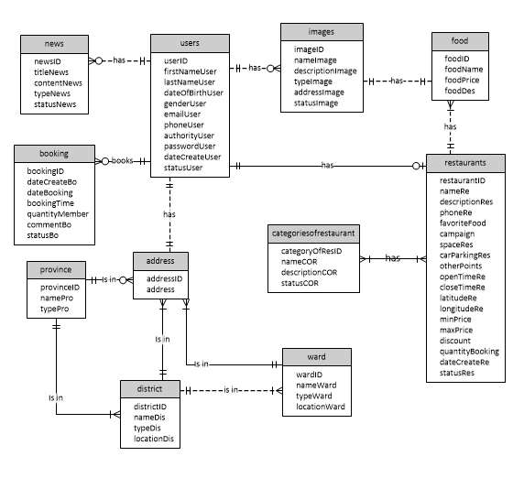
Entity Relationship Diagram
Architecture and Technology

Slide 27
Testing
Quality Assurance Model
Testing Policies
Testing Schedule
Testing Environment and Resources
Testing result
Testing

Slide 28
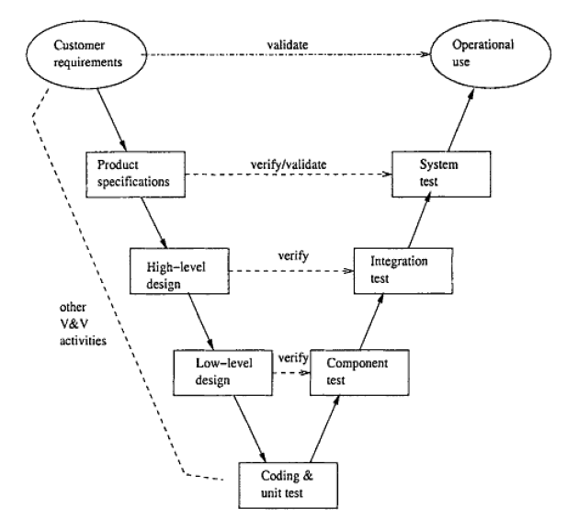
Quality Assurance Model
Testing

Slide 29
Reason of using V - Model
Simple and easy to use.
Testing activities like planning, test designing happens well before coding. Proactive defect tracking – that is defects are found at early stage.
Avoids the downward flow of the defects.
Works well for small projects where requirements are easily understood.
Testing

Slide 30
Testing Policies
Try to discover as many bugs as possible.
Identify and document all bugs found.
Test all possible scenarios.
Test with real devices, no simulation.
All AGC team members much involve in testing phased.
Test much be involved in every stage of software development life cycle (SDLC).
Testing

Slide 31
Testing Schedule
Unit Testing
Developer during coding phases
Integration Testing
Developer and Testing Team during Aug 1 – Aug 4, 2016
System Testing
Testing team
from Aug 3 – Aug 15, 2016
System Test
Integration Test
Unit Test
Testing

Slide 32
Testing Environment and Resources
Name | Purpose
Laptop computers | test all activities in laptop computers
Android phones | test if the system work correctly in android system, with responsive screen
iPad mini 2, iPad 4 | test if the system work correctly in iPad/tablet system, with responsive screens
iPhone 5 | test if the system work correctly in IOS system, with responsive screens
environment
Testing

Slide 33
Testing Environment and Resources
Name | version | Purpose
Microsoft word | 2013 | write test plan and keep tracking defects
Microsoft excel | 2013 | write test case, checklist, and test report
MySQL workbench | 6.3 CE | perform database testing
Google chrome | 52.0.2743.116 m | web browser testing
Firefox | 48.0 | web browser testing
Safari | 5.0.6 | Apple web browser testing
Coc Coc | 41.0.2272.119 | Vietnamese web browser testing
resources
Testing

Slide 34
Project result
Project result
Compilation result
Limitation and Expectation
Lesson learnt
Project Result

Slide 35
Project Result
AGC web application is now available to used.
Users no longer worry about trying new restaurants and menus
Restaurants are able to gain more potential customers
Tra Da team have fulfilled capstone project requirements
Project Result

Slide 36
Compilation Result
Main objective | develop a web application that connect customers to restaurant owners
Purpose | provides a convenient way for users to access restaurants’ information
Items | Plan | Actual
Release date | 24 August 2016 | 24 August 2016
Release version | 1.0 | 1.0
Days |  | 144
Weeks |  | 20 weeks and 4 days
Months | 4 | 4 months and 22 days
Test cases + checklists |  | 191
Documentation pages |  | 257
Lines of code |  | Approximately 12470
Project Result

Slide 37
Limitation and Expectation
Limitation
Expectation
Functions for restaurant owners cover only basic functions
Images management rely on third party web server.
No live notification service for users
Develop more functionalities for restaurant management
Manage images purely in AGC system without using third party server
Develop live notification service for users
Project Result

Slide 38
Lesson Learnt
Team work
Documentation
Programming languages
Domain and Hosting
Software development
Have more understanding of software testing
Project integration tool like GitHub
Project Result

