Slide 1



4.Software Design Description
4.1 Architectural Representation.
4.2 Package Diagram.
4.3 Database Design.
4.4 Screen.
4.5 Class design and sequence diagram.
SDD
Quality Control
SRS

Slide 2





4.1 Architectural Representation
Technologies and Frameworks:
SDD

Slide 3
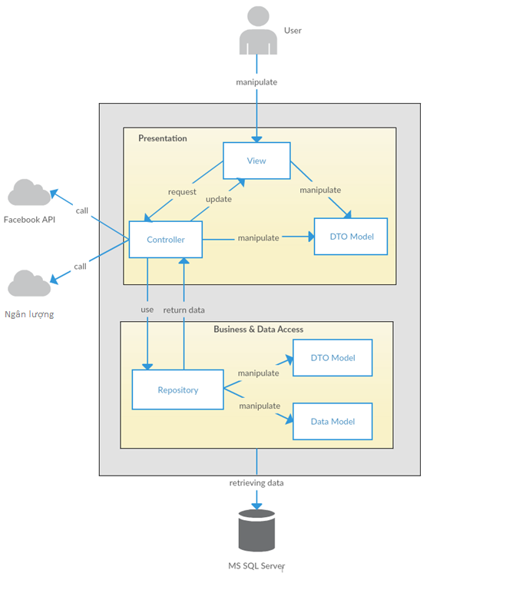
System Overall Architectural.
SDD

Slide 4
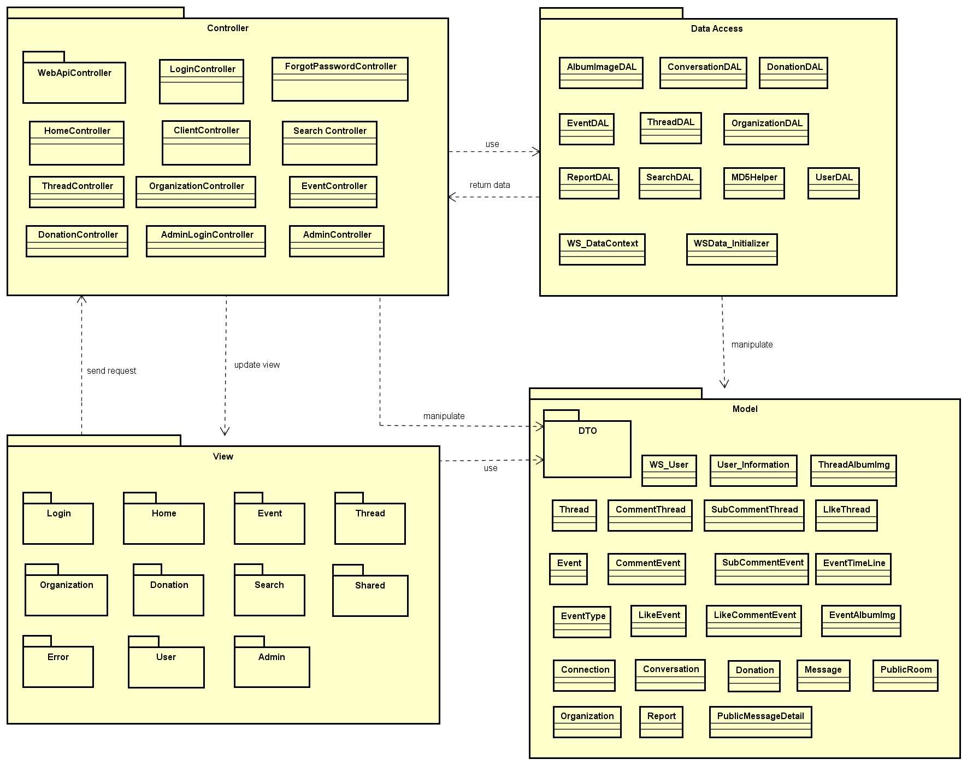
4.2 Package Diagram:
SDD

Slide 5
4.3 Database Design:
SDD

Slide 6
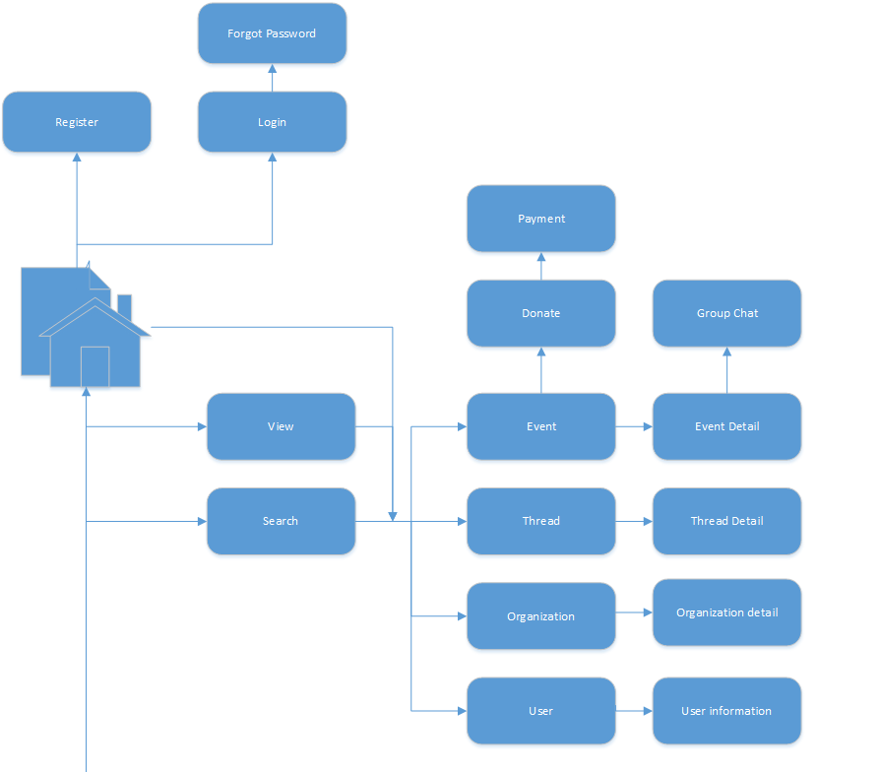
4.4.1 Screen flow:
SDD

Slide 7
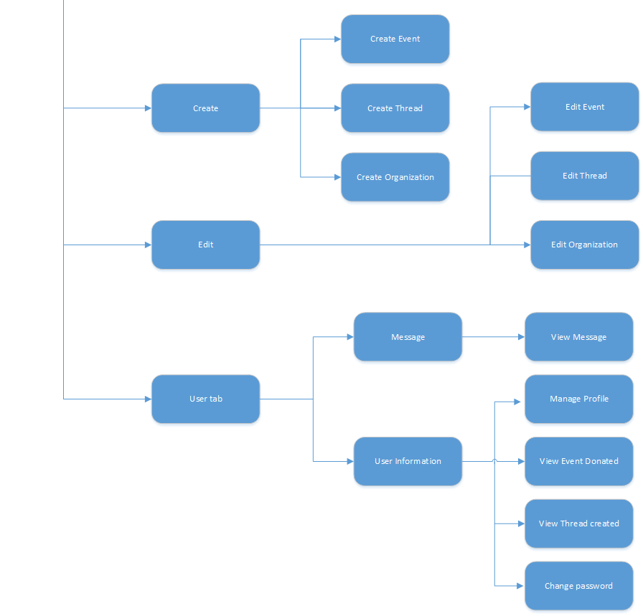
Screen flow:
SDD
Screen flow for user

Slide 8
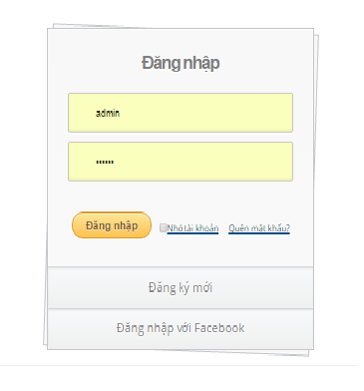
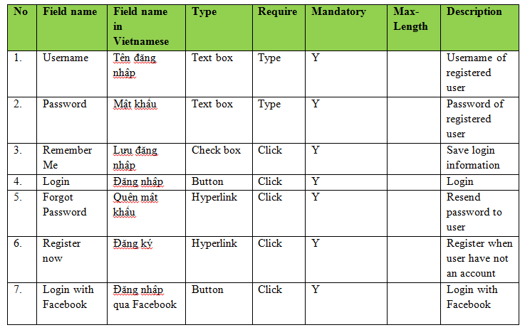
4.4.2 Screen design:
SDD
Screen design for login

Slide 9
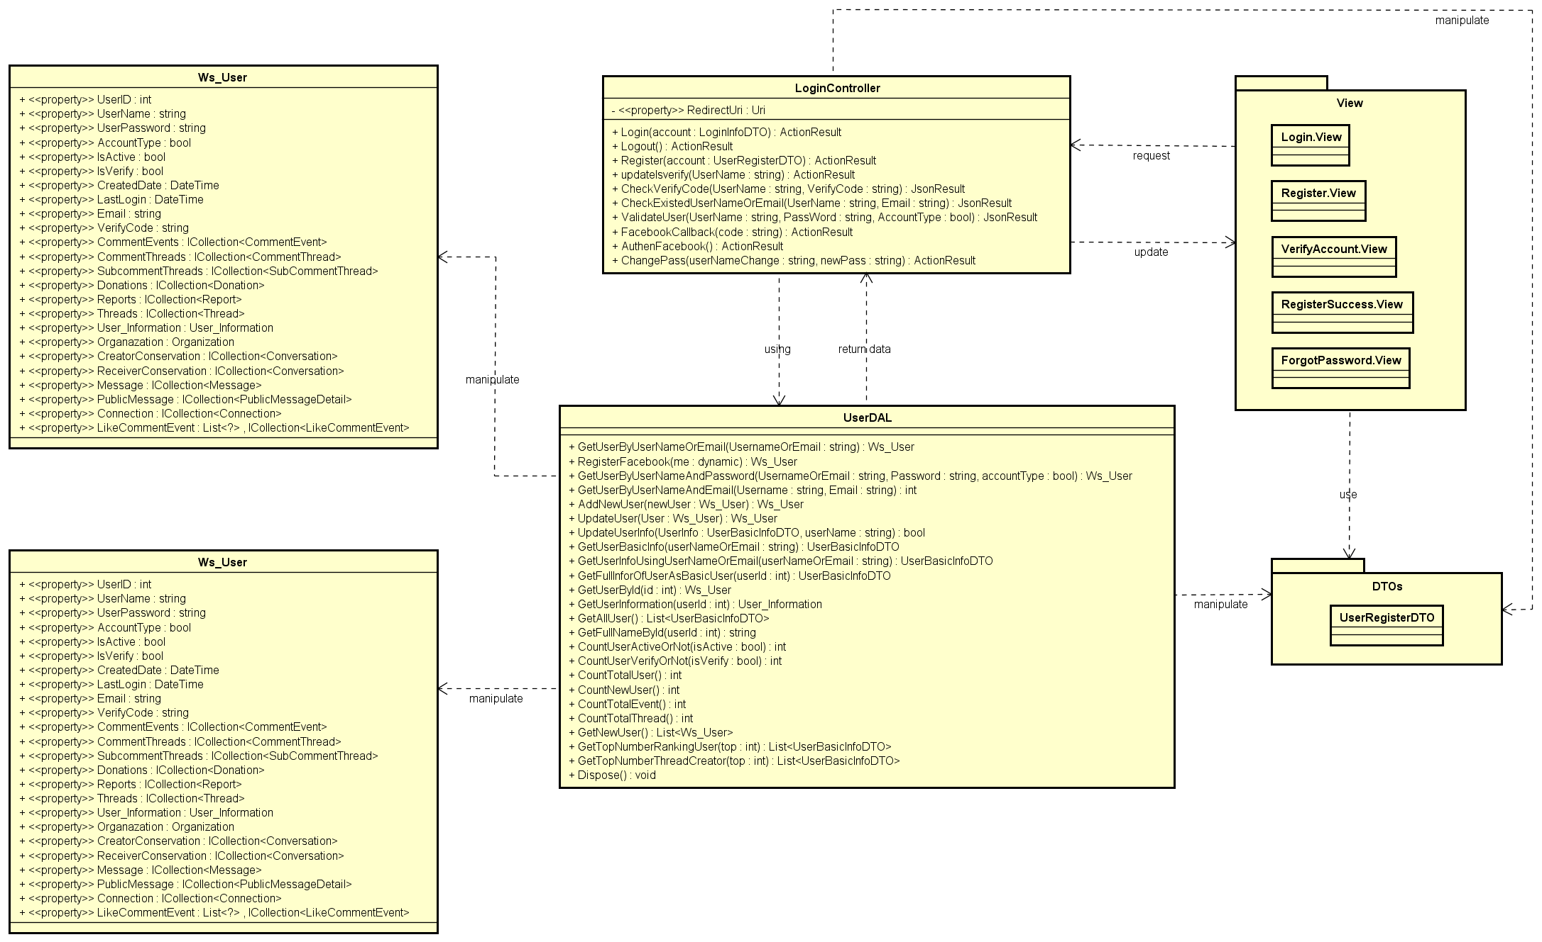
4.5.1 Class design:
SDD
Login class design

Slide 10
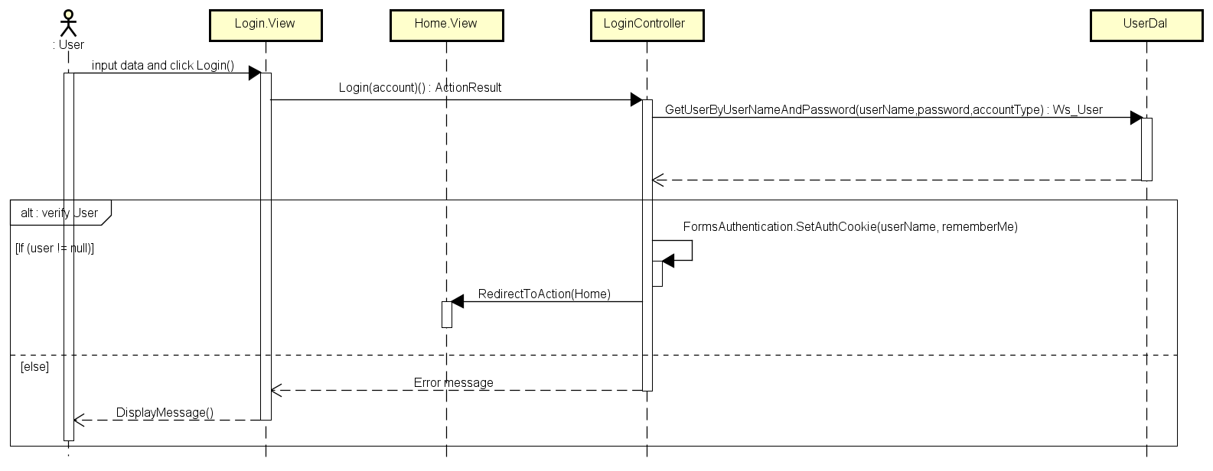
4.5.2 Sequence diagram:
SDD
Login sequence diagram

